Slide 1
RGB LED sensor for fat quantification in milk
AUTHORS:
Marina Salukova, Anastasiia Surkova, Yana Shmakova, Natalya Samokhina, Julia Kostyuchenko, Alina Parshina, Ildar Ibatullin, Andrey Bogomolov

Slide 2
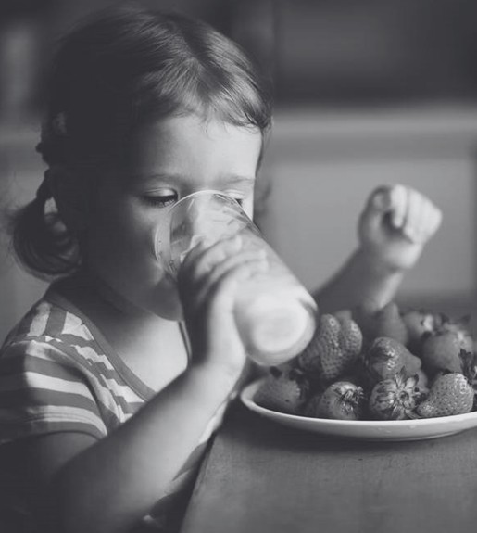
ANNUAL CONSUMPTION OF LIQUID COW'S MILK WORLDWIDE IN 2022 (1,000 TONS)
100
75
50
25
0
India
EU
USA
Brazil
Russia
UK
Mexico
milk
SOURCE: USDA FOREIGN AGRICULTURAL SERVICE

Slide 3
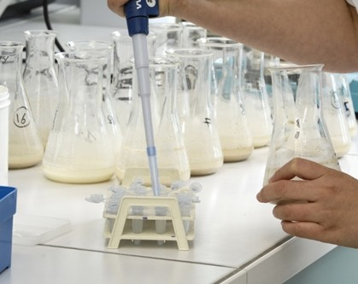
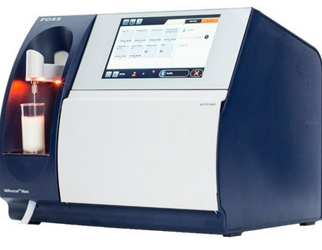
METHODS OF MILK ANALYSIS
FAT CONTENT IN MILK IS ANALYZED BY CHEMICAL AND INSTRUMENTAL METHODS
CHEMICAL METHODS:
High accuracy
Require special reagents and highly skilled personnel
INSTRUMENTAL METHODS
Fast
High precision
Expensive
MILKOSCAN
(FOSS Electric, Denmark)

Slide 4
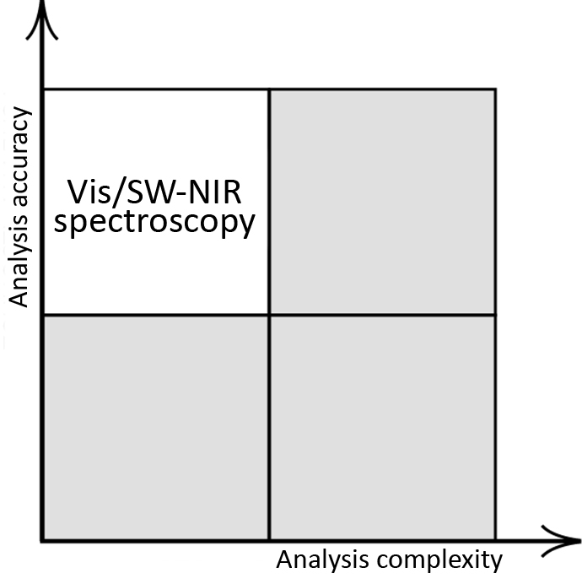
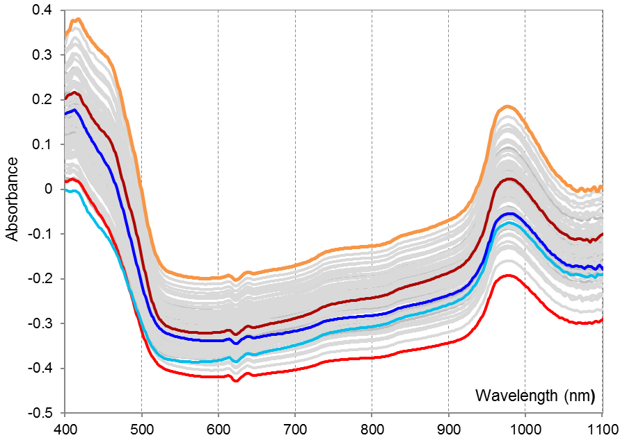
VISIBLE/SW-NIR SPECTROSCOPY
high fat 20 s homogenized
high fat raw
high protein raw
low protein raw
low fat raw

Slide 5
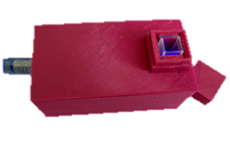
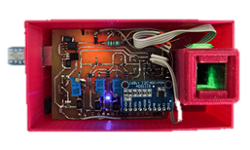
LED RGB-SENSOR
The device consists of:
Light source: three LEDs (red, green, blue);
Detector: photodetector;
Microcontroller: Arduino Nano
Developed at the Samara State Technical University

Slide 6
GOALS AND OBJECTIVES
GOAL
To develop and test an RGB sensor consisting of three LEDs for the quantitative determination of fat in milk.
Objectives
To create a prototype of an express analyzer;
To built a calibration model for determining the fat content in homogenized and raw cow's milk;
To suggest the ways to improve the results of the analysis.

Slide 7
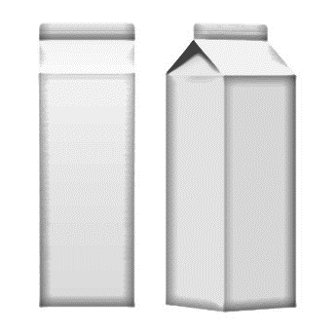
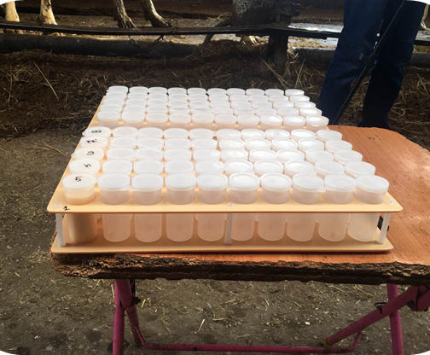
EXPERIMENT
Designed experiment
Real milk samples
Purchased homogenized milk
10 samples (2 original samples and 8 mixed samples)
Fat content 1.5-3.2% in 0.19% increments
milk
1.5%
milk
3.2%
fat, %
1.69
1.88
2.07
2.26
2.44
2.63
2. 82
3.01
29 samples
Fat content: 3.1-6.01%

Slide 8
EXPERIMENTAL RESULTS

Slide 9
RESULTS: HOMOGENIZED MILK
Dataset | LV | Calibration |  | CV
 |  | RMSE, % | R² | RMSE, % | R²
PLS
R | 1 | 0.08 | 0.98 | 0.10 | 0.98
G | 1 | 0.14 | 0.94 | 0.18 | 0.91
B | 1 | 0.29 | 0.71 | 0.42 | 0.51
RG | 1 | 0.10 | 0.96 | 0.13 | 0.95
RGB | 2 | 0.07 | 0.98 | 0.08 | 0.98
Spectrometer | 2 | 0.02 | 1.00 | 0.03 | 0.99
MLR
R | - | 0.08 | 0.98 | 0.10 | 0.98
G | - | 0.14 | 0.94 | 0.18 | 0.89
B | - | 0.29 | 0.71 | 0.42 | 0.51
RG | - | 0.07 | 0.98 | 0.08 | 0.98
RGB | - | 0.07 | 0.99 | 0.10 | 0.97

Slide 10
RESULTS: RAW MILK
29 RAW MILK SAMPLES
Fat ranges from 3.1 to 6.01%
Results of full cross-validation:
RMSECV = 0.37% R² (CV) = 0.72

Slide 11
CONCLUSION
The developed prototype is sensitive to the fat content of milk
The best results are achieved with homogenized milk
As part of further improvement of the device:
the measurement geometry can be refined
the optimal sensor channels can be preliminarily calculated using full-spectrum analysis

Slide 12
ACKNOWLEDGEMENTS
Samara State Technical University
Art Photonics GmbH
the Samara Oblast Agro-Industrial Complex Support Center
the Samara Regional Veterinary Laboratory

Slide 13
thank you
for your attention

