Slide 1


The 2nd International Electronic Conference on Chemical Sensors and Analytical Chemistry (CSAC 2023)
Classification of teas using different feature extraction methods from signals of a lab-made electronic nose
Irari Jiménez López
Jeniffer Molina Quiroga
Juan Manuel Gutiérrez Salgado
Bioelectronics Section, Department of Electric Engineering, CINVESTAV-IPN Mexico City, Mexico

Slide 2

Content
Introduction
Objective
Materials and methodology
Results and discussion
Conclusions
References
Contact detail

Slide 3

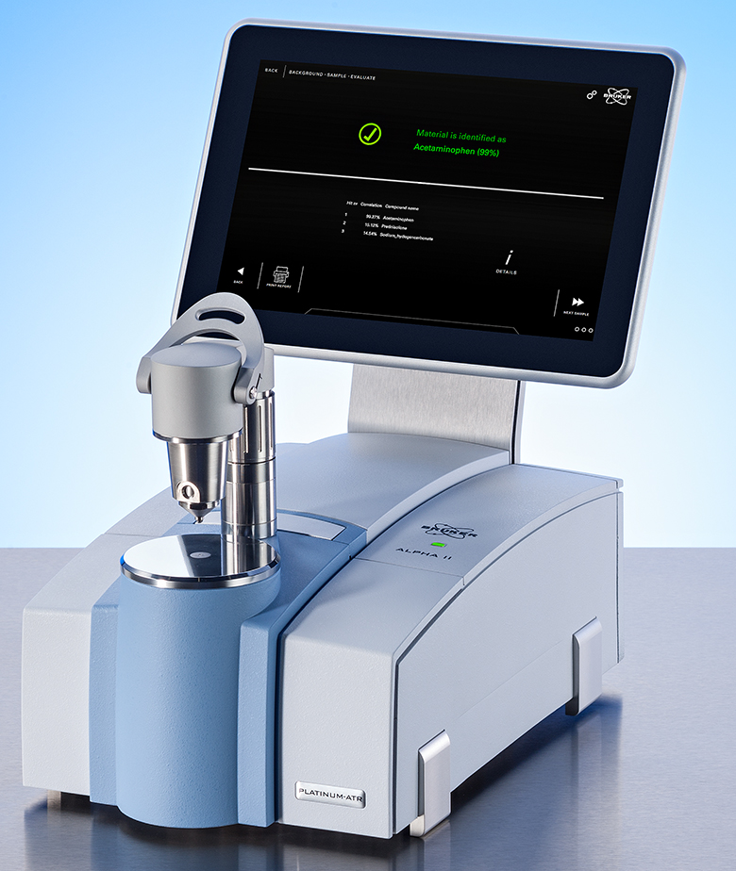

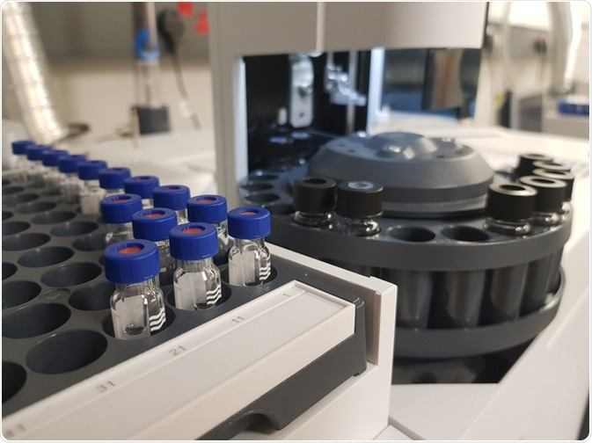
Introduction
Electronic Nose
(e-nose)
Tea
Analytical methods
Tea is the world’s most consumed aromatic, non-alcoholic beverage after water.
It possess multiple human health function [1].
There are chemical components responsable for the color, taste and aroma.
Gas chromatography-mass spectrometry (GC-MS) [2].
Fourier Transform Infrared Spectroscopy (FT-IR) [3].
Disadvantages
High operating cost
Complex sample
preparation
Monitor odors in real time
Detect a “fingerprint” of a chemical component
It is a bioinspired system
Smell sense
[1] G. Y. Tang et al. Int. J. Mol. Sci. vol. 20, pp. 6196, 2019.
[2] W. Chen et al. Food Control., vol. 140, pp. 109103, 2022.
[3] F. Yousefbeyk et al. Fharm. Sci., vol. 29, pp. 100, 2023.

Slide 4
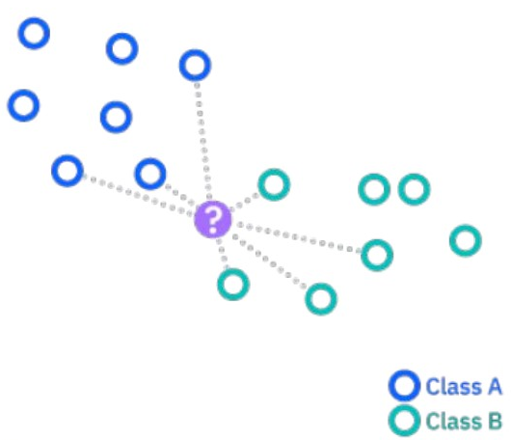
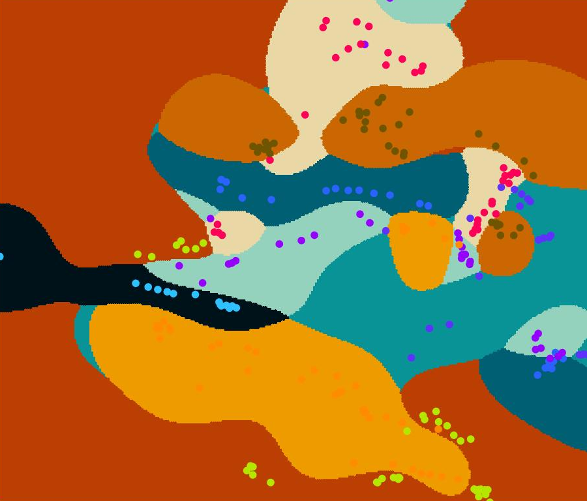
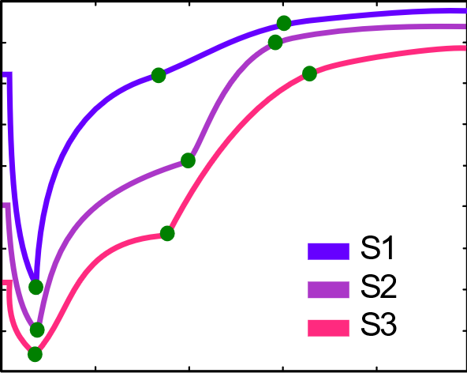
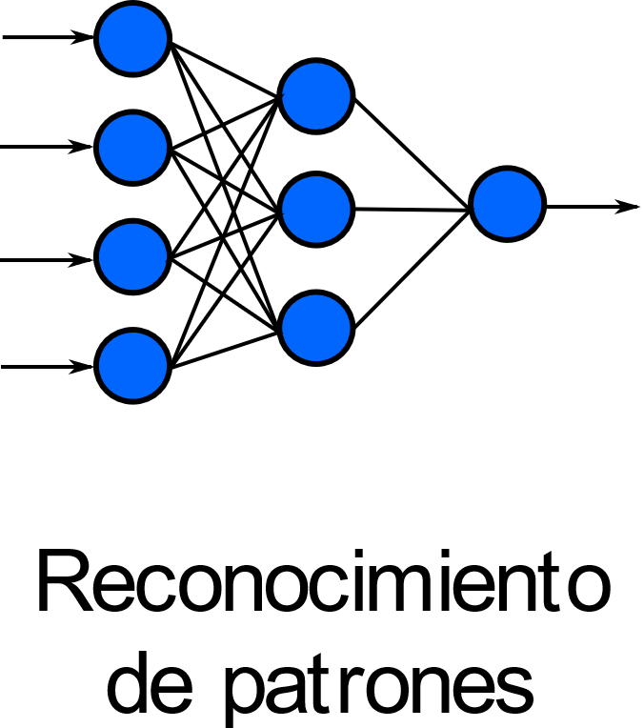

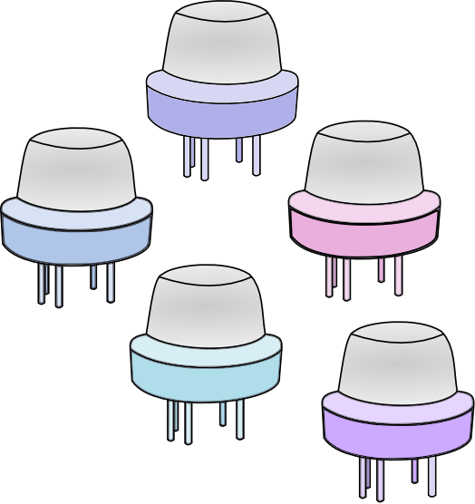
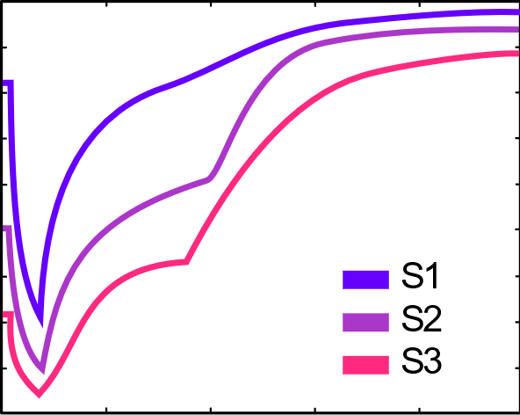
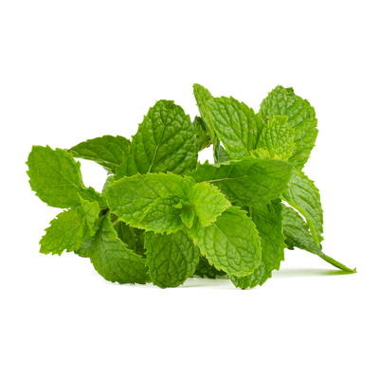




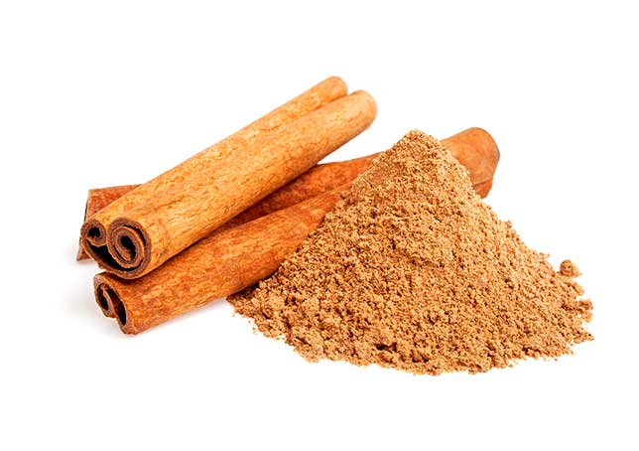
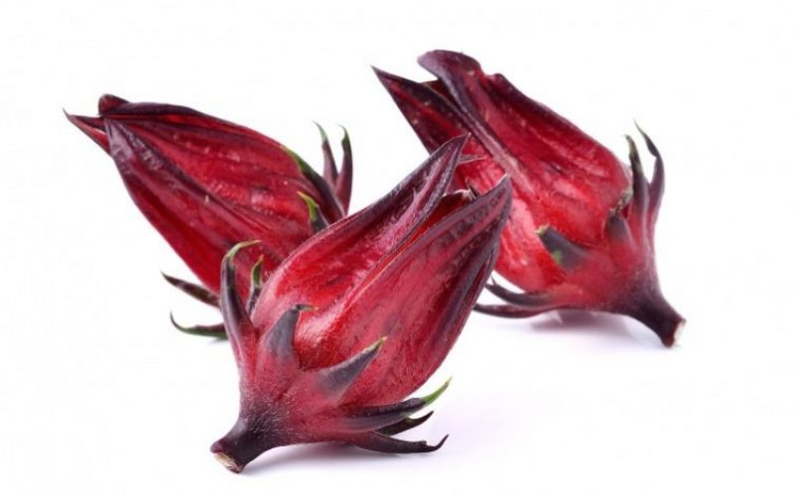
E-nose
Persaud and Dodd proposed it in 1989 [4].
Data processing
Sample handling
Gas-sensor array
Applications
Voltage
Time
Figure 1. Diagram of e-nose [5].
Feature extraction
Classification methods
Mean, max, min values
Principal Components Analysis (PCA)
Parallel Factor Analysis (PARAFAC)
Artificial Neural Network (ANN)
K-Nearest Neighbor (k-NN)
Suport Vector Machine (SVM)
[4] K. Persaud et al. Nature. vol. 299, pp. 352, 1989.
[5] J. Covington et al. IEEE Sens. J. vol. 21, pp. 12969, 2021.

Slide 5


Objective
To implement PCA and PARAFAC to extract data features of tea using an e-nose that measured samples and compare the relevance of the two methods through ANN and k-NN as classification methods.

Slide 6
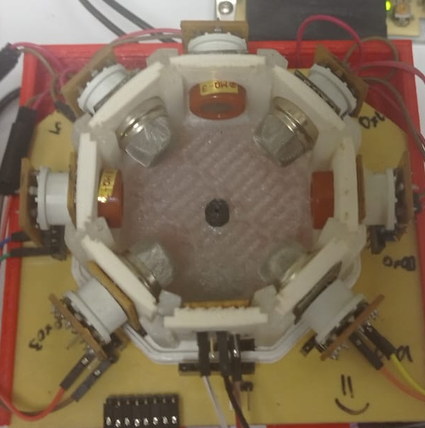
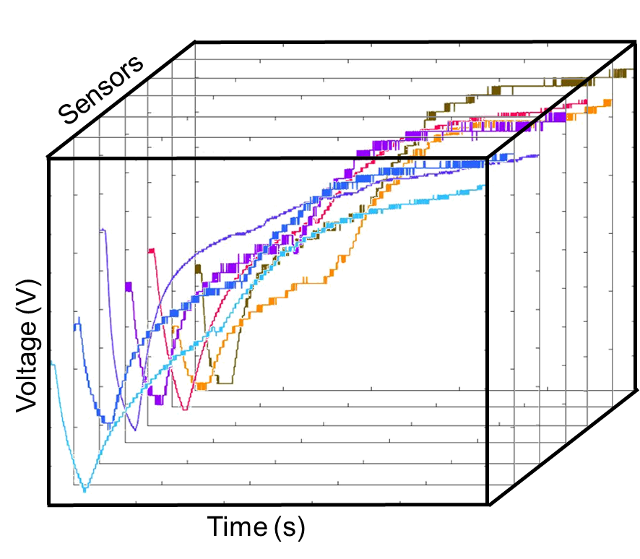
Materials and methodology
E-nose
Samples
Processing data
The database was acquired using a lab-made e-nose [6] consisting of:
Seven metal oxide sensors (MOX)
The set of samples was formed by 34 unblended tea samples from commercial brands
White
Spearmint
Hibiscus
Lemongrass
Mint
Chamomile
Black
Green
Data feature extraction
PCA
PARAFAC
Classification models
ANN
K-NN
[6] L. Valdez et al. Sensors., vol. 16, pp. 1745, 2016.

Slide 7
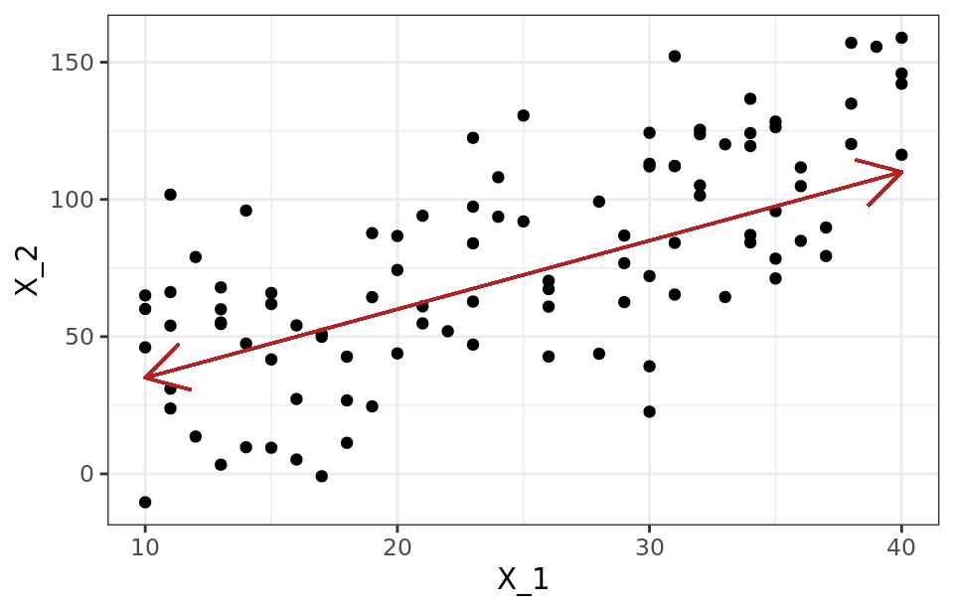
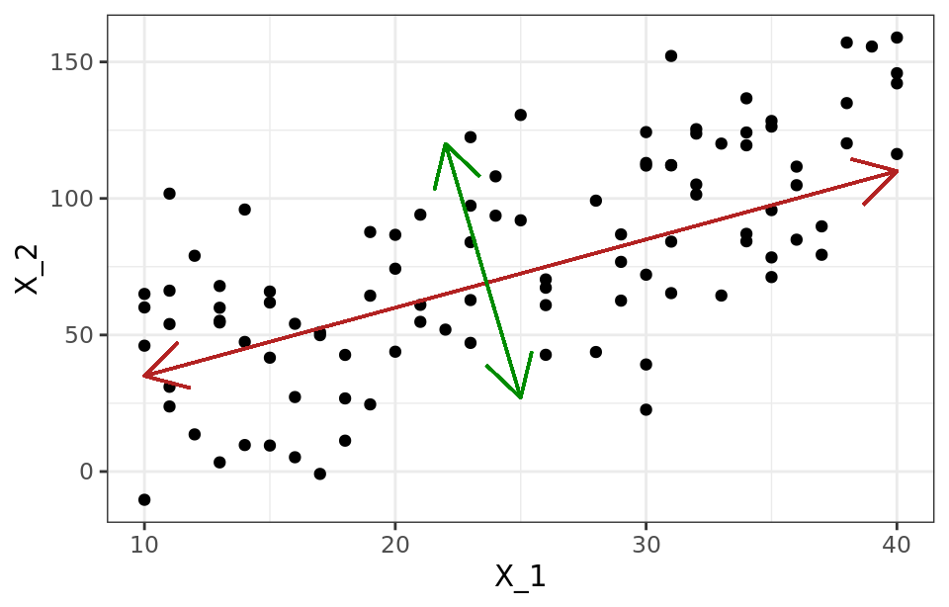
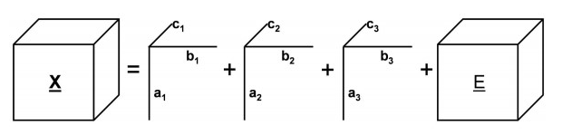
Feature extraction
Principal Component Analysis (PCA) [7].
Evaluation
Variance
Figure 2. Graphical representation of PCA
Parallel Factor Analysis (PARAFAC) [8].
Core Consistency Diagnostic (CORCONDIA)
[7] I. Jolliffe et al. Principal Components., pp. 1-6, 2016.
[8] E. Acar et al. IEEE Trans. Knowl Data Eng, vol. 21, pp. 6, 2009.
Figure 3. Graphical representation of PARAFAC model

Slide 8
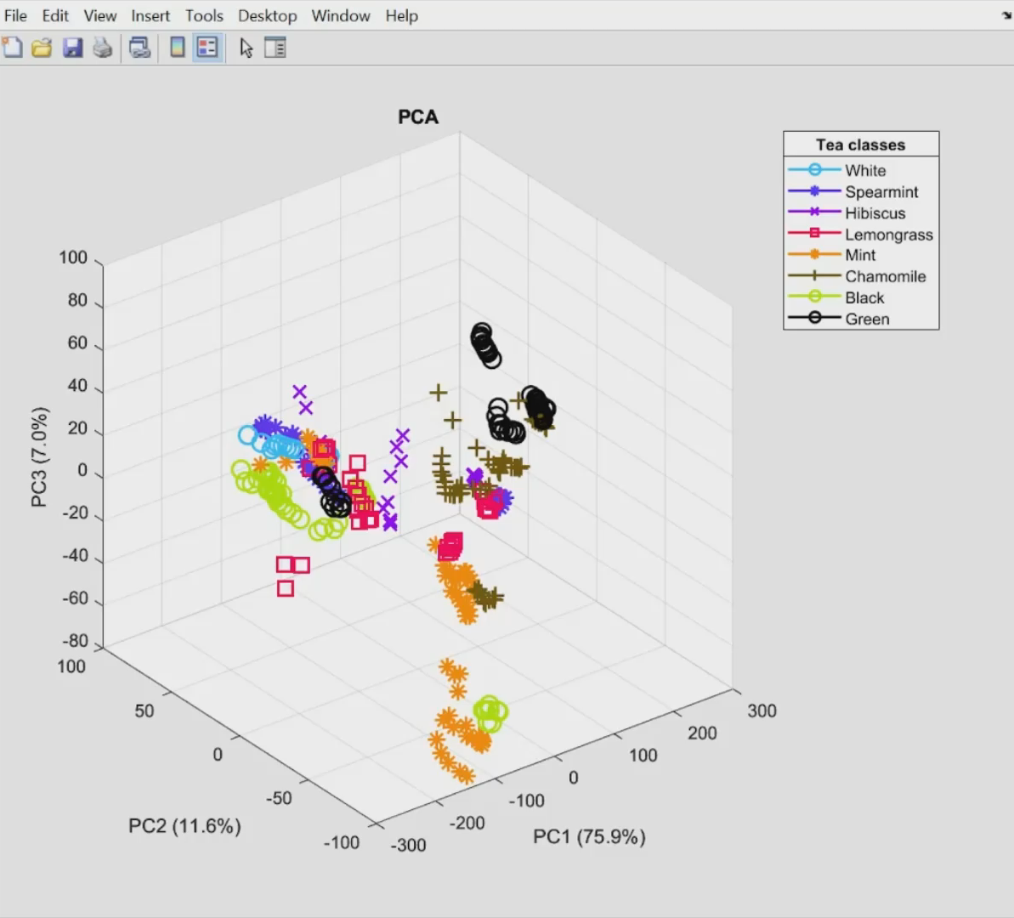
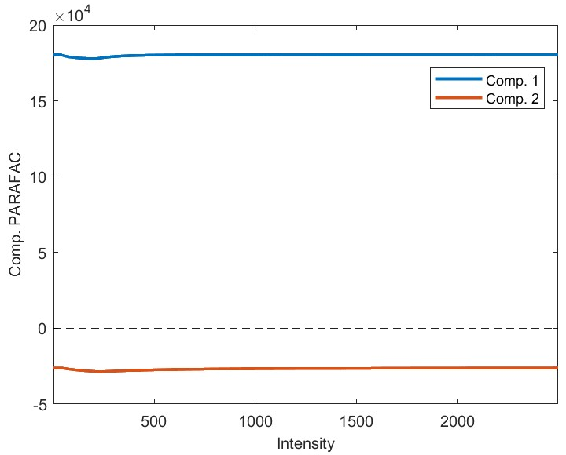
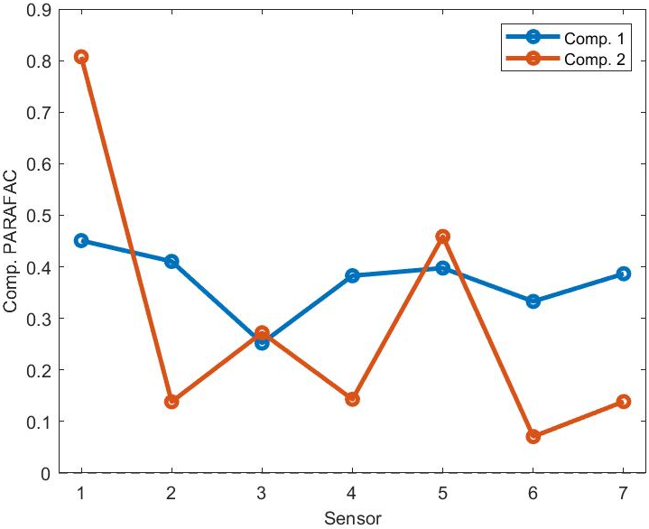
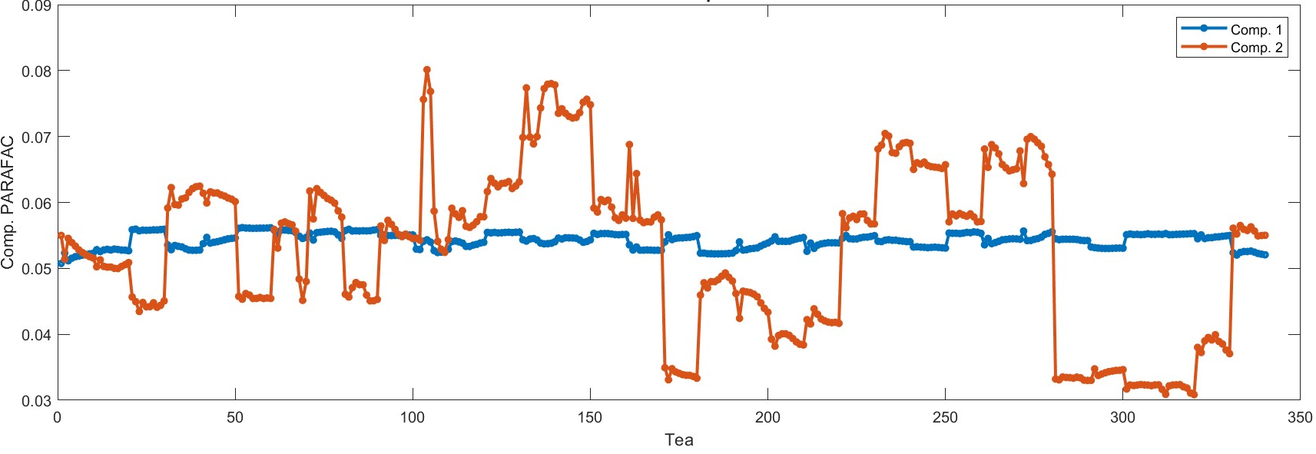
Feature extraction results
Principal Component Analysis (PCA)
Parallel Factor Analysis (PARAFAC)
a)
b)
c)
Figure 4. PCA score plot of the 3 first components of 8 tea classes.
Figure 5. PARAFAC loadings for (a) intensities, (b) sensors, and (c) tea samples.

Slide 9
Classification models
Artificial Neural Network (ANN)
k-Nearest Neighbor (k-NN)
Using Principal Components
6 layers: 4 x 35 x 40 x 14 x 5 x 1
Learning rate: 0.002
Error: 0.02
Using PARAFAC components
6 layers: 2 x 30 x 40 x 20 x 5 x 1
Learning rate: 0.09
Error: 0.09
Both arquitectures uses:
logsig, tansig, logsig, logsig, tansig, and purelin activations functions
Using Principal Components and PARAFAC components
Distance: Euclidean
Neighbors: 3

Slide 10
Results and discussion
Table 1. Confusion matrix and classification rate of PCA and PARAFAC using ANN of 10-fold cross validation.
FE_1* = PCA
FE_2** = PARAFAC
Notes:
Quitar classifed as: Classes
Quitar mayúscula a rate
Aclarar a que corresponde FE_1

Slide 11
Results and discussion
Table 2. Confusion matrix and classification rate of PCA and PARAFAC using k-NN of 10 fold cross validation
FE_1* = PCA
FE_2** = PARAFAC

Slide 12
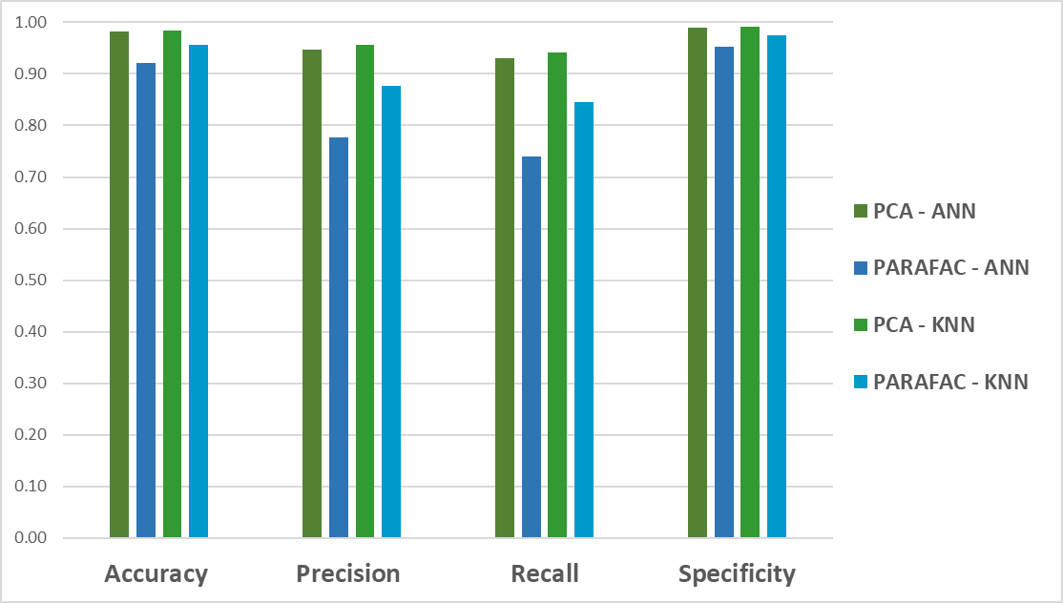
Results and discussion
The metrics are higher using PCA than PARAFAC components
PCA extracts the most relevant information
Figure 6. Metrics comparison of all classification models

Slide 13
Conclusions
The results show that feature extraction by PCA has superior metrics than PARAFAC.
PCA-ANN combination achieved the most remarkable accuracy.
Using only the variance as the main feature allows a better data evaluation.
E-noses are likely sensitive to the mixture of VOCs.
In future exists the possibility to quantified from MOX signals.

Slide 14
References
[1] G. Y. Tang et al. Int. J. Mol. Sci. vol. 20, pp. 6196, 2019.
[2] W. Chen et al. Food Control., vol. 140, pp. 109103, 2022.
[3] F. Yousefbeyk et al. Fharm. Sci., vol. 29, pp. 100, 2023.
[4] K. Persaud et al. Nature. vol. 299, pp. 352, 1989.
[5] J. Covington et al. IEEE Sens. J. vol. 21, pp. 12969, 2021.
[7] I. Jolliffe et al. Principal Components., pp. 1-6, 2016.
[8] E. Acar et al. IEEE Trans. Knowl Data Eng, vol. 21, pp. 6, 2009.

Slide 15

Contact Details
THANK YOU!
Authors
Irari Jiménez López irari.jimenezl@cinvestav.mx
Jeniffer Molina Quiroga jeniffer.molinaq@cinvestav.mx
Juan Manuel Gutierrez Salgado mgutierrez@cinvestav.mx
Bioelectronics Section
Electrical Engineering Department
CINVESTAV-Zacatenco, CDMX, Mexico

