Slide 1
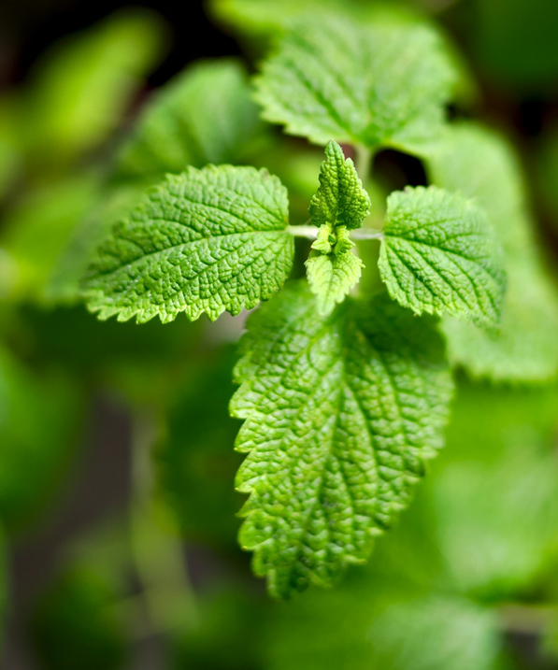
Enhancing Essential Oil Yield and Agronomical Traits in Melissa Officinalis L. through Synthetic Polyploidization
Presented by – Rohit Bharati
4th Year Ph.D. Scholar
Faculty of Tropical AgriSciences,
Czech University of Life Sciences Prague

Slide 2
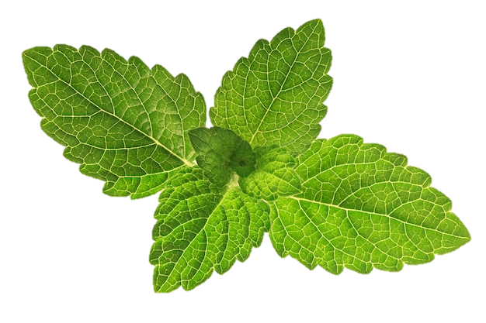
Introduction
Melissa officinalis L. (lemon balm) is a perennial herb with ethnopharmacological properties widely used across agricultural, medicinal, sanitary, food, and beverage industries (Miraj et al., 2017; Shakeri et al., 2016).
These pharmacological properties are primarily attributed to the essential oil of the lemon balm (Shakeri et al., 2016).
The average essential oil yield in M. officinalis is relatively low (0.02% - 0.30%), considering the rising demand due to climate change, seasonal variation, and low-yielding varieties (Shakeri et al., 2016).
Previous Synthetic Polyploidization attempts in other members of the Lamiaceae family suggest it could be an excellent approach to increase the average essential oil yield in this species (Bharati et al., 2023; Homaidan Shmeit et al., 2020; Dhooghe et al., 2011).

Slide 3
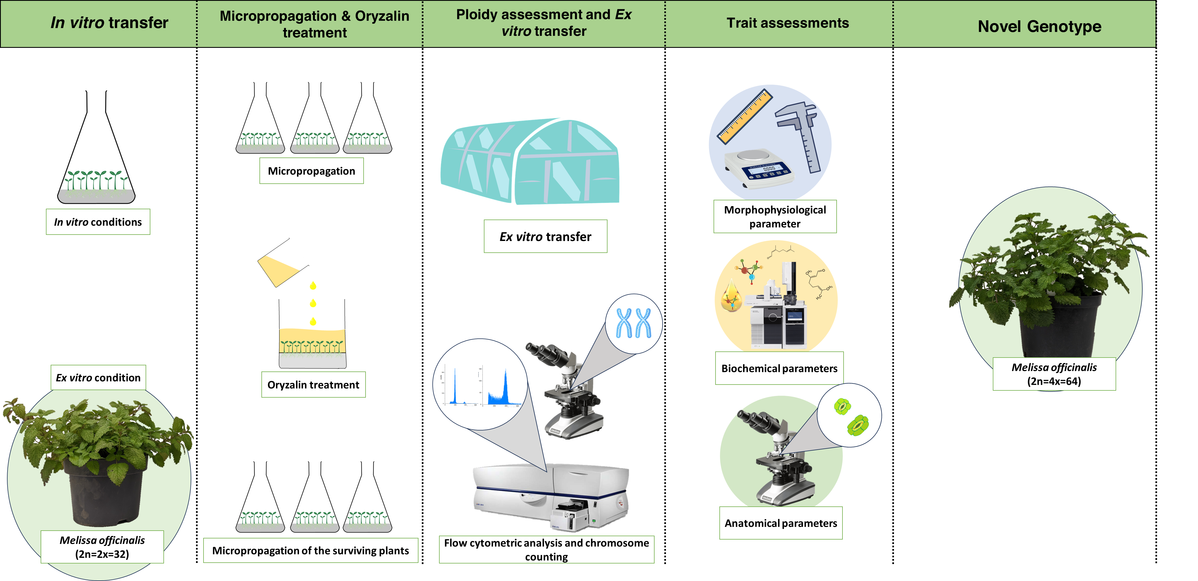
3.0 Methodology

Slide 4
4.0 Results
4.1 Survival and polyploid induction rate
Survival rate decreased with increasing concentration of oryzalin
8% polyploid plants were obtained
40 μM for 24 h was found to be the most effective.
Figure 1. Effect of different concentrations and duration of oryzalin treatment on survival rate and polyploid induction rate in M. officinalis.
Notes:
Upon oryzalin treatment, the survival rate of the treated plants decreased significantly. 40 μM of oryzalin for 24 h was found to be the most effective treatment with an 8% polyploid induction rate.

Slide 5
4.2 Ploidy confirmation through flowcytometry and chromosome counting
Figure 2. Flow cytometry analysis of M. officinalis (A) diploid and (B) tetraploid plants, depicting relative DNA content along with chromosomes under 100× magnification for (C) diploid and (D) tetraploid plants.

Slide 6
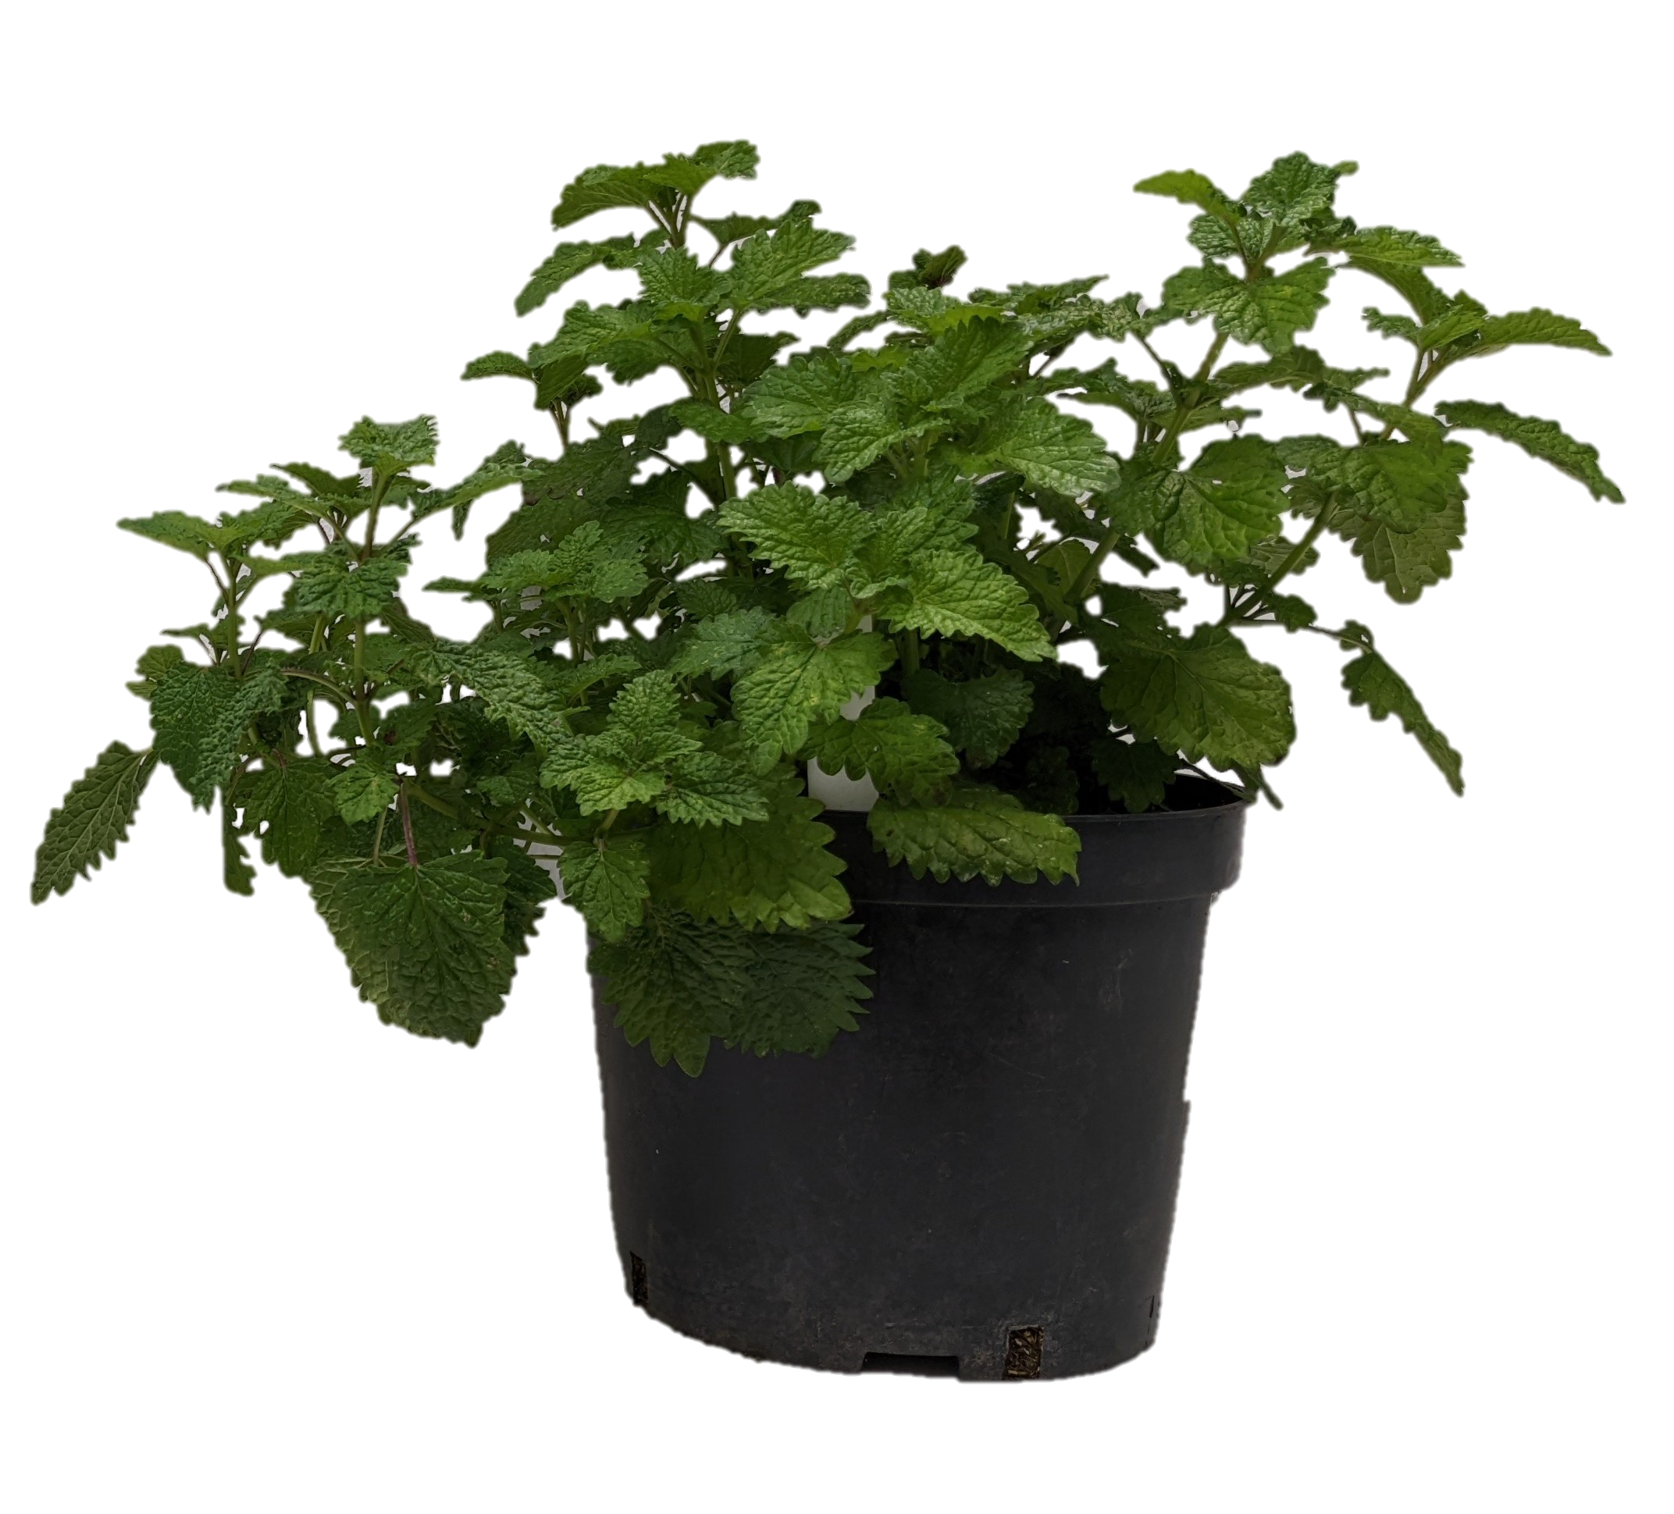
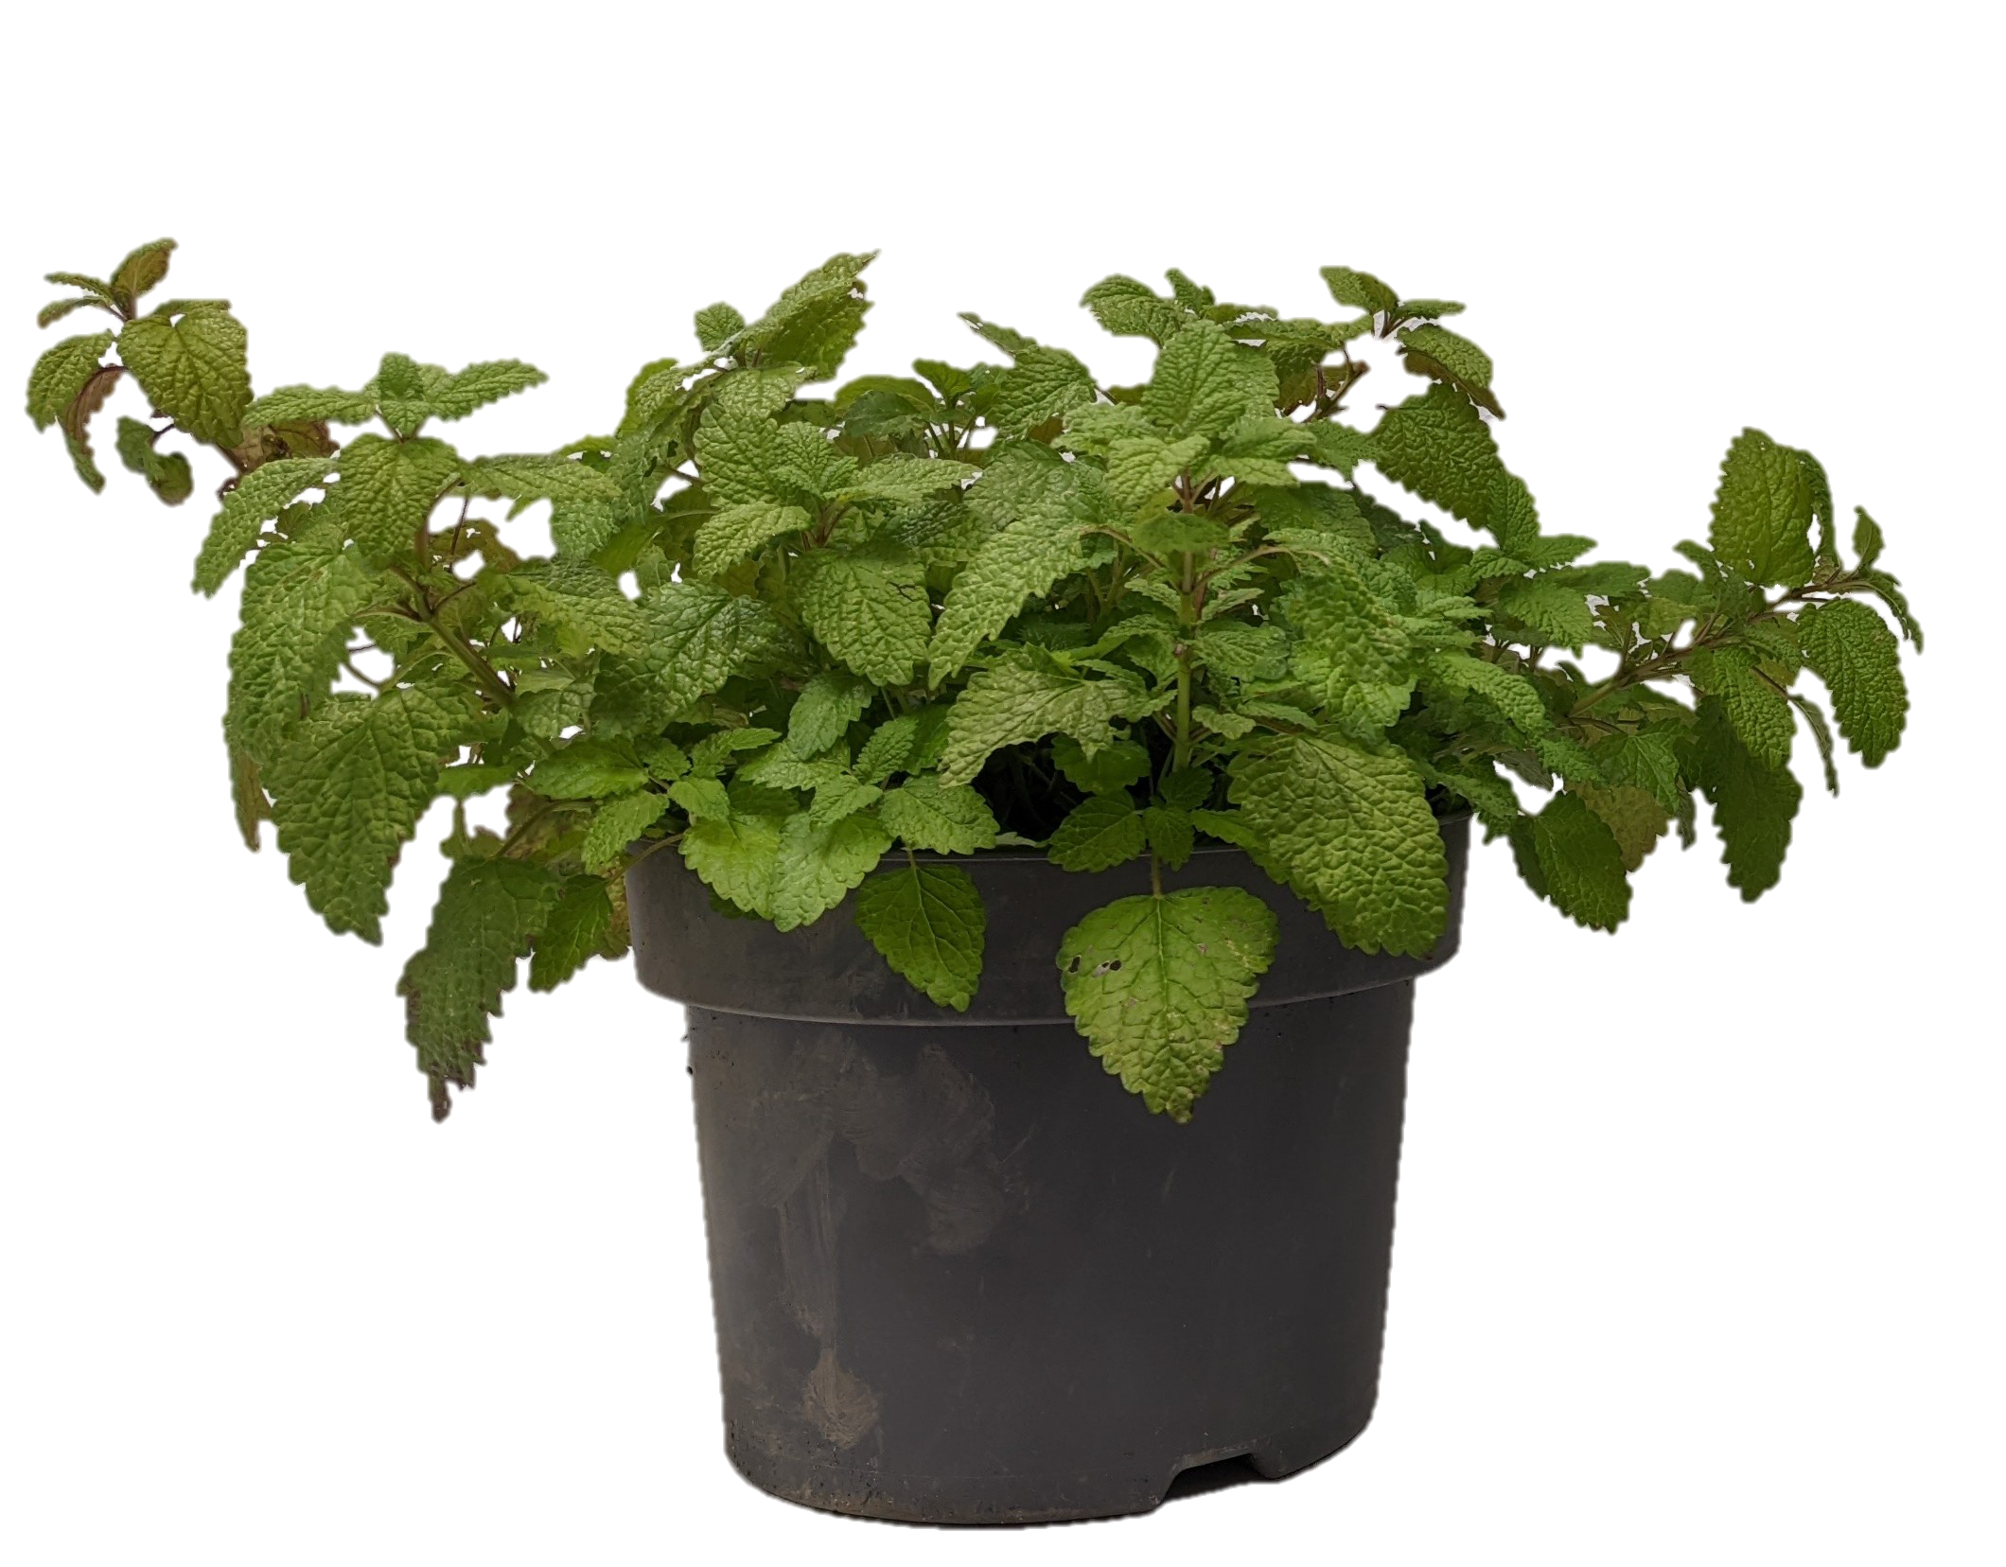
4.3.2 Plant Morphology
Average Shoot length
19.96 cm
26.85 cm
Average Number of Shoots
24.28
21.76
Number of leaves per shoot
11.98
14.23
Figure 4. Phenotype of M. officinalis (A) control diploid and (B) induced tetraploid plant.
Notes:
Plant morphological variations in tetraploid plants were evident. Briefly, the average Shoot length & number of leaves per shoot increased significantly whereas, a significant decrease in the Average number of shoots was observed in tetraploid plants.

Slide 7
4.3.1 Leaf Morphology
Average leaf area – 8.17 cm²
Average leaf area – 15.87 cm²
Figure 3. : Leaf shape and size of M. officinalis (A) control diploid and (B) induced tetraploid plant
Notes:
Interesting results were obtained in leaf morphologies between diploid and tetraploid genotypes where it increased nearly 100%, rising from 8.17 cm2 in diploid to 15.87 cm2 in tetraploid plants.

Slide 8
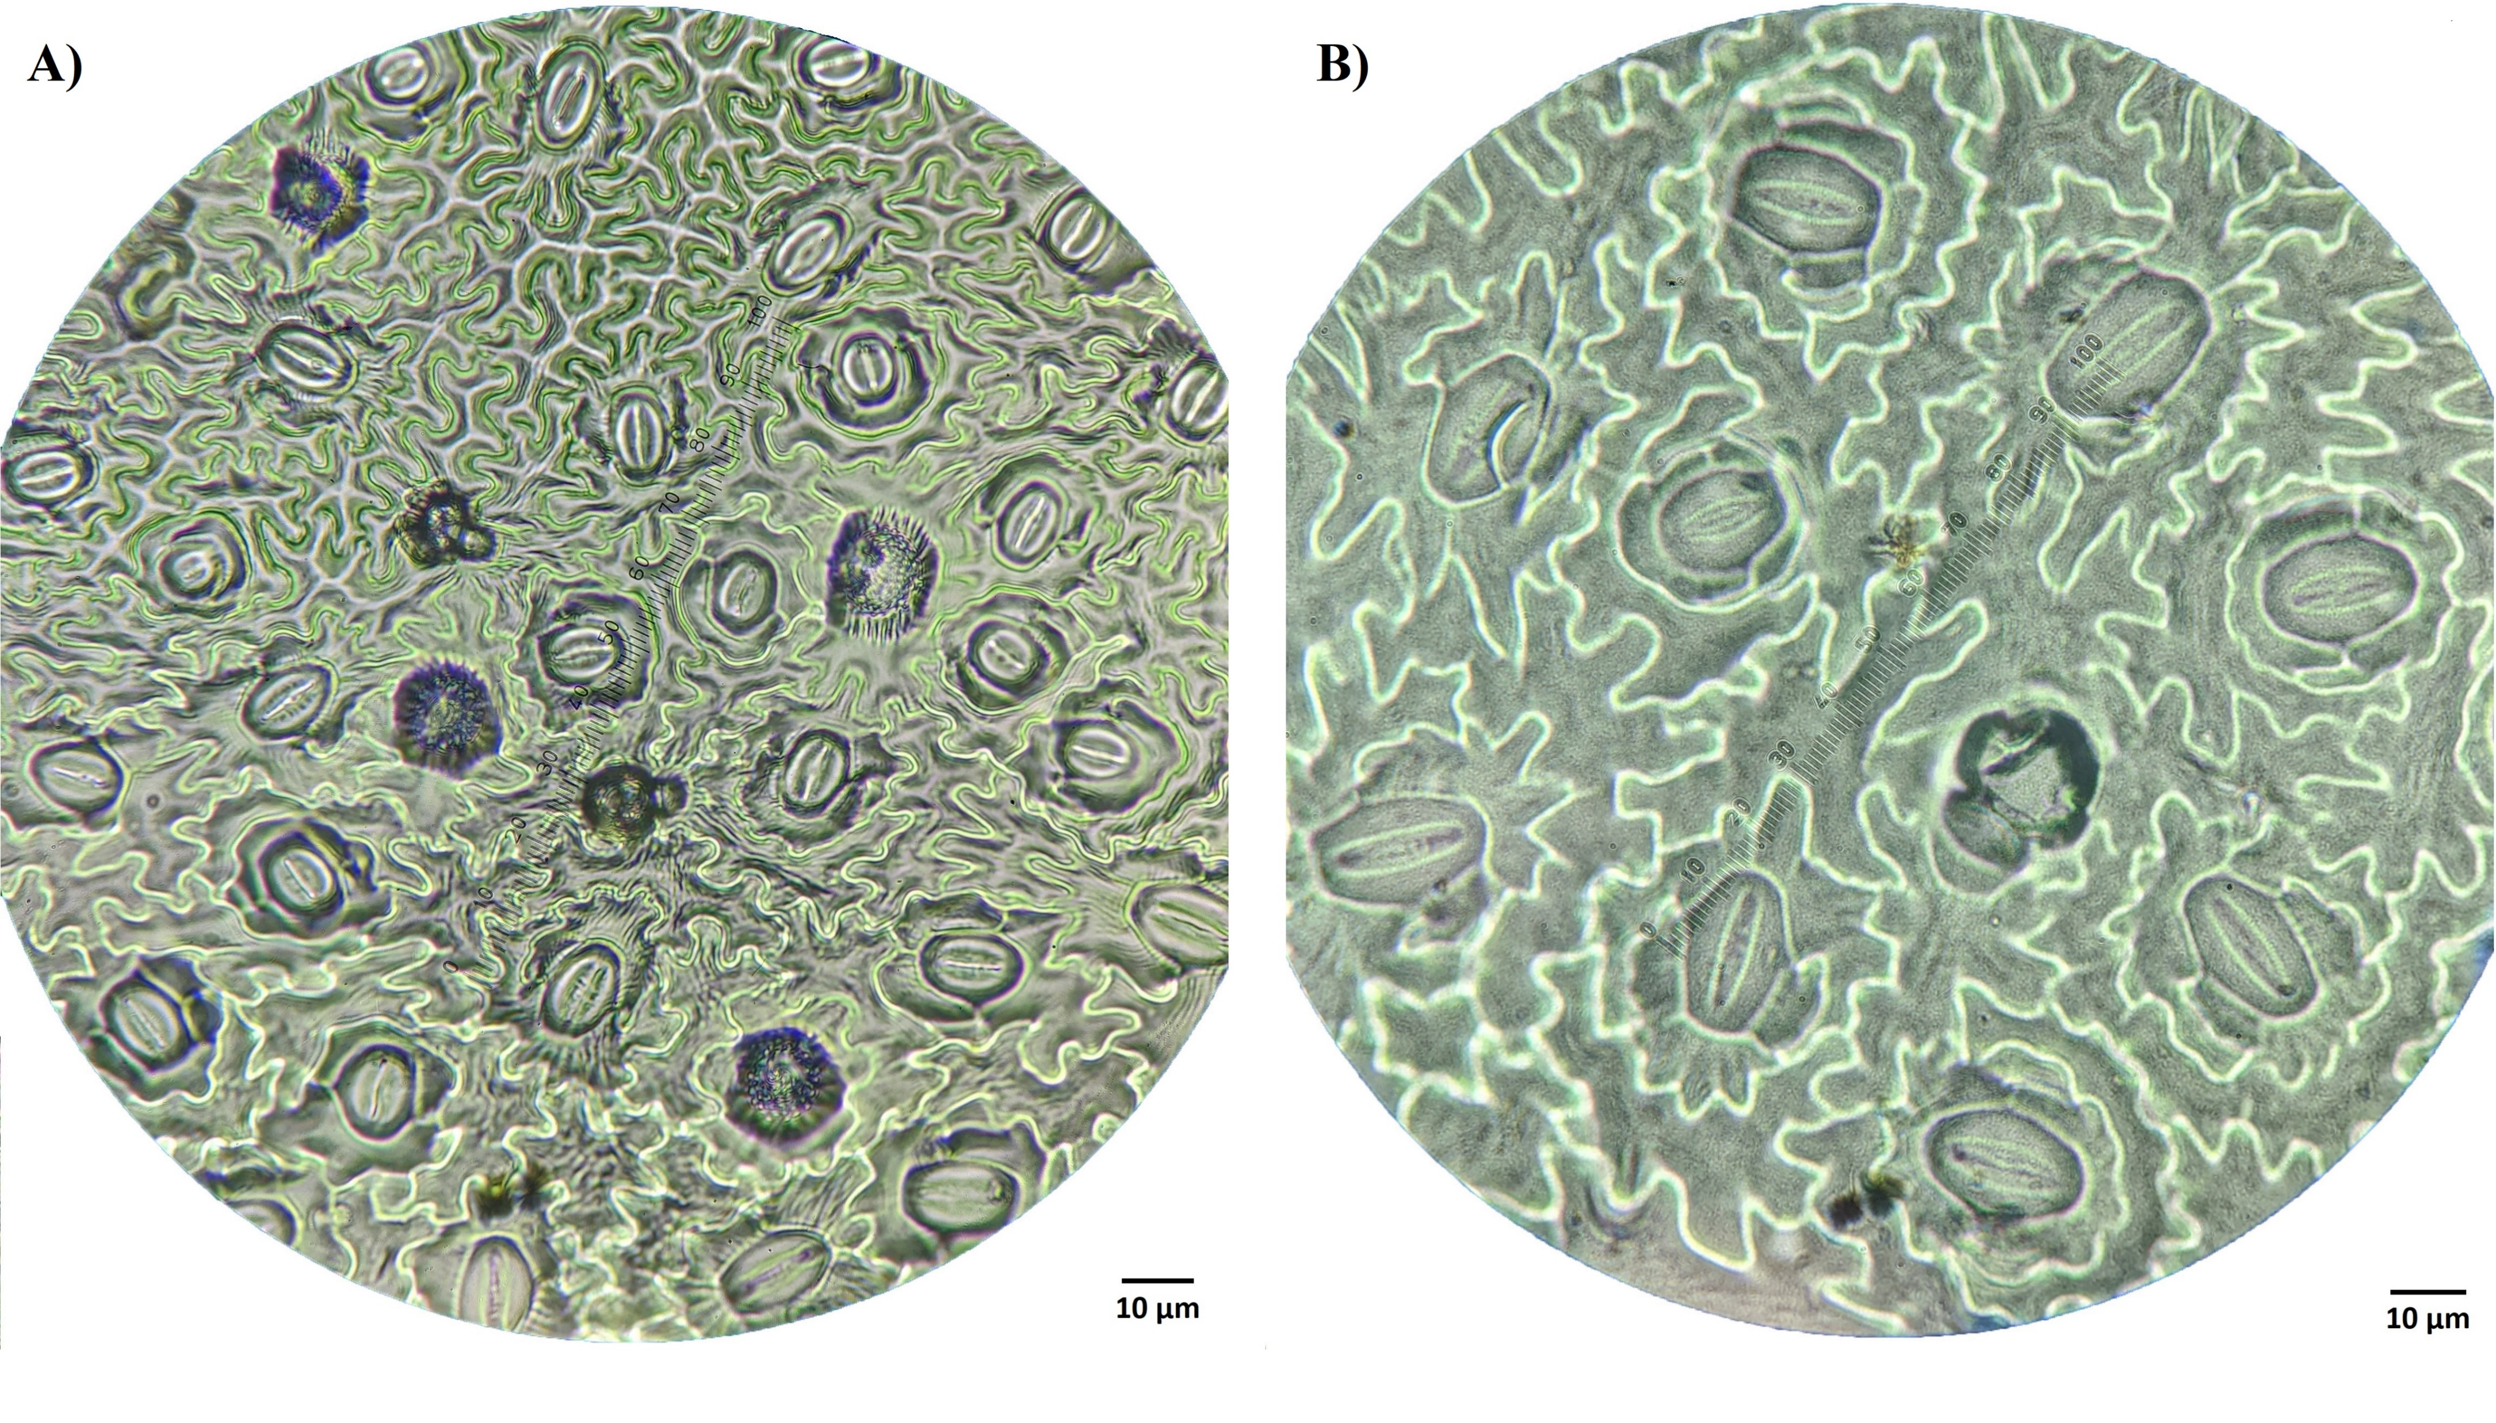
4.4 Stomatal Comparison
Table 2. Comparison of stomatal characteristics between diploid control and polyploid genotypes of M. officinalis.
Variant | Average number of stomata per magnification field (60x) | Average Stomata Length (µm) | Average Stomata Width (µm)
Control | 24.33±3.21a | 11.34±1.95b | 7.86±1.05b
Polyploids | 10.00±1.50b | 20.76±1.52a | 12.57±0.79a
Different superscript letters within the same column differ significantly (Tukey HSD Test, p < 0.05) The data presented are mean ± standard deviation (n=20).
Figure 5. Stomata size and frequency in M. officinalis (A) control and (B) induced polyploid plant.
Notes:
A similar increase was also observed in the stomatal length and width of the tetraploid plants. However, the stomatal frequency decreased significantly in the tetraploid plants.

Slide 9
4.5 Essential Oil Yield
Control (diploid) 0.12 % (w/v)
75% increment
Polyploid (tetraploid) 0.21 % (w/v)
Figure 6. Essential oil yield in control diploid and induced tetraploid plants of M. officinalis. Different letters on the vertical bars differ significantly (Tukey HSD Test, p < 0.05) (n = 20).
Notes:
Finally, essential oil yield comparison revealed an astonishing 75% increase in tetraploid plants, rising from 0.12% in diploid to 0.21% in tetraploid plants

Slide 10
Conclusions
Oryzalin was effective in inducing polyploidization in Melissa officinalis.
The newly developed polyploid genotype had a significant increase in essential oil content (75 %) and exhibited various superior agronomical traits.
The current study could be a valuable addition to the breeding attempts to increase essential oils and other secondary metabolites in this and related species.

Slide 11
References
Shakeri, A., Sahebkar, A., Javadi, B., 2016. Melissa officinalis L. – A review of its traditional uses, phytochemistry and pharmacology. Journal of Ethnopharmacology 188, 204–228. https://doi.org/10.1016/j.jep.2016.05.010
Miraj, S., Rafieian-Kopaei, Kiani, S., 2017. Melissa officinalis L: A Review Study With an Antioxidant Prospective. J Evid Based Complementary Altern Med 22, 385–394. https://doi.org/10.1177/2156587216663433
Dhooghe, E., Van Laere, K., Eeckhaut, T., Leus, L., Van Huylenbroeck, J., 2011. Mitotic chromosome doubling of plant tissues in vitro. Plant Cell Tiss Organ Cult 104, 359–373. https://doi.org/10.1007/s11240-010-9786-5
Bharati, R., Fernández-Cusimamani, E., Gupta, A., Novy, P., Moses, O., Severová, L., ... & Šrédl, K. (2023). Oryzalin induces polyploids with superior morphology and increased levels of essential oil production in Mentha spicata L. Industrial Crops and Products, 198, 116683. https://doi.org/10.1016/j.indcrop.2023.116683
Homaidan Shmeit, Y., Fernandez, E., Novy, P., Kloucek, P., Orosz, M., Kokoska, L., 2020. Autopolyploidy effect on morphological variation and essential oil content in Thymus vulgaris L. Scientia Horticulturae 263, 109095. https://doi.org/10.1016/j.scienta.2019.109095

