Slide 1
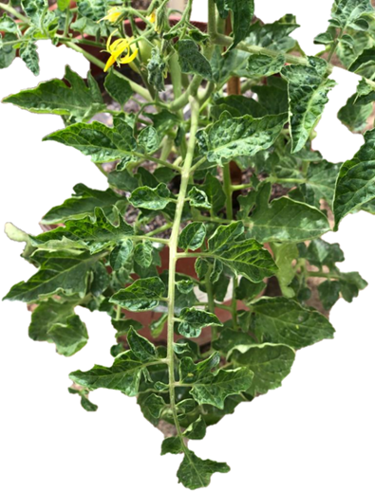
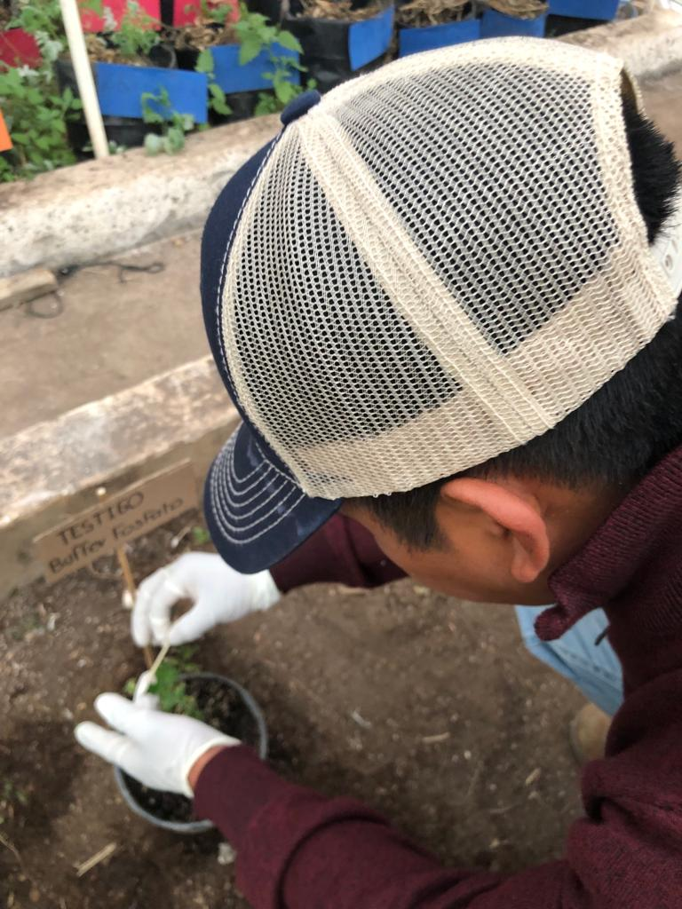
ANTONIO NARRO AUTONOMOUS AGRARIAN UNIVERSITY
DEPARTMENT OF AGRICULTURAL PARASITOLOGY
MASTER OF SCIENCE IN AGRICULTURAL PARASITOLOGY
Pathogenicity of three Tomato brown rugose fruit virus isolates and response in tomato (Solanum lycopersicum L.)
UBILFRIDO VASQUEZ-GUTIERREZ
October, 2023.

Slide 2
AUTHORS:
1st.- MSc. Ubilfrido Vasquez-Gutierrez
2nd.- PhD. Juan Carlos Delgado-Ortiz
3rd.- PhD. Gustavo Alberto Frias-Treviño
4th.- PhD. Luis Alberto Aguirre-Úribe
5th. PhD. Alberto Flores Olivas

Slide 3
Characterization of ToBRFV
Family: Virgaviridae; Genus: Tobamovirus Species: Tomato brown rugose fruit virus (ToBRFV)
Shape and Size: Rigid rods 300 nm long and 18 nm in diameter
Transmission: mechanical Survival: In residues, soil and wise.
Genome: 6.4 kb single-stranded RNA Protein (PM): serologically with Tobacco mosaic virus and Tomato mosaic virus
(Hakan et al.,2021; ICTV, 2022)

Slide 4
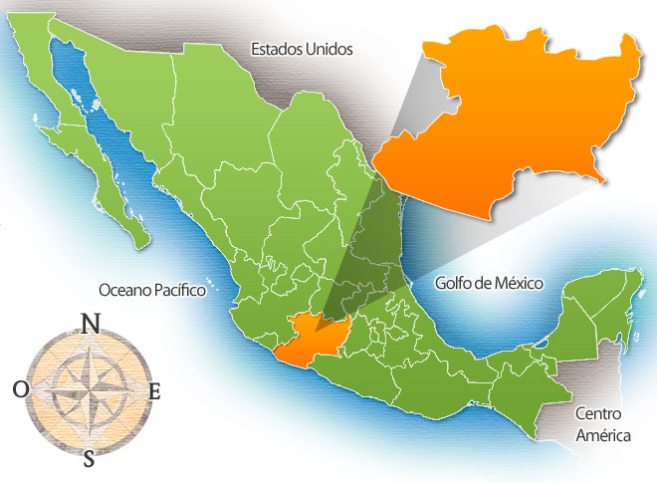
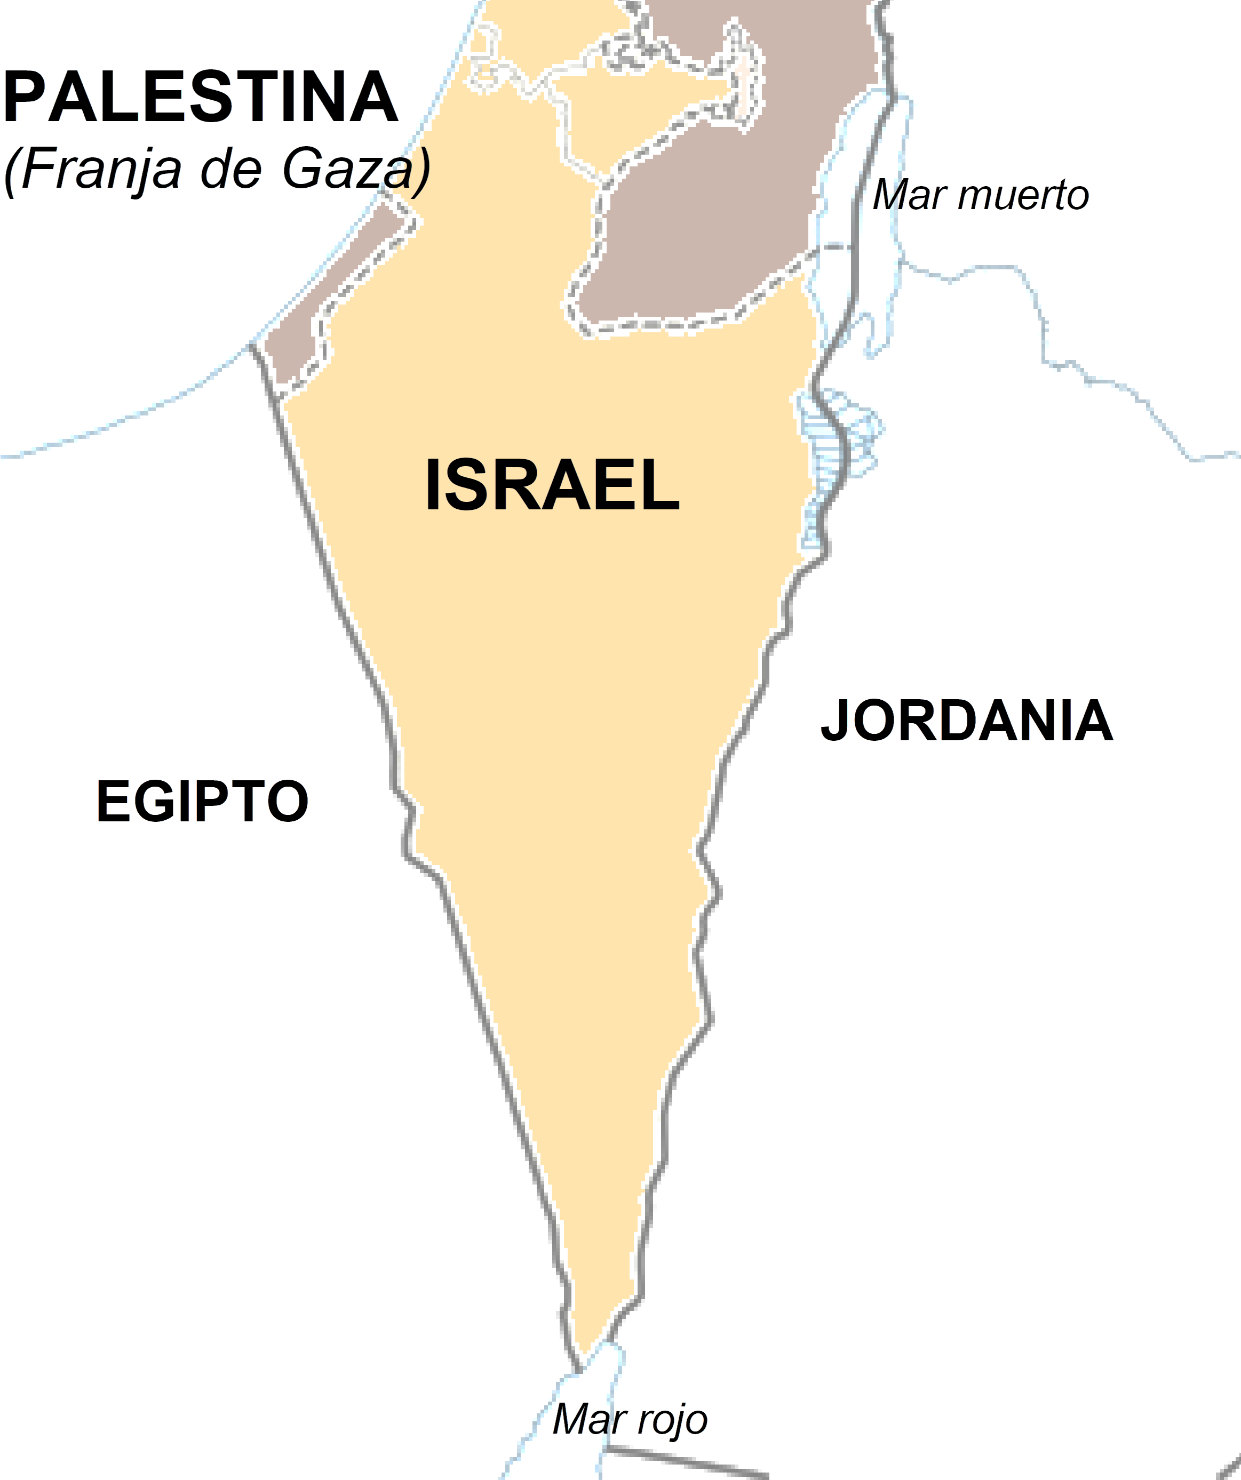
INTRODUCTION
ToBRFV disease of recent introduction to Mexico
Yurecuaro, Michocán.
2019-2022 “NON-REGULATED QUARANTINE PEST”
2014
2018
2018
Germany, Italy and E.U.
2015
(Menzel et al., 2019; EPPO, 2022)

Slide 5
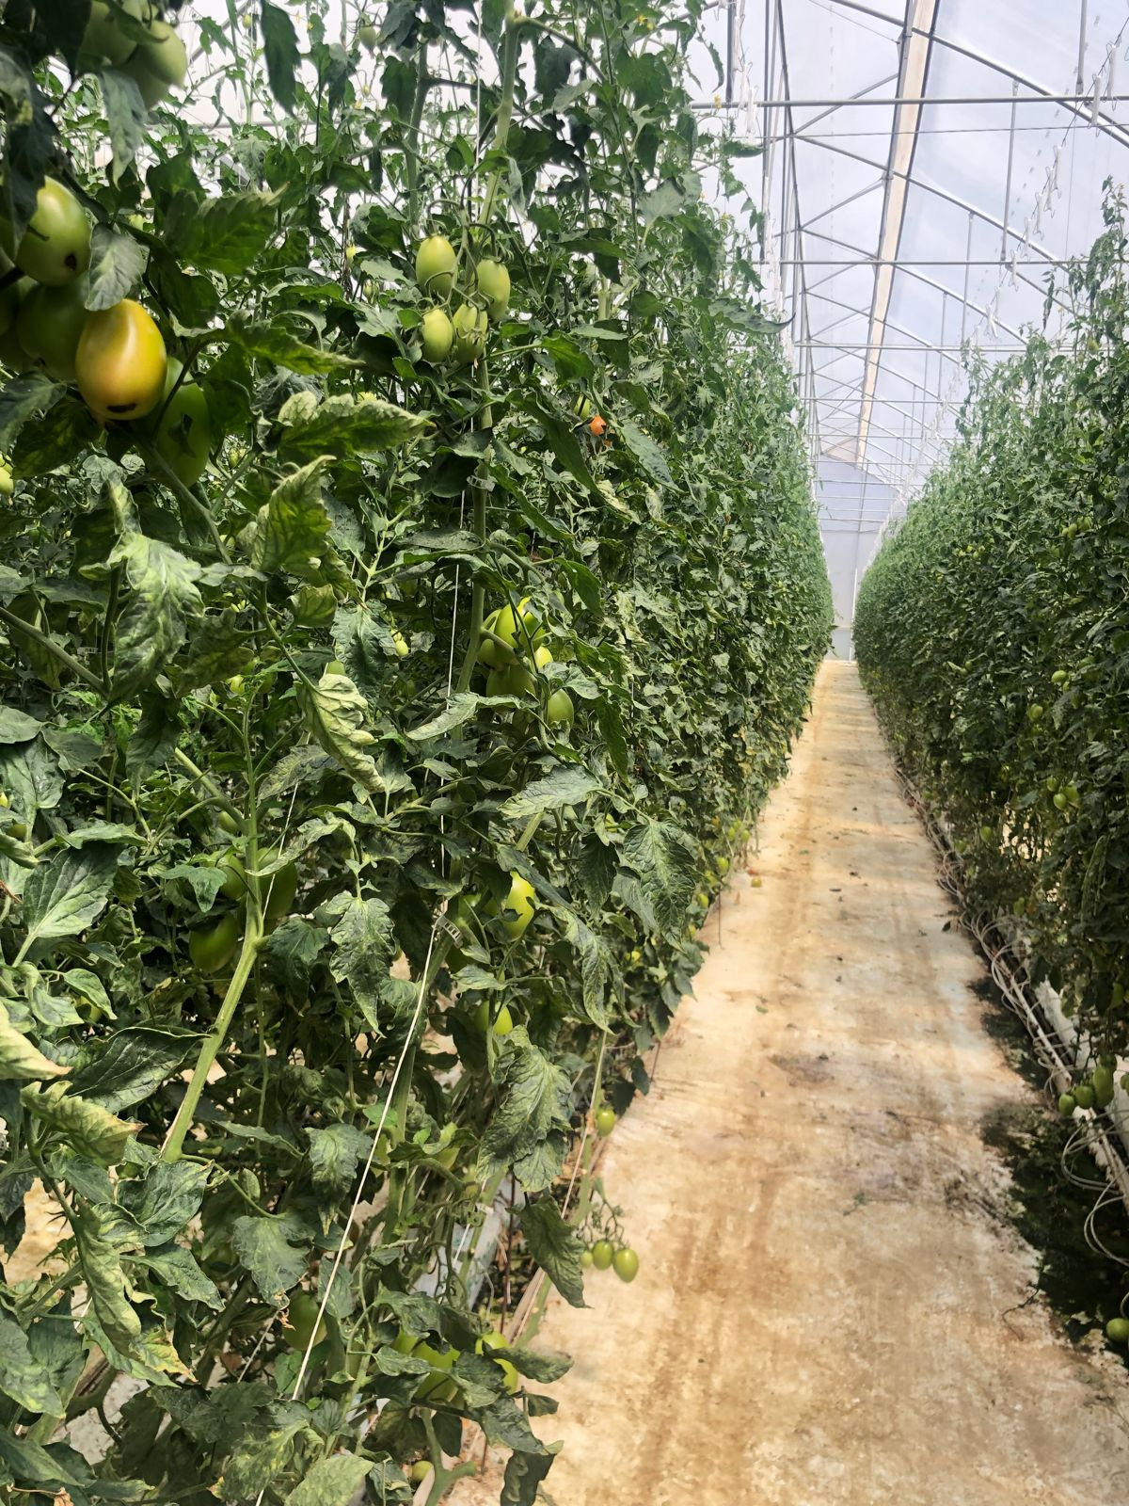
MATERIALS AND METHODS
Research Location
Sampling located in 4 hectares of greenhouses in the Coahuila Region.
General Cepeda, Coahuila, Mexico
Experiment UAAAN greenhouse.

Slide 6
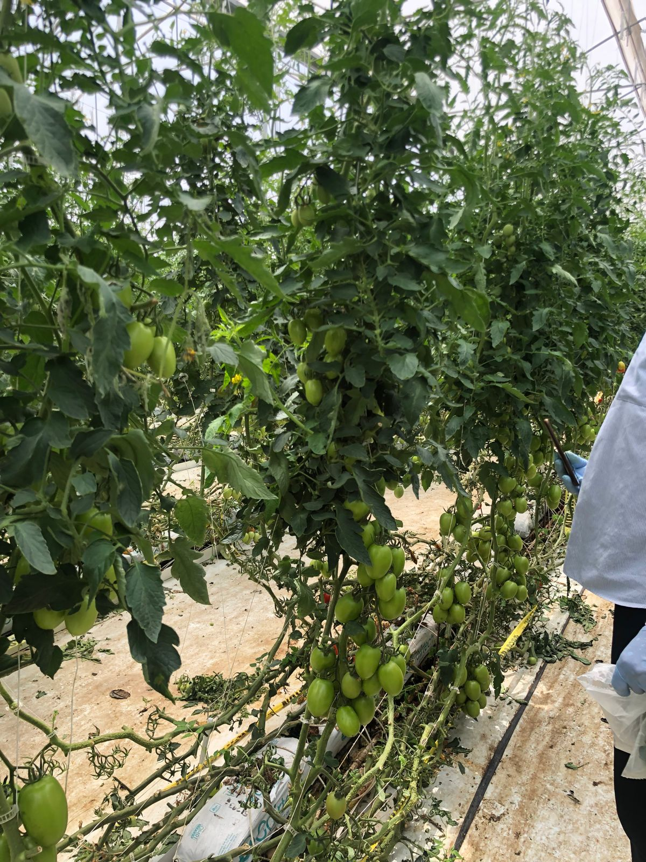
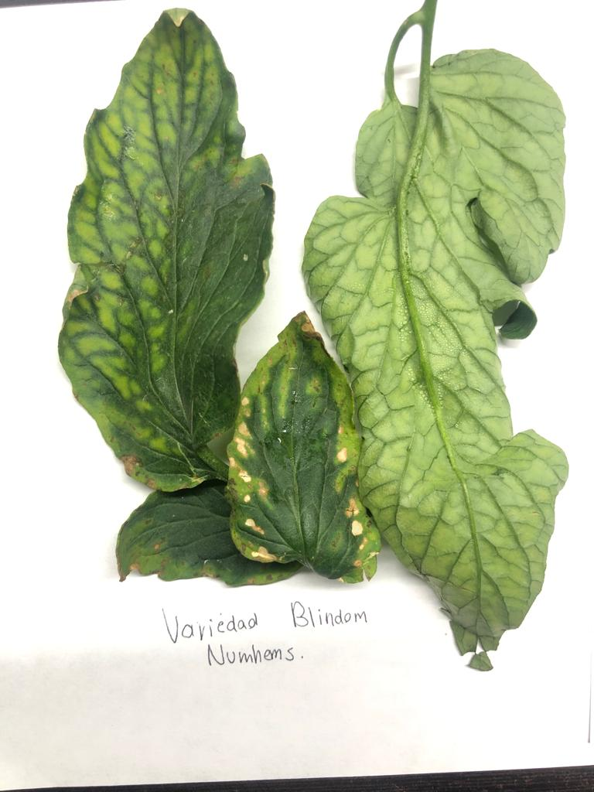
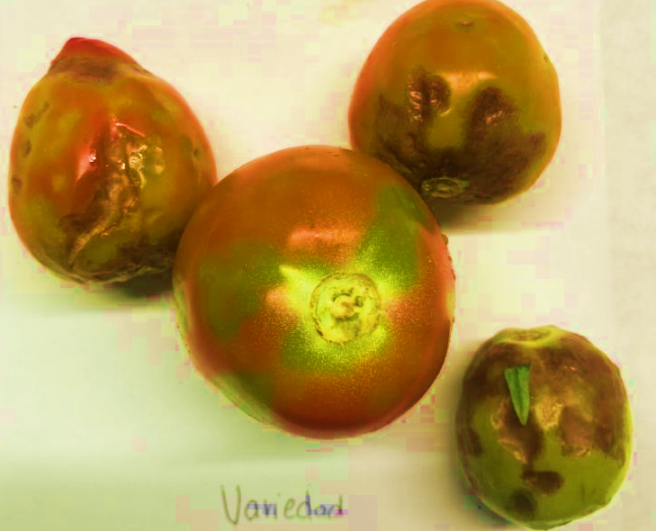
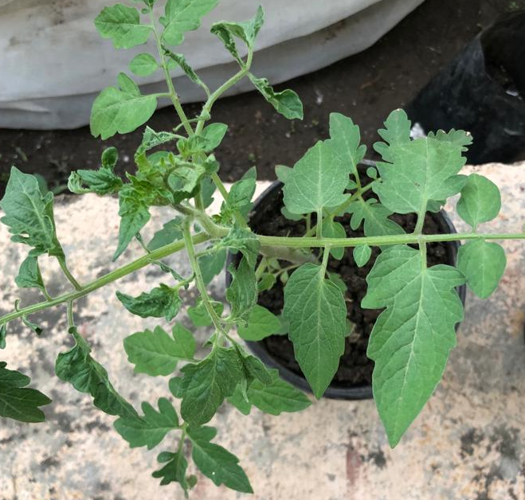
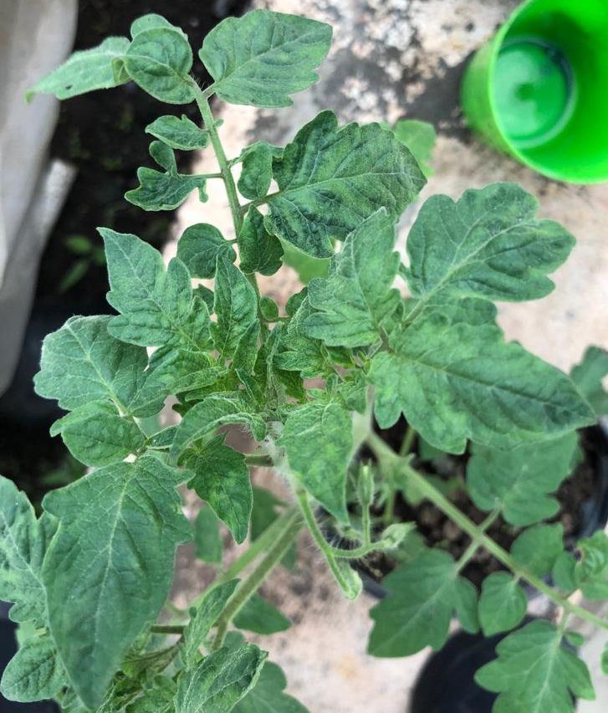
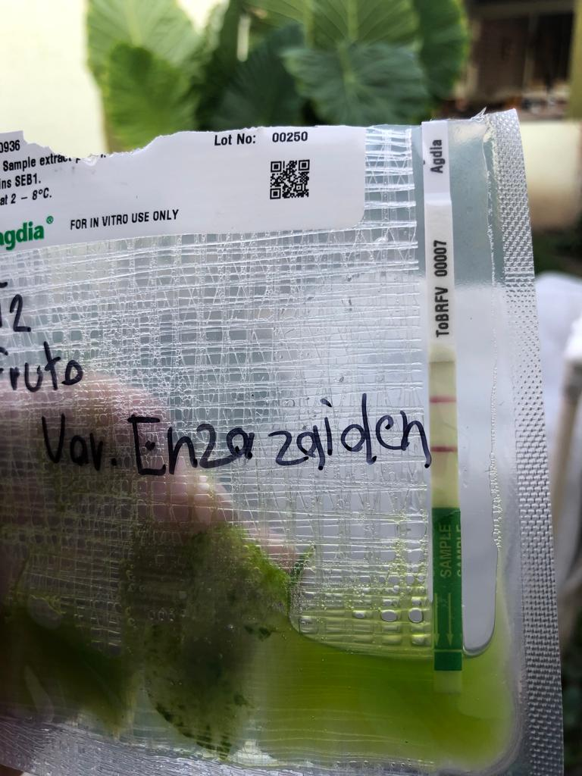
Sampling and isolation of ToBRFV
Collection of 200 leaflets per hectare (one leaflet per plant) with ToBRFV symptoms, in tomato greenhouses.
ImmunoStrip® ToBRFV Agdia
Leaves (young) and symptomatic fruits.
(González, 2020)

Slide 7
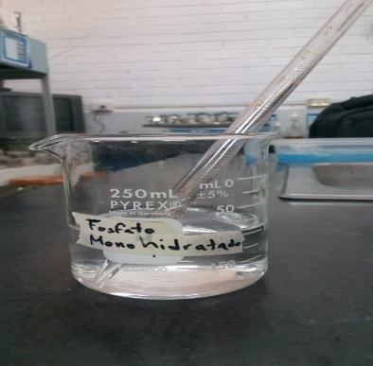
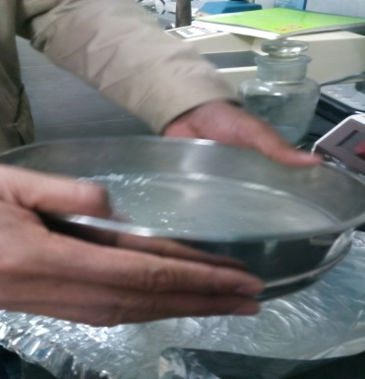
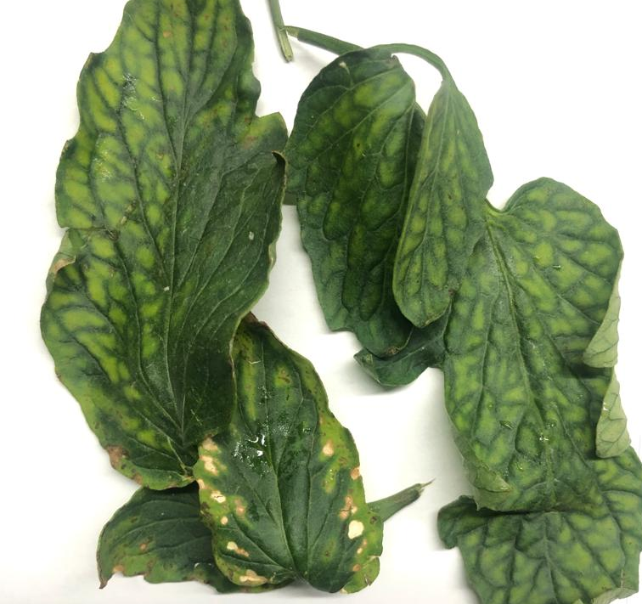
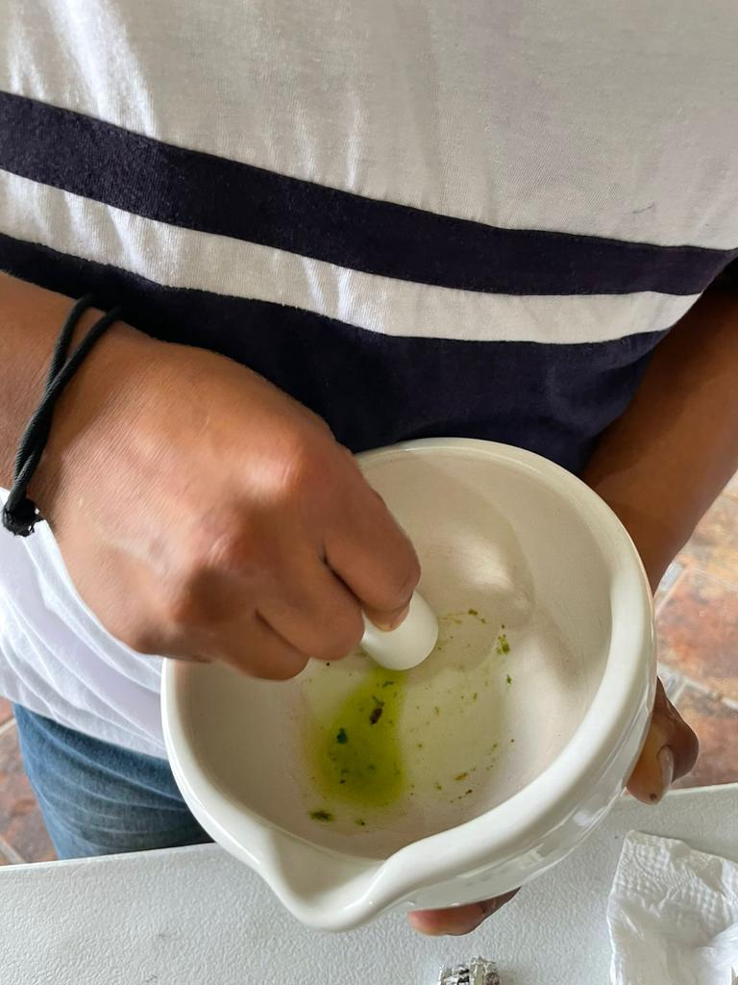
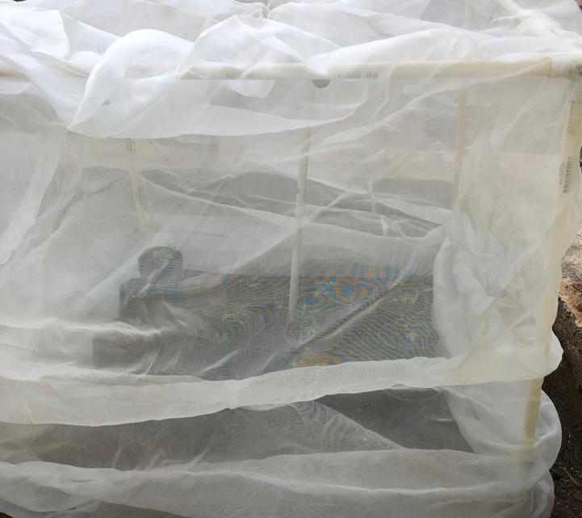
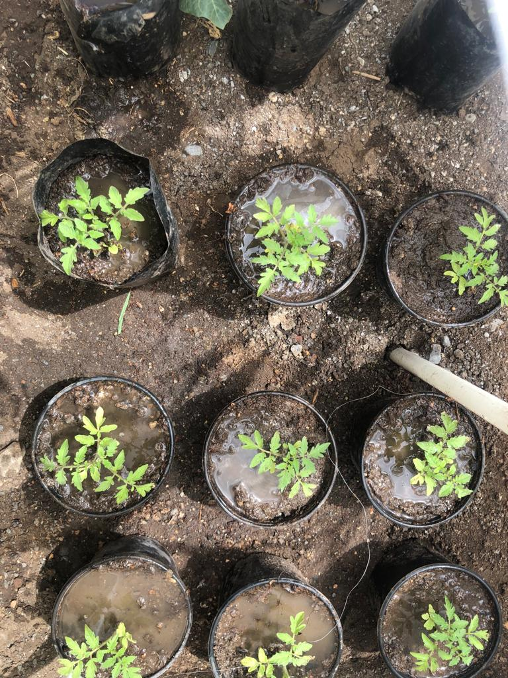
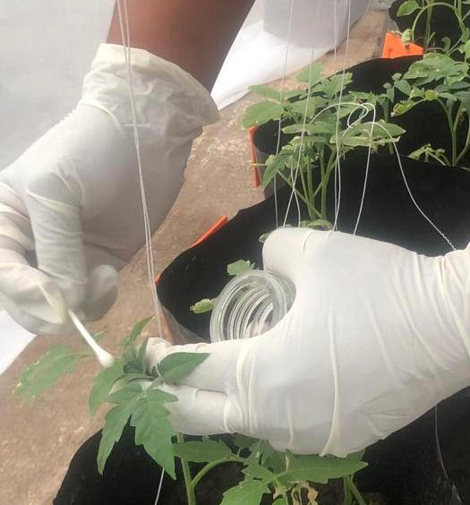
Isolation and inoculation
Extractión
Phosphate buffer (0.1 M; pH 8.0).
Silicon carbide (abrasive)
selection of fabrics
Macerate 1gram/ 10 milliter phosphate bufferadd abrasive
Inoculation 10 days after transplant (dat)
Avoid contact with control plants
Rub healthy plants
(Filipic et al., 2021; Rodríguez et al., 2020; Peña & Trujillo, 2007)

Slide 8
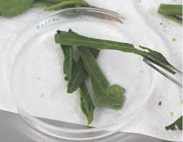
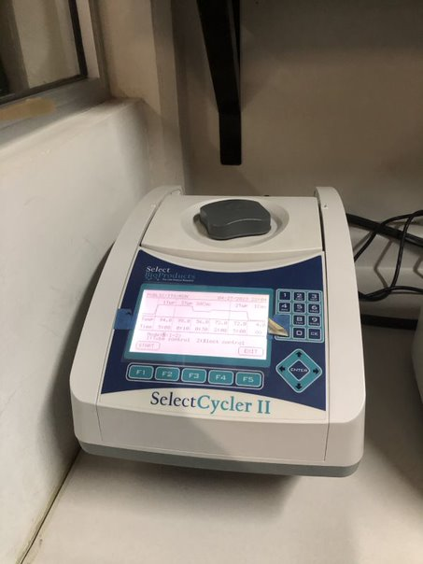
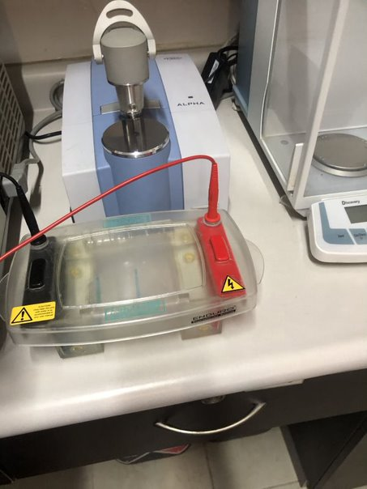
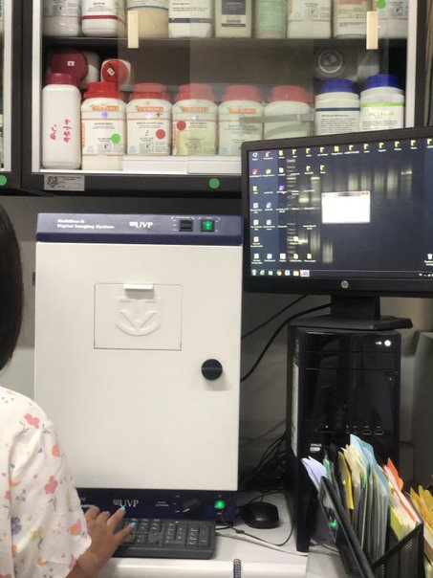
Identification of the isolate (source of inoculum)
ToBRFV detection was performed by RT-PCR end point, with the primers designed by Rodriguez et al. (2019) that amplify a 475bp fragment. Subsequently, they were visualized on a 1.5% agarose gel.
1
3
4
5
6
2

Slide 9
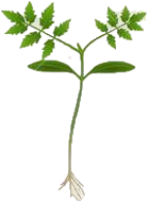
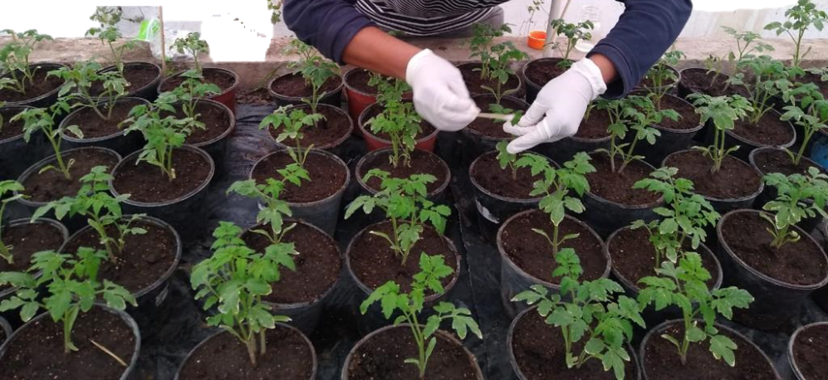
Establishment of experimentation under a greenhouse conditions
Treatments
Tomato plant var. 172-300 Yüksel®.
three treatments with 10 repetitions: Isolated TB1, TQ2 and FQ3.
Negative control: Phosphate buffer solution (PBS) + celite
Fertilization 2 times/week
35 days after sowing (das).

Slide 10
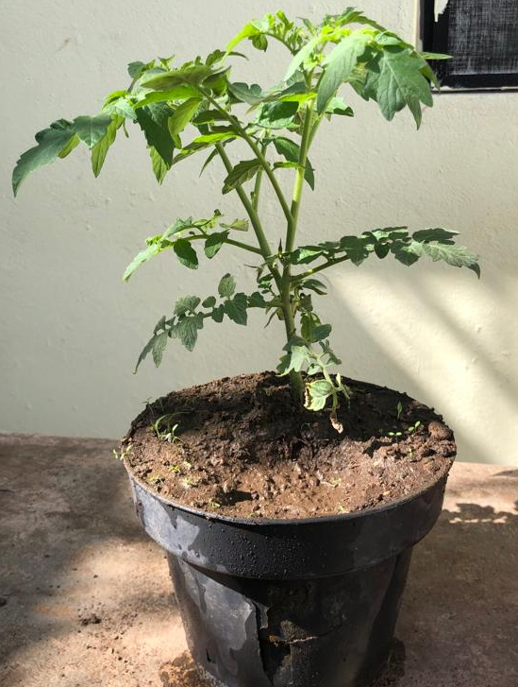
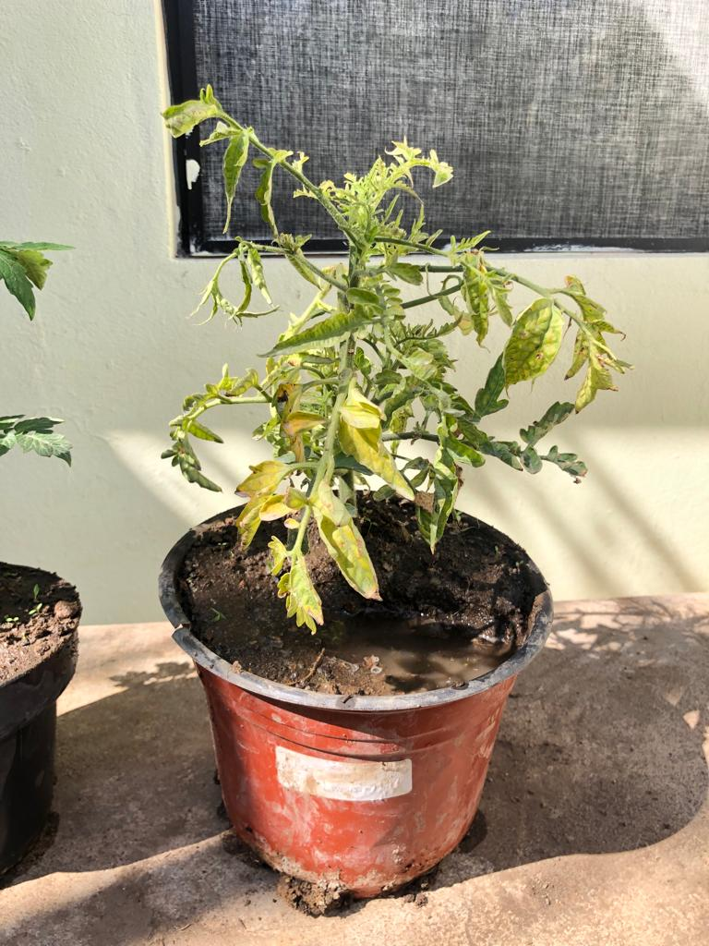
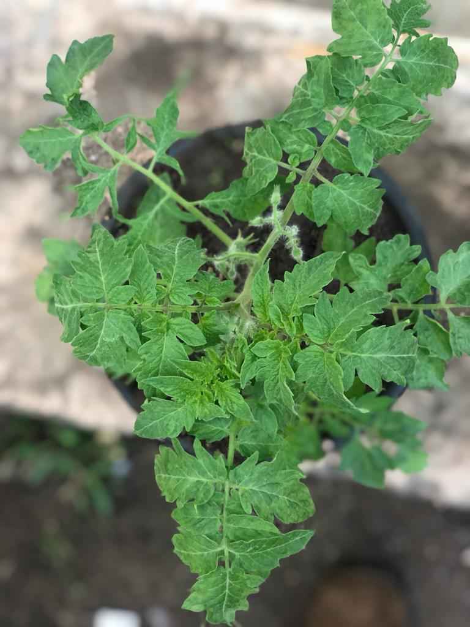
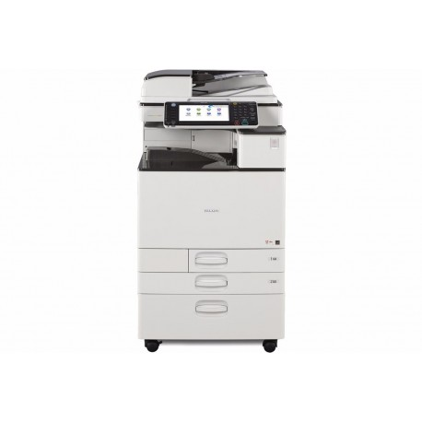
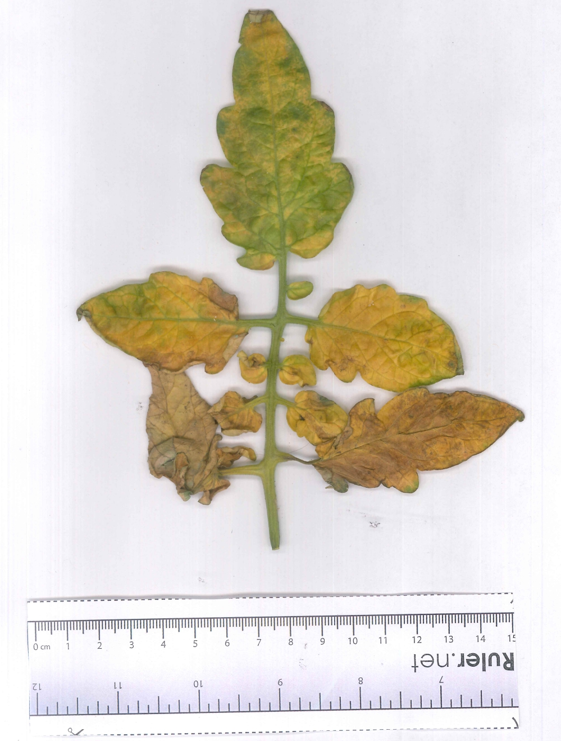
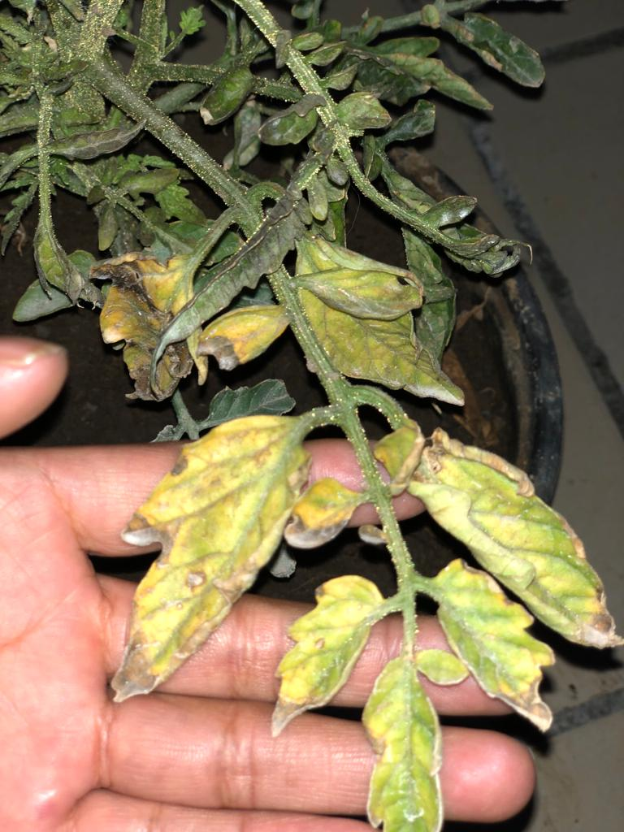
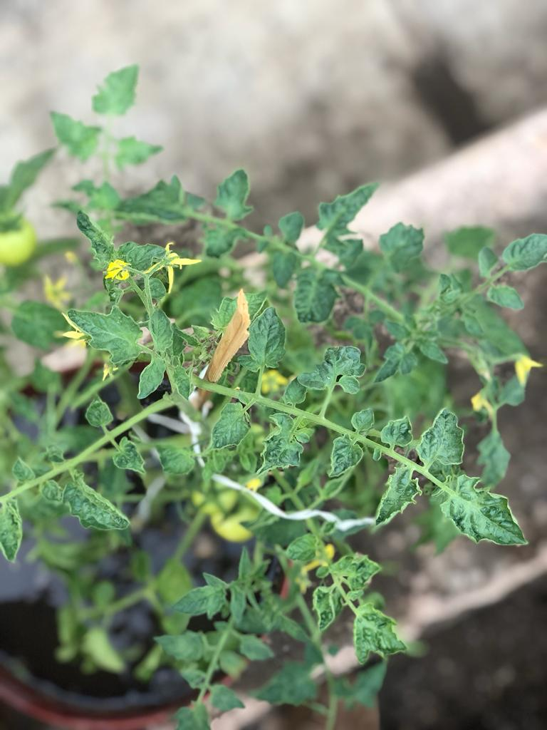
Design of a severity scale for leaves and fruits.
Observation 10 dpi.
Sampling every 15 days-death of the plant.
5 leaves/sampling and treatment with different degrees of severity.
Scan to RICOH MP C2003 Printer
Mosaics
Yellowing
Curling
Necrosis
Dwarfism
(Nutter et al.,2001).

Slide 11
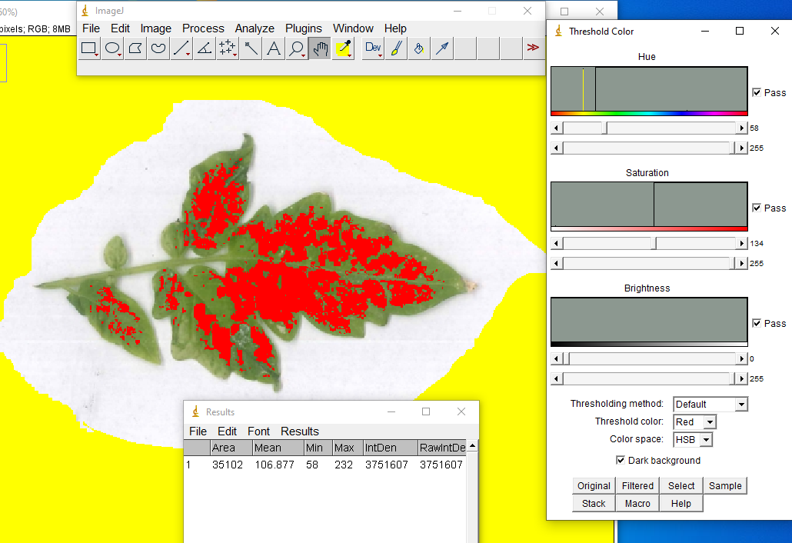
Using the imageJ 1.53t Software (NIH, USA) the total area affected was quantified.
$$Severity=\left(\frac{affected area}{total area}\right)100$$
9 classes with the Infostat® program for leaves and fruits.
(Nutter et al., 2001).

Slide 12
Fruit damage scale
Fruits with different damage caused by ToBRFV infection were selected.
Brown and necrotic spots (exterior and interior), irregular ripening and roughness. In fruits (1st harvest →Last).
(Ortega-Acosta, 2016; Ortíz-Martínez, 2021)

Slide 13
Agronomic variables evaluated
c/30 days x 3 mounthes
Plant height (PH)
Stem diameter (SD)
Root Dry Weight (RDW)
Plant Dry Weight (PDW)
5. Fruit index (FI): $\left(\frac{equatorial diameter}{ Polar diameter}\right)$ (Sánchez, 1999).
Polar diameter (PD), equatorial diameter (ED).
6. Total fruit weight (TFW) 200das
Flexometer
Vernier ® electronic
Electronic balance
Bonvoisin ® 3000gx0.01g

Slide 14
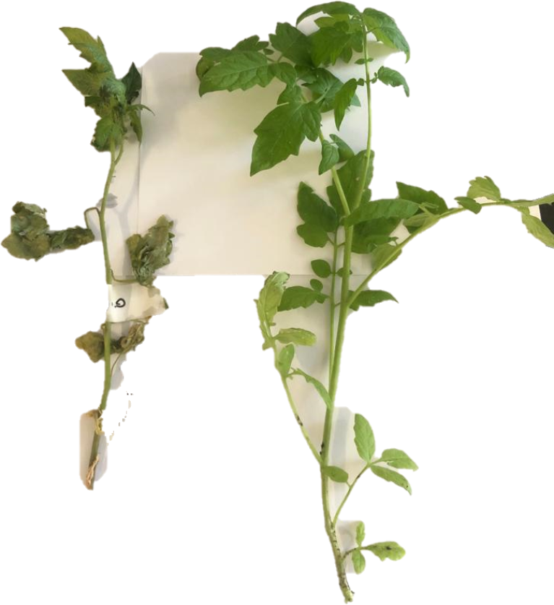
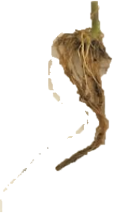
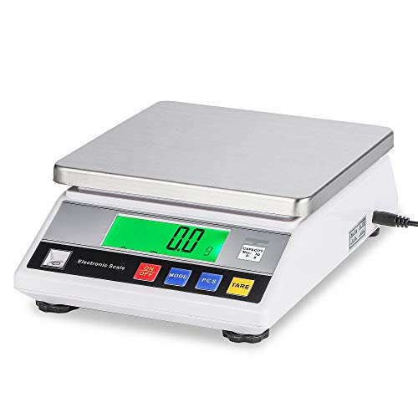
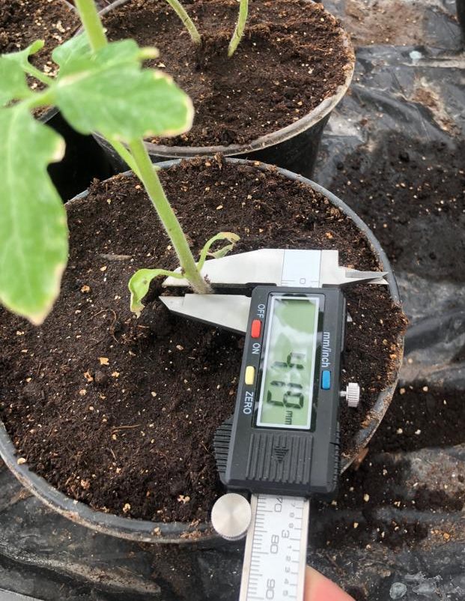
Difference of plants before drying
Difference of roots before drying
Fuit yield
Healthy root
Diseased root
Diseased plant
Healthy plant
Data register
Statistical analysis
Comparison of means of each isolate inoculated versus not inoculated. t-student test (P≤0.05) with the Infostat® software.

Slide 15
GENERAL OBJECTIVE
To evaluate the pathogenicity caused by three ToBRFV isolates from commercial greenhouses in General Cepeda, Coahuilia, Mexico; using agronomic parameters. And propose a diagrammatic scale, to measure the degree of severity in leaves and fruits of infected plants.

Slide 16
RESULTS AND DISCUSSION

Slide 17
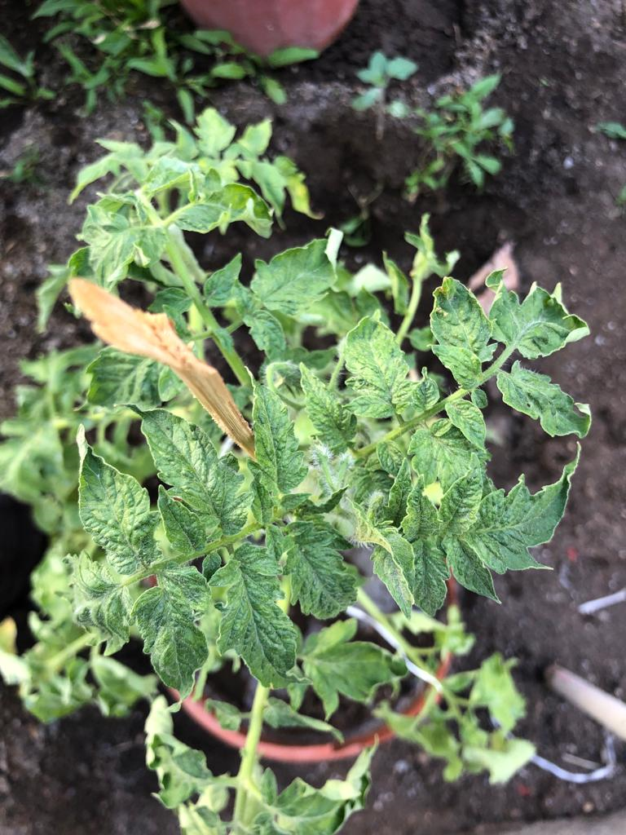
Presence of symptoms in the three isolates:
Mosaics
Dwarfism
Deformation
Rugosity and brown spots on fruits
(Adams et al., 2017; Ullah et al.,2019)

Slide 18
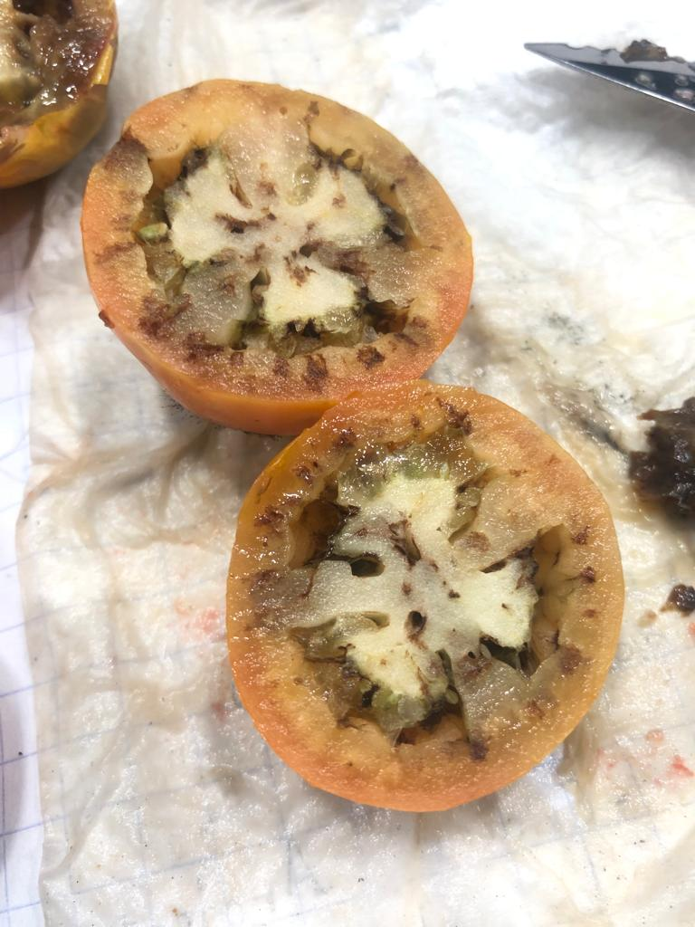
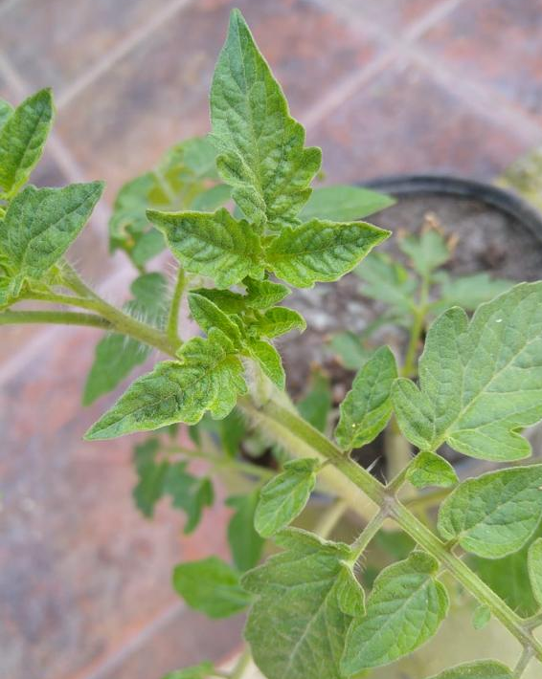
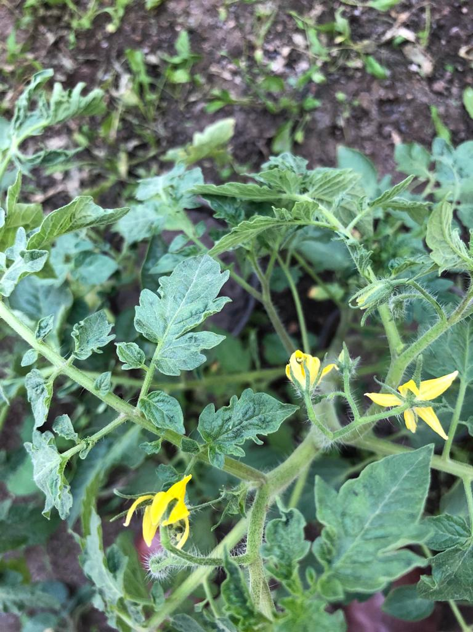
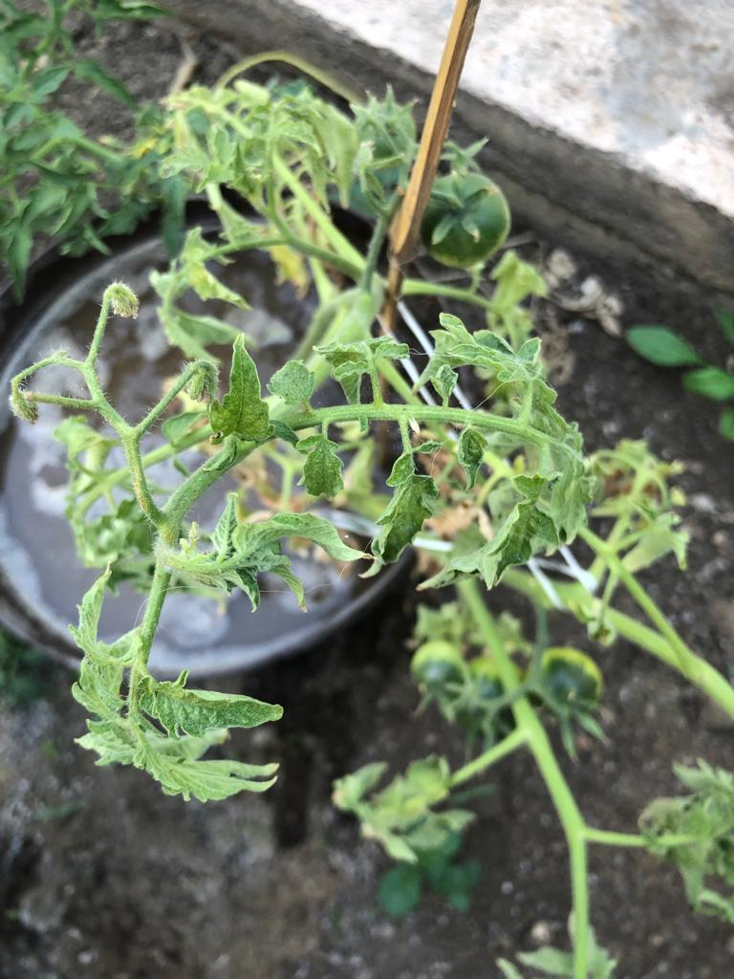
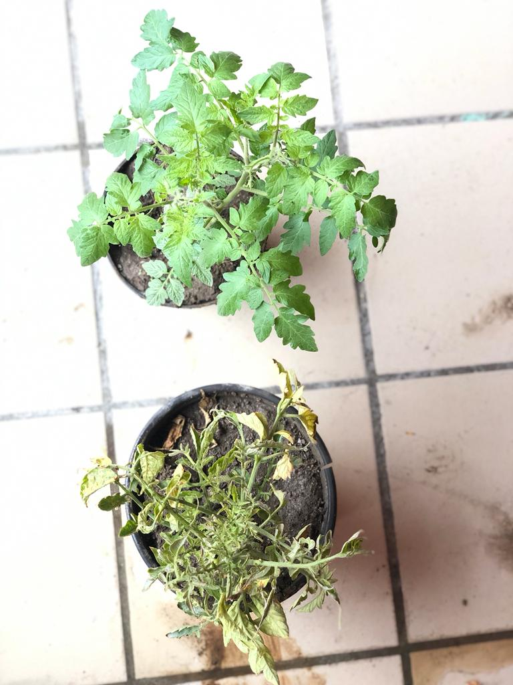
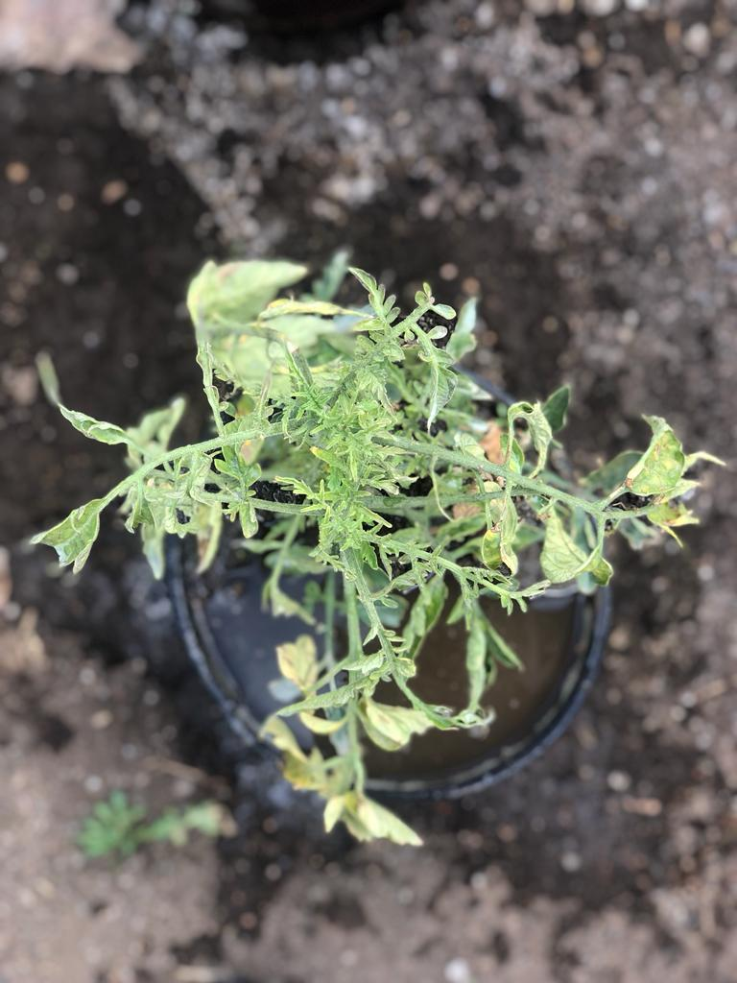
RESULTS AND DISCUSSION
Brown and necrotic spots on the outside and inside of the fruit
Curls in apical leaflets and slight mosaics (Isolation TB1))
Mosaic, chlorosis and deformation in leaflets (Isolate TQ2)
Plants of the FQ3 isolation of 60dai compared with its control (Isolation TQ2)

Slide 19
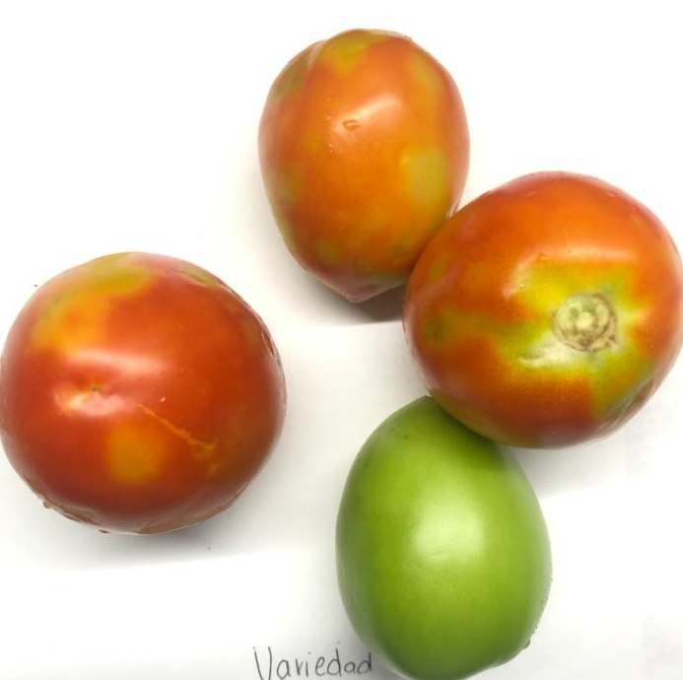
The selected fruits were classified into classes, according to the severity expressed.
TB1
FQ3
TQ2
Ortega-Acosta, 2016; Ortíz-Martínez, 2021

Slide 20
Factors observed in tomato isolates.
Table 1. Variables evaluated in tomato isolates
Isolation |  | Incidence | Incubation period (dai) | Severity 150 dai (%)
TB1 |  | 75 | 12 | 31
TQ2* |  | 85 | 11 | 50
FQ3 |  | 100 | 9 | 80
Dai: days after inoculation.
Source: self made.

Slide 21
Table 2. Diagrammatic scale for ToBRFV according to leaf area, and affected fruits in tomato plants
Classes |  | Severity %
0 | 0 |  | Healthy
1 | 0.1 – 3.3 |  | Very mild
2 | 3.3 – 23.3 |  | Minimum severity
3 | 23.3 – 32.2 |  | moderately severe
4 | 32.2 – 47.1 |  | Severe
5 | 47.1 – 60.9 |  | Very severe
6 | 60.9 – 81.1 |  | Medianamente severo
7 | 81.1 – 90.5 |  | Agresivo
8 | 90.5 – 97.3 |  | Muy agresivo

Slide 22
TB1
TQ2
FQ3
TB1
TQ2
FQ3
Evaluation of morphological agronomic parameters (plant height, stem diameter, root dry weight and plant dry weight) and fruit quality (fruit index and average fruit weight) in inoculated isolates (treatments) versus non-inoculated (witness). Within each isolate, bars with the same letter are significantly equal (Student's t-, P≤0.05).

Slide 23
TB1
TQ2
FQ3
Testigo 1
Testigo 2
Testigo 3

Slide 24
Conclusions
ToBRFV affected the agronomic parameters in the three isolates studied, being the Fruit Index (IF) the most affected.
There was a relationship between the fitness of ToBRFV and its virulence, where PH, RFW and PFW are reduced in relation to virus infection, affecting the fecundity of tomato plants, that is; if there is a multiplication in the viral concentration in the isolates, the accumulation of ToBRFV affects the physiological processes in the plant.
On the other hand, performance (TFW) was markedly reduced in isolates (31.94% to 38.73%), showing a significant correlation with severity. Regarding the severity diagrammatic scale, it allowed to quantify the syndrome caused by ToBRFV in tomato through the pathogenicity analysis of the three isolates studied.

Slide 25
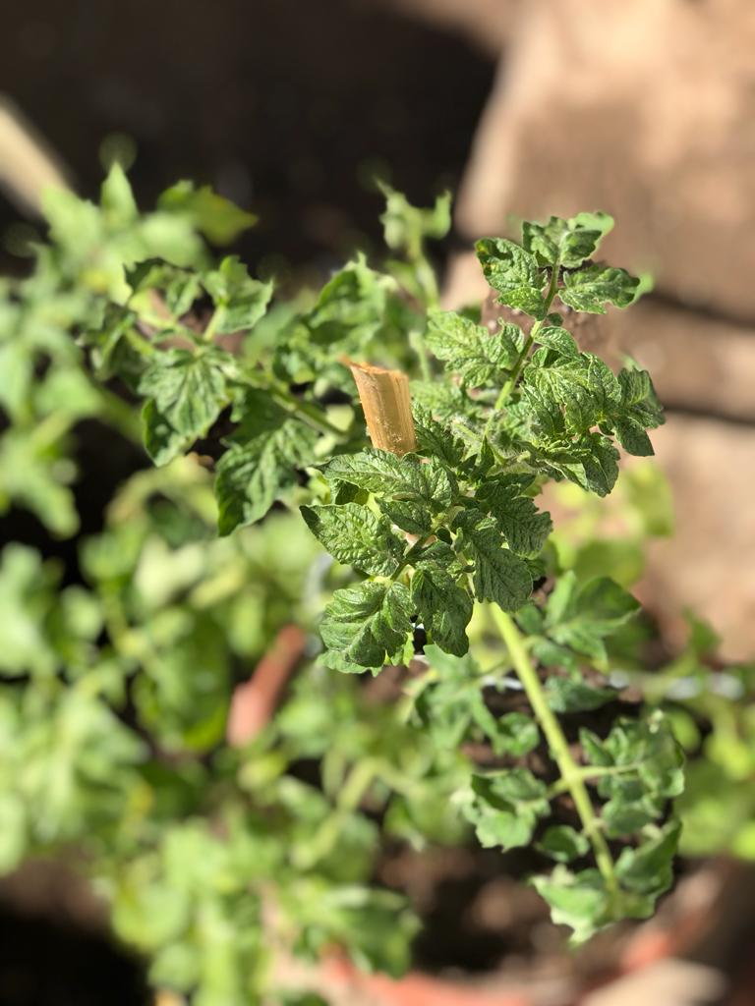
THANK YOU FOR YOUR TIME
https://orcid.org/0000-0001-8281-5075
Contact:
d_ubilfrido.vazquezG@uaaan.edu.mx
vagu.99@hotmail.com

