Slide 1

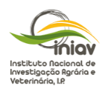

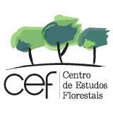




Precision Agriculture in Rice (Oryza sativa L.) Biofortified with Selenium
Ana Coelho Marques ^{1,2,}*, Cláudia Campos Pessoa ^{1,2}, Diana Daccak ^{1,2}, Inês Carmo Luís ^{1,2}, Ana Rita F. Coelho ^{1,2}, Manuela Simões ^{1,2}, Paula Scotti-Campos ^{2,3}, Ana Sofia Almeida ^{2,4}, Maria Graça Brito ^{1,2}, José Carlos Kullberg ^{1,2}, José C. Ramalho ^{2,5}, José Manuel N. Semedo ^{2,3}, Mauro Guerra ^{1,6}, Roberta G. Leitão ^{1,6}, Fernando Reboredo ^{1,2}, Maria Manuela Silva ^{1,2}, Paulo Legoinha ^{1,2}, Maria Fernanda Pessoa ^{1,2}, Lourenço Palha ⁷, Cátia Silva⁷ , Isabel P. Pais ^{2,3} and Fernando C. Lidon ^{1,2}
¹ Earth Sciences Department, NOVA School of Science and Technology (FCT NOVA), Campus de Caparica, 2829-516 Caparica, Portugal;
²GeoBioTec Research Center, NOVA School of Science and Technology (FCT NOVA), Caparica, Portugal;
³Instituto Nacional de Investigação Agrária e Veterinária, I.P. (INIAV), Avenida da República, Quinta do Marquês, 2780-157 Oeiras, Portugal;
⁴Instituto Nacional de Investigação Agrária e Veterinária, I.P. (INIAV), Estrada de Gil Vaz 6, 7351-901 Elvas, Portugal;
⁵PlantStress & Biodiversity Lab., Centro de Estudos Florestais (CEF), Associate Laboratory TERRA, Instituto Superior Agronomia (ISA), Universidade de Lisboa (ULisboa), Quinta do Marquês, Av. República, 2784-505 Oeiras and Tapada da Ajuda, 1349-017 Lisboa, Portugal;
⁶LIBPhys, Physics Department, NOVA School of Science and Technology (FCT NOVA), Campus de Caparica, 2829-516 Caparica, Portugal;
⁷Centro de Competências do Arroz (COTArroz), 2120-014 Salvaterra de Magos, Portugal.

Slide 2
Abstract: Remote sensing data is a powerful tool that contributes to sustainability and efficiency in crop management. Rice (Oryza sativa L.) is widely recognized as one of the most important crops in terms of economic and social impact. The aim of this study was to evaluate the efficiency of the use of an Unmanned Aerial Vehicles (UAVs) in two rice varieties (Ariete and Ceres) submitted to a biofortification workflow with two types of selenium (sodium selenate and sodium selenite) in providing valuable information re-garding plant health and status. In this context, through the use of an UAVs synchro-nized, the state of the culture was further assessed, digital elevation model, water lines, slope classes / infiltration suitability and Normalized Difference Vegetation Index (NDVI) were considered. Additionally, leaf gas exchange measurements were con-ducted during the biofortification process and Se content in rice was quantified. The NDVI index ranged from 0.76 to 0.80 without significant differences regarding control. It was observed that the water drainage pattern following the artificial pattern created by grooves between plots. Furthermore, selenite application up to 100 g Se.ha−1 did not exhibit toxicity effects on the biofortified plants and presented a grain enriched of 16.09 µg g-1 (Ariete) and 15.46 µg g-1 (Ceres). In conclusion, through precision agriculture techniques and utilizing data from leaf gas exchanges allows an efficient monitoring of the experimental field conditions and is a highly useful tool in decision making.
Keywords: leaf gas exchanges; Oryza sativa L.; precision agriculture; selenium biofortification

Slide 3

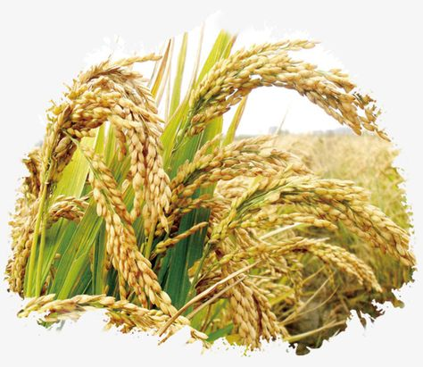
Materials and Methods
Ceres variety
Selenate and Selenite
0, 25, 50, 75 and 100 g Se.ha⁻¹
Precision Agriculture
Leaf Gas Exchange Measurements
Selenium Content

Slide 4
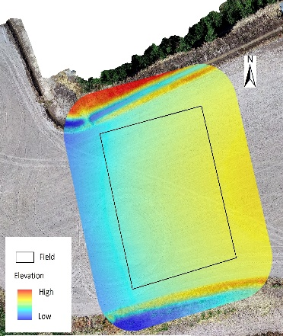
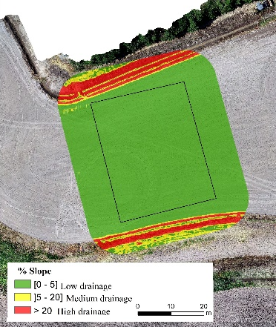
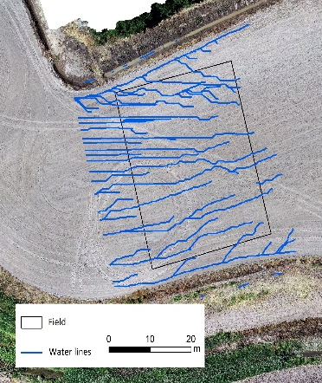
Results and Discussion
The elevation model (Figure 1) shows the average and minimum elevation zones associated with the location of the paddy rice field. The direction of water lines suggests that if surface drainage is present, it is likely to follow the trajectory of the estimated water lines. The experimental field has a slope of about 5 %, which results in reduced surface drainage.

Slide 5
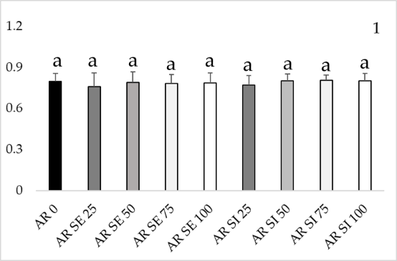
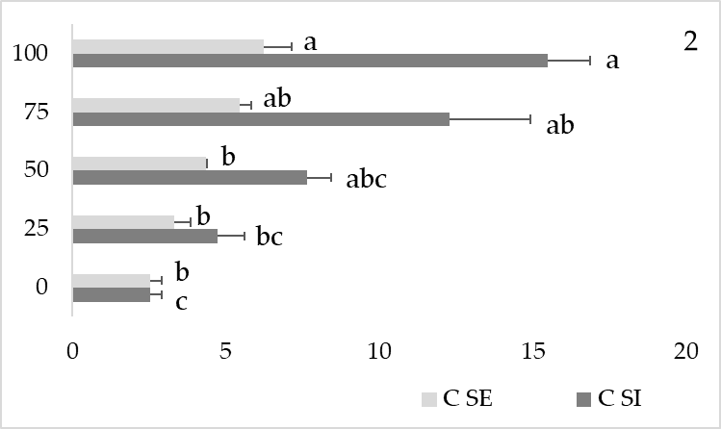
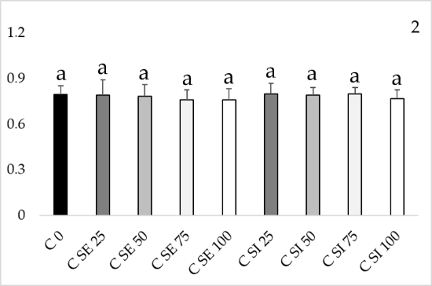
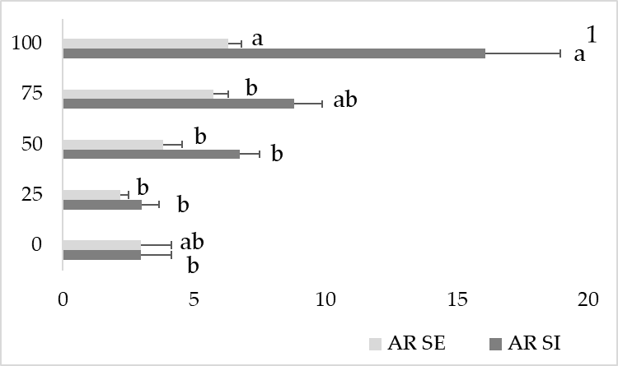
Results and Discussion
The application of increasing concentrations of Se, in both forms, allowed the gradual increase of this element in the paddy rice grain (Figure 3). In both varieties, selenate application showed significant differences compared to the control, however, the increment of Se in the grain was lower when compared to the selenite form. In the Ariete variety, by applying selenite at 100 g Se.ha⁻¹, 16.09 µg g⁻¹ was obtained in the grain. Ceres variety showed a higher value in selenite treatment (15.49 µg g⁻¹), while in selenate treatment the maximum value was 6.25 µg g⁻¹.
Regarding NDVI values, no significant changes were observed in the selenium (Se) treatments when compared to the control in the different varieties (Figure 2). The values ranged from 0.76 to 0.80. The maximum value was obtained in the control plants and with selenite application, in both varieties.

Slide 6
Results and Discussion
Physiological data were acquired after the 2nd foliar fertilization with Se in rice (Table 1). In the Ariete variety, the net photosynthesis (P_{n}) values did not show significant differences between treatments.
However, in the Ceres variety, the values were higher than the control in all treatments, with the maximum values obtained in the treatment with 100 g Se.ha⁻¹ of selenite (17.82 μmol CO₂ m⁻².s⁻¹).
This positive effect on Pn was found along with higher stomatal conductance to water vapor (gs) and lower instantaneous water use efficiency (iWUE).

Slide 7
Conclusion
Using the Unmanned Aerial Vehicle (UAVs), it was possible to map the site where the rice (Oryza sativa L.) biofortification itinerary was implemented. Normalized Difference Vegetation Index (NDVI) data, photosynthesis analysis, and selenium (Se) concentration in the grain were integrated.
Furthermore, Se application up to 100 g Se.ha⁻¹ did not exhibit toxicity effects on the biofortified plants. With the application of selenite, grain enriched in 16.09 µg g⁻¹ (Ariete) and 15.46 µg g⁻¹ (Ceres) was obtained. In conclusion, precision agriculture techniques and utilizing data from leaf gas exchanges allow an efficient monitoring of the experimental field conditions and is a highly useful tool in decision making.

Slide 8



Acknowledgments
The research was funded by PDR2020, grant number 101-030671 and Fundação para a Ciência e a Tecnologia, I.P. (FCT) 2022.10859.BD.
The authors give thanks to Lourenço Palha, Cátia Silva (COTArroz) and Orivárzea (Orizicultores do Ribatejo, S.A.) for technical assistance. We also thank the research centers (GeoBioTec) UIDB/04035/2020, (CEF) UIDB/00239/2020 and Associare Laboratory TERRA (LA/P/0092/2020) for support facilities.

