Slide 1
YOGHURT-LIKE DRINK ENRICHED WITH LATTOBACILLI
AND BIFIDOBACTERIA
Annalisa d’Amelio, Clelia Altieri, Daniela Campaniello*
Department of the Science of Agriculture, Food, Natural Resources and Engineering, University of Foggia, Italy

Slide 2
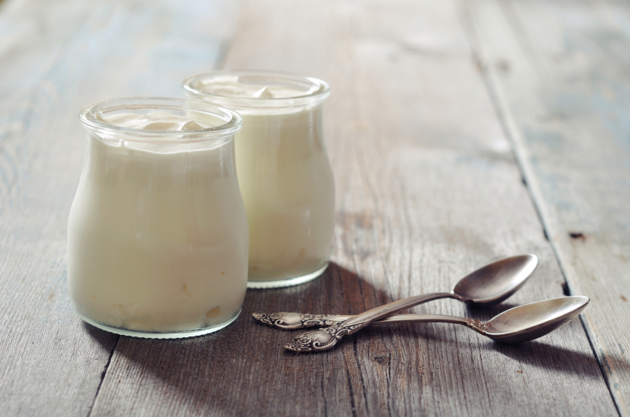
INTRODUCTION
Yoghurt is a fermented drink obtained through the metabolic cooperation of specific acidifying microorganisms, such as Streptococcus thermophilus and Lactobacillus delbrueckii subsp. bulgaricus. However, different bacteria (e.g. probiotics) can be added.
Notes:
The aim of this work was to formulate a yoghurt-like drink with Lactobacilli and Bifidobacteria, using microorganisms isolated from oenological matrices of the Apulian territory.

Slide 3
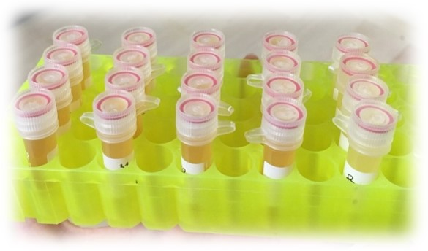
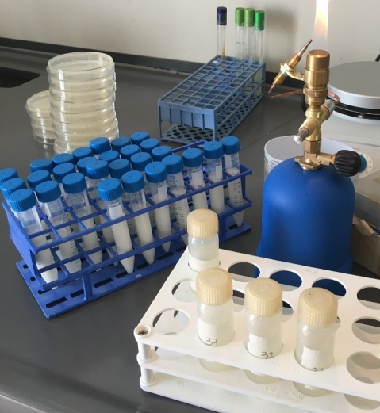
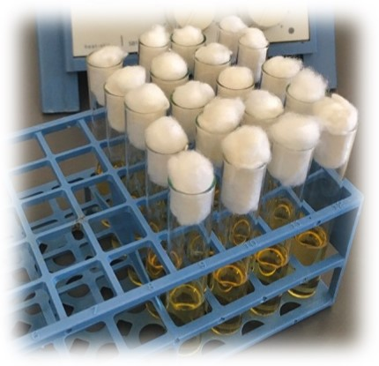
MATERIALS AND METHODS
MICROORGANISMS
Lactiplantibacillus plantarum 33;
Bifidobacterium animalis subsp. lactis DSM 10140.
EXPERIMENTAL DESIGN:
CENTROID
Lpb. plantarum 33 (4, 5 and 6 log CFU/mL);
B. animalis subsp. lactis 10140 (4, 5 and 6 log CFU/mL);
Temperature (30, 35 and 40°C).
MATRIX: pasteurized milk + 10% honey (V/V)
ΔpH=
ΔpH_{max,} d_{max,} α
Notes:
The pH was periodically measured and the data obtained for each combinations were modelled as acidification, that is the pH decrease relative to the start of the experiment. This was used as dependent variable for a primary modelling through the “lag-exponential model”; to obtain : - ΔpH max, the maximum level of acidification; - dmax , the maximum acidification rate and; - α, the time before the beginning of the kinetic acidification (h).

Slide 4
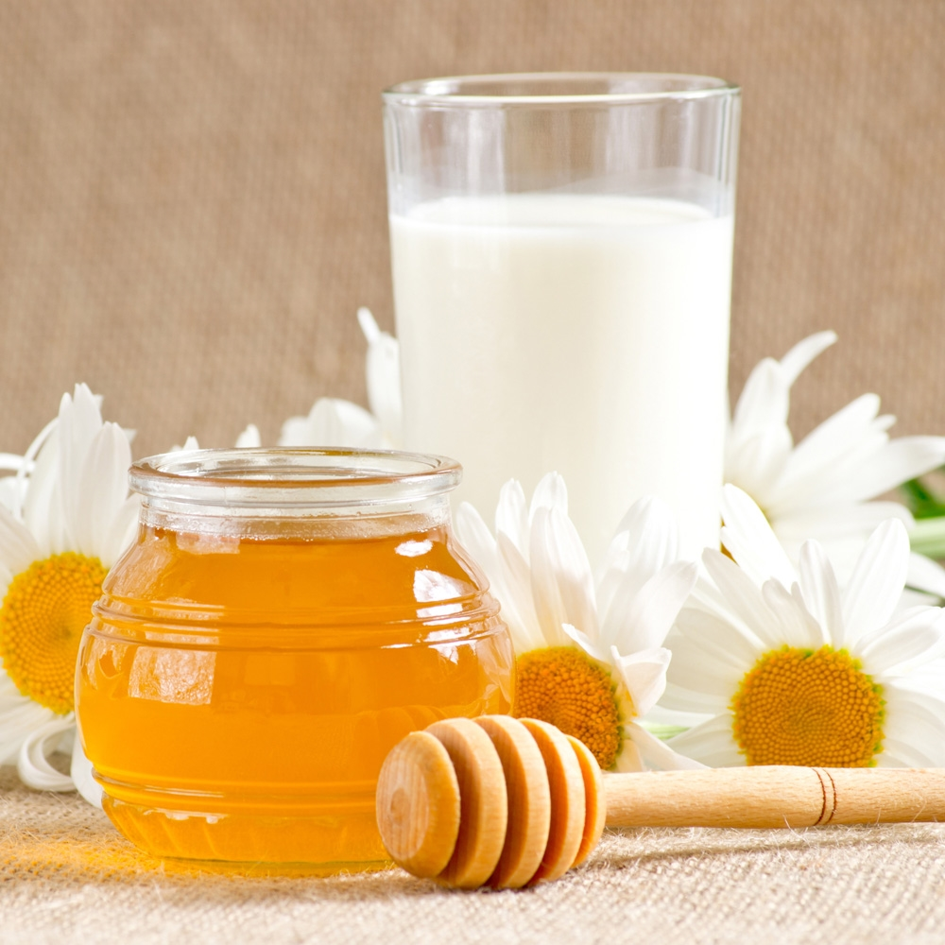
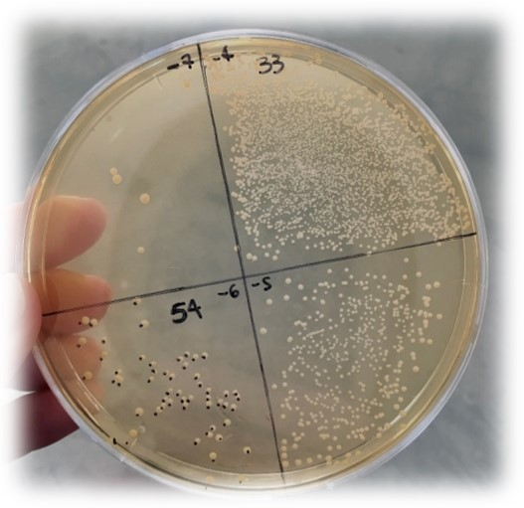
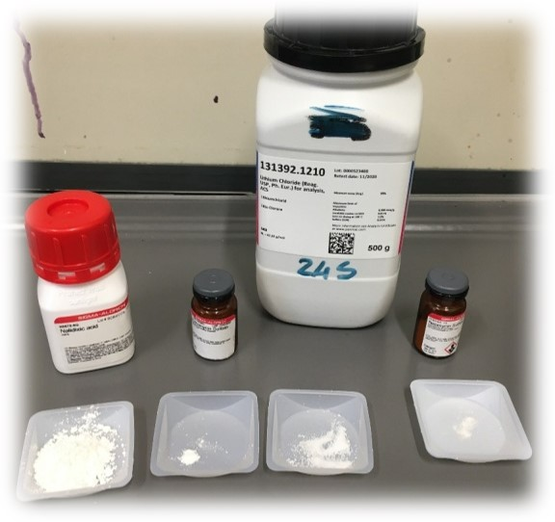
MATERIALS AND METHODS
YOGURT-LIKE REALIZATION
1. 5 log CFU/mL of two strains were inoculated in pasteurized milk + 10% honey (V/V);
2. Incubate at 35 °C for 24 hours;
3. Store at 4 °C;
4. pH measurements;
5. Microbiological analyses;
MRS Agar acidified to pH 5 for Lpb. plantarum 33,
MRS Agar added with a solution of 4 antibiotics for B. animalis subsp. lactis :
Paromomycin sulphate 0.01 g,
Neomycin sulphate 0.005 g,
Lithium 0.15 g,
Nalidixic acid 0.75 g.
Notes:
To produce a Yogurt-like drink 5 log CFU/mL of both strains were inoculated in milk + 10% honey and incubated at 35 °C for 24 hours; then they were stored at 4 °C. Then microbiological analyses and pH measurement were carried out.

Slide 5
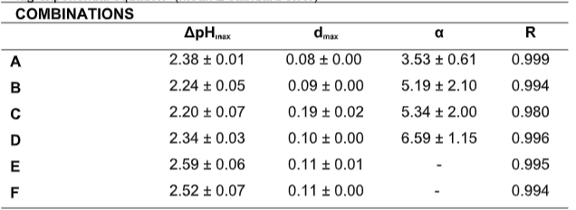
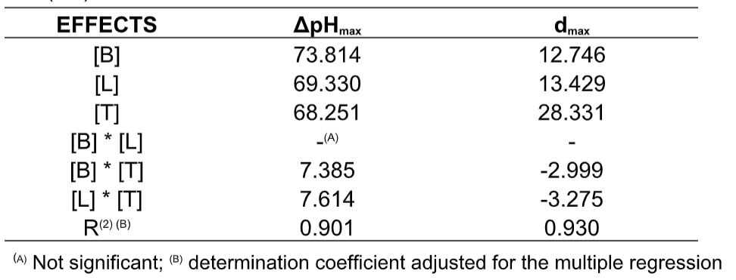
RESULTS
Table 1: Acidification of Lpb. plantarum 33 and B. animalis subsp. lactis: fitting parameters of the “lag-exponential equation” (mean ± standard error)
Table 2: Standardized effects of the inoculum of B. animalis subsp. lactis DSM 10140 [B], Lpb. plantarum [L] and temperature [T] on the maximum acidification (ΔpH_{max}) and on the acidification rate (d_{max})
ΔpH_{max} = maximum acidification (pH reduction at the end of the test);
d_{max} = acidification rate (ΔpH/day);
α= time before start of acidification (g);
R= regression coefficient.
Notes:
Table 1 shows the combinations of the experimental design and the performance of both strains in term to ΔpH max, dmax and alfa. ΔpH max ranged from…. To.., while . Do to high standard error of α parameters, we focused on the parameters ΔpH max and dmax only.
Table 2 shows the standardized effects of the three variables on ΔpH max and dmax. For ΔpHmax, as individual term, Bifidobacterium showed the greatest effect (73.814), while the most significant interaction was “Lpb. plantarum-temperature”. For d max, temperature had the maximum effect.

Slide 6
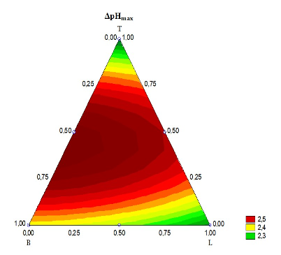
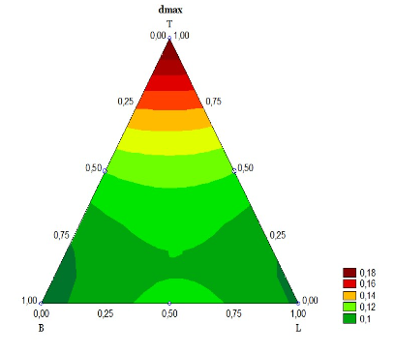
RESULTS
Figure 1: Triangular graph relating to the effects of B. animalis subsp. lactis (B), Lpb. plantarum (L) and temperature (T) on the ΔpH_{max} (a) and d_{max} (b).
a)
b)
Level 0.50 = corresponding to 5 log CFU/mL and 35 °C
Level 1 = corresponding to 40 °C
Notes:
Another output of the centroid is the ternary plot. As you can see, the model predicted the maximum acidification at the “Bifidobacterium animalis subsp. lactis-temperature” and at “Lpb. plantarumtemperature” interactions, at coded levels 0.5 (5 log CFU/mL and 35 °C). For d max (Figure 1b) the model predicted the highest values (d max = 0.18) at the coded level 1 of the temperature (40 °C). Triangular surfaces provide a quantitative assessment of interactive effects, but not of each individual term. This type of evaluation is possible through the desirability profile.

Slide 7
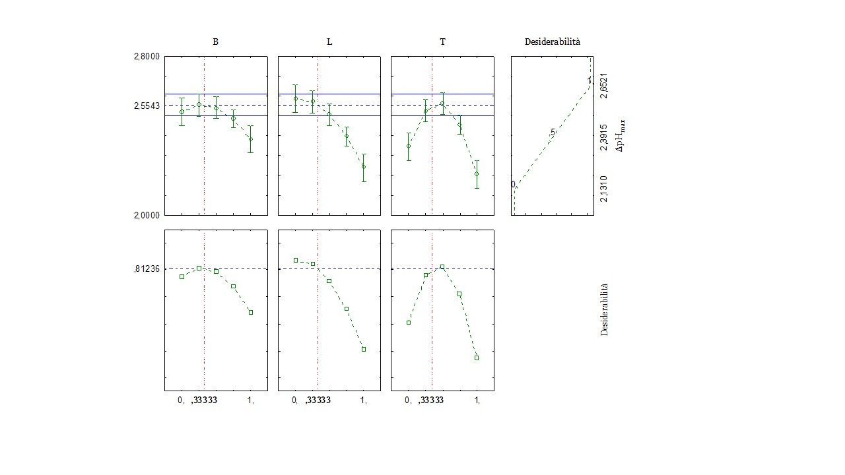
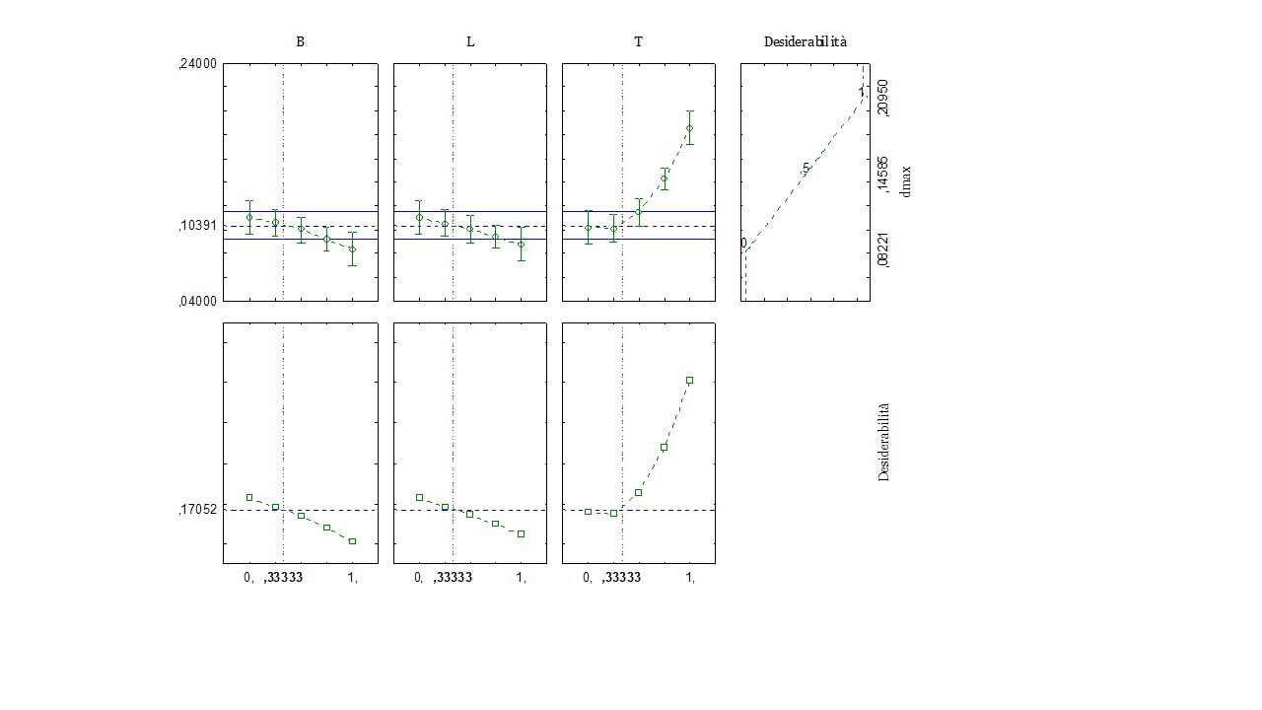
RESULTS
Figure 2: Prediction (upper side) and desirability profiles (down side) for the effect of the inoculum level of B. animalis subsp. lactis (B), Lpb. plantarum (L) and temperature (T) on ΔpH_{max} (a) and d_{max} (b)
Desirability
Desirability
ΔpH_{max}
d_{max}
Desirability
Desirability
a)
b)
Coded levels as 0.75 and 1 (corresponding to 5.50 and 6 log CFU/mL)
Coded levels as 0.75 and 1 (corresponding to 37.5 and 40 °C)
Notes:
The desirability profile of ΔpHmax shows that for both strains, the increase of the inoculum level had a negative effect on acidification, with a decrease in strains performance at coded levels 0.75 or 1. For temperature, ΔpHmax was minimal at 30 °C and also decreased at coded levels 0.75 and1.
For d max both strains reduced the acidification rate at the inoculum coded level 1, while temperature had a positive correlation.
As shown, by increasing the temperature, acidification decreases and the rate increases, it is known as decoupling of the parameters.

Slide 8
CONCLUSIONS
OPTIMAL COMBINATION
5 Log CFU/mL of B. animalis subsp. lactis;
5 Log CFU/mL of Lpb. plantarum;
Fermented at 35 °C for 24 hours.
SHELF-LIFE test
Stored at 4 °C for 50 days
> 7 log CFU/mL
(criticality threshold)
YOGURT-LIKE REALIZATION
OPTIMAL TEXTURE
OPTIMAL ODOR
OPTIMAL COLOR
Notes:
In conclusion, this slide shows optimal combination to obtain the final product. The shelf life test shown that both strains survived in the sample for 50 days at 4 °. Finally, the texture, odor and color of the yoghurt-like drink were optimal (data not shown).

Slide 9
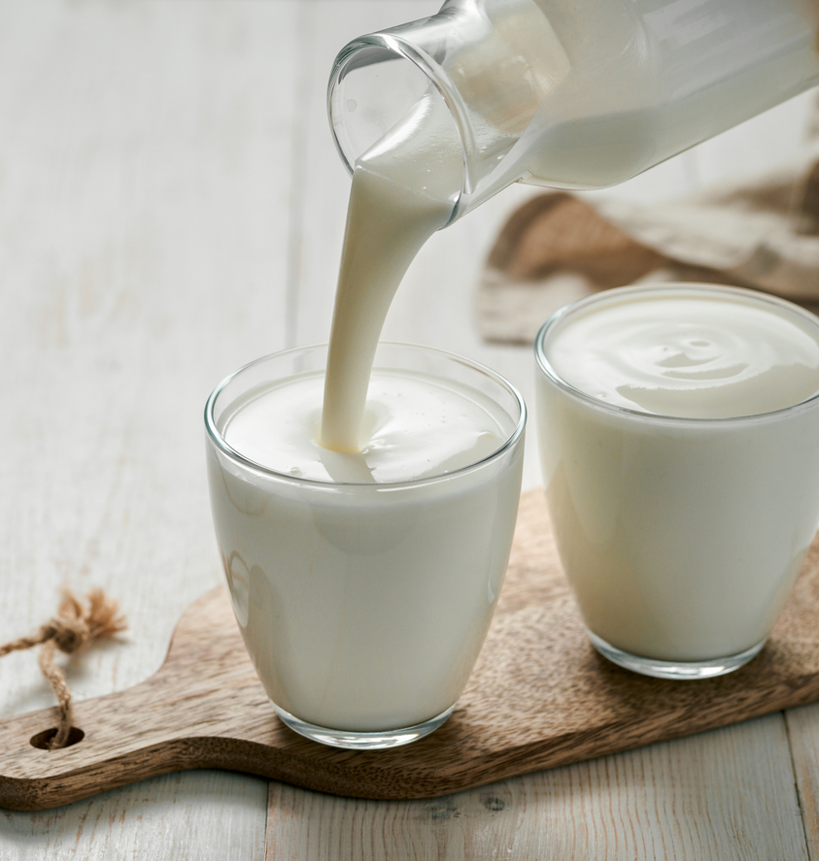
THANKS FOR THE ATTENTION

