Slide 1
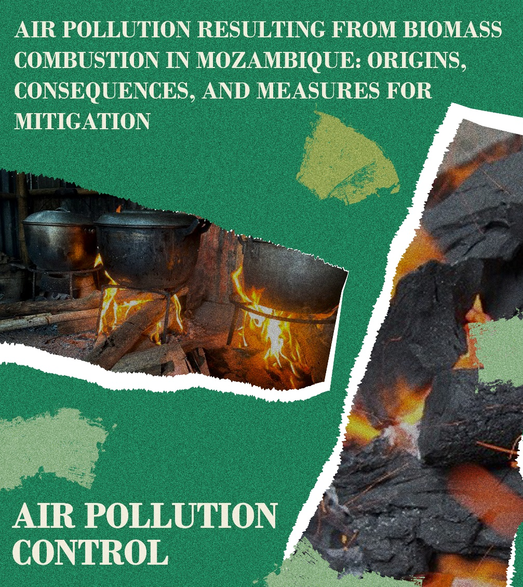
Air Pollution Resulting From Biomass Combustion In Mozambique:
Origins, Consequences, And Measures For Mitigation
Samuel Aires Master Lazaro ^{a, *}, Vanessa Fathia Baba ^{b}
ª College of Civil Engineering, Taiyuan University of Technology, No. 79 West Street Yingze, Taiyuan 030024, Shanxi, PR China
^{b} College of Economics & Management, Taiyuan University of Technology, No. 79 West Street Yingze, Taiyuan 030024, Shanxi, PR China
* Corresponding author: E-mail address: samuelaires01@gmail.com

Slide 2
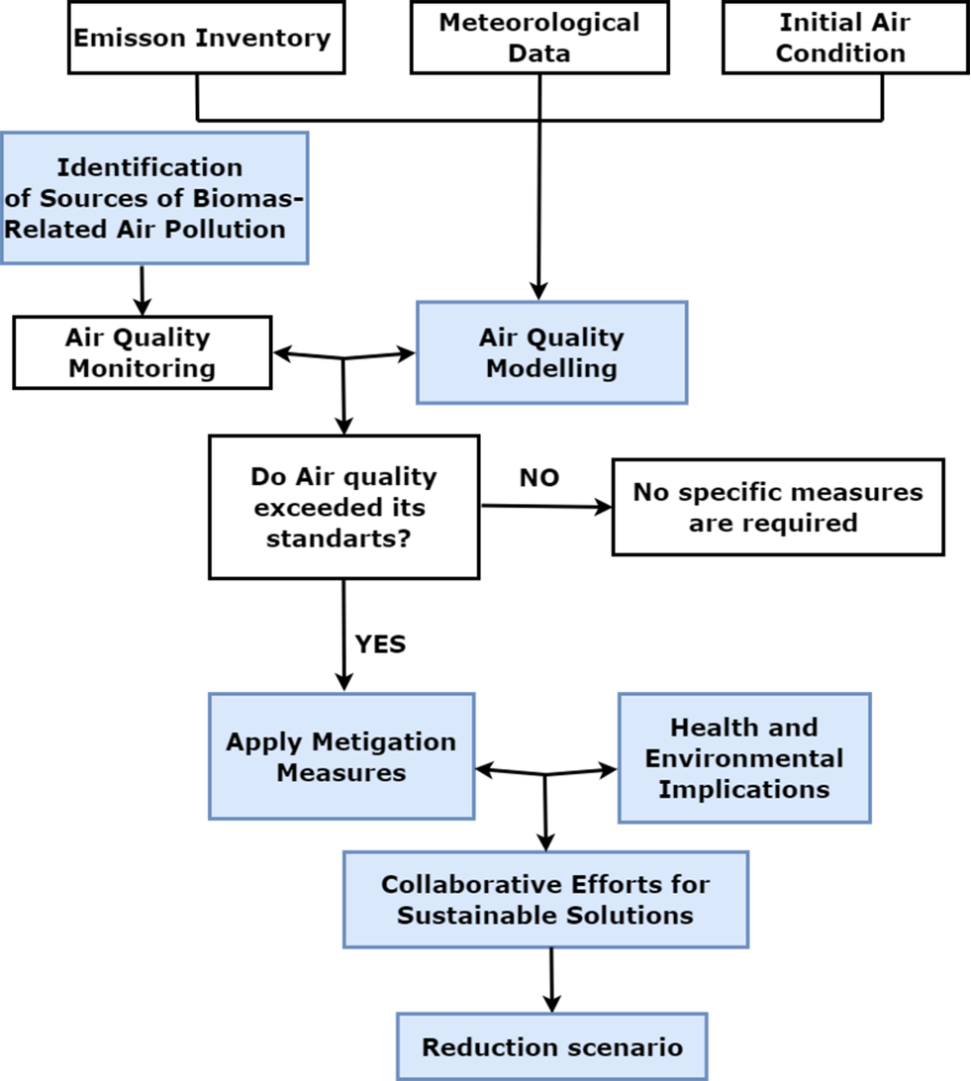
Air Pollution Resulting From Biomass Combustion In Mozambique:
Origins, Consequences, And Measures For Mitigation

Slide 3
Introduction
Air pollution is an increasing worldwide problem with far-reaching consequences for human health, ecosystems, and long-term development.
Air pollution caused by biomass burning has become a serious environmental concern in Mozambique, a country rich in natural resources and cultural variety.
In this presentation, the authors examine how biomass burning affects the air quality in Mozambique, focusing on the sources of pollution, the types of pollutants emitted, and the resulting impact on human health and the environment.

Slide 4
Sources of biomass related to air pollution
Dependence on Biomass:
Mozambique's heavy reliance on biomass fuels for daily activities.
Types of Biomass Fuels:
Overview of wood, agricultural residues, and charcoal as familiar biomass sources.
Emissions during Biomass Burning:
Pollutants released including particulate matter (PM), carbon monoxide (CO), nitrogen oxides (NOx), volatile organic compounds (VOCs), and hazardous air pollutants (HAPs).

Slide 5
Impacts Resulting from Biomass Burning
Health Consequences:
The adverse effects of biomass burning on health issues that can occur include low birth weight, cataracts, cardiovascular disease (CVD), asthma, tuberculosis, chronic obstructive pulmonary disease (COPD), and lower respiratory tract infections.
Environmental Implications:
Environmental impacts, including climate change, global warming, and regional weather patterns.

Slide 6
Climate and Weather Impact
Contribution to Climate Change:
Biomass burning significantly contributes to greenhouse gas emissions, including CO2 and CH4. Also, as biomass burning occurs, vast amounts of stored carbon dioxide can quickly be released into the atmosphere. If the vegetation is not replaced, burning can also permanently lose a vital carbon dioxide sink.
Regional Climate Effects:
Influence on climate and weather patterns in Mozambique and neighbouring regions.

Slide 7
Intervention Strategies and Mitigation Measures
Cleaner Cooking Technologies:
Promoting improved cookstoves and biogas systems to reduce traditional biomass burning.
Raising Awareness:
Educating the public about the health risks associated with biomass combustion.
Access to Alternative Energy Sources:
Ensuring availability and affordability of clean energy options as alternatives to biomass.

Slide 8
Intervention Strategies and Mitigation Measures
Any implemented intervention aims to decrease household air pollution emissions from indoor cooking or heating with solid biomass fuel.
Role of Government:
Implementing policies and regulations to promote cleaner energy and reduce emissions.
Involvement of NGOs and International Partners:
Collaborative efforts to support initiatives and fund projects for pollution reduction.

Slide 9
Conclusion
Recapitulate Key Points:
Summarising the impact of biomass-related air pollution in Mozambique.
Urgency for Action
Emphasising the importance of immediate measures to safeguard public health and the environment.
Call to Action:
Encouraging collective efforts to combat air pollution through cleaner technologies and sustainable practices

Slide 10
THANK YOU

