Slide 1

A new predictive Hypothesis for Phase Difference Reflection in GHz
Imadeldin Elsayed Elmutasim¹
emadcts@yahoo.com
^{University Malaysia Pahang UMP}

Slide 2

A new predictive Hypothesis for Phase Difference Reflection in GHz
Abstract
Introduction
Model Approach
Results and Discussion
Conclusion

Slide 3
ABSTRACT
The wave phase difference is a fundamental property that characterizes the relative behavior of transmitted signals. It plays a crucial role in signal wave analysis and understanding various propagation phenomena, which could accommodate when designing the wireless link and various applications in signal processing techniques, optics, and acoustics. This study explores the concept of phase difference significance using high frequencies such as 1, 2.4, 10, and 20 GHz to offer a willingness to the upcoming era. The study reviews existing phase difference models and their shortcomings, emphasizing the need for greater accuracy and precision in quantifying phase differences. The final result shows that 1 GHz is the lowest phase difference among other frequencies. However, the constructive signal could be accommodated, providing a better link build-up. Overall, Addressing the importance of phase difference in GHz and identifying the signal attitude would contribute to the advancement of wave analysis and encourages further exploration in this domain.
Keywords: Phase difference; Wavelength; Reflection; Frequency; Signal Propagation.

Slide 4
INTRODUCTION
The phase difference is the variation between the two waves' phase angles that could occur when the signal hits the surface and is reflected, considering the properties. The amplitude, wavelength, or phase of the reflection at the surface of the separation of two mediums can be changed, it plays a crucial role in interference, diffraction, and wave interactions via affects constructive or destructive signal interference.
Microphone device that works under the constructive phase phenomenal that would increase the signal amplitude, on the other hand, when the two waves cancel each other certainly lead to zero waves this is called destructive interference.
It quantifies how much one wave is shifted or delayed relative to the other, and hence accommodates the impact of the phenomenal.
The paper aims to distinguish the GHz wavelength impact in the predictive phase difference, which would be extremely valuable to wireless engineers when designing the link.

Slide 5
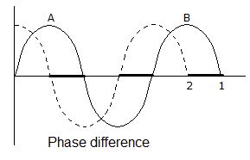
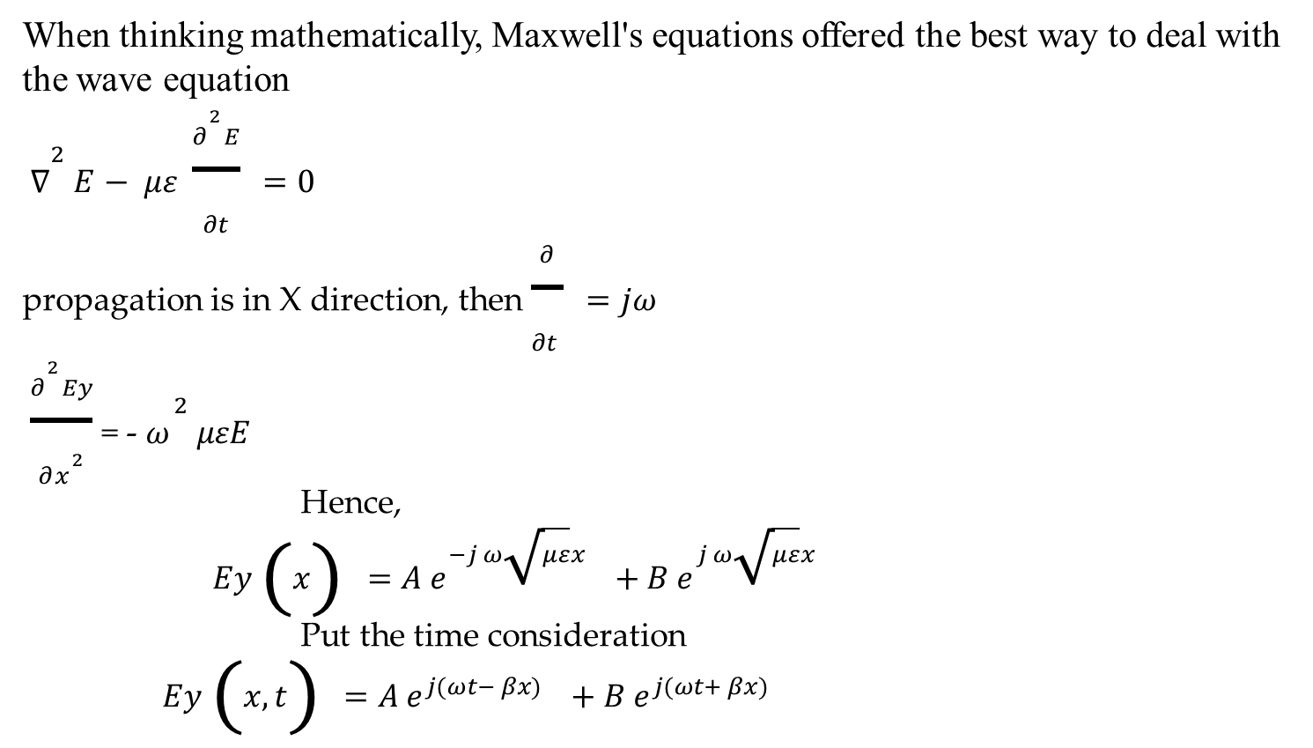
Model Approach
When thinking mathematically, Maxwell's equations offered the best way to deal with the wave equation
$∇^{2 }E− με \frac{∂^{2}E}{∂t}=0$
propagation is in X direction, then $\frac{∂}{∂t }=jω$
$\frac{∂^{2}Ey}{∂x^{2}}$ = - $ω^{2 }μεE$
Hence,
$Ey \left(x\right)=A e^{−j ω\sqrt{με}x }+B e^{j ω\sqrt{με}x }$
Put the time consideration
$Ey \left(x,t\right)=A e^{j(ωt− βx) }+B e^{j(ωt+ βx) }$

Slide 6
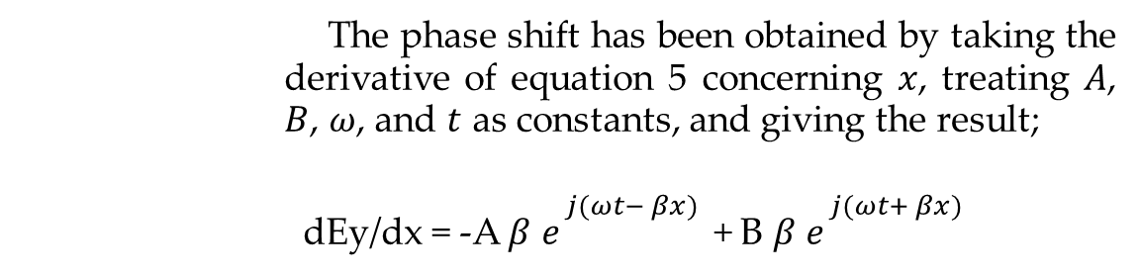
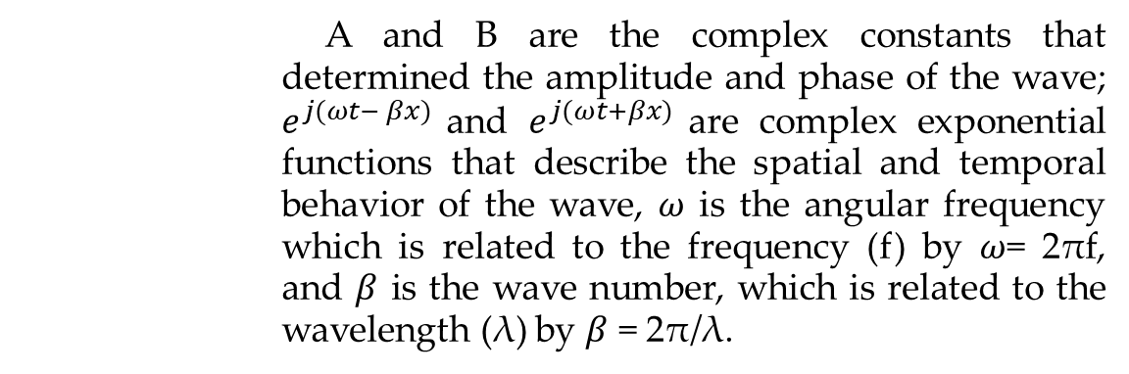
Model Approach
The equation obtained is commonly used in engineering to represent wave propagation which could use to analyze various wave phenomena, such as interference, propagation, and diffraction, that would lead to modeling the behavior of waves in different contexts, where Ey(x, t) represents the electric field component in the y-direction as a function of position (x) and time (t).
$$Ey \left(x,t\right)=A e^{j(ωt− βx) }+B e^{j(ωt+ βx) }$$
A and B are the complex constants that determined the amplitude and phase of the wave; $e^{j(ωt− βx) }$and $e^{j(ωt+βx) }$are complex exponential functions that describe the spatial and temporal behavior of the wave, $ω$ is the angular frequency which is related to the frequency (f) by $ω$= 2πf, and $β$ is the wave number, which is related to the wavelength (λ) by $β$ = 2π/λ.
The phase shift has been obtained by taking the derivative of equation 5 concerning $x$, treating $A$, $B$, $ω$, and $t$ as constants, and giving the result;
dEy/dx = -A $β$ $e^{j(ωt− βx) }$+ B $β$ $e^{j(ωt+ βx) }$

Slide 7

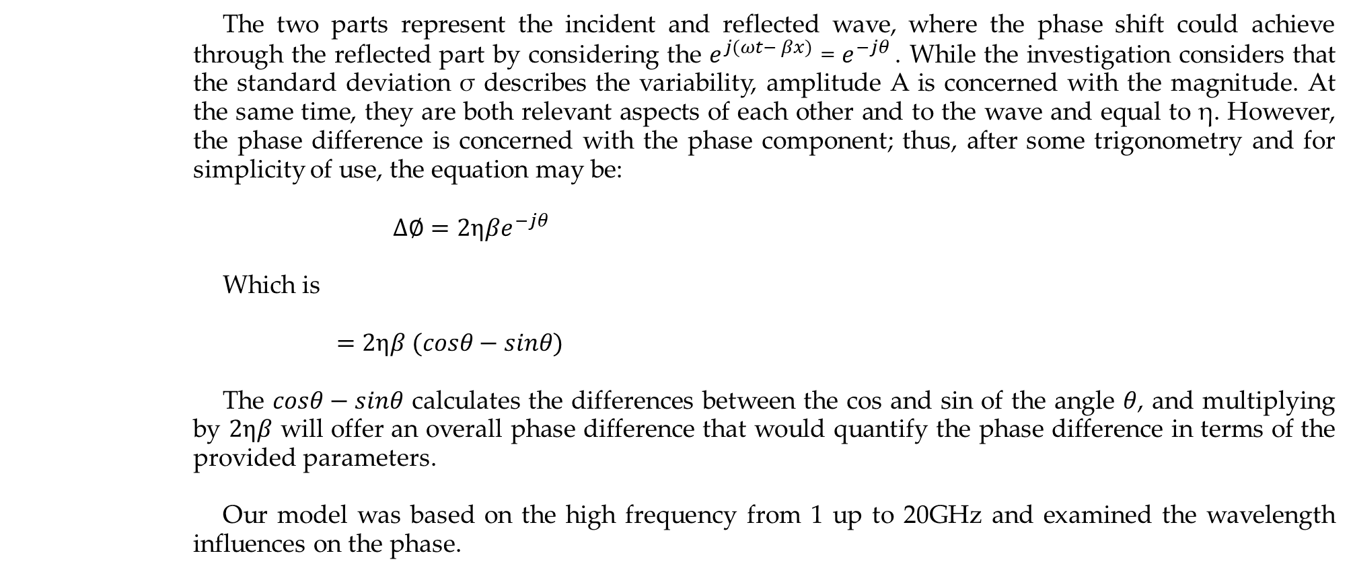
Model Approach
The two parts represent the incident and reflected wave, where the phase shift could achieve through the reflected part by considering the $e^{j(ωt− βx) }$= $e^{−jθ }$. While the investigation considers that the standard deviation σ describes the variability, amplitude A is concerned with the magnitude. At the same time, they are both relevant aspects of each other and to the wave and equal to η. However, the phase difference is concerned with the phase component; thus, after some trigonometry and for simplicity of use, the equation may be:
$∆∅=2ηβe^{−jθ }$
Which is
$=2ηβ (cosθ−sinθ)$
The $cosθ−sinθ$ calculates the differences between the cos and sin of the angle $θ$, and multiplying by $2ηβ$ will offer an overall phase difference that would quantify the phase difference in terms of the provided parameters.
Our model was based on the high frequency from 1 up to 20GHz and examined the wavelength influences on the phase.

Slide 8

Results and Discussion
The study investigates the 1, 2.4, 10, and 20 GHz, which are represented from left above, the first diagram considers 1GHz and the second is 2.4 GHz in row 1, while in the second row, the first one from the left is 10 GHz and the other one is 20 GHz, which are all equivalent to 0.29, 0.12, 0.02, and 0.01 wavelengths in meters, respectively, to distinguish the comprehensive phase shift notion that offers a paramount outcome using Matlab simulation. The results were obtained for each wavelength and combined to distinguish the impact. The upcoming figures explicate the concept.

Slide 9

Phase difference at GHz frequency up to 20 GHz

Slide 10

Conclusion
The phase difference in GHz is significant because the technological revolution must be aware of the occurrence at high frequencies.
The study addressed the phase when dealing with GHz frequencies such as 1, 2.4, 10, and 20 GHz, equivalent to 0.29, 0.12, 0.02, and 0.01 wavelengths in meters.
The results show that 1 GHz, represented by 0.29-meter wavelength, has the lowest phase shift than others, indicating that lower frequencies would deal better than higher frequencies in terms of the phase difference.
Construction interference might be handled in that band, allowing for profound benefits when designing the wireless link, and vice versa happens when getting destructive interference between the waves.
The future work would be in the wave phase difference when combined with intelligent surfaces.

Slide 11

Acknowledgment
University Malaysia Pahang, Malaysia.

