Slide 1
The 4th International Electronic Conference on Foods
In vitro evaluation of plant extracts as antifungal agents against Botrytis cinerea
Ítala M.G Marx; Elizandra Ardohain; Paula Rodrigues; Lillian Barros; Sandrina A. Heleno*
15-30 October, 2023 | Online

Slide 2
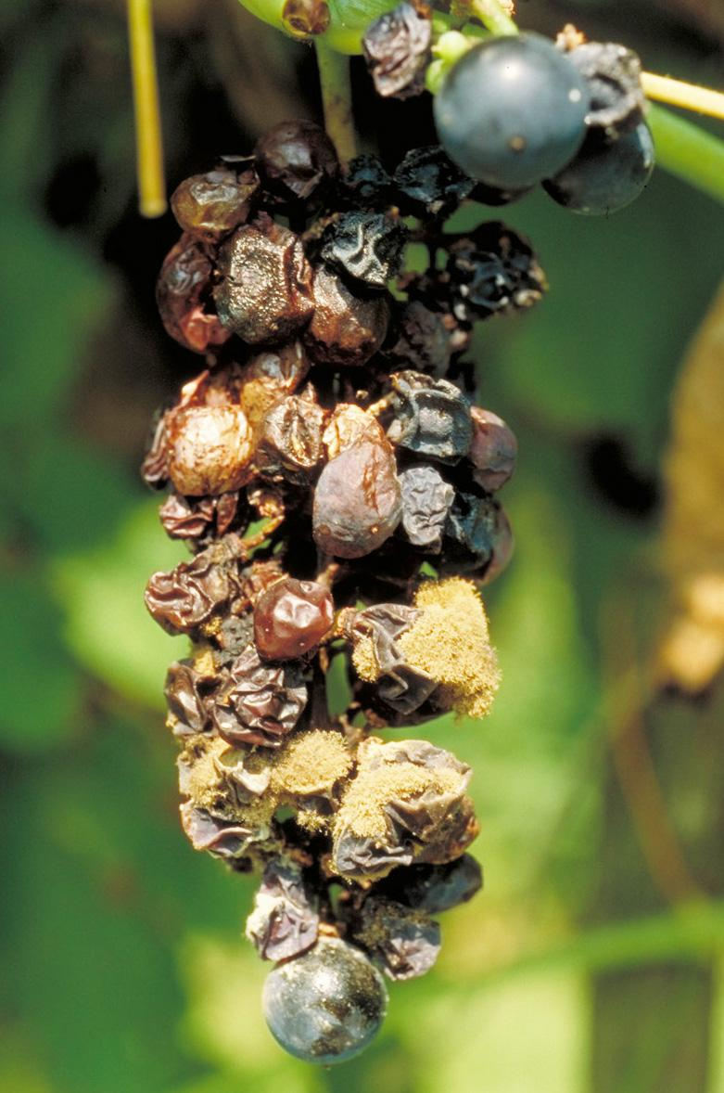
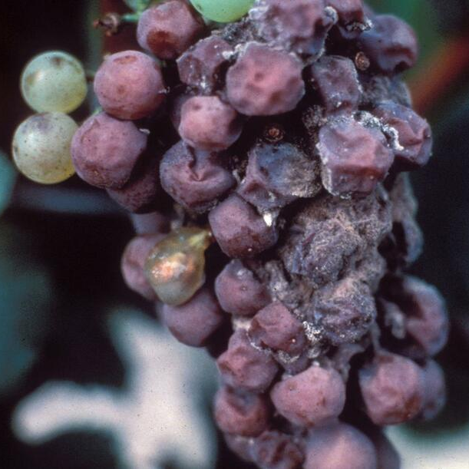
The 4th International Electronic Conference on Foods
CHEMICAL FUNGICIDE
INTRODUCTION
Resistance
Environmental impact
Health and safety concerns
Cost
Limited effectiveness
Risk of chemical residues
Short-term solution
Cultivation of grapes is an important economic activity in Mediterranean region;
Especially in warm and humid conditions, grapevine bunch rot (also known as gray mold), causes significant losses in grapes’ yield and quality;
Botrytis cinerea is the main pathogen responsible for gray mold disease that affects grapes.
Increased need for natural alternatives to chemical fungicides against grape pathogens
BIOFUNGICIDE
(natural compounds from plant by-products)
Environmentally friendly
Safe for human health
Reduced resistance
Long-term sustainability
Cost-effective
Better crop quality
Improved soil health
Plants extracts are potential source of bioactive compounds, including phenolics, flavonoids, tannins and organic acids with biological properties.
Ítala Marx; itala.marx@ipb.pt

Slide 3
The 4th International Electronic Conference on Foods
RESEARCH OBJECTIVES
Valorization of plant extracts rich in bioactive compounds with potential to inhibit grape pathogens
To evaluate the effect of plant extracts rich in phenolic compounds on mycelial growth of B. cinerea.
Ítala Marx; itala.marx@ipb.pt

Slide 4
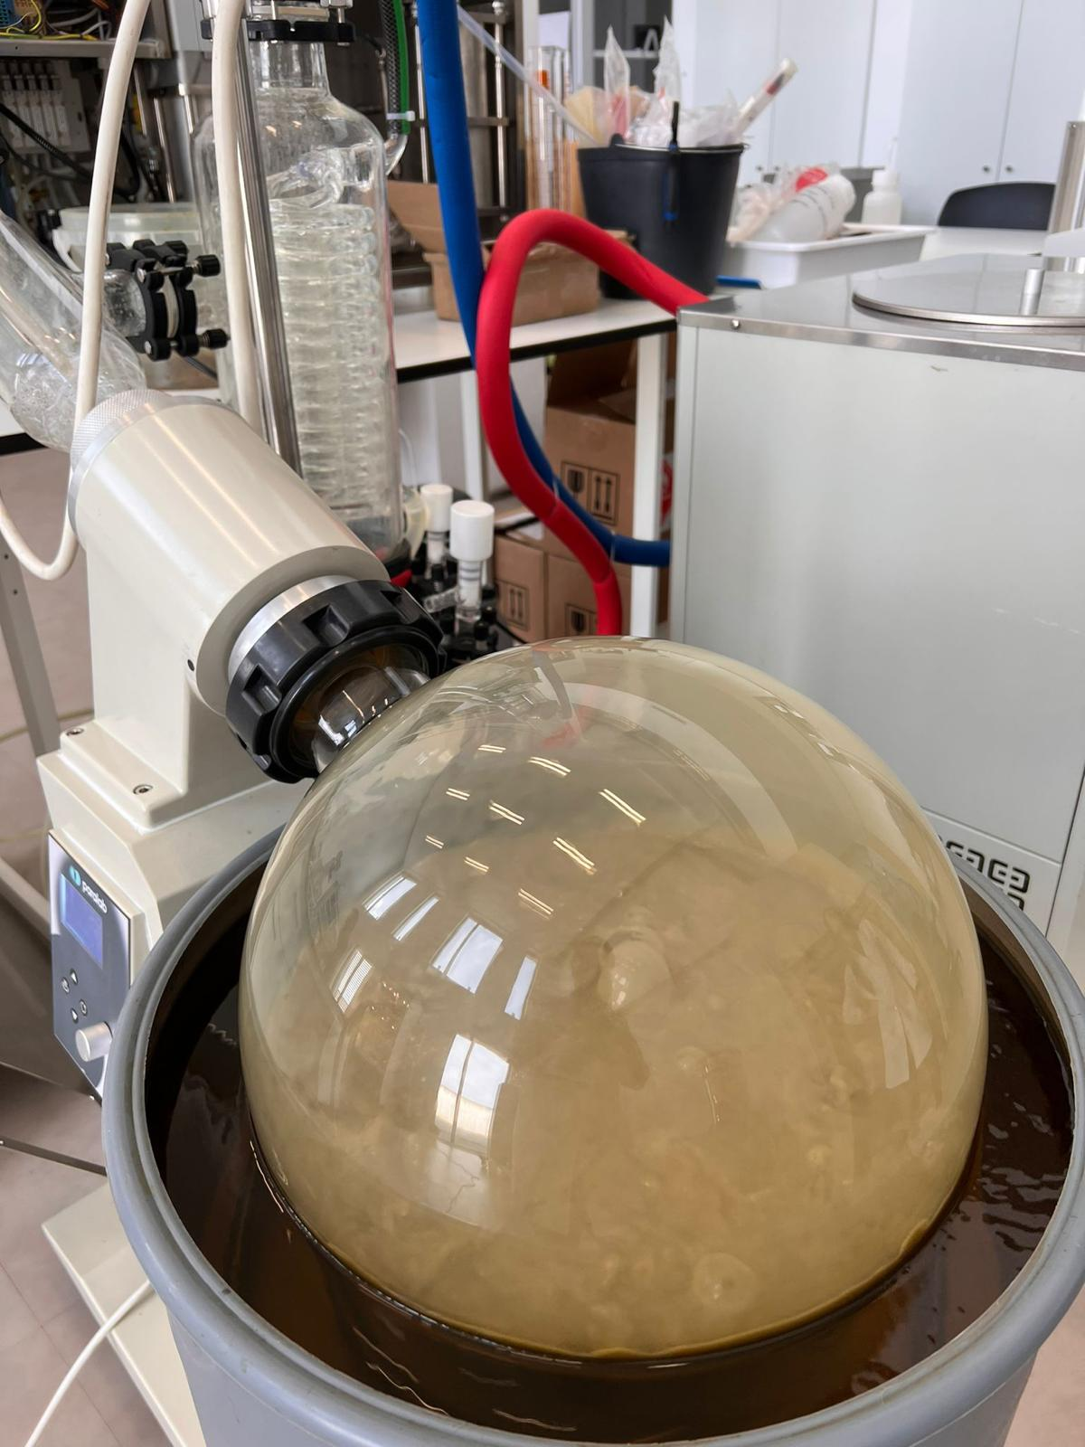
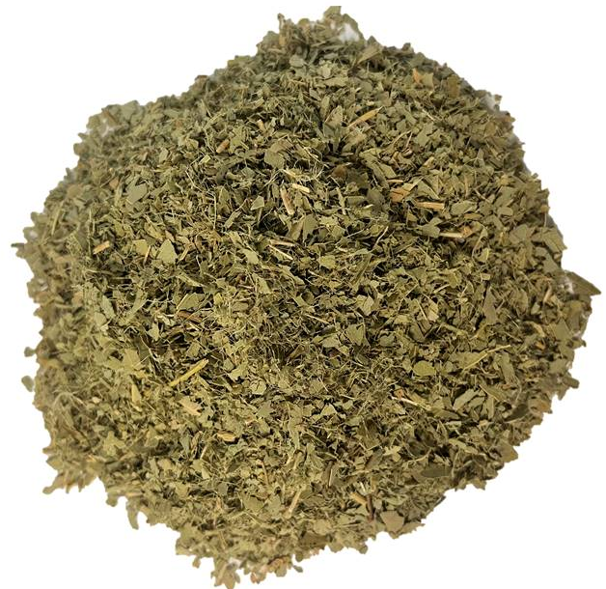
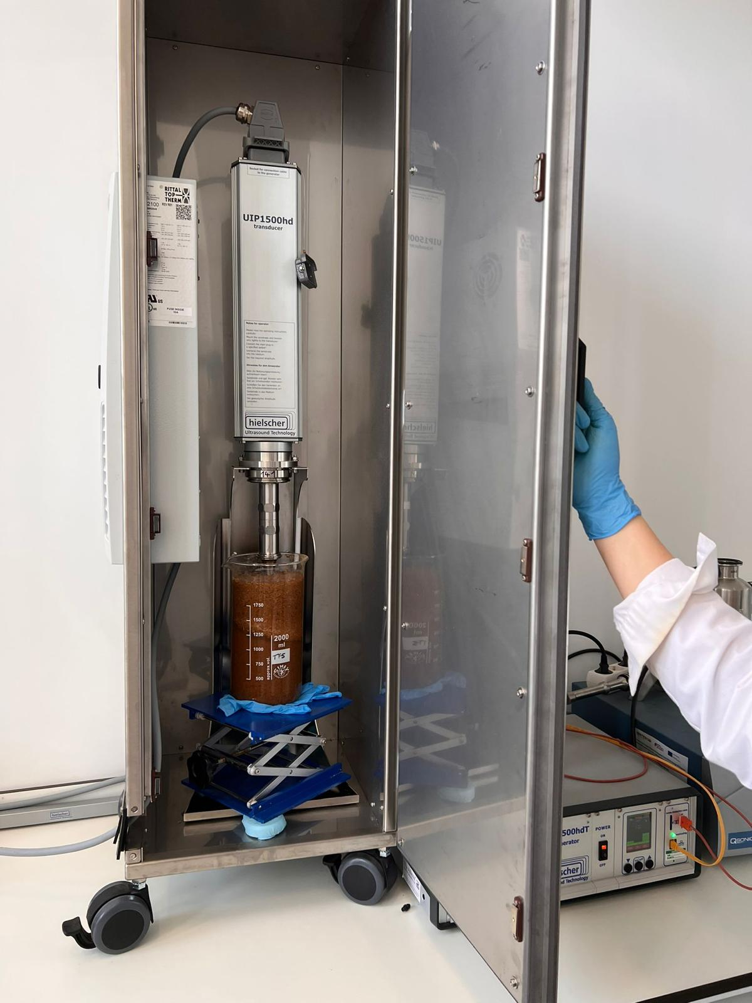
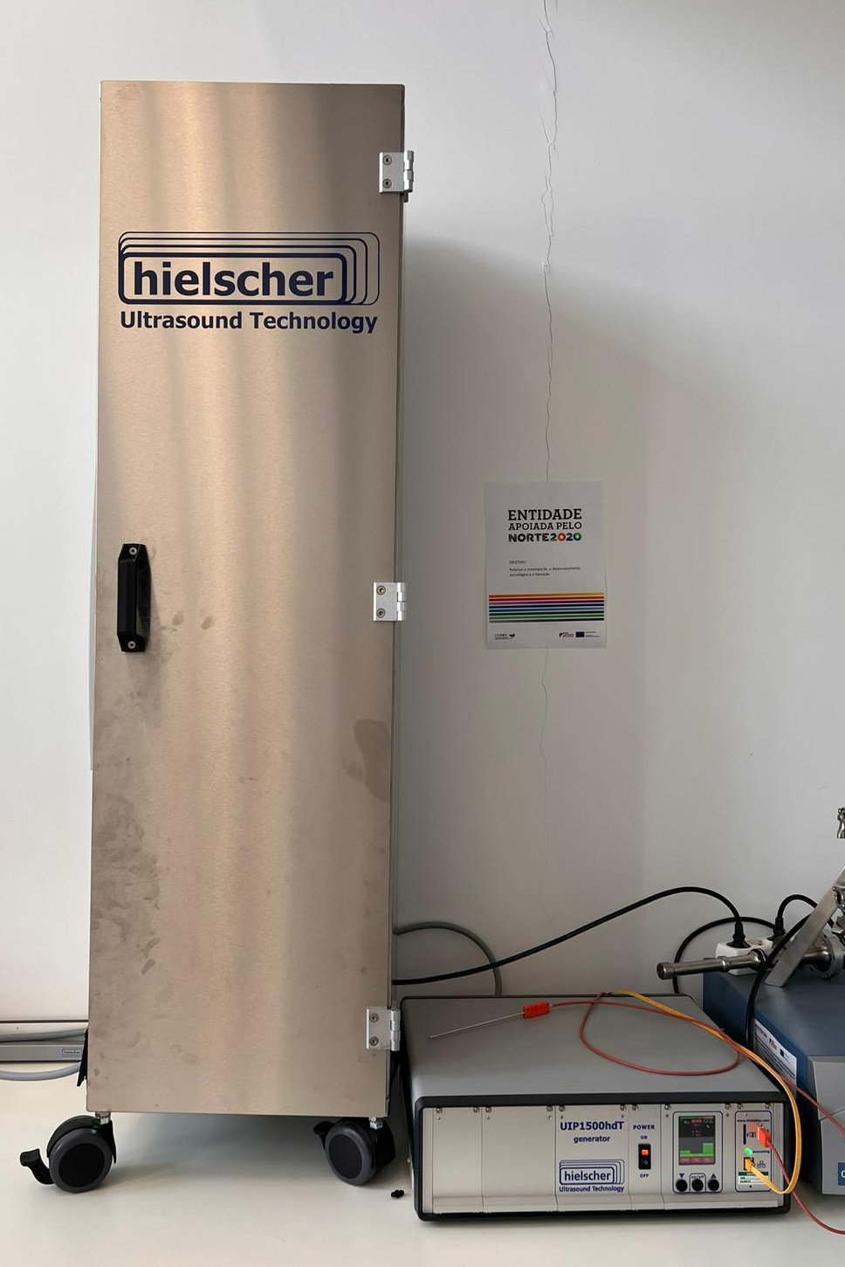
The 4th International Electronic Conference on Foods
MATERIALS AND METHODS
Extracts preparation
1
2
3
4
Plant matrix preparing
Drying and reducing to powder by crushing
Plant matrix (g)
Solvent EtOH:H₂O (v/v)
Ultrasound-assisted extraction
Filtration
Evaporation
Ítala Marx; itala.marx@ipb.pt

Slide 5
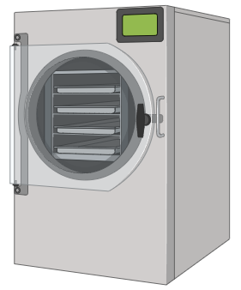
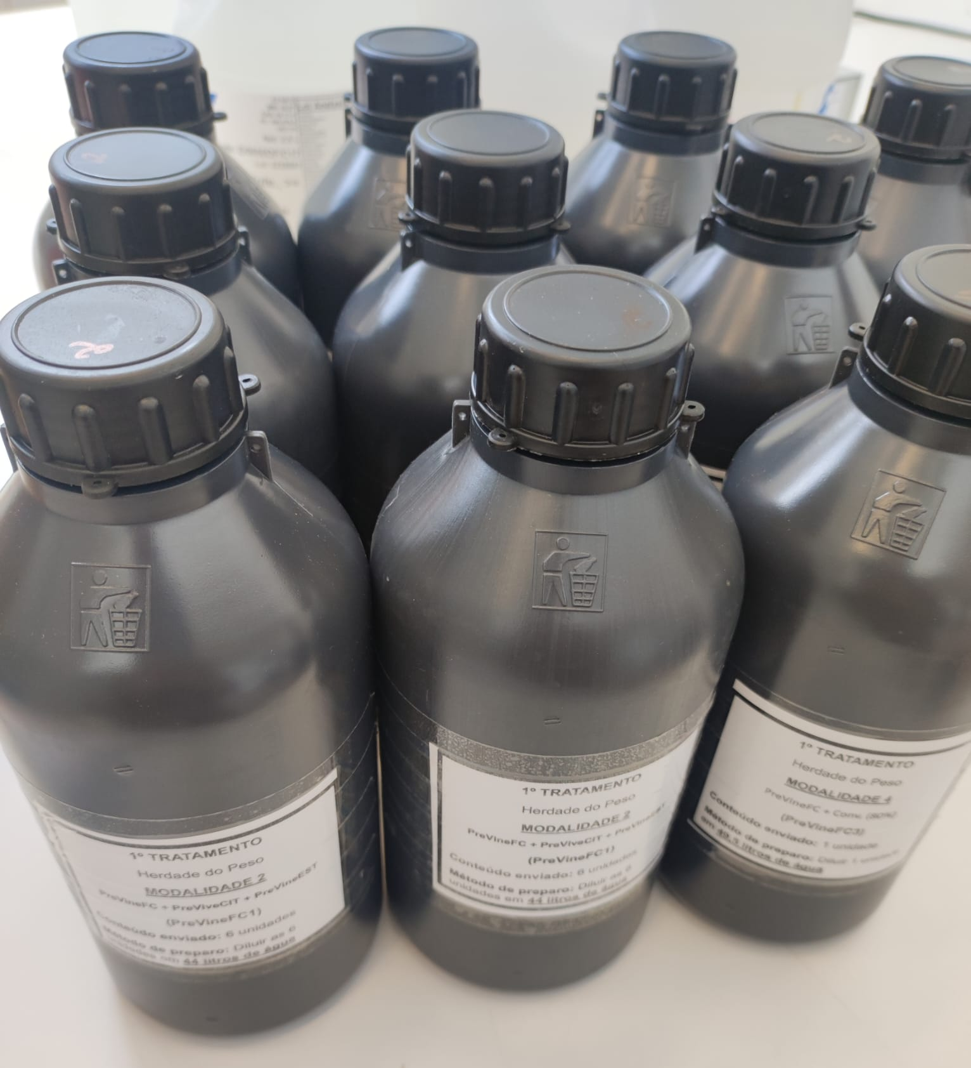
The 4th International Electronic Conference on Foods
PreVine Ingredients preparation
Mixtures of extracts with a known concentration of 10 mg/mL were made for each individual matrix (3 different formulations)
The formulations (PreVine 1, PreVine 2 and PreVine 3) were freeze-dried before testing
PreVine 1
PreVine 2
PreVine 3
Ítala Marx; itala.marx@ipb.pt

Slide 6
The 4th International Electronic Conference on Foods
Evaluation of the antifungal activity of the plant extracts
Culture medium preparation
Potato Dextrose Broth (PDB) medium was prepared with agar and enriched with the three formulations of plant extracts (concentration of 10 mg/mL, each plant matrix)
PreVine 1
PreVine 2
PreVine 3
Positive control: conventional fungicide Teldor® (active substance fenhexamid) concentration of 0.075 mg/mL.
Negative control was treated only with water
Ítala Marx; itala.marx@ipb.pt

Slide 7
The 4th International Electronic Conference on Foods
Mycelial growth of B. cinerea experiment
An isolate of B. cinerea from the Micoteca of the University of Minho was used;
From the pure culture of a B. cinerea isolate, cultivated in PDA, for five days, discs of mycelium (1cm in diameter) were removed, which were transferred individually to the center of Petri dishes, containing 15 mL, approximately, of the different medium tested;
The plates were incubated at 25 ºC;
Mycelial growth was determined by measuring the diameter of the colonies, in diametrically opposite directions, with a millimeter ruler, subtracting 1cm from the initial inoculum disc;
The evaluations were daily, starting 24 hours after the experiment was set up, with readings being carried out until any of the repetitions reached the entire diameter of the plate, in any culture medium;
The daily mycelial growth data were used to prepare the fungus growth curves, expressed in cm/day.
Ítala Marx; itala.marx@ipb.pt

Slide 8
The 4th International Electronic Conference on Foods
RESULTS AND DISCUSSION
Growth inhibitory potential of
B. cinerea after 9 days of inoculation
The inhibitory potential was greater for formulation PreVine 1, being responsible for inhibiting the mycelial growth (cm) against B. cinerea by 64% at 9 days of incubation, when compared to the negative control samples.
Vila Real, 30 de junho de 2023
Ítala Marx; itala.marx@ipb.pt

Slide 9
The 4th International Electronic Conference on Foods
B. cinerea growth rate
The formulation PreVine 1 was able to reduce the mycelial growth rate from 1.8391 (Negative control) to 1.2051 cm/day.
Mycelial growth (cm/day)
Mycelial growth (cm/day)
1 2 3 4 5 6 9
1 2 3 4 5 6 9
Time (Days)
Time (Days)
Negative control
PreVine 1
Ítala Marx; itala.marx@ipb.pt

Slide 10
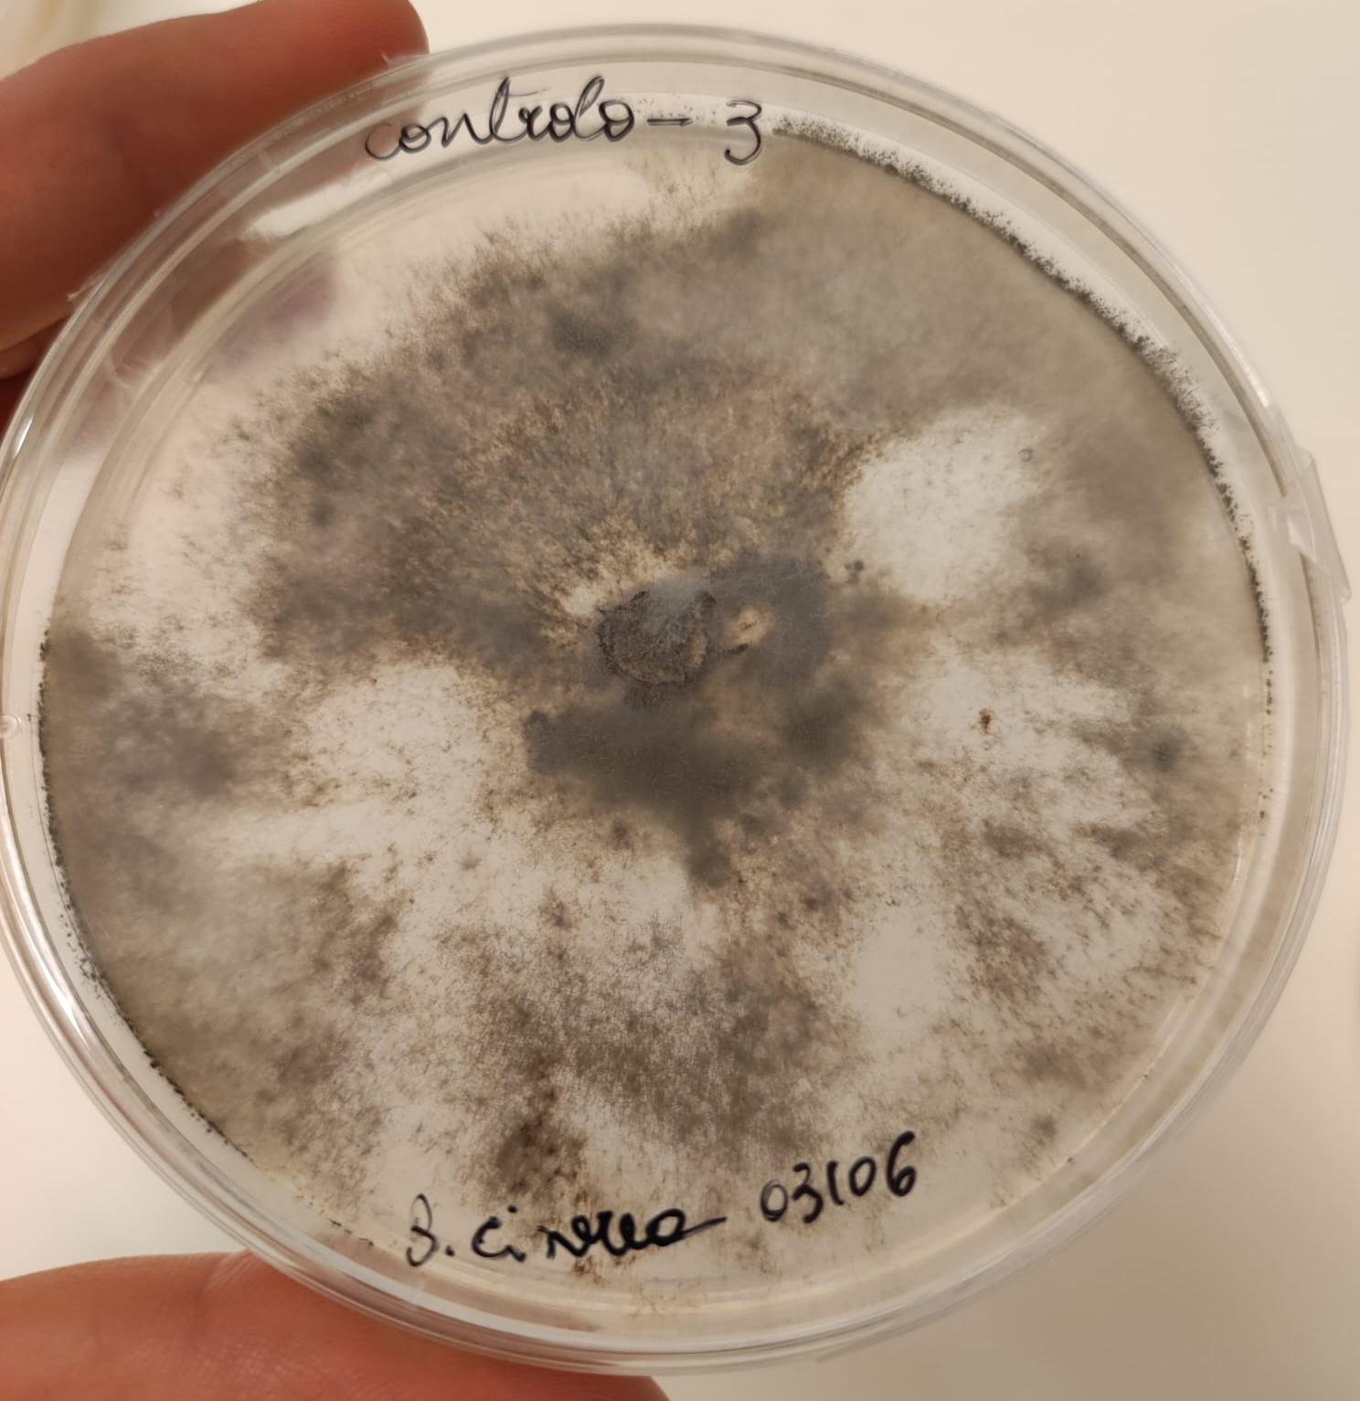
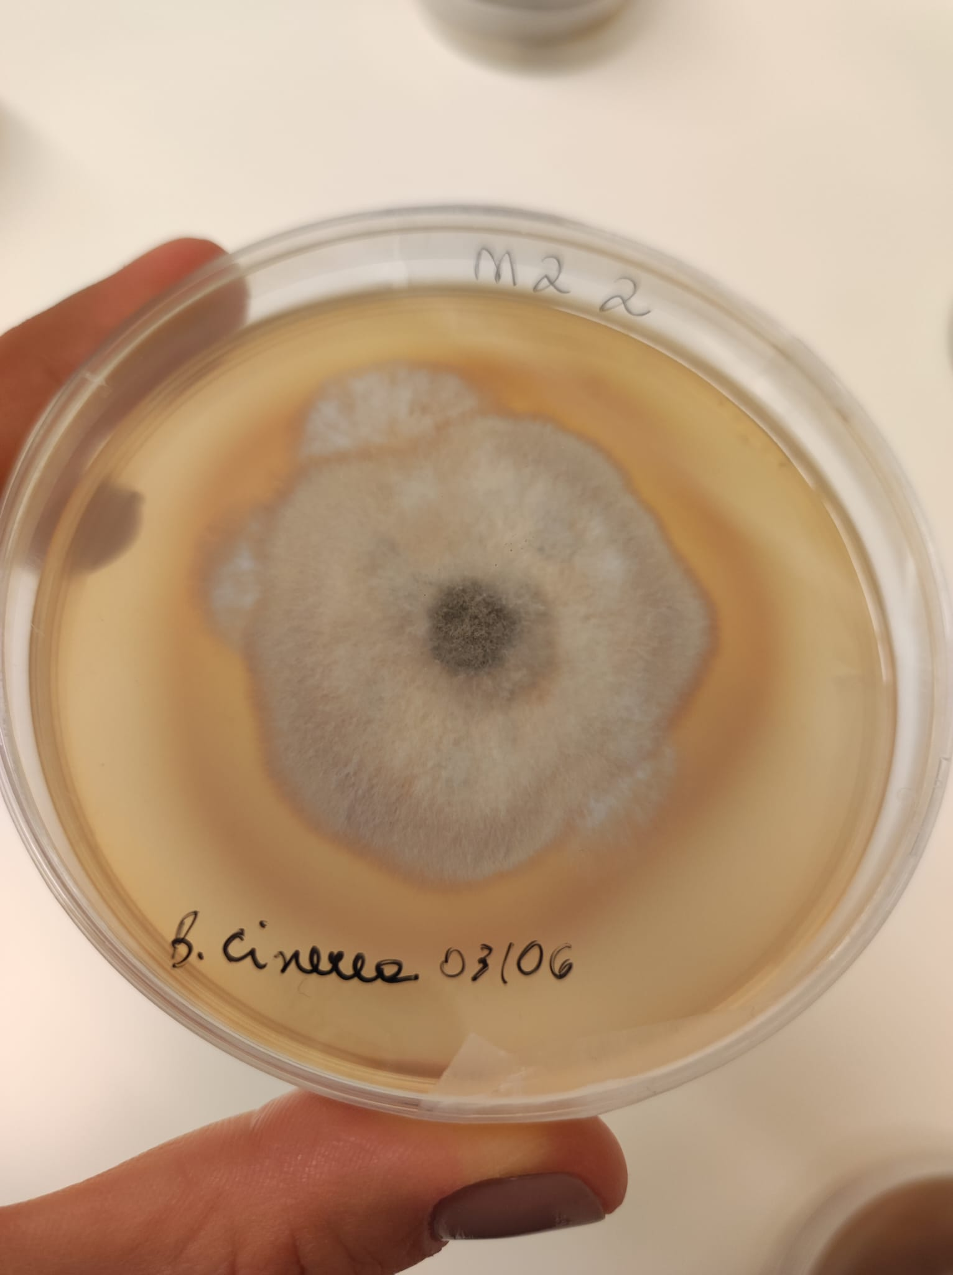
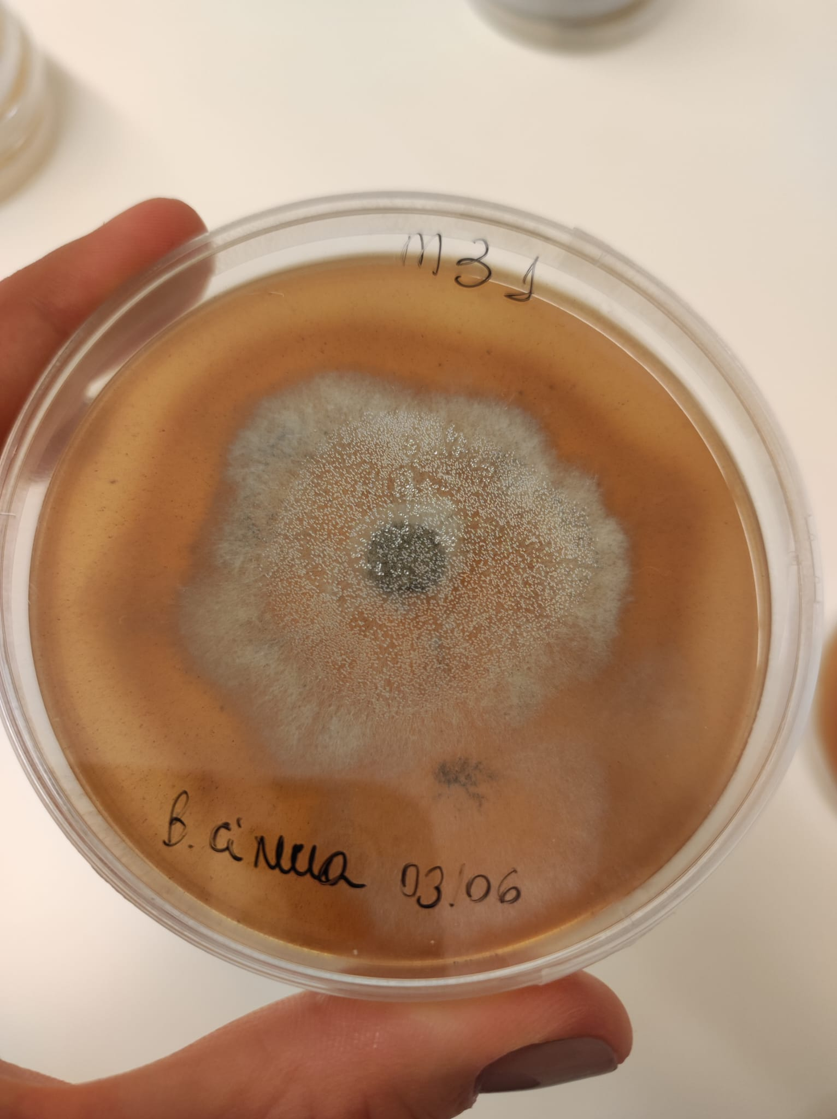
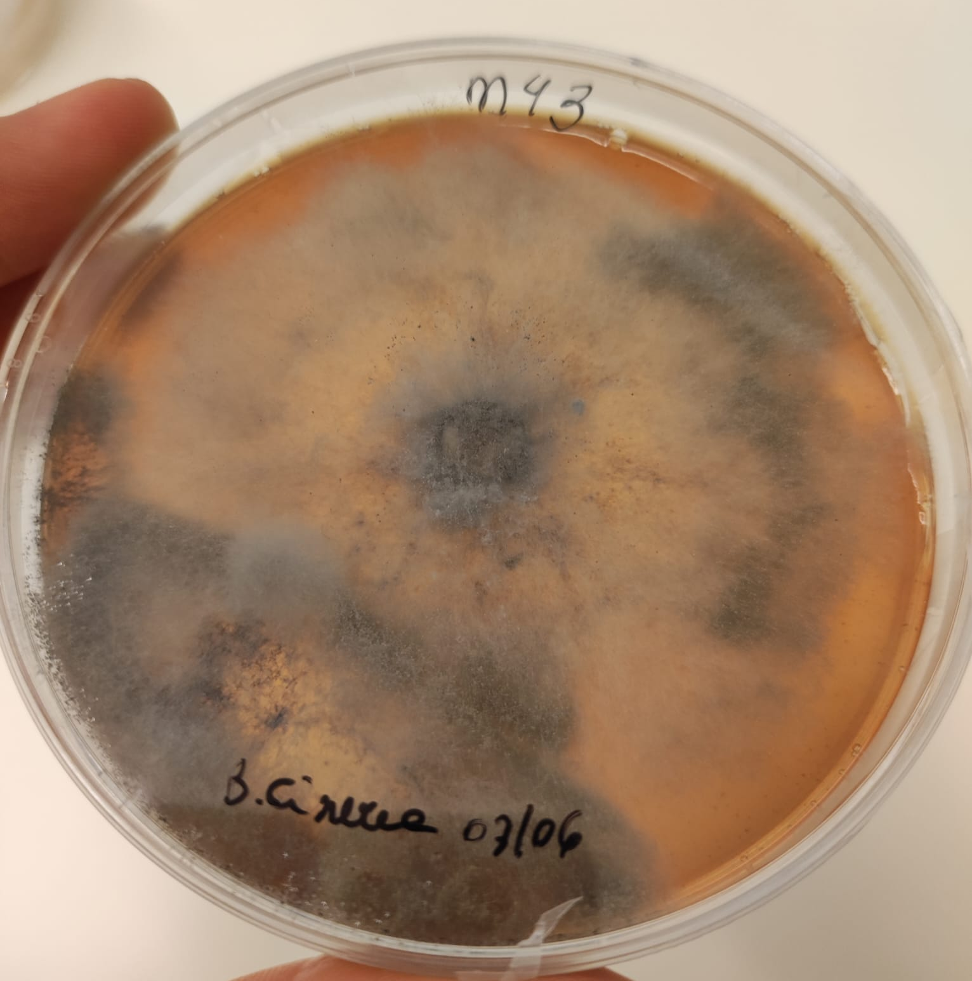
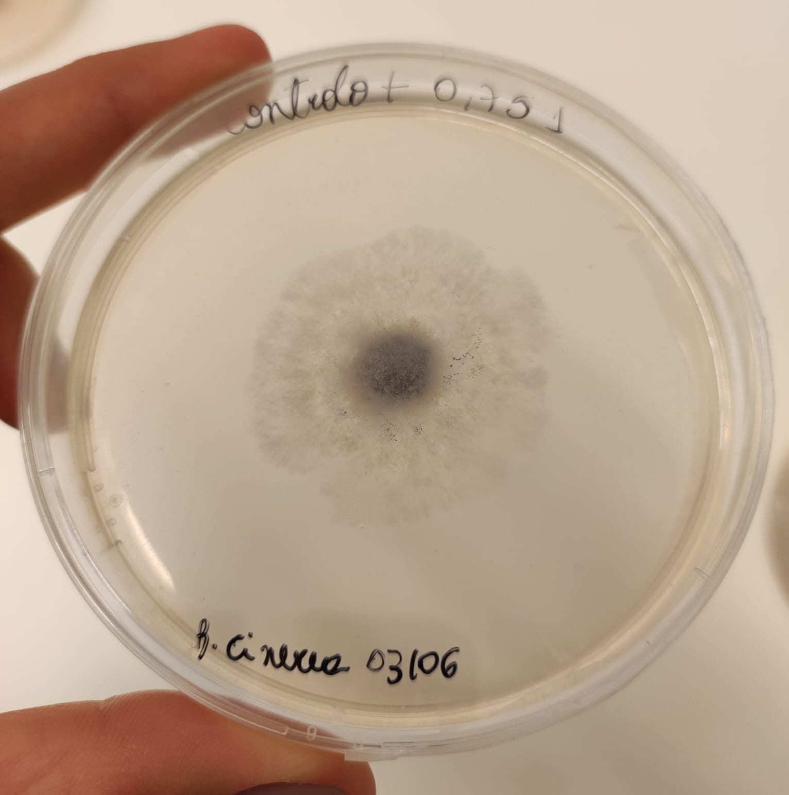
The 4th International Electronic Conference on Foods
Growth inhibitory potential of
B. cinerea after 9 days of inoculation
Negative control
PreVine 1
PreVine 2
PreVine 3
Positive control
Ítala Marx; itala.marx@ipb.pt

Slide 11
The 4th International Electronic Conference on Foods
The positive antifungal activity of the plant extracts assessed, especially for the PreVine 1, could be attributed to their varied bioactive composition, such as several classes of phenolic compounds as previous reported by literature:
Flavonoids
Phenolic acids
Tannins
The proposed mechanisms of action of the bioactive compounds from plant extracts:
Promoting a disruption of fungal cell membranes
Inhibiting fungal enzymes
Inducing oxidative stress in fungal cells
Ítala Marx; itala.marx@ipb.pt

Slide 12
2nd Global Summit on Food Science and Technology
The 4th International Electronic Conference on Foods
CONCLUSIONS
Considering the potential antifungal properties of the studied plant extracts formulations, these natural formulations could be candidates for application grape and wine industries as biofungicides, acting against grape pathogens, such as B. cinerea, decreasing, or avoiding the use of chemical fungicides.
Natural antifungals, based on plant extracts, represent a promising alternative for grapevine pathogens control and could provide significant economic benefits for the wine industry;
Valorization of plant by-products can reduce waste and create a more sustainable approach to agro-industrial production.
Ítala Marx; itala.marx@ipb.pt

Slide 13
The 4th International Electronic Conference on Foods
ACKNOWLEDGMENT
Ítala Marx; itala.marx@ipb.pt

Slide 14
The 4th International Electronic Conference on Foods
THANK YOU
FOR YOUR ATTENTION!
Ítala M.G Marx
15-30 October, 2023 | Online
Ítala Marx; itala.marx@ipb.pt

