Slide 1
2nd International Electronic Conference on Chemical Sensors and Analytical Chemistry
Synthesis of carboxylated magnetite nanoparticles
covalent conjugates with folic acid antibody FA-1 for
lateral flow immunoassay
Zolotova M.O., Znoyko S.L.,
Orlov A.V., Nikitin P.I., Sinolits A.V.
Moscow
2023

Slide 2
Objectives and tasks
Objective
To obtain magnetite nanoparticles able to conjugate with
folic acid antibodies covalently
Tasks
Preparation of magnetite nanoparticles
Functionalization of magnetite nanoparticles with amino- and carboxyl groups
Conjugation of carboxylated magnetite nanoparticles with folic acid antibodies FA-1
Testing and quantifying of bonding of magnetite nanoparticles conjugates with antibodies with folic acid with magnetometric assay

Slide 3
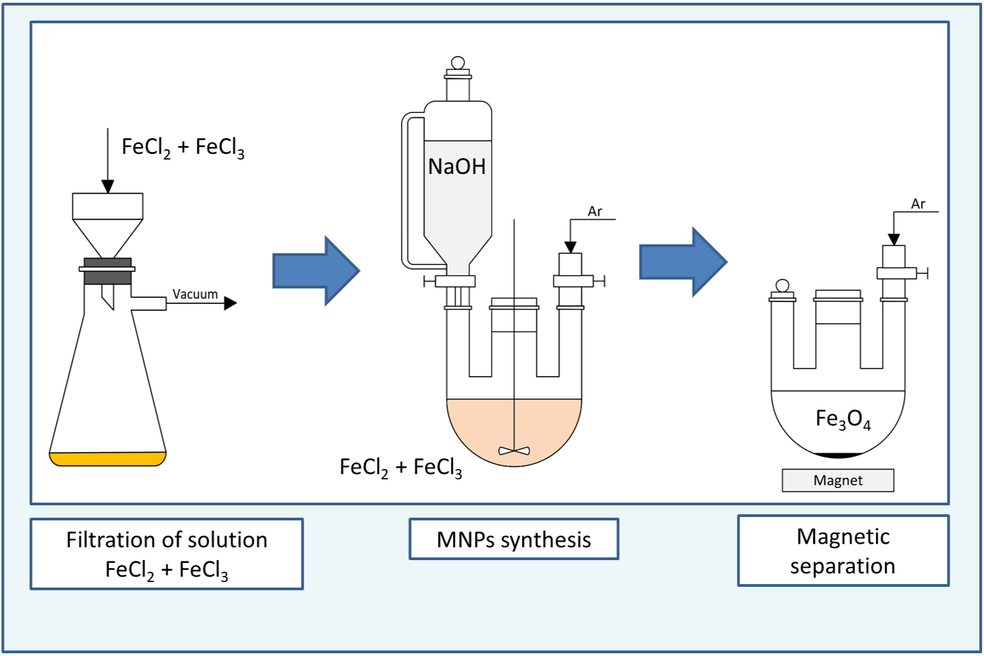
Synthesis of MNPs
4

Slide 4
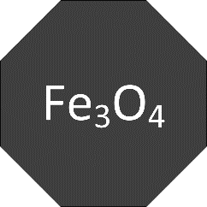
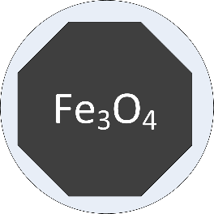
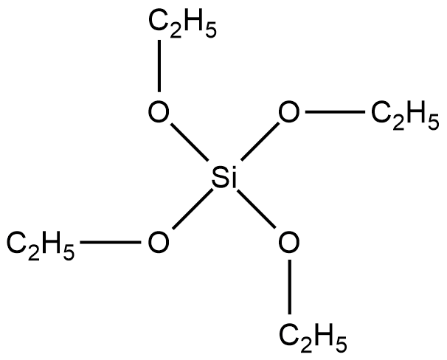
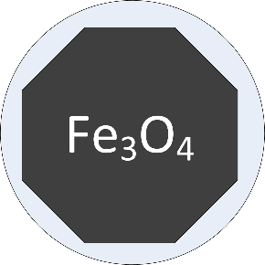
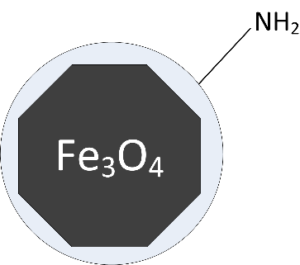
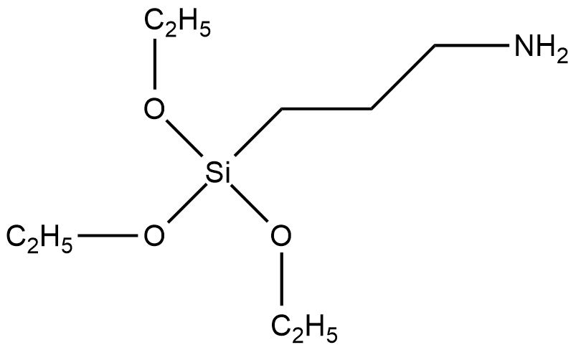
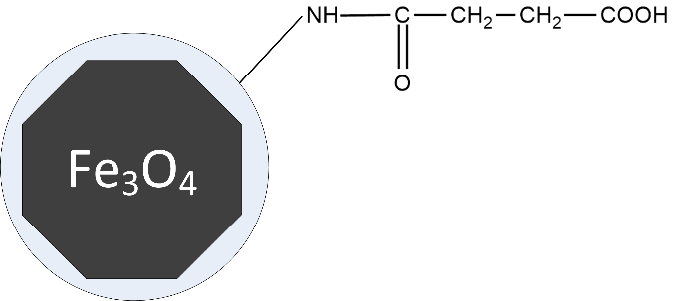
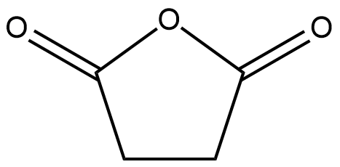
Functionalization of magnetic nanoparticles
TEOS, H₂O, Et₃N
2 hour
tetraethoxysilane (TEOS)
APTES, EtOH
30 min
APTES
succinic anhydride
DMFA, Et3N
2 hour
succinic anhydride

Slide 5
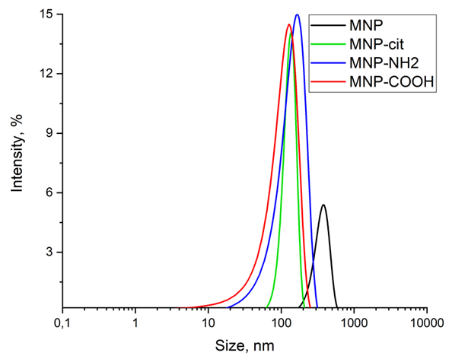
Results and discussion
XRD of MNPs synthesized
Hydrodynamic radii of particles in MNP suspensions
ζ-potential
MNP | 0 mV
MNP-cit | -48±7 mV
MNP-NH₂ | +25±7 mV
MNP-COOH | -25±10 mV
6

Slide 6
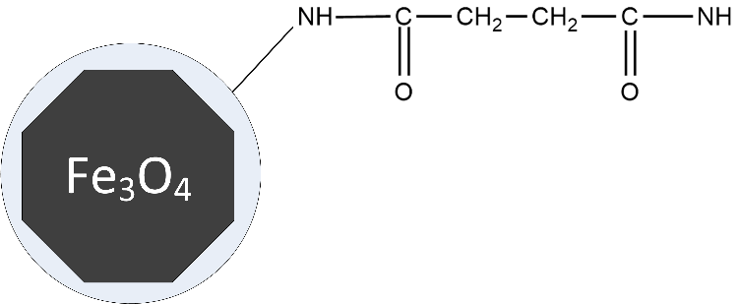
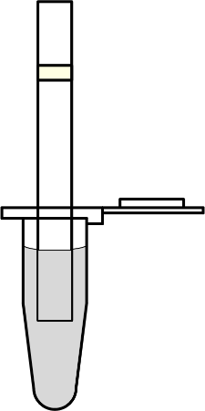
Magnetic particle quantification (MPQ) technique
folic acid antibody
lgG
EDC
FA-gelatin
Fe₃O₄-lgG-FA-gelatin
Magnitometry
Fe₃O₄-lgG

Slide 7
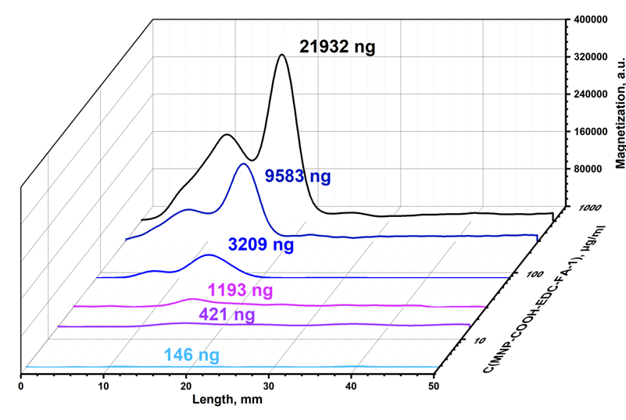
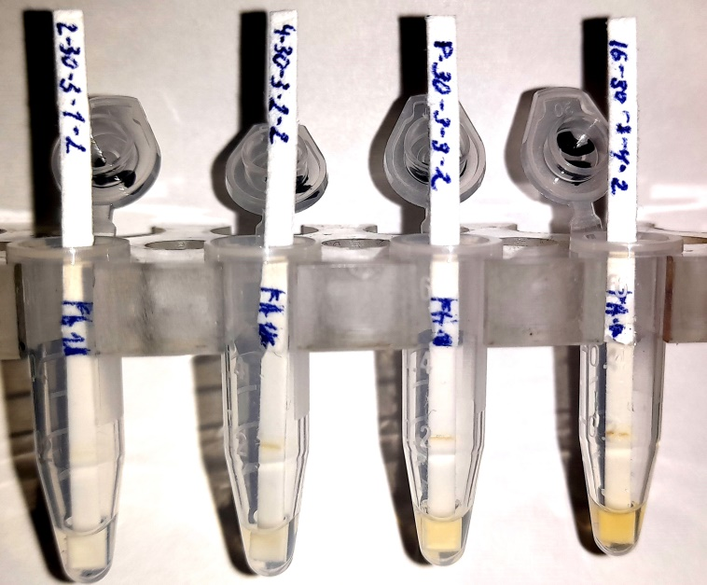
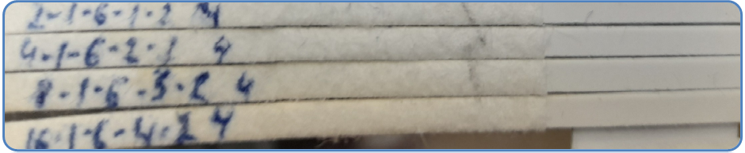
Magnetic particle quantification (MPQ) technique
Magnetograms of test stripes with MNP-COOH-EDC-FA-1 against FA-gelatin conjugates
Test stripes:
MNP-COOH
Control

Slide 8
Conclusions
Synthesis of MNPs in Ar atmosphere allows obtaining MNPs without any other phases but magnetite
MNPs may serve both as a platform for immobilization of antibodies and a magnetic label for them
MPQ may be quite a precise tool for detection and quantitative analysis of MNPs, so the magnetometric lateral flow immunoassay is possible with use of them, for example, to quantify the interaction antibody-antigen

