Slide 1
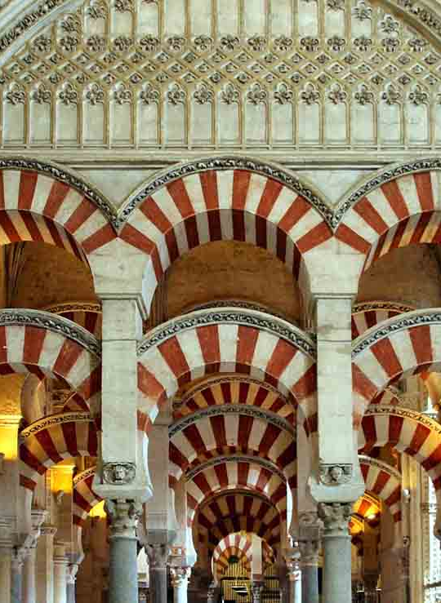

Preserving The Great Mosque of Córdoba (Spain):
Characterization of Natural Stone based on Rebound Hammer and Ultrasonic Tests.

Slide 2
AUTHORS:
José Daniel Rodríguez Mariscal 1 Beatriz Zapico Blanco 2 Natalia Valverde Garrido1 Francisco Javier García-Calabrés Ibáñez 1 Marta González Pozo 1 Mario Solís Muñiz 1 | 1 Department of Continuum Mechanics and Structural Theory, University of Seville, Spain 2 Department of Building Structures and Geotechnical Engineering, University of Seville, Spain

Slide 3
1. INTRODUCTION: Objetives
Objective 1 (main):
Characterize The Mosque’s natural Stone using NDT.
INDEX
Introduction
Methods
Results
Conclusions
Acknowledgments
Contact information
Objective 2:
Assess material behaviour based on different test directions.
Objective 3:
Investigate the influence of sample size.
Objective 4 (future work):
Establish correlations between mechanical properties from DT.

Slide 4
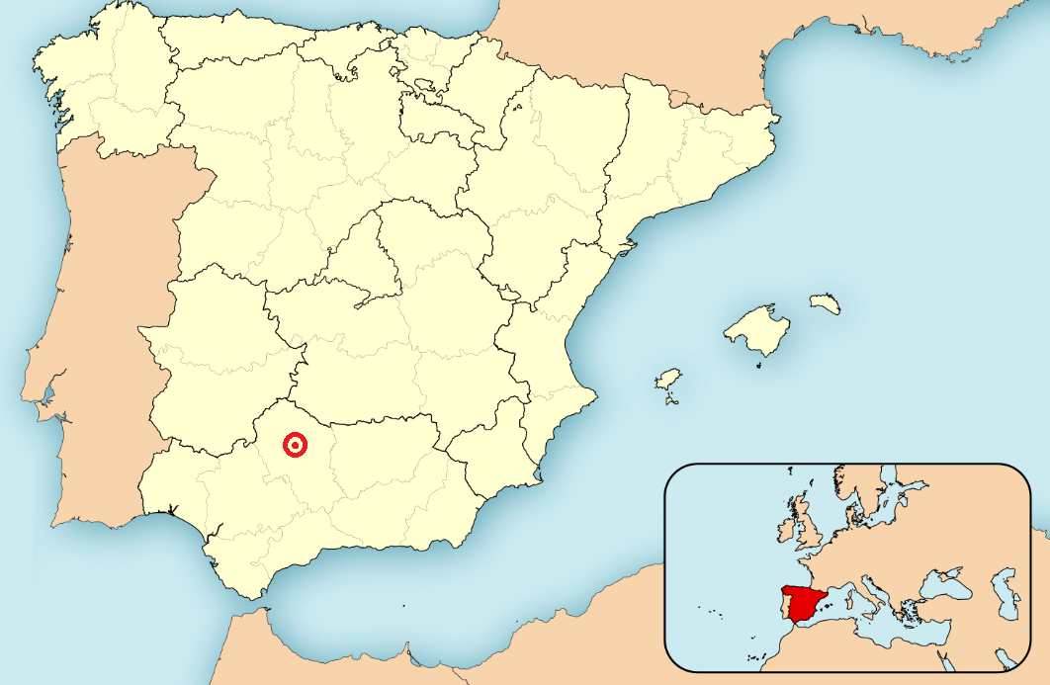
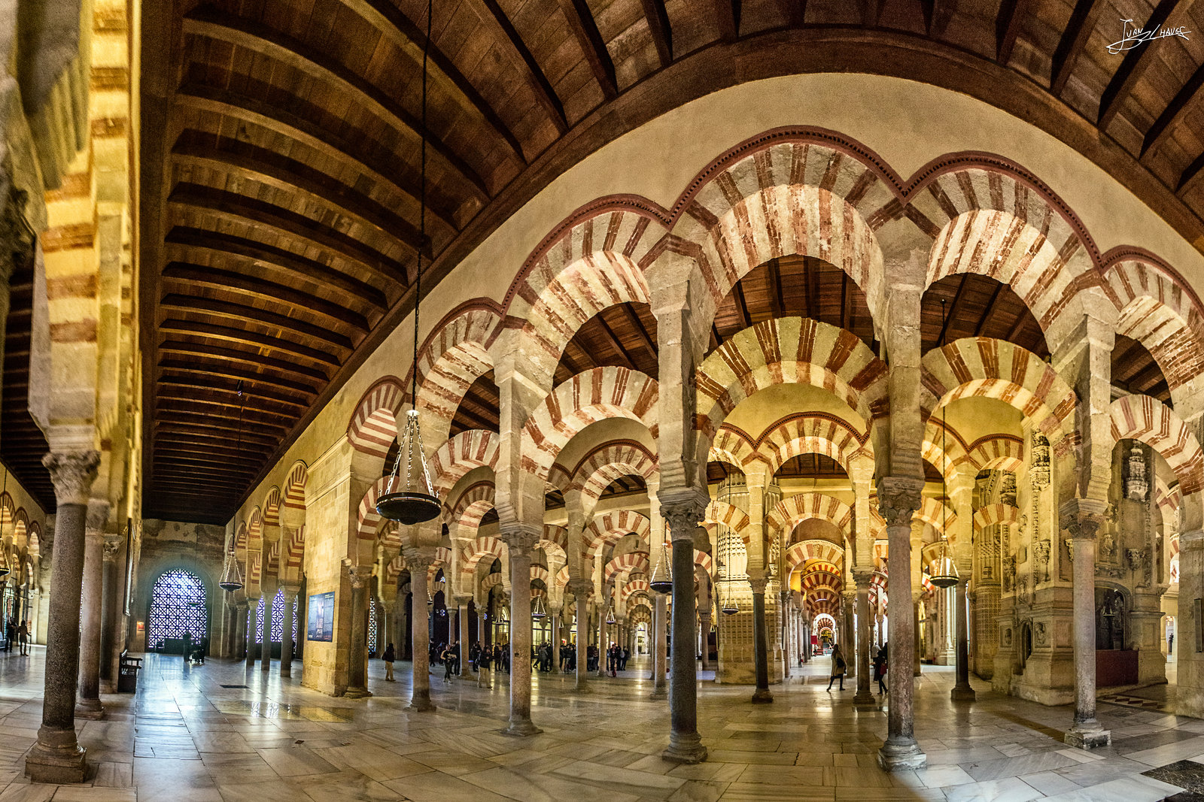
1. INTRODUCTION: Location
INDEX
Introduction
Methods
Results
Conclusions
Acknowledgments
Contact information

Slide 5
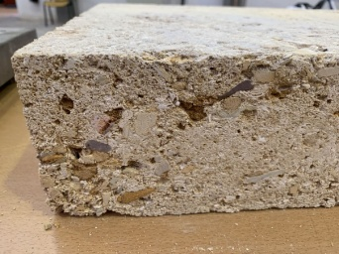
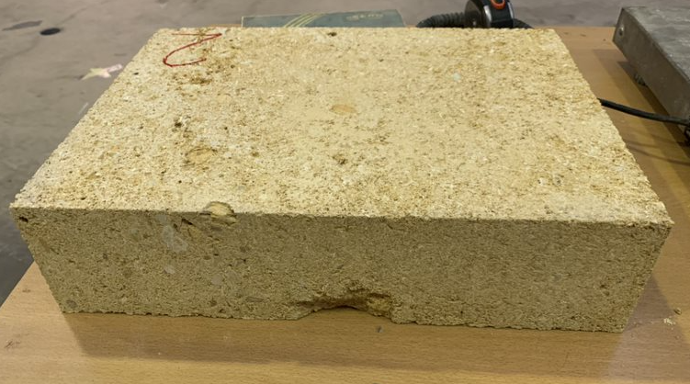
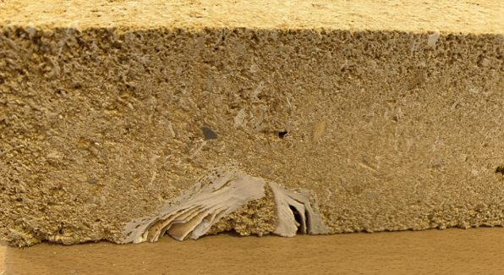
1. INTRODUCTION: Material
INDEX
Introduction
Methods
Results
Conclusions
Acknowledgments
Contact information
Córdoba freestone
Mármoles y Piedra Gutierrez

Slide 6
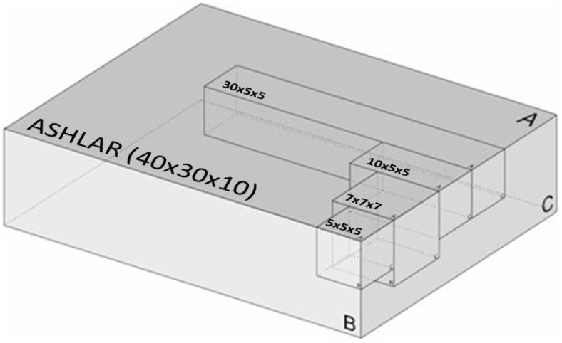
2. METHODS: Initial hypothesis
Loading direction effect
INDEX
Introduction
Methods
Results
Conclusions
Acknowledgments
Contact information
1
Size effect
2

Slide 7
2. METHODS: Non-destructive tests
INDEX
Introduction
Methods
Results
Conclusions
Acknowledgments
Contact information
Ultrasonic test (UST)
Rebound Hammer tests (RHT)

Slide 8
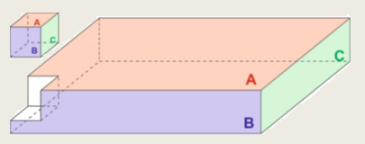
2. METHODS: Ultrasonic Tests
Direct test
INDEX
Introduction
Methods
Results
Conclusions
Acknowledgments
Contact information

Slide 9
2. METHODS: Rebound Hammer tests
INDEX
Introduction
Methods
Results
Conclusions
Acknowledgments
Contact information

Slide 10
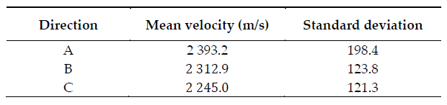
3. RESULTS: UST
Ashlars
INDEX
Introduction
Methods
Results
Conclusions
Acknowledgments
Contact information
Cubic and prismatic specimens

Slide 11
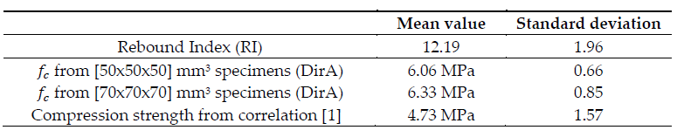

3. RESULTS: RHT
INDEX
Introduction
Methods
Results
Conclusions
Acknowledgments
Contact information

Slide 12
4. CONCLUSIONS
INDEX
Introduction
Methods
Results
Conclusions
Acknowledgments
Contact information
The results presented here can be regarded as a preliminary step toward developing valid correlations for material inspection and damage detection in The Great Mosque of Cordoba.
Loading direction effect: A lack of determined anisotropic behaviour in the tested directions.
Size effect: The results indicate a consistent mechanical behaviour for different specimen dimensions (ashlars, cubic, and prismatic specimens).

Slide 13
5. ACKNOWLEDGMENTS
INDEX
Introduction
Methods
Results
Conclusions
Acknowledgments
Contact information
The Cordoba Cathedral Chapter of Canons
Professor Gabriel Rebollo
Mármoles y Piedras Gutiérrez
Miguel Carrión Colchero
Lidia Molina Sanz

Slide 14

5. CONTACT INFORMATION
INDEX
Introduction
Methods
Results
Conclusions
Acknowledgments
Contact information
José Daniel Rodríguez Mariscal
Email: josedrm@us.es
Department of Continuum Mechanics and Structural Theory
Escuela Técnica Superior de Ingeniería (ETSI)
University of Sevilla – Spain

Slide 15

THANKS FOR YOUR ATTENTION!
Any questions?

