Slide 1
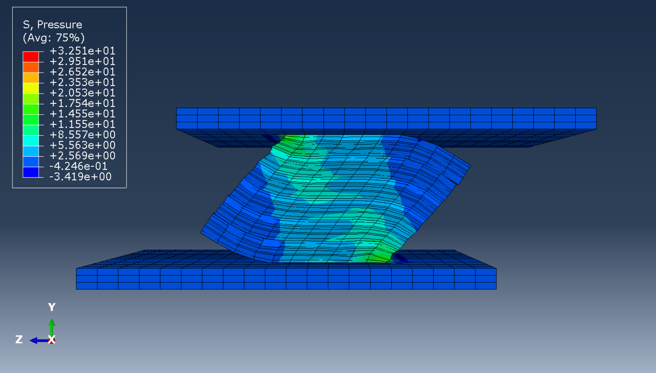
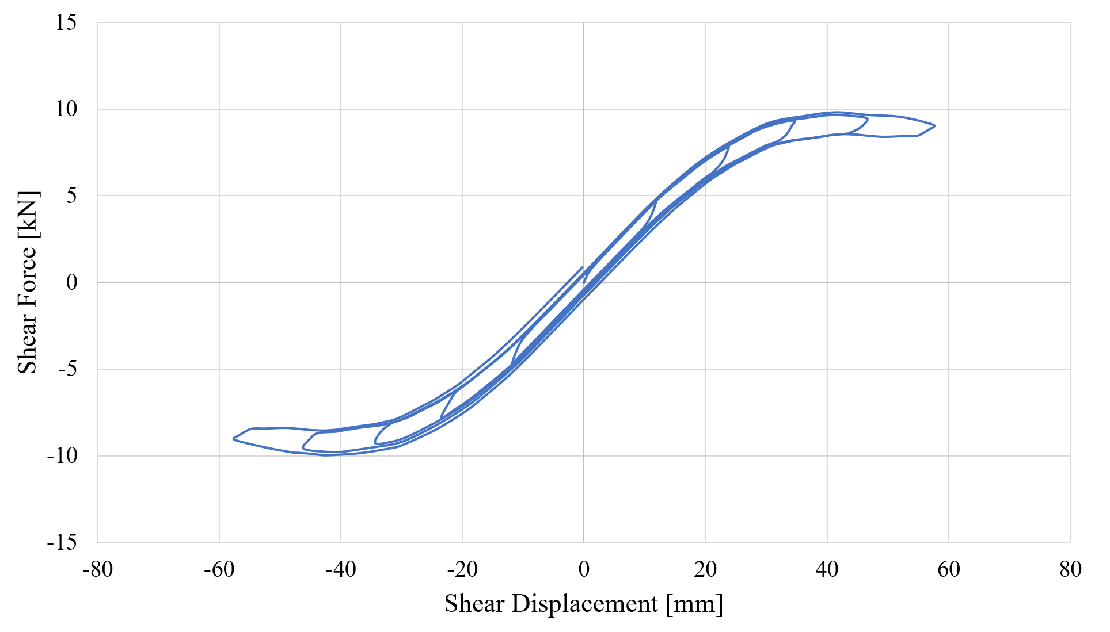
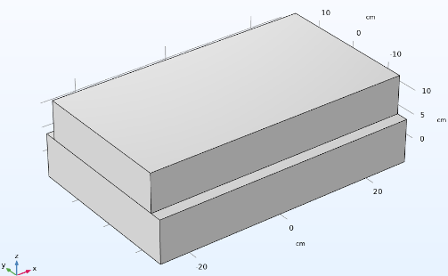
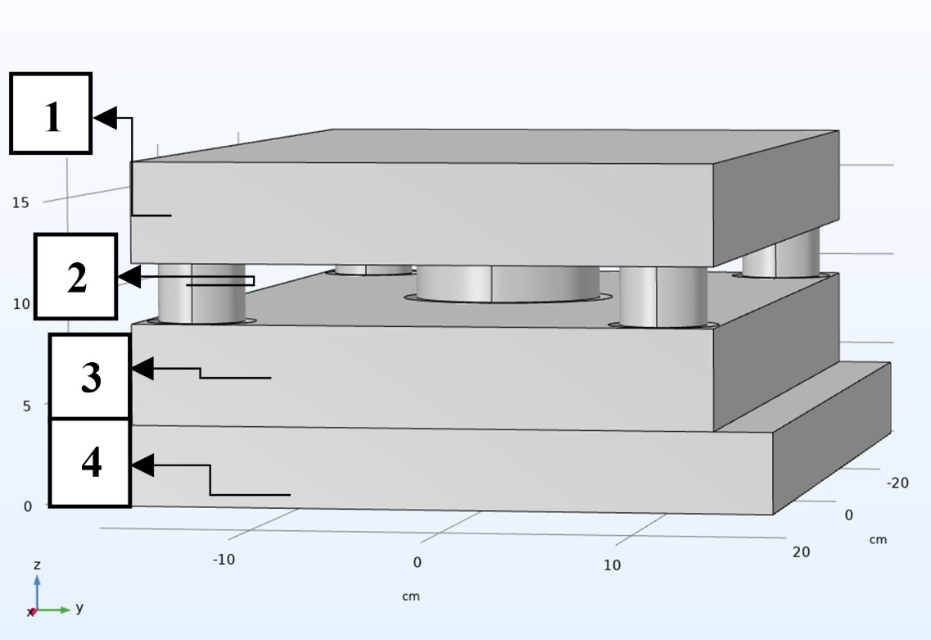
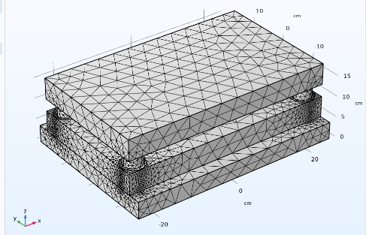
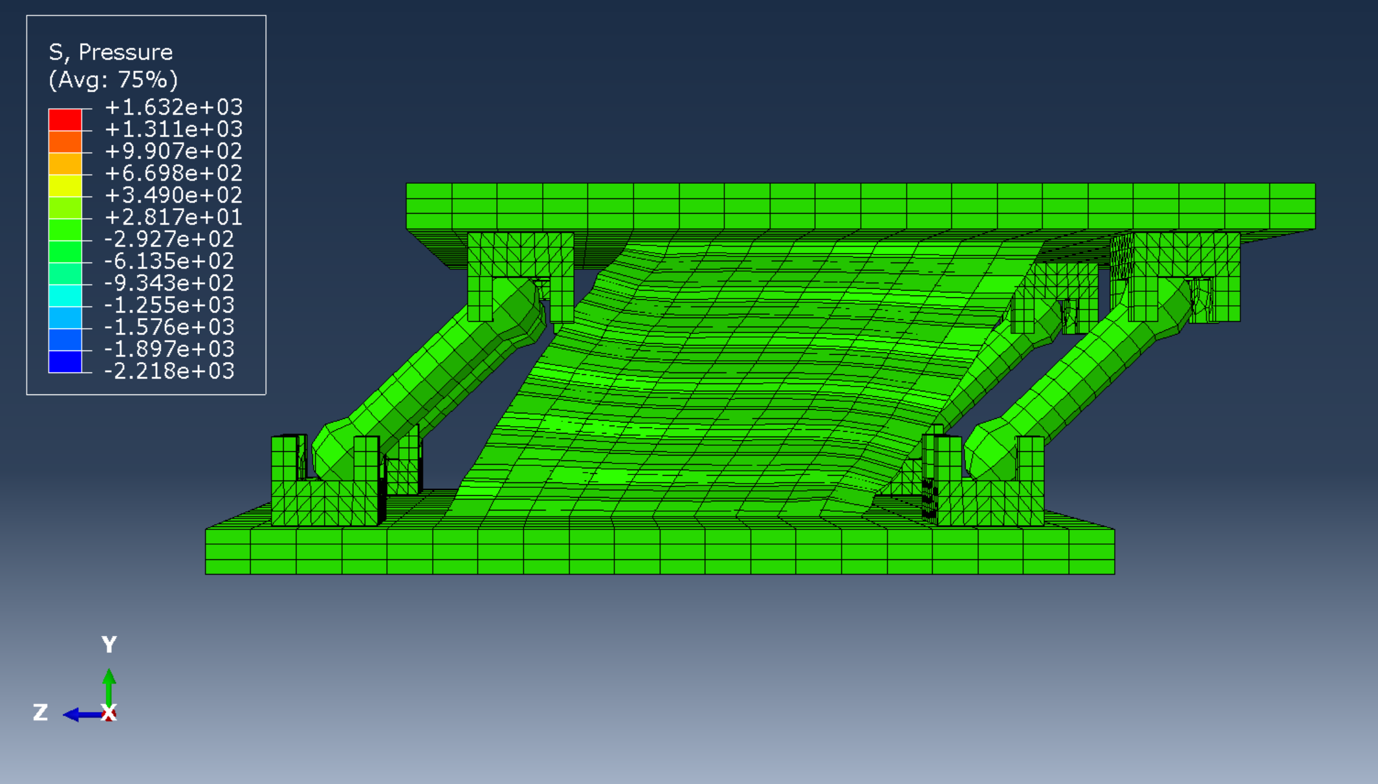
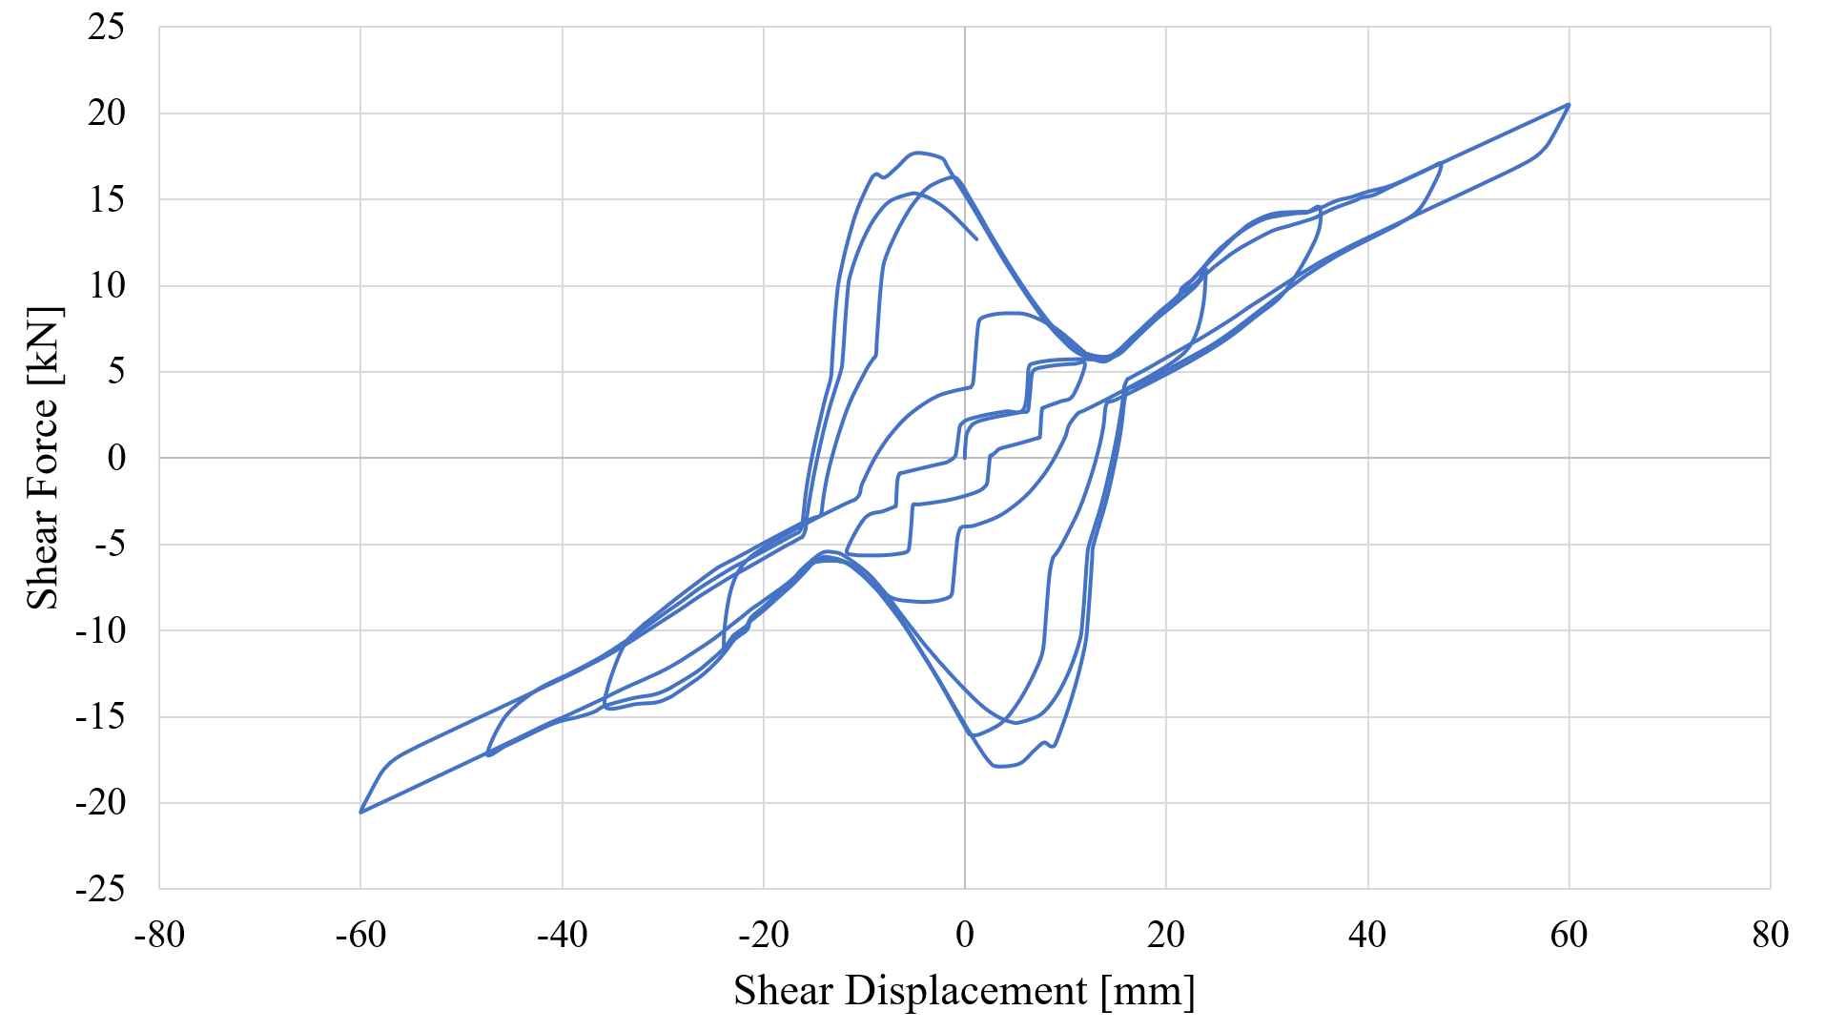
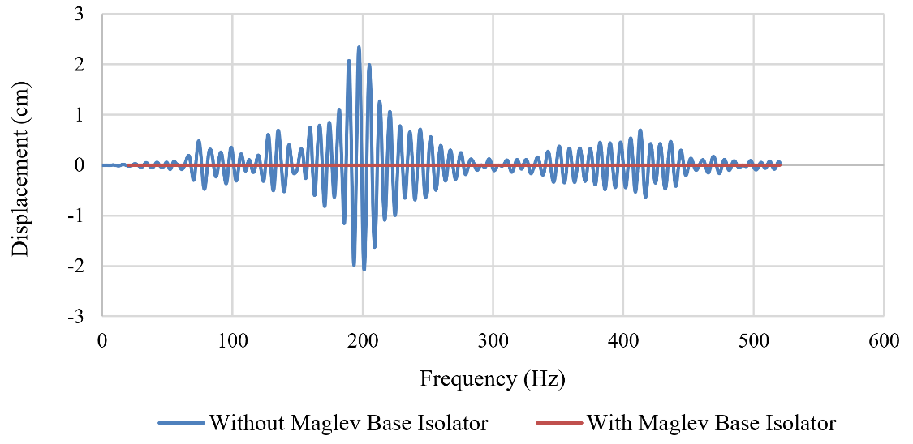
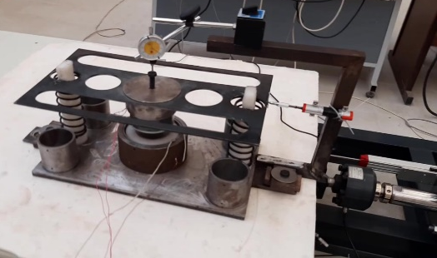
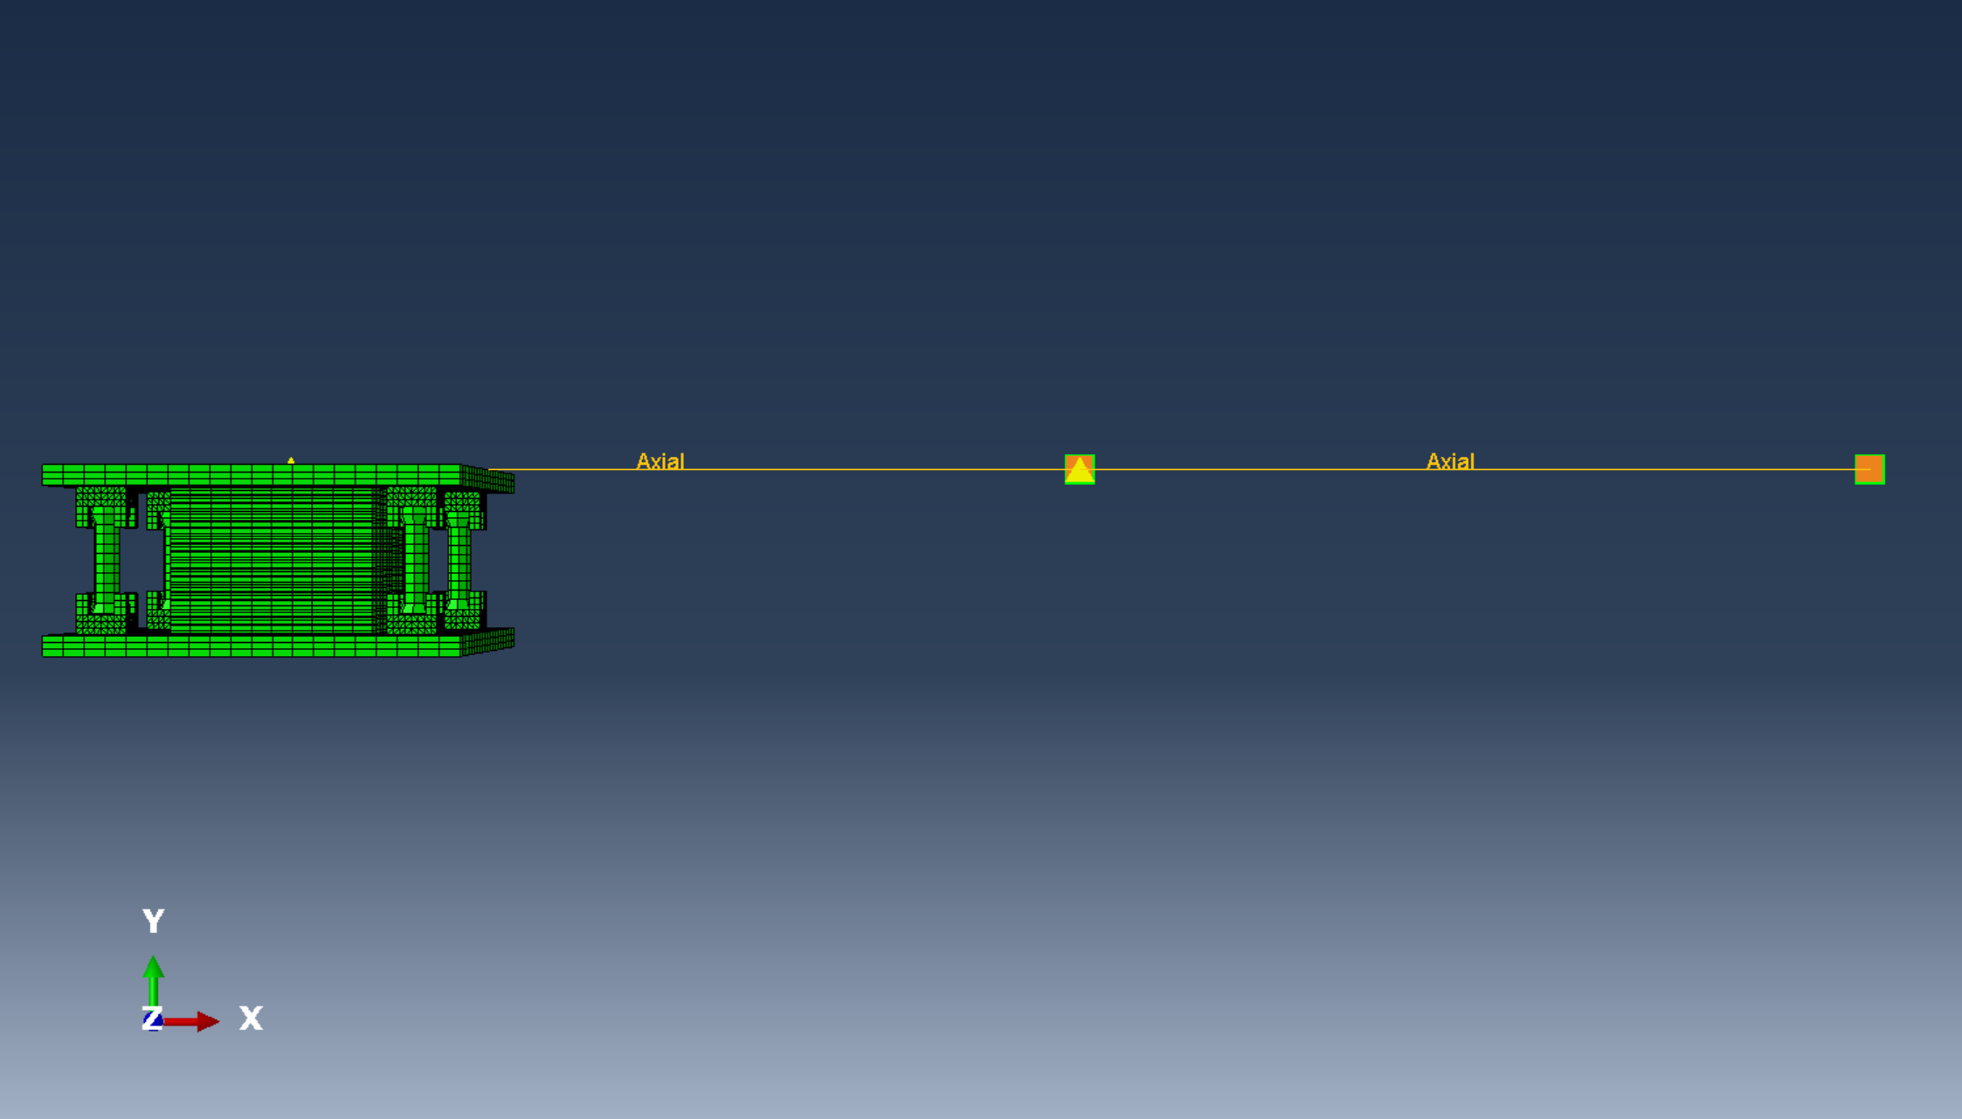
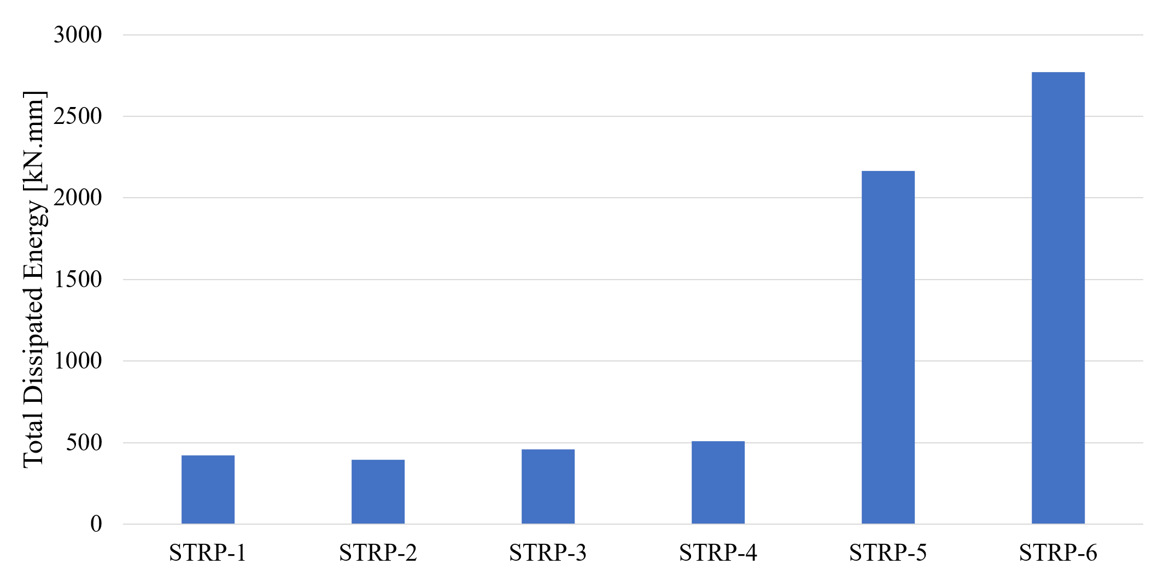
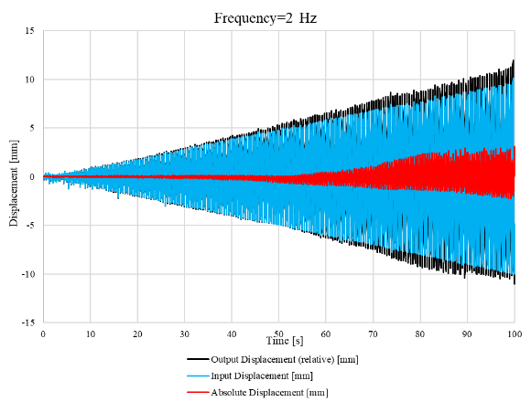
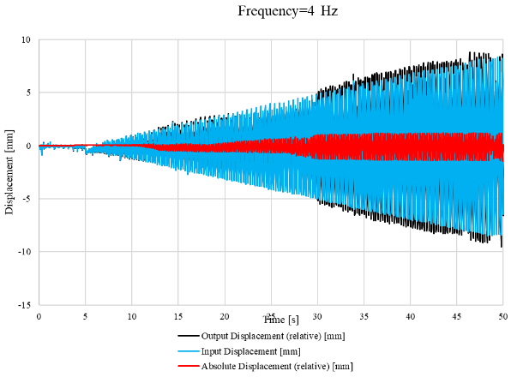
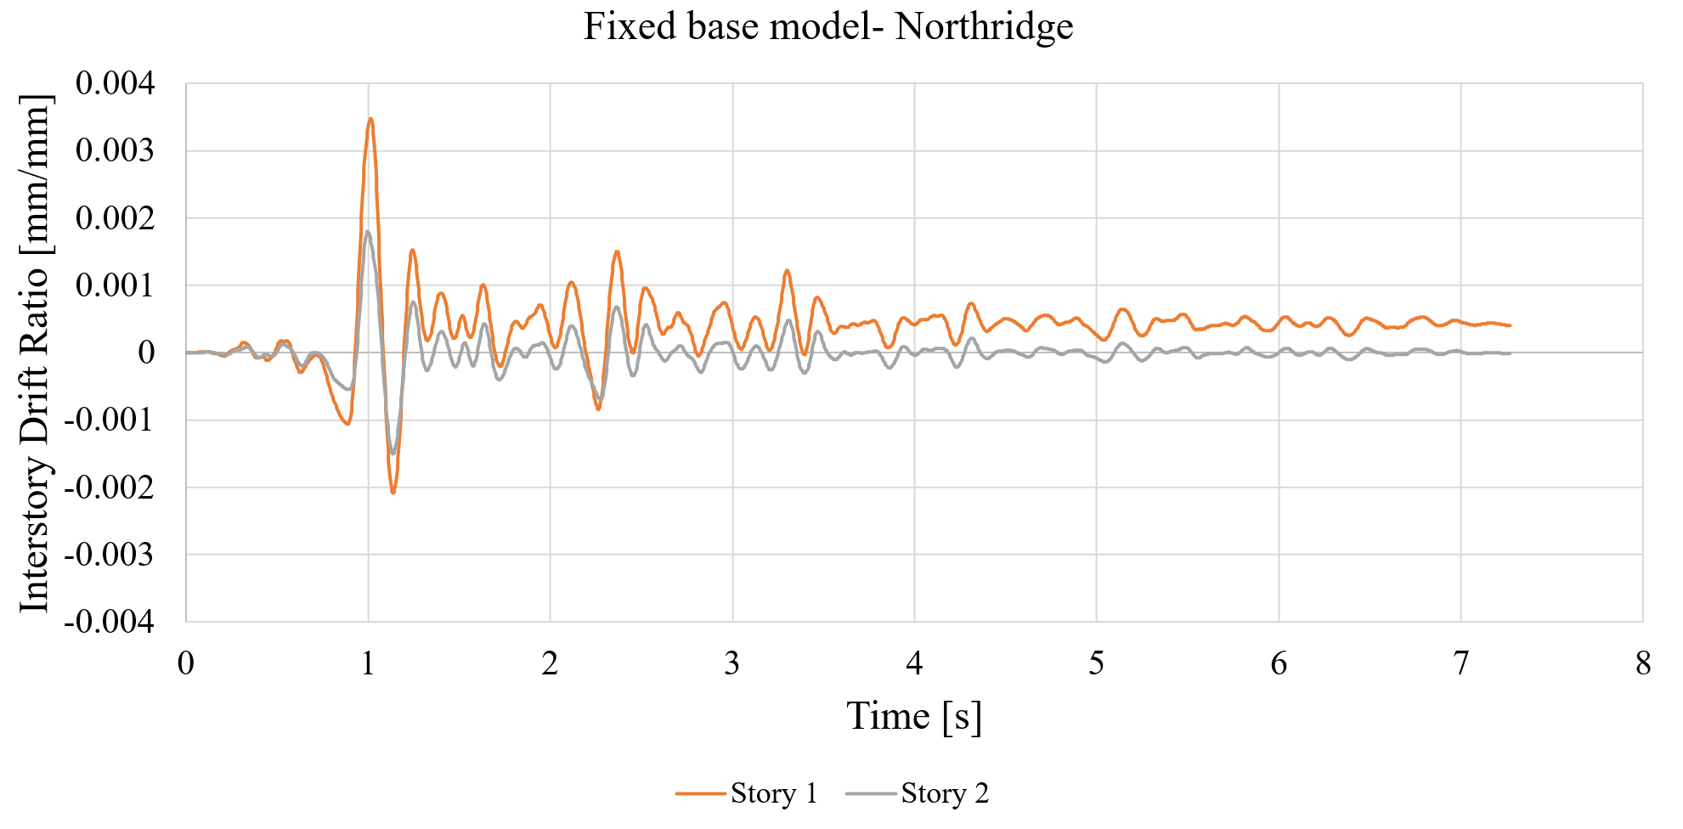
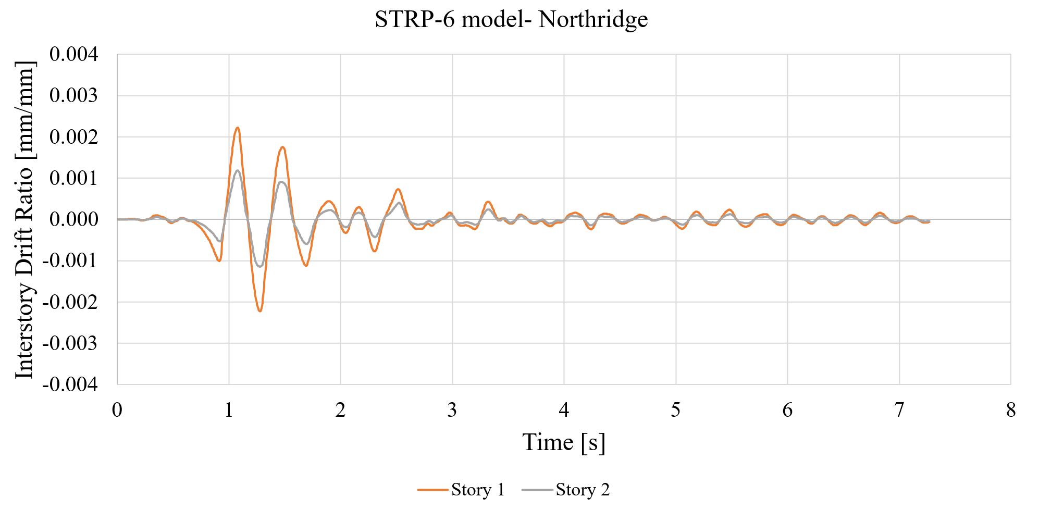
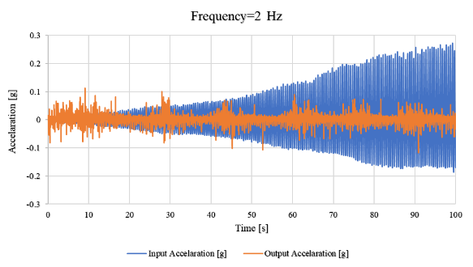
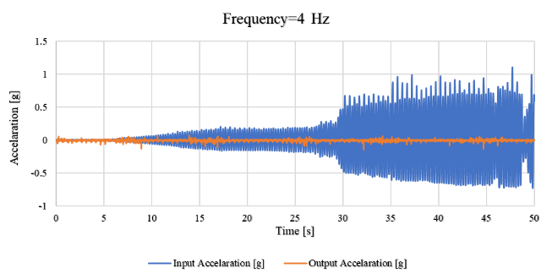
Novel STRP-SR and Maglev seismic isolators
Arash Akbari Hamed*, Mahsa Saeidzadeh, Hamid Reza Hassani Ghoraba, Farid Ostadhasanzadeh Maleky
Faculty of Civil Engineering, Sahand University of Technology, Tabriz, Iran
* Correspondence : akbarihamed.a@sut.ac.ir
Introduction
Conventional base isolators have two main issues including: 1) High cost of production, 2) Presence of a certain amount of horizontal lateral stiffness. To address these issues, this paper introduces two novel base isolators called Scrap Tire Rubber Pad with Steel Rods (STRP-SR) isolator and Magnetic Levitated (Maglev) isolator.
STRP-SR isolator
Maglev isolator
To reduce the production cost, the STRP-SR isolator consisting of bonded piled up scrap tire pads accompanying by four steel rods is introduced which could be used in light buildings with low importance.
To provide an ideal bearing with zero horizontal lateral stiffness, the Maglev isolator is introduced in which the building is levitated with a zero-footprint using the magnetic levitation technology.
In this research, the STRP-SR bearing was examined numerically under compressive and cyclic shear loadings and the efficiency of STRP-SR bearing was investigated for an isolated 2-story building model using ABAQUS software. Moreover, the Maglev bearing was studied numerically using COMSOL software and its experimental specimen was tested on a shaking table.
The fixed-base model
Deformed shape and the force-displacement hysteretic curves of the STRP: with unbonded rubber layers
The overall view of the proposed Maglev isolation system
The considered meshing for the finite element model
Deformed shape and the force-displacement hysteretic curves of STRP-SR
Comparison of the absolute displacement of the structure with and without the Maglev isolator
The installed Maglev isolator specimen on the shaking table
The considered small scale mass-spring-damper building models with a STRP-SR
Comparison of the performance of the considered STRP models based on total dissipated energy
Comparison of inter-story drift ratio time-histories for the building models with the fixed-base and isolated with STRP-SR bearings under the Northridge earthquake
(a)
(b)
The displacement-time and acceleration-time diagrams for the experimental specimen of Maglev isolator at the frequency of: (a) 2 Hz, (b) 4 Hz
Conclusions
Acknowledgments
Based on the obtained numerical results, it was concluded that STRP-SR and Maglev bearings can reduce the absolute acceleration and displacement values by average percentages of 53.24 and 100, respectively which approves their capability in keeping safe the isolated buildings. The experimental results for Maglev isolator showed that the aforementioned reduction percentage was reduced to an average value of 74.67% which still is an acceptable value for approvement of the efficiency of a practical bearing.
Funding for the research on "sustainable and economic base isolators made by scrap tires" was provided by the Iranian National Science Foundation (INSF) under a research project grant No. 4021667 which is gratefully acknowledged.
References
Mishra, H.K., Experimental and analytical studies on scrap tire rubber pads for application to seismic isolatiion of structures. 2012, PhD Dissertation, Kyoto University: Japan.
Dolga, V. and L. Dolga, Modeling and simulation of a magnetic levitation system. Fascicle of Management and Technological Engineering, 2007. 6(XVI).

