Slide 1
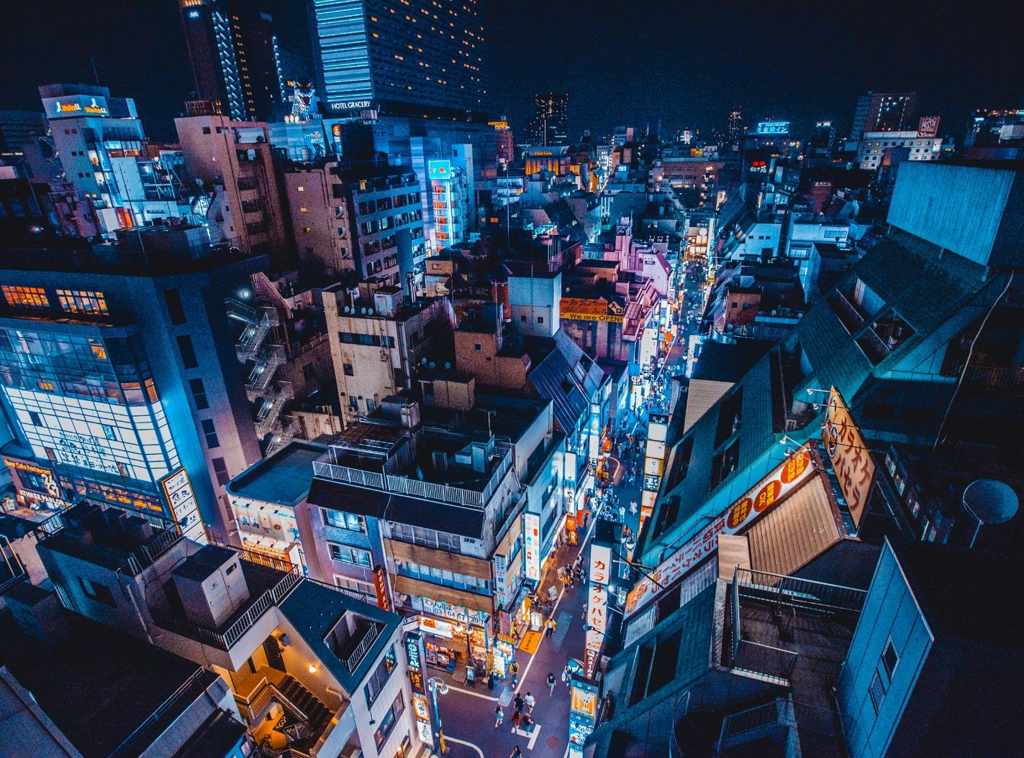
A Data Envelopment Analysis to Benchmark Hotel Energy Consumption in an Urban Locality
Presented at International Online Conference on Buildings (October 2023)
By
Chukwudi Okpala (presenting author), Howard Njoku, and Paul Ako
Sustainable Energy Engineering Research Group, Department of Mechanical Engineering, University of Nigeria, Nsukka 410001, Nigeria.

Slide 2
Introduction
Literature review
Methodology
Conclusion
Results and discussion
Outline
Things to follow

Slide 3
Introduction
Background of study
The hospitality industry, including hotels, relies heavily on energy for its operations. Efficient energy management can significantly impact customer experiences and overall revenue. Energy efficiency involves using less energy to achieve the same or better results.
As of January 2022, Nsukka has around 30 hotels consuming a substantial amount of electrical energy monthly (over 130MWh). The challenge faced by hoteliers is to find a balance between providing an optimal guest experience and effective energy management practices.

Slide 4
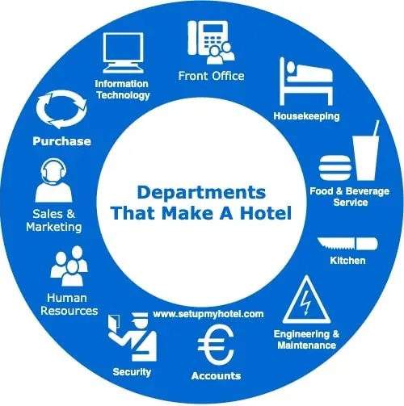
Introduction
Just like in other parts of Nigeria, hotel owners in Nsukka face this challenge in the midst of managing increasing energy costs.

Slide 5
Aim and Objectives
Aim and Objectives
What to expect
To benchmark the energy consumption of hotels within Nsukka Metropolis.
To determine the current energy costs incurred by the hotels.
To identify energy wastage avenues observed in the hotels.
To identify possible energy management recommendations to be implemented by the hotels.
To compare cost savings achieved by the implementation of these recommendations.

Slide 6
Literature Review
Literature
Many authors have written on Hotel energy management and energy efficiency in the hotel sector while employing various methods of analysis such as energy benchmarking, regression-based analysis, clustering technique and data envelopment analysis (DEA).
There are several factors that affect hotel energy consumption and these factors play a significant role in determining energy efficiency.
Energy conservation is also synonymous to energy efficiency and is defined by Unachukwu and Onyegegbu (2000) in their publication on electrical energy consumption pattern of a cement company in Nigeria. That is, the strategy of modifying energy utilizing systems and processes in an optimal way to minimize the energy input per unit output while maintaining or reducing overall costs of using these systems to provide the output.
Review

Slide 7
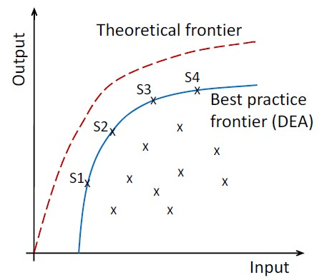
Literature Review
While other methods may be considered proficient, DEA is most often used because it is a multivariate mathematical method that can absorb multiple inputs and outputs simultaneously.
The DEA is a linear programming technique that measures relative performances of decision making units (DMUs).
Basic Concept of Data Envelopment Analysis (DEA)

Slide 8
Literature Review
Generally, a basic DEA model known as input-oriented Charnes-Cooper-Rhodes (CCR-i) model under constant returns to scale (CRS) assumes that there are ’n’ number of DMUs, each with varying amounts of ’m’ different inputs to produce ’s’ different outputs. Where x is an (m*n) matrix and y an (s*n) matrix, the relative efficiency of a test DMU_{p} is obtained by
solving:
$max\frac{\sum_{k=1}^{s}{v_{k}y_{kp}}}{\sum_{j=1}^{m}{u_{j}x_{jp}}}$ (2.6)
subject to
$\frac{\sum_{k=1}^{s}{v_{k}y_{ki}}}{\sum_{j=1}^{m}{u_{j}x_{ji}}}≤1;$ (2.7)
∀ i and v_{k}, u_{j} ≥ 0; ∀ k, j

Slide 9
Literature Review
where y_{ki} = amount of output k produced by DMUi, x_{ji} = amount of input j utilised by DMUi, v_{k} = weight given to output k, u_{j} = weight given to input j
The DEA fractional models in 2.6 and 2.7 can be converted to a linear programming model as shown in 2.8 subject to 2.9 [47].
$max\sum_{k=1}^{s}{v_{k}y_{kp}}$ (2.8)
subject to
$\sum_{j=1}^{m}{u_{j}x_{jp}=1}$ and $\sum_{k=1}^{s}{v_{k}y_{ki}−\sum_{j=1}^{m}{u_{j}x_{ji} ≤0}}$ (2.9)
∀ i and v_{k}, u_{j} ≥ 0; ∀ k, j

Slide 10
Methodology
Methodology
Design of Questionnaire
Energy Use Intensity (EUI)
DMU selection
Normalization
Number of employees
Administration of questionnaires to the selected Hotels
Diesel Consumption
Correlation coefficients of variables
Inputs
Selection of input and output variables
Occupancy ratio
Output
Application of CCR-i DEA model under CRS
T.E for
DMU H1
T.E for
DMU H2
T.E for
DMU H3
T.E for
DMU H4
T.E for
DMU H5
T.E for
DMU H6
T.E for
DMU H7
T.E for
DMU H8
T.E for
DMU H9
T.E for
DMU H10

Slide 11
Methodology
Table showing correlation between our inputs and output variables. Zero-order correlation coefficients for all variables in the study
 | 1. | 2. | 3.
1. Occupancy ratio | ---
2. Number of employees | 0.42 | ---
3. Electricity unit | 0.54 | 0.03 | ---
4. Diesel Consumption | 0.55 | 0.32 | 0.58
Note. Bold coefficients are significant (p>.05).

Slide 12
Results
Results
Hotel 1 (DMU H1)
Hotel 2 (DMU H2)
Hotel 3 (DMU H3)
Hotel 4 (DMU H4)
Hotel 5 (DMU H5)
Fig. 4.1. Monthly occupancy rates of the surveyed hotels in Nsukka metropolis

Slide 13
Results
Results
DMU H2 recorded the highest mean occupancy rate of 79.75% while DMU H7 had the lowest mean occupancy rate of 26%. Most of the DMUs recorded their highest occupancy ratios in the months of December, January.
Hotel 6 (DMU H6)
Hotel 7 (DMU H7)
Hotel 8 (DMU H8)
Hotel 9 (DMU H9)
Hotel 10 (DMU H10)
Fig 4.1. Monthly occupancy rates of the surveyed hotels in Nsukka metropolis (cont’d)

Slide 14
Results
Results
The surveyed hotels had a mean EUI of 51.42kWh/m²/year.
DMU H5 recorded the highest EUI of 97.77kWh/m²/year and the lowest from the set was recorded by DMU H10 with 17.68kWh/m²/year.
Fig. 4.2. Annual Energy Use Intensities
of the surveyed hotels (DMUs)

Slide 15
Results
Results
Hotel 1 (DMU H1)
Hotel 2 (DMU H2)
Hotel 3 (DMU H3)
Hotel 4 (DMU H4)
Hotel 5 (DMU H5)
Hotel 6 (DMU H6)
Fig. 4.3. Monthly EUIs for surveyed Hotels (DMUs)

Slide 16
Results
Results
Though the EUI varied for each hotel, most of them showed that electricity consumption in January, April and December were above the mean electricity consumption. These months were also the top three in terms of the occupancy ratios.
Hotel 7 (DMU H7)
Hotel 8 (DMU H8)
Hotel 9 (DMU H9)
Hotel 10 (DMU H10)
Fig. 4.3. Monthly EUIs for surveyed Hotels (cont’d)

Slide 17
Results
Results
The DMUs consumed an average of 22,970 litres of diesel annually to run their businesses. DMU H2 had the highest consumption with a value more than thrice the volume consumed by DMU H3.
Fig. 4.4. Annual diesel consumption of surveyed hotels

Slide 18
Results
Results
Hotel 1 (DMU H1)
Hotel 2 (DMU H2)
Hotel 3 (DMU H3)
Hotel 4 (DMU H4)
Hotel 5 (DMU H5)
Hotel 6 (DMU H6)
Fig. 4.5. Monthly diesel consumption for the surveyed hotels (DMUs)

Slide 19
Results
Results
The DMUs used the most quantity of diesel in December and April where they had high average occupancy ratios of 62.3 and 57.9, respectively. It generally appeared that the quantity of diesel consumed increased as the occupancy ratios increased.
Hotel 7 (DMU H7)
Hotel 8 (DMU H8)
Hotel 9 (DMU H9)
Hotel 10 (DMU H10)
Fig. 4.5. Monthly diesel consumption for the surveyed hotels (DMUs)[cont’d]

Slide 20
Results
Results
DMU H3 was most efficient with a technical efficiency score of 1.
DMUs H2, H5, H8 and H9 were closest to the efficiency frontier, DMUs H1, H4, and H6 were average while DMUs H7 and H10 were lowest.
The least efficiency score of 0.474 was recorded by DMU H7.
Fig. 4.6. Technical Efficiencies of DMUs over one year period

Slide 21
Results
Results
DMUs | Jan | Feb | Mar | Apr | May | Jun | Jul | Aug | Sep | Oct | Nov | Dec
H1 | 1.000 | 1.000 | 0.687 | 0.867 | 1.000 | 0.719 | 0.460 | 0.435 | 0.836 | 1.000 | 1.000 | 0.401
H2 | 0.555 | 1.000 | 1.000 | 1.000 | 1.000 | 1.000 | 1.000 | 1.000 | 1.000 | 1.000 | 1.000 | 0.889
H3 | 1.000 | 1.000 | 1.000 | 1.000 | 1.000 | 1.000 | 1.000 | 1.000 | 1.000 | 1.000 | 1.000 | 1.000
H4 | 1.000 | 0.964 | 0.733 | 0.823 | 0.463 | 0.736 | 0.989 | 0.509 | 1.000 | 0.965 | 0.698 | 0.857
H5 | 0.812 | 1.000 | 0.931 | 0.892 | 0.729 | 1.000 | 1.000 | 0.941 | 1.000 | 1.000 | 0.550 | 0.639
H6 | 0.664 | 0.760 | 0.862 | 0.879 | 0.790 | 1.000 | 0.897 | 0.875 | 0.846 | 0.993 | 0.639 | 0.514
H7 | 0.611 | 0.330 | 0.377 | 0.354 | 0.261 | 0.448 | 0.386 | 0.398 | 0.434 | 0.591 | 0.747 | 0.745
H8 | 0.803 | 0.769 | 1.000 | 0.950 | 0.993 | 0.993 | 0.941 | 0.855 | 0.908 | 1.000 | 0.889 | 1.000
H9 | 0.750 | 0.719 | 1.000 | 1.000 | 0.880 | 0.862 | 0.653 | 0.775 | 0.772 | 0.750 | 1.000 | 0.943
H10 | 0.593 | 0.320 | 1.000 | 0.713 | 0.592 | 0.596 | 0.598 | 0.767 | 1.000 | 0.834 | 0.580 | 0.504
Highest value
50th percentile
Lowest value
Fig. 4.7. Monthly Technical Efficiencies of the Hotels (DMUs)

Slide 22
Results
Results
DMUs | Jan | Feb | Mar | Apr | May | Jun | Jul | Aug | Sep | Oct | Nov | Dec
H1 | H1 | H1 | H10, H2 | H3, H2 | H1 | H3, H2 | H2, H3 | H3, H2 | H10, H2 | H1 | H1 | H3
H2 | H4, H1 | H2 | H2 | H2 | H2 | H2 | H2 | H2 | H2 | H2 | H2 | H3
H3 | H3 | H3 | H3 | H3 | H3 | H3 | H3 | H3 | H3 | H3 | H3 | H3
H4 | H4 | H3, H2 | H3, H9, H2 | H3, H9, H2 | H2, H3 | H5, H6, H3 | H3, H2 | H3, H2 | H4 | H5, H3 | H3, H9 | H3
H5 | H3 | H5 | H9 | H9 | H3 | H5 | H5 | H3 | H5 | H5, H3 | H9 | H3
H6 | H3, H4 | H3, H2 | H8, H9, H3 | H3, H9, H2 | H3 | H6 | H5, H3 | H3 | H5, H4 | H5, H3, H8 | H3, H9 | H3
H7 | H4, H1 | H3, H2 | H9, H2 | H3, H9, H2 | H3 | H3, H6, H2 | H3, H2 | H2, H3 | H4, H5 | H5, H3 | H9, H3 | H3
H8 | H3 | H3 | H8 | H9, H3 | H3 | H5, H3 | H5, H3 | H3 | H3, H4 | H8 | H3, H1 | H8
H9 | H3 | H3, H5 | H9 | H9 | H3 | H3, H5, H6 | H5, H3 | H3 | H5, H4 | H5, H3 | H9 | H3
H10 | H1, H3 | H3, H2, H1 | H10 | H3, H2 | H3, H1 | H2, H3 | H2, H3 | H3, H2 | H10 | H1, H2 | H2, H3 | H3
From the result of the analysis for the month of January, three DMUs had an efficiency score of 1 with DMU H2 having the least technical efficiency of 0.555. Therefore, DMU H2 can improve her efficiency score to unity by following input-output trends of any of DMUs H4 or H1.
Fig. 4.8. Summary of peers

Slide 23
Results
DMU H7 had the highest potential for savings in electricity consumption to the tune of N2,437,120 in the year. It was closely followed by DMU H9 with potential savings of N1,807,480 and then DMU H6 with N1,640,241.
Although DMU H2 had optimum electricity consumption in 10 out of 12 months, it had the highest potential savings for electricity in a month. DMU H2 could potentially save N409,304 in January alone.
DMU H7
DMU H6
Fig. 4.9. Monthly Current Electricity consumption, Optimum Electricity consumption and Potential Savings in electricity costs for surveyed hotels
DMU H4

Slide 24
Results
DMU H3 recorded optimum diesel consumption in the 12 months considered.
DMU H7 on the other hand, had all 12 months recording potential savings for diesel consumption followed by DMU H6, then DMU H4 and H10 with 11, 10 and 10 months respectively.
As regards potential monthly savings, DMU H2 recorded the highest for an individual month in January – N498,144, followed by DMU H1 with N480,327 in July.
DMU H7
DMU H6
Fig. 4.10. Monthly Current diesel consumption, Optimum diesel consumption and Potential Savings in diesel costs for surveyed hotels
DMU H2

Slide 25
Results
DMU H1 had the highest total potential savings for staffing in excess of N4,080,000 even though it recorded optimum staffing in 5 out of 12 months. It also recorded potential savings of N880,000 in the month of August alone, making it the DMU with the highest potential savings for staffing in a single month. These figures emanating from DMU H1 are not unrelated to its high number of employees in relation to its occupancy rates in many of the months considered.
DMU H7, although not having optimum staffing in all 12 months, was ranked third in total potential savings from staffing after DMU H10.
DMU H1
Fig. 4.11. Monthly No. of employees, Optimum No. of employees and Potential Savings in staff costs for DMU H1

Slide 26
Results
This shows that all but one of the surveyed hotels had some amount of potential savings should they implement the recommended adjustments to improve their energy performances.
DMU H7, H1 and H10 had the highest potential savings of over N8.91 million, N7.03 million and N6.12 million respectively.
While DMU H2, H8 and H3 operated more efficiently with potential savings of less than N2 million in a year.
Fig. 4.12. Potential annual savings from recommended
adjustments for surveyed hotels.

Slide 27
Conclusions
Conclusions and
Notably, the hotels depended more on electricity for their energy needs complemented by diesel for their back-up electricity generators and gas for cooking. It was also observed that more than 70% of the electricity was used for HVAC indicating the weight impact of cooling energy use on the total energy used by hotels in the study environment.
We have shown that significant savings opportunities exist in the studied hotels. Such potentials can similarly be identified in other hotels to improve profitability and reduce the environmental burden of their operations.
This research is significant due to Nigeria's energy supply challenges, including inadequate power supply from the national grid. Hoteliers can benefit from this study as it explores a methodology for assessing energy losses, improving energy efficiency, and exploring alternative energy sources like solar and generators.
Recommendations

Slide 28
Thank you

