Slide 1
Evaluation of DNA extraction methods for PCR analysis of maize and sunflower oils
The 4th International Electronic Conference on Foods , 15–30 Oct 2023
Tamara Kutateladze¹, Kakha Bitskinashvili¹, Boris Vishnepolsky¹, Kakha Karchkhadze², Tata Ninidze^{1, 2},
Nelly Datukishvili^{1, 2}
¹ Ivane Beritashvili Center of Experimental Biomedicine, Tbilisi, Georgia
² School of Natural Sciences and Medicine, Ilia State University, Tbilisi, Georgia

Slide 2
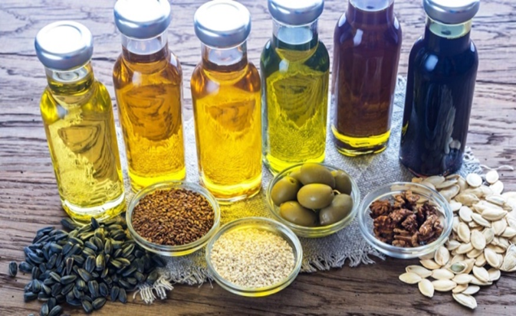
Challenges of the Modern Food Industry
The modern food industry has a big challenge dealing with the adulteration of different types of plant oils
International legislation requires food authentication and traceability at all stages of production
It is necessary to provide accurate information about the presence of food ingredients and allergens through labeling
Oil plants differ in the following indicators:
Chemical and molecular composition
Toxic and allergenic properties
Nutritional value and safety
industrial value
A food monitoring system needs effective methods of detecting food ingredients!

Slide 3
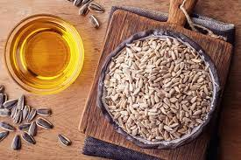
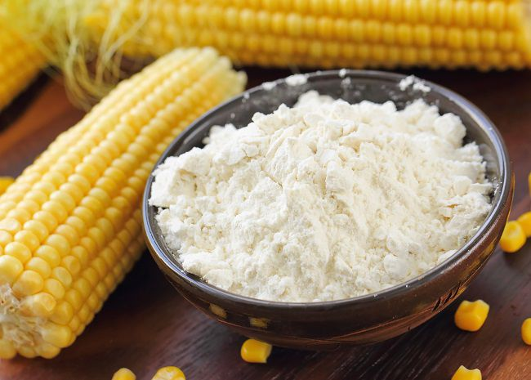
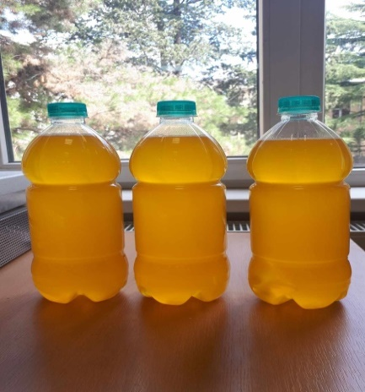
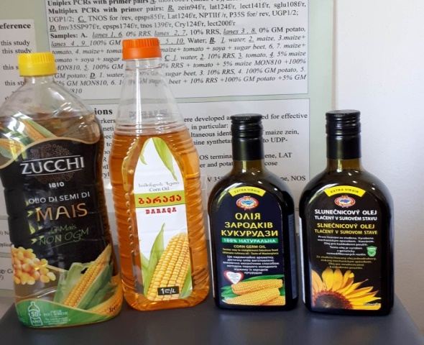
Study Aim:
To develop efficient PCR technology for plant DNA traceability in oils
Sunflower samples
Maize samples
Objects:
Sunflower and Maize
Seeds
Flours
cold-pressed oils
refined oils
Sunflower and maize seeds and flours were purchased from a supermarket
Cold-pressed sunflower oil was provided by the company
„AgroPro Ltd”
Refined and cold-pressed corn oils were purchased from a supermarket

Slide 4
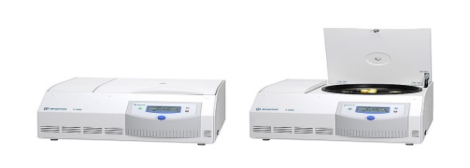
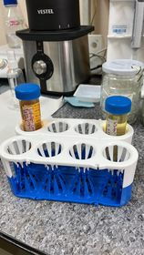
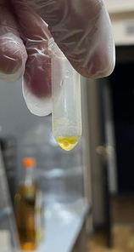
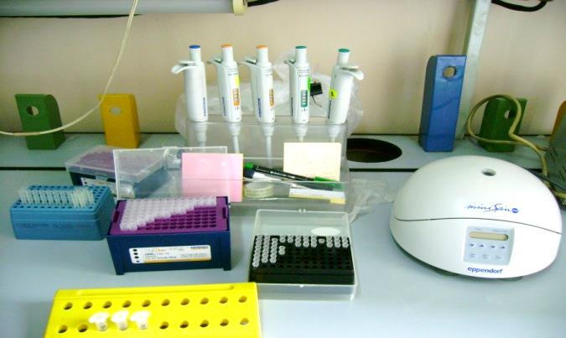
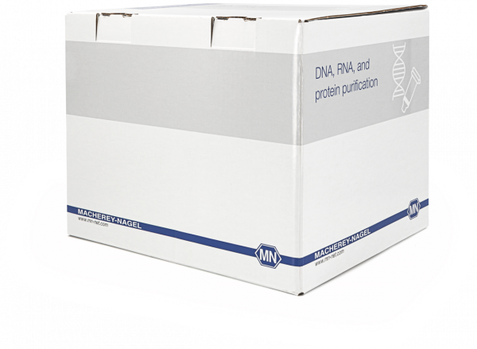
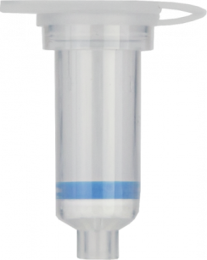
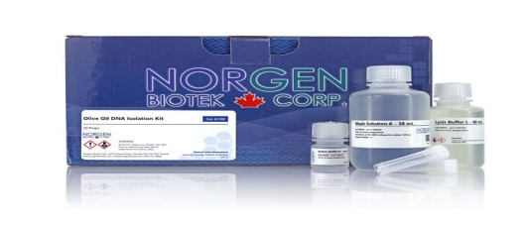
Preparation of DNA samples of appropriate quality and sufficient quantity from oils remains a major drawback for successful PCR detection!
Our study examines several approaches to DNA enrichment and extraction
Centrifugation of oils
at 18,000 g, 4 ºC
DNA enrichment
Adding of TE Buffer and centrifugation in microcentrifuge at 25⁰C
Standard CTAB method
DNA extraction
Modified CTAB method - Developed in this study
NucleoSpin Food Mini Kit
Olive Oil DNA Isolation Kit

Slide 5
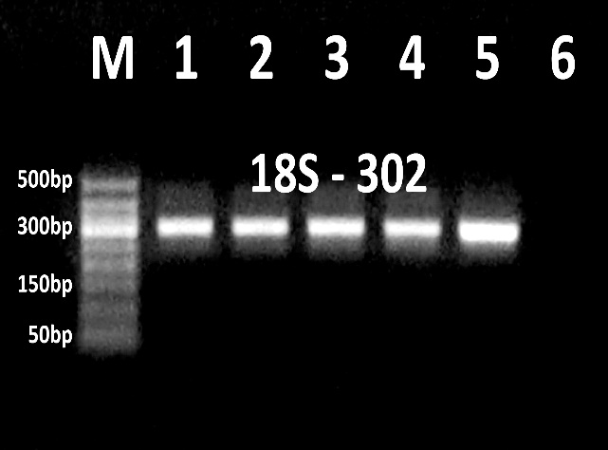
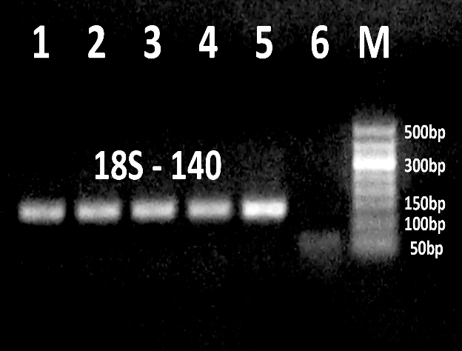
The genomic DNA band visible on the agarose gel was obtained from cold-pressed sunflower oil!
Genomic DNA extraction
PCRs specific to 18S ribosomal RNA gene
Agarose gel electrophoresis
of genomic DNAs
Amplicon 18S-302
Amplicon 18S-140
Samples
1-2. cold-pressed sunflower oil, Olive Oil kit
3-4. cold-pressed sunflower oil, NucleoSpin Food kit
5. Sunflower seeds, plant mini kit
6. Water negative control
Oil DNA enrichment – Centrifugation of 30 ml cold-pressed sunflower oil at 18,000 g, 4 ºC
DNA samples:
cold-pressed sunflower oil - extraction by modified CTAB method
cold-pressed sunflower oil - extraction by standard CTAB method
3 - 4. sunflower seeds - extraction by standard CTAB method
5. Maize flour - extraction by standard CTAB method
Results
DNA enrichment by oil centrifugation at 18,000 g, 4 ºC gave best results
Olive oil kit and Nucleospin food kit gave amplifiable DNA from cold pressed sunflower oil

Slide 6
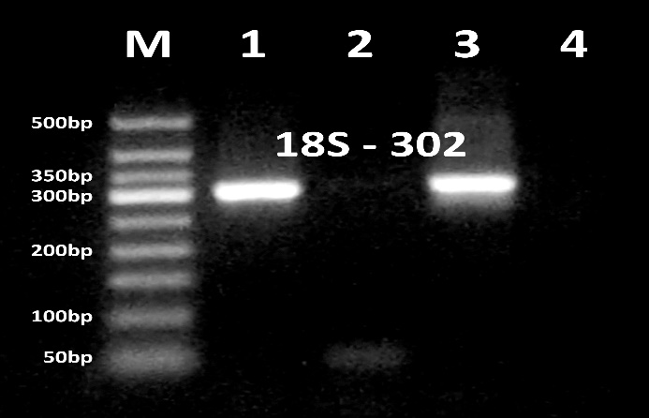
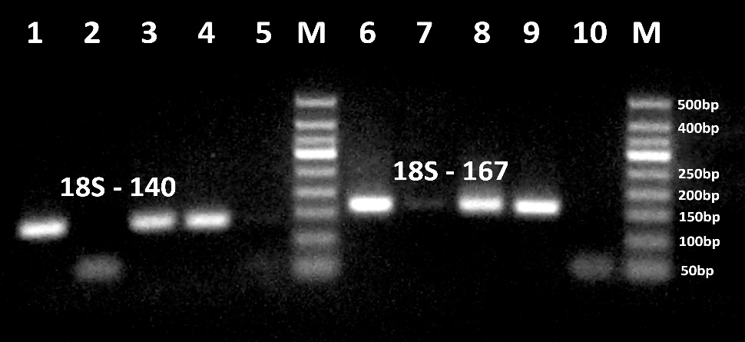
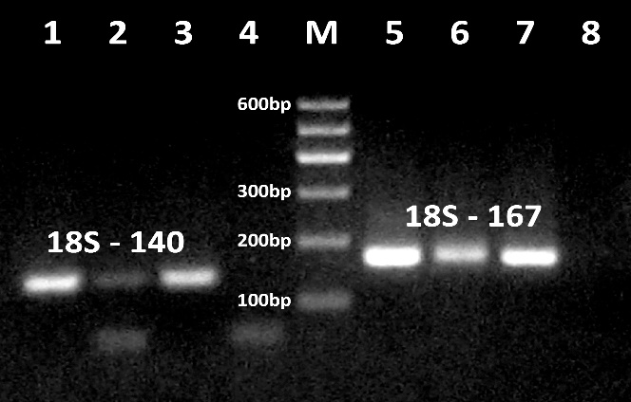
PCRs specific to 18S ribosomal RNA gene Comparison standard and modified CTAB methods
Amplicon 18S-302
Samples:
1. Sunflower seeds, standard CTAB method
2.cold-pressed sunflower oil, standard CTAB method
3. cold-pressed sunflower oil, modified CTAB method
4. Water -negative control
Amplicons 18S-140 (1-5) and 18S – 167(6-10)
Samples:
1, 6. Sunflower seeds, standard CTAB method
2, 7.cold-pressed sunflower oil, standard CTAB method
3-4, 8-9. cold-pressed sunflower oil, modified CTAB method
5.10. Water negative control
Amplicons 18S-140 (1-4) and 18S – 167 (5-8)
Samples:
1, 5. maize seeds, standard CTAB method
2, 6. refined maize oil, modified CTAB method
3, 7. cold-pressed sunflower oil, modified CTAB method
4, 8. Water negative control
Results
The modified CTAB method gave amplifiable DNA from oils, but standard CTAB method did not give genomic DNA from oils
Standard CTAB method gave amplifiable DNA from Sunflower and maize seeds
The expected amplicons were amplified in both seeds and oil samples by PCRs targeting 18S RNA gene
18S302 amplicon-specific PCR is a more efficient method than 18S167 and PCR 18S140 amplicon-specific PCRs

Slide 7
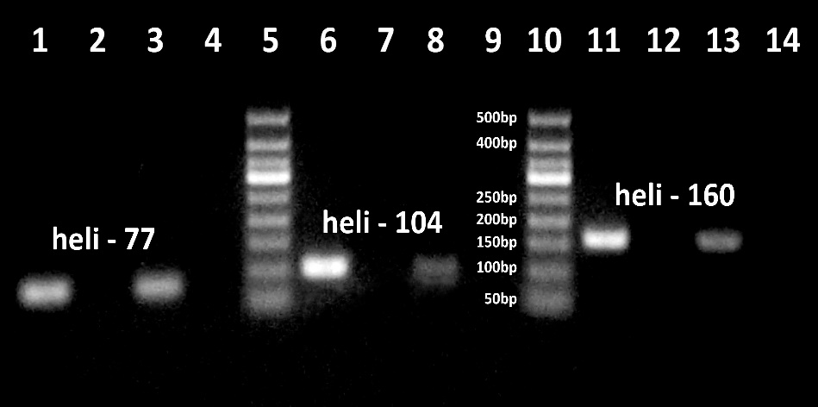
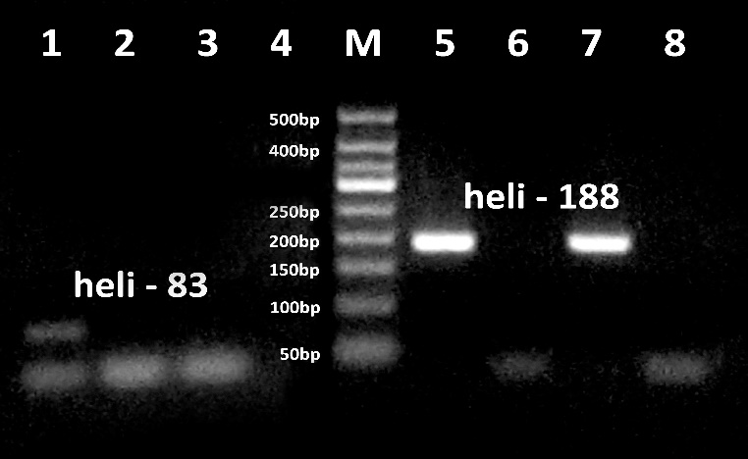
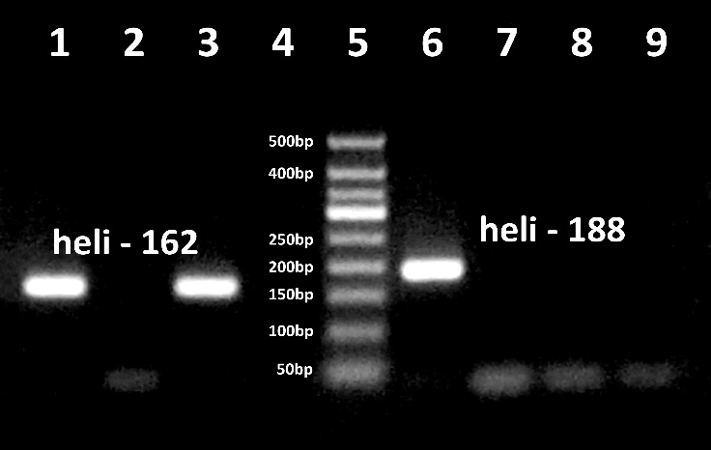
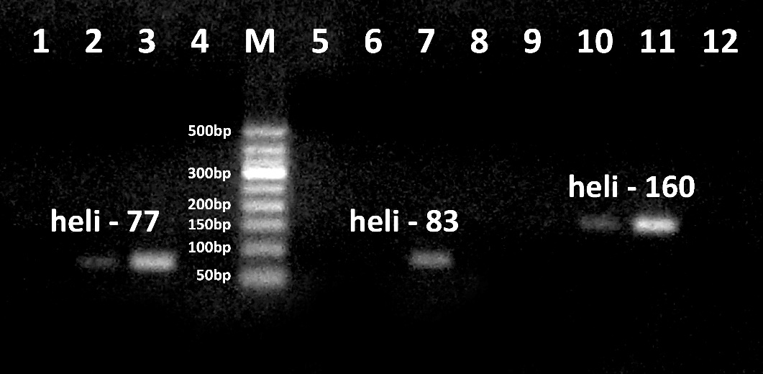
Sunflower detection in oils by PCR Comparison of standard and modified CTAB methods
PCR amplicons
heli-77 (1-4); heli-104 (6-9; heli-160 (11-14)
PCR amplicons
heli -83 (1-4); heli-188 (6-9)
PCR amplicons
heli -162 (1-4); heli-188 (6-9;
PCR amplicons
Heli-160 (1-4), heli -162 (5-8);
heli-188 (9-12); heli-104 (13-16)
PCR amplicons
Heli-77 (1-4), heli -83 (5-8);
heli-160 (9-12)
Samples
1, 6, 11. Sunflower seeds, standard CTAB method
2, 7, 12. 2.cold-pressed sunflower oil, standard CTAB method
3, 8, 13. cold-pressed sunflower oil, modified CTAB method
4. Water negative control
Samples
1, 5, 9, 13. cold-pressed sunflower oil, Olive Oil kit
2, 6, 10, 14. cold-pressed sunflower oil, NucleoSpin Food kit
3, 7, 11, 15. Sunflower seeds, plant mini kit
4, 8, 12, 16. Water negative control
Results
A modified CTAB method was found to be the best method for extracting amplifiable DNA from sunflower oil
The standard CTAB method was found to be the best method for extracting amplifiable DNA from sunflower seeds
DNA obtained by the NucleoSpin Food Mini Kit is useful for PCR detection of sunflower in oil
DNA obtained with the Olive Oil DNA Isolation Kit failed to detect sunflower by PCR in the oil

Slide 8
Conclusions
The oil type (cold-pressed, refined), DNA extraction and amplification methods are important for successful PCR analysis
Centrifugation of the oils at 18,000 g, at 4 ºC was the best method for DNA enrichment from the oils
The modified CTAB method was found to be the best DNA extraction method for PCR analysis of sunflower and maize oils
In addition, a PCR system specific for the 18S-302 amplicon of the 18S ribosomal RNA gene was identified as the best method for DNA traceability in oils

Slide 9
Acknowledgments - This work was supported by Shota Rustaveli National Science Foundation of Georgia (SRNSFG) [Grant AR-22- 636] - The co-funding organization of the project is "Biodiesel Georgia" LLC.
Thank You for Your Attention!
Ilia State University
Nelly Datukishvili
Kakha Karchkhadze
Tata Ninidze
Tamar Koberidze
I.Beritashvili Center of Experimental Biomedicine
Kakha Bitskinashvili
Tamar Kutateladze
Boris Vishnepolsky

