Slide 1


OPTIMIZING THE ENERGY EFFICIENCY IN 5G SECURITY SYSTEMS FOR INTRUSION DETECTION WITH AN EMPHASIS ON DDOS ASSAULTS
Presenter:
UMAR DANJUMA MAIWADA
The 4th International Electronic Conference on Applied Sciences

Slide 2
ABSTRACT
High data speeds, extensive coverage provided by dense base station deployment, higher capacity, improved Quality of Service (QoS), and extremely low latency are required for 5G wireless networks.
These developments further increase the need to secure the security of 5G systems and their functionality as well as Energy Efficiency problems.
We recommend an Intrusion Detection system (IDS) which makes use of Traffic Volume methods to detect the existence of DDoS Attack in a network.

Slide 3
BACKGROUND AND PROBLEM STATEMENT
BACKGROUND
The exponential expansion of customers who rely on internet and network with paradigm shift in mobile networks necessitates modifications to the security architecture due to new security issues that do not exist in existing or previous mobile networks.
The amount of data sent via different wireless technologies, including numerous mobile phones and Internet of Things (IoT) devices, is rapidly increasing, and is impacted by a variety of variables.
Previous studies on 5G cellular system have been motivated by the exponential growth of consumers who depend on mobile devices such as wireless broadband services, mobile phones, and other smart devices.
PROBLEM STATEMENT
Common threats include Distributed Denial of Service (DDoS) attacks while a common weakness is insecure wireless networking.
The evaluation of Energy Efficient component vulnerabilities is a challenging task due to the sheer number of devices and their varied configurations.

Slide 4
LITERATURES
T. E. Ali et al, analyses the DoS (DDoS) attack mitigation principles and provides a complete study of existing prevention techniques.
M. A. Surekha et al, the infrastructure layer's devices are controlled by software from the control layer, which sits in the middle of both the application and service layers
M. U. A. Siddiqui et al, the method to achieving optimal Energy Efficiency (EE) in 5G and beyond networks is the main emphasis of their research. This approach is based on a new design concept that offers higher system-wide capacity at a low energy cost.

Slide 5
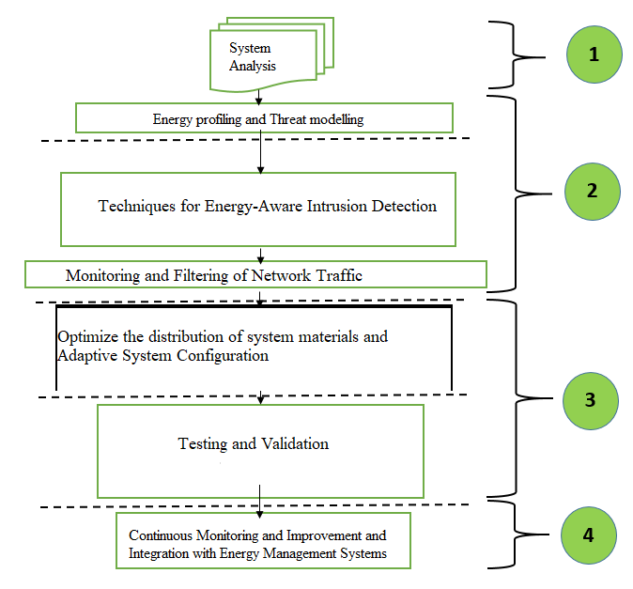
METHODOLOGY

Slide 6
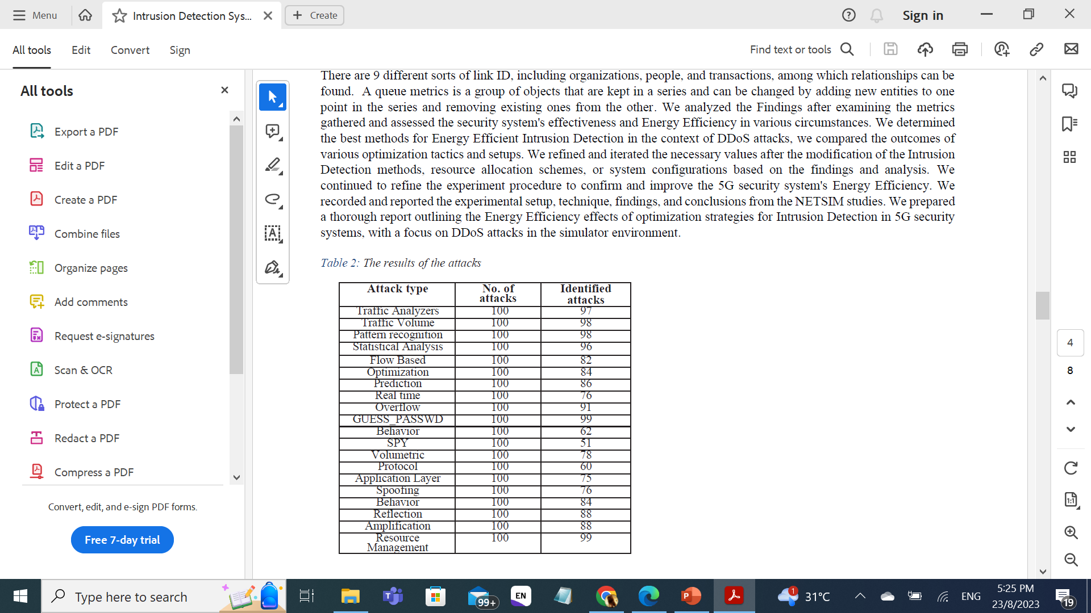
EXPERIMENT
Link metrics serves as a data-analysis method used in network theory to assess connections (Tap link) among nodes. There are 9 different sorts of link ID, including organizations, people, and transactions, among which relationships can be found.
A queue metrics is a group of objects that are kept in a series and can be changed by adding new entities to one point in the series and removing existing ones from the other.
We analyzed the Findings after examining the metrics gathered and assessed the security system's effectiveness and Energy Efficiency in various circumstances.

Slide 7
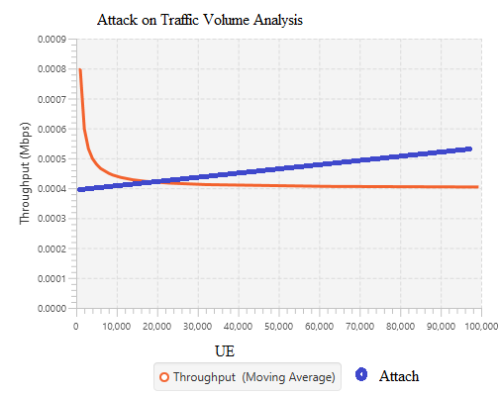
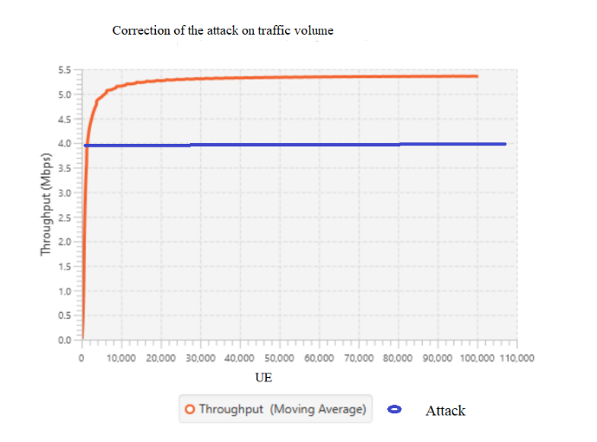
RESULTS

Slide 8
DISCUSION
DISCUSSION
In a 5G network, several factors affect the UE's throughput. These variables include the UE's own capabilities, signal strength, distance from the base station, network congestion, available bandwidth, network load, and signal intensity. The user's experience when gaining access to services and apps is directly impacted by the UE's throughput.
To maximize throughput, the network adapts to changing circumstances and modifies the modulation, coding, and resource allocation. As a result, the network's overall performance is improved and the radio resources that are available can be used more effectively.
It's crucial to remember that the actual throughput that a UE experiences can change depending on a variety of elements and the kinds of services being requested. For analyzing and improving network performance for improved user experiences, throughput measurements are often gathered by network testing, field trials, or simulation tools.

Slide 9
CONCLUSION
Because it is crucial to have security measures in place to defend the system against 5G network threats and good mobility state detection is also required. The provided detection system for intrusions will assist in defending against the relevant threats.
The provided IDS provides a high level of protection with 89% accuracy compared to other methods, yet it still has performance issues. For the 5G network to provide secure services, significant work must be done.
Higher throughput is advantageous for applications with high data demands, including video streaming or huge file downloads. Slower data transfer rates may cause buffering or latency problems because of reduced throughput.

Slide 10
REFERENCES
A. Aminu Ghali, R. Ahmad, and H. S. A. Alhussian, "Comparative analysis of DoS and DDoS attacks in Internet of Things environment," in Artificial Intelligence and Bioinspired Computational Methods: Proceedings of the 9th Computer Science On-line Conference 2020, Vol. 2 9, 2020: Springer, pp. 183-194.
I. P. Chochliouros et al., "Energy efficiency concerns and trends in future 5G network infrastructures," Energies, vol. 14, no. 17, p. 5392, 2021
T. E. Ali, Y.-W. Chong, and S. Manickam, "Machine Learning Techniques to Detect a DDoS Attack in SDN: A Systematic Review," Applied Sciences, vol. 13, no. 5, p. 3183, 2023.
M. A. Surekha, K. Induvadana, R. C. Krishna, B. Harini, B. Neeha, and R. Aakash, "DETECTION OF DISTRIBUTED DENIAL OF SERVICE ATTACKS IN SDN USING MACHINE LEARNING TECHNIQUES."
M. U. A. Siddiqui, F. Qamar, M. Tayyab, M. N. Hindia, Q. N. Nguyen, and R. Hassan, "Mobility Management Issues and Solutions in 5G-and-Beyond Networks: A Comprehensive Review," Electronics, vol. 11, no. 9, p. 1366, 2022

Slide 11
THANK YOU
QUESTIONS

