Slide 1
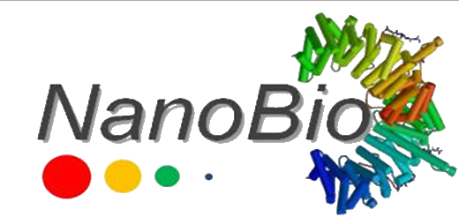
Bimodal nanoprobes containing AgInSe₂ hydrophilic quantum dots and paramagnetic chelates for diagnostic magnetic resonance imaging
Rebeca Muniz de Melo^{1,}*, Gabriela M. Albuquerque¹, Goreti Pereira^{1,2}, Giovannia A. L. Pereira¹
¹Department of Fundamental Chemistry, Federal University of Pernambuco, Recife, Brazil
²Department of Chemistry & CESAM, University of Aveiro, Portugal
*rebeca.muniz@ufpe.br

Slide 2
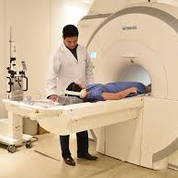
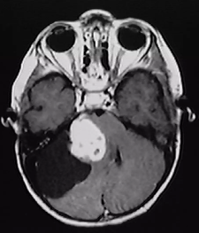
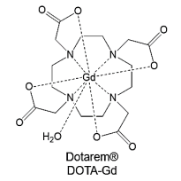
Introduction
2
Magnetic Resonance Imaging (MRI)
No contrast agent
With contrast agent

Slide 3
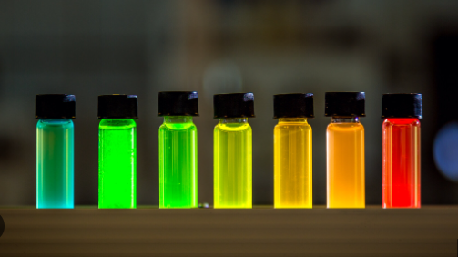
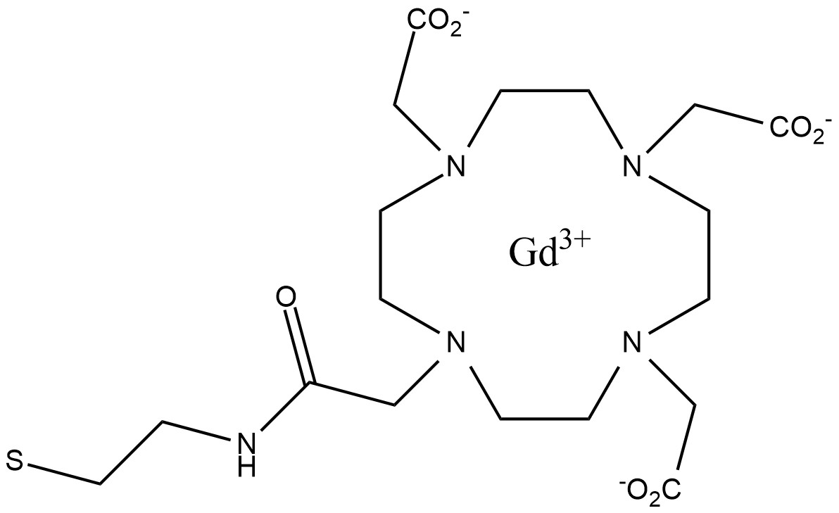
Introduction
3
Nanoparticulate Contrast Agents (CAs):
Quantum Dots - QDs
QD
CAs more efficient
With high relaxivities;
Increased technique sensitivity.
Bimodal Nanoprobes

Slide 4
Objectives
4
Prepare cadmium-free QDs (AgInSe₂) and conjugate them with Gd³⁺ complexes, for the preparation of bimodal probes that combine paramagnetic and optical properties for diagnostic imaging.

Slide 5
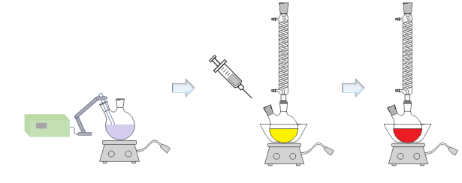
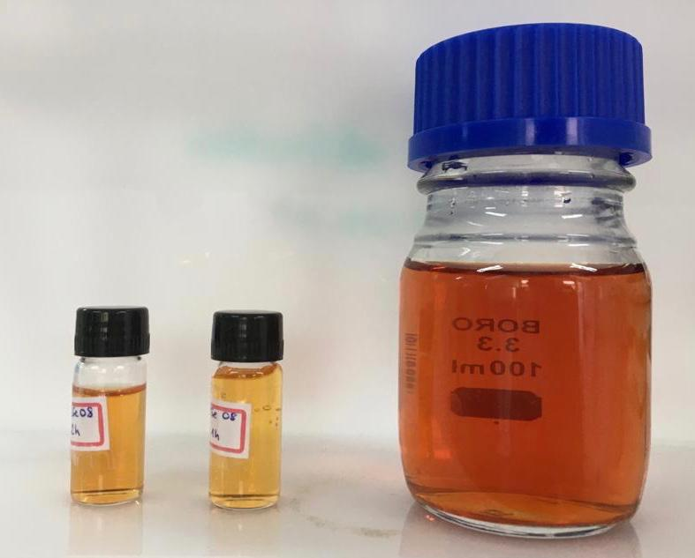
Methodology
5
The QDs were characterized by UV-Vis absorption (Evolution 600 spectrophotometer, Thermo Scientific) and emission (LS 55 spectrometer, PerkinElmer) spectroscopy.
Preparation of AgInSe₂ QDs (AISe)
AgNO₃ + In(NO₃)₃ + MSA
NaBH₄
e
Na₂SeO₃
Miscellaneous parameters:
Temperature;
Molar ratio of Ag:In;
Quantity of MSA;
Quantity of Se;
Reaction time.
15 syntheses

Slide 6
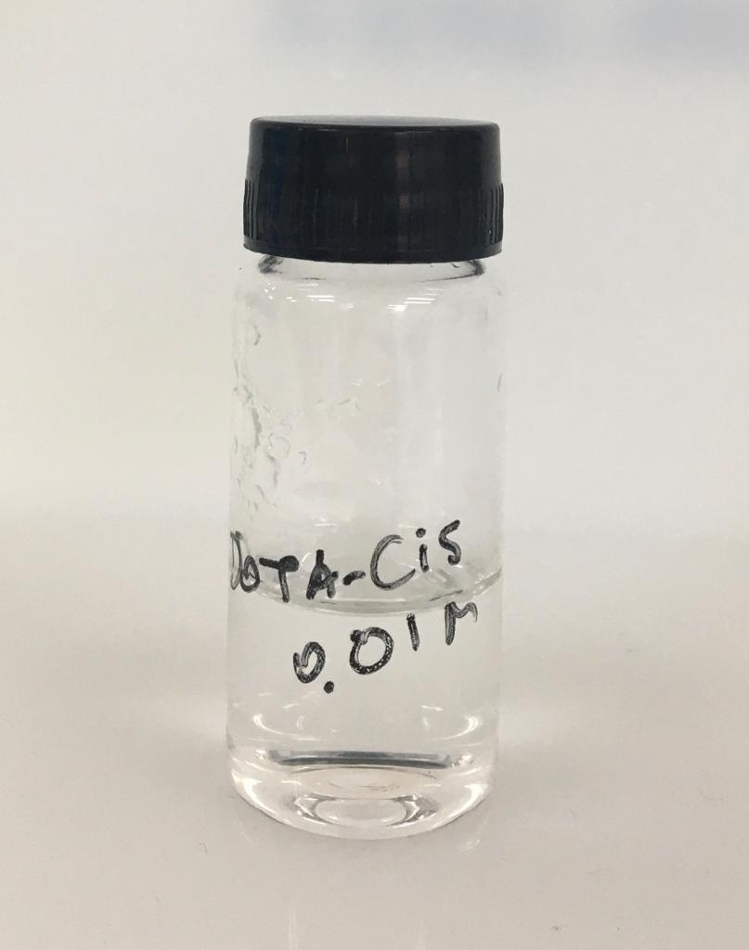
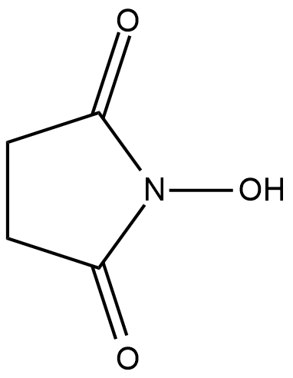
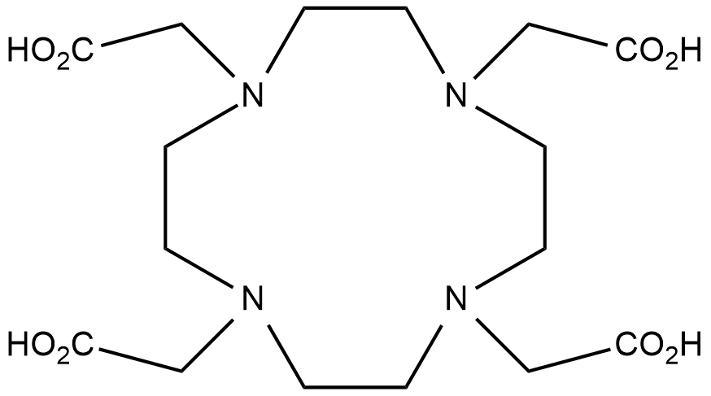
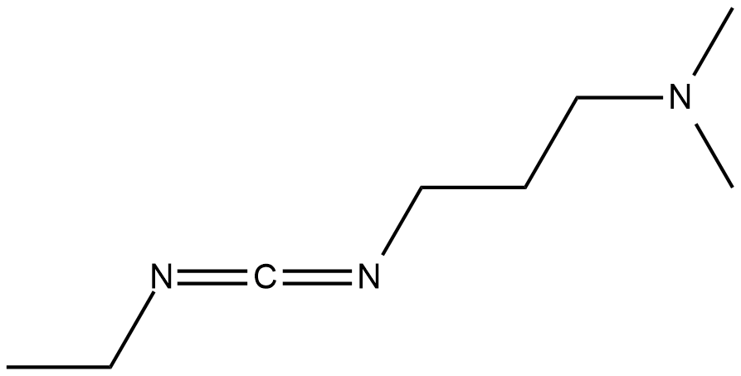
Methodology
6
The complex was characterized by relaxometry (Minispec Bruker 20 MHz) and the xylenol orange test using a UV-Vis absorption spectrophotometer.
Preparation of the complex Gd³⁺ : DOTA-Gd-CYA
EDC
NHS
cysteamine (CYA)
DOTA
Gd³⁺
(GdCl₃)
DOTA-CYA

Slide 7
Methodology
7
The bimodal systems were characterized by UV-Vis absorption and emission spectroscopy and by relaxometry.
Preparation of the Bimodal System (AISe-DOTA)
AgInSe₂
AgInSe₂
Quantum Dot
DOTA-CYA
Bimodal System
(AISe-DOTA)

Slide 8
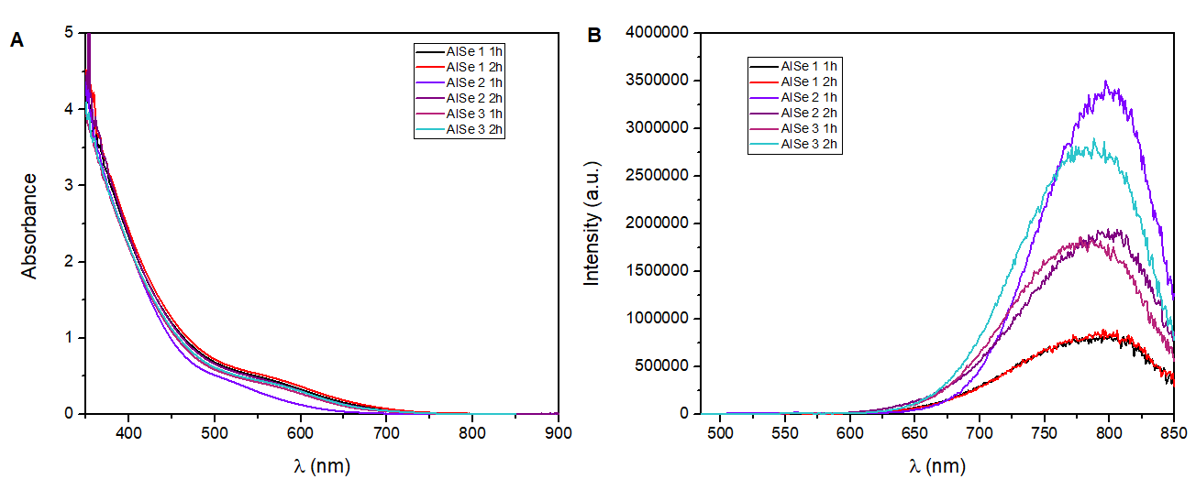
Results
8
Preparation of AgInSe₂ QDs (AISe)
Absorption spectra of AISe QDs syntheses.
Emission spectra of AISe QDs syntheses.

Slide 9
Results
9
Preparation of the complex Gd³⁺ : DOTA-Gd-CYA
Complexation yield of the Gd³⁺ complexes prepared with the DOTA linker, without and with the linker, and relaxivity of the prepared complexes (20 MHz and 37 ºC).
Sample | Complexation yield (%) | r₁ (mM⁻¹s⁻¹)
DOTA-Gd | 98,8 | 3,83
DOTA-Gd-CYA | 98,7 | 3,75
CAs used clinically (DOTA-Gd = 3.4 mM⁻¹s⁻¹, at 20 MHz and 37 ºC, in water).

Slide 10
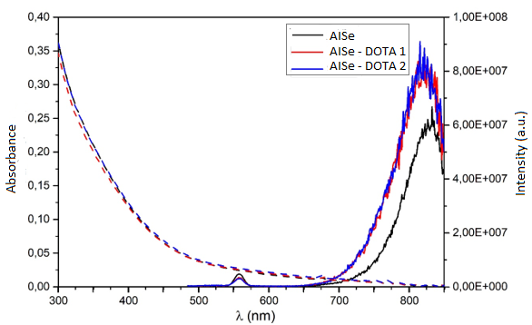
Results
10
(DOTA-Gd = 3,4 mM⁻¹s⁻¹, à 20 MHz and 37 ºC, in water)
Preparation of the Bimodal System (AISe-DOTA)
Found values of longitudinal relaxivity r₁ of bimodal systems (20 MHz em 25 °C and 37 ºC).
Sample | V ($μ$m) | r₁ (mM⁻¹s⁻¹) 25 °C | r₁ (mM⁻¹s⁻¹) 37 °C
AISe-DOTA 1 | 50 | 5,20 | 5,23
AISe-DOTA 2 | 100 | 6,78 | 6,30
*per Gd³⁺, considering the total DOTA-Gd added.
Absorption and emission spectra of the bimodal system QD+DOTA-CYA (AISe-DOTA) and QD.

Slide 11
Conclusion
11
The heating methodology used to prepare the complexes proved to be effective;
With a promising and easy-to-execute conjugation route;
The prepared bimodal systems have the potential to be used as contrast agents for optical and magnetic resonance imaging.

Slide 12
Acknowledgment
12

Slide 13
13
Thank you!!

