Slide 1
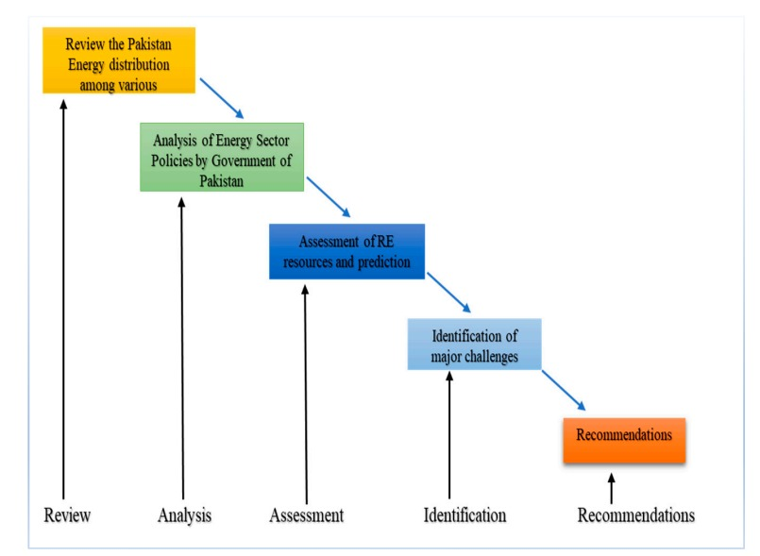
Potential of untapped renewable energy resources in Pakistan: current status and future prospects
Yasir Abbas ; Rana Ammar Aslam
Department of Structures and Environmental Engineering, University of Agriculture Faisalabad
Introduction
Methods
Reference
Energy is mean ability to work. Energy is a very important indicator for the sustainable development o and economic growth of any country. Energy is very important role for eradicate poverty, improve human welfare and raise living standards.
Many regions of the world have no proper energy supplies, which limits economic progress, but other areas of environmental degradation from energy used inhibits sustainable progress.
Now the world has shifted towards renewable energy sources such as biomass, wind energy, solar energy, ocean energy, hydropower, and geothermal energy.
Pakistan is using wind, solar, biomass and hydropower for renewable energy.
This study has presented by determinate qualitative data from many of sources, including government annual performance reports, review papers, research works, journals, books, publications, and newspapers.
Vera, I., & Langlois, L. (2007). Energy indicators for sustainable development. Energy, 32(6), 875-882.
Xin, Y., Bin Dost, M. K., Akram, H., & Watto, W. A. (2022). Analyzing Pakistan’s Renewable Energy Potential: A Review of the Country’s Energy Policy, Its Challenges, and Recommendations. Sustainability, 14(23), 16123.
Renewable Energy.2022.Avaliable: https://www.trade.gov/country-commercial-guides/pakistan-renewable-energy
[Accessed: July 10,2023]
Expanding Renewable Energy in Pakistan’s Electricity Mix.2020. Available: https://www.worldbank.org/en/news/feature/2020/11/09/a-renewable-energy-future-for-pakistans-power-system
[Accessed: July 11,2023]
Sibtain, M., Li, X., Bashir, H., & Azam, M. I. (2021). Hydropower exploitation for Pakistan's sustainable development: A SWOT analysis considering current situation, challenges, and prospects. Energy Strategy Reviews, 38, 100728.
Can Pakistan capitalise on solar as it becomes popular. Hayat A,.2023. https://tribune.com.pk/story/2420254/can-pakistan-capitalise-on-solar-as-it-becomes-popular
[Accessed: July 13,2023]
Aized, T., Sohail Rehman, S. M., Kamran, S., Kazim, A. H., & Ubaid ur Rehman, S. (2019). Design and analysis of wind pump for wind conditions in Pakistan. Advances in Mechanical Engineering, 11(9), 1687814019880405.
Purpose
The main purpose of the study to determine the potential of untapped renewable energy resources in Pakistan: current status and future prospects.
The purpose of the study is to examine the opportunities that are provided by renewable energy resources and the role of government performed in the process of policy development.
Results
Pakistan fulfills 5.4% of its energy demand from renewable energy sources including biomass, wind, and sun and 25% from hydropower. By 2030, Pakistan plans to fulfill 30% of its energy demand from renewable sources. The untapped potential of energy from renewable sources in Pakistan is nearly 60,000 MW from hydropower, 40,000 MW from Sun, 346,000 MW from wind.
Conclusions
The base on study large amount of untapped renewable resources in Pakistan for current and future prospects.
Contact
yasirabbasuaf@gmail.com
ammar.aslam@uaf.edu.pk

