Slide 1
The Structural and Electrical Characterization of Europium Sulfide Thin Films Prepared with E-beam Evaporation
Lutfi Bilal Tasyurek, Frowin Dörr, Mustafa Erkovan,
Yasser A. Shokr, Necmettin Kilinc, Paul Fumagalli
Notes:
1

Slide 2
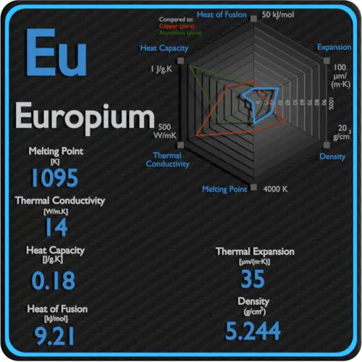
Motivation
EuS has both magnetic and electrical properties. It possesses an exceptionally high magnetic moment due to localized 4f orbitals and has a bandgap energy that can be tuned through quantum effects. Its electrical properties are diverse, transitioning from insulating to metallic behavior under different conditions and temperatures. It can serve as an insulator with surface state-carrying capabilities and becomes metallic under high pressure.
In summary, Europium sulfide is a versatile material with promising applications in spintronics due to its unique magnetic and electrical properties, though challenges related to its Curie temperature and electrical behavior require further investigation.

Slide 3
Research Overview
Systematic examination of film thickness (15, 25, and 50 nm) impact on EuS thin films.
Goal: Understand film thickness and temperature effects on EuS electrical behaviour.
Findings: Temperature-dependent behaviours in current-voltage (I-V) measurements.
Objective: Enhance Schottky behaviour with increasing film thickness.
Exploration: AC electrical and dielectric properties across 4 Hz – 8 MHz frequency range.
Potential: Advancement in electronic device efficiency and functionality.

Slide 4
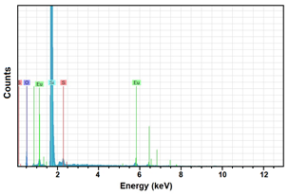
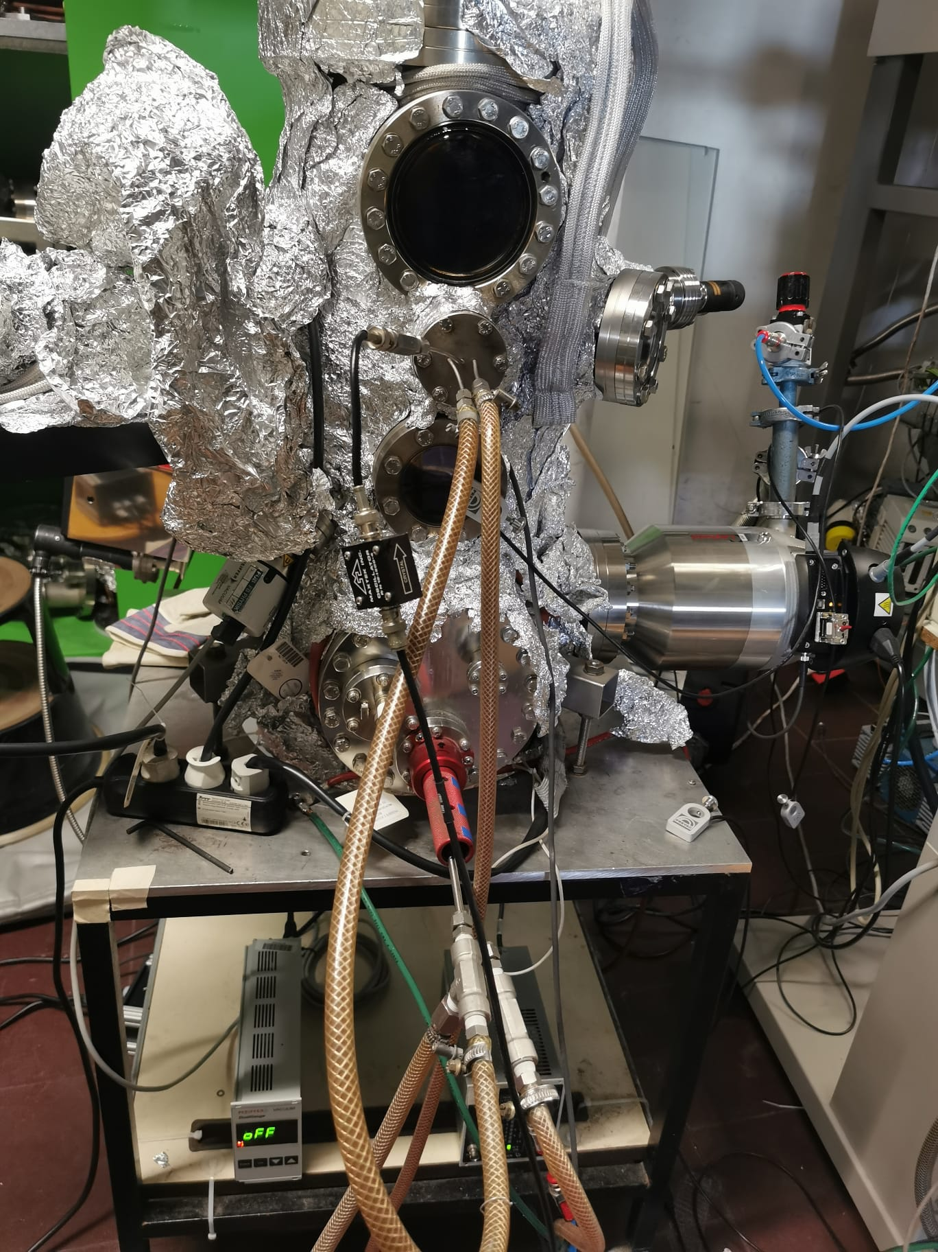
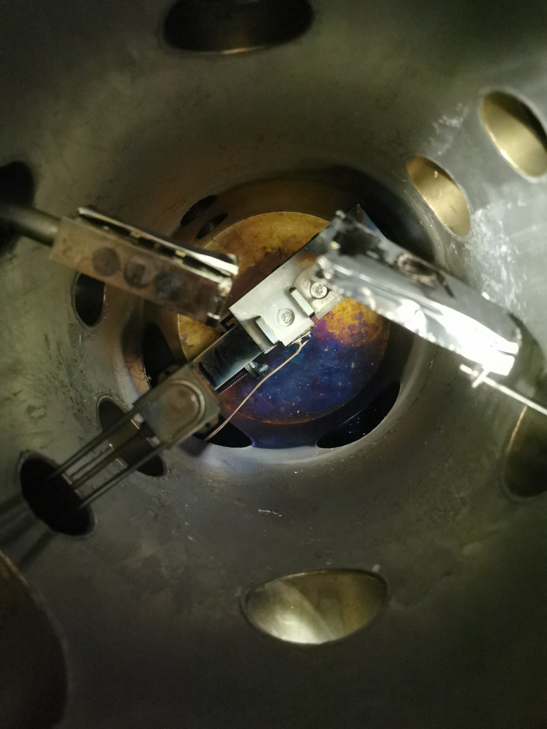
Preparation Sample &Structural Analysis
The samples using e-beam evaporation of high-purity (99.99%) EuS powder.
The evaporation process was carried out in an ultra-high-vacuum chamber with a base pressure of 2 × 10⁻⁹ mbar.
The substrates employed for deposition were commercially available 1 cm x 1 cm Si/SiO₂ wafers.

Slide 5
Results and Discussion
Temperature dependent I-V plots of EuS thin films of various thicknesses
$$I=I_{0}\left[\exp\left(\frac{qV}{nkT}\right)−1\right]$$
The I-V characteristics of all the EuS thin films across the measured temperature range consistently support the notion of Schottky junction formation.

Slide 6
Results and Discussion
The variation of the logarithmic value of the electrical current versus 1000/T showed linear behavior.
Variation of lnI against 1000/T

Slide 7
Results and Discussion
Temperature dependent capacitance-logarithmic frequency graph
The behavior for all thicknesses is the same. Initially, the capacitance increases with increasing temperature from 4 Hz up to 10⁶ Hz, then capacity reduces as temperature increases as frequency exceeds 10⁶.

Slide 8
Results and Discussion
Temperature dependent conductance-logarithmic frequency graph
G-f graps showed similar behaviour to Cp-f graphs at high frequencies.

Slide 9
Results and Discussion
Temperature dependent impedance-logarithmic frequency graph

Slide 10
Conclusions
The I-V characteristics of the EuS thin films with varying thicknesses demonstrated temperature-dependent behavior, revealing a decrease in current in the reverse bias region and an increase in the forward bias region as the film thickness increases.
This behavior suggests the formation of Schottky junctions between Ag and EuS.
The capacitance-frequency (Cp-f), the conductance-frequency (G-f), and impedance-frequency (Z-f) measurements displayed temperature-dependent trends,
(Cp-f) and (G-f) measurements changed their temperature dependent behavior at high frequencies.
These observations suggest that the electrical properties of the thin films are influenced by the movements of charges within traps, particularly at low frequencies, and signal periods at high frequencies may not capture the full behavior of these traps.

