Slide 1
A High Efficient Cross Connected H-bridge Style Multilevel Inverter with Lower Power Components
The 4th International Electronic Conference on Applied Sciences
AUTHORS:
Dr. L VIJAYARAJA , DEEE , SRI SAIRAM INSTITUTE OF TECHNOLOGY
Dr. R DHANASEKAR, DEEE , SRI SAIRAM INSTITUTE OF TECHNOLOGY
Mr. S KESAV SANADHAN, DEEE , SRI SAIRAM INSTITUTE OF TECHNOLOGY
Mrs. RUPA KESAVAN, DCSE, SRI VENKATESHWARA COLLEGE OF ENGINEERING

Slide 2
OBJECTIVE
The main purpose of a multilevel
inverter is to provide sinusoidal
waveforms with low-level harmonic
content
To improve the efficiency
of the inverter
To reduce distortion in a
grid
1
2
3

Slide 3
ABSTRACT
03
The proposed inverter is constructed in real-time, and the performance of the inverter is studied by testing with fixed and variable reactive loads.
Compare to the classical inverters, the multilevel inverter finds remarkable advantages, which can be suitably implemented in green energy power generation.
01
02
An asymmetric multilevel inverter with fewer components is proposed for renewable energy applications. The proposed inverter is a cross between two H bridge-style devices

Slide 4
PROPOSED SOLUTION
The inverter produces higher efficieny and low THD .
5
The inverter is connected to the grid.
4
The proposed inverter uses Nearest Level Modulation Technique as controller
3
It produces the 19 levels of output voltage and simulated using matlab software.
2
The proposed Multilevel Inverter converts the DC source to AC source.
1

Slide 5
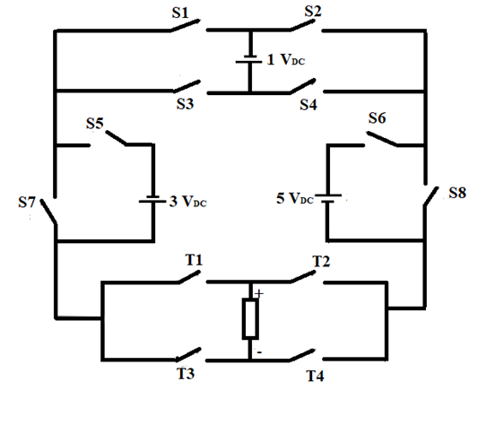
CIRCUIT DIAGRAM
The proposed asymmetric multilevel inverter structure is shown in the figure 1. The inverter consists of three asymmetric sources and 12 power electronic switches. The proposed inverter produces 19 levels of output voltage and the inverter is controlled by the Nearest Level Modulation (NLM) technique. The unequal DC magnitude i.e, V1 = V_{DC}, V2 = 3V_{DC}, V3 = 5V_{DC}, the configured inverter produces 9 +ve voltage levels , 9 –ve voltage levels and with zero voltage level.

Slide 6
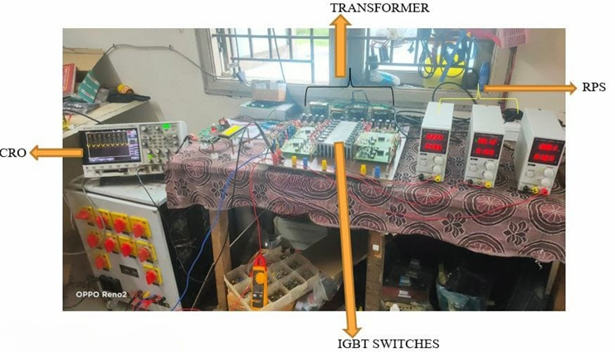
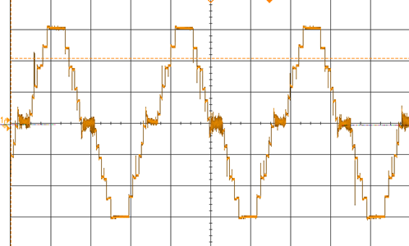
HARWARE MODEL
FIG 2 VOLTAGE WAVEFORM
FIG 1 HARDWARE MODEL
The prototype of proposed inverter. The inverter receives pulses from the edge control mechanism. The program is flased to the controller using FGPA controller. The IGBT devices are used as switches. The four stepdown transformers are used to stepdown the grid voltage and fed to the driver circuits. The driver circuits are used to drive the 12 IGBT switches. The protoype is validated with variable and fixed resistive, impedance loads.

Slide 7
THANK YOU

