Slide 1


Synthesis, Spectral Characteristics, and Molecular Docking Studies
of 2-(2,4-Dichlorophenoxy)-N-(2,2,2-Trichloro-1-(3-Arylthioureido)Ethyl)Acetamide
Elizaveta R. Lominoga, Pavlo V. Zadorozhnii *, Valeria V. Kobets, Vadym V. Kiselev, Aleksandr V. Kharchenko
Department of Pharmacy and Technology of Organic Substances, Ukrainian State University of Chemical Technology, Gagarin Ave 8, 49005 Dnipro, Ukraine
1

Slide 2
Introduction:
Figure 1. Structure of the obtained potential COX-2 inhibitors simultaneously containing
2,4-dichlorophenoxy, alkylamide, and thiourea pharmacophore groups.
2

Slide 3
Results and Discussion:
Scheme 1. Synthesis of 2-(2,4 dichlorophenoxy)-N-(2,2,2-trichloro-1-(3- arylthioureido)ethyl)acetamides (7a-h).
Reagents and conditions:
heating, solvent-free;
SOCl₂ , CCl₄ , reflux 1.5 h;
KSCN, MeCN, r.t., 24 h;
MeCN, reflux 1 min then left at r.t. 24 h.
3

Slide 4
Figure 2. ¹H NMR (400 MHz, DMSO-d₆) and ¹³C NMR (100 MHz, DMSO-d₆) spectra
of 2-(2,4-dichlorophenoxy)-N-(2,2,2-trichloro-1-(3-(naphthalen-1-yl)thioureido)ethyl)acetamide (7h).
4

Slide 5
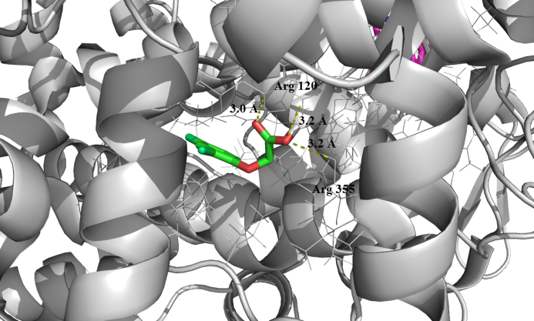
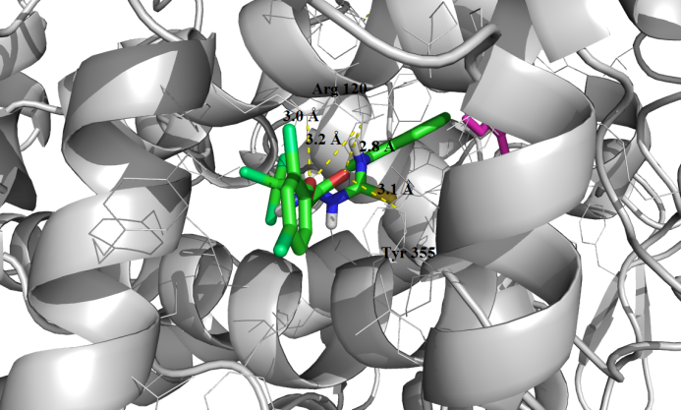
Molecular Docking Studies:
(a)
(b)
Figure 3. Molecule position of 2,4-dichlorophenoxyacetic acid (a) and 2-(2,4-dichlorophenoxy)-N- (2,2,2-trichloro-1-(3-(naphthalen-1-yl)thioureido) ethyl)acetamide (7h) (b) in the active site of COX-2 according to the results of molecular docking.
5

Slide 6
Conclusion:
In this study, we have obtained a series of 2-(2,4-dichlorophenoxy)-N-(2,2,2-trichloro-1-(3-arylthioureido)ethyl)acetamides simultaneously containing 2,4-dichlorophenoxy, alkylamide and thiourea harmacophore groups.
The structures of the obtained compounds have been tested for the ability to inhibit the COX-2 enzyme using molecular docking. It has been shown that the test compounds are significantly superior to 2,4- dichlorophenoxyacetic acid in terms of the strength of the complex formed with this enzyme.
6

Slide 7
Thank you for attention!)
7

