Slide 1
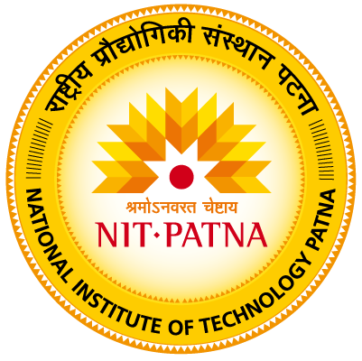
Diverse Applications of Remote Sensing and GIS in Implementing Integrated Solid Waste Management: A Short Review Id- sciforum-075875 Presented by: Sakshi
ASEC2023: The 4th International Electronic Conference on Applied Sciences

Slide 2
Introduction
Due to the ever-growing population, rising urbanization, industrialization, and changing lifestyles, there is now more waste being produced than ever before [1].
According to recent data, there were 2.24 billion tons of solid waste produced in 2020, and by 2050, that number is expected to rise to 3.88 billion tons [2].
Solid waste is a useless solid material that is produced by human activity in household, industrial, or commercial settings. [3].
The general goal of an ISWM system is to achieve environmental benefit, economic optimization, and social acceptability.

Slide 3
Introduction (Cont.)
ISWM is a sustainable alternative to SWM in that it focuses on resource usage efficiency by integrating the creation, segregation, transfer, sorting, treatment, recovery, and disposal of waste [1].
The planning of waste collection (segregated waste), reuse and recycling, storage, and transfer, transportation (primary/secondary), processing, and disposal all depend on the use of RS, GIS, and GPS [1].
The geospatial technologies used for route optimization, the best route, choosing a dumping site, and gathering trash generation data are GIS, GPS, and RS.
GIS is used to identify sites, optimize routes, choose bin locations, and estimate garbage generation. The activities that are available with GPS include vehicle tracking, route planning, driver tracking, and collection monitoring. RS is used to aid in environmental assessment and environmental feature monitoring.

Slide 4
A Comprehensive Framework for ISWM
To effectively manage trash and protect both human and environmental health, a waste management framework known as ISWM combines waste prevention, recycling, recovery, and controlled and monitored disposal [5].
Sustainability in all of its dimensions, including environmental, social, and economic, is ISWM's primary objective. By promoting reuse and recycling of waste materials, environmental preservation, pollution reduction, and waste generation reduction are all accomplished [6].
It is also important to set targets for waste collection and adopt appropriate approaches when designing new waste management facilities in order to build a sustainable future that balances the needs of the present and safeguards resources for future generations [7].

Slide 5
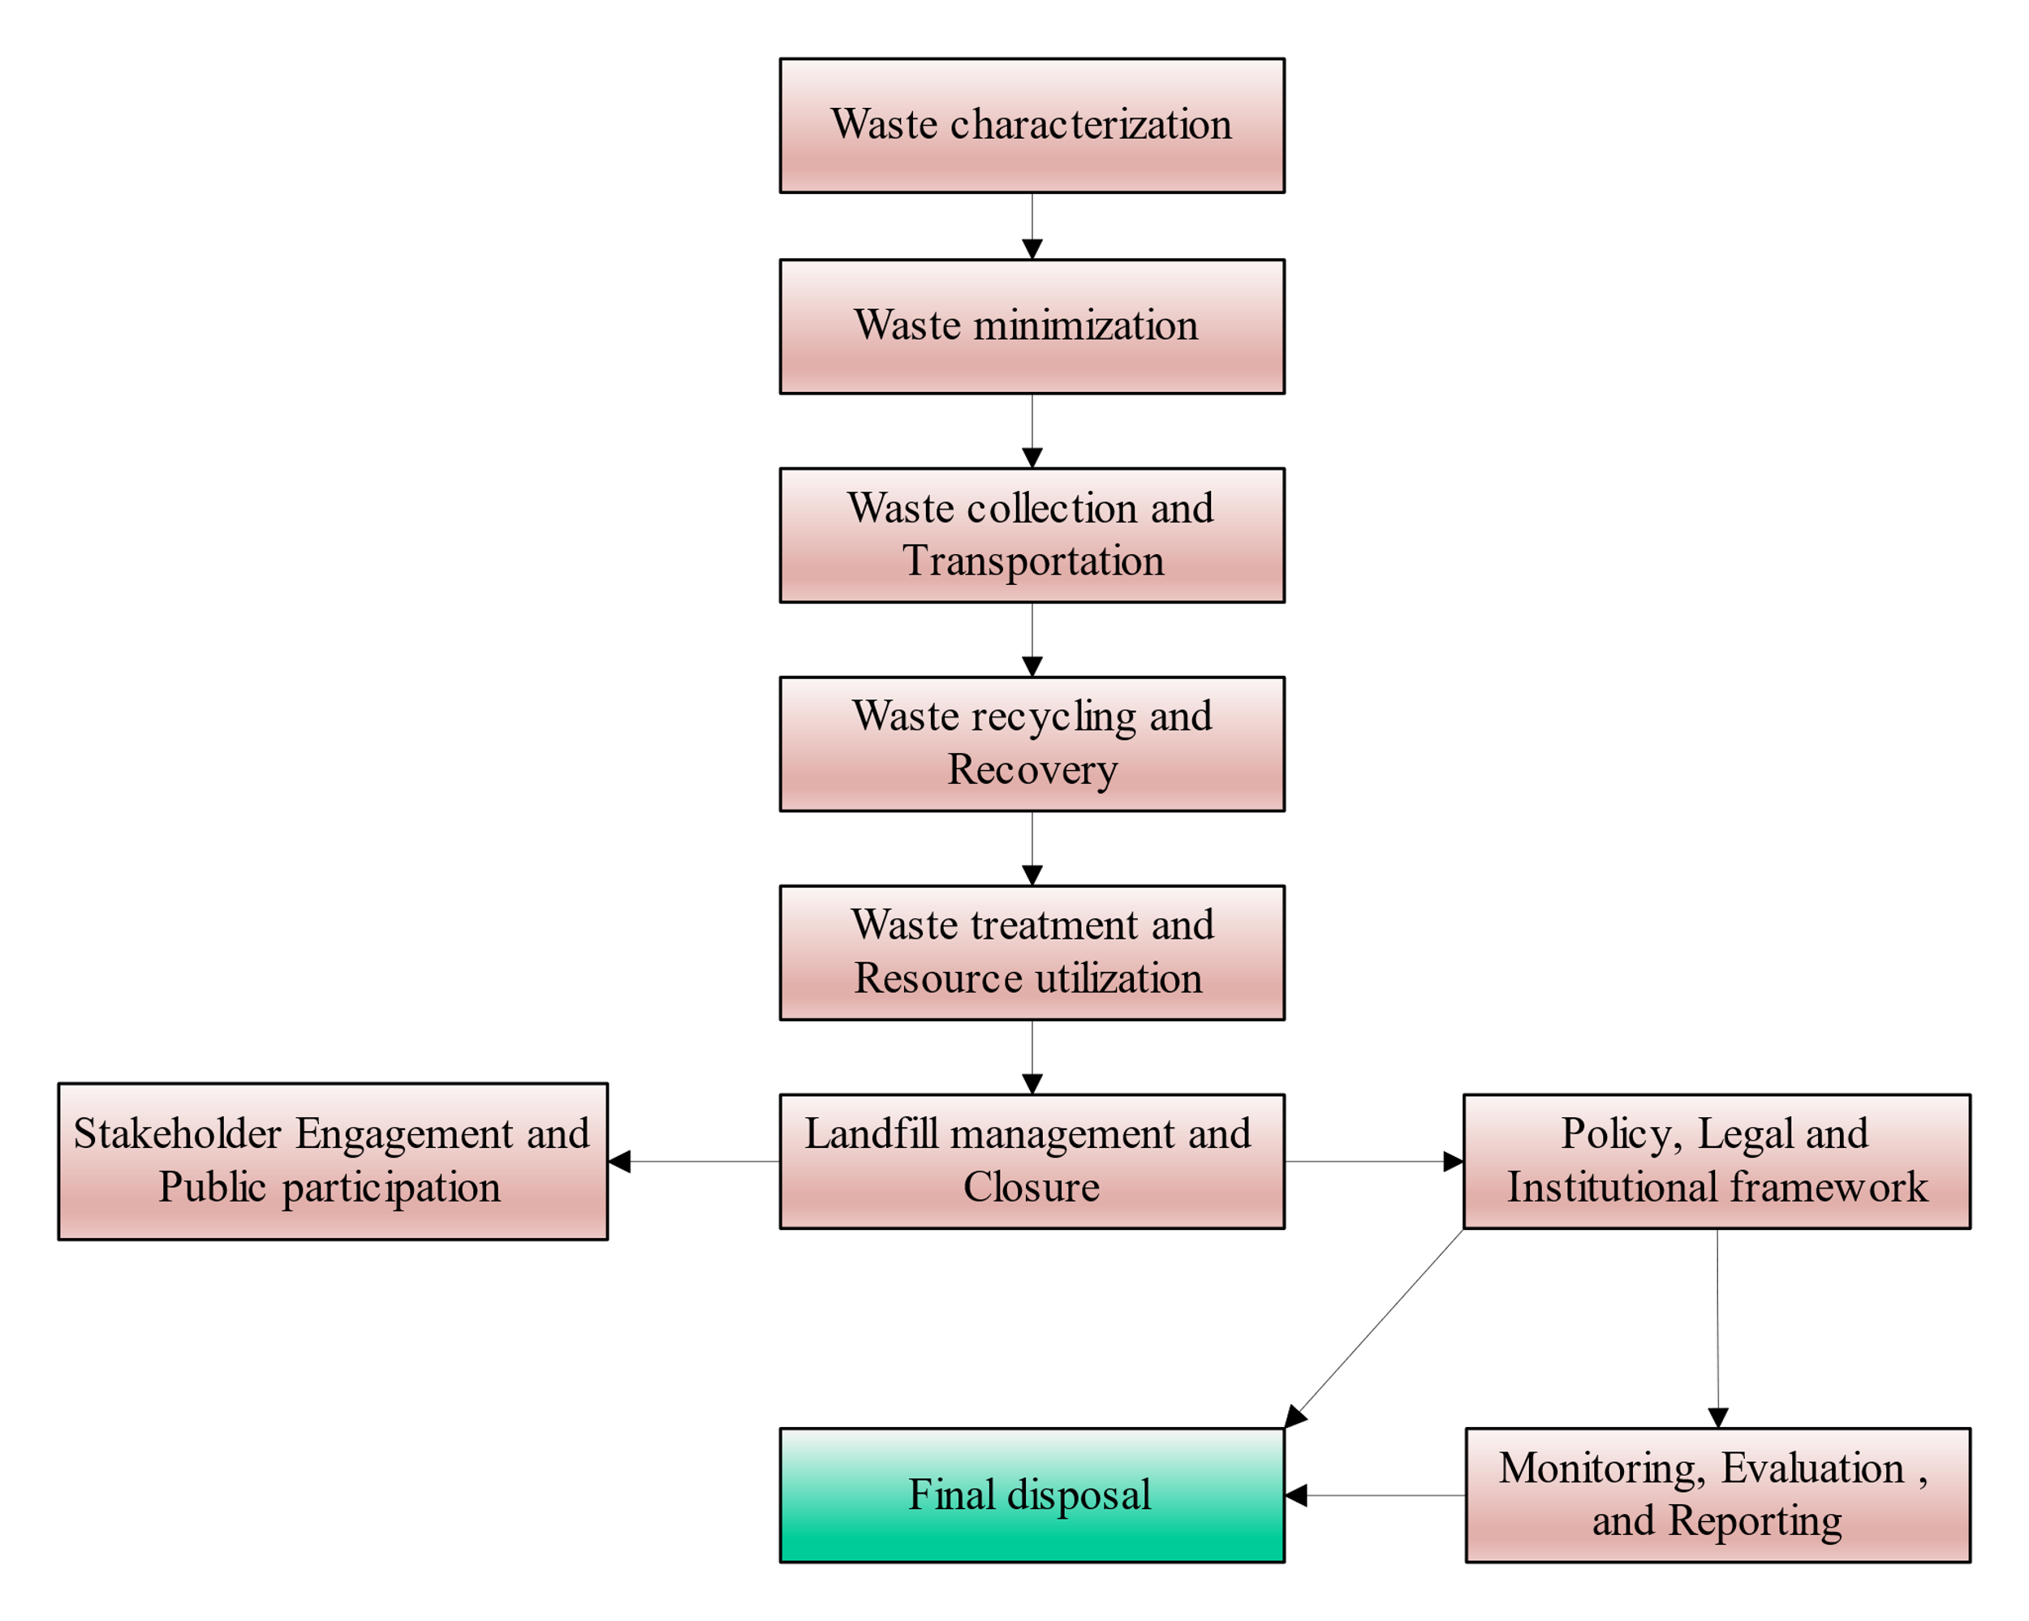
Flowchart Framework for Integrated Solid Waste Management
Figure 1. Flowchart Framework for Integrated Solid Waste Management

Slide 6
Application of RS and GIS in ISWM
RS and GIS play diverse roles in implementing ISWM. RS techniques, like satellite imagery and aerial photography, enable accurate waste generation mapping, monitoring disposal sites, and recycling facilities [8].
GIS aids in optimizing waste collection routes, selecting landfill sites, and identifying locations for waste-to-energy projects.
RS and GIS al-so provide valuable insights into waste composition analysis, landfill stability assessment, and environmental impact evaluation, enhancing overall waste management efficiency and sustainability [9].
The table 1 and 2 below highlights the applications of RS and GIS in ISWM.

Slide 7
Indian Scenario of Algal Biofuel
Table 1. Applications of RS in ISWM [8,10,11]
RS Application | Uses | Data Sources | Technological Advancements | Cost-Benefit Analysis | Advantages | Challenges | Environmental Impact | Future Potential
Waste Generation Mapping | Municipal waste planning, Resource allocation for recycling programs | Satellite imagery, aerial photography | Enhanced spatial resolution, Real-time data acquisition | Improved waste management costs | -Enhanced resource allocation - Improved hotspot identification | - Data interpretation complexities - Seasonal variations in waste generation | Reduction in waste hotspots | Integration with Internet of Things (IoT) for real-time monitoring
Waste Disposal Site Monitoring | Landfill stability assessment, Detection of illegal dumping activities | Satellite imagery, aerial photography | Advanced spectral bands, Improved image classification algorithms | Enhanced cost-efficiency in landfill management | - Early risk detection - Environmental impact assessment | - Frequent data acquisition required - Weather-dependent observations | Reduced environmental risks | Enhanced integration with unmanned aerial vehicles (UAVs)
Recycling Facility Monitoring | Recycling facility performance assessment, Resource allocation for recycling | Satellite imagery, aerial photography | Hyper-spectral sensors, Enhanced object recognition techniques | Optimized resource allocation for recycling | - Enhanced recycling efficiency - Resource utilization assessment | - Facility accessibility challenges - Data accuracy and timeliness | Increased recycling rates | Real-time monitoring through advanced sensor networks
Waste Composition Analysis | Resource recovery program optimization, Reduction of waste sent to landfills | Hyperspectral imagery, multispectral data | AI-based spectral analysis, Enhanced data fusion techniques | Reduced waste in landfills | - Informed resource recovery strategies - Reduction of landfill waste | - Spectral data processing complexity - Limited spectral resolution | Enhanced recycling rates | Automated robotic sorting systems for recycling
Environmental Impact Evaluation | Environmental impact assessments, Policy development for sustainable waste management | Remote sensing data, environmental models | Enhanced machine learning algorithms, Integration with environmental sensors | Informed investment decisions for sustainable waste management | - Environmental policy support - Data-driven decision-making | - Data interpretation subjectivity - Temporal data limitations | Enhanced environmental sustainability | Real-time environmental impact monitoring for rapid response

Slide 8
Indian Scenario of Algal Biofuel (Cont…)
Table 2. Applications of GIS in ISWM [1,8,12,13]
GIS Application | Examples of Use | Data Sources | Technological Advancements | Cost-Benefit Analysis | Advantages | Challenges | Environmental Impact | Future Potential
Waste Collection Route Optimization | Optimal waste collection route planning, Fleet management | Geographic data, traffic data | Real-time traffic data integration, Integration with mobile apps for route optimization | Lower operational costs | - Reduced operational costs - Improved route planning | - Data accuracy dependencies - Initial setup costs | Reduced vehicle emissions | Autonomous waste collection vehicles with AI-driven routing
Landfill Site Selection | Sustainable landfill site selection, Land use planning | Environmental data, socioeconomic data | Advanced environmental modelling, Stakeholder engagement platforms | Optimized land use and site selection | - Minimized environmental impact - Comprehensive site assessment | - Regulatory compliance challenges - Stakeholder engagement complexities | Reduced environmental footprint | AI-driven predictive modelling for site selection
Waste-to-Energy Project Identification | Site selection for waste-to-energy facilities, Energy resource optimization | Geographic data, energy infrastructure data | Integration with energy grid data, Enhanced energy generation modelling | Enhanced energy production and revenue | - Energy generation optimization - Landfill waste reduction | - Land use conflicts - Technological integration complexities | Reduced waste sent to landfills | Advanced waste-to-energy technologies for efficient resource recovery

Slide 9
Overall Contribution of RS and GIS in ISWM
It is not only possible to optimize operations but also to benefit the environment through the integration of RS and GIS technologies.
In addition to contributing to reduced environmental risks, improved recycling rates, and a reduction in waste sent to landfills, these technologies also improve the level of environmental sustainability.
A low operating cost and informed investment decisions enable them to facilitate cost-effective waste management.
In conclusion, the RS and GIS technologies, as shown in Tables 1 and 2, provide a comprehensive solution to the complex challenges posed by the growing number of waste generators and the limited amount of landfill space in the world.
ISWM practices are significantly enhanced by their combined contributions in terms of efficiency, sustainability, and environmental impact.
ISWM will be shaped more environmentally friendly and cost-effectively in the future as these technologies continue to evolve and integrate.

Slide 10
Overall Contribution of RS and GIS in ISWM (Cont..)
It is not only possible to optimize operations but also to benefit the environment through the integration of RS and GIS technologies.
In addition to contributing to reduced environmental risks, improved recycling rates, and a reduction in waste sent to landfills, these technologies also improve the level of environmental sustainability.
A low operating cost and informed investment decisions enable them to facilitate cost-effective waste management.
In conclusion, the RS and GIS technologies, as shown in Tables 1 and 2, provide a comprehensive solution to the complex challenges posed by the growing number of waste generators and the limited amount of landfill space in the world.
ISWM practices are significantly enhanced by their combined contributions in terms of efficiency, sustainability, and environmental impact.
ISWM will be shaped more environmentally friendly and cost-effectively in the future as these technologies continue to evolve and integrate.

Slide 11
Conclusion
GIS and RS have proven invaluable in advancing ISWM strategies. By using these technologies in a variety of ways, we have been able to overcome the challenges posed by growing waste production and limited landfill space.
The use of RS techniques, such as satellite imagery and aerial photography, has enabled accurate mapping of waste generation and disposal sites, while GIS has enabled spatial analysis for waste collection route optimization, landfill site selection, and waste-to-energy projects.
Additionally, RS and GIS have contributed to waste composition analysis, landfill stability assessment, and environmental impact evaluation.
Waste management practices have been significantly enhanced through the combination of RS and GIS technologies.
Due to the exponential growth of the world's population, these technologies offer valuable insights and recommendations for future waste management research, which makes them imperative to shaping the future of this field.

Slide 12
References
Gurjar, S.K.; Gaur, A. Application of Remote Sensing and GIS in Integrated Solid Waste Management - a Short Review; First Edit.; Elsevier Ltd., 2022; ISBN 9780323857925.
Abdallah, M.; Abu Talib, M.; Feroz, S.; Nasir, Q.; Abdalla, H.; Mahfood, B. Artificial Intelligence Applications in Solid Waste Management: A Systematic Research Review. Waste Manag. 2020, 109, 231–246, doi:10.1016/j.wasman.2020.04.057.
Akram, S.V.; Singh, R.; Gehlot, A.; Rashid, M.; Alghamdi, A.S.; Alshamrani, S.S.; Prashar, D. Role of Wireless Aided Technologies in the Solid Waste Management: A Comprehensive Review. Sustain. 2021, 13, doi:10.3390/su132313104.
Shahab, S.; Anjum, M. Solid Waste Management Scenario in India and Illegal Dump Detection Using Deep Learning: An AI Approach towards the Sustainable Waste Management. Sustain. 2022, 14, doi:10.3390/su142315896.
Suryodiningrat, S.P.; Ramadhan, A. Integrated Solid Waste Management System Using Distributed System Architecture for Indonesia: An IT Blueprint. Int. J. Adv. Sci. Eng. Inf. Technol. 2023, 13, 1177, doi:10.18517/ijaseit.13.3.17307.
Umar, U.A.; Shafiq, N.; Ahmad, F.A. A Case Study on the Effective Implementation of the Reuse and Recycling of Construction & Demolition Waste Management Practices in Malaysia. Ain Shams Eng. J. 2021, 12, 283–291, doi:10.1016/J.ASEJ.2020.07.005.
Mautla, M.Z. Evaluating the Monitoring and Review of the Integrated Waste Management Plans (IWMPs) of the Drakenstein Local Municipality. 2022.
Asefa, E.M.; Barasa, K.B.; Mengistu, D.A.; Asefa, E.M.; Barasa, K.B.; Mengistu, D.A. Application of Geographic Information System in Solid Waste Management. Geogr. Inf. Syst. Appl. Coast. Stud. 2022, doi:10.5772/INTECHOPEN.103773.
Singh, A. Remote Sensing and GIS Applications for Municipal Waste Management. J. Environ. Manage. 2019, 243, 22–29, doi:10.1016/J.JENVMAN.2019.05.017.
Singhal, A.; Goel, S. An Integrated Solid Waste Management (ISWM) Plan Using Google Earth and Linear Programming: A Case Study of Kharagpur City, West Bengal. Treat. Dispos. Solid Hazard. Wastes 2022, 159–183, doi:10.1007/978-3-030-29643-8_8/TABLES/7.
Dutta, D.; Goel, S. Applications of Remote Sensing and GIS in Solid Waste Management - A Review. Adv. Solid Hazard. Waste Manag. 2017, 133–151, doi:10.1007/978-3-319-57076-1_7/COVER.
Sankar Cheela, V.R.; Dubey, B. Review of Application of Systems Engineering Approaches in Development of Integrated Solid Waste Management for a Smart City. Water Resour. Environ. Eng. II 2019, 159–177, doi:10.1007/978-981-13-2038-5_16.
Sanjeevi, V.; Shahabudeen, P. Optimal Routing for Efficient Municipal Solid Waste Transportation by Using ArcGIS Application in Chennai, India. http://dx.doi.org/10.1177/0734242X15607430 2015, 34, 11–21, doi:10.1177/0734242X15607430.

Slide 13
THANK YOU

