Slide 1
Some microbiological characteristics of the biofilm on the surface of pre-production pellets of polypropylene microplastics after short exposure in the soil
Nataliia Tkachuk¹, Liubov Zelena²
¹T.H. Shevchenko National University “Chernihiv Colehium”,
Chernihiv, Ukraine, nataliia.smykun@gmail.com
²Kyiv National University of Technologies and Design,
Kyiv, Ukraine, zelenalyubov@gmail.com

Slide 2
Microplastics are defined as synthetic organic polymer particles with a size (or, more precisely, the largest size) <5 mm.
The problem of environmental pollution caused by microplastic accumulation in various ecosystems draws attention in the whole world and in Ukraine specifically.
Biological activity of microorganisms on polymeric materials that get into the soil, in particular, as garbage, leads to biofilm formation and initialization of material biodegradation occurs.
Soil microorganisms-biodegraders of synthetic polymers are heterotrophic bacteria and sulfate-reducing bacteria (SRB), since they are part of the plastisphere and are able to form a biofilm on the surfaces of plastics.
The aim of this study was to investigate some chemical and microbiological characteristics of the soil and the surface biofilm of both polypropylene microplastic and quartz sand.

Slide 3
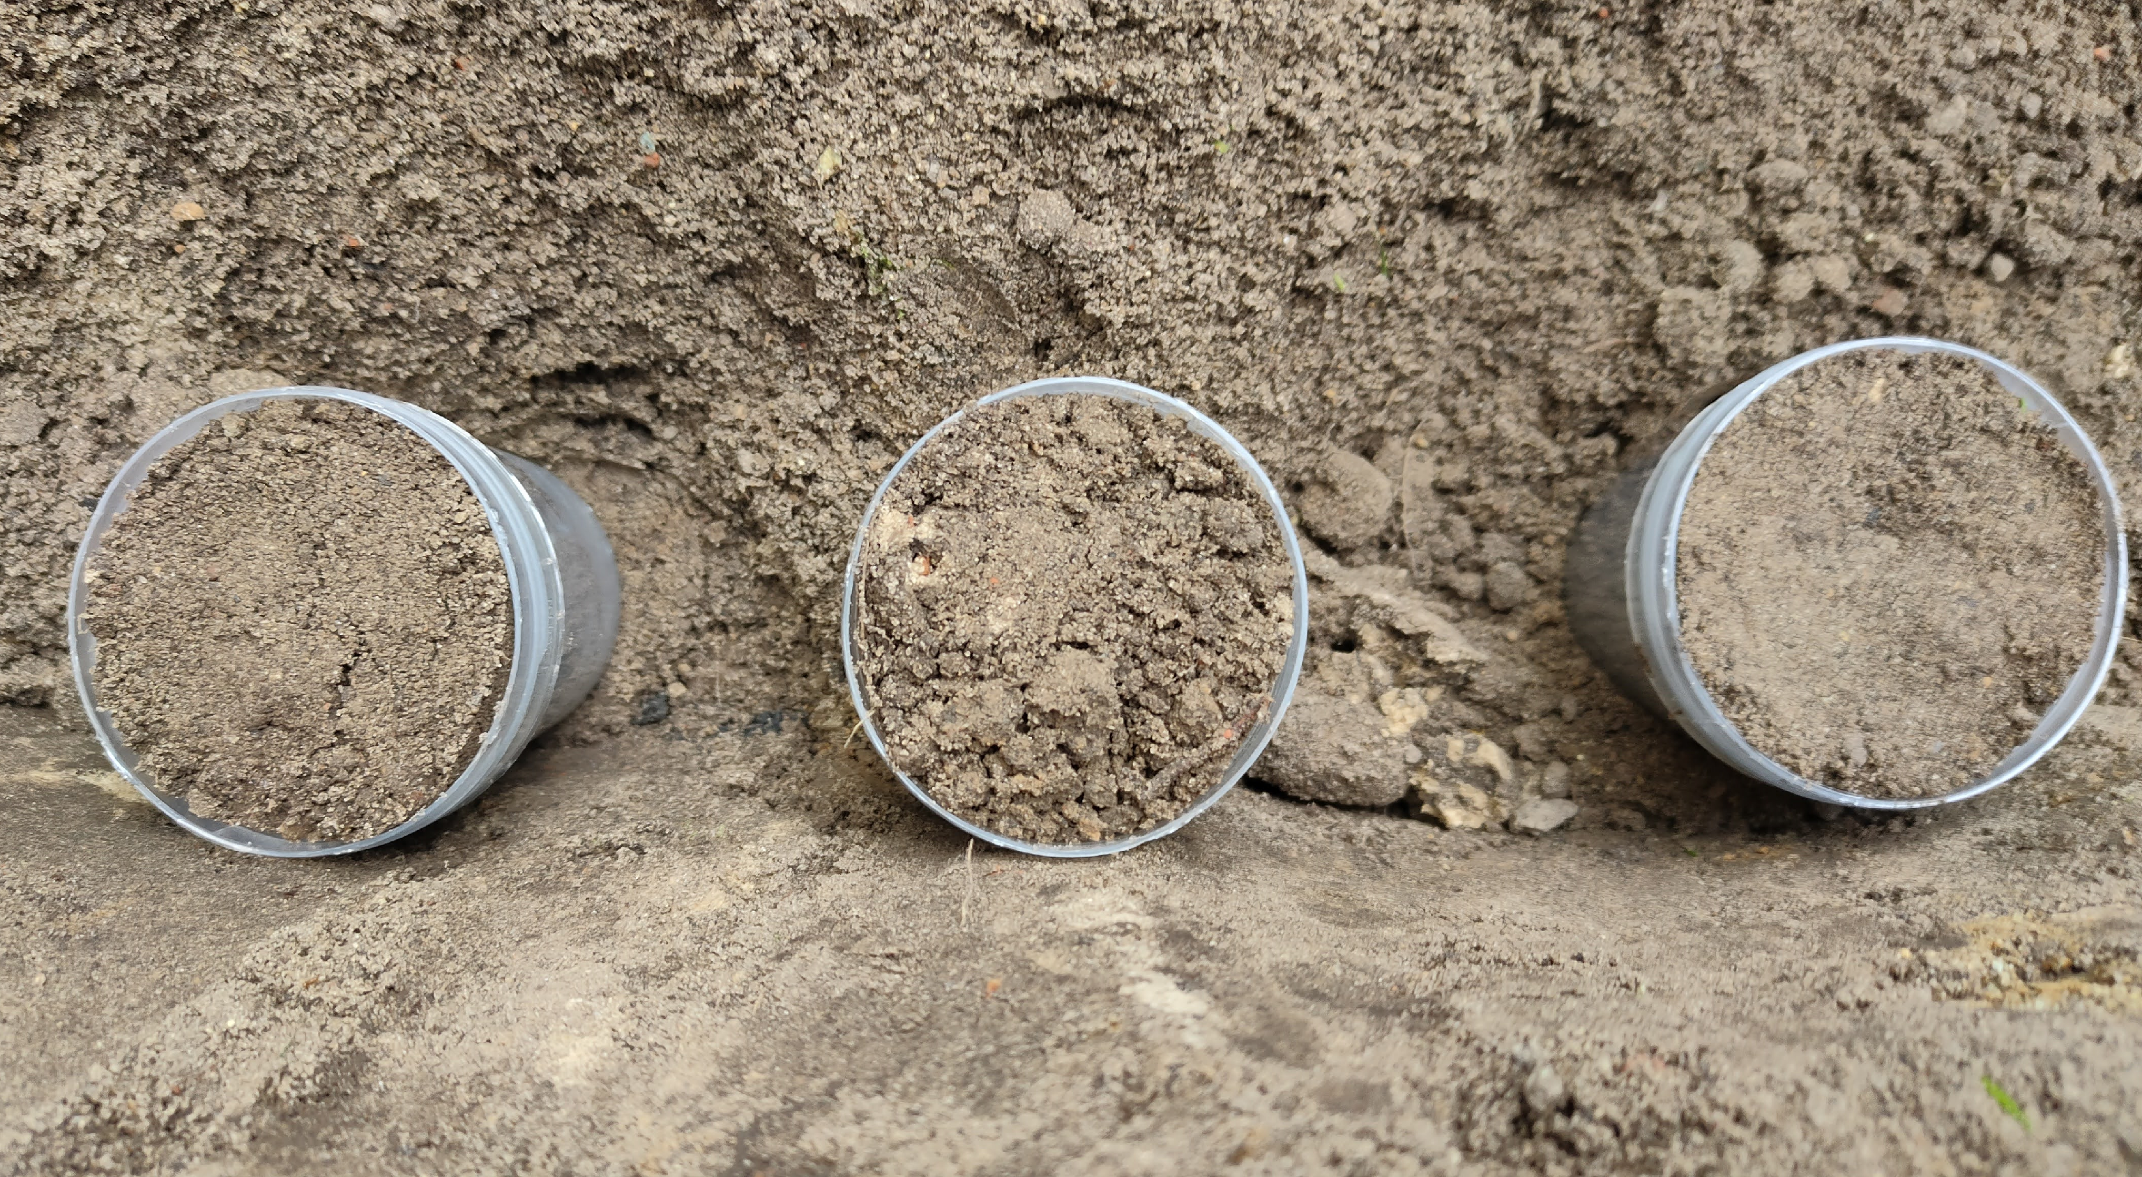
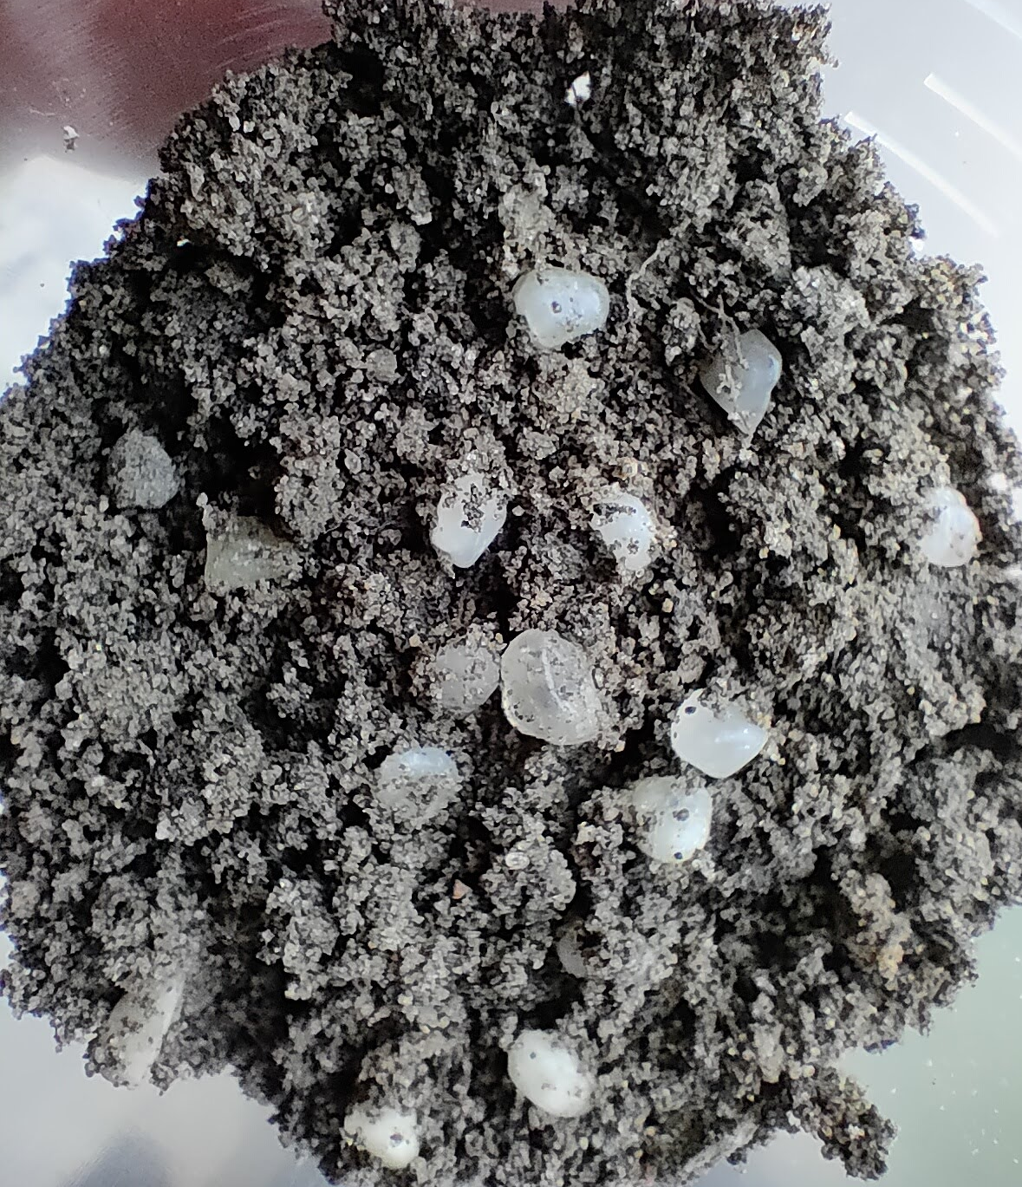
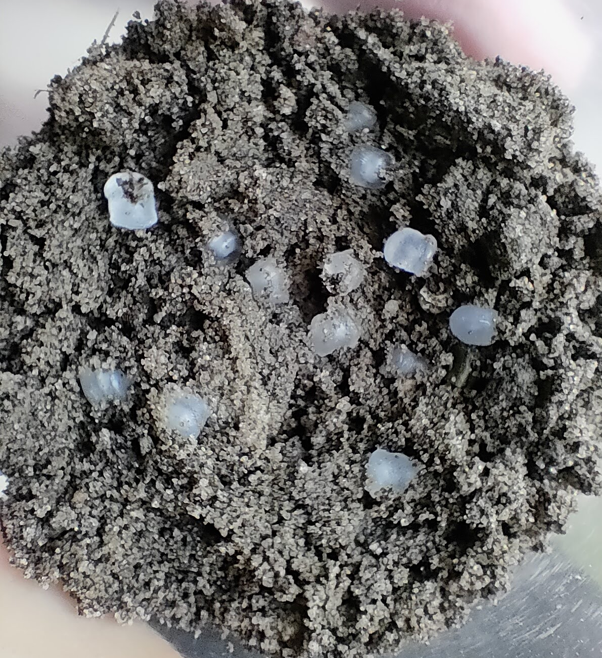
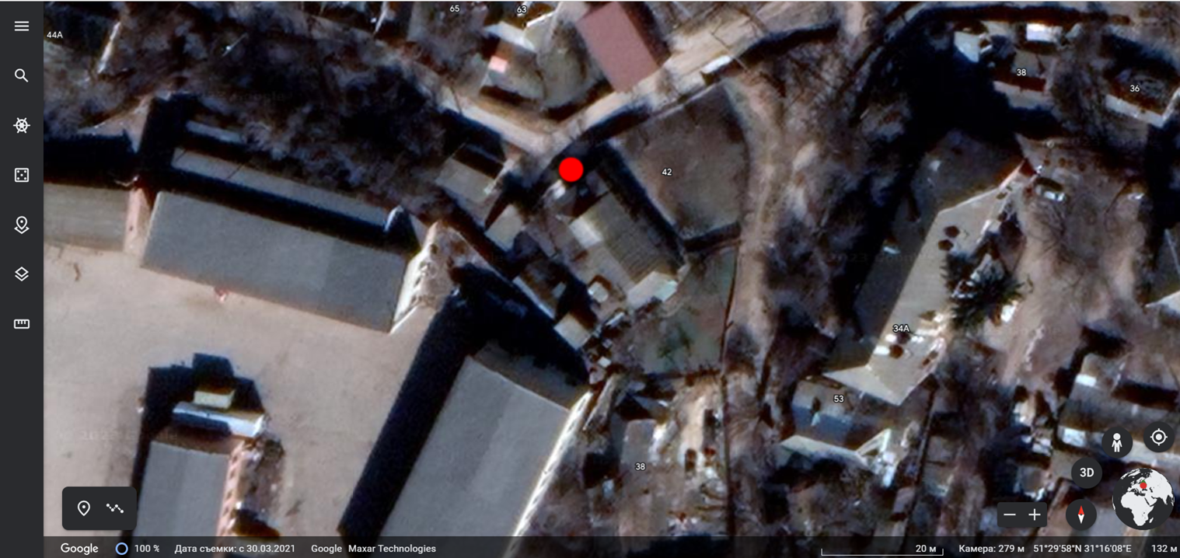
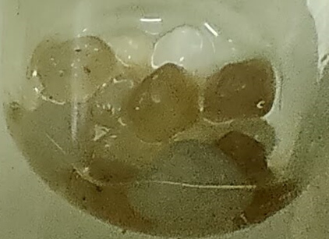
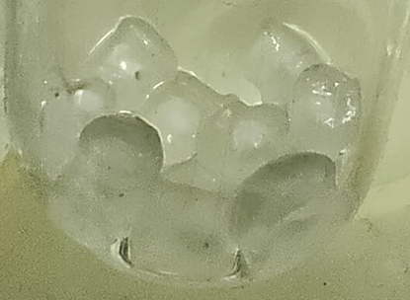
Samples and the site of exposition
а
b
Polypropylene containers with samples in soil (a depth of 20-25 cm)
Samples of materials mixed with the sod-podzolic soil: (а) Quartz sand;
(b) Polypropylene
The location of the site of samples exposition (Chernihiv, Ukraine, 51°29’58’’N, 31°16’08’’E)
а
b
The samples of materials removed from the soil and washed with sterile physiological NaCl solution:
(a) Quartz sand; (b) Polypropylene microplastic

Slide 4
Methods
Initial chemical characteristics of the soil (nitrate nitrogen, ammonium nitrogen, pH, sulfates, chlorides, sulfur, humidity) were studied in the laboratory of Government Agency “Chernihiv Regional Center for Disease Control and Prevention” of Ministry of Health of Ukraine (Chernihiv, Ukraine) by the methods recommended by regulatory documents of Ukraine.
Microbiological characteristics of the soil and the biofilm on the surface materials were studied in the laboratory of T.H. Shevchenko National University “Chernihiv Colehium” (Chernihiv, Ukraine): the total microbial count (TMC) - deep inoculation of soil suspension dilutions (or dilutions of physiological NaCl solution with biofilm removed by ultrasound) in meat-peptone agar, aerobic cultivation conditions at 37 °C; the number of sulfate-reducing bacteria - inoculation of dilutions of soil suspension (or dilutions of physiological NaCl solution with biofilm removed by ultrasound) into liquid Postgate’s “C” medium, anaerobic cultivation conditions at 29 ± 2 °С. The preparation of the soil suspension and its dilutions was carried out according to the generally accepted method.
The biofilm of the surface of quartz sand particles and polypropylene microplastics (pre-production pellets) was removed in a physiological NaCl solution by ultrasound with a frequency of 28 kHz (30 sec) twice with an interval of 60 sec.

Slide 5
Chemical characteristics of the studied soil

Slide 6
Microbiological characteristics of soil and biofilm
CFU - colony forming units;
abs. dry soil - absolutely dry soil

Slide 7
Conclusions
The obtained results expand the understanding of biofilm formation processes on the surface of microplastics in soil and the participation of microorganisms in its biodegradation. It can be used in processes for removing harmful materials from soil.
7
7

Slide 8
Thank you for your attention!
Contact:
nataliia.smykun@gmail.com
zelenalyubov@gmail.com
8
8

