Slide 1
FEM Modeling for Enhancing Fatigue Strength of Asphalt Pavements through an Optimum Tack Coat Layer Insertion
Presenting by
ENGR FAYIZ AMIN

Slide 2
INTRODUCTION
Fatigue cracking is a significant cause of asphalt pavement failure.
Tack coat improves bonding, reduces stress, extends pavement life
Five interlayer bonding types are studied in this paper

Slide 3
OBJECTIVES
Two Main Objectives
Improving Shear Fatigue Resistance
Optimal Placement of Tack Coat Layer

Slide 4
METHADOLOGY
WORK PACKAGE 01
LITERATURE REVIEW AND COLLECTION OF DATA
WORK PACKAGE 02
MODELLING AND ANALYSIS
WORK PACKAGE 03
ANALYSIS OF RESULTS

Slide 5
WORK PACKAGE # 01
The asphalt layer in a road pavement exhibits viscoelastic properties.
To replicate this behavior in Abaqus, it is essential to incorporate relaxation modulus test data into the model.
Four different types of tack coat layers are used in the model.

Slide 6
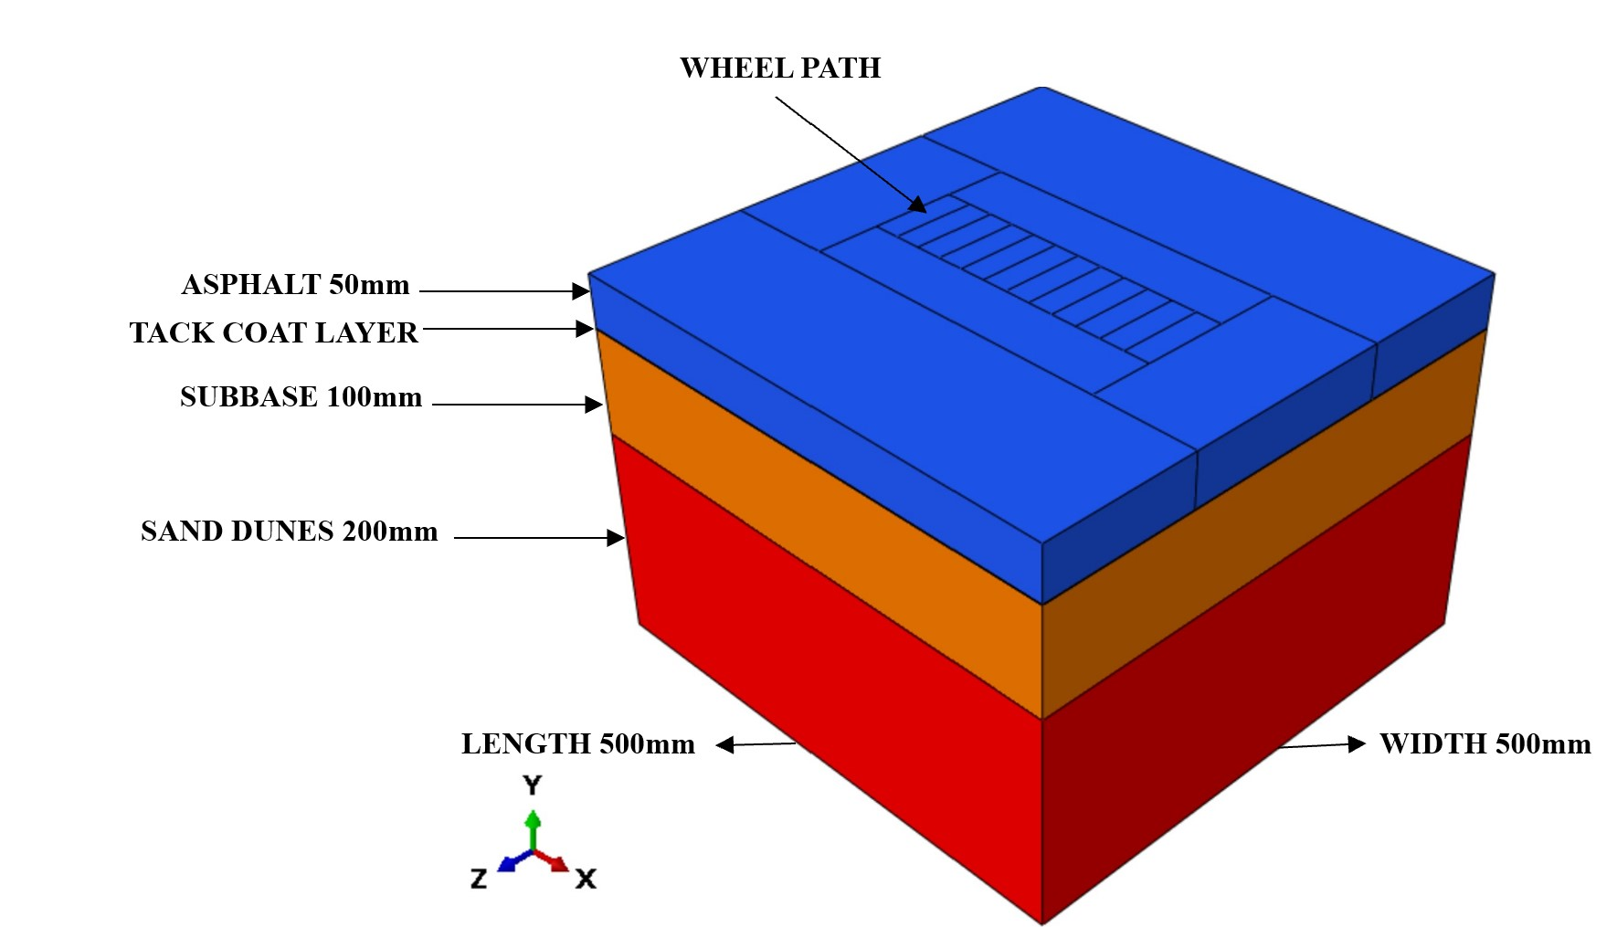
WORK PACKAGE # 02
Geometry of the Model
Layers | Length (mm) | Width (mm) | Depth (mm)
Asphalt | 500 | 500 | 50
Tack Coat | 500 | 500 | 5
Subbase | 500 | 500 | 100
Sand Dunes | 500 | 500 | 200

Slide 7
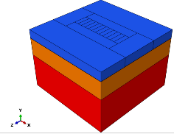
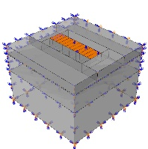
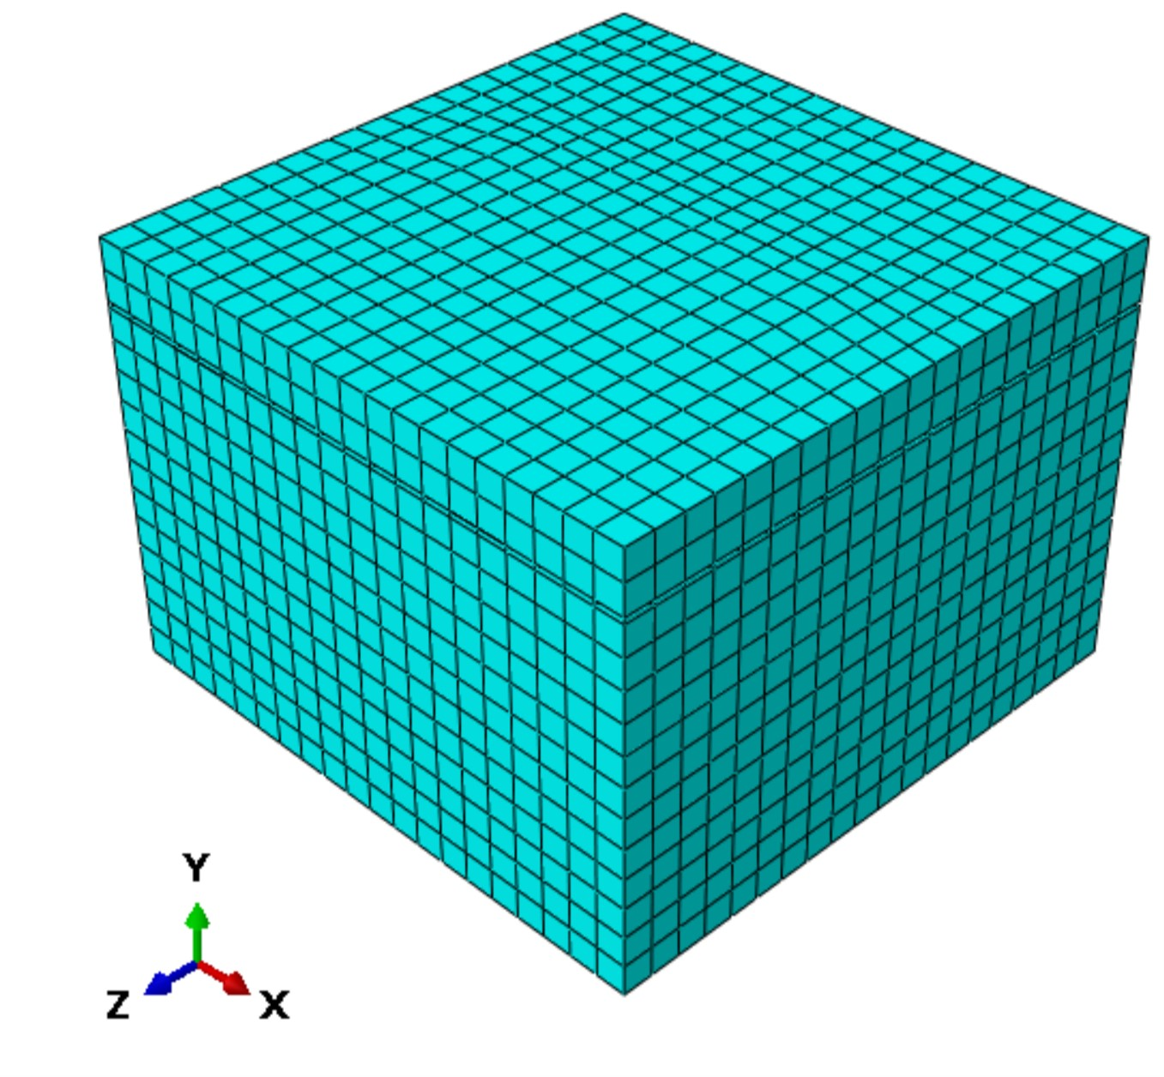
WORK PACKAGE # 02
Modeling Steps in Abaqus
Geometry of Constitutive Parts
Material Properties
Assembly
Step (time, type of Analysis)
Loads, BCs, Interactions
Meshing
Geometry
Load, Interactions & BCs
Meshing

Slide 8
RESULTS
The presence of a tack coat reduces the rutting depth of an asphalt pavement.
The SBS-modified hot asphalt is the best tack coat layer for asphalt pavements, as it has the least rutting depth.
SBS-modified hot asphalt has more fatigue strength and life.
Comparison of rutting depth using FEM
Thickness variation of SBS-modified hot Asphalt

Slide 10
THANK YOU

