Slide 1
On the sensitivity of the potential evapotranspiration of Egypt to different dynamical downscaling options and boundary layer schemes using a high-resolution regional climate model (RegCM4)
Samy Ashraf Anwar¹ and Ankur Srivastava²
¹Egyptian Meteorological Authority - Research Department
²Faculty of Science, University of Technology Sydney, Sydney, Australia

Slide 2
Motivation
The present study aims to:
Examine the influence of dynamical downscaling options (direct versus one-way nesting) and boundary layer schemes (HOLT versus UW) on the simulated PET in comparison with ERA5 reanalysis product as the ground truth of observations of the PET.
Examine the dependence of the simulated PET on the global incident solar radiation and daily mean air temperature (as inputs of the HS equation) by constructing a regional map of the Pearson correlation coefficient in each case. The significant correlation was calculated using student t-test of alpha equals to 5%. .
Investigate the performance of the RegCM4 concerning the climatological annual cycle of the PET with respect to ERA5.

Slide 3
Experiment Design
To serve the purpose of the present study, the four simulations were grouped to two cases.
The first case considers the dynamical downscaling options: direct (DIR) and one-way nesting (NEST).
The second case manipulates the boundary layer scheme: HOLT and UW.
In the four simulations, the PET was calculated using a calibrated version of the HS equation.
In each case, the simulated PET was evaluated with respect to the derived ERA5-land reanalysis product.

Slide 4
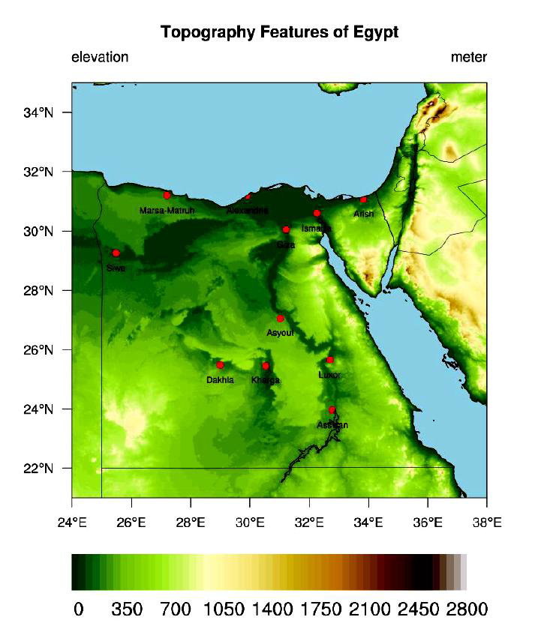
Figures
Figure 1. The figure shows surface elevation of Egypt (in meters). The red dots indicate the location of stations reported in this study except of Port-Said where the hPET shows missed data.

Slide 5
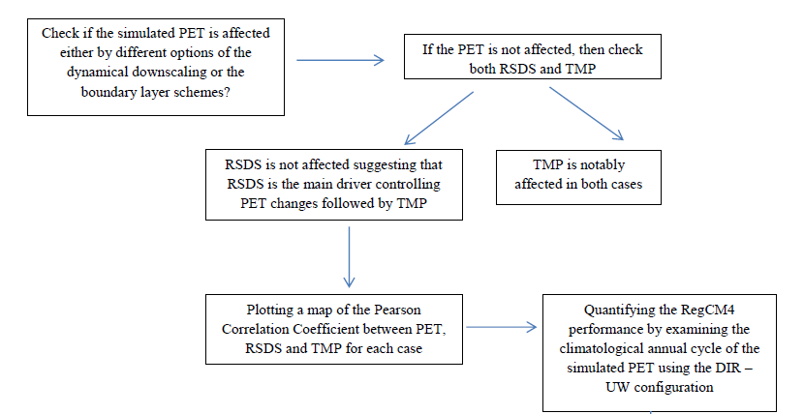
Figure S1. The figure shows a methodological flowchart summarizing the steps of the present study.

Slide 6
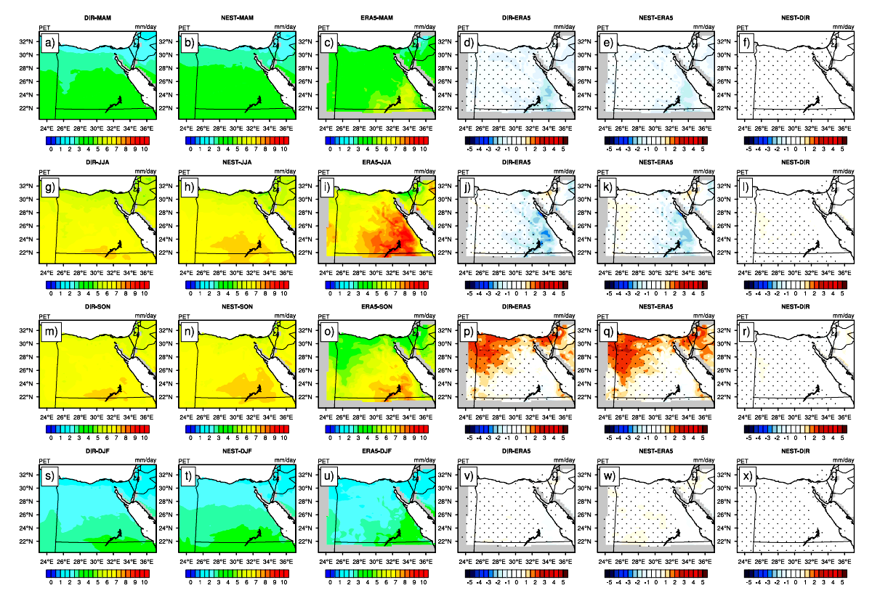
Influence of downscaling option: direct and nesting
Figure 2. The figure shows the potential evapotranspiration over the period 1998–2017 (PET; in mm day−1) for: MAM season in the first row (a − f); JJA in the second (g − l); SON in the third (m − r); and DJF in the fourth (s − x). For each row, DIR is on the left, followed by NEST; ERA5 is the third from left, DIR minus ERA5, NEST minus ERA5 and the difference between NEST and DIR. Significant difference/bias is indicated in black dots using student t-test with alpha equals to 5%.

Slide 7
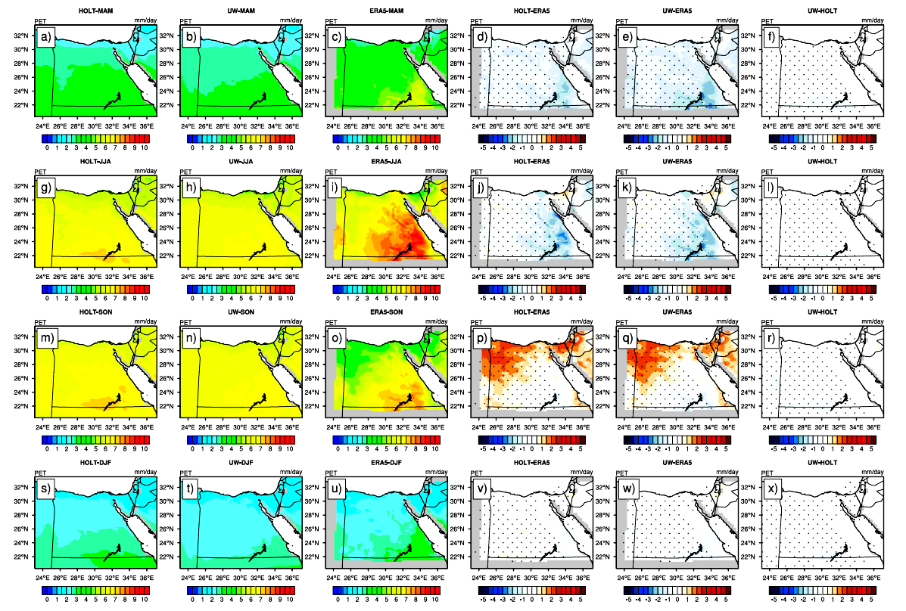
Influence of boundary layer schemes: HOLT and UW
Figure 3. The figure shows the potential evapotranspiration over the period 1998–2017 (PET; in mm day−1) for: MAM season in the first row (a − f); JJA in the second (g − l); SON in the third (m − r); and DJF in the fourth (s − x). For each row, HOLT is on the left, followed by UW; ERA5 is the third from left, HOLT minus ERA5, UW minus ERA5 and the difference between UW and HOLT. Significant difference/bias is indicated in black dots using student t-test with alpha equals to 5%.

Slide 8
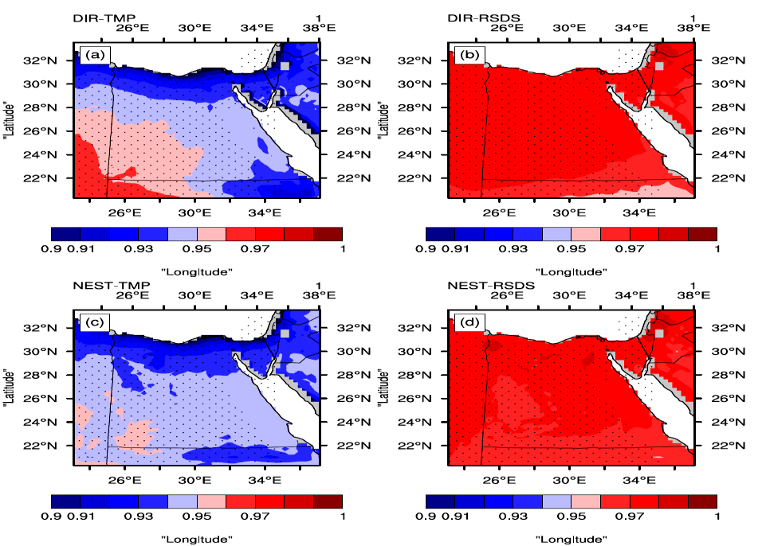
Dependence of PET on RSDS and TMP
Figure 4. The Figure shows the Pearson correlation coefficient for each grid point for: DIR (a for TMP), (b for RSDS); NEST (c for TMP) and (d for RSDS). Note that the range of 0.9 and 1 has been chosen after many trials to choose the appropiate range.

Slide 9
Figure 5. The Figure shows the Pearson correlation coefficient for each grid point for: HOLT (a for TMP), (b for RSDS); UW (c for TMP) and (d for RSDS). Note that the range of 0.9 and 1 has been chosen after many trials to choose the appropiate range.

Slide 10
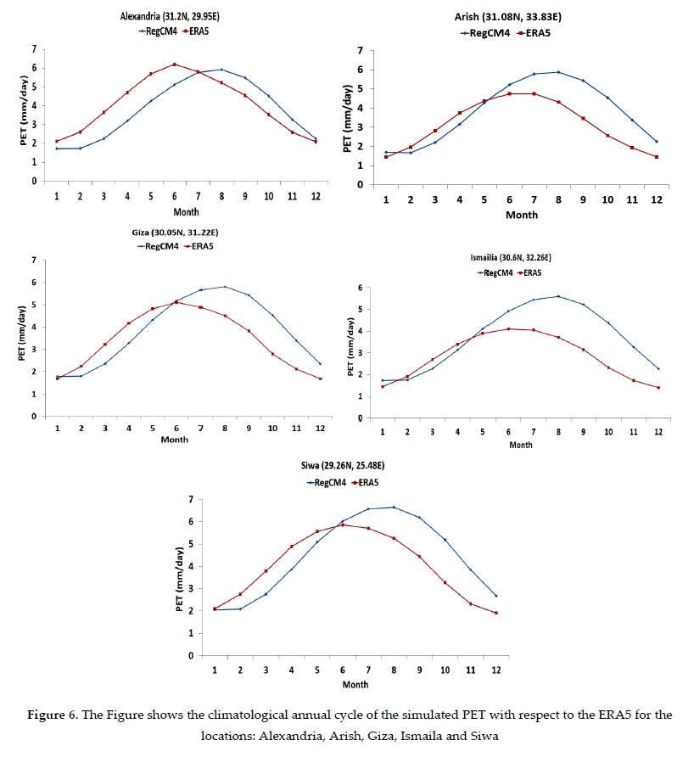
Climatological annual cycle of PET

Slide 11
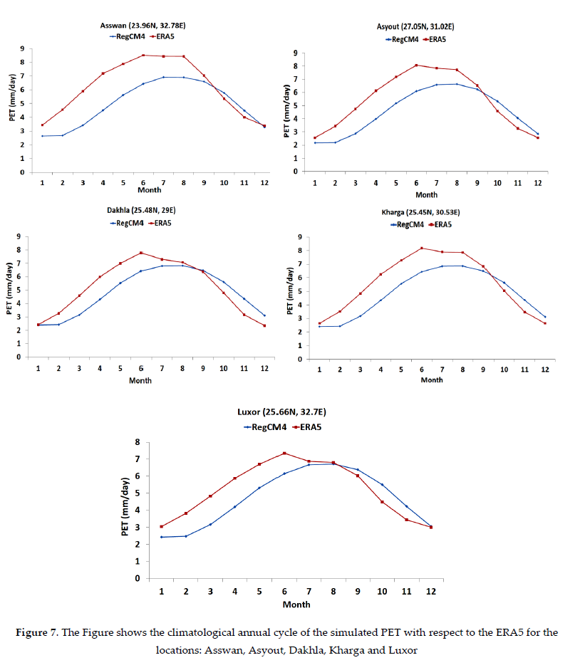

Slide 12
Discussion
The present study addressed the influence of different options of dynamical downscaling and boundary layer schemes by conducting four simulations with 25 km horizontal grid spacing over the period 1997 – 2017. Also, the simulated PET was calculated using a calibrated version of the HS.
The high−resolution global gridded PET product (hPET) was used as the benchmark for evaluating the simulated PET.
The results of this study are summarized in the following points:
1. The simulated PET is insensitive to the choice of either the option of the dynamical downscaling or the boundary layer schemes despite of noted changes of the TMP.
2. RSDS is the main driver of PET changes followed by the TMP. This noted behavior was indicated by a higher Pearson correlation coefficient (for each grid point) between PET and RSDS than between PET and TMP for each case.
3. On a point-scale, the simulated climatological annual cycle of the PET has been categorized as: phase and non-phase shift. Additionally, the noted over/underestimated PET varies with location and month.

Slide 13
Conclusion
The RegCM4 can be used to develop a PET map of Egypt using the DIR-UW configuration.
This finding not only aids policy makers in assessing the daily water requirements of crops, which is crucial for daily forecasts, especially in regions with limited data, but also holds potential for projecting future water needs under varying warming scenarios.
Such insights provide a vital resource for strategic decision-making in agricultural and water resource management, offering a bridge between scientific advancements and actionable policies.

