Slide 1
Spatio-temporal Assessment of Land Use Land Cover Changes and population dynamics Using Geoinformatics: a case study of Mardan, Khyber Pakhtunkhwa, Pakistan
Kamran^{1*}, Muhammad Fahim Khokhar¹, Junaid Aziz Khan², Iftikhar Hussain Adil3
*Corresponding author (student): Kamran, kamran.phdiese@student.nust.edu.pk
1. Institute of Environmental Sciences and Engineering (IESE), School of Civil and Environmental Engineering (SCEE), National University of Science and Technology (NUST), H-12, Islamabad, 44000, Pakistan.
2. Institute of Geographical Information Systems (IGIS), School of Civil and Environmental Engineering (SCEE), National University of Science and Technology (NUST), H-12, Islamabad, 44000, Pakistan.
3. Department of Economics, School of Social Sciences & Humanities (S3H), National University of Sciences and Technology (NUST), H-12, Islamabad, 44000, Pakistan

Slide 2
01
Introduction
Content of Presentation
02
Study Area Description
03
Methodology and Data Set
04
Results and Discussion
05
Conclusion and Recommendations
06
Selected References

Slide 3
01-Introduction
1
2
3
Global land use has changed by one-third over the last decades once or multiple times.
According to a United Nations report in 1950, only 30% of the global population was residing in urban areas which increased to 55% in 2018 and are projected to be 68% by 2050
The dynamic conditions of land use land cover changes (LULC) have given birth to various socio and environmental issues like degradation of the ecosystem, food security, water, and climatic variation.
(K. Winkler et al., 2021)
(Nations, 2018)
(Song et al., 2018; Karina Winkler et al., 2021; Wolde et al., 2021)
Notes:
The speedy conversion of permeable earth surface to impervious cover due to land use and land cover changes have triggered regional as well as local environmental impacts such as water quality and quantity, deforestation, and agricultural land conversion, reducing infiltration capacity.

Slide 4
01-Introduction
4
5
6
According to the Pakistan Bureau Statistics, and World Bank 2017 reports, Pakistan ranked 6th in the list of most populous countries in the world.
The accelerated rate of unplanned urbanization in Pakistan has not only influenced demographic conditions in cities but also gear up the conversion of rural areas, and decreased urban sustainability
A developing country like Pakistan is urbanizing with an annual growth rate of 3%, which is the highest in South Asia
(Kotkin & Cox, 2013)
(PBS-2017 Census Report)
(Dubovyk et al., 2011; Patra, Sahoo, et al., 2018)

Slide 5
01-Introduction
7
8
Information System (GIS) and Remote Sensing (RS) applications/techniques are widely used to assess and quantify land use land cover changes over a long-term spatio-temporal range measurement, change detection, and analysis.
Satellite imagery data was successfully used for the assessment of LULC change analysis for the last 30 years.
(Lu et al., 2013; Maity et al., 2020; Mallick et al., 2021)
(Rimal et al., 2018; Coppin et al., 2004; Lu et al., 2013)
Notes:
The speedy conversion of permeable earth surface to impervious cover due to land use and land cover changes have triggered regional as well as local environmental impacts such as water quality and quantity, deforestation, and agricultural land conversion, reducing infiltration capacity.

Slide 6
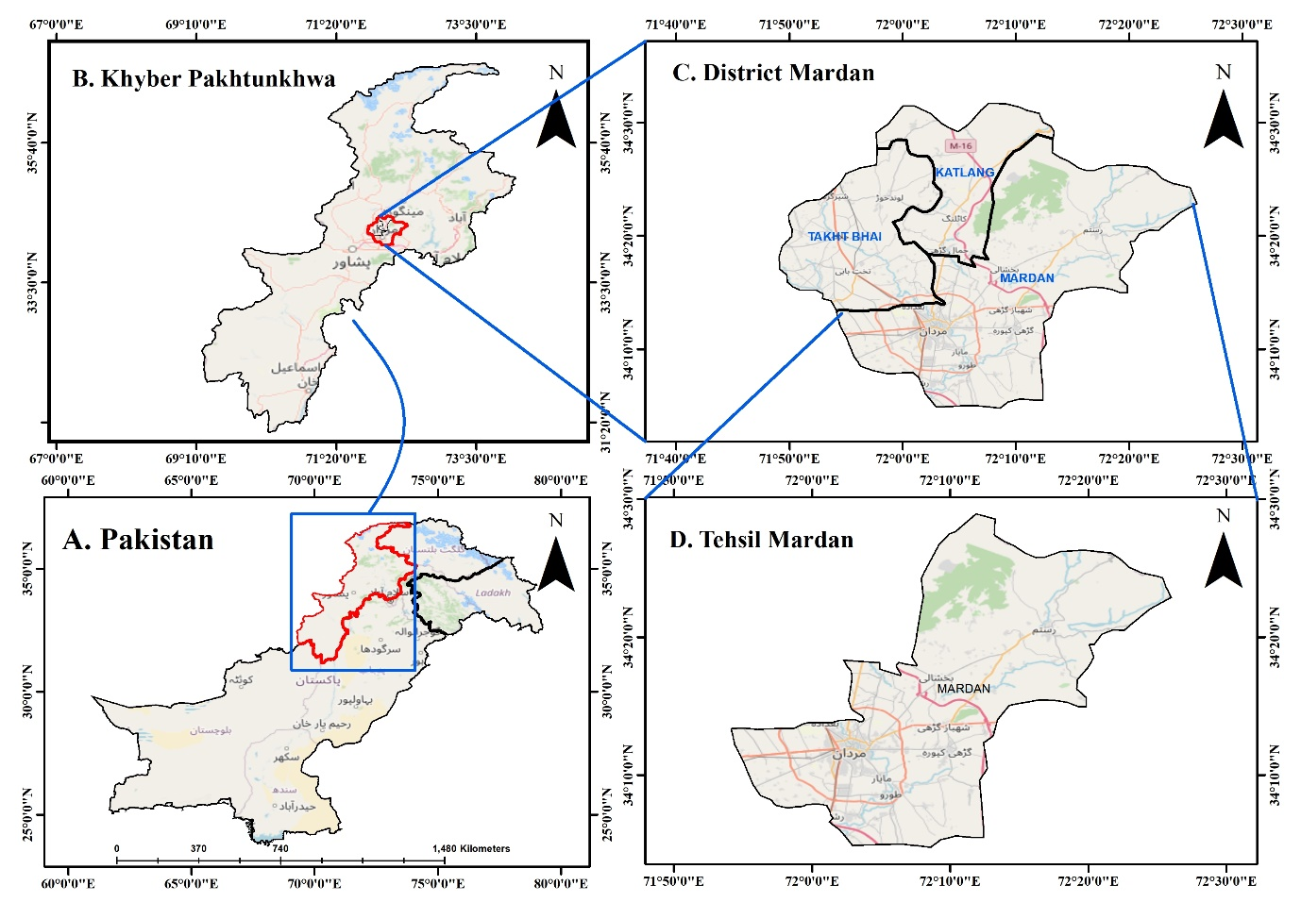
2. Study Area-Mardan
Tehsil Mardan was chosen based on its rapid urban expansion and population growth over the last three decades.
Mardan is the 2nd big city after the provincial capital Peshawar of Khyber Pakhtunkhwa and 23rd on the list of the biggest cities in the country.
It is about 32 km and 148 km away from Peshawar and Islamabad respectively.
The average annual temperature remained 22⁰C with June being the hottest month and total annual rainfall of 560 mm, with August having the highest rainfall of 122 mm.
Notes:
Tehsil Mardan being a divisional office holder and having the facilities of 3 public sector universities (Abdul Wali Khan University and Women University, and University of Engineering and Technology, Mardan), two major government hospitals (District Headquarter and Mardan Medical Complex), Bacha Khan Medical College, tobacco and sugar industry, Sheikh Maltoon Township, Punjab Regiment Centre, Cantonment, Gajju Khan Market, and other market-based opportunities become a source of attraction for living, studying and business. Since 1990 Mardan witnessed a shift in population growth and spatial change (Yar, 2014), and was recognized as a business circle for the adjoining districts of Khyber Pakhtunkhwa.

Slide 7
3. Methodology and Data Set
Both primary and secondary data sets (literature and published reports) were accessed and analyzed during the current study
To know the extent and space of urbanization, Landsat satellite imageries were downloaded from the USGS website (https://earthexplorer.usgs.gov/).
Landsat imageries
Atmospheric Correction
Study Area Extraction
LULC Classification
Accuracy Assessment
Change Detection
LULC and Population Correlation Analysis
Population 1981
Population 1998
Population 2017
Forecast 2021 till 2027
Notes:
The downloaded imageries were passed through the radiometric and geometric correction process (Mukherjee et al., 2018). The radiometric correction technique was used to improve the brightness of the image while geometric calibration was required for the removal of geometric distortion

Slide 8
S.No. | Year | Satellite | Sensor | Acquisition date | Cloud Cover (%) | Remarks
1 | 1990 | Landsat 5 | TM | 14th March 1990 | 2 | -Targeted Months -Minimum Cloud Coverage -Clear Study Area -Free from Scan-Line Error -Resolution =30x30 meters
2 | 1995 | Landsat 5 | TM | 13th April 1995 | 1
3 | 2000 | Landsat 7 | ETM+ | 18th April 2000 | 3
4 | 2010 | Landsat 5 | TM | 6th April 2010 | 1
5 | 2015 | Landsat 8 | OLI/TIRS | 19th March 2015 | 1.7
6 | 2021 | Landsat 8 | OLI/TIRS | 19th March 2021 | 2.4
S.No. | LULC Class | Description
1 | Built-up | This class includes buildings, roads, concrete, and asphalt structures that are covered with impervious surfaces and anthropogenic.
2 | Vegetation | This class includes forest, grasslands, green belts, and cropland
3 | Water bodies | This class includes lakes, reservoirs and streams, and inundated area
4 | Bare land | This class includes areas where no permanent built-up, vegetation, or water bodies exist.

Slide 9
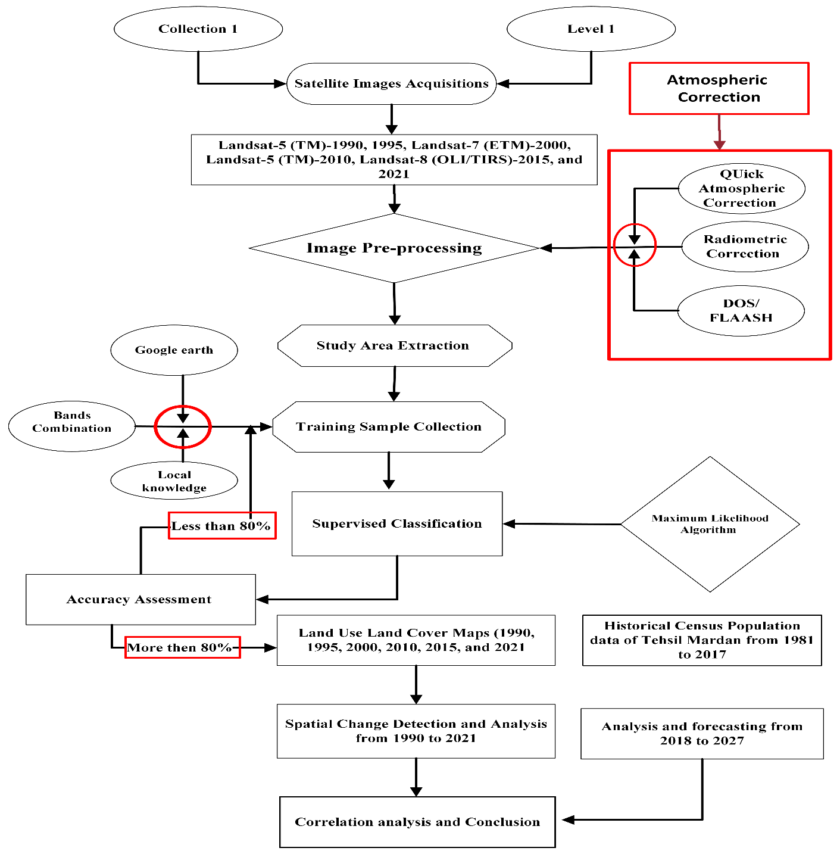
3. Methodology and Data Set

Slide 10
4. Results and Discussions
LULC Classification Maps (19990, 1995, 2000, 2010, 2015, and 2021)
Accuracy Assessment
Change Detection (1990-2021)
Population dynamics
Correlation Matrix
01
02
03
Text Here
Text Here
Easy to change colors.
Easy to change colors.

Slide 11
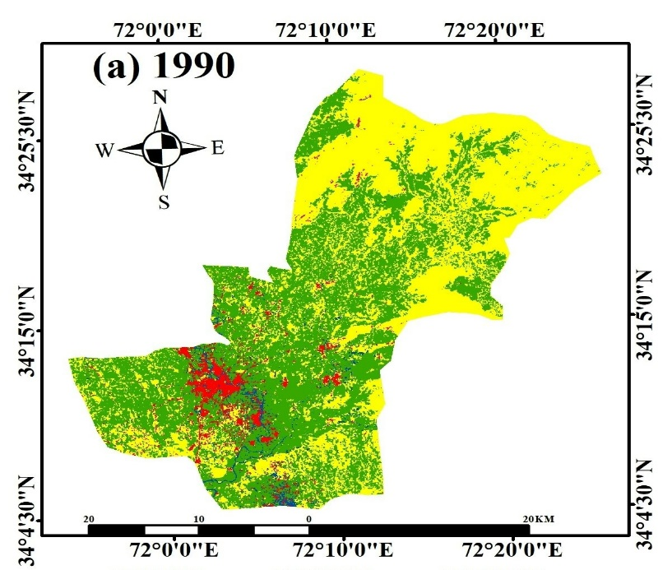
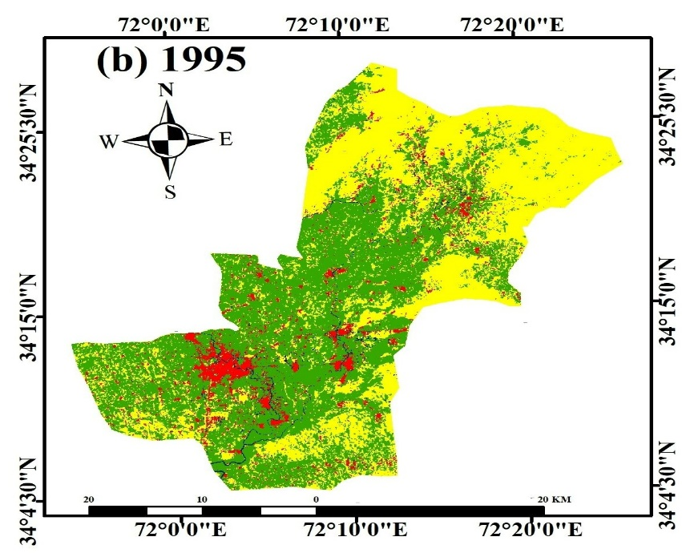
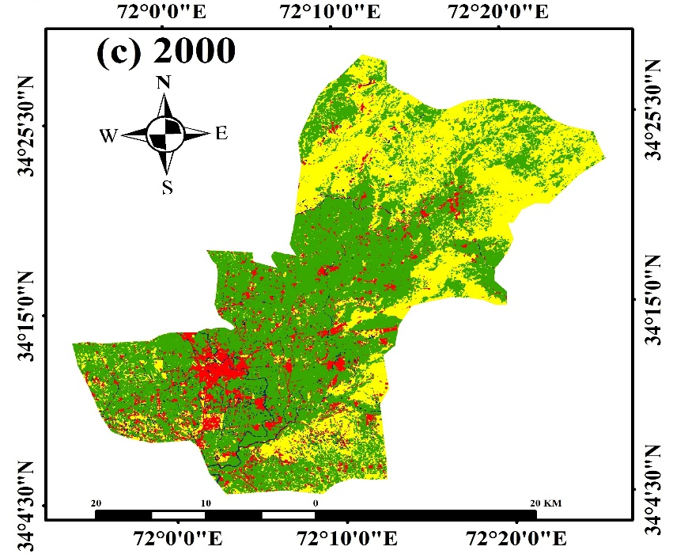
4. Results and Discussions (A. LULC Maps)
01
02
03
Text Here
Text Here
Easy to change colors.
Easy to change colors.
Area= Km2

Slide 12
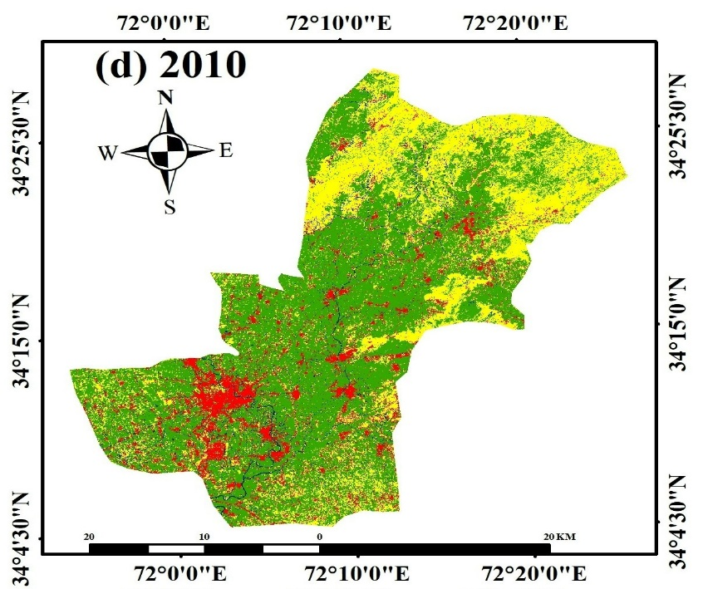
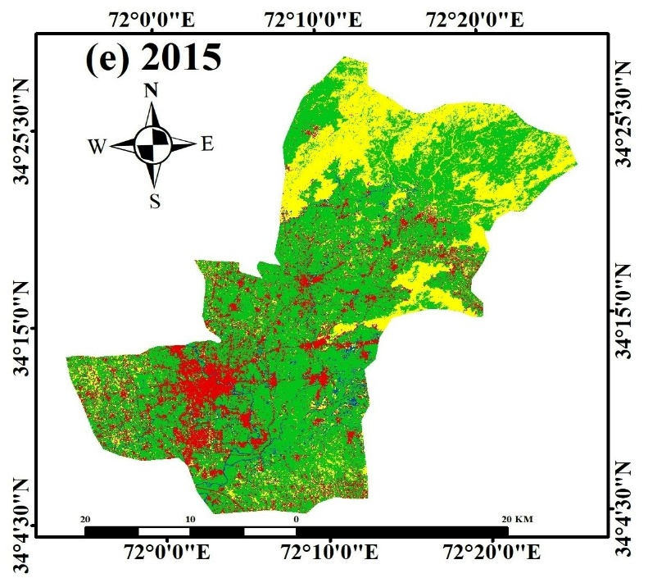
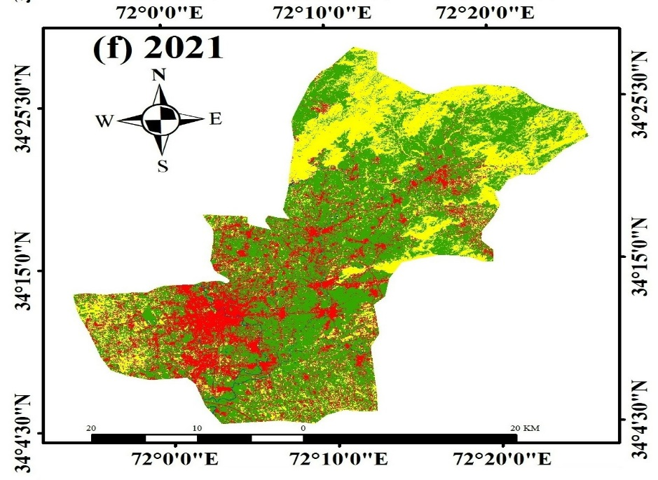
4. Results and Discussions (A. LULC Maps)
01
02
03
Text Here
Text Here
Easy to change colors.
Easy to change colors.
Area= Km2

Slide 13
4. Results and Discussions (A. LULC Graph)
01
02
03
Text Here
Text Here
Easy to change colors.
Easy to change colors.

Slide 14
4. Results and Discussions
B. Accuracy Assessment
Overall classification accuracy for the years under study was more than 90 % except for 2010. Kappa Coefficient was also recorded above 0.80 for all the imageries.
Year/Parameter | 1990 | 1995 | 2000 | 2010 | 2015 | 2021
Overall Accuracy (%) | 97.25 | 96.69 | 94.15 | 87.42 | 94.71 | 98.30
Kappa Coefficient | 0.95 | 0.95 | 0.91 | 0.82 | 0.88 | 0.97
01
02
03
Text Here
Text Here
Easy to change colors.
Easy to change colors.
Notes:
Another accuracy indicator is the kappa coefficient. It is a measure of how the classification results compare to values assigned by chance.

Slide 15
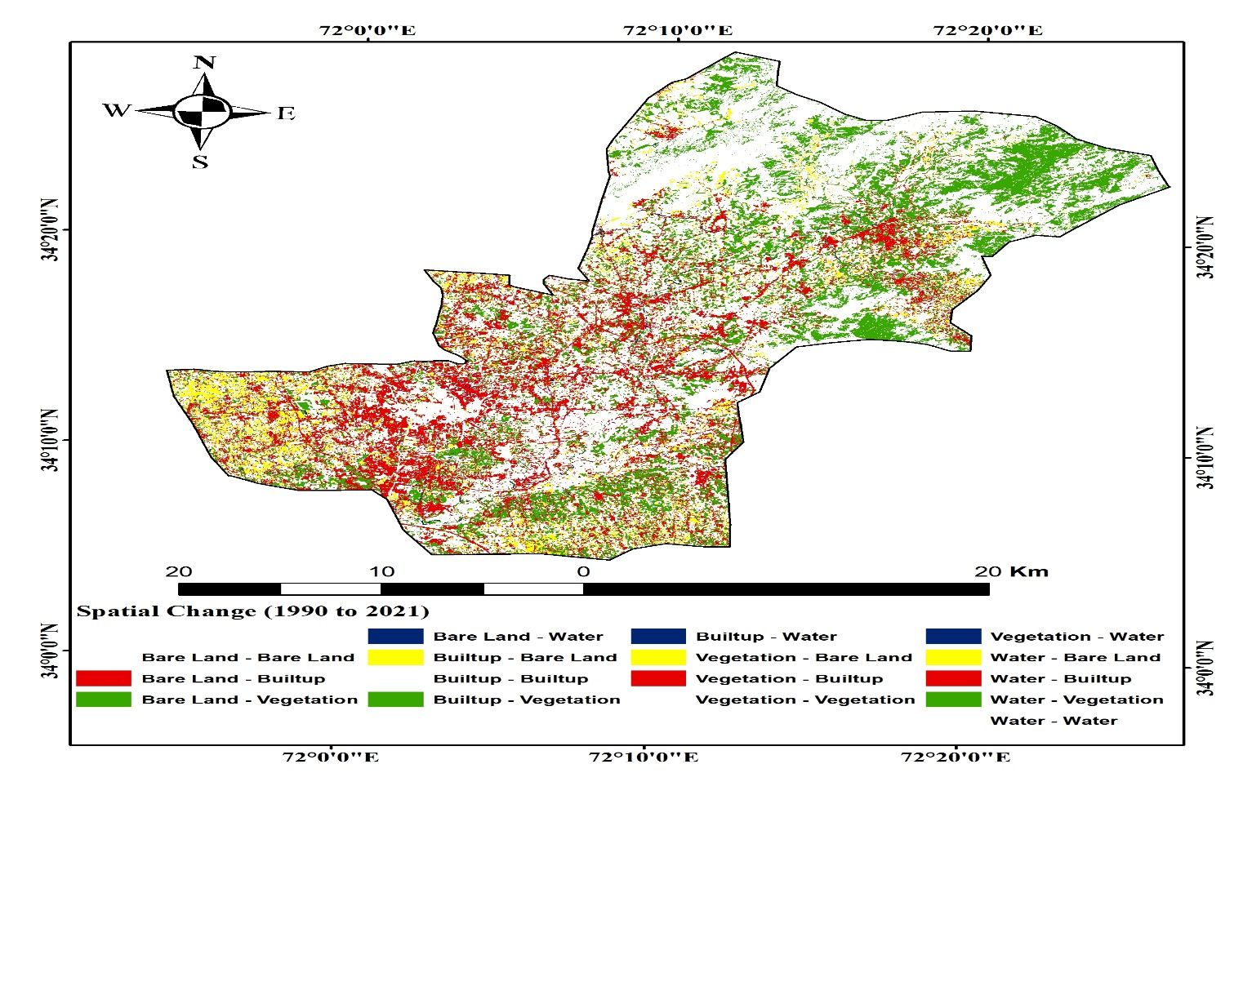
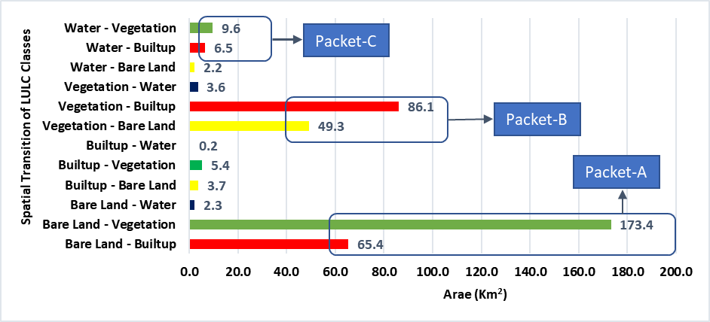
4. Results and Discussions (C. Change Detection (1990-2021)
01
02
03
Text Here
Text Here
Easy to change colors.
Easy to change colors.

Slide 16
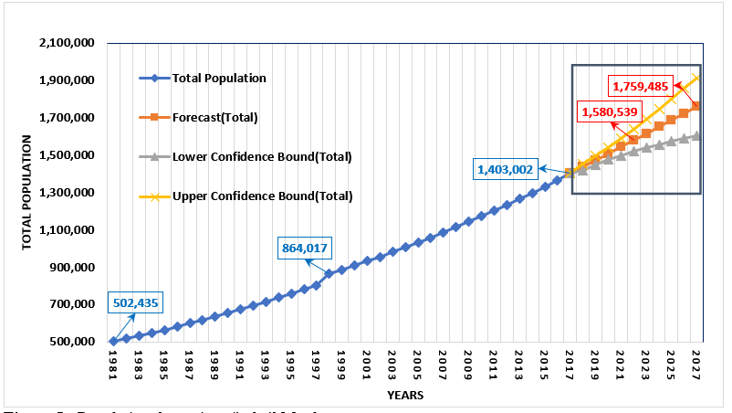
4. Results and Discussions (D. Population Dynamics)
According to the 6th population census in 2017, the total population of tehsil Mardan was 1,403,002.
Similarly, in 1998 and 1981, the total population was 864,017 and 502,435 respectively.
The forecasted population of tehsil Mardan for the years 2021 and 2027 was recorded as 1,580,539 and 1,759,485 respectively.
01
02
03
Text Here
Text Here
Easy to change colors.
Easy to change colors.

Slide 17
4. Results and Discussions (E. Correlation Matrix)
Correlation analysis was performed to assess the correlation between the land use classes and total population data.
The total population showed a strong positive correlation (0.98) with built-up and a strong negative correlation with bare land (-0.90).
Built-up showed a significant negative correlation with bare land (-0.86).
01
02
03
 | Total Population | Built-up | Vegetation | Water | Bare Land
Total Population | 1
Built-up | 0.982 | 1
Vegetation | 0.554 | 0.486 | 1
Water | 0.077 | -0.096 | 0.537 | 1
Bare Land | -0.907 | -0.868 | -0.851 | -0.300 | 1
Text Here
Text Here
Easy to change colors.
Easy to change colors.

Slide 18
5. Conclusion and Recommendations
The study showed that the built-up cover increased from 4% to 20% from 1990 to 2021. The built-up cover is increasing at the cost of bare land and vegetation cover conversion.
The main drivers behind the increase in the built-up cover are population growth, infrastructure development, and provision of basic amities of life in the city.
Bare land decreased from 46.7% to 27%.
The population of tehsil Mardan increased from 502,435 in 1981 to 1,544,750 in 2021.
It is recommended that further research should be carried out on the impact assessment of LULC changes on environmental parameters such as water quality and quantity, and climatic parameters like temperature and precipitation.
Government should formulate an approved and sustainable land use plan for current and future generations of the tehsil Mardan.
An awareness campaign should be launched to raise awareness among all stakeholders regarding the negative implication of the built-up layer and consequent ecosystem degradation.
01
02
03
Text Here
Text Here
Easy to change colors.
Easy to change colors.

Slide 19
6. Selected References
Ali, S. AR and S. Ali. 2019. Impact of built environment on land use of rapidly growing tehsil Takht Bhai, District Mardan. Sarhad Journal of Agriculture, 35(3), 966-975.
Assessment, M. E. (2005). Ecosystems and human well-being: wetlands and water. World resources institute.
Badamasi, M. M., Yelwa, S. A., AbdulRahim, M. A., & Noma, S. S. (2010). NDVI threshold classification and change detection of vegetation cover at the Falgore Game Reserve in Kano State, Nigeria. Sokoto Journal of the social sciences, 2(2), 174-194.
Baig, M. B., Shabbir, S., Khan, N., Ahmad, I., & Straquadine, G. S. (2008). The history of social forestry in Pakistan: an overview. International Journal of Social Forestry, 1(2), 167-183.
Borrelli, P., Robinson, D. A., Fleischer, L. R., Lugato, E., Ballabio, C., Alewell, C., . . . Panagos, P. (2017). An assessment of the global impact of 21st century land use change on soil erosion. Nature Communications, 8(1), 2013. https://doi.org/10.1038/s41467-017-02142-7
Burghardt, W. (2006). Soil sealing and soil properties related to sealing. 266(1), 117-124. https://doi.org/10.1144/GSL.SP.2006.266.01.09 %J Geological Society, London, Special Publications
Butt, A., Shabbir, R., Ahmad, S. S., & Aziz, N. (2015). Land use change mapping and analysis using Remote Sensing and GIS: A case study of Simly watershed, Islamabad, Pakistan. The Egyptian Journal of Remote Sensing and Space Science, 18(2), 251-259. https://doi.org/https://doi.org/10.1016/j.ejrs.2015.07.003
Chavez, P. S., & MacKinnon, D. J. (1994). Automatic detection of vegetation changes in the southwestern United States using remotely sensed images. Photogrammetric engineering and remote sensing, 60(5).
Cheema, A. R., Kemal, M., Ahmed, N. & Hassan, H.,. (2021). Pakistan SDGs Status Report. https://www.sdgpakistan.pk/uploads/pub/Pak_SDGs_Status_Report_2021.pdf
Congalton, R. G., & Green, K. (2019). Assessing the accuracy of remotely sensed data: principles and practices. CRC press.

Slide 20
6. Selected References
Heidari, H., Arabi, M., Warziniack, T., & Sharvelle, S. (2021). Effects of Urban Development Patterns on Municipal Water Shortage [Original Research]. Frontiers in Water, 3. https://www.frontiersin.org/article/10.3389/frwa.2021.694817
Huang, A., Xu, Y., Sun, P., Zhou, G., Liu, C., Lu, L., . . . Wang, H. (2019). Land use/land cover changes and its impact on ecosystem services in ecologically fragile zone: A case study of Zhangjiakou City, Hebei Province, China. Ecological Indicators, 104, 604-614. https://doi.org/https://doi.org/10.1016/j.ecolind.2019.05.027
Jabeen, N., Farwa, U., & Jadoon, M. J. J. o. t. R. S. o. P. (2017). Urbanization in Pakistan: a governance perspective. 54(1), 127-136.
Jat, M. K., Garg, P. K., & Khare, D. (2008). Monitoring and modelling of urban sprawl using remote sensing and GIS techniques. International Journal of Applied Earth Observation and Geoinformation, 10(1), 26-43. https://doi.org/https://doi.org/10.1016/j.jag.2007.04.002
Jianya, G., Haigang, S., Guorui, M., & Qiming, Z. (2008). A review of multi-temporal remote sensing data change detection algorithms. The International Archives of the Photogrammetry, Remote Sensing and Spatial Information Sciences, 37(B7), 757-762.
Jongman, B. (2018). Effective adaptation to rising flood risk. Nature Communications, 9(1), 1986. https://doi.org/10.1038/s41467-018-04396-1
Khan, M. Z., & Gul, H. (2013). Impact of Green Revaluationn Variables on Agriculture Productivity in Pakistan. Sarhad J. Agric, 29(3), 455-460.
Khan, N., Shah, S. J., Rauf, T., Zada, M., Yukun, C., & Harbi, J. (2019). Socioeconomic impacts of the billion trees afforestation program in Khyber Pakhtunkhwa Province (kpk), Pakistan. Forests, 10(8), 703.
Kotkin, J., & Cox, W. J. F. M. A. (2013). The World’s fastest-growing megacities.
Landis, J. D. (1994). The California Urban Futures Model: A New Generation of Metropolitan Simulation Models. Environment and Planning B: Planning and Design, 21(4), 399-420. https://doi.org/10.1068/b210399

Slide 21
Thank you

