Slide 1
Simulating the Daily Soil Temperature of Egypt using a High-resolution Regional Climate Model: sensitivity to soil moisture and temperature initial conditions
Samy Ashraf Anwar
Research Department
Egyptian Meteorological Authority

Slide 2
Motivation
Soil temperature is an important variable in the climate system because it modulates the surface energy balance components (sensible and latent heat fluxes) and therefore controlling the water and energy fluxes exchanged between the land surface and the atmosphere as well as the mesoscale circulations (Weaver and Avissar 2001).
Because of limited availability of soil temperature records both spatially or temporary, regional climate models and offline land surface models can be alternative tools to estimate the soil temperature at a particular depth.
Zhu and Liang (2005) examined the potential skills of the fifth-generation PSU-NCAR Mesoscale Model (MM5)-based regional climate model (CMM5) concerning the annual cycle and interannual variability of the United States soil temperature and moisture. They found that the CMM5 bias can be attributed to the inconsistencies between measurements taken under short grass versus model representations beneath other land cover types.
In Egypt, Anwar and Hejabi (2023) used the regional climate model (RegCM4; Giorgi et al. 2012) to simulate the soil temperature profile with respect to the in-situ observations. They found that the RegCM4 is able to reproduce the daily variability despite of notable biases between the RegCM4 and the observations.
However, the sensitivity of the simulated soil temperature (40 cm in this study) to different initial conditions of the soil temperature and moisture has not been examined till the present day. Therefore, the present study aims to address this issue using a high-resolution regional climate model (RegCM4).

Slide 3
Experiment Design
In the present study, the International Center of Theoretical Physics (ICTP) regional climate model (RegCM4) was used.
The RegCM4 domain covers Egypt and it was centered at 27º latitude and 30º longitude with 60 grid points in zonal and meridional directions and 25 km horizontal grid spacing following Anwar and Lazić (2023).
The present study adopted the physical configuration of Anwar and Mostafa (2023).
For the RegCM4 to produce a daily forecast, the Global Forecast System of one degree grid spacing (GFS; Sela 2009) was used to provide the lateral boundary condition and sea surface temperature (SST).
To simulate the soil temperature of depth 40 cm (ST40), the RegCM4 was configured with version 4.5 of the community land model (CLM45; Oleson et al. 2013) following the procedure adopted in Anwar and Hejabi (2023).
To examine the sensitivity of the simulated ST40 to different initial conditions of the soil moisture and temperature, four experiments were conducted and grouped to two cases.
The first case considers initializing the RegCM4 from the bare soil and ESACCI global satellite soil moisture product. On the other hand, the second case examines the sensitivity of the simulated ST40 to two initial conditions: bare soil and version 3 of the Century reanalysis product.
For the purpose of the present study, the long-term average of the Century was calculated.

Slide 4
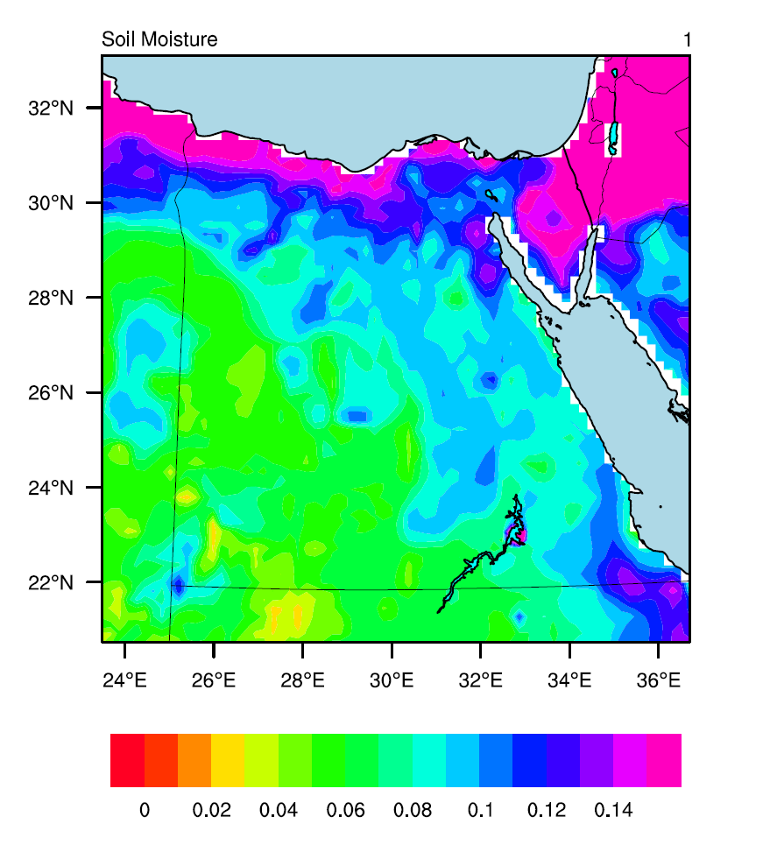
Figures
Figure 1. The figure shows the interpolated ESACCI satellite soil moisture product on the RegCM4 curvilinear grid. Note that soil moisture is expressed in percentage (%).

Slide 5
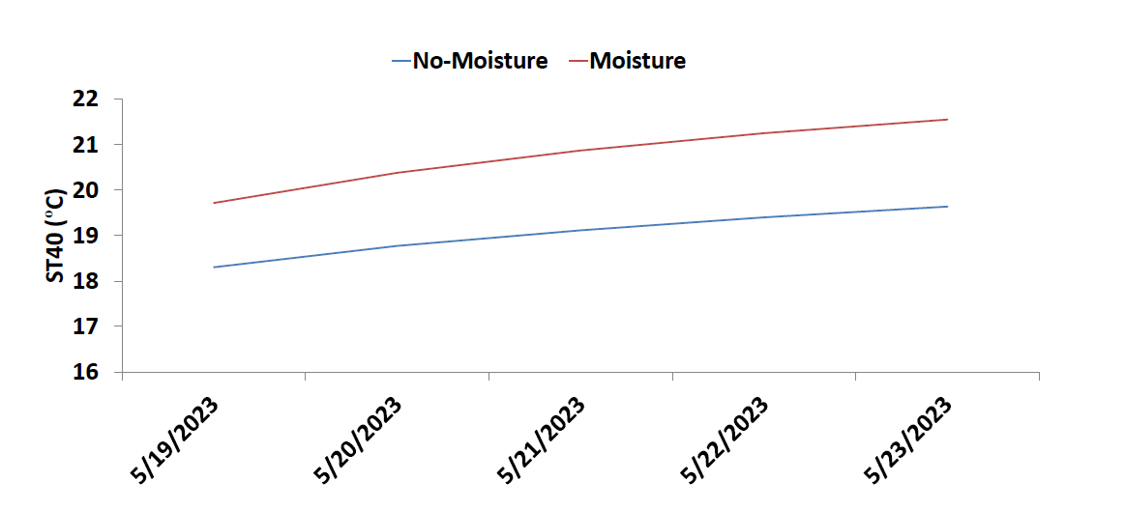
Figure 2. The figure shows the simulated ST40 (in ºC) over the period 19-05-2023 till 23-05-2023. Initializing from bare soil (No-Moisture) is shown in blue color, while from the ESACCI is presented in red color.

Slide 6
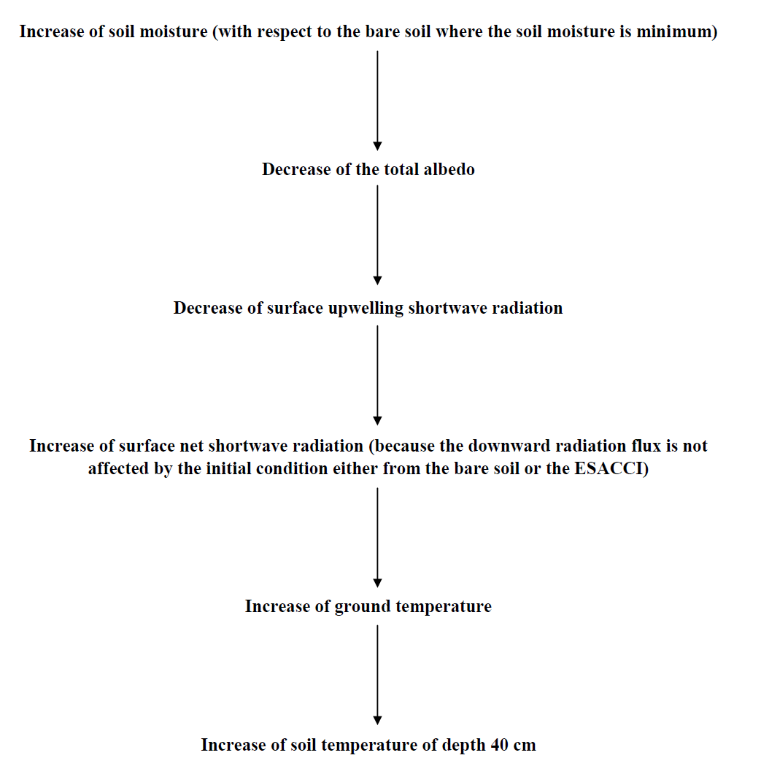
Figure 3. The figure shows the ESACCI mechanism of action on the simulated soil temperature of depth 40 cm (ST40).

Slide 7
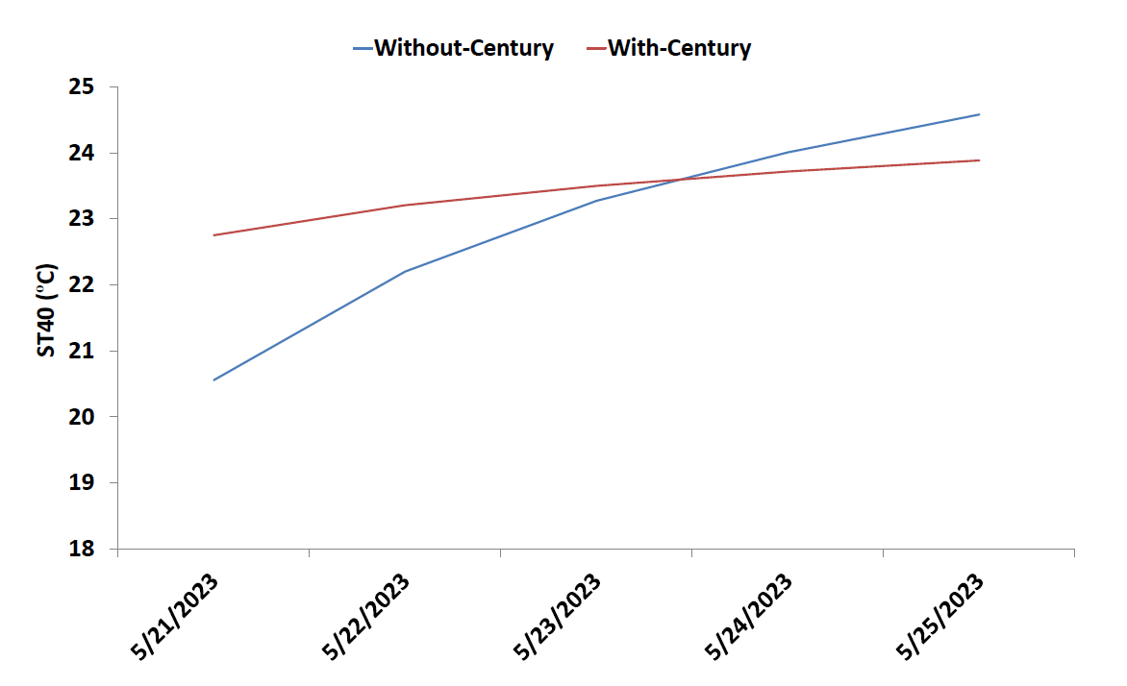
Figure 4. The figure shows the simulated ST40 (in ºC) over the period 21-05-2023 till 25-05-2023. Initializing from zero values (Without-Century) is shown in blue color; while from the Century (With-Century) is presented in red color.

Slide 8
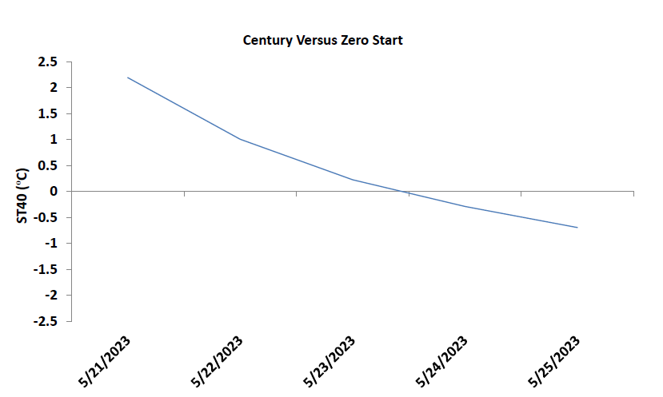
Figure 5. The figure shows the difference between (in ºC) Century and Without-Century over the period 21-05-2023 till 25-05-2023.

Slide 9
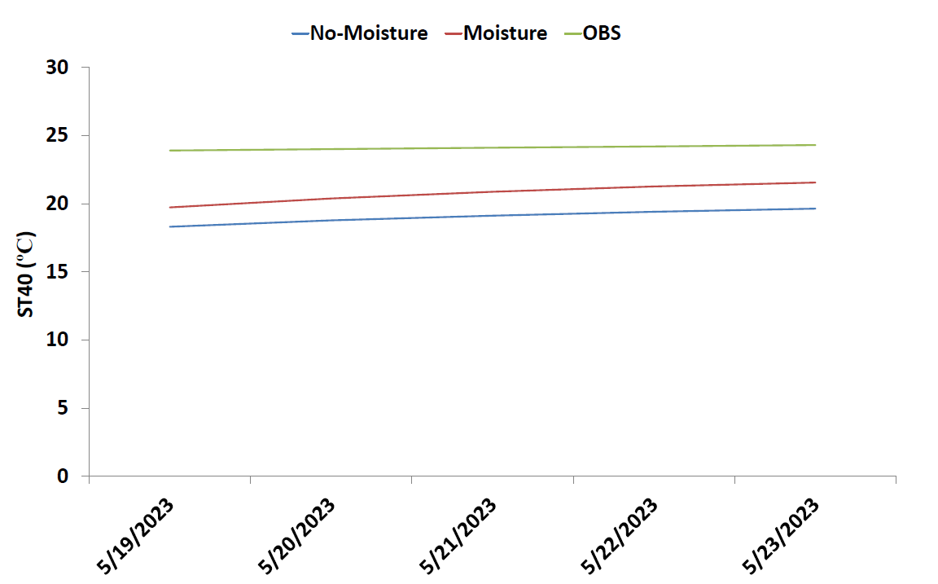
Figure 6. The figure shows the comparison between the NoMoisture (in blue) and Moisture (in red) with respect to the Century reanalysis product (OBS; in green).

Slide 10
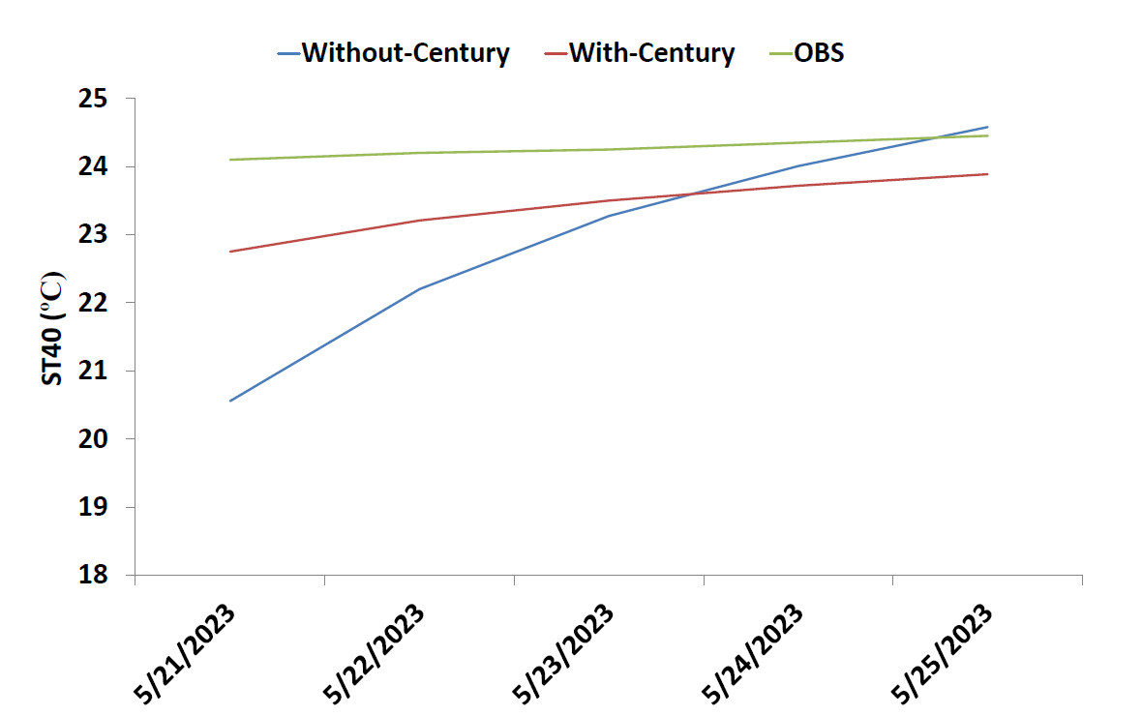
Figure 7. The figure shows the comparison between Without-Century (in blue) and With-Century (in red) with respect to the Century reanalysis product (OBS; in green).

Slide 11
Discussion
Soil temperature is important in monitoring daily agricultural activities as well as controlling the status of the land surface.
When station observation is limited or not available, regional climate models (e.g., RegCM4) are valuable tools to simulate the soil temperature with high-resolution at any grid point. Hence, it was necessary to examine the RegCM4’s performance as reported by Anwar and Hejabi (2023).
In arid regions (as in the present study), the RegCM4 can be sensitive to different initial conditions of the soil temperature and moisture.
To handle this issue, it was necessary to initialize the RegCM4 (with different initial conditions) to ensure a reasonable accuracy of the simulated ST40 especially in places where station observation is not available.
In the present study, the sensitivity of the simulated ST40 (to different initial conditions of the soil moisture and temperature) was investigated using a high-resolution of the RegCM4. To this end, four simulations were conducted and grouped to two cases. The RegCM4 model output was evaluated with respect to the Century reanalysis product (OBS).
The results showed that the simulated ST40 is considerably sensitive to the soil moisture initial conditions. This can be clearly seen as Moisture is warmer than No-Moisture.
Initializing the RegCM4 with the Century product showed a smoother trend and a narrower range of the simulated ST40 than initializing from zero values.
Compared to the Century reanalysis product (OBS), the RegCM4 gives a good performance when it is initialized with the ESACCI/Century products.

Slide 12
Conclusion
The RegCM4 can give a reliable forecast (of the simulated ST40) when it is initialized with the ESACCI satellite soil moisture and a long-term Century reanalysis products.
A future study will consider the following points:
Using a long-term spin-up soil temperature file (as an initial condition) and check its added value with respect to the results reported in the present study.
Addressing the sensitivity of the simulated ST40 to different global reanalysis products of the soil moisture such as Climate Prediction Center (CPC) and ECMWF's atmospheric reanalysis of the 20th century (ERA-20C).

Slide 13
Thank You. Any questions??

