Slide 1
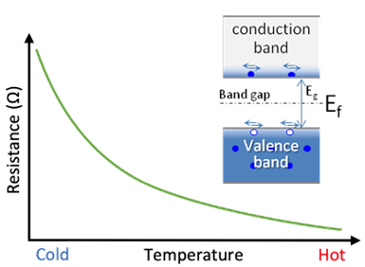
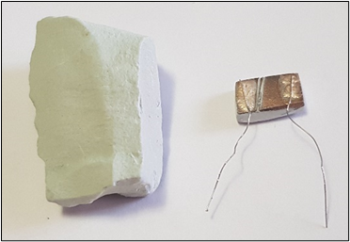
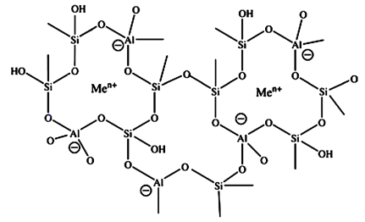
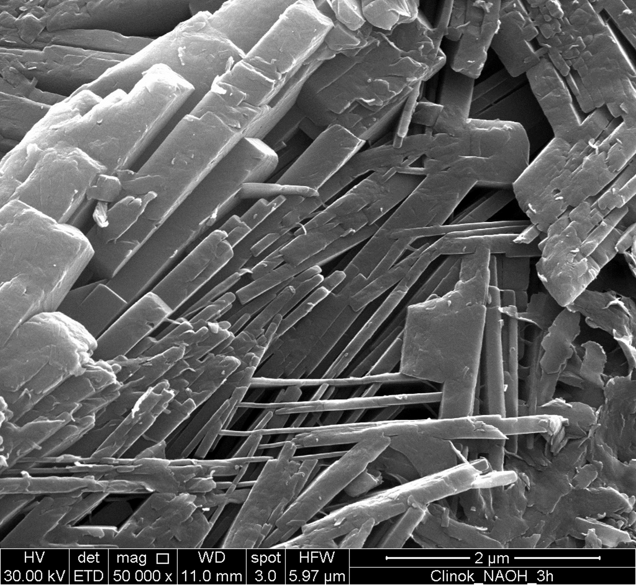
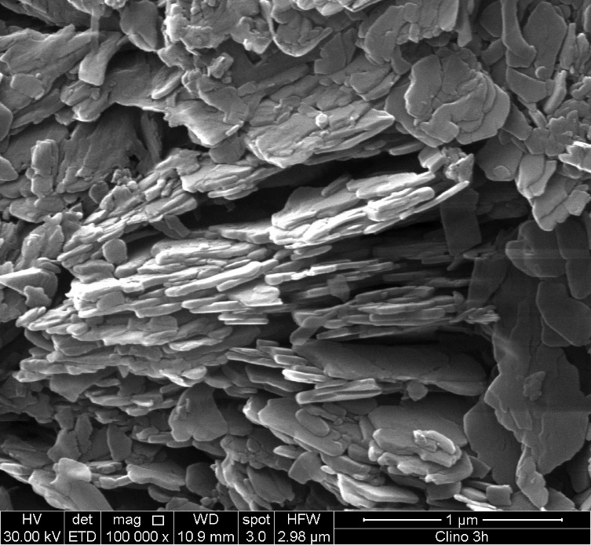
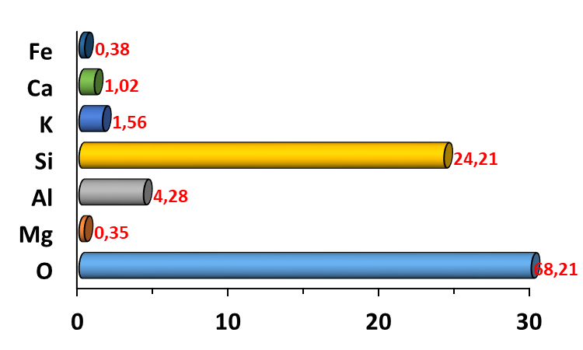
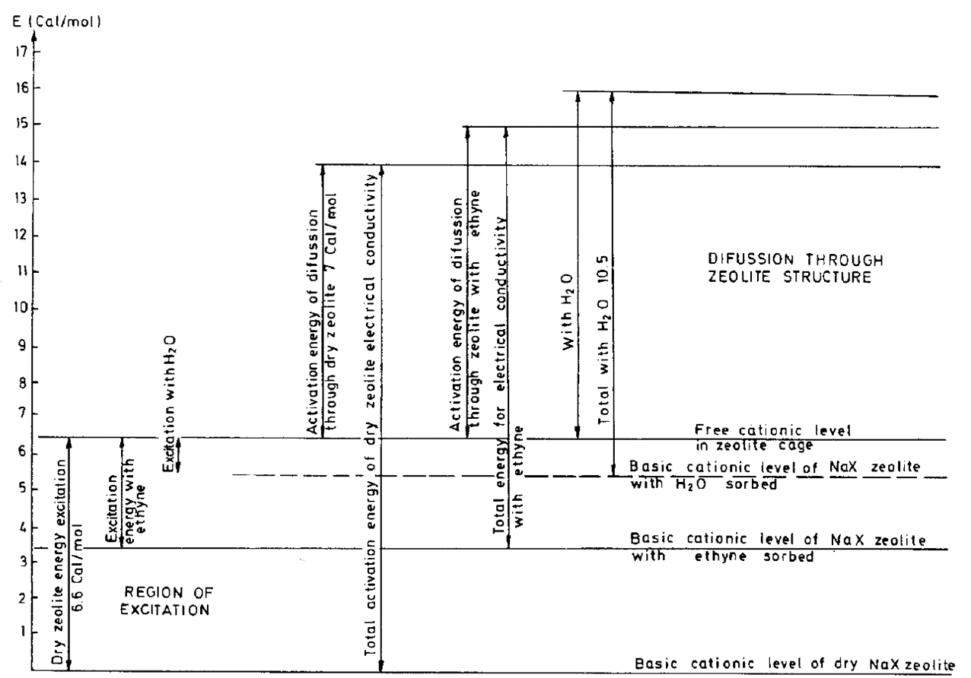
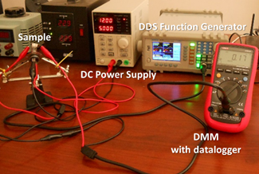
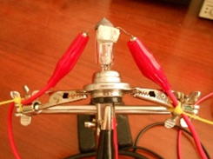
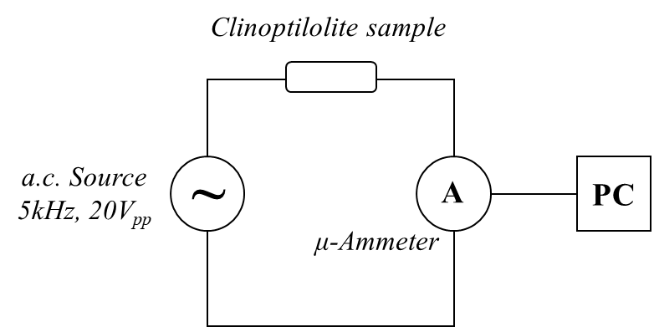
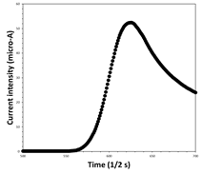
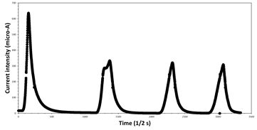
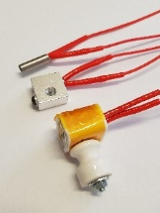
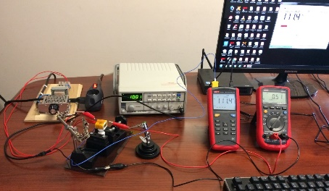
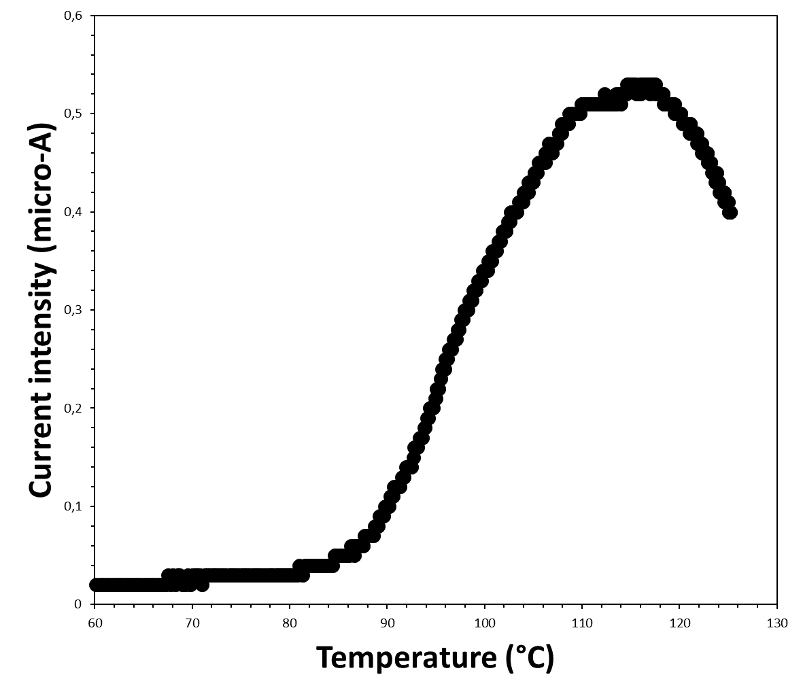
USE OF A NATURAL CLINOPTILOLITE MONOLITH AS NTC-THERMISTOR
Gianfranco Carotenuto^{1,*}, Loredana Schiavo¹
¹ Institute of Polymers, Composites and Biomaterials - National Research Council, Piazzale E. Fermi, 1 - 80055 Portici (NA), Italy.
*Corresponding author (email: giancaro@unina.it)
Abstract. Geomorphic clinoptilolite, a mechanically and thermally stable mineral substance, has very useful electrical properties due to the presence of extra-framework cations in the crystal structure. Indeed, owing to the electrical transport that alkaline-earth metal cations may give, this ceramic material behaves like an electrical insulator at room temperature, while it changes to an electrical conductor with the increasing of temperature. Such unusual electrical property of clinoptilolite can be advantageously exploited for a number of functional applications in the industrial field like, for example, thermal sensors, electrical/thermal switches, thermistors, etc. Here, the capability of a simple natural clinoptilolite monolith to switch from electrical insulator to conductor under fast and slow temperature changes has been investigated by a.c. electrical transport measurements.
Green-Electronics
Material selection: the clinoptilolite mineral
Zeolites are interesting electrical conductors that can be exploited for developing “green thermistors”.
Natural clinoptilolite is one of the most used zeolite for technological applications. It can be useful also for the NTC-thermistors fabrication (see Fig. 2), because of the following reasons:
Thermistor: it is an electrical conductor characterized by a resistance value depending on temperature much more strictly than an ordinary resistor.
Materials Information
Manufacturer:
Technische Produkte, GmbH;
Origin:
Est-Europe;
Silver conductive paint:
XeredEx, XD-120, SGS;
Copper wire:
0,6 mm.
Electrodes were obtained by coating the monolith surface with a thermally-stable silver paint.
(a)
(b)
low Si/Al ratio (good electrical conductivity in temperature);
structural stability at extreme temperature (750°C);
high zeolite content;
no toxic, biocompatible;
stability to water;
low cost;
availability on the market;
wide distribution in the world.
NTC-thermistors: these thermistors have lower resistance at higher temperature. As temperature increases, the resistance of a NTC-thermistor decreases in a non-linear way, according to a particular curve (see Fig. 1). Oxide-based semiconductor NTC-thermistors are typically adopted for sensing applications.
Figure 1. R-T plot for a NTC thermistor.
Figure 2. Clinoptilolite mineral-form (a) and the achieved NTC-thermistor (b).
Clinoptilolite texture and chemical composition
The clinoptilolite conduction model
SEM analysis (see Figure 3 a,b) shows that the clinoptilolite matrix is made of randomly oriented stacks of lamellar crystals. All lamellas have the same thickness (40nm) and the other two sizes are of a few hundred microns. Owing to the high clinoptilolite content, the electrically conductive zeolite lamellar crystals are interconnected and form a percolation network, with paths crossing the full solid structure.
Zeolites are low-density crystalline aluminosilicates (see Fig. 4), containing:
a covalent crystalline structure;
several extra-framework charges.
Vučelić defined this particular structure as a ‘reverse’ metal lattice. According to the electrical conduction model of Vučelić, only those extra-framework charges moving in a ‘free ionic conduction zone’ (i.e., the free cationic conduction band located in the middle of channels) can promote electrical conduction. Indeed, ions at the centers of cavities are carrier of current and move through the zeolite with a low activation energy (see Fig.5).
(a)
(b)
(c)
Figure 4. Schematic representation of the zeolite crystalline structure.
The clinoptilolite electrical conductivity, σ(T), depends only on the following three factors: (i) charge of the electrical carriers: Z∙e⁻, where e⁻ is the elementary charge (e⁻=1.602∙10⁻¹⁹ C), (ii) concentration of the electrical carriers: [Me^{Z+}], and (iii) mobility of the electrical carriers: μ, according to the following physical law: σ(T)= Σ_{i}[Z_{i}∙e⁻∙[Me^{Z+}]_{i}∙μ_{i}], where the sum is formally extended to all extra-framework cations present in the substance. However, since the tested sample is clinoptilolite-K,Ca, excited potassium ions located in the super-cage centers are principally involved in the migration under the applied sinusoidal signal. Finally, it is possible to approximately write:
Figure 3. SEM micrographs of clinoptilolite lamellas presents in the mineral (a,b) and chemical composition of the sample obtained by EDS-analysis (c).
The Si/Al atomic ratio is a determining factor for the zeolite properties because the Al-O bond is weaker than the Si-O bond (the Al-O bond is longer and less polarized). The Si/Al atomic ratio defines the mechanical/chemical stability, the ion exchange capability and the electrical conductivity of these materials.
This ratio has been determined by using EDS analysis (see Figure 3,c). It resulted of 5.6, which is a characteristic value for this mineral. In addition, the same EDS analysis has shown that K⁺ and Ca²⁺ are the most abundant types of charge compensating cations and therefore the mineral sample consists of clinoptilolite-K,Ca.
Figure 5. Cationic conduction band of the Vučelić model.
σ(T)= e⁻∙[K⁺]*∙μ_{K}
where [K⁺]* is the concentration of excited K⁺ cations. Each K⁺ ions is in a potential well generated by the four negatively-charged oxygen atoms and the concentration of excited K⁺ present at zeolite cage center is temperature-dependent, indeed it increases with raising of temperature, thus determining an increase in the material electrical conductivity.
Clinoptilolite as NTC-Thermistor
The NTC behaviour of geomorphic clinoptilolite can be technologically exploited for different device types, like for example a fast thermal switch. Such system is a sensing device capable of rapidly detecting the presence of a surface at a temperature higher than 100°C. To test the clinoptilolite behaviour under fast uncontrolled heating, two electrodes were placed on the surface of a clinoptilolite monolith and this simple device was thermally connected with the light bulb surface. The electric current intensity was measured by a true-RMS digital multimeter (DMM) placed in series with a sinusoidal signal generator. Electric signals were measured and recorded during the time by using the devoted DMM datalogger.
The effect of a fast increase of temperature on the mobility of the extra-framework cations (actually, K⁺ is the only really involved cation type) has been investigated by monitoring, during a rapid heating process, the change of the current intensity in the sample, biased by a constant a.c. sinusoidal voltage value. In particular, the small piece of clinoptilolite was polarized by using an a.c. voltage source (sinusoidal voltage signal of 20Vpp, 5kHz) and the current intensity moving in it was measured by connecting a wide-band true-RMS digital multimeter (DMM), set as a.c. micro-ammeter, in series with the sample (see Fig. 5). A direct digital synthesis (DDS) function generator (Gratten, ATF20B+) was used as voltage source and a true-RMS, 10kHz bandwidth, DMM (Uni-Trend, UT61E) was used as a.c. micro-ammeter. The effective current intensity value (Ieff) was recorded on a PC by a devoted datalogging software (see Fig. 5, a).
Fast heating of the specimen was achieved by placing its free-from-electrodes surface in contact with the glass bulb surface of an halogen lamp, powered by a D.C. power supply (Velleman, LABPS 3005D). A ceramic silver thermal paste was placed between the specimen and the glass bulb surface in order to allow efficient heat transfer.
(a)
(c)
(b)
(a)
OFF
(b)
As visible in Fig.6-a, the application of a thermal pulse to the clinoptilolite monolith promptly caused the formation of an electrical micro-current in the ceramic sample. During the successive cooling step (i.e., turning off of the incandescent lamp), the current intensity readily decreased until a negligible value. The resulting peak had a slightly asymmetric profile. Fig.6,b shows as repeated heating/cooling steps did not modified the electric behaviour of such simple thermal device.
Figure 5. Experimental setup used to test the clinoptilolite-based device thermal behaviour under a fast, uncontrolled heating (a); detail of the incandescent light bulb used to produce such type of heating (b); schematic representation of the electric circuit (c).
ON
Figure 6. Change in the current intensity as an effect of the turning on/off of the halogen light bulb (a); successive thermal pulses applied to the NTC–material.
Heating tests at calibrated temperature were also performed (see Fig. 7). In this case also temperature was measured during the time. The sample heating was achieved by using an aluminium block containing a ceramic heater cartridge and the sample was thermally insulated by a layer of Kapton/cotton wool (the heating block set of a 3D-printer was used for this purpose). A digital thermometer (Uni-Trend, UT-325) was used to measure and record the temperature during time.
As visible in Fig.7-b, also a slow heating process was capable to give a quite symmetric I_{eff} – T peak, just like in the thermal-pulse case. The temperature threshold, determined by calibrated electrical measurements, resulted of ca. 90°C.
Figure 7. Experimental setup used for the calibrated temperature tests (a) and obtained I_{eff}-T curve (b).
Conclusions. Zeolites have a temperature-dependent electrical conductivity, that can be exploited to fabricate useful thermal devices. Here, a thermal switch has been fabricated simply by painting two silver electrodes on the surface of a piece of geomorphic clinoptilolite. Fast heating tests showed a prompt and completely reversible change in the device electrical conductivity. In particular, this simple device switched from an electrical insulator to a good electrical conductor above a certain temperature threshold. This temperature threshold was determined by calibrated electrical measurements and it resulted of ca. 90°C.
Acknowledgments. The authors are grateful to Maria Cristina Del Barone of LAMEST laboratory (IPCB-CNR) for SEM analysis, to Mario De Angioletti of (IPCB-CNR) for his technical support and useful discussion, to Alessandra Aldi and to Maria Rosaria Marcedula of (IPCB-CNR) for the technical support.

