Slide 1

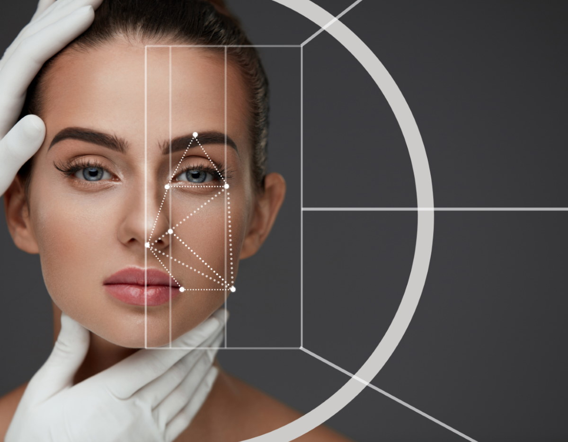
Ministry of Higher Education and Scientific Research
University Of El Oued
Facial Beauty Prediction using an Ensemble of Deep Convolutional Neural Networks
Presented by:
Djamel Eddine BOUKHARI
boukhari-djameleddine@univ-eloued.dz

Slide 2

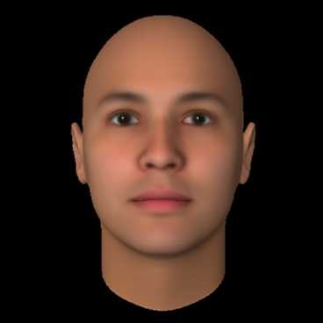

CONTENTS
Introduction
Key Problems and Difficulties
Proposed Method
Experimental Result of EN-CNNs
Conclusion and Perspective

Slide 3





Introduction
Facial beauty analysis is an emerging topic. The study of facial beauty has attracted efforts of researchers from diverse fields.
Face Analysis to recognize facial attributes (such as gender, race, beauty, age, expression, etc.) from a portrait image. It has been widely used among SNS and short video platforms (like TikTok, Facebook and Instagram).
History of Facial Beauty Research
The exploration of human physical beauty dates back 4000 years.
In 1960s, two important findings facilitated the study of facial beauty in the psychological field.
Left Marquardt’s Phi mask Right Egyptian queen Neferneferuaten Nefertiti (1370–1330 BC)

Slide 4
Key Problems and Difficulties
Key Problems
Difficulties
Deepen the understanding of facial beauty perception.
More accurate facial beauty prediction.
Face beautification. It is a typical application of the learned facial beauty rules and models.
Develop application systems.
Computer-based facial beauty analysis
There is no public database for facial beauty study.
The goal of facial beauty analysis is different from other facial analysis tasks.
In facial beauty study, perception experiments have to be often carried out, which require a lot of labor and time consumption.

Slide 5
Facial Beauty Prediction Methods
02
Semi-supervised Learning
Manifold-learning FSCLDE, NFME ..etc
Methods
of Facial Beauty Prediction
01
Supervised Learning
A meta-learning, Manifold-learning, MT-ResNet, Residual-in-residual Nets, AaNet , R3CNN, CRNet, PI-CNN ..etc

Slide 6
Proposed Method
Images dataset
S-CNN
Training Dataset
Inception-v3
Ensemble
FBP Score
Testing Dataset
MobileNetV2
Figure: Proposed deep CNN ensemble networks (EN-CNNs)

Slide 7
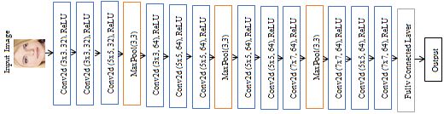
S-CNNs Network Proposed
Figure. The architecture of proposed S-CNNs network

Slide 8
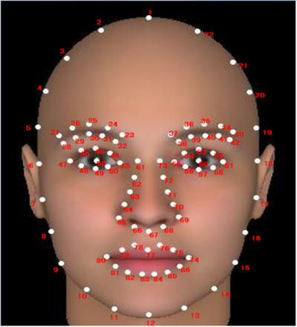
Xccelerate FTDS
Project 3 - Deep Learning
Experimental Result
of EN-CNNs
Group member:
Eva,Ian,Tony
Notes:
Experimental Result of Facial Beauty Prediction

Slide 9
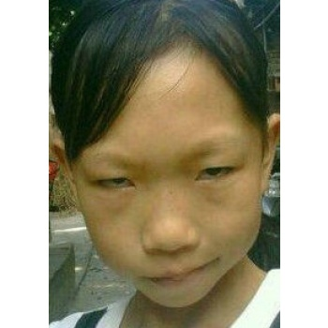
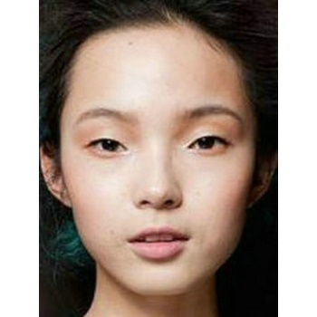
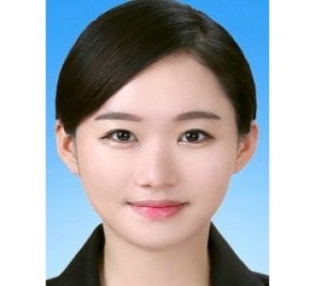
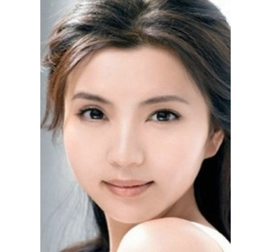
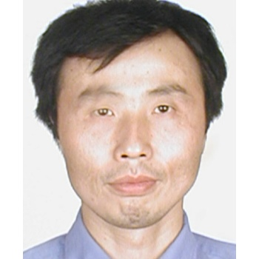
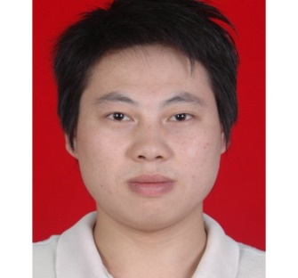
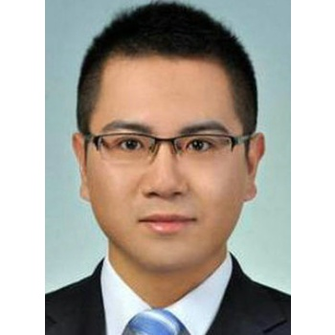
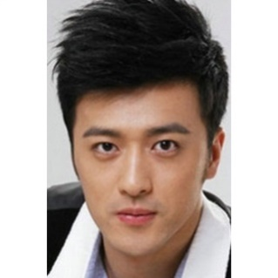
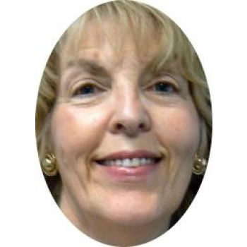
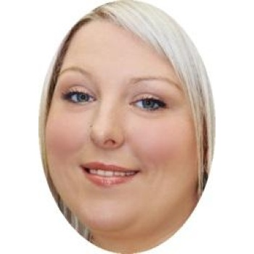
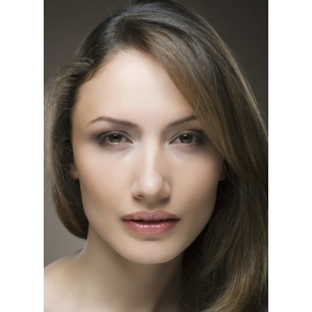
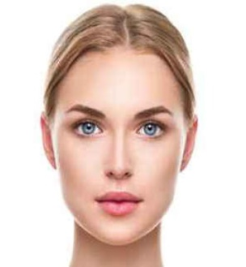
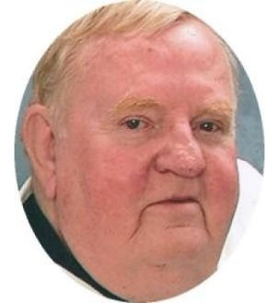
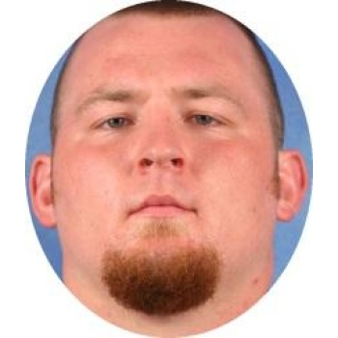
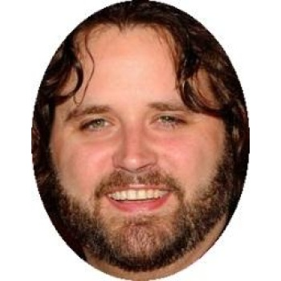
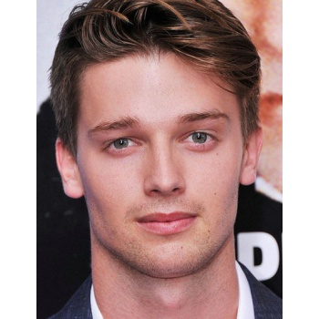
Facial beauty samples from the SCUT-FBP5500 database used
(a) Female Asian
(b) Male Asian
(c) Female Caucasian
(d) Male Caucasian

Slide 10
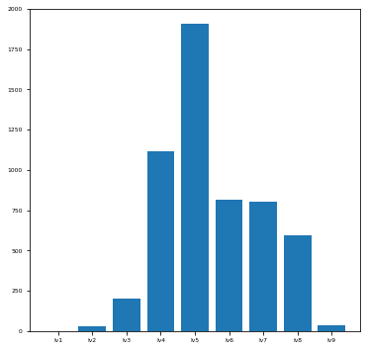
Scores SCUT-FBP 5500
Lv1 : x<1 : 0
Lv2 : x>=1 and x<1.5 : 28 items
Lv3 : x>=1.5 and x<2 : 203
Lv4 : x>=2 and x<2.5 : 1115
Lv5 : x>=2.5 and x<3 : 1907
Lv6 : x>=3 and x<3.5 : 814
Lv7 : x>=3.5 and x<4 : 801
Lv7 : x>=4 and x<4.5 : 594
Lv9 : x>=4.5 : 38
Total : FBP 5500

Slide 11
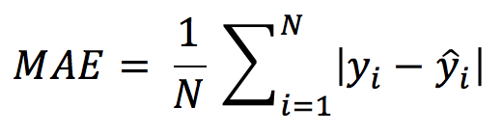
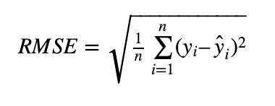
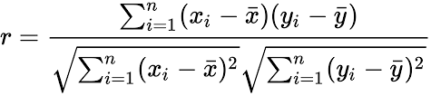
Performance Evaluation
Mean Absolute Error (MAE)
Root Mean Squared Error (RMSE)
Pearson Correlation (PC)

Slide 12
Result of Proposed Method
Table 1. Performance comparisons on the SCUT-FBP5500 dataset
Methods | Pre-training | MAE | RMSE | PC
AlexNet [15] ResNet-18 [15] ResNeXt-50 [15] | ImageNet ImageNet ImageNet | 0.2651 0.2419 0.2291 | 0.3481 0.3166 0.3017 | 0.8634 0.8900 0.8997
CNN – SCA [5] R3CNN [16] Semi-supervised[20] CNN-ER [22] NAS4FBP Net [23] | ImageNet ImageNet VGGFace2 VGGFace2 ImageNet | 0.2287 0.2120 0.2210 0.2009 0.1939 | 0.3014 0.2800 0.2870 0.2650 0.2579 | 0.9003 0.9142 0.9113 0.9250 0.9275
EN-CNN Ours | ImageNet | 0.1933 | 0.2482 | 0.9350

Slide 13
Result of Proposed Method
Figure : Performance comparisons on the SCUT-FBP5500 dataset

Slide 14
Conclusion and perspective
We studied Convolutional Neural Networks (CNN).
In this work, we popose an ensemble of deep CNNs for the facial beauty prediction.
we propose a new ensembles are three separate deep convolutional neural networks, each with a unique structural representation built by previously trained models from Inceptionv3, Mobilenetv2 and a new simple network based on Convolutional Neural Networks (CNNs) for facial beauty prediction problem
The experimental findings show that our network can perform better than previous CNN baselines approaches.
we propose to expand the scope of database and improve network using different architectures collected from Transfomer and ResNeSt.

Slide 15
THANK YOU
For your Attention

