Slide 1
Consumer Attitude Towards Food Additives – A Case Study
Pramod Bandara, Pramod Bandara, Narmada Weerakkody, Niroshan T, Thivya V
Department of Food Science & Technology, Faculty of Applied Sciences,
Sabaragamuwa University of Sri Lanka, Belihuloya, Sri Lanka

Slide 2
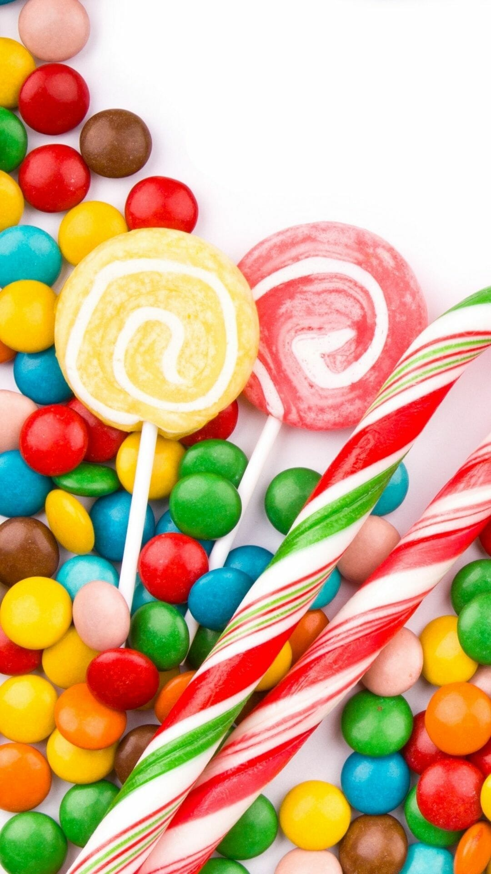
Content
Introduction
Objectives
Methodology
Sociodemographic characteristics
Results and discussion
Overall attitude of consumers
Conclusions
References

Slide 3
Introduction
Food additives are used to improve flavor, texture, or for preserving the food (Kaptan & Kaysoglu, 2015)
It can be divided into preservatives, nutritious additives, flavoring agents, coloring agents, texturizing agents, and miscellaneous additives (Carocho et al., 2014)
The European Union - E system
Codex Alimentarius Commission – International Numbering System (INS) (Altu & Elmaci, 1995; Nadia et al., 2014; Tarnavölgyi, 2003)
A Joint FAO/WHO Expert Committee on Food Additives is the international body responsible for the evaluating the safety of the food additives

Slide 4
Objectives
Overall objectives
To assess the consumer attitudes towards the food additives
Specific objectives
To identify the consumer awareness on the use of food additives
To evaluate the consumer knowledge on food additives and their applications
To evaluate the consumer attitude on the safety aspects of food additives
To evaluate the consumer awareness on regulations on food additives in Sri Lanka
To compare the attitudes towards food additives among different demographic characteristics
To identify overall attitude on the food additives in terms of safety, application and food quality

Slide 5
Methodology
Developing a structured questionnaire using google form
Sharing the questionnaire among respondents
Collecting data (504 respondents)
Analyzing the data using Chi square test of association (Minitab 19.0)
Interpretation and discussion

Slide 6
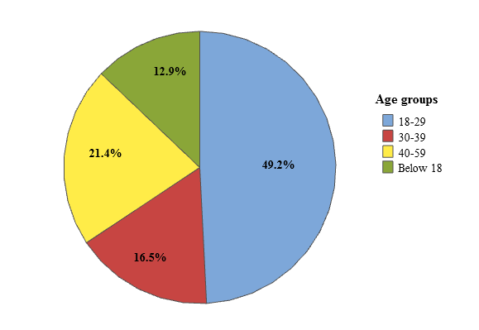
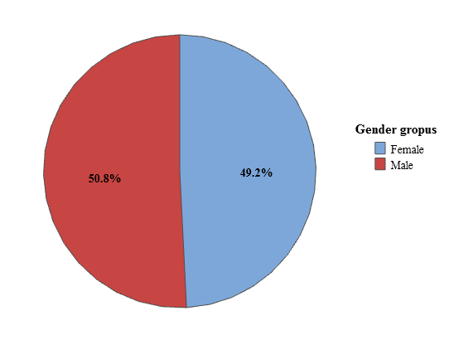
Socio-demographic characteristics
groups
Fig 01: Age distribution of the selected respondents
Fig 02 : Gender distribution of the selected respondents

Slide 7
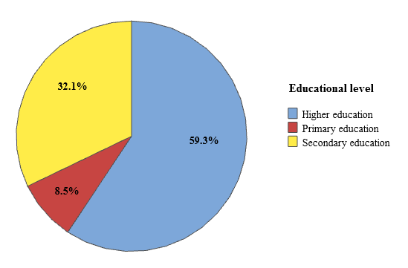
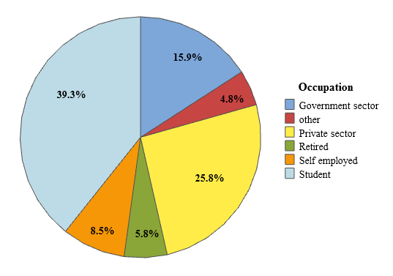
Socio. cont.
Fig 03 :Educational levels of selected respondents
Fig 04 :The occupations of selected respondents

Slide 8
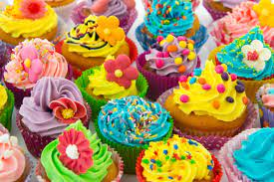
Consumer attitudes
Attitude of paying more for foods without food additives
Attitude towards the type diseases caused by additives
Attitude towards food additive Mono Sodium Glutamate (MSG)
Awareness on regulations on food additives in Sri Lanka
Attitude of using food additives in food processing
Attitude that food additives cause disease and health issues
Awareness on E and INS numbering system
Attitude towards food colorings

Slide 9
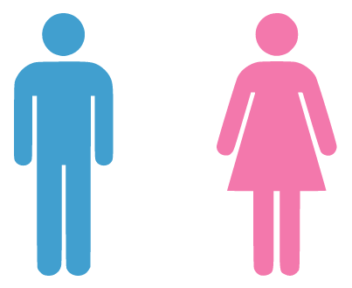
INFLUENCE OF GENDER FOR CONSUMER ATTITUDES TOWARDS FOOD ADDITIVES

Slide 10
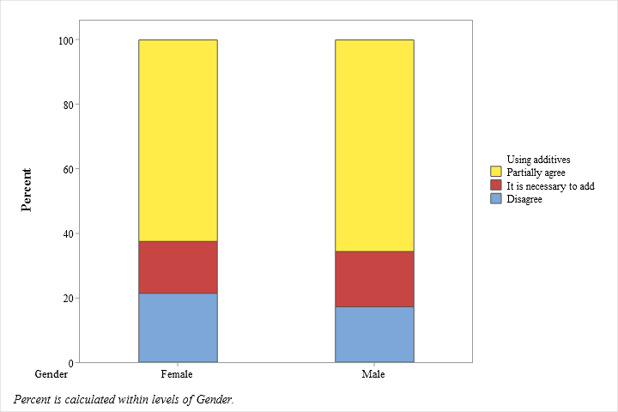
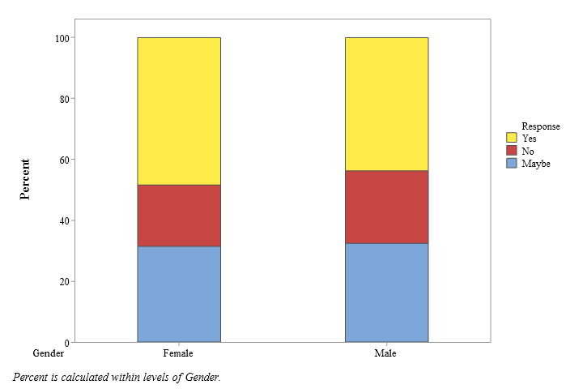
Results
Fig 05: Attitude of using food additives in food processing
Fig 06: Attitude of paying more for foods without food additives

Slide 11
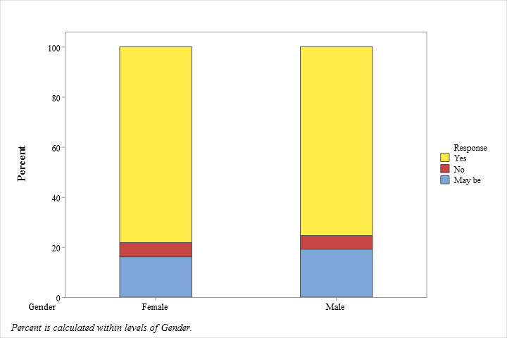
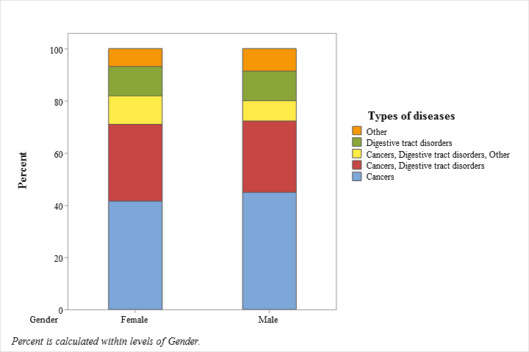
Results cont.
Fig 07: Attitude that food additives cause disease and health issues
Fig 08: Attitude on the type diseases caused by additives

Slide 12
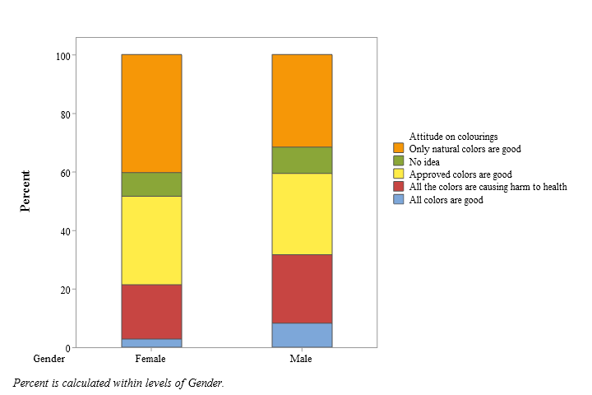
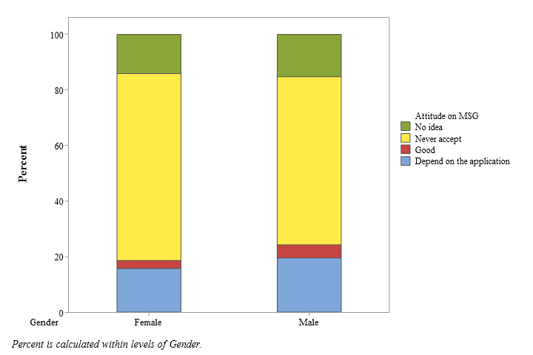
Results cont.
Fig 09: Attitude towards the food additive MSG (INS 621)
Fig 10: Attitude towards the food colorings (p<0.05)

Slide 13
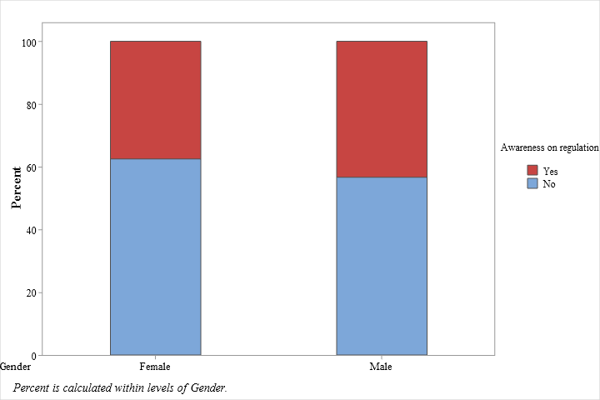
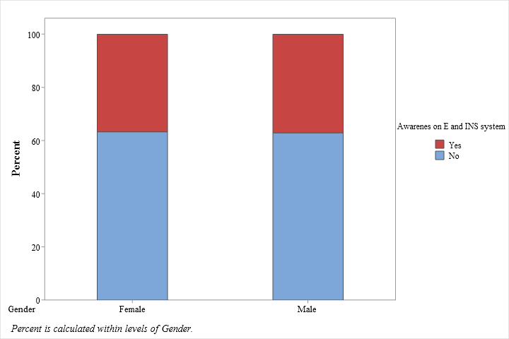
Results cont.
Fig 11: Awareness of regulations on food additives in Sri Lanka
Fig 12: Awareness of E and INS numbering system

Slide 14
INFLUENCE OF OCUUPATION FOR CONSUMER ATTITUDES TOWARDS FOOD ADDITIVES

Slide 15
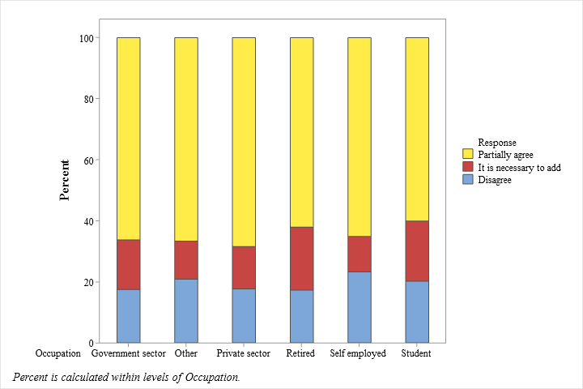
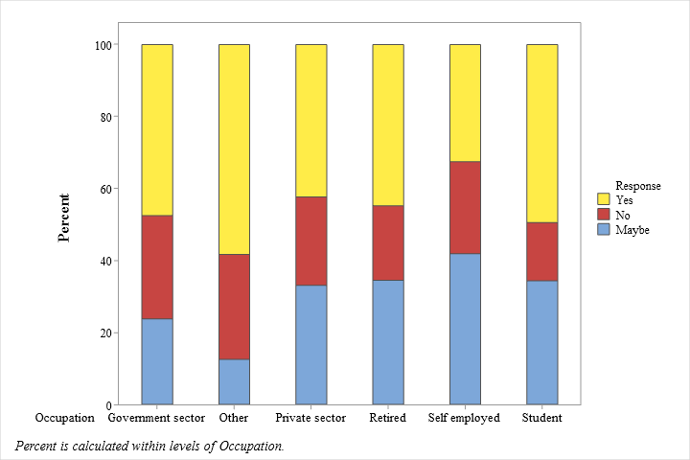
Results cont.
Fig 13: Attitude of using food additives in food processing
Fig 14: Attitude of paying more for foods without food additives

Slide 16
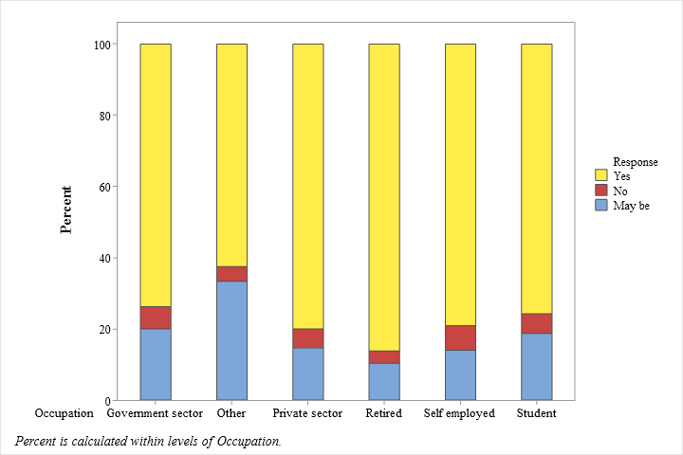
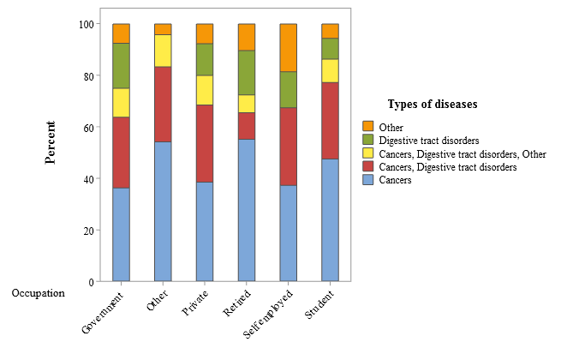
Results cont.
Fig 15: Attitude that food additives cause disease and health issues
Fig 16: Attitude on the type of diseases caused by additives

Slide 17
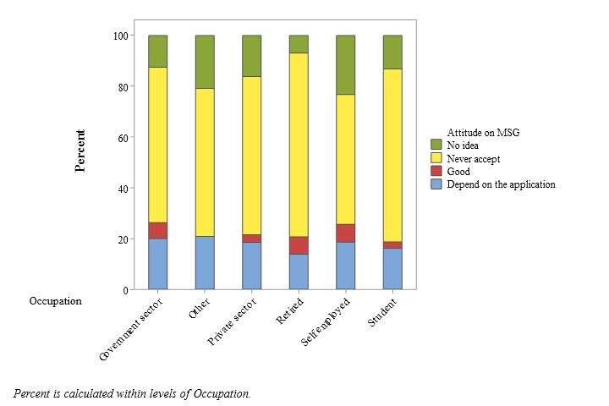
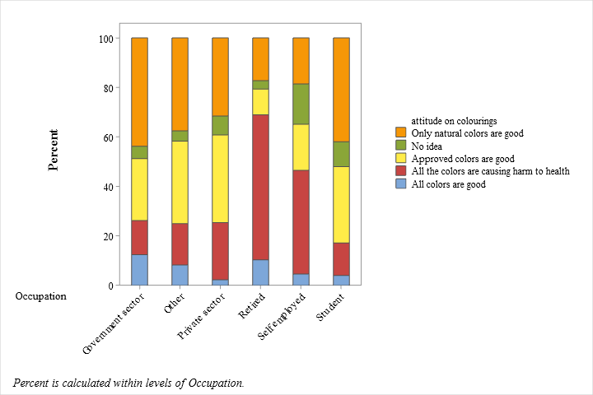
Results cont.
Fig 17: Attitude towards the food additive MSG (INS 621)
Fig 18: Attitude towards the food colorings

Slide 18
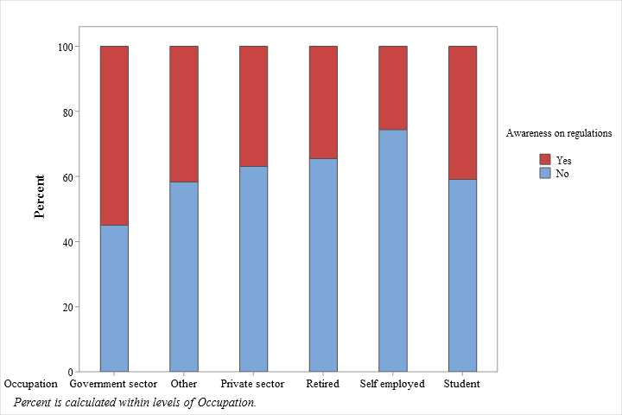
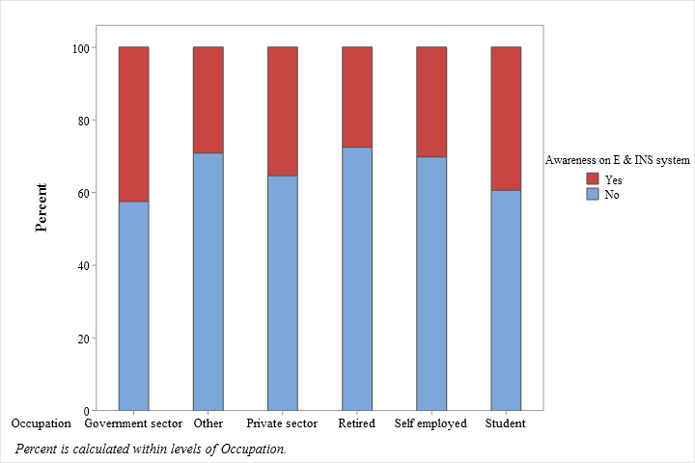
Results cont.
Fig 19: Awareness of regulations on food additives in Sri Lanka
Fig 20: Awareness of E and INS numbering system

Slide 19
INFLUENCE OF THE AGE GROUP FOR THE ATTITUDES TOWARDS FOOD ADDITIVES

Slide 20
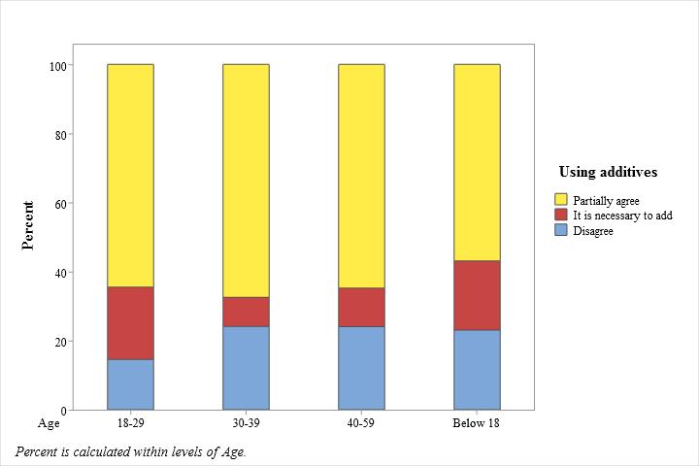
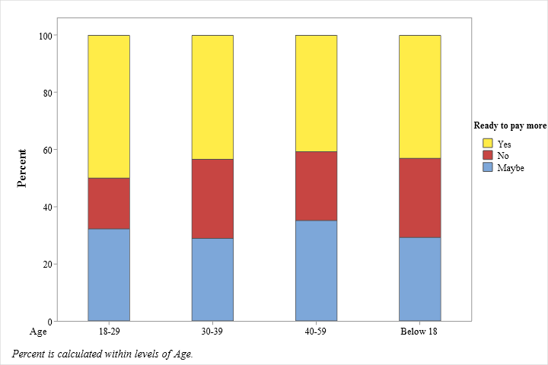
Results cont.
Fig 21: Attitude of using food additives in food processing (p<0.05)
Fig 22: Attitude of paying more for foods without food additives

Slide 21
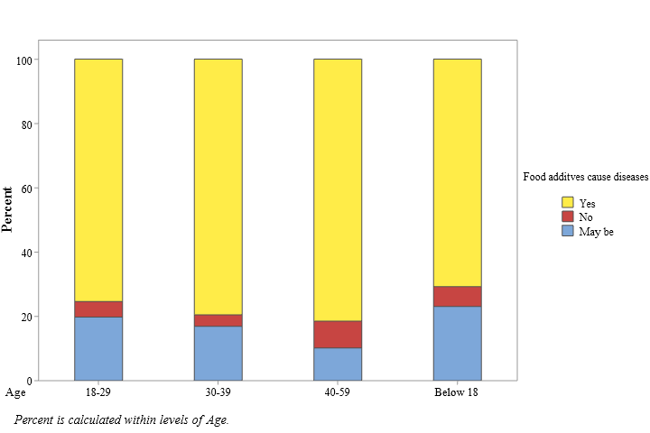
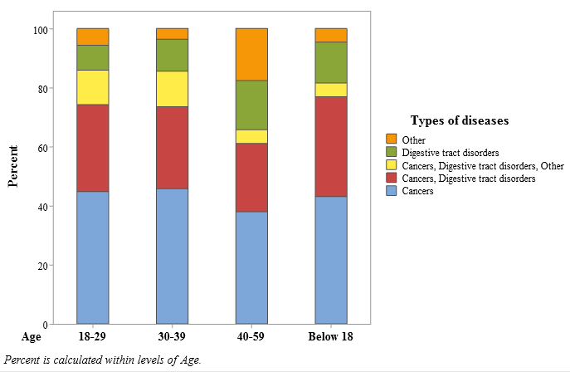
Results cont.
Fig 23: Attitude that food additives cause disease and health issues
Fig 24: Attitude on the type diseases caused by additives (p<0.05)
Survey by Zugravu et al., (2017) repotted that 83.60% of the population thought food additives are dangerous to health Similarly

Slide 22
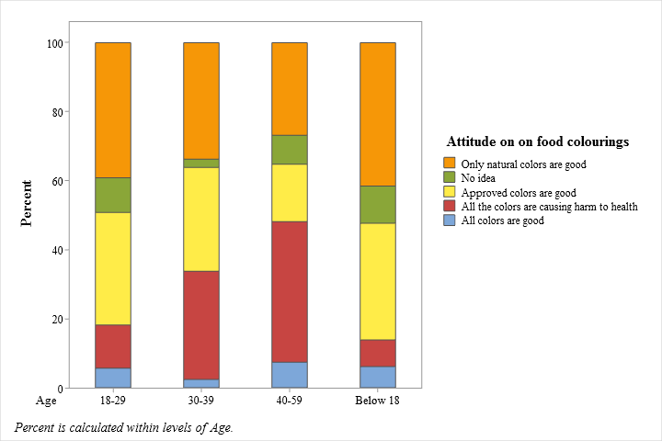
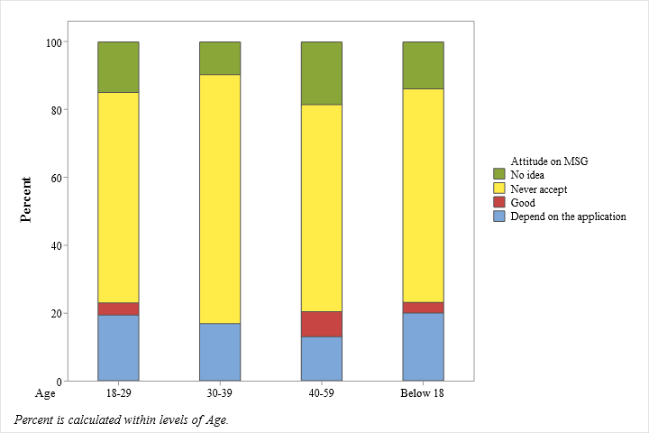
Results cont.
Fig 25: Attitude towards the food additive MSG (INS 621)
Fig 26: Attitude towards the food colorings
Most of the United States (U.S) consumers had a negative attitude towards the MSG (Wang & Adhikari, 2018)

Slide 23
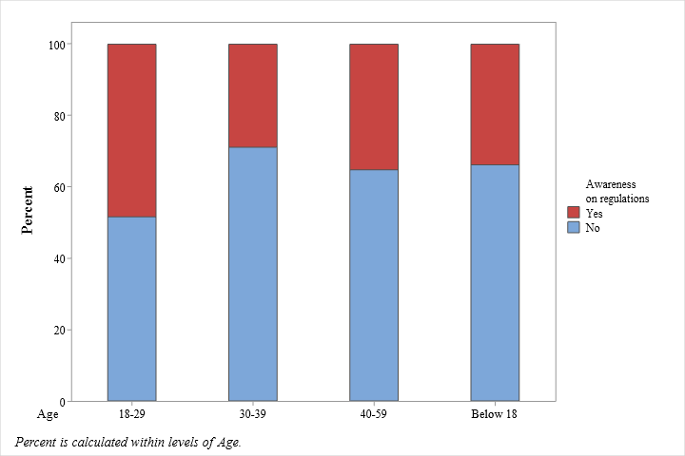
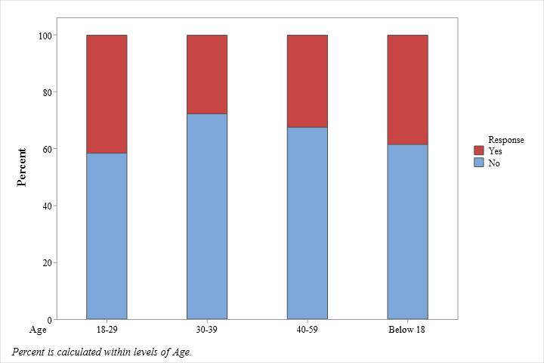
Results cont.
Fig 27: Awareness of regulations on food additives in Sri Lanka (p<0.05)
Fig 28: Awareness of E and INS numbering system

Slide 24
INFLUENCE OF EDUCATIONAL LEVEL FOR CONSUMER ATTITUDES TOWARDS FOOD ADDITIVES

Slide 25
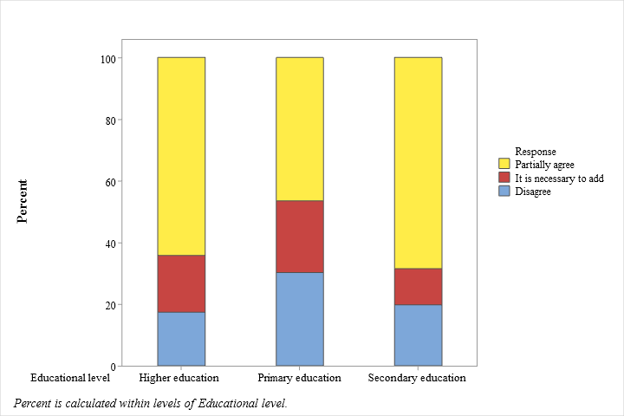
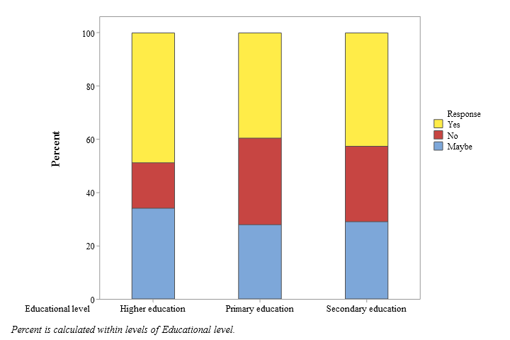
Results cont.
Fig 29: Attitude of using food additives in food processing
Fig 30: Attitude of paying more for foods without food additives (p<0.05)

Slide 26
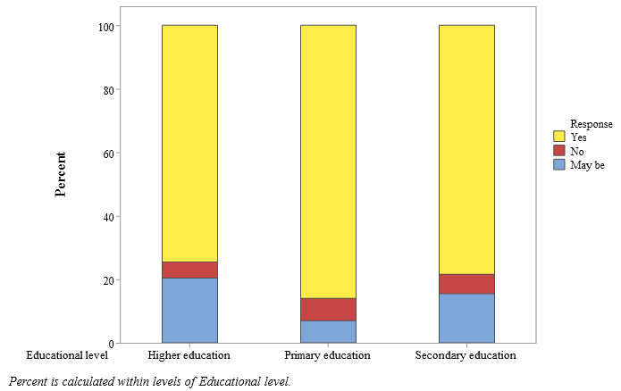
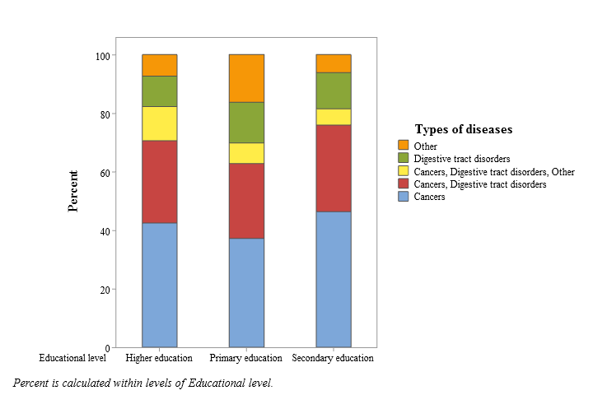
Results cont.
Fig 31: Attitude that food additives cause disease and health issues
Fig 32: Attitude on the type diseases caused by additives

Slide 27
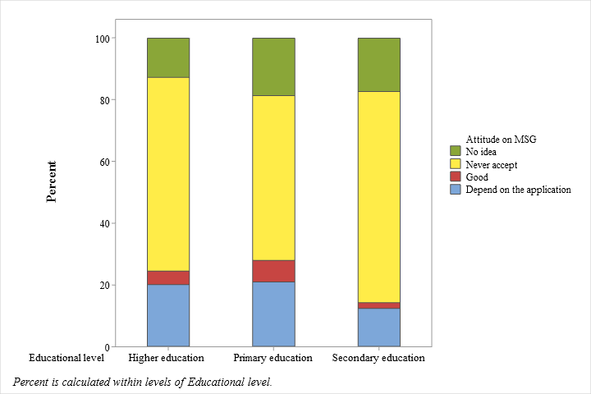
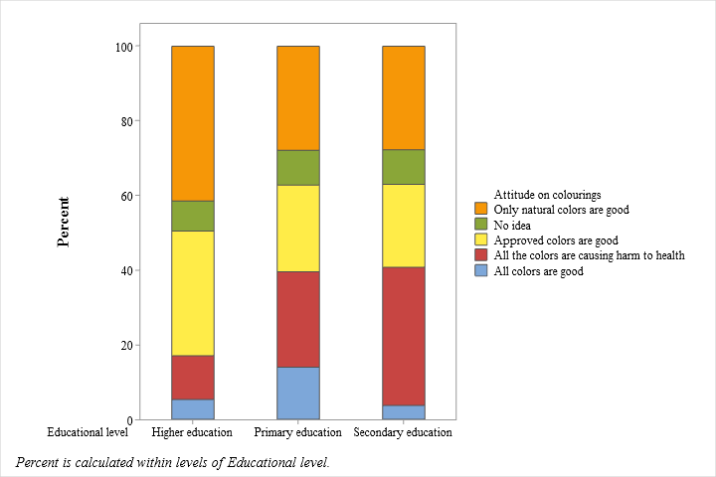
Results cont.
Fig 33: Attitude towards the food additive MSG (INS 621)
Fig 34: Attitude towards the food colorings

Slide 28
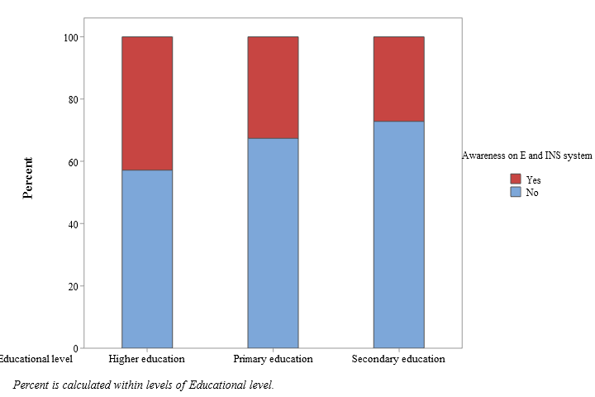
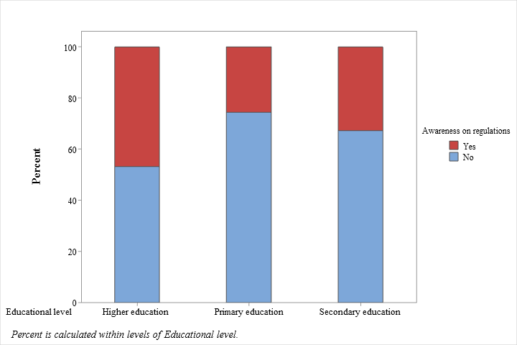
Results cont.
Fig 35: Awareness of regulations on food additives in Sri Lanka
Fig 36: Awareness of E and INS numbering system

Slide 29
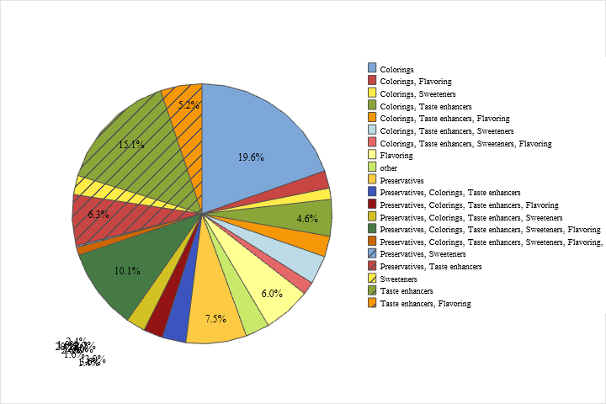
Overall effect
Fig 37: Attitude on un-healthy food additives
Survey by Zugravu et al., (2017) reported that preservatives and colourings were considered as most unsafe additives

Slide 30
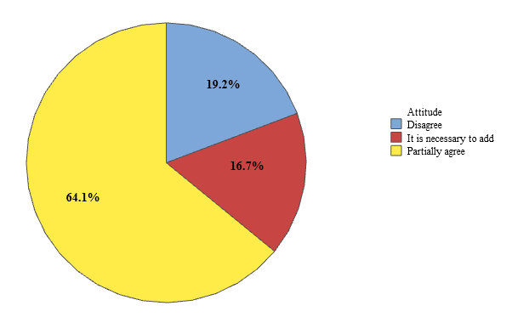
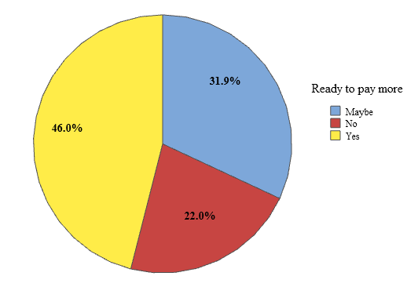
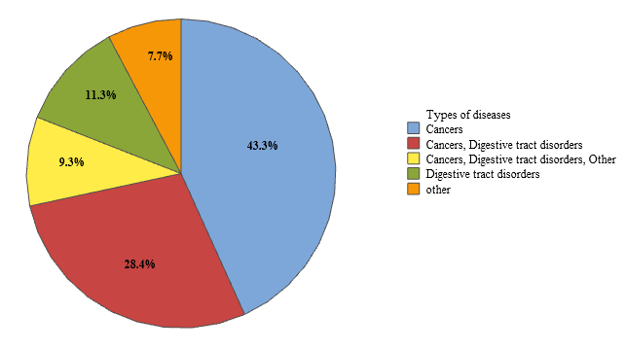
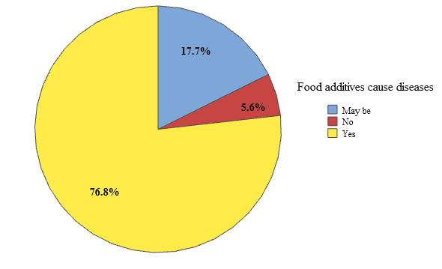
Overall cont.
Fig 38: Overall attitude on using food additives
Fig 39: overall ready to pay more for foods without additives
Fig 40: Overall on safety in terms of disease caused

Slide 31
Conclusions
Irrespective of age, gender, occupation and educational level most of the people showed a negative attitude towards the food additives and majority of the respondents didn’t have a sound knowledge on food additives and their attitudes reflected indecision and certain misconceptions
Recommendation: awareness programmes on food additives

Slide 32
References
Al-Harthy, A., Harib, A., Al-Shaaibi, A., Al-Toubi, S., & AbuKhader, M. (2016). Food Additives Content in Selected Snack Foods and Beverages and Public Perception of E-Numbers in Muscat, Oman. Athens Journal of Health, 4(1), 83–96.
Carocho, M., Barreiro, M. F., Morales, P., & Ferreira, I. C. F. R. (2014). Adding molecules to food, pros and cons: A review on synthetic and natural food additives. Comprehensive Reviews in Food Science and Food Safety, 13(4), 377–399.
Food Act No 26. 1980, https://www.ecolex.org/details/legislation/food-act-1980-no-26-of-1980-lex-faoc014452/>
Kaptan, B., & Kayısoglu, S. (2015). Consumers’ attitude towards food additives. American Journal of Food Science and Nutrition Research, 2(2), 21–25. http://www.openscienceonline.com/journal/fsnr
Nadia Shaheen Koyratty, B., Aumjaud, B., & Amnee Neeliah, S. (2014). Food additive control: A survey among selected consumers and manufacturers. British Food Journal, 116(2), 353–372.
Tarnavölgyi, G. (2003). Analysis of Consumers´ Attitudes Towards Food Additives Using Focus Group Survey. Agriculturae Conspectus Scientificus (ACS), 68(3), 193–196
Wang, S., & Adhikari, K. (2018). Consumer perceptions and other influencing factors about monosodium glutamate in the United States. Journal of Sensory Studies, 33(4)
Zugravu, C. A., Pogurschi, E., & Nicolae, C. (2017). Attitudes towards food additives : A pilot study The Annals of the University Dunarea de Jos of Galati. February.

Slide 33
THANK YOU…

