Slide 1
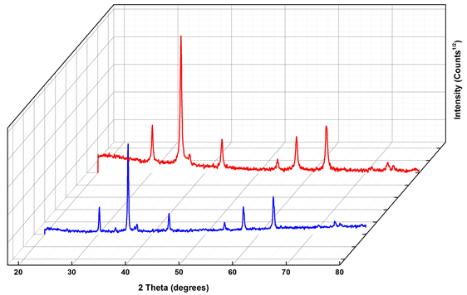
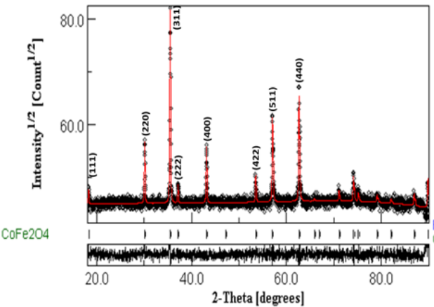
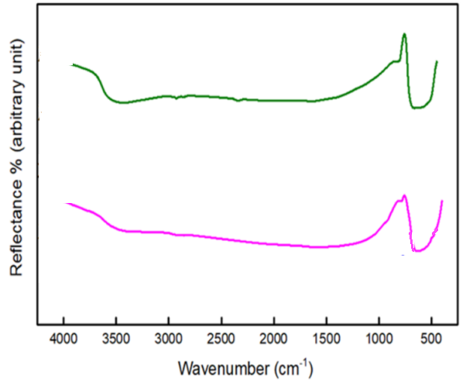
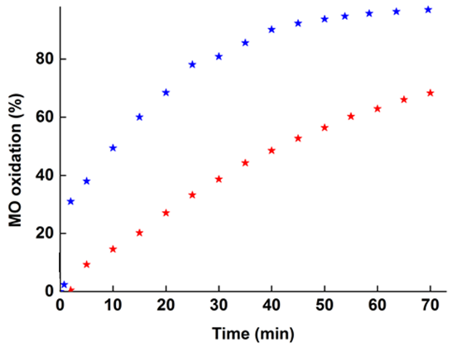
CoFe₂O₄ spinel used as a catalyst for the degradation of organic dyes
K. DADDA^{1,*}, S. DJERAD²
¹Laboratoire des Matériaux Semi-conducteurs et Oxydes Métalliques (LMSOM), Faculté de Physique, Université des Sciences et de la Technologie Houari Boumediene Alger (USTHB), Algérie
²Laboratoire de Génie de l’Environnement, Depatement de Génie des Procédés. Université Badji Mokhtar Annaba (UBMA), Algérie
^{1,*}daddakarima21@gmail.com
Abstract
Experimental
Spinel ferrites have been widely studied owing to their structural, optical, dielectric, and magnetic properties leading to numerous applications. CoFe₂O₄ nanoparticles have been synthesized directly via the sol-gel method with glycine as a fuel. The Rietveld refinement of the X-ray diffraction patterns revealed the formation of a single cubic structure with a space group, no secondary phase was observed. The lattice parameter and the average crystallite size of powders produced from the standard and alkaline solutions were 8.36/8.38 Å, and 511/1060 Å, respectively. The characteristic vibrations modes of the spinel structure have been revealed by Fourier Transform Infrared spectroscopy. CoFe₂O₄ powders were tested for Fenton catalysis, and their performance was investigated for dye degradation.
The cobalt ferrite powders were prepared by the sol-gel method by mixing iron nitrates [Fe(NO₃)₃.9H₂O], cobalt nitrates [Co(NO₃)₂.6H₂O], and glycine [C₂H₅NO₂] at the considered proportions. Nitrates were used as the oxidizers and the glycine as the fuel. The mixture were dissolved in 100 mL of dionized water. The first preparation of this mixture (standard, S) was heated at 100°C and the second one (alkaline, A) was regulated at pH = 11 by adding droplets of ammonia solution [NH₄OH].
The two products were characterized by means of X-ray diffraction (PANalytical Empyrean diffractometer) and Fourier Transform Infrared Spectroscopy, FT-IR, (Spectrum two model FTIR spectrometer).
Results
1- XRD analysis
Table 1: crystal structure, lattice parameter (a), and crystallite size (< L >) of the standard (S) and alkaline (A) samples.
Sample | Space group | a (Å) | < L > (Å)
S | Fd-3m:1 | 8.36 | 511
A | Fd-3m:1 | 8.38 | 1060
S
The XRD patterns show well resolved and intensive diffraction peaks indicating a good crystallinity. The formation of CoFe₂O₄ type structure is confirmed by the presence of the most important diffraction peaks. The indexed (111), (220), (311), (222), (400), (422), (511), and (440) planes are in good agreement with those of the cobalt ferrite structures.
A
Fig.1: Evolution of the XRD diffractograms of the standard (S) and alkaline (A) samples.
Fig.2: Rietveld refinement of the XRD pattern of the standard sample.
2- FT-IR analysis
3- Activity of spinel ferrites in the discoloration of methyle orange (MO)
FT-IR spectra of the synthesized ferrite powders reveal the characteristic peaks associated with the vibrations corresponding to cobalt and iron ions. In the wavenumber range of 385−450 cm⁻¹ , the metal–oxygen bands are divided into two types: the first type, which is observed in the range of 500 – 600 𝑐𝑚⁻¹ is due to intrinsic stretching vibrations of 𝐹𝑒³⁺ – 𝑂 ²⁻ ions in tetrahedral sites, while the second type in the range of
A
In oxic conditions, systems formed by metals/O2 may produce H₂O₂ in situ via the reduction of the dissolved oxygen in water by these metals. In this case, the oxidation of the metal and the reduction of oxygen occurred simultaneously:
M↔M^{n+}+ne‒ and O₂+2H⁺+ 2e‒ ↔ H₂O₂
The formed M^{n+} and H₂O₂ allows the implementation of Fenton process (an advanced oxidation process) thereby hydroxyl radicals are generated:
M^{n+}+ H₂O₂ ↔ M^{n+1}+OH‒+ •OH
Hydroxyl radicals (•OH) with redox potential of 2.8 V are non-selective oxidants that aggressively attack all organic pollutants.
S
A
S
Fig.3: FT-IR spectra of the standard (S) and alkaline (A) samples.
Fig.4: Methyle orange oxidation by spinel ferrites.
385–450 𝑐𝑚⁻¹ which is attributed to the stretching vibrations of 𝐶𝑜²⁺− 𝑂 ⁻² at octahedral sites.
Increasing the pH of the solution improved the discoloration efficiency of MO. In fact, it increased from 64 to 91 % when the pH increased from 7 to 11 attained after 70 min of reaction.
Conclusions
Ferrite powders were elaborated using the sol- gel process, the precursors are iron nitrate and cobalt nitrate. glycine was used as complexation and polymerization agent. The characterization techniques are X-ray diffraction (XRD) and Fourier Transform Infrared Spectroscopy (FT-IR).
The Rietveld refinement of the XRD patterns reveals the formation of the spinel ferrite cubic structure. Increasing the pH of the solution causes a slight change in the lattice parameter and crystallite size values.
FT-IR spectroscopy results confirm the formation of the spinel ferrite structure. Two types of metal oxygen bands are observed. The first type that appears for CoFe₂O₄ spectrum, in the range of 385 – 450 cm⁻¹ , is attributed to the stretching vibrations of 𝐶𝑜²⁺− 𝑂 ⁻² ions. While the second type that appears in the range of 500 – 600 cm⁻¹ is linked to intrinsic stretching vibrations of 𝐹𝑒³⁺ – 𝑂 ²⁻ ions.
The 4th International Electronic Conference on Applied Sciences

