Slide 1
Optimizing Microtubers Production for Sustainable Potato Cultivation in Gujarat, India
Mass-production of microtubers from biotic and abiotic resistant cultivars of potato (Solanum tuberosum L.) under in vitro conditions
Samarth R. Shukla^{1,2}, Harshvardhan N. Zala², Satyanarayan D. Solanki² and Hamir M. Ant¹
¹Department of Botany, Shri U P Arts, Smt M G Panchal Science &
Shri V L Shah Commerce College, Pilvai, Gujarat, India, 384550
²Department of Genetics and Plant Breeding,
Sardarkrushinagar Dantiwada Agricultural University, Banaskantha, Gujarat, India, 385506
The 3rd International Electronic Conference on Agronomy
15-30th October 2023

Slide 2
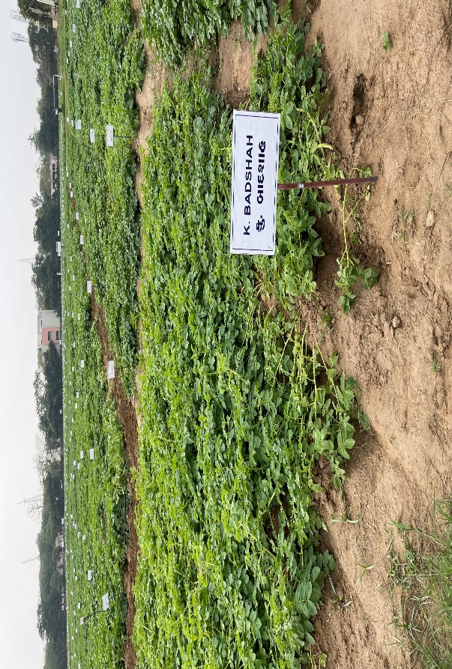
Introduction
The potato is an economically important crop of Gujarat (ranked fourth) and is comprised of 1.25 lakh hectares land cultivation and 37 lakh tones production.
Many potato processing industries are developing in the state, which increase the demand for suitable potato cultivars
Potato crops are vegetatively propagated using tubers, and farmers are getting seed tubers from other states
Production is severely affected by major diseases caused by bacteria and fungi (Kromann et al., 2014)
Majority of the cold storage spaces are occupied by potatoes
High input costs increase the production cost
Potato Research station, SDAU, Deesa (GUJARAT)

Slide 3
Major issues in potato cultivation in Gujarat State, India
There is no formal seed tuber production or long-term germplasm storage in Gujarat: Gujarat farmers are buying seed tubers from other states like Himachal Pradesh and Punjab
Limited availability of healthy seed tubers of cultivars that are resistant to abiotic and biotic stress: Lack of enough seed tubers of selected cultivars for potato cultivation
There is no domestic supply of preferred late maturing cultivars resistant to late blight diseases: Late blight disease is a major threat for potato cultivation
High seed tuber cost, nearly 34% of the total cost of production: The cost of seed tuber is very high due to limited resources and supply
High transportation and storage cost: Gujarat farmers are importing from other states with additional cost

Slide 4
Hypothesis
In vitro technology will lead to efficient mass-production of microtubers from potato cultivars using liquid culture system and germplasm conservation.
Objectives
The main goal is to optimize an efficient method for microtubers production from biotic and abiotic resistant potato cultivars and living germplasm storage.
The main research focus is based on the following objectives to optimize the protocol:
In vitro culture initiation of clean stock cultures from selected cultivars
Optimization of shoot multiplication under in vitro conditions
Development of mictotuberization protocol for elite cultivars using liquid based culture system
Optimization of microtubers storage and germination conditions
Development of living germplasm collection

Slide 5
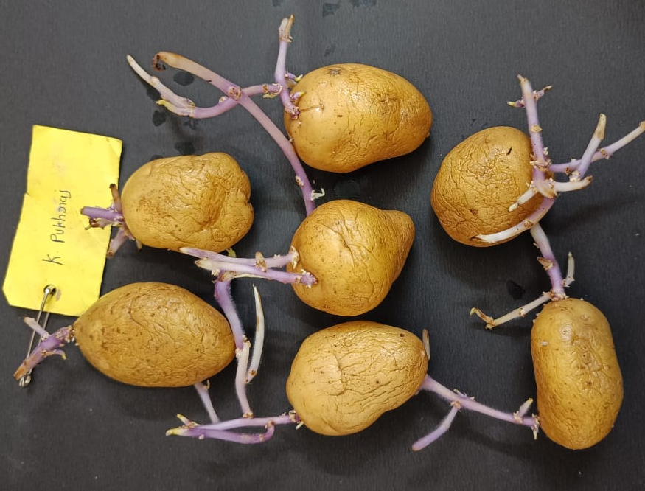
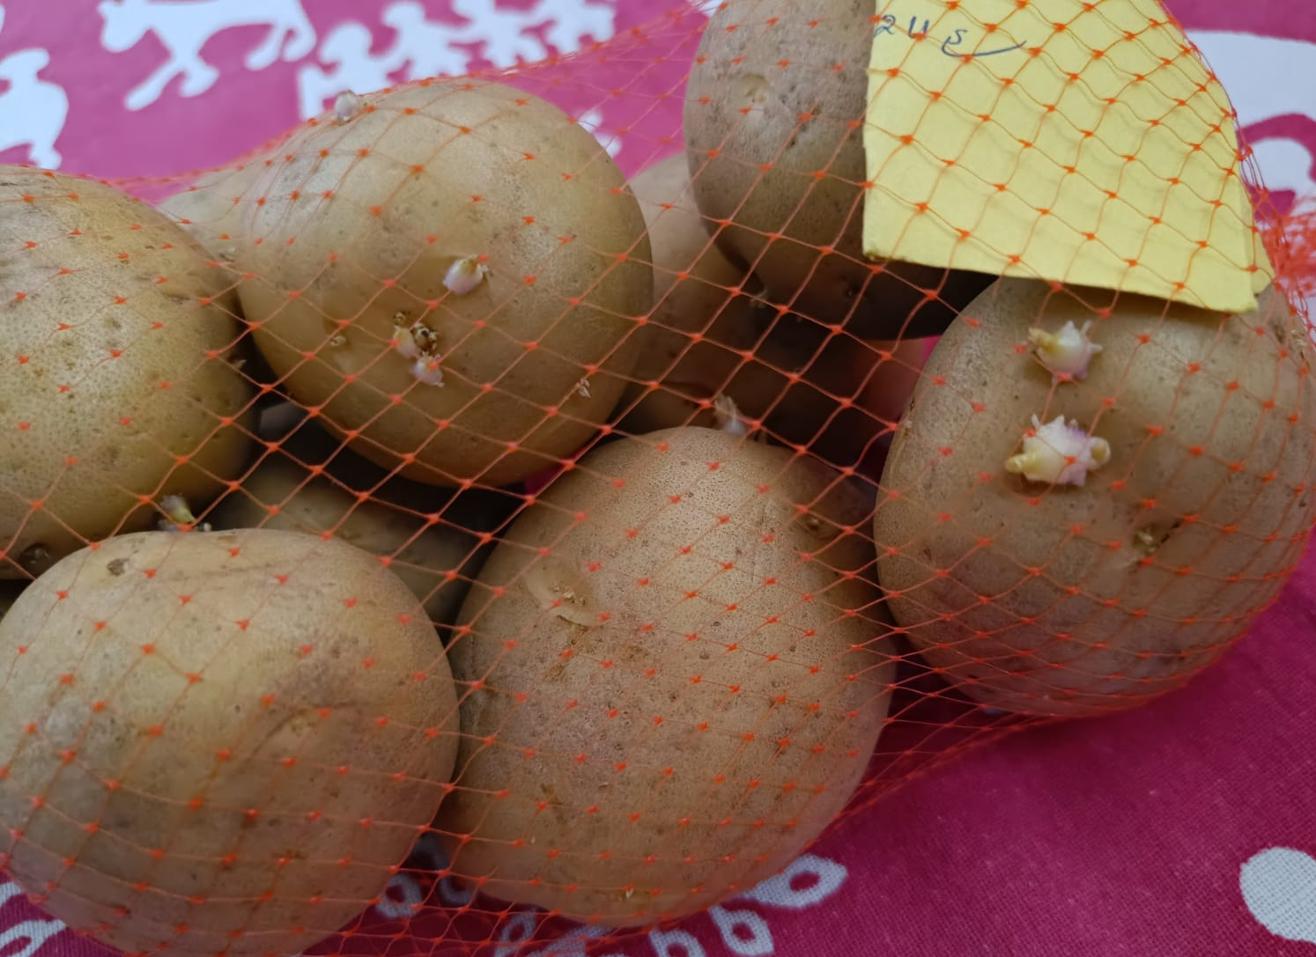
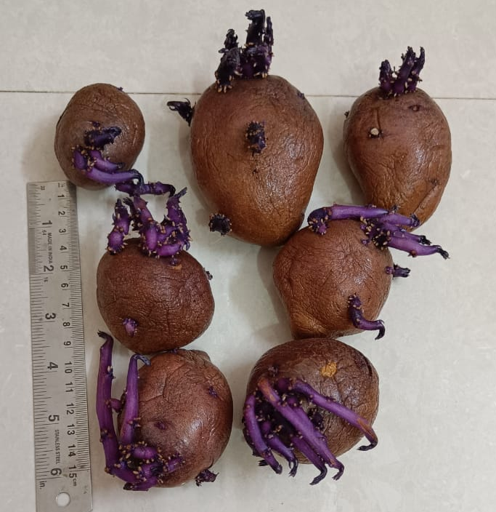
In vitro culture initiation and
living germplasm collection of potato cultivars
Potato cultivar: Kufri Badshah
Potato cultivar: Kufri Pukharaj
Potato cultivar: Kufri Nilkanth
Potato cultivars and potential lines have been collected from Potato Research Station, Gujarat, India
Potatoes were stored at 4 °C for 6-8 weeks
Potato bud sprouts have been used to initiate in vitro culture

Slide 6
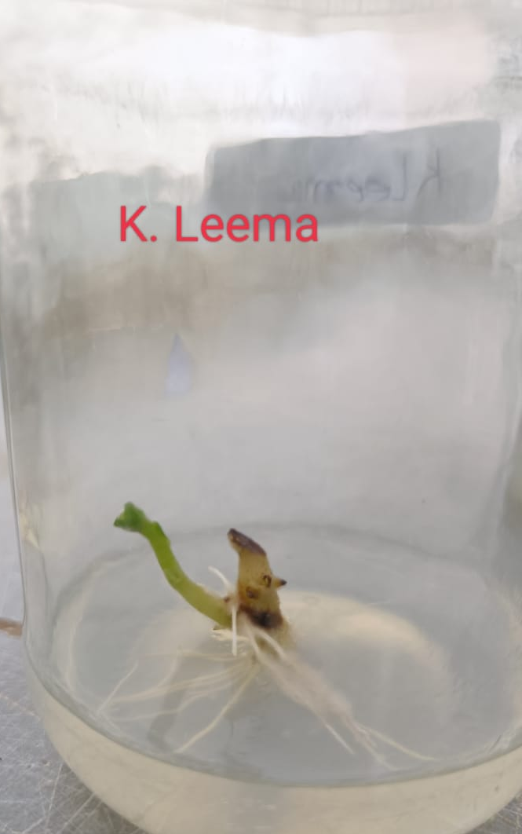
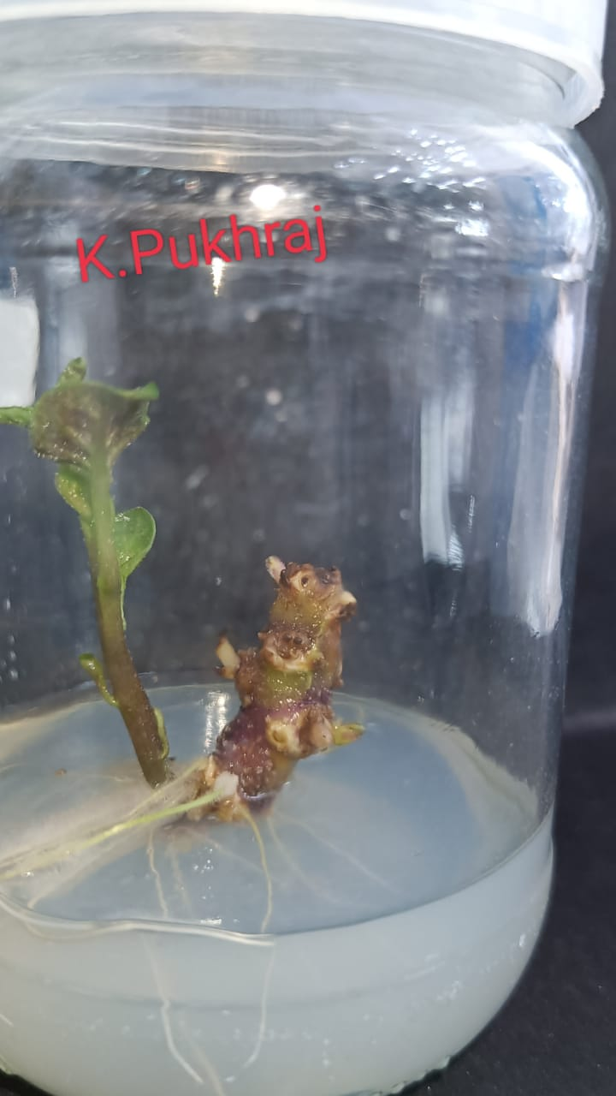
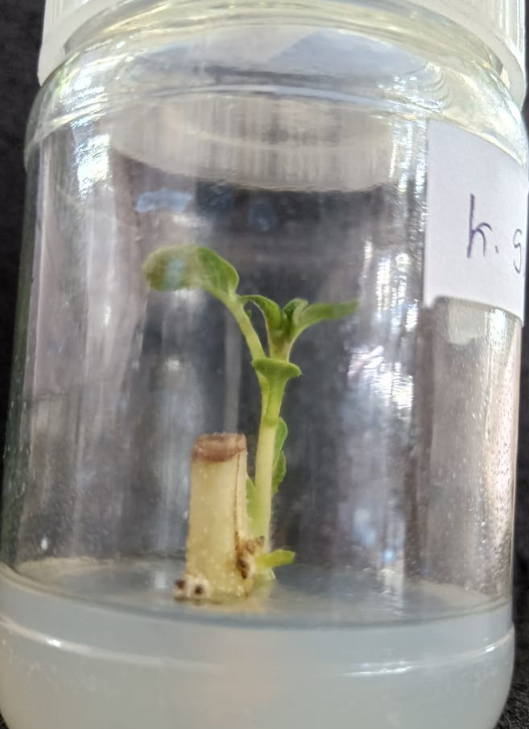
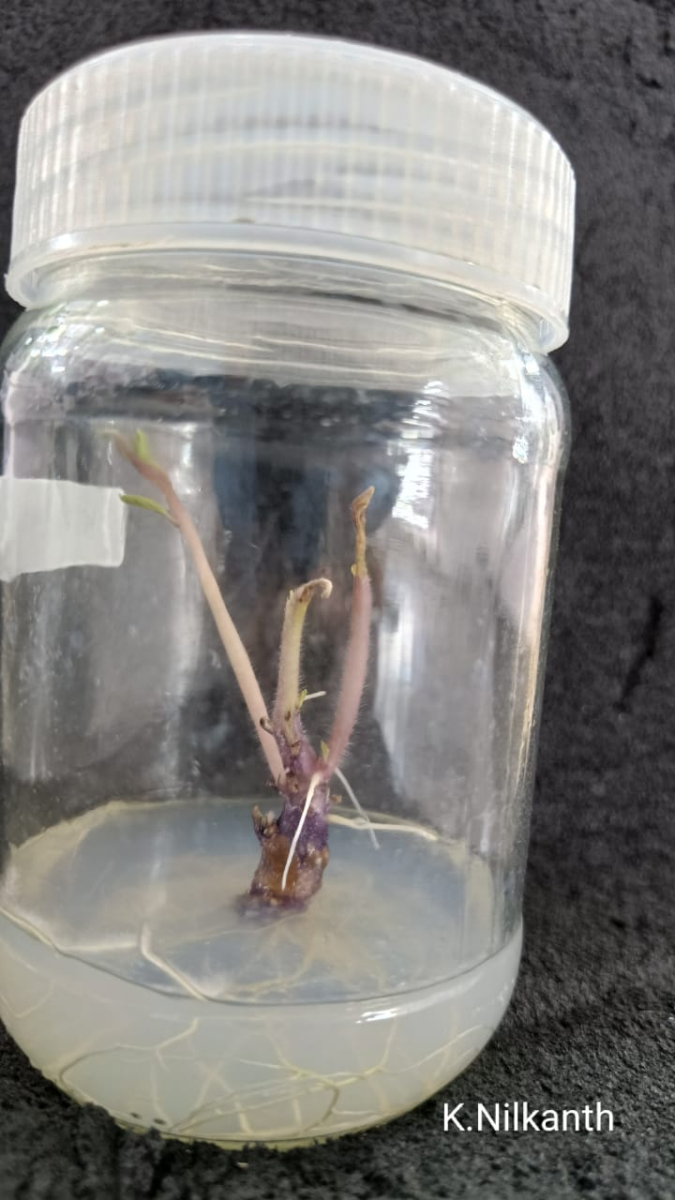
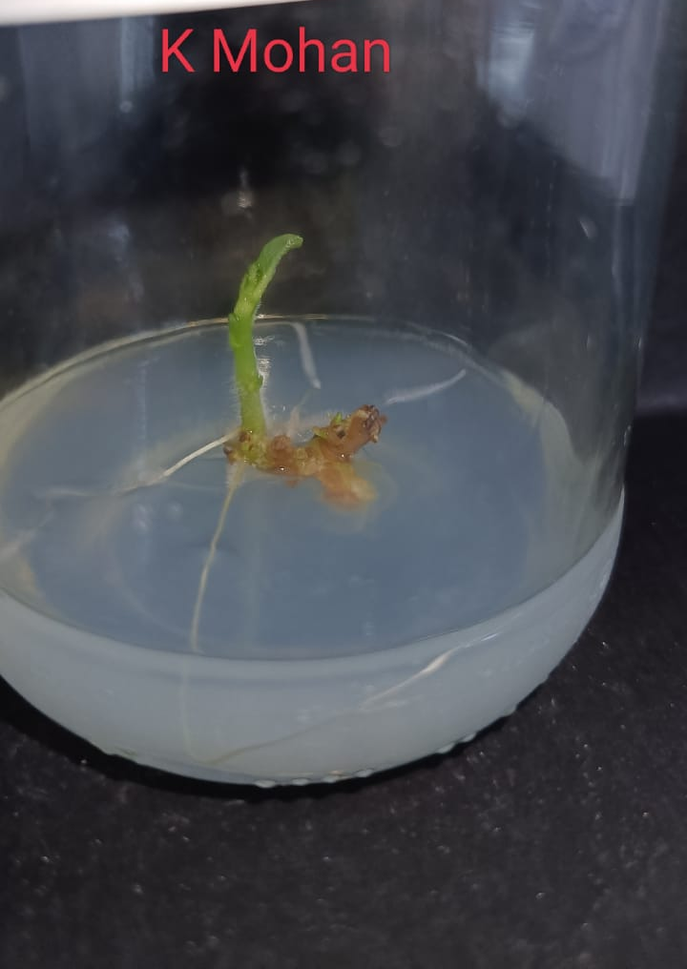
In vitro culture initiation and
living germplasm collection of potato cultivars
Clean in vitro culture initiation of different potato cultivars
Potato bud sprouts’ surface was sterilized using 0.1 % HgCl2 for 5 minutes followed by 8% Sodium hypochlorite for 5 minutes
Average 80% bud response was observed among six cultivars
Four-week shoots were used for shoot multiplication medium optimization

Slide 7
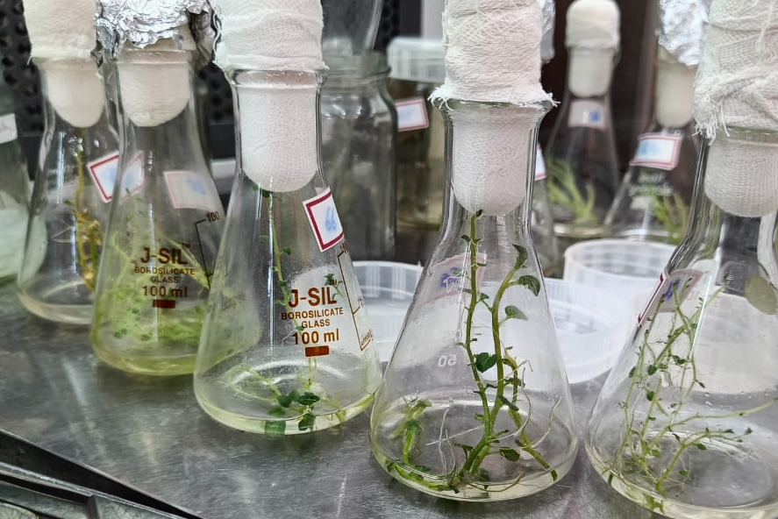
In vitro shoot multiplication
In vitro shoot multiplication medium was evaluated by comparing semi-solid and liquid culture system
Different plant growth regulators (Benzyl aminopurine, Kinetin, Gibberellic acid, and Indole Butyric acid) have been used to optimize shoot multiplication
Higher shoot multiplication rate (3.5) was observed in liquid culture compared to semi-solid medium
Normal shoot development with average shoot height (4 cm) was observed in liquid culture system

Slide 8
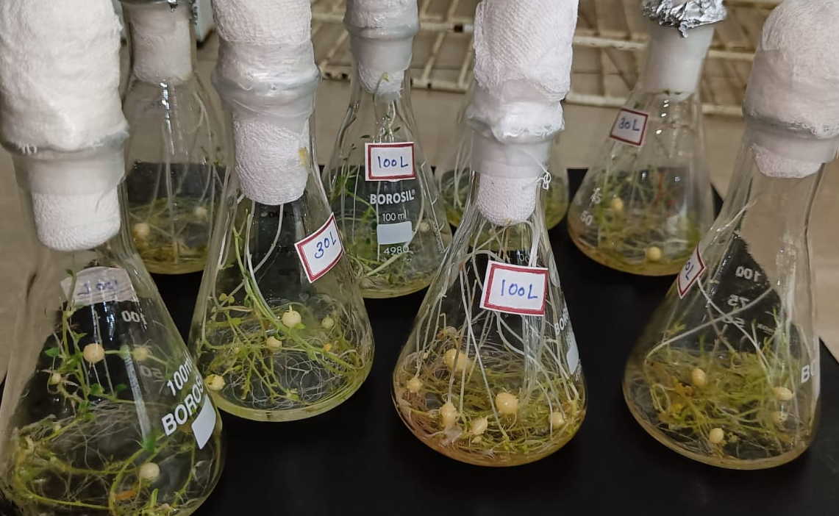
In vitro microtuber development
In vitro microtuber development medium optimized by comparing semi-solid and liquid culture system
Maximum numbers of microtubers (4 microtuber/shoot) on the Murashige and Skoog medium were supplemented with 6-benzylaminopurine (0.88 µM) and sucrose (8%)
Higher numbers of microtubers (4) were observed in liquid culture compared to semi-solid medium
Average 15 microtubers harvested after 6 weeks of cultures
100% of microtubers developed shoots under in vitro conditions

Slide 9
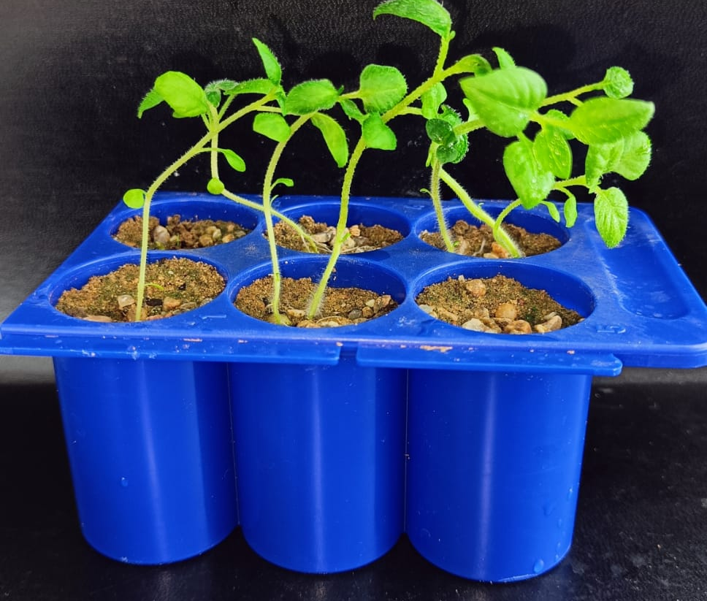
Microtuber storage and shoot development
Microtuber collection, storage and shoot development under in vitro and ex vitro conditions
Microtubers (>0.5 cm) were harvested and stored at 4 °C in dark conditions
100% of microtubers developed normal shoots after 18 days of storage
All shoots survived in the greenhouse conditions
Rooted shoots from microshoots have been acclimatized with a survival rate more than 90%

Slide 10
Summary and future prospect
In vitro cultures of locally adapted various potato cultivars have been initiated
The shoot multiplication microtuberization protocols have been standardized.
All shoots developed from microtubers have survived in the greenhouse conditions
Future prospects:
Evaluation of plantlet development from microtubers and their macrotubers
Assessment of liquid culture system for mass-production of disease-free microtubers on a commercial scale.
Living germplasm bank for potato growers and breeders
Collection of various potato cultivars
Culture initiation using potato bud sprout
Establishment and shoot multiplication
Microtuber development
Microtuber storage conditions
Pre-treatment and field evaluation
Germplasm maintenance

Slide 11
References
Barker WG. 1953. A method for the in vitro culturing of potato tubers. Science 118:384-385.
Gami RA, Parmar SK, Patel PT, Tank CJ, Chauhan RM, Bhadauria HS, Solanki SD. 2013. Microtuberization, minitubers formation and in vitro shoot regeneration from bud sprout of potato (Solanum tuberosum L.) cultivar K. badshah. African Journal of Biotechnology. 12(38).
Garkeroodi PG, Zaare-Nahandi F, Azar AM, Panahandeh J, Dadpour MR. 2016. Optimization of in vitro microtuberization of potato (Solanum tuberosum L. cv. Agria) using paclobutrazole and uniconazol. Iranian Journal of Horticultural Science. 47(2).
Gopal J, Minocha JL, Dhaliwal HS. 1998. Microtuberization in potato (Solanum tuberosum L.). Plant Cell Reports. 17(10):794-8.
Khan PS, Sanjay S, Vibha D. 2000. Tissue culture technology for large-scale production of microtubers of chipping potato. In Potato, global research & development. Proceedings of the Global Conference on Potato, New Delhi, India, 6-11 December, 1999: Volume 1: 698-700.
Khuri S, Moorby J. 1995. Investigations into the role of sucrose in potato cv. Estima microtuber production in vitro. Annals of Botany. 75(3): 295-303.
Mes MG, and I Menge. 1954. Potato shoot and tuber cultures in vitro. Physiol Plant 7:637-649
Nistor AN, Campeanu GH, Atanasiu NI, Chiru NI, Karacsonyi DI. 2010. Influence of potato genotypes on “in vitro” production of microtubers. Romanian Biotechnological Letters. 15(3):5317-24.
Sarkar D, Naik PS. 1998. Effect of inorganic nitrogen nutrition on cytokinin-induced potato microtuber production in vitro. Potato Research. 41(3):211-7.
Acknowledgement
I gratefully acknowledge the ScHeme Of Developing High-quality research (SHODH) Education Department, Gujarat State for a research fellowship.

