Slide 1
Study on the feasibility of agrivoltaics in the Kansai region of Japan
Hideki Nakata and Seiichi Ogata
Kyoto University Graduate School of Energy Science
This research was funded by JST SPRING Grant Number JPMJSP2110, MEXT/JSPS KAKENHI Grant Number 19K12444, and Sompo Environment Foundation
Photo by Takeshi Magami
Notes:
I am Hideki Nakata from Kyoto University.
I will explain through this video, about our research -"Study on the feasibility of agrivoltaics in the Kansai region of Japan."

Slide 2
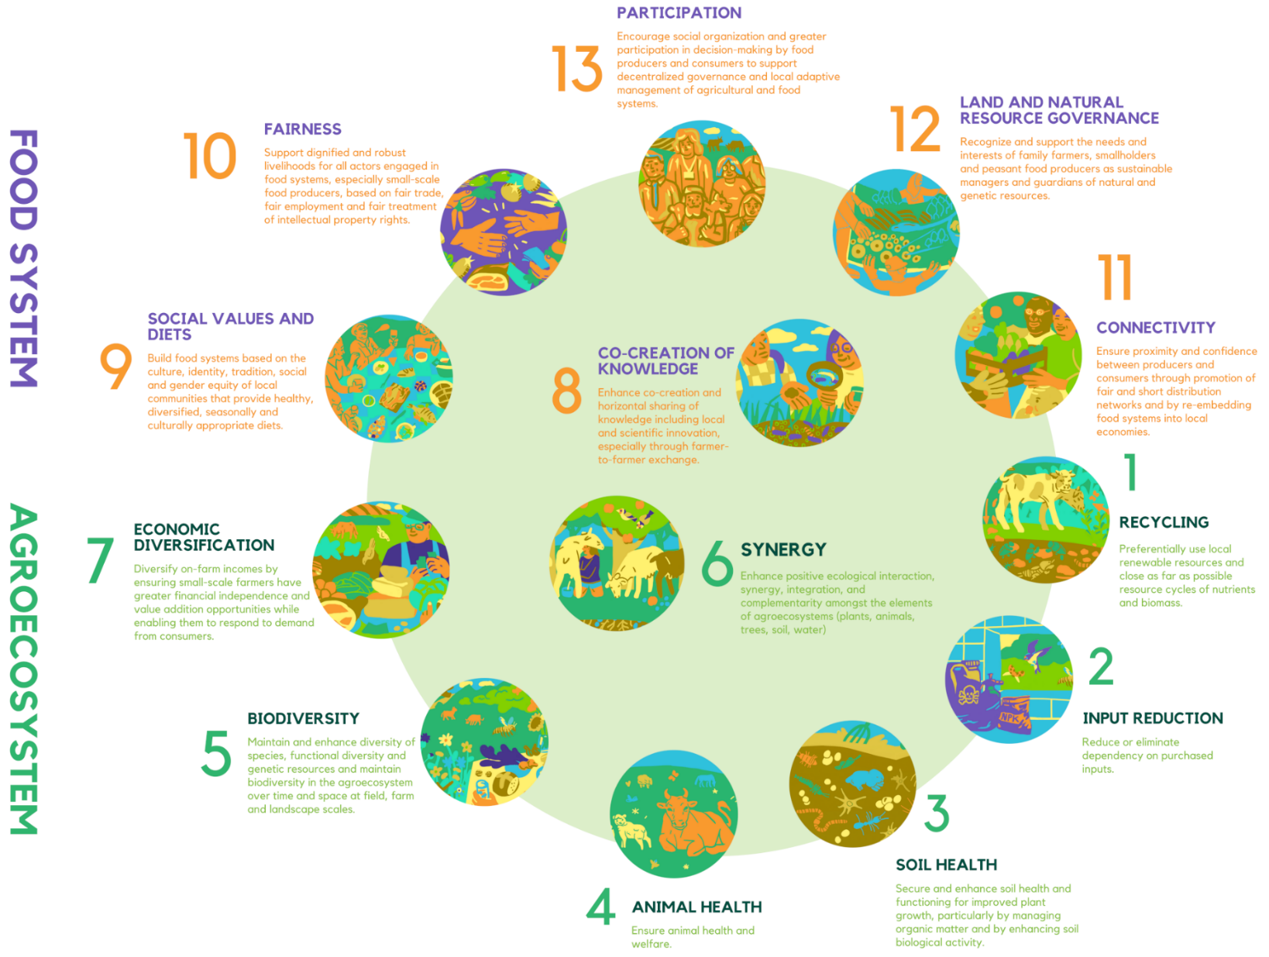
About agrivoltaic system
Introduction
Results
Methods
Discussions
Agrivoltaic system (AVS):
Utilizes land for both agriculture and solar energy generation
Promotes agroecological principles through:
Improved water use efficiency
Diversified farmer’s income
Ecosystem conservation etc.
The 13rinciples of agroecology
Source: Agroecology Europe (2019)
Notes:
The climate crisis necessitates decarbonizing all sectors, including agriculture, responsible for nearly 30% of global greenhouse gas emissions. The agrivoltaic system (AVS) allows for simultaneous solar power generation and farming on the same land, offering multiple agroecological benefits like plant protection and income diversification. However, it's important to note that inappropriate design can lead to challenges, like "pseudo-agriculture," where agriculture takes a backseat to energy production.

Slide 3
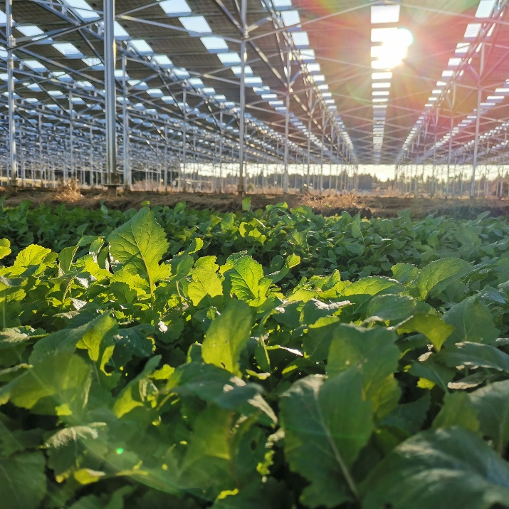
Research purpose
Introduction
Results
Methods
Discussions
Purpose of this study:
Evaluate the feasibility of implementing AVSs while balancing agricultural and power generation activities
Contribute to optimal AVS design and effective agroecology policy formulation
Photo by Takeshi Magami
Notes:
Our research evaluates AVS implementation potential to maintain a balance between agriculture and power generation. We focus on the unique conditions of our study area to provide policy makers with data for better system design and effective agroecology policies.

Slide 4
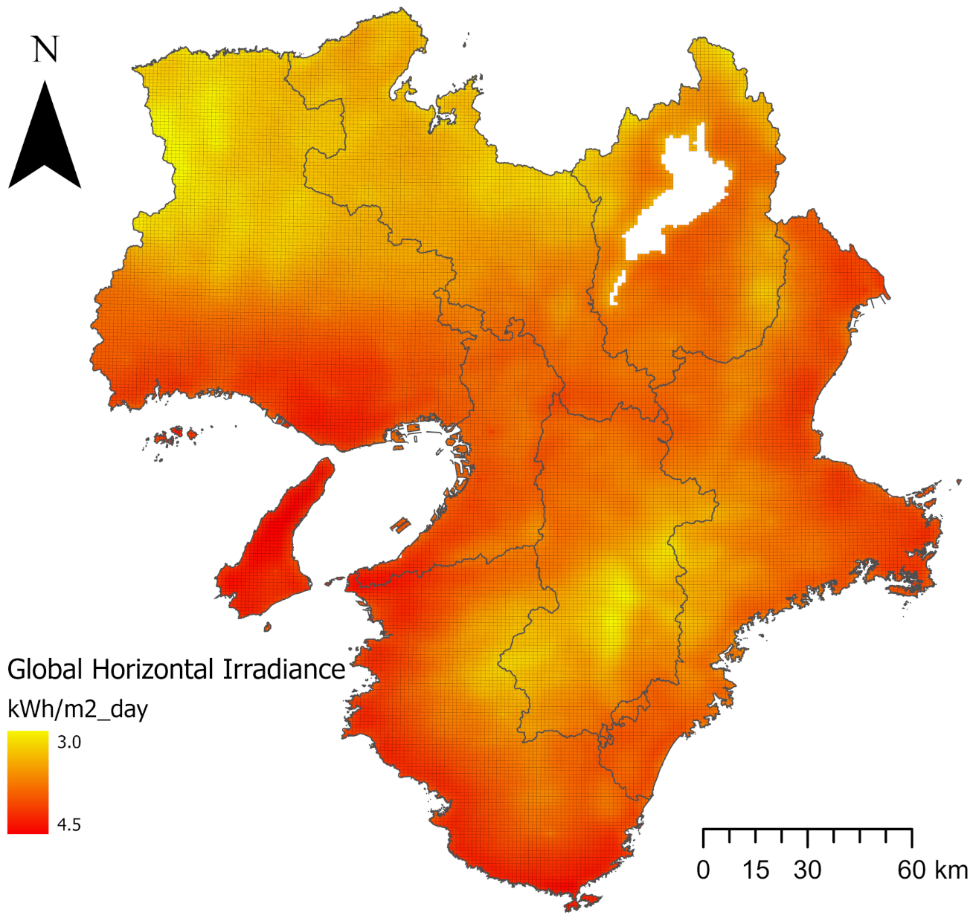
Study area
Introduction
Results
Methods
Discussions
Kansai region of Japan:
Located in southern central Japan
Comprises seven prefectures and 227 municipalities
Population of 22,311,695 (2020), covering a total area of 33,126 km²
Dominant industry is manufacturing
Hyogo
Kyoto
Shiga
Osaka
Mie
Nara
Wakayama
Kansai region of Japan
GHI data source: New Energy and Industrial Technology Development Organization (NEDO) (2020)
Notes:
Our study focuses on the Kansai region of Japan, which is in the southern central part of the country. This region is made up of seven prefectures, with a total population of over 22 million as of 2020.

Slide 5
Design of scenarios
Introduction
Results
Methods
Discussions
Target farmlands:
Focus on reclaimable idle croplands
Excludes currently farmed lands to minimize risk to local food security
Excludes severely degraded areas due to high rehabilitation costs
System design:
Limit Land Area Occupation Ratio for AVS to 35%
Allows for cultivation of a wide variety of crops grown in Japan
Focus on growing soybeans through conventional farming methods
High demand across various applications
Domestic self-sufficiency is low (6-7%)
Research scenarios:
Full coverage (FC) scenario
Considers AVS installation on all reclaimable idle croplands
Priority coverage (PC) scenario
Limits AVS to areas suitable for deployment, as identified in FC scenario
Notes:
Our quantitative evaluation targets reclaimable idle croplands, excluding active farms to prevent risk to food security and omitting severely degraded lands due to high rehabilitation costs. We cap the Land Area Occupation Ratio for AVS at 35%, minimizing disruption to most Japanese crops. We select soybean for its versatility and national food security importance. Our study considers two AVS deployment scenarios: Full Coverage scenario and Priority Coverage scenario.

Slide 6
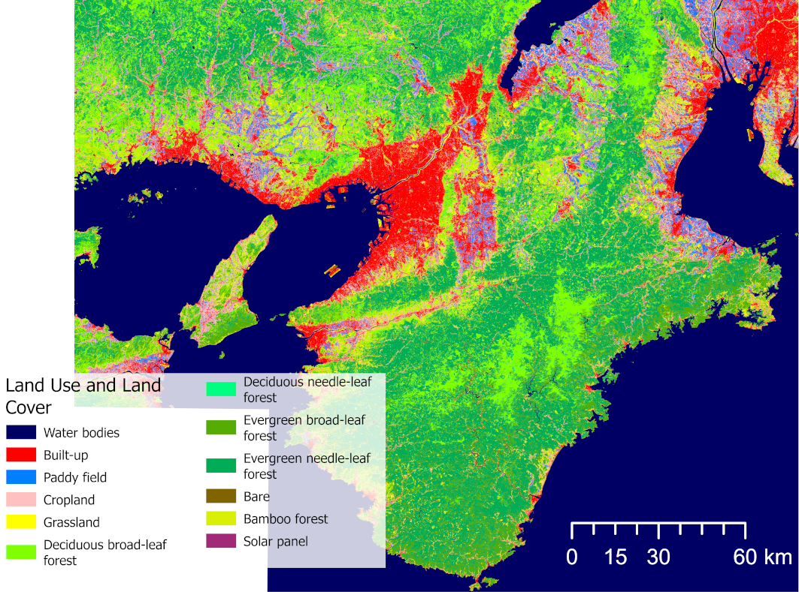
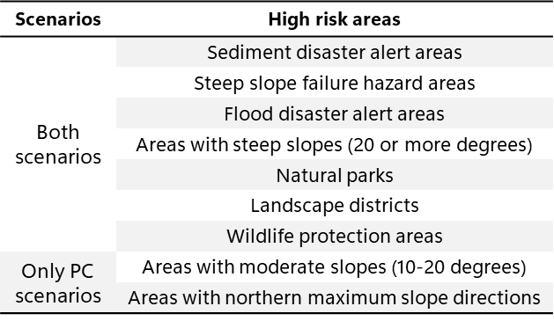
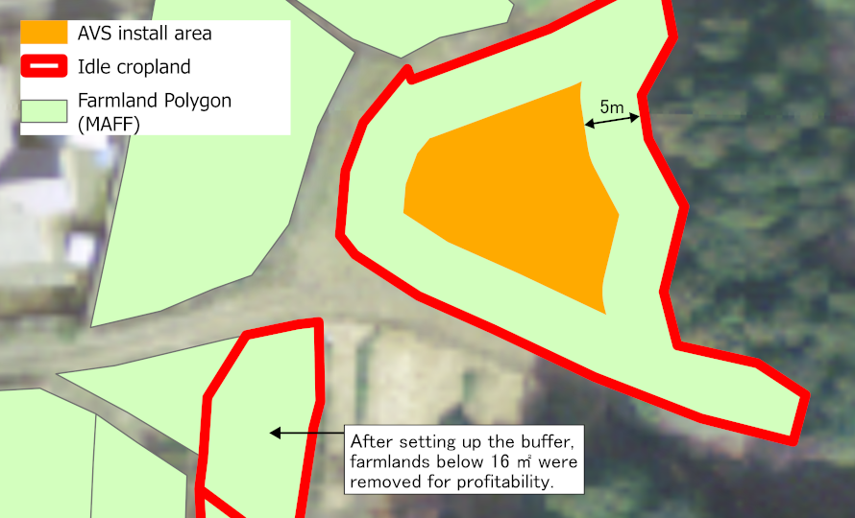
Detection of idle croplands
Introduction
Results
Methods
Discussions
Datasets used:
Farmland polygon data
by Ministry of Agriculture, Forestry and Fisheries (MAFF)
High-Resolution Land Use and Land Cover Map of Japan (HRLULC)
by Japan Aerospace Exploration Agency (JAXA)
Excluded high risk areas
HRLULC of Kansai region
Source: Compiled from JAXA (2021)
Source: Compiled from Ministry of Land, Infrastructure, Transport and Tourism (2023) and Geospatial Information Authority of Japan (2023)
Farmland polygons and install area
Source: Compiled from MAFF (2023)
Notes:
To map revitalizable idle agricultural lands, we utilized two datasets: Farmland Polygon Data by MAFF and the Land Use and Land Cover Map by JAXA. These datasets allowed us to identify potential farmlands with high precision, while excluding currently used and severely degraded lands. Lands prone to natural disasters and requiring ecosystem conservation were also excluded. Our Priority Coverage scenario refines targets based on factors like slope. Finally, 5-meter non-installed buffer zones were established around each field to prevent the shadow of AVS structures from extending onto adjacent lands.

Slide 7
Estimation of AVS impacts
Introduction
Results
Methods
Discussions
Annual power generation:
Calculations based on NEDO's solar radiation and temperature data
Uses JIS methods for PV generation simulations
Agricultural Production:
Assumes use of conventional agricultural methods
Expected to be 80% of average harvest per area by prefecture
Meets the minimum level for continued under Japan's AVS support program
Job Creation Effects:
Power Generation Sector
Employment calculated using coefficients for both construction and O&M phases
Agriculture Sector
Employment estimated based on average number of farmers per area by prefecture
Economic Ripple Effects in the prefecture:
Analysis using MOE-published tool
Power Generation: Assumes electricity sales through feed-in tariffs
Agriculture: Based on average bid price of domestically-produced soybeans
Notes:
After mapping, we assessed AVS impact across multiple criteria. Power generation relied on solar radiation and temperature data, while yields were set at 80% of standard soybean harvests. Ripple economic effects and employment were estimated using MOE’s analysis tool and local employment coefficients.

Slide 8
Results of full coverage scenario
Introduction
Results
Methods
Discussions
Indicators of performance | Unit | Mie | Shiga | Kyoto | Osaka | Hyogo | Nara | Wakayama | Total
Idle cropland area | km² | 39.59 | 22.73 | 14.67 | 7.45 | 37.29 | 8.16 | 17.09 | 33125.97
The rate of idle cropland area to total area | % | 0.69 | 0.57 | 0.32 | 0.39 | 0.44 | 0.22 | 0.36 | 0.44
System capacity | MWac | 3353.59 | 1872.26 | 1190.38 | 615.19 | 3096.18 | 669.76 | 1419.09 | 12216.43
Annual electricity generation (1st year) | GWh | 3954.12 | 2104.31 | 1271.87 | 708.42 | 3575.55 | 749.55 | 1677.67 | 14041.49
The rate of electricity generated compared to consumption¹ | % | 21.4 | 18.5 | 8.0 | 1.3 | 10.7 | 11.9 | 28.2 | 9.6
Food production (soybeans) | t | 234.40 | 278.20 | 100.91 | 42.29 | 253.55 | 61.34 | 120.31 | 1091.00
Job creation (Construction) | Person-years | 6761.55 | 3598.38 | 2174.9 | 1211.39 | 6114.19 | 1281.73 | 2868.82 | 24010.95
Job creation (O&M) | Person-years | 4468.16 | 2377.88 | 1437.21 | 800.51 | 4040.37 | 846.99 | 1895.77 | 15866.88
Job creation (Agriculture) | Person-years | 1573.70 | 743.42 | 883.08 | 652.97 | 2146.89 | 525.16 | 1648.32 | 8173.54
Economic ripple effects (Construction) | EUR 1M | 4811.75 | 2656.85 | 1766.44 | 943.09 | 4581.82 | 999.90 | 2027.28 | 17787.14
Economic ripple effects (O&M, 1st year) | EUR 1M | 507.79 | 279.49 | 188.86 | 101.02 | 487.04 | 108.38 | 215.5 | 1888.08
Economic ripple effects (Agriculture) | EUR 1M-years | 0.33 | 0.38 | 0.14 | 0.06 | 0.36 | 0.09 | 0.17 | 1.54
Nominal gross regional product² | EUR 1M | 58,683 | 50,067 | 78,177 | 299,810 | 161,916 | 28,485 | 27,262 | 704,400
¹ FY2021 electricity consumption by MOE (2023), ² FY2019 nominal gross regional product by Ministry of Internal Affairs and Communications (2023)
Notes:
These are our results of Full Coverage Scenario analysis. The highest estimated annual power generation in the first year is about 3,950 GWh in Mie, while Osaka could generate a low of 710 GWh. In Wakayama, nearly 30% of annual electricity could come from AVS. Employment opportunities range from roughly 2,650 person-years in Nara to over 12,800 in Mie. When it comes to economic ripple effects during the construction stage, they vary from 0.1% of Gross Regional Product in Osaka to 3.5% in Mie.

Slide 9
Results of priority coverage scenario
Introduction
Results
Methods
Discussions
Indicators of performance | Unit | Mie | Shiga | Kyoto | Osaka | Hyogo | Nara | Wakayama | Total
Idle cropland area | km² | 16.97 | 7.11 | 5.48 | 3.41 | 16.41 | 3.82 | 6.20 | 59.39
The rate of idle cropland area to total area | % | 0.29 | 0.18 | 0.12 | 0.18 | 0.20 | 0.10 | 0.13 | 0.18
System capacity | MWac | 1436.35 | 584.48 | 444.36 | 282.22 | 1361.58 | 313.12 | 515.42 | 4937.54
Annual electricity generation (1st year) | GWh | 1689.39 | 651.26 | 474.04 | 325.07 | 1569.14 | 350.00 | 610.54 | 5669.44
The rate of electricity generated compared to consumption¹ | % | 9.1 | 5.7 | 3.0 | 0.6 | 4.7 | 5.6 | 10.3 | 3.9
Food production (soybeans) | t | 100.48 | 87.03 | 37.69 | 19.38 | 111.56 | 28.70 | 43.62 | 428.46
Job creation (Construction) | Person-years | 2888.86 | 1113.65 | 810.62 | 555.88 | 2683.23 | 598.50 | 1044.02 | 9694.74
Job creation (O&M) | Person-years | 1909.01 | 735.92 | 535.67 | 367.33 | 1773.13 | 395.50 | 689.91 | 6406.47
Job creation (Agriculture) | Person-years | 674.59 | 232.56 | 329.86 | 299.32 | 944.59 | 245.67 | 597.59 | 3324.18
Economic ripple effects (Construction) | EUR 1M | 2060.78 | 829.39 | 659.39 | 432.65 | 2014.87 | 467.45 | 736.27 | 7200.81
Economic ripple effects (O&M, 1st year) | EUR 1M | 219.85 | 88.27 | 70.71 | 46.38 | 214.78 | 50.91 | 78.93 | 769.82
Economic ripple effects (Agriculture) | EUR 1M-years | 0.14 | 0.12 | 0.05 | 0.03 | 0.16 | 0.04 | 0.06 | 0.61
Nominal gross regional product² | EUR 1M | 58,683 | 50,067 | 78,177 | 299,810 | 161,916 | 28,485 | 27,262 | 704,400
¹ FY2021 electricity consumption by MOE (2023), ² FY2019 nominal gross regional product by Ministry of Internal Affairs and Communications (2023)
Notes:
These are results of Priority Coverage Scenario, the focus is narrowed to areas highly suitable for AVS, resulting in a smaller installation scale. For example, idle farmland area shrinks by half: down to 3.4 km² in Osaka from 17 km² in Mie. The most significant reduction is in Shiga, with a 69% decrease in land area. However, both Mie and Wakayama still hold the potential to meet about 10% of their annual electricity needs through AVS.

Slide 10
Discussion
Introduction
Results
Methods
Discussions
Interpretation :
AVS installation aligns well with principles of agroecology
Benefits include ecosystem conservation and increased agricultural resilience etc.
FC/PC scenarios could restore 59-147 km² of idle cropland
Implication:
Policymakers should leverage agroecological benefits
Must discourage short-term, opportunistic land use
Urgent need for:
Publication of good practices
Financial support
Strict regulation of problematic practices
Limitation:
Future research could explore more advanced systems
Current study focuses on basic rattan-shelf AVS and conventional soybean farming
More complex approaches could include:
Variety mixtures
Crop-livestock integration
Diverse power generation options also exist, such as vertical bifacial systems and PV greenhouse systems
Notes:
This study shows AVS's significant potential in Kansai. Under two scenarios, idle cropland from 60 to 150 km² can be reclaimed, improving food and energy security, and ecosystem preservation. Policymakers should consider these benefits while preventing inappropriate land use. While our focus is mainly on soybean farming using rattan-shelf AVS, future research could explore more complex agricultural systems and diverse power generation setups to further enrich the agroecological framework.

