Slide 1
Nutritional, Compositional and Antioxidant Properties of Tropical Almond (Terminalia catappa) Press Cake
Pramod Bandara¹, L. J. P. A. P. Jayasooriya² and Mahinda Senevirathne^{1*}
¹Department of Food Science & Technology, Faculty of Applied Sciences,
Sabaragamuwa University of Sri Lanka, Belihuloya, Sri Lanka
²Department of Basic Veterinary Sciences, Faculty of Veterinary Medicine and Animal Science,
University of Peradeniya, Peradeniya, Sri Lanka

Slide 2
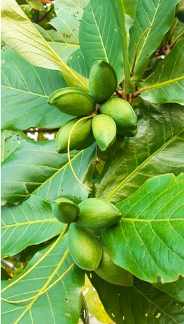
Content
Introduction
Objectives
Methodology
Results and Discussion
Conclusion
References

Slide 3
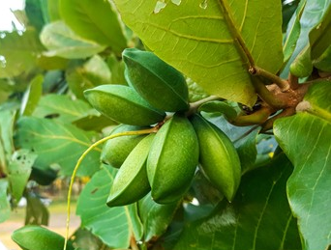
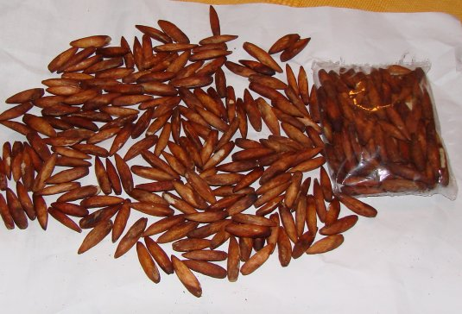
Introduction
Tropical almond (TA) is a highly nutritious underutilized nut having numerous potentials in food and many other industries (Jahurul et al., 2022; Ng et al., 2015).
Mechanical press oil extraction from TA nut generates a by-product known as press cake or tropical almond meal which is rich in number of nutrients
Based on the zero waste concept of circular economy
press cake can be utilized to prepare natural gluten-free ingredient
replace part or all of the wheat flour

Slide 4
Objectives
Overall Objective
To valorize the tropical almond press cake as an alternative ingredient to wheat flour
Specific Objective
To analyze the nutritional profile,
To evaluate the morphology,
To evaluate the bioactive and antioxidant properties,
of tropical almond press cake

Slide 5
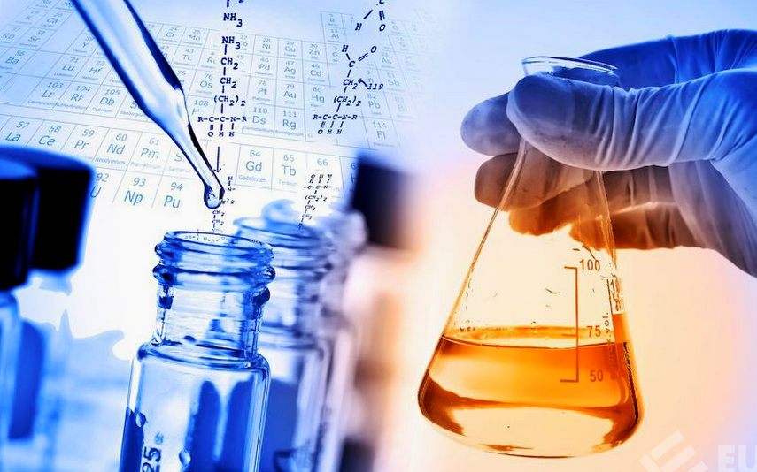
Methodology
Proximate Composition
Elemental Composition
(AOAC, 2005)
(Diyabalanage et al., 2020)
Oil extraction
Scanning Electron Micrograph View
Pulverization
Press Cake (By-product)
Pulverized Press Cake
Antioxidant Properties (DPPH, ABTS, FRAP)
Total Phenolic and Total Flavonoid Estimation
Tropical Almond Oil
(Adekola et al., 2017; Bopitiya & Madhujith, 2015)

Slide 6
Method cont.
Statistical analysis
All the measurements were carried out in triplicates (n=3) and the results were presented in the form of mean ± standard error
The software package : Minitab 19.0
Experimental model : One-way analysis of variance (ANOVA)
Mean separation : Tukey’s multiple comparison test
Probability level :95%

Slide 7
Results and Discussion
Proximate Composition of Press Cake
Table 01. Proximate composition of press cake compared with DRI
Component | TA press cake (g/100g) | DRI* (g/day)
Moisture | 6.80 ± 1.01 | -
Ash | 6.99 ± 0.78 | -
Crude protein | 41.94 ± 1.22 | 46-56
Crude fat | 8.66 ± 0.89 | 44-97
Crude fiber | 5.71 ± 1.48 | -
Carbohydrate | 28.90 ± 0.79 | 130
Energy (kcal/100 g) | 335.52 | 2000-2500
Gluten | ND | -
*DRI – Dietary Recommended Intake

Slide 8
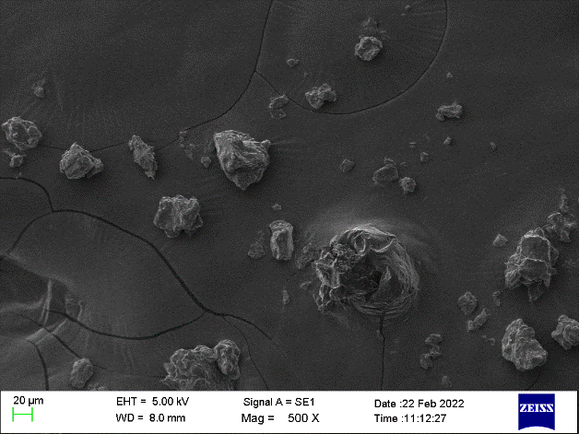
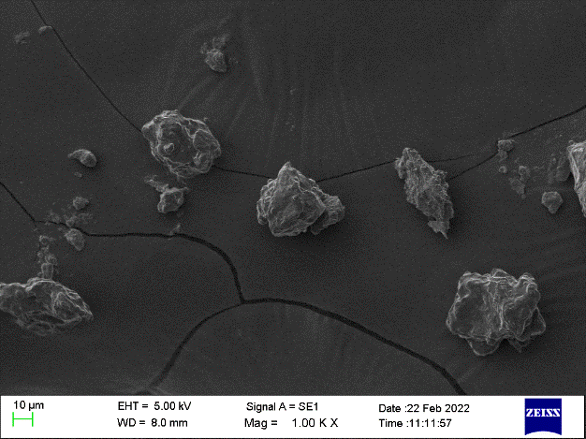
Results cont.
Scanning Electron Micrograph View
a
b
SEM images of tropical almond press cake (magnification of (a) ×500 and (b) ×1000)

Slide 9
Results cont.
Elemental Composition
Mineral composition of press cake

Slide 10
Results cont.
Total Phenolic and Flavonoid Contents
(a)
(b)
Total phenolic (a) and flavonoid (b) content of press cake in comparison to nut (p<0.05)

Slide 11
Results cont.
Antioxidant Properties
TA samples compared with positive controls (p<0.05)
Sample | IC₅₀ (mg/ml)
TA nut | 53.77ª
TA press cake | 37.86^{b}
Ascorbic acid | 0.016^{c}
Tocopherol | 0.077^{c}
DPPH radical scavenging percentage of TA nut and press cake (p<0.05)

Slide 12
Results cont.
Antioxidant Properties cont.
Ferric reducing antioxidant power of TA press cake in comparison to nut (p<0.05)

Slide 13
Results cont.
Antioxidant Properties Cont.
IC₅₀ of TA samples compared with positive controls (p<0.05)
Sample | IC₅₀ (mg/ml)
TA nut | 7.68ª
TA press cake | 8.24ª
Tocopherol | 0.016^{b}
Trolox | 0.007^{b}
ABTS radical scavenging percentage of TA nut and press cake (p>0.05)

Slide 14
Conclusions
The TA press cake could be an excellent sources of proteins, Potassium, calcium and iron with lower sodium content
The press cake was significantly high in phenolics, flavonoids and antioxidant capacity
The gluten free, highly nutritious press cake could be an excellent alternative ingredient with the potential to develop functional food products

Slide 15
References
Adekola, K. A., Salleh, A. B., Zaidan, U. H., Azlan, A., Chiavaro, E., Paciulli, M., & Marikkar, J. M. N. (2017). Total phenolic content, antioxidative and antidiabetic properties of coconut (Cocos Nucifera L.) testa and selected bean seed coats. Italian Journal of Food Science, 29(4), 741–753.
AOAC. (2005). Official methods of analysis. 15th ed. Washington D.C: Association of official analytical chemists.
Bopitiya, D., & Madhujith, T. (2015). Antioxidant potential of rice bran oil prepared from red and white rice. Tropical Agricultural Research, 26(1), 1
Diyabalanage, S., Kalpage, M. D., Mohotti, D. G., Dissanayake, C. K. K., Fernando, R., Frew, R. D., & Chandrajith, R. (2020). Comprehensive assessment of essential and potentially toxic trace elements in bovine milk and their feeds in different agro-climatic zones of Sri Lanka. Biological Trace Element Research 199(4), 1377–1388
Jahurul, M. H. A., Adeline, K. B., Norazlina, M. R., Islam, S., Shihabul, A., & Zaidul, I. S. M. (2022). Characterization and nutritional content of Terminalia catappa kernel and its oil from Sabah, Malaysia. Applied Food Research, 2(1), 100088. ht
Ng, S., Lasekan, O., Muhammad, K. S., Hussain, N., & Sulaiman, R. (2015). Physicochemical properties of Malaysian-grown tropical almond nuts (Terminalia catappa). Journal of Food Science and Technology, 52(10), 6623.

Slide 16
Acknowledgement
Professor Rohana Chandrajith
Department of Geology, Faculty of Science, University of Peradeniya
Professor S.K Gunathilake & Mr. Udara Hasantha
Department of Natural Resources
Ms K.M Somawathie
Senior lecturer, Department of Food Science and Technology
All the academic and non-academic staff
Department of Food Science and Technology & Department of Physical Science & Technology
All the academic and non-academic staff
Faculty of Agriculture, Sabaragamuwa University of Sri Lanka
My family members and my friends

Slide 17
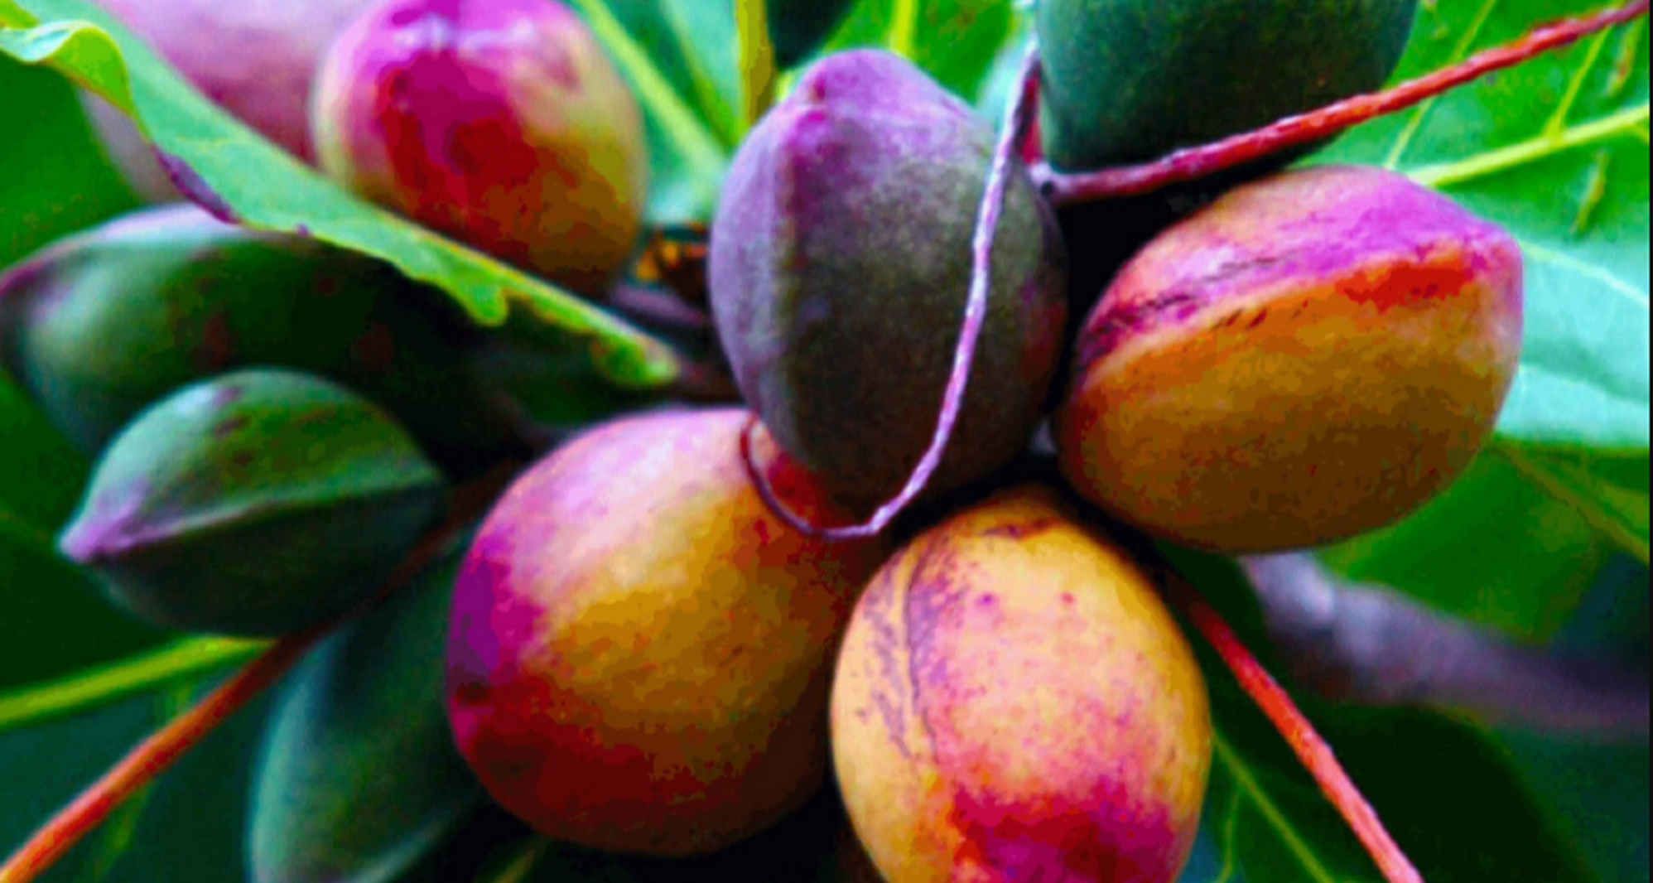
THANK YOU…

