Slide 1
Evaluation of the toxicity of wet wipes based on the growth test with Lepidium sativum L.
Nataliia Tkachuk¹, Liubov Zelena²
¹T.H. Shevchenko National University “Chernihiv Colehium”,
Chernihiv, Ukraine, nataliia.smykun@gmail.com
²Kyiv National University of Technologies and Design,
Kyiv, Ukraine, zelenalyubov@gmail.com

Slide 2
Hygienic products, in particular, wet wipes, occupy a significant share of everyday goods.
Wet wipes contain various chemical compounds that can have a negative impact on the environment and human health, in particular, surface-active substances.
The toxicity of chemical compounds and substrates is determined by biotesting methods, in particular for garden cress (Lepidium sativum L.).
Since after use, wet wipes become garbage, enter the environment, in particular, the soil, accumulate there, they can become a source of dangerous compounds, therefore, it is advisable to investigate their toxic properties.
The aim of this study was to investigate the toxicity of wet wipes according to the growth test with garden cress.

Slide 3
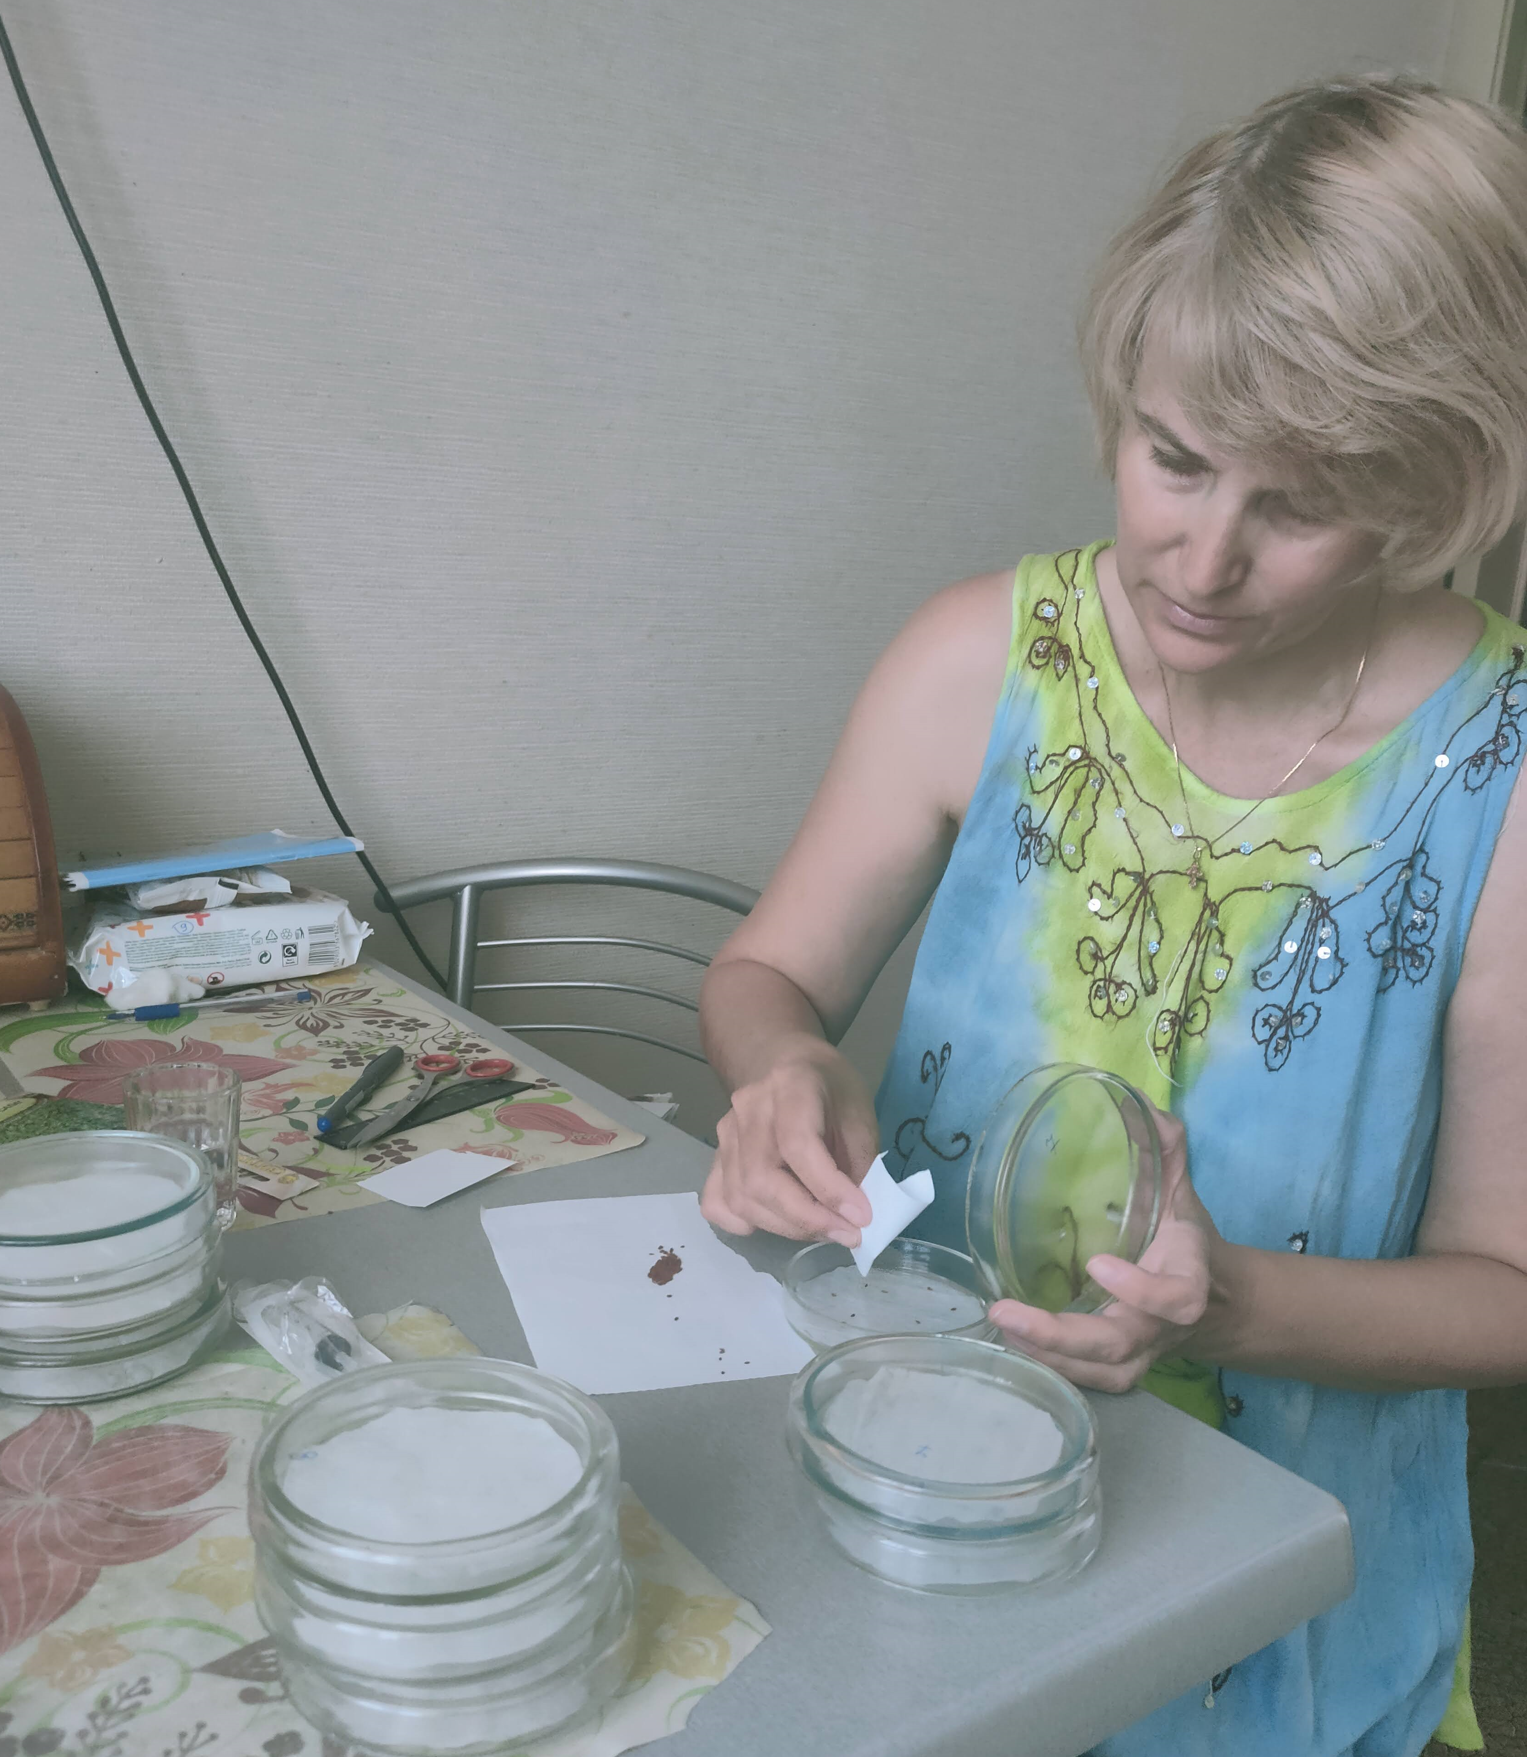
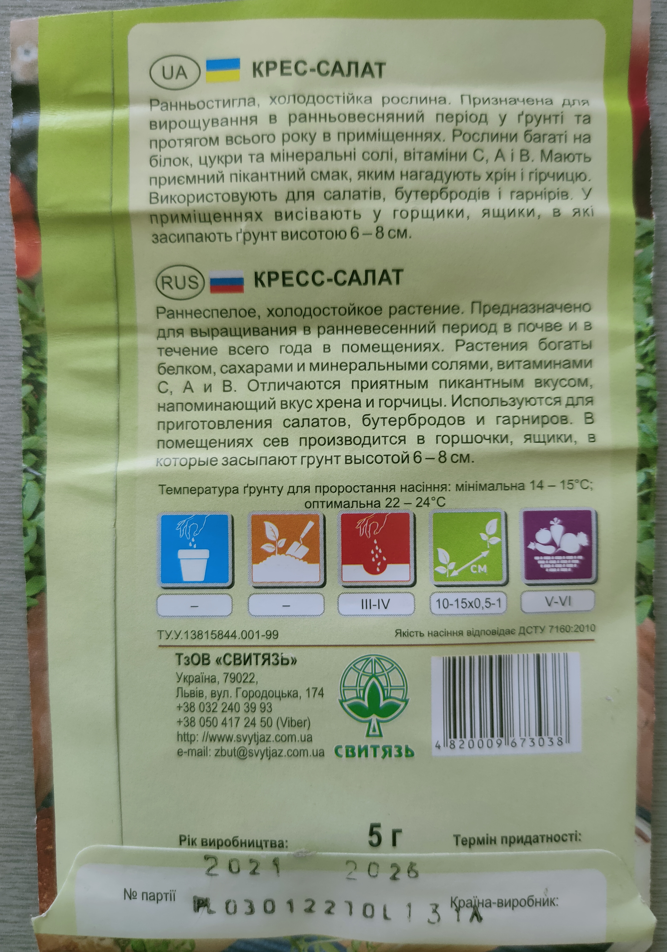
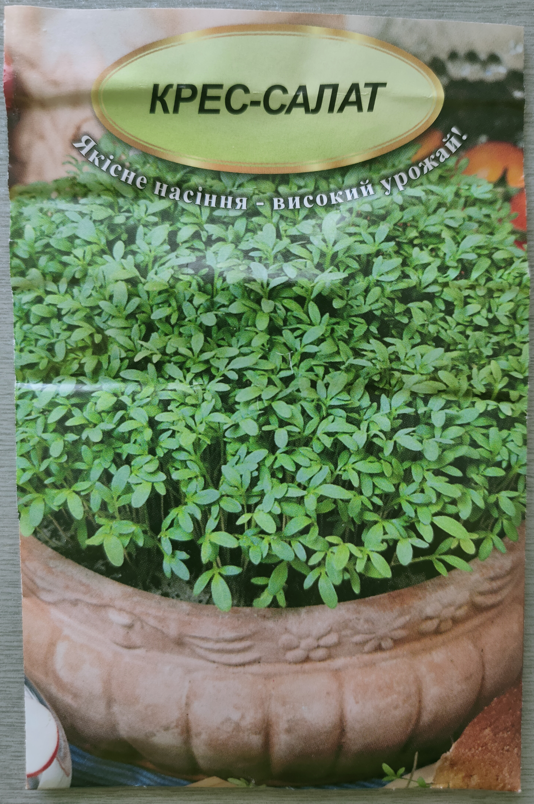
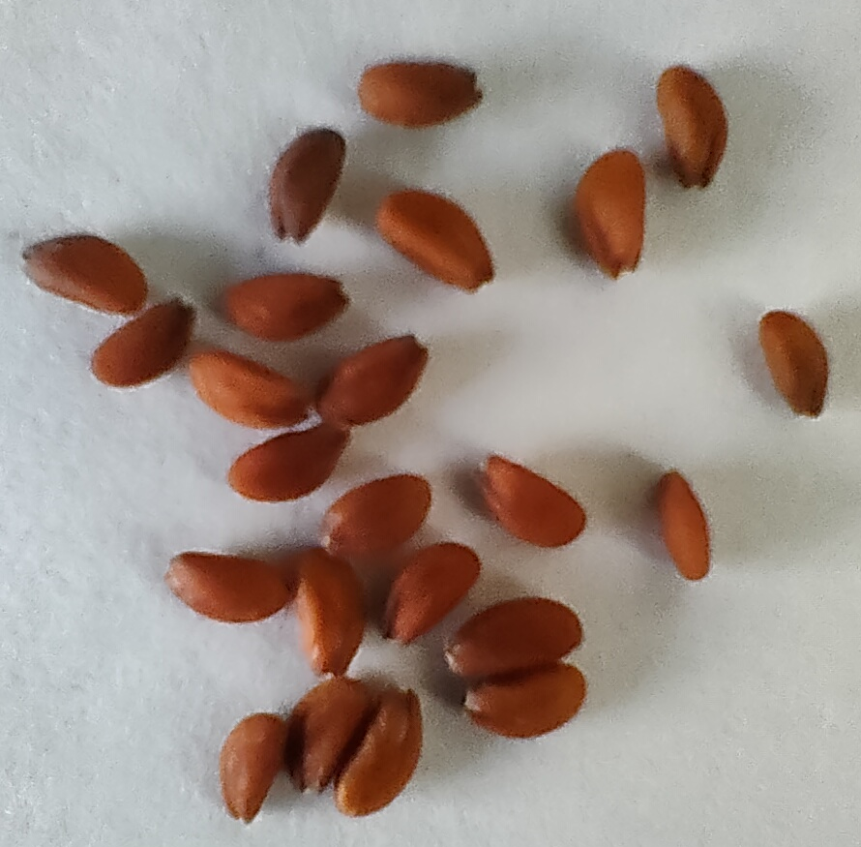
Test plant seeds
In the process of research preparation

Slide 4
Chemical compounds in the composition of wet wipes (according to manufacturer) Surface-active substances are highlighted in red
Production of Ukraine
WW1 - demineralized water, glycerin, propylene glycol, benzalkonium chloride, cocamidopropyl betaine, PEG-40 hydrogenated castor oil, PPG-2 methyl ether, ethylparaben, 2-bromo-2-nitropropane-1,3-diol, cetrimonium bromide, extracts of sedum, chamomile, calendula, perfume composition, citric acid. Material of wipes: non-woven fabric (60% polyester, 40% viscose).
WW2 - demineralized water, glycerin, propylene glycol, benzalkonium chloride, cocamidopropyl betaine, PEG-40 hydrogenated castor oil, PPG-2 methyl ether, ethylparaben, 2-bromo-2-nitropropane-1,3-diol, cetrimonium bromide, flavor, citric acid. Material of wipes: non-woven fabric.
WW3 - water, flavor, citric acid, tocopheryl acetate (vitamin E), aloe vera extract, glycerin, allantoin, cocamidopropyl betaine, polypropylene glycol, phenoxyethanol, polysorbate-20, dehydroacetic acid, benzoic acid, tetrasodium EDTA, cetearyl isononanoate, cetearet-12, cetearete-20, cetearyl alcohol, glyceryl stearate, cetyl palmitate. Material of wipes: not specified.
WW4 - water, flavor, citric acid, tocopheryl acetate (vitamin E), sea buckthorn (Hippophae rhamnoides) extract, cranberry (Vaccinium macrocarpon) extract, glycerin, allantoin, cocamidopropyl betaine, polypropylene glycol, phenoxyethanol, polysorbate-20, dehydroacetic acid, benzoic acid, tetrasodium EDTA, cetearyl isononanoate, cetearet-12 , cetearet-20, cetearyl alcohol, glyceryl stearate, cetyl palmitate. Material of wipes: not specified.
WW5 - water, flavor, citric acid, tocopheryl acetate (vitamin E), aloe vera, sea buckthorn (Hippophae rhamnoides) extract, chamomile extract, glycerin, allantoin, cocamidopropyl betaine, polypropylene glycol, phenoxyethanol, polysorbate-20, dehydroacetic acid, benzoic acid, tetrasodium EDTA, cetearyl isononanoate, cetearet-12, cetearet-20, cetearyl alcohol, glyceryl stearate, cetyl palmitate. Material of wipes: not specified.

Slide 5
Chemical compounds in the composition of wet wipes (according to manufacturer) Surface-active substances are highlighted in red
Production of Turkey
WW6 - do not contain alcohol and parabens; there are water, phenoxyethanol, perfume, benzoic acid, glycerin, tetrasodium EDTA, cetearyl isononanoate, cocamidopropyl betaine, dehydroacetic acid, cetearet-20, cetearyl alcohol, glyceryl stearate, allantoin, panthenol, cetearet-12, cetyl palmitate, chlorhexidine digluconate, D-limonene. Material of wipes: not specified.
WW7 - alcohol-free: deionized water, cetearyl isononanoate, ceteareth-20, cetostearyl, glyceryl stearate, glycerin, ceteareth-12, cetyl palmitate, polysorbate-20, phenoxyethanol, methylparaben, propylparaben, 2-bromo-2-nitropropane-1,3-diol, cocamidopropyl betaine, PEG-7 glyceryl cocoate, EDTA, citric acid, vitamin E, chamomile extract, perfume. Material of wipes: not specified.
WW8 - without alcohol and parabens; there are water, C12-15 pareth-12, phenoxyethanol, benzoic acid, dehydroacetic acid, glycerin, perfume, citric acid. Material of wipes: not specified.
Production of the United Kingdom of Great Britain and Northern Ireland
WW9 - water, polysorbate 20, caprylyl glycol, sodium benzoate, coco-betaine, maleic acid, sodium citrate. Material of wipes: 70% cellulose and 30% plastic (prevents tearing during use).

Slide 6
Germination energy, % relative to control
*
*
*
* - differences from the control are significant at p ≤ 0.05

Slide 7
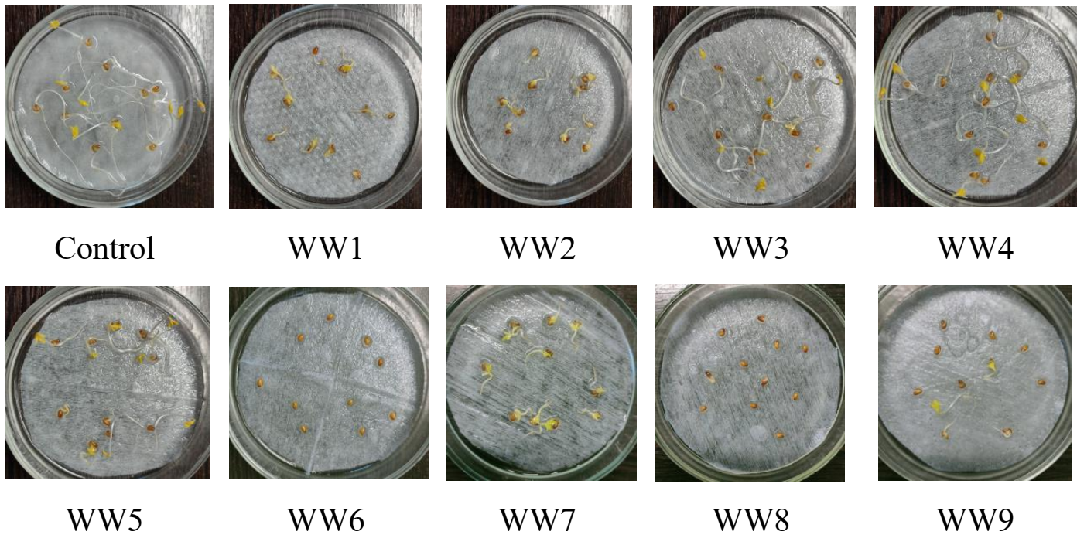
Research results (5 days)

Slide 8
Germination, % relative to control
*
*
*
* - differences from the control are significant at p ≤ 0.05

Slide 9
Length of roots, % relative to control
*
*
*
*
*
*
*
*
*
* - differences from the control are significant at p ≤ 0.05

Slide 10
Length of above-ground part, % relative to control
*
*
*
*
*
*
*
* - differences from the control are significant at p ≤ 0.05

Slide 11
Interpretation of the bioassay data
Research option | SGI | RLI | Interpretation of the results of phytotest | Comments
Control | 0.000 | 0.000 | No toxicity | No inhibition of growth
Production of Ukraine
WW1 | 0.001 | -0.927 | Extreme toxicity | Inhibition of growth more than 90%
WW2 | -0.068 | -0.958 | Extreme toxicity | Inhibition of growth more than 90%
WW3 | -0.001 | -0.699 | High toxicity | Inhibition of growth more than 60%
WW4 | -0.068 | -0.627 | High toxicity | Inhibition of growth more than 60%
WW5 | -0.034 | -0.770 | Extreme toxicity | Inhibition of growth more than 75%
Production of Turkey
WW6 | -0.778 | -0.990 | Extreme toxicity | Inhibition of growth more than 90%
WW7 | 0.037 | -0.937 | Extreme toxicity | Inhibition of growth more than 90%
WW8 | -0.741 | -0.990 | Extreme toxicity | Inhibition of growth more than 90%
Production of the United Kingdom of Great Britain and Northern Ireland
WW9 | -0.408 | -0.946 | Extreme toxicity | Inhibition of growth more than 90%

Slide 12
Conclusions
78% of the tested wet wipes (60% Ukrainian production and 100% foreign) showed extreme toxicity.
The tested wet wipes contain toxic substances (in particular, surface-active substances), show phytotoxicity and can be a source of environmental pollution.
12
12

Slide 13
Thank you for your attention!
Contact:
nataliia.smykun@gmail.com
zelenalyubov@gmail.com
13
13

