Slide 1
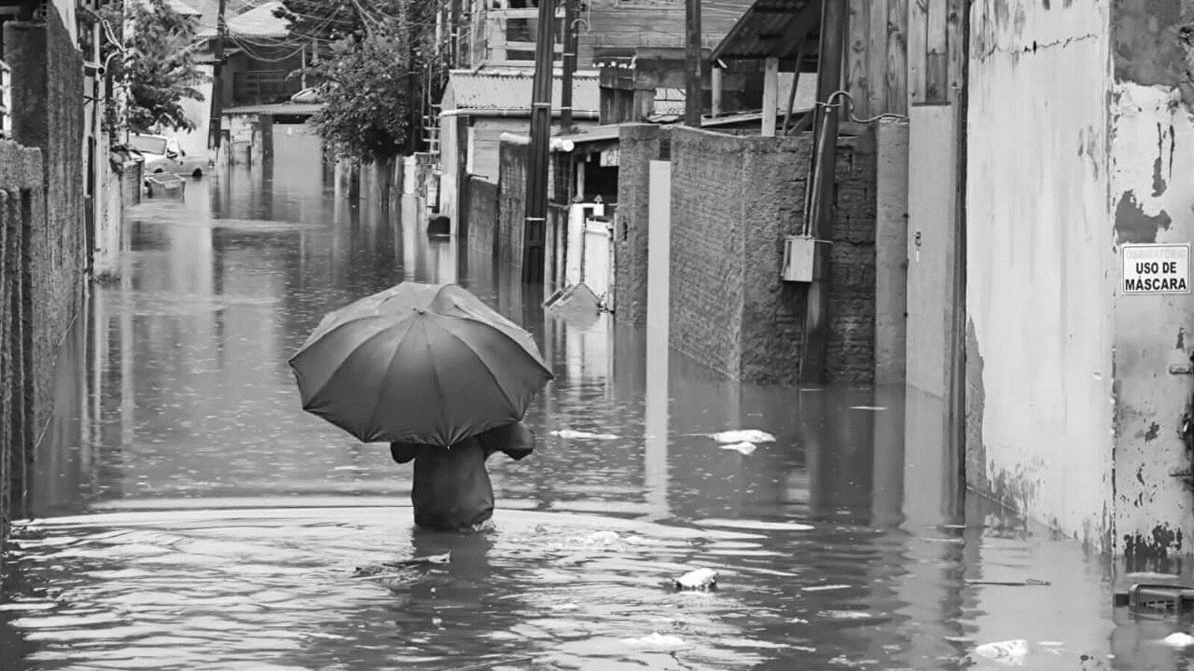
The 6th International Electronic Conference on Atmospheric Sciences 15 - 30 October | Online
THE RAINFALL IN THE MUNICIPALITY OF FLORIANÓPOLIS (BRAZIL): THE CASE OF DECEMBER 2022.
Bárbara de Aguiar Dutra¹*
^{1*}PhD candidate in Geography and Territorial Planning at NOVA University Lisbon (NOVA-FCSH), oc.barbaraaguiar@gmail.com
Portugal,
August 2023.

Slide 2
THE RAINFALL IN THE MUNICIPALITY OF FLORIANÓPOLIS (BRAZIL): THE CASE OF DECEMBER 2022.
INTRODUCTION
1.1 The Municipality of Florianópolis;
1.2 The State of Santa Catarina;
1.3 Study Objective.
2. METHODS
2.1 The present article:
Rainfall data from National Institute of Meteorology - Excel Software;
Satellite images, Defense Civil website, photographs, and images from newspapers;
Atlas of Natural Disasters in the State of Santa Catarina.
4. CONCLUSIONS
Heavy rainfall during December 2022, exceeding 450 mm;
Mayor of Florianópolis declared a state of emergency;
Adverse effects on other places and cities;
Florianópolis has experienced situations over the years - documented in the Atlas;
Sometimes, intense rainfall can lead to landslides and slips.
3. RESULTS AND DISCUSSION
December 2022 rainfall:
Rainfall occurred at the 1st and between 19th and 20th;
Figure 2 shows the accumulated precipitation in December 2022;
Figure 3 illustrates the annual rainfall distribution in 2022;
Exceeding 450 mm;
Figure 4 shows a map of the State with precipitation alerts;
SC Hoje News and G1 Santa Catarina Newspapers;
Figure 5 illustrates photographs of Florianópolis;
Other events recorded: flood in January 2018; 1997; December 1995 and November 2008.
Author: Bárbara de Aguiar Dutra¹*
^{1*}PhD candidate in Geography and Territorial Planning at NOVA University Lisbon (NOVA-FCSH), oc.barbaraaguiar@gmail.com

Slide 3
Abstract: The Municipality of Florianópolis is located in the State of Santa Catarina (SC), at the South Region of Brazil. The place is considered the capital of the State or Island of Santa Catarina. According to the census accomplished in 2022 by the Brazilian Institute of Geography and Statistics the Municipality had 537.217 habitants, distributed in a territorial area of 674,844 km². The State of SC is recognized by the numbers of disasters that frequently occurs, whether caused by precipitations, such as flood or drought, landslides, windstorms, hail and the occurrence of the first storm in the South Atlantic Ocean – Hurricane Catarina. According Monteiro (2001), SC is one of the States in Brazil with the best distribution of precipitation. This is due to a series of factors and different situations, such as cold fronts, the South Atlantic Convergence Zone (SACZ), medium-level troughs, maritime circulation, tropical convection, cyclonic vortices, and relief. The municipality’s economy is based on tourism, technology sector, commerce, civil construction, mariculture and aquaculture. In accordance with Murara (2012) the average annual rainfall of Florianopolis is 1.734 mm. This study aims to analyze and demonstrate the precipitation rates that led to the flooding episodes in December 2022 in the Municipality of Florianopolis and also compare with other extremes situations recorded in the past. For this, information and data were collected from the National Institute of Meteorology, satellites images, facts from the Civil Defense website, photographs, and images from state and municipal newspapers.
Keywords: Precipitation; Flood; Santa Catarina; Florianópolis.

Slide 4
PRESENTATION INDEX
INTRODUCTION
1.1 The Municipality of Florianópolis;
1.2 The State of Santa Catarina;
1.3 Study Objective.
METHODS
2.1 The present article.
RESULTS AND DISCUSSION
SC Hoje News Newspaper;
G1 Santa Catarina Newspaper;
The Municipality experienced other situation in January 2018;
Herrmann and Alves (2014);
The 1997 year.
CONCLUSIONS
REFERENCES

Slide 5
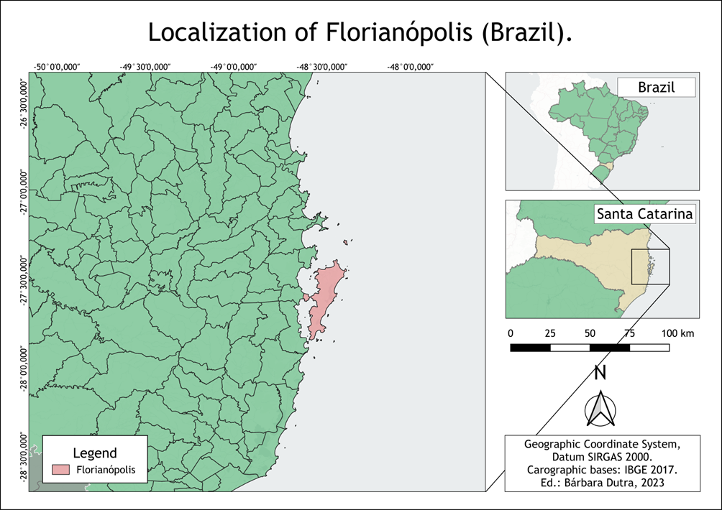
1. INTRODUCTION
1.1 THE MUNICIPALITY OF FLORIANÓPOLIS
Situated at the State of Santa Catarina (SC) in the South Region of Brazil;
Located in the Mesoregion of Grande Florianópolis;
Considered the capital of the State or Island of Santa Catarina;
Census realized in 2022 the Municipality contained 537.213 habitants (IBGE, 2022);
The second most populous in the State;
The Municipality covers a territorial area of 674,844 km²;
Economy is based on tourism, technological sector, commerce, construction, mariculture and aquaculture;
According to Murara (2012) the average annual rainfall is 1.734 mm;
Figure 1 represents the localization of the Municipality of Florianópolis.
Figure 1: Localization of the Municipality of Florianópolis (Brazil).
.

Slide 6
1. INTRODUCTION
1.2 THE STATE OF SANTA CATARINA (SC)
295 Municipalities and territorial area of 95.739,690 km².
The census registered a population of 7.609.601 habitants;
Represented by six Mesoregions such as West, Serrana, Vale do Itajaí, North, South and Grande Florianópolis;
Recognized by the number of disasters that have occurred over the years;
Disasters: influenced by precipitation, including floods or droughts, landslides, windstorms, hail, and even the first occurrence of a hurricane in the South Atlantic Ocean, known as Hurricane Catarina;
According to Monteiro (2001) SC is one of the States in Brazil with the best distribution of precipitation;
Attributed to several factors: cold fronts, South Atlantic Convergence Zone (SACZ), mid-level troughs, maritime circulation, tropical convection, cyclonic vortices and the relief;
1.3 STUDY OBJECTIVE
Analyze and present the precipitation index that contribute to the flooding episodes in the Municipality of Florianópolis in December 2022;
Additionally, compare this with other extremes situations previously recorded.

Slide 7
2. METHODS
2.1 THE PRESENT ARTICLE:
Rainfall data and information from the National Institute of Meteorology (INMET);
The precipitation data was processed using Excel Software;
In addition: satellite images, information from the Defense Civil website, photographs, and images from state and municipal newspapers;
The Atlas of Natural Disasters in the State of Santa Catarina for the period between 1980 and 2010, which was published in 2014.
National Institute of Meteorology (INMET)
Atlas of Natural Disasters in the State of Santa Catarina

Slide 8
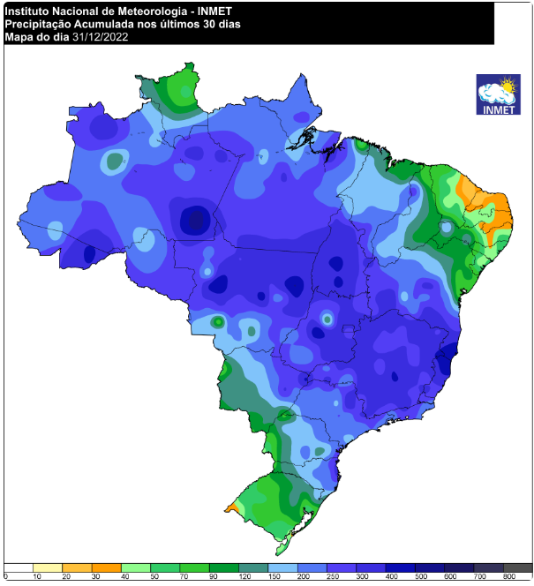
3. RESULTS AND DISCUSSION
December 2022: rainfall totaled approximately 477 mm;
The average monthly rainfall is 177 mm, the deviation was 299,8 mm;
The highest rainfall volumes occurred at the beginning of the month and between the 19th and 20th;
On the December 20th: 207 mm in just 24 hours (INMET, 2023);
At the beginning of the month was associated with a hot and wet mass of air, especially in the State of Santa Catarina;
On the 20th, it was related to a low-pressure system with high humidity levels, resulting in expressive rainfall in the cities of Itajaí and Florianópolis, with 229.4 and 207 mm, respectively;
Figure 2 illustrates the accumulated precipitation in December 2022, with areas in blue indicating the highest volumes and areas in yellow/green the lowest volumes.
Figure 2: Accumulated rainfall for December 2022 in Brazil. Source: INMET, 2023.

Slide 9
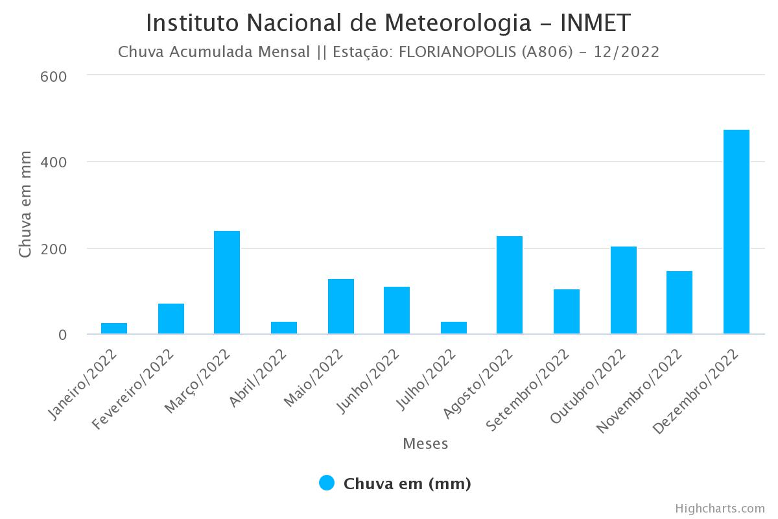
3. RESULTS AND DISCUSSION
Extreme events in the country were related to the South Atlantic Convergence Zone (SACZ) and humidity levels;
Precipitations were observed in nearly all of Brazil, from the South and Southeast coast to certain areas in the central and northern of the North Region;
Precipitation in Santa Catarina varied, with the highest indices recorded in the central and northern regions and the lowest levels in the Western Region;
Figure 3 illustrates the annual rainfall distribution for the Municipality of Florianópolis in 2022;
December had the highest rainfall, exceeding 400 mm, followed by March with 242 mm;
In December some days experienced intense precipitation, while on other days, no precipitation was recorded.
Figure 3: Annual total precipitation for 2022 in Florianópolis. Source: INMET, 2023.

Slide 10
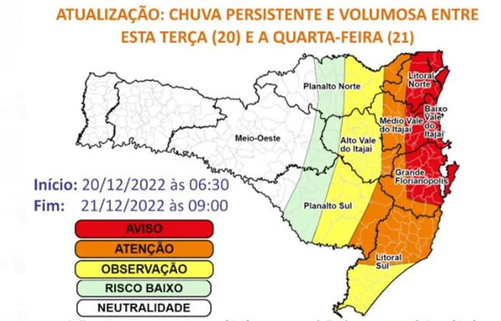
3. RESULTS AND DISCUSSION
Figure 4 represents a map of Santa Catarina with precipitation alerts for each region:
The red area represents alerts for persistent and voluminous precipitations, particularly in Grande Florianópolis, Baixo Vale do Itajaí, and North Littoral regions;
These alerts were issued for the period of December 20th and 21st;
Precipitation was influenced by maritime circulation, resulting in substantial and sometimes intense rainfall – a very high risk of episodes such as landslides in the regions of Grande Florianópolis, North Littoral, Baixo, and Médio Vale do Itajaí (CIVIL DEFENSE DEC., 2022).
Figure 4: Precipitation volume alert in the December 20th and 21st for the State of Santa Catarina. Source: Civil Defense, 2022.

Slide 11
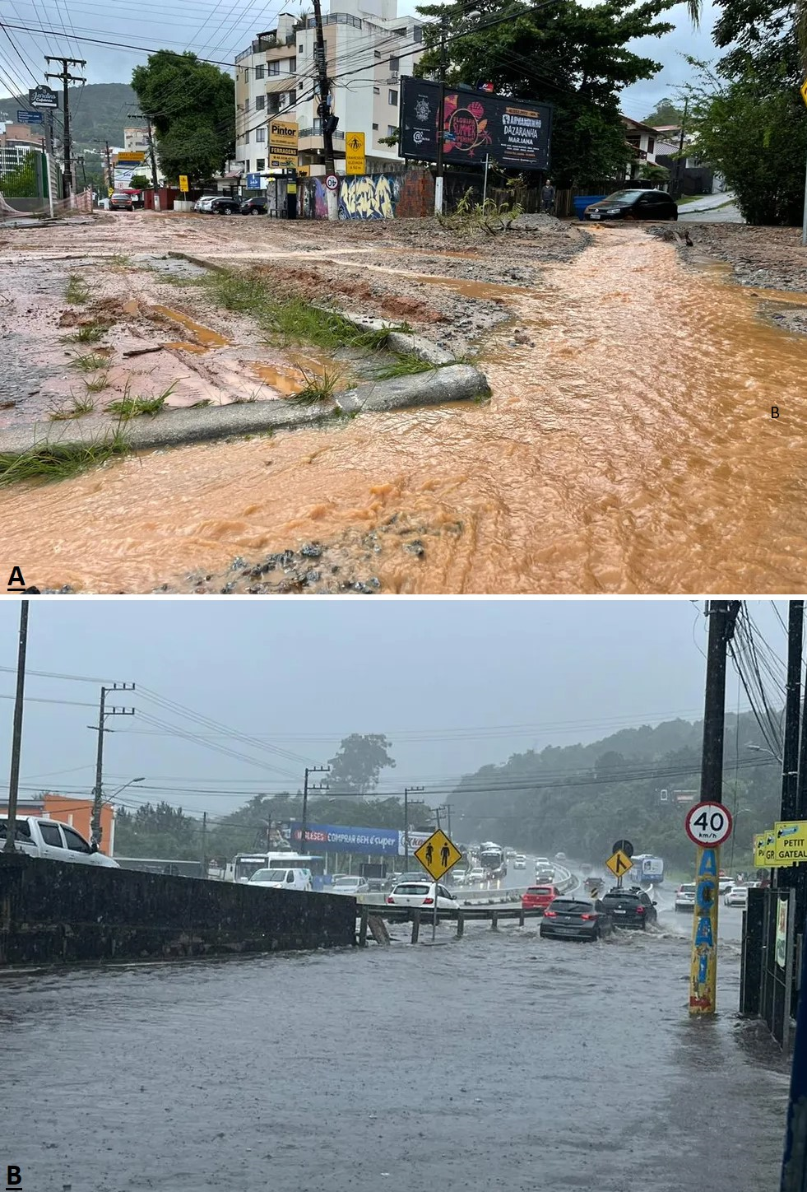
3. RESULTS AND DISCUSSION
The SC Hoje News Newspaper published a note on December 21st:
90 incidents in Florianópolis as a result of heavy precipitation, leading to landslides and flooding;
15 people homeless and 1.600 displaced;
40 residences were interdicted totally or partially.
The G1 Santa Catarina Newspaper :
Landslides and flooding occurred in several cities in the State of Santa Catarina between November 30th and December 1st;
Roadways were interdicted, including the BR-101 at Morro dos Cavalos in Palhoça;
The Mayor of Florianópolis declared a state of emergency;
Classes and public transportation services, were suspended.
Figure 5 represents two photographs in the Municipality of Florianópolis:
The first one (A) is from December 1st and illustrates the damage caused on a traditional street in the Córrego Grande;
The second (B) is from December 19th shows Highway SC-401, a route used by hundreds of vehicles every day, and has flooding points, impeding traffic.
Figure 5: Damages caused from the December 2022 rainfall. Source: G1 Santa Catarina.

Slide 12
3. RESULTS AND DISCUSSION
The Municipality experienced other flood situation in January 2018:
Resulted in one death and left many residents isolated in Florianópolis;
500 people becoming homeless across the State;
Precipitation exceeded the climatological average between the 9th and 11th, with approximately 400 mm;
Civil Defense - this amount of precipitation was nearly three times the monthly average, which ranges from 150 to 170 mm;
The Mayor declared a state of emergency, and over 200 streets were affected (TORRES, 2018);
Alves and Silveira (2018), the accumulated monthly precipitation reached 625,4 mm at the Carijós Station, located in the Jurerê neighborhood.
Herrmann and Alves (2014):
Mesoregion of Grande Florianópolis observed a total of 292 flooding facts;
159 were flash floods and 133 were gradual flooding (between 1980 and 2010);
Landslides were sometimes associated with heavy rainfall;
The Municipalities of Florianópolis and Blumenau have the highest frequency of the landslides incidents;
21 Municipalities situated in the Grande Florianópolis area, Florianópolis had the highest number of flooding episodes, totaling 24.

Slide 13
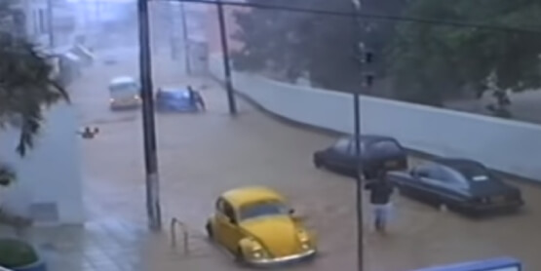
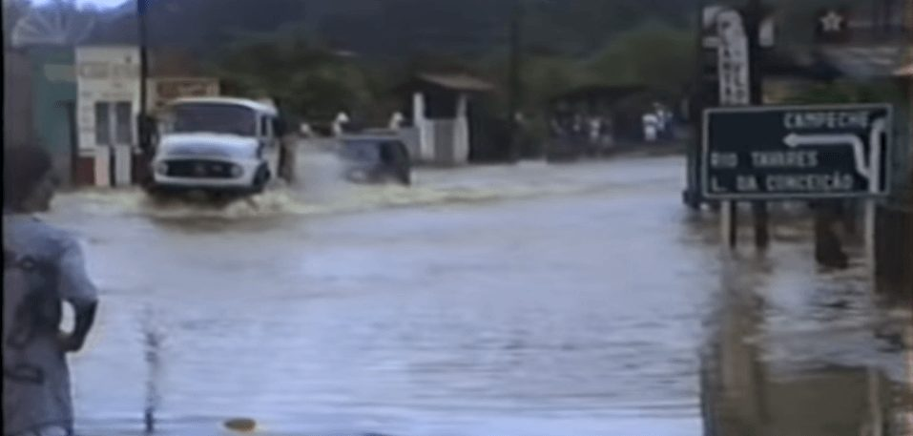
3. RESULTS AND DISCUSSION
The 1997 year:
Florianópolis experienced several events throughout the year.;
In January: precipitation deviations exceeded the average, influenced by the South Atlantic Convergence Zone (SACZ);
In January, the Municipality of Florianópolis recorded a deviation of 453 mm above the average precipitation;
During the summer, there were flash flood and gradual floods, especially in Grande Florianópolis and Vale do Itajaí Mesoregions;
Precipitation exceeding 250 mm;
35 Municipalities were affected in January, and 37 were affected in October (Marcelino et al, 2014; Herrmann e Alves, 2014).
Other significant events: December 1995 and November 2008.
Figure 6: Damages caused by the December 1995 rainfall. Source: IFSC Campus Florianópolis.

Slide 14
4. CONCLUSIONS
Based in the collected information about the precipitation, it is evident that heavy rainfall occurred during December 2022, exceeding 450 mm and being three times above the historical average;
In response for this situation, the Mayor of Florianópolis declared a state of emergency;
In addition, the precipitation that affected the Municipality also had adverse effects on the other places and cities located at the North of the State, as well as in the Baixo and Médio Vale of Itajaí;
The Municipality of Florianópolis has experienced other situations over the years, as demonstrated and documented in the Atlas of Natural Disasters in the State of Santa Catarina;
Sometimes, heavy and intense rainfall can lead to new incidents, such as landslides and slips.
.

Slide 15
5. REFERENCES
Brazilian Institute of Geography and Statistics (IBGE). Cities and States: Florianópolis. Available online: https://cidades.ibge.gov.br/brasil/sc/florianopolis/panorama (accessed on 23 August 2023).
Monteiro, M. Climatic Characterization for the State of Santa Catarina: an approach to main atmospherics systems which acted during the year. Geosul 2001, Volume 16, pp.69-78.
Murara, P.G.S. Climatic variability and circulation and respiration diseases in Florianópolis (SC): a contribution to the Medical Climatology. Master Dissertation in Geography. Federal University of Santa Catarina (UFSC), Florianópolis, Brazil. 2012.
National Institute of Meteorology (INMET). Extreme events in Brazil in December 2022. Brasília (Distrito Federal). Available online: https://portal.inmet.gov.br/uploads/notastecnicas/Nota_EventosExtremos_Brasil_Dezembro2022v.pdf (accessed on 22 August 2023.
Civil Defense. Actualization: Meteorological Special Aviso DC/SC 20/12 06:30 – Actualization: persistent and voluminous rainfall between this Tuesday (20) and Wednesday (21). Available online: https://www.defesacivil.sc.gov.br/avisos-meteorologicos/atualizacao-aviso-meteorologico-especial-dc-sc-20-12-0630-atualizacao-chuva-persistente-e-volumosa-entre-esta-terca-20-e-a-quarta-feira-21/ (accessed on 23 August 2023).
SC News Hoje. Civil Defense attended 90 occurrences because of the rainfall in Florianópolis. December 2022. Available online: https://schoje.news/2022/12/21/defesa-civil-atende-90-ocorrencias-por-conta-das-chuvas-em-florianopolis/ (accessed on 22 August 2023).
G1 Santa Catarina. Heavy rainfall cause flooding, landslides and interdicted highways in the Grande Florianópolis and others regions of SC. December 2022. Available online: https://g1.globo.com/sc/santa-catarina/noticia/2022/12/01/chuvas-e-alagamentos-em-santa-catarina-e-florianopolis.ghtml (accessed on 22 August 2023).
Torres, A. Rainfall causes obtis, leave the residents isolated in Florianópolis and 500 homeless in SC. Cotidiano - Notícias/UOL. Available online: <https://noticias.uol.com.br/cotidiano/ultimas-noticias/2018/01/11/chuva-deixa-moradores-ilhados-em-florianopolis-e-provoca-mortes.htm> (acessed on 21 August 2023).
Alves, M.P.A.; Silveira, R.B. Spacial Analyze of the precipitation in Florianópolis – SC: the case of January 2018. Proceedings of XIII Geographic Climatology Brazilian Symposium 2018, pp.1469-1478.
Herrmann, M.L.P.; Alves, D.B. The main negatives consequences provocated by the atmospherics adversities in the Santa Catarina State. In Naturals Disasters Atlas of the State of Santa Catarina between the periodo of 1980 and 2010, 2nd ed.; Editor 1, M.L.P.H. Publisher: Geographic and Historical Institute of Santa Catarina – IHGSC; Geographics Notebooks – GCN/UFSC, Florianópolis, Brazil, 2014. Volume 1, pp. 83-93.
Marcelino, I.P.V.O et al. Atmospherics adversisties in the State of Santa Catarina between 1980 and 2010. In: Naturals Disasters Atlas of the State of Santa Catarina between the periodo of 1980 and 2010, 2nd ed.; Editor 1, M.L.P.H. Publisher: Geographic and Historical Institute of Santa Catarina – IHGSC; Geographics Notebooks – GCN/UFSC, Florianópolis, Brazil, 2014. Volume 1, pp. 13-82.

Slide 16
Thank you for your attention!
Obrigada pela sua atenção!
.

