Slide 1
“Synoptic scale factors involved in the appearance of tropospheric ducts in the Caribbean Sea”
Presented at the 6th International Electronic Conference on Atmospheric Sciences
Authors: Laura Leiva Pit ^{1,} *; Adrián Luis Ferrer Hernández²; Ailyn Caridad Justiz Águila² and Lanyer Pérez Galorbo³
¹ National Forecast Center, Institute of Meteorology, La Habana, Cuba; laurapit09@gmail.com.
²Center for Atmospheric Physics, Institute of Meteorology, La Habana, Cuba; aluislfh@gmail.com; ailyncita13@gmail.com.
³ Ministry of Communications, La Habana, Cuba; lanyer1978@gmail.com.
*Correspondence: laurapit09@gmail.com.

Slide 2
Tropospheric ducts are an abnormal condition of the atmosphere that affects the propagation of electromagnetic waves, which has a direct impact on the performance of various radio systems, including mobile telephony, which is especially sensitive to these interferences in communications.
Tropospheric Ducts
What do they casuse ?
The wave is trapped
The wave will propagate in jumps
Notes:
Tropospheric ducts are an abnormal condition of the atmosphere that affects the propagation of electromagnetic waves, which has a direct impact on the performance of various radio systems, including mobile telephony, which is especially sensitive to these interferences in communications.
According Marine López and a collective of authors, in a tropospheric duct, the wave is trapped in a kind of natural guide between the earth's surface and the layer in which the vertical gradient threshold is exceeded, or between two layers with the same condition. Due to this, the wave will propagate in jumps within the guide, with communication ranges that can reach hundreds of kilometers. These waves that travel through the troposphere experience a refraction due to the non-uniformity of the atmospheric layers, which manifests itself as a variation of the refractive index with height. When speaking of ducts reference is made to the most important short-term mechanism.

Slide 3
Tropospheric Ducts and its relationship with meteorological conditions
Analyzing and forecasting interference in radio communications networks
A NOVEL TOPIC
Also is possible to avoid carrying out long periods of field tests and other types of similar studies.
Implementing this method will allow the generation of short, medium and long-term alerts of possible interruptions in radio communications systems due to refractive anomalies.
Notes:
In general, at the national level, research focused on the study of the occurrence of ducts is scarce, hence it is useful to study the occurrence of tropospheric duct events at the national level, specifying what synoptic factors favor the appearance of these, with the objective to have a tool that enables early warning.
Therefore, contributing to the development of a system for analyzing and forecasting interference in radio communications networks caused by anomalous meteorological conditions constitutes a novel topic from a scientific point of view. Implementing this method will allow the generation of short, medium and long-term alerts of possible interruptions in radio communications systems due to refractive anomalies. It is good to clarify that so far there is no known similar system implemented. Therefore, research aimed at the forecast and detection of tropospheric ducts has a positive impact on the radiometeorological diagnosis of the functioning of existing communication links, representing a valuable contribution to the country's economy. Knowledge of the meteorological conditions that can lead to the appearance of ducts can strategically support decision-making that ranges from the way antennas are installed, taking into account orientation and power parameters, as well as the management of the country's telecommunications system. Thanks to the possibility of obtaining products derived from meteorological models, which provide the behavior of meteorological variables for an area, it is possible to avoid carrying out long periods of field tests and other types of similar studies.

Slide 4
For the accomplishment of this work the ERA-5 reanalysis was used.
Duct base height.
Minimum vertical gradient of refractivity inside trapping layer.
Trapping layer top height.
Mean vertical gradient of refractivity inside trapping layer.
Trapping layer base height.
Atmospheric pressure adjusted to mean sea level.
Relative humidity at 2m from the ground.
For this study, was used the data from the record of occurrence of ducts, these records are obtained from products produced by the Ministry of Communications of Cuba.
Notes:
For the accomplishment of this work the ERA-5 reanalysis was used. A group of duct parameter products and meteorological variables are available on the website for expample:
Duct base height.
Minimum vertical gradient of refractivity inside trapping layer.
Trapping layer top height.
Mean vertical gradient of refractivity inside trapping layer.
Trapping layer base height.
Atmospheric pressure adjusted to mean sea level.
Relative humidity at 2m from the ground.

Slide 5
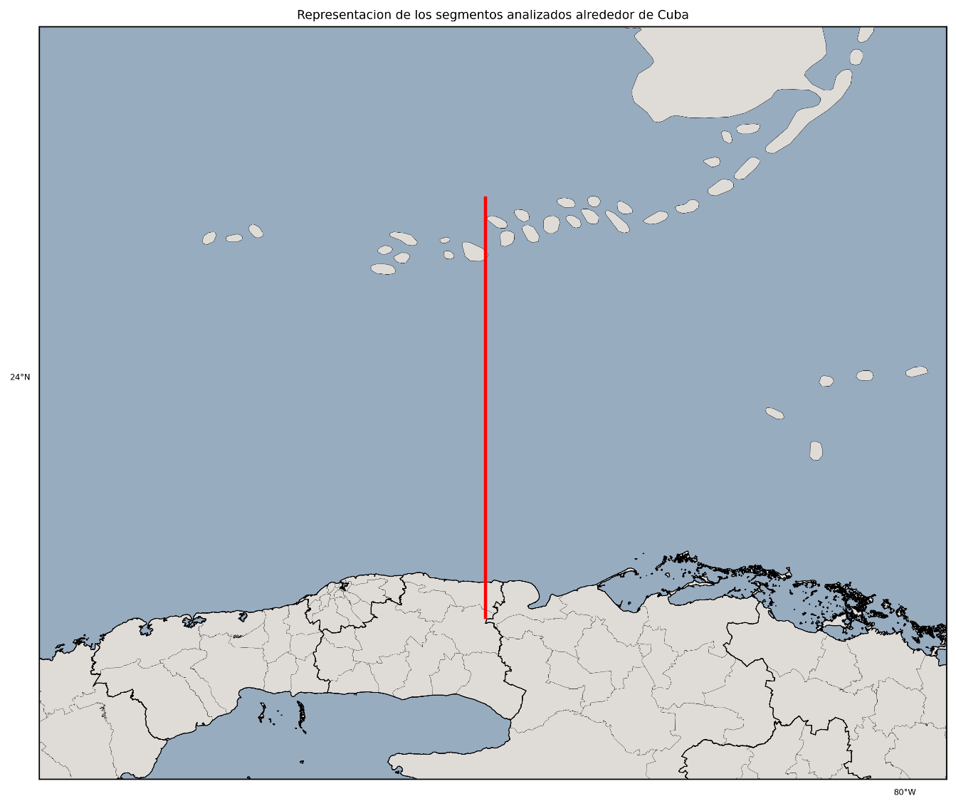
Results Discussion
1: 24.58 °N – 81.79 °W
2: 22.94 °N – 91.79 °W
1
The section selected for the investigation corresponds to the Florida Straits area , due to the proximity of this area to the country’s capital, also due to the socioeconomic interest and the impact that the occurrence of an interference in this area, which is the most populated in the country, has on communications.
2
Notes:
From the processing of the data series of duct parameters available in the ERA5 reanalysis using the Python programming language, the climatic behavior of these variables was obtained for the period 1981-2021. The section selected fot the investigation corresponds to the Florida Straits area, due to the proximity of this area to the country’s capital, also due to the socioeconomic interest and the imapct that the occurrence of an interference in this area, which is the most populated in the country, has on communications.

Slide 6
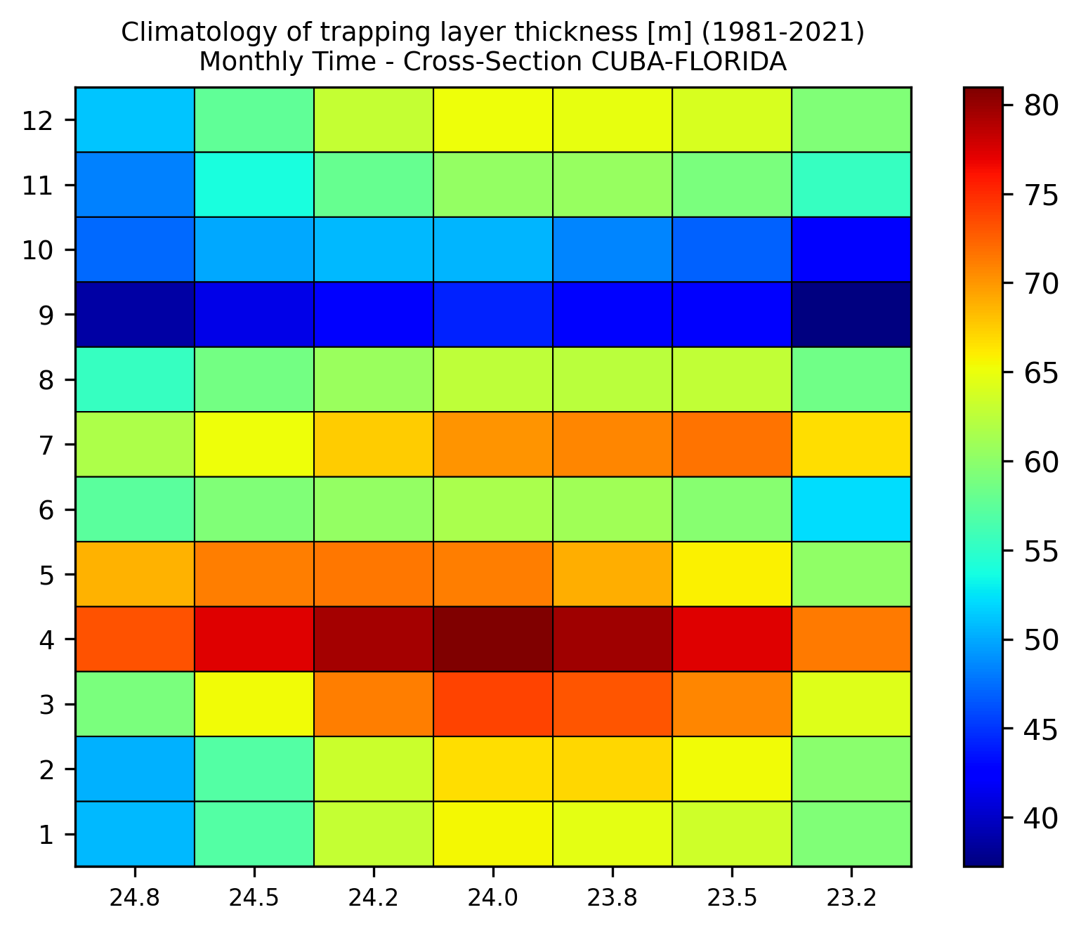
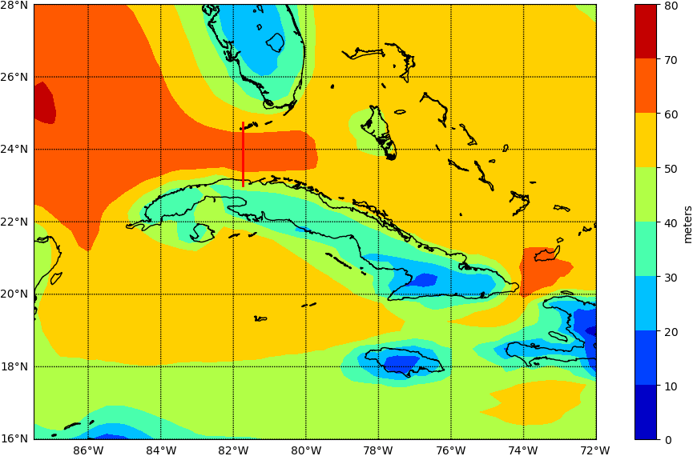
Ducts layer thickness.
Time (Months)
Latitude
Latitude
Longitude
Reflects the annual behavior of the ducts layer thickness around the archipielgo. It is observed that the highest thickness values are located in the Yucatan Channel, the Florida Strait and in Paso de los Vientos.
During the months of March to May the greatest thicknesses of ducts are present, also seeing that the maximum values can be in April where for all the analyzed section the values are greater than 70 meters thick of the duct layer on average.
Notes:
Thanks this type of graphs was possible to determine that in the Florida Strait during the months of March to May the greatest thicknesses of ducts are present, also seeing that the maximum values can be in April where for all the analyzed section selected the values are greater than 70 meters thick of the duct layer on average. In this analysis, it is important to consider that the highest values of thickness are also associated with more intense ducts, which from these maps it was possible to show that they occur at this time of the year, with average maximum values of 90 meters in the months of April. To generalize the variable in question, figure 1b was prepared, wich reflects the annual behavior of the ducts layer thickness around the archipielgo. It is observed that the highest thickness values are located in the Yucatan Channel, the Florida Strait and in Paso de los Vientos.

Slide 7
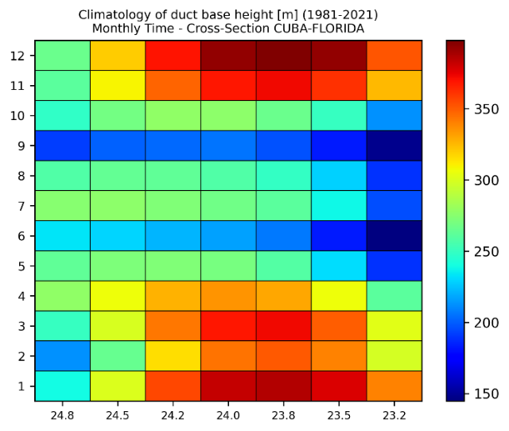
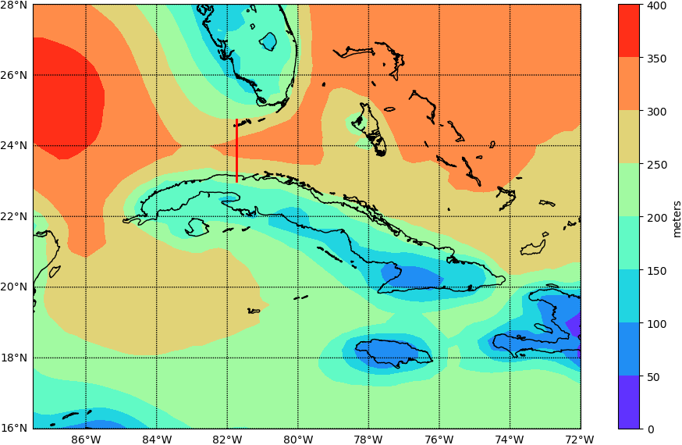
Duct base height
Latitude
Time (Months)
Latitude
Longitude
May, June, July, August, September and October:
Between 150 – 250 m.
January, February, March and December:
Between 300 – 400 m.
The same variable but taking into account its behavior during an entire year, it is seen that during the period the average values of duct height range between 250 meters and 350 meters to the north and west of Cuba, being inferior to the south of the island.
Notes:
During the months included in the rainy season (May, June, July, August, September and October) there is a predominance of occurrence of ducts in which the height of the layer oscillates between approximately 150 m and 300 m, while during the dry period (January, February, March and December) these heights are higher, generally between 300 m and 400 m. This situation occurs because in this period there is a humid layer at low levels, in addition, as throughout this time there is more instability there is less stratification of the atmosphere, this will influence less thermal stratification to predominate, therefore, the incidence of the elevated ducts will be less compared to the surface ones, the absence of forcing phenomena that generate uplift also makes it possible for the ducts to occur at lower heights in this period. At the moment that dry air predominates on the surface due to the advance of the frontal systems over the Gulf of Mexico, the Florida Peninsula and the Atlantic Ocean, an uplift of this humid layer is generated (figure 2), for which reason it is already It will not be located only on the surface. That is why when the monthly averages of the height of the duct base are obtained (figure 3a) there are moments in the same month of the dry season when the height of the base takes high values (greater than 350m) and others where the values decrease (between 250 m and 250 m). When analyzing this same variable but taking into account its behavior during an entire year, as shown in Figure 3b, it is seen that during the period the average values of duct height range between 250 meters and 350 meters to the north and west of Cuba, being inferior to the south of the island.

Slide 8
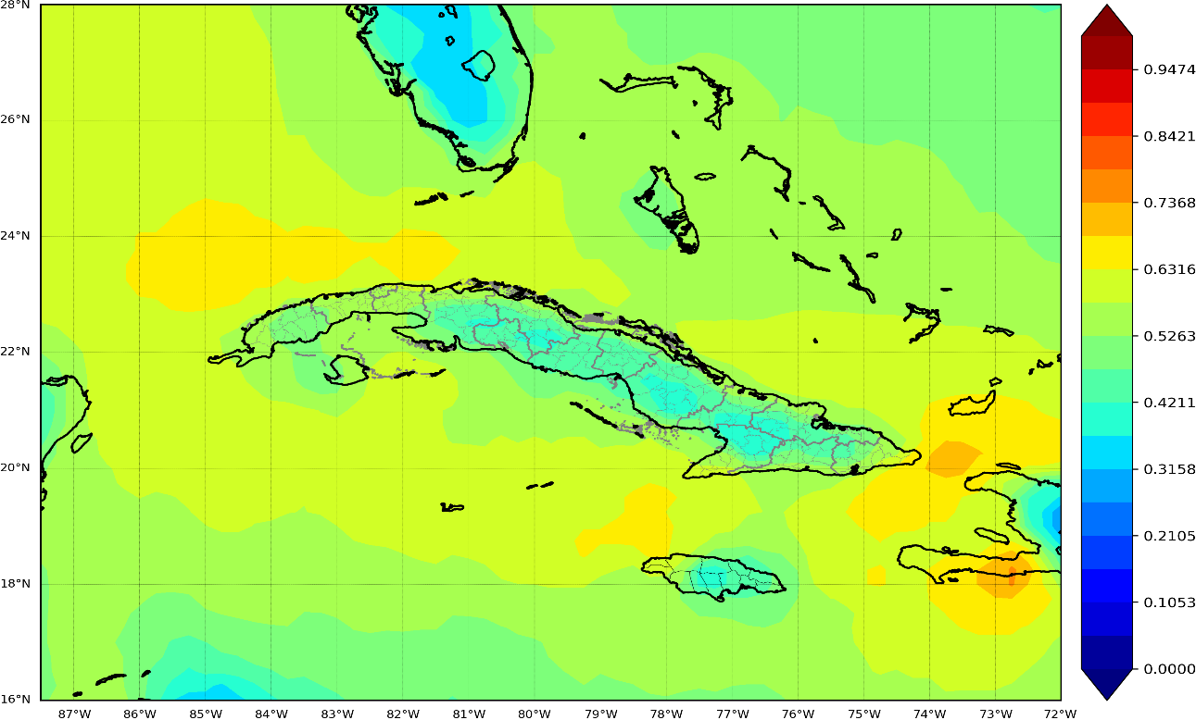
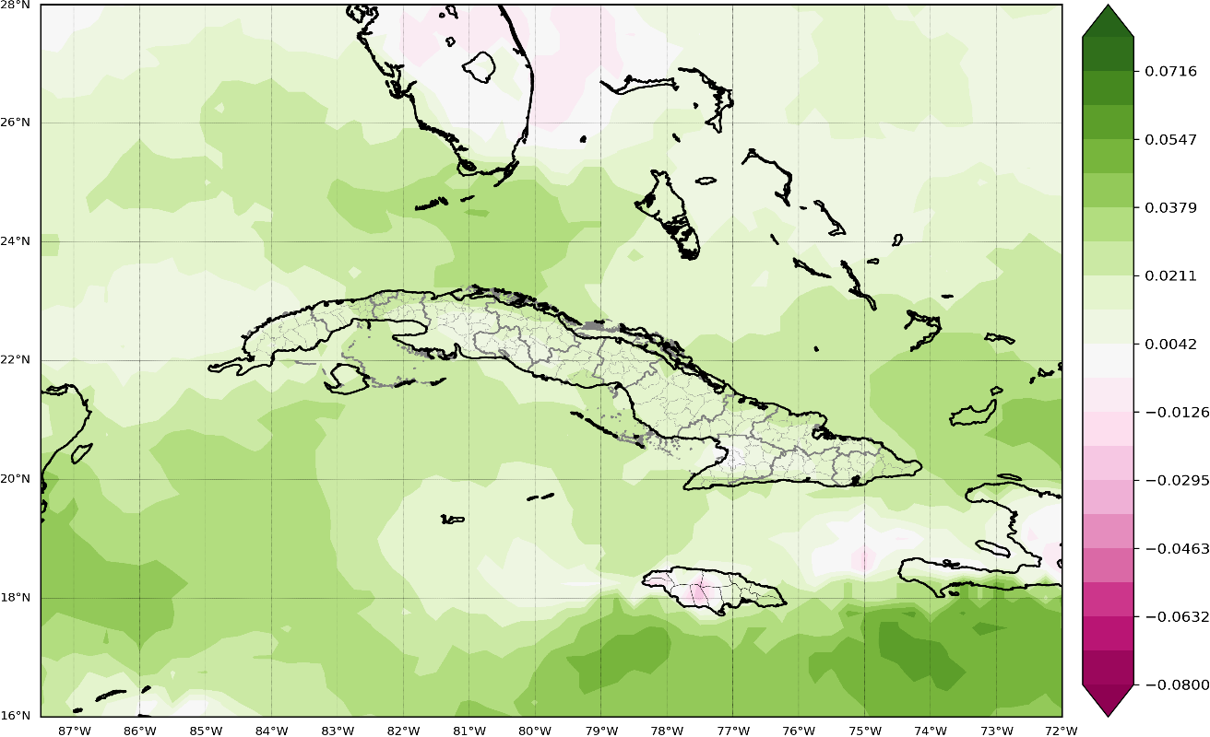
Annual frequency of duct´s occurrence
This variable has an average annual behavior that presents values close to 0.56 higher in the Straits of Florida, southeast of the Gulf of Mexico and southwest of Granma.
It was observed that there was a tendency to increase this variable in the last 10 years of the period. This is happening because in recent years an expanssion in the Atlantic subtropical anticyclon has been observed.
Notes:
Several studies have shown that the frequency of occurrence of tropospheric ducts has a variable behavior and is dependent on factors such as geographic position, weather conditions, and time of year. Figure 4a shows that in the case of Cuba and adjacent seas this variable has an average annual behavior that presents values close to 0.56 higher in the Straits of Florida, southeast of the Gulf of Mexico and southwest of Granma. When analyzing the sequence of maps corresponding to the average frequency of occurrence of ducts in the period 1981 - 2021, it was observed that there was a tendency to increase this variable in the last 10 years of the period (Figure 4b). This is happeing because in recent years an expanssion in the Atlantic subtropical anticyclon has been observed. Due to this change in circulation the days wiith predominace of stable atmospheric conditions have incresed.

Slide 9
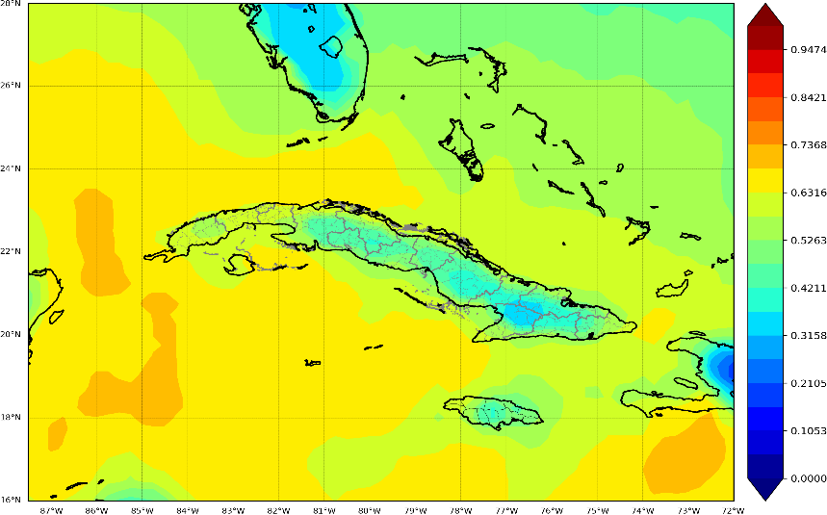
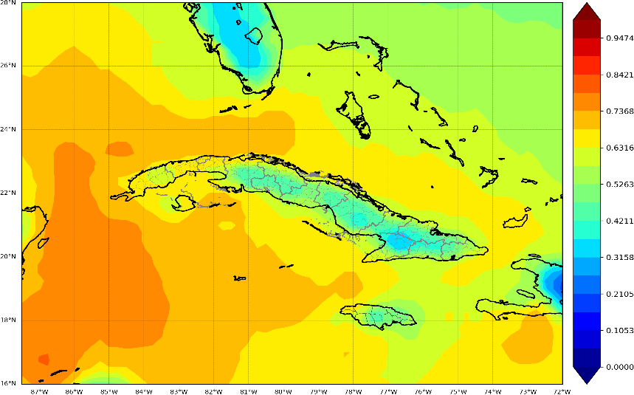
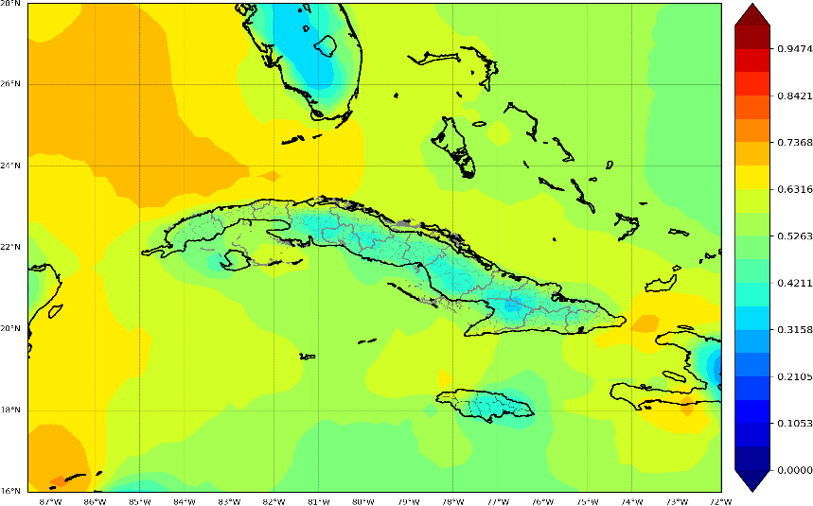
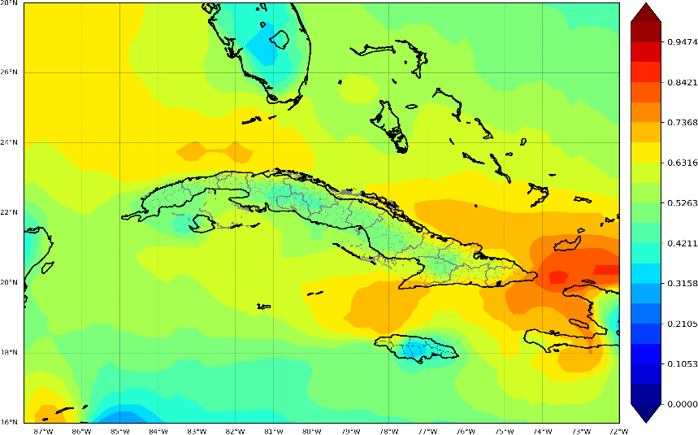
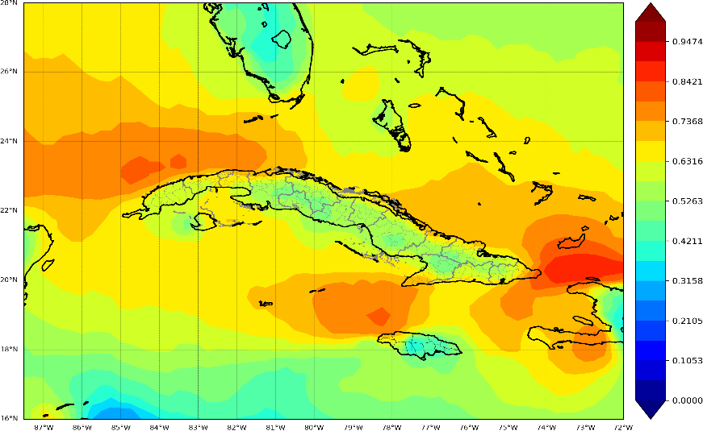
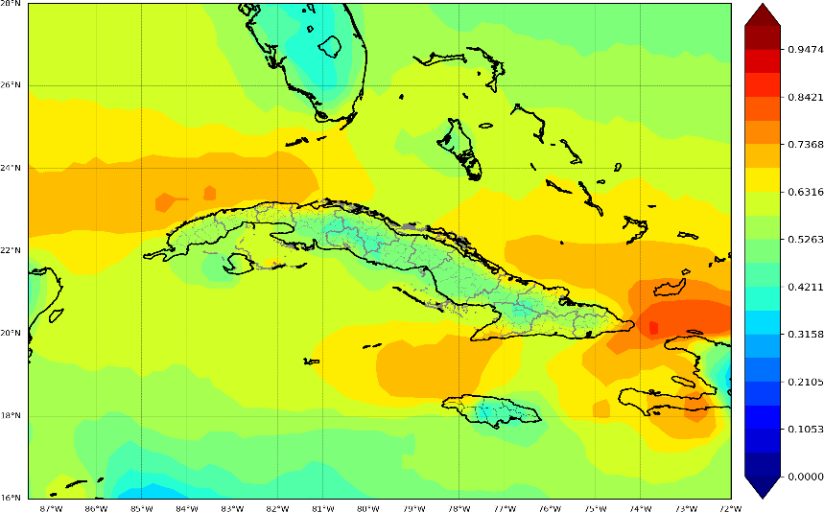
Maps of average monthly frequency between 1981-2021
March
April
May
June
July
August
Is noticeable that during the March-August semester there is an increase in this variable in the seas adjacent to the entire Cuban archipelago
Notes:
When analyzing the average frequency of duct by month of the year, it is noticeable that during the March-August semester there is an increase in this variable in the seas adjacent to the entire Cuban archipelago (Figure 5). The seas to the east of the eastern provinces are where the highest values of frequency of occurrence of these events are shown, with values higher than 0.85 in the month of July. On the other hand, the areas to the north of the Western region show maximum values above 0.66 in the months of April and July.

Slide 10
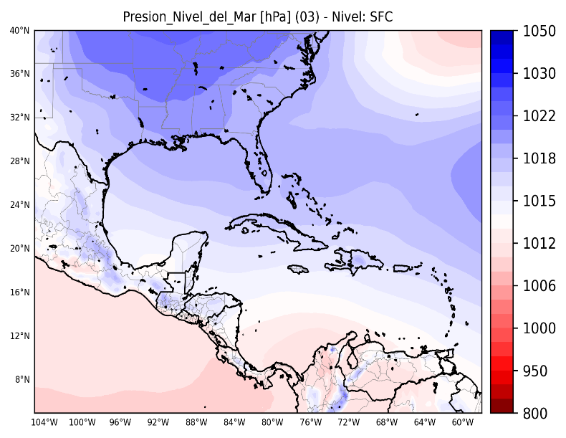
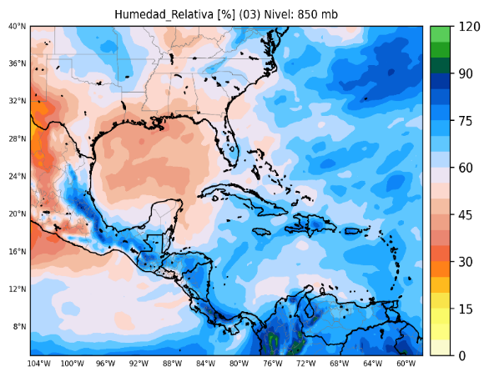
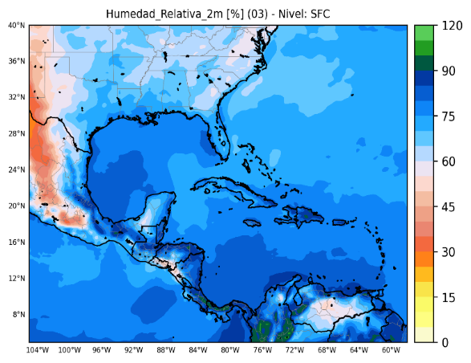
Monthly averages in the month of March of Atmospheric Pressure (Surface level) (Source: Prepared by the author).
Average in 5 years of relative humidity in the month of March, Left: Relative humidity at altitude (850 mb), Right: Relative humidity on the surface, (Source: Prepared by the author).
Notes:
The Caribbean geographic basin is subject to the influence of continental anticyclones during the winter period, the centers that move to the southern part of the United States cause intense cold air transport from the center of this country to the western half of Cuba. During this displacement process, the migratory air mass changes slightly, consequently it loses its representation on the surface and ends up being absorbed by the Atlantic Subtropical Anticyclone. The presence of these secondary centers of high pressure favors subsidence, helping moisture to accumulate on the surface. In March (like you can see in the picture), when the subtropical anticyclone is withdrawn, a certain homogeneity is created between its ridge and the ridge of the migratory anticyclone (Figure 6), the latter is also weakened, therefore, successive processes of air mass replacement begin to emerge. and since this cycle is repeated, an accumulation of air takes place that creates a dry layer in the height (left picture), confining the humidity on the Surface (right picture).
In the months of June and July, the subtropical anticyclone reaches its maximum expansion in the ridge, during this period there is no influence of migratory anticyclones either, but these months coincide with the maximum intensity and frequency of the tropical waves from the East, generating a pattern very similar to that observed in the month of March.

Slide 11
Conclussions
The ERA5 reanalysis was feasible to determine the behavior of the parameters associated with the tropospheric ducts in the area of the Caribbean Sea, Gulf of Mexico and Florida Strait, then it can be affirmed that during the quarter March - May in the period between 1981-2021 the greatest thicknesses of the ducts are observed.
The presence of atmospheric stability and the combination of a humid layer at low levels with a dry layer at altitude favors the formation of tropospheric ducts, therefore, the possibility of interference in communications increases.
The synoptic situations that mainly enable the formation of tropospheric ducts are: Interaction of the Atlantic Subtropical Anticyclone with migratory anticyclones during the winter period, mainly in the March-May quarter, and the interaction of the Atlantic Subtropical Anticyclone with eastern tropical waves during the month of July.

