Slide 1
Research Title: Author: Affiliation:
Estimation of 28-day Compressive Strength of Self-compacting Concrete using Multi Expression Programming (MEP): An Artificial Intelligence approach
Waleed Bin Inqiad
National University of Sciences and Technology Pakistan

Slide 2
SEQUENCE OF PRESENTATION
01.
Introduction
02.
Literature Review
03.
Research Methodology
04.
Results
05.
Conclusion

Slide 3
ARTIFICIAL INTELLIGENCE (AI)
It is the ability of computers and machines to mimic the problem-solving capabilities of human mind.
Machine learning is a branch of AI.
Usage of mathematical algorithms to help a computer learn without direct instruction.
ML algorithms can predict different properties of concrete.

Slide 4
Self-Compacting Concrete (SCC)
A special type of concrete that has following properties:
Increased flowability.
Segregation resistance.
Can settle under its own weight.
Can compact itself without external vibration.
The utilization of powder industrial by-products like fly ash and silica fume in production of SCC for environmental and economic benefits has attracted the attention of researchers as an effective way for renewable resources.

Slide 5
PROBLEM STATEMENT
Very few methods can reliably predict the compressive strength of SCC based on the mix components.
This is due to the highly non-linear behavior exhibited by the compressive strength in relation to the components of the concrete mixtures.
Although we have conventional methods to find the 28-day compressive strength, but there are many limitations with these methods.

Slide 6
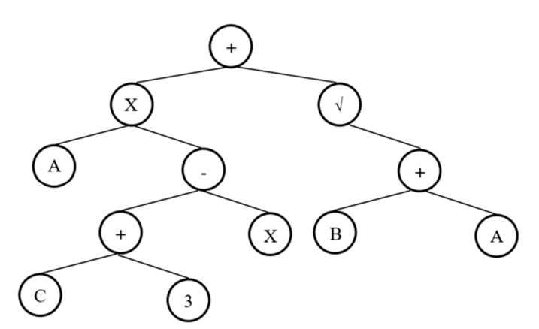
Genetic Programming (GP)
Genetic Programming is an evolutionary technique used for breeding a population of computer programs.
It is a problem-solving approach in which computer programs are evolved to solve problems based on the Darwinian principle of reproduction and using operations such as reproduction, crossover and mutation.
GP individuals are represented and manipulated as nonlinear entities, usually trees..
GEP and MEP are sub-techniques of genetic programming.

Slide 7
Multi Expression Programming (MEP)
MEP uses linear chromosomes for solution encoding and has a special ability to encode multiple solutions in a single chromosome. According to the fitness values of the individuals, the best encoded solution is chosen to represent the chromosome.
Comparing to the other GP variants that store a single solution in a chromosome, MEP does not increase the complexity of the decoding process.
In the evolution process of MEP, the mathematical inconsistencies are read and eliminated from the ultimate expression. Also, in MEP the process of decoding is much simple related to other soft computing techniques.
It is an upgraded version of GP that has the capacity of processing an accurate result even when the ultimate form of equation is not known.

Slide 8
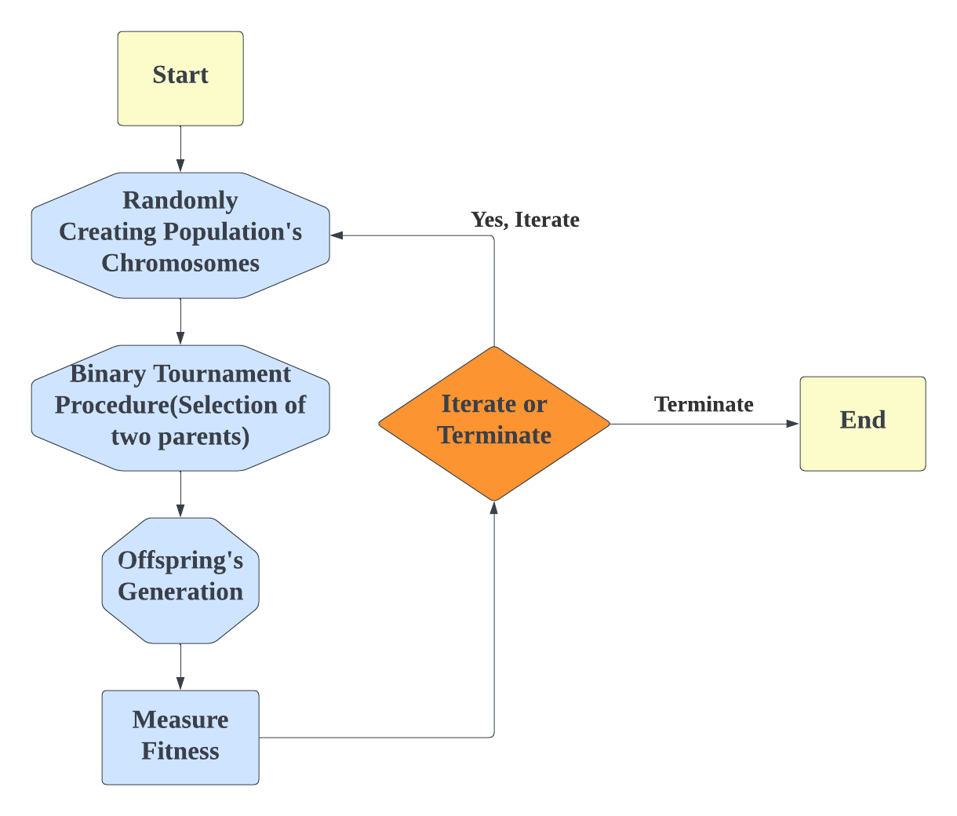
Flow Chart of MEP Algorithm

Slide 9
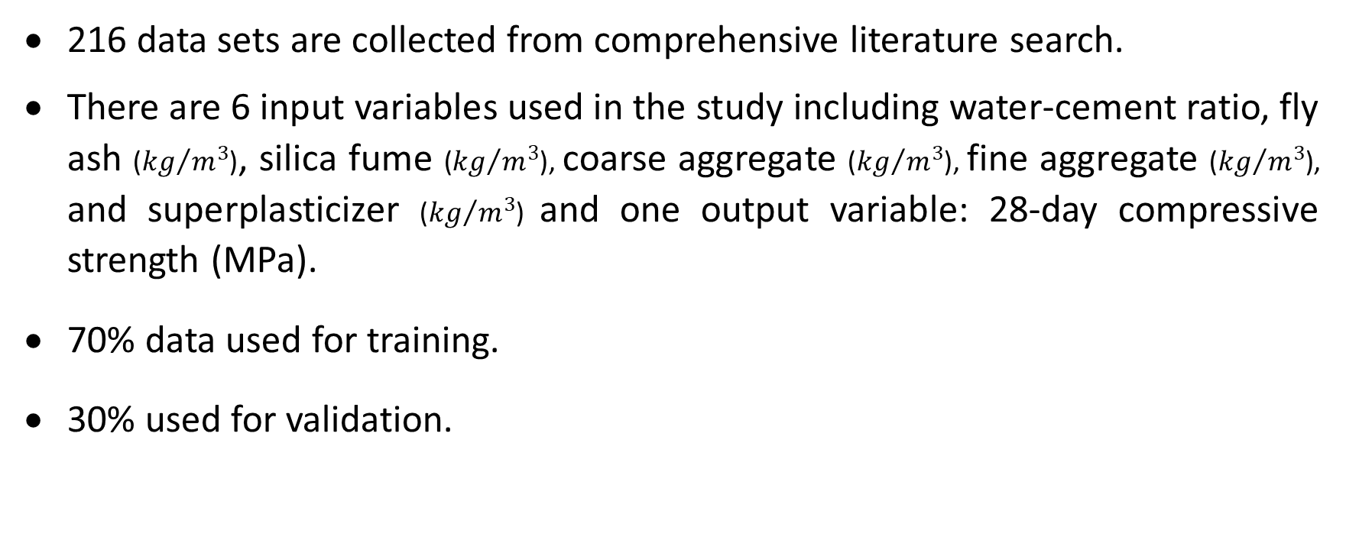
Data Collection
216 data sets are collected from comprehensive literature search.
There are 6 input variables used in the study including water-cement ratio, fly ash (${kg}/{m^{3}}$), silica fume (${kg}/{m^{3}}$), coarse aggregate (${kg}/{m^{3}}$), fine aggregate (${kg}/{m^{3}}$), and superplasticizer (${kg}/{m^{3}}$) and one output variable: 28-day compressive strength (MPa).
70% data used for training.
30% used for validation.

Slide 10
Error Metrics and Performance Indicators
The model’s effectiveness is assessed by estimating numerous statistical error metrices and fitness indicators. The following error metrices are used to assess the model:
Coefficient of Correlation (R)
Mean Absolute Error (MAE)
Root Mean Squared Error (RMSE)

Slide 11
Development of MEP Model
MEPX 2021.05.18.0 a commercially available computer tool, was used to implement the MEP algorithm.
The fitting parameters are chosen using earlier recommendations and a trial-and-error method.
Parameter | Value
No. of Subpopulations | 200
Size of Subpopulation | 1000
Code Length | 40
Number of Generations | 1000
Number of Runs | 10
Functions | +, -, ×, ÷, sqrt, sin, cos, tan

Slide 12
Development of MEP Model
The software gives the output in the form of C++ code and the output has been decoded to get the empirical equation for the compressive strength. The equation thus derived is given below:
$y= \frac{(x_{1}x_{5}+x_{2})+[(x_{1}\sqrt{\sqrt{x_{3}+x_{4}}})−\sqrt{x_{3}+x_{4}}]+(\frac{x_{1}+x_{2}+x_{3}}{x_{0}})}{(\sqrt{x_{3}+x_{4}})+{(\tan{(\sin{(x_{4})})})}^{2}}−\cos{(x_{1})}$

Slide 13
Error Metrices
Error Metric | Training | Validation
MAE | 3.66 | 3.15
RMSE | 4.68 | 3.69
R | 0.94 | 0.96

Slide 14
Scatter plots

Slide 15
Series plot

Slide 16
Conclusions
The predicting ability is verified by plotting scatter and series plots.
The statistical evaluation revealed that the model is statistically accurate having coefficient of correlation 0.94 and 0.96 for training and validation respectively.
The error values of validation sets are less or at least equal to training errors which indicates that the models have good generalization capacity, and the problem of overfitting is eliminated effectively.

Slide 17
Recommendations
To develop a more efficient predictive model, maximize explanatory variables.
This study used six parameters for modelling the strength but it is crucial to consider other variables in subsequent research.
Other mechanical characteristics of SCC should be explored.
It is recommended to employ diverse artificial intelligence (AI) techniques to predict the aforementioned mechanical properties of SCC.
Conduct an extensive investigation focusing on other various mechanical properties of fiber-reinforced SCC.

Slide 18
References
[1] Sizirici, B.; Fseha, Y.; Cho, C.-S.; Yildiz, I.; Byon, Y.-J. A Review of Carbon Footprint Reduction in Construction Industry, from Design to Operation. Materials 2021, 14, 6094. https://doi.org/10.3390/ma14206094
[2] P.G. Asteris, K.G. Kolovos, M.G. Douvika & K. Roinos (2016) Prediction of selfcompacting concrete strength using artificial neural networks, European Journal of Environmental and Civil Engineering, 20:sup1, s102-s122, DOI: 10.1080/19648189.2016.1246693
[3] Self-Compacting Concrete :Hajime Okamura and Masahiro Ouchi
[4] Self-Compacting Concrete: Theoretical and experimental study H.J.H. Brouwers , H.J. Radix
[5] Properties of self-compacting concrete containing class F fly ash by Rafat Siddique , Department of Civil Engineering, Thapar University, Patiala, Punjab 147 004, India
[6] Performance of Self-Compacting Concrete Containing Different Mineral Admixtures: P. Ramanathan, I. Baskar, P. Muthupriya, and R. Venkatasubramani
[7] Effect of composition variations on bond properties of Self-Compacting Concrete specimens Ioannis P. Sfikas , Konstantinos G. Trezos

