Slide 1
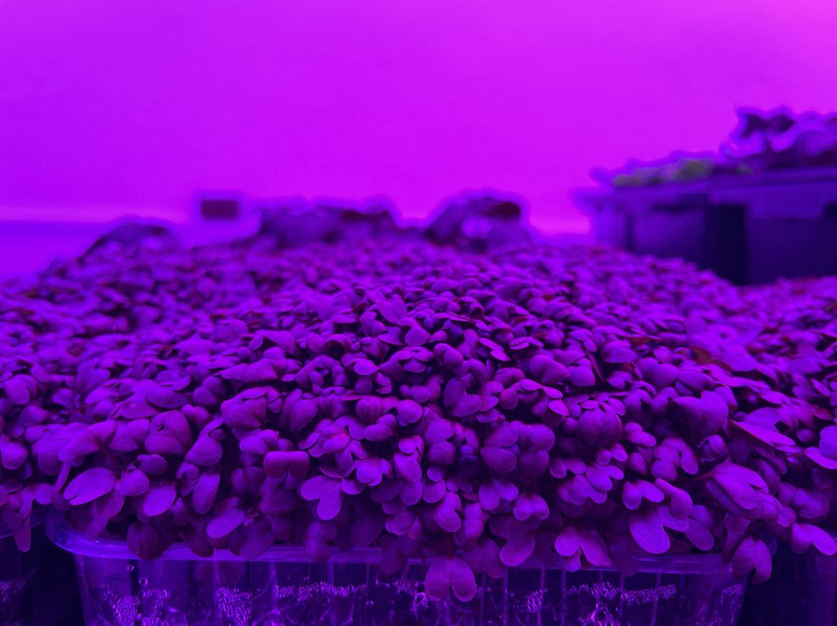
Comparative analysis of antioxidant activity in mustard grown under different lighting conditions
I. Gudžinskaitė^{1*}, G. Samuolienė^{1,2}, K. Laužikė¹
¹ Institute of Horticulture, Lithuanian Research Centre for Agriculture and Forestry, Kaunas str. 30, Babtai, LT-54333, Lithuania.
² Vytautas Magnus University Agriculture Academy, Studentų str. 11, Akademija, Lithuania.

Slide 2
----------
Antioxidant activity of leafy vegetables is an important aspect of its nutritional value. Light can be used as a natural factor to alter the antioxidant activity during harvest and prolong the shelf-life.
It is important to understand how efficiently plants use the light they receive, that kind of knowledge may help to reduce energy costs and impact profitability, and productivity.
Our aim was to determine if the spectral composition affects antioxidant activity of mustard microgreens at the same light intensity.

Slide 3
Growing conditions
Mustard microgreens (Brassica juncea) were grown in a peat substrate
in a (I) greenhouse natural light was supplemented with white light-emitting diodes (LEDs) lighting (16h)
(II) in controlled-environment chamber under lighting consisted of R_{61%}, B_{20%}, W_{15%}, and FR_{4%} spectral composition LED’s.
20±3 °C temperature was maintained
total PPFD of 150, 200 and 250 µmol m-²s-¹ was maintained in both treatments.

Slide 4
Samples
Samples were taken on a harvest day (D₀), one (D₁) and three (D₃) days after harvest
/
Samples taken after harvest were held in the light or dark at +4°C

Slide 5
Results (1)
On harvest day significantly the lowest antioxidant activity was found to be in plants grown in a greenhouse under white light when PPFD was 200 and 250 µmol m-²s-¹ .

Slide 6
RESULTS (2)
After 1 day of postharvest storage significantly the lowest FRAP antioxidant activity was detected in mustards grown under 200 µmol m-²s-¹ PPFD white light and held in light during storage.
Between the samples held in the dark there were no significant differences in FRAP antioxidant activity.

Slide 7
RESULTS (3)
After 3 days of postharvest storage there were found significant differences in mustard grown under white light in a green house and under R_{61%}, B_{20%}, W_{15%}, and FR_{4%} light in a controlled environment chamber. All three PPFD treatments resulted in a higher FRAP antioxidant activity when grown in a controlled environment chamber, compared to those under same PPFD treatment in a greenhouse.

Slide 8
Conclusions (1)
Results showed that on harvest day the lowest FRAP antioxidant activity was found in plants grown under white light when PPFD’s were 200 and 250 µmol m-²s-¹ .
During postharvest storage after 3 days there was a visible tendency where plants grown under white light in a greenhouse had a significantly lower FRAP antioxidant activity than those grown in a controlled environment chamber under R_{61%}, B_{20%}, W_{15%}, and FR_{4%} light.

Slide 9
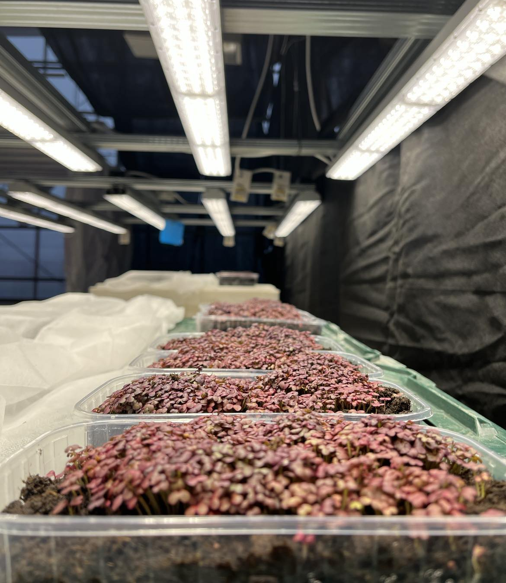
Conclusions (2)
Our findings show that even separate light components such as PPFD can enable in a higher efficiency.
Concluding by manipulating the spectral composition of the light during mustard microgreen growth, antioxidant activity may be altered during storage.

