Slide 1
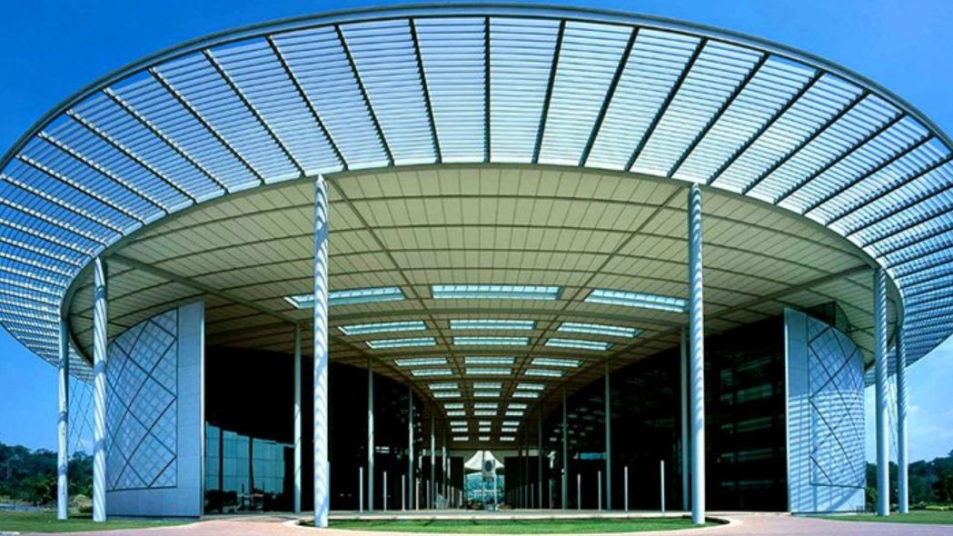

Evaluating the effect of asphalt binder and biochar based Geopolymer Composite on the Permanent Deformation Resistance of Asphalt Concrete employing response surface method
  Presented By:
  Nura Shehu Aliyu Yaro
  Civil & Environmental Engineering
  Universiti Teknologi PETRONAS

Slide 2
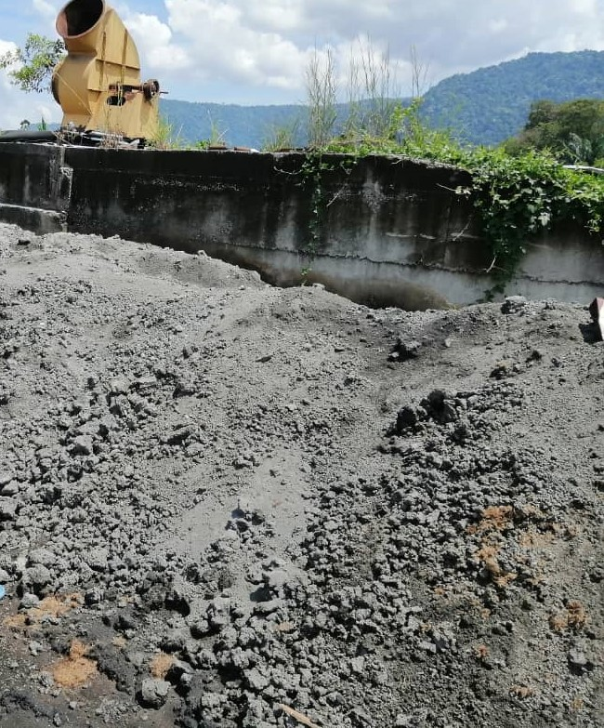
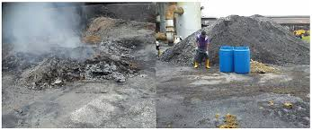
Research Background
Million tones of waste are generated yearly, and its potential is not fully harnesses
To help improve asphalt binder’s and asphalt mixtures characteristics, several experts have turned to waste materials
Permanent deformation, also known as rutting, transpires when the asphalt pavement develops excessive and permanent distortion because of frequent traffic loading, eventually leading to decreased road safety
The recent interest in the use of composite is a relatively new phenomenon with little study on the topic of modifying asphalt binder with waste material-based composites

Slide 3
Problem Statement
Waste disposal crisis due to the non-biodegradability nature of waste material because they are polluting the oceans, littering the landfills, generation of toxic fumes
The present exposure to excessive tire pressures, and traffic volumes which make the conventional materials unable to withstand these challenges.
The cost, practicality and environmental issues of the current available bitumen modifier mostly chemical .

Slide 4

Objectives
The goal of this study is to determine the influence and interaction of the asphalt binder and biochar-based geopolymer composite as a sustainable modifier on asphalt concrete's permanent deformation resistance by employing the response surface method.

Slide 5
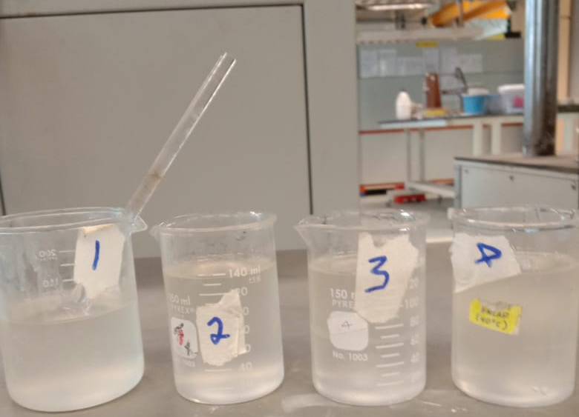
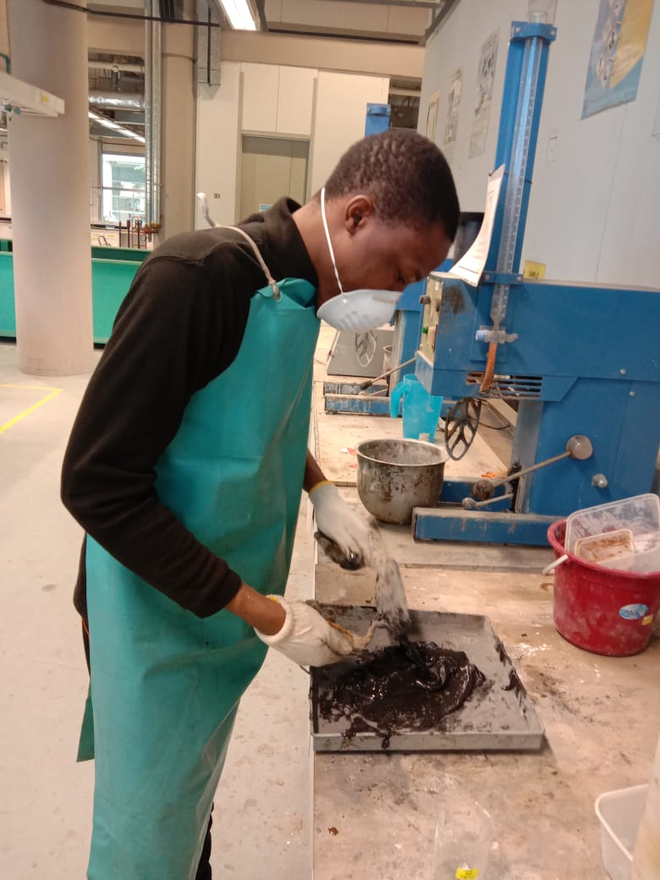
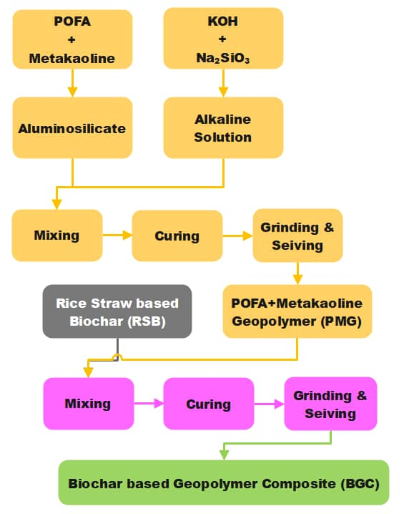
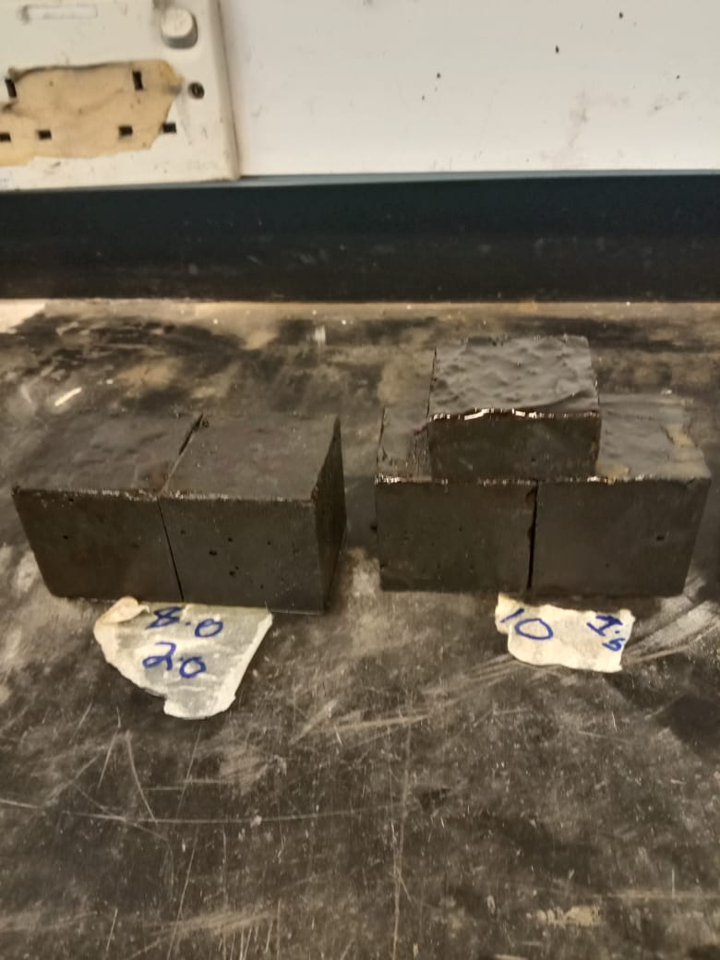
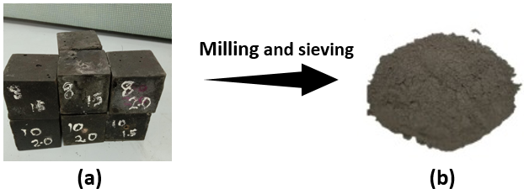
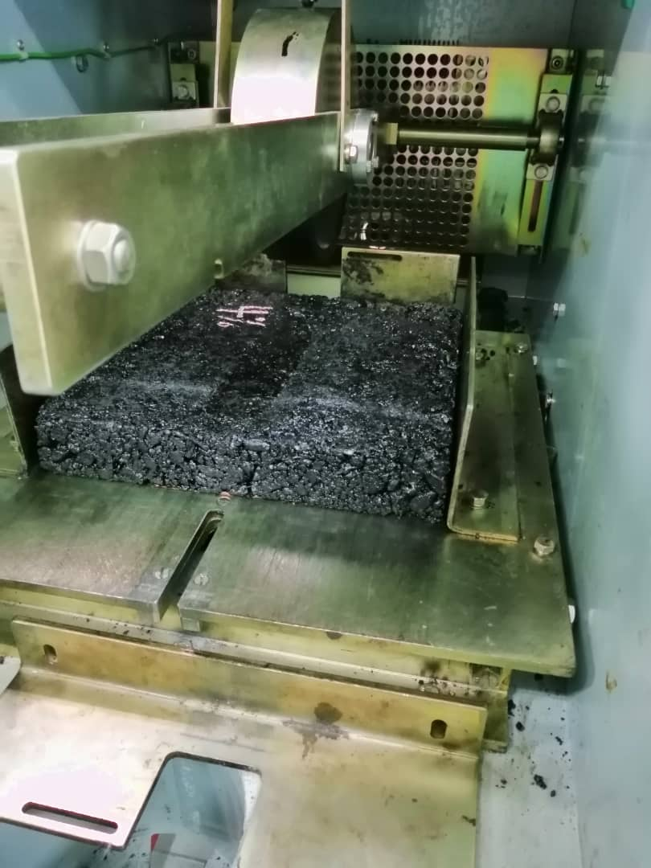
Methodology Flow Chart
(a)
(b)
(c)
(d)
(e)

Slide 6
Results and discussions cont’d
Table 1. Table: study design of experiments matrix
Table 2. ANOVA and fit statistics for the study ARD model
The derived model for ARD is represented by equation
$$ARD= 2.612 −0.559A−0.373B−0.901 C + 0.165AB + 0.188AC−0.115BC +0.295B^{2} + 0.833C^{2} (1)$$

Slide 7
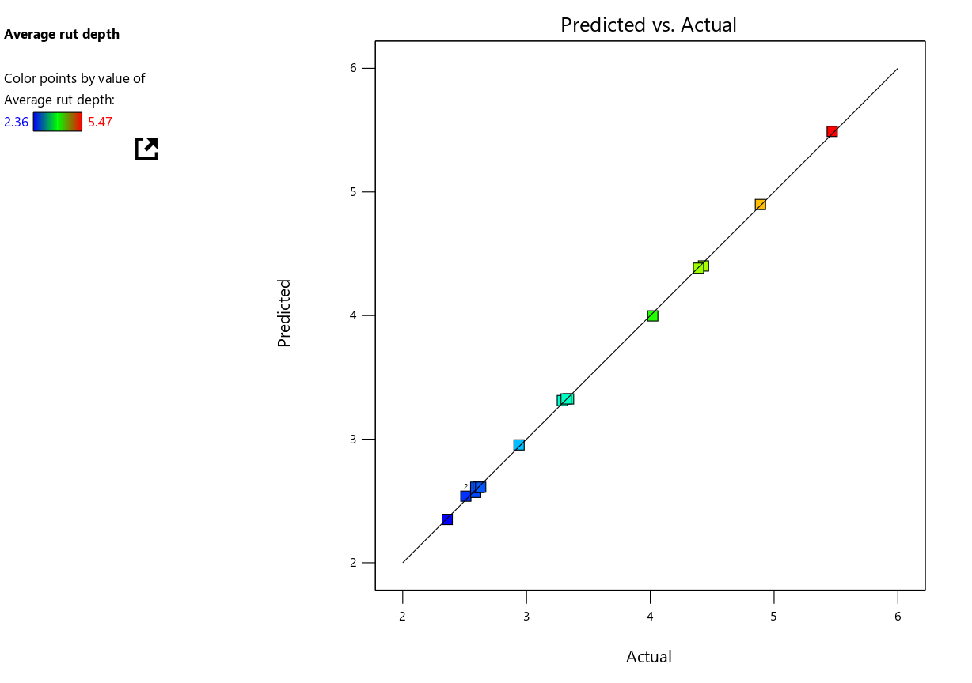
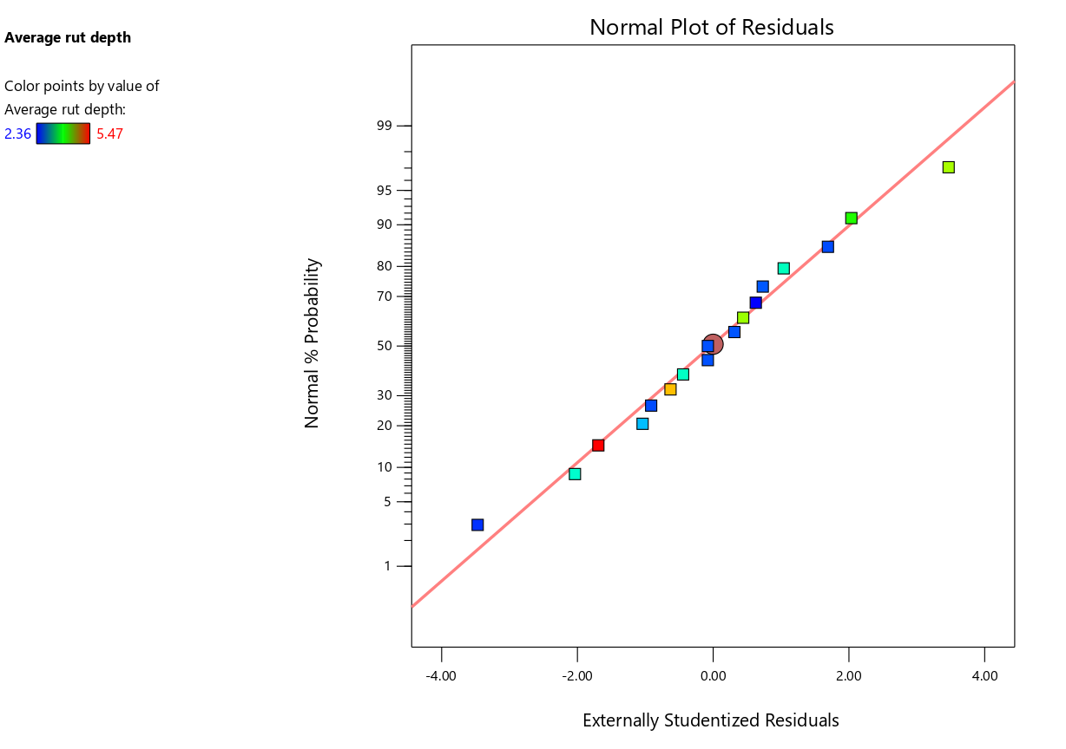
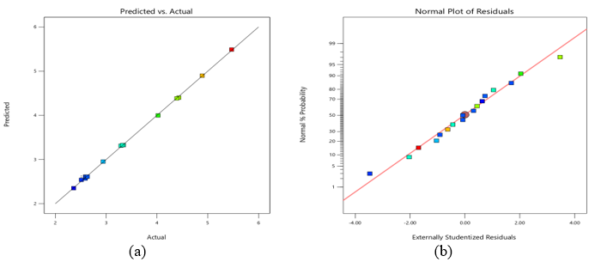
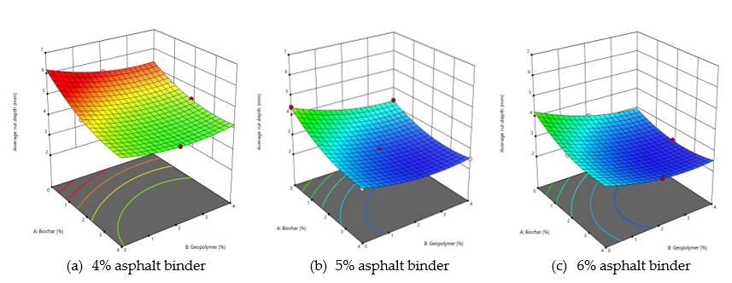
Results and discussions cont’d
Figure 1. Degree of agreement between predicted and experimental results
Figure 2. 3D synergetic influence of biochar and geopolymer on permanent deformation at different asphalt binder content
As observed from the 3D contour lines with elliptical shapes, indicating a strong interaction between the input variables. This implies that all the variables considerably impact the model's response. The increased PDR in the asphalt concrete can be attributed to the asphalt binder's improved viscoelasticity and stiffness due to the incorporation of the composite binder. These contribute to a more efficient aggregate covering and promote a well-connected aggregate binder structure, which improves asphalt concrete permanent deformation resistance
Table 3. Verification of optimized findings
Input Variable | % Content | ARD values (mm) |  | % Error
 |  | RSM predicted | Experimental
Biochar | 3.22 | 2.27 | 2.36 | 3.96
Geopolymer | 1.81
Asphalt content | 5.4

Slide 8
Conclusions
Based on the study's findings, the following key findings can be drawn:
The incorporation of biochar-based geopolymer composite as a modifier significantly impacted the rut depth resistance of asphalt concrete.
The RSM models used in this study demonstrated a high degree of correlation, predictability, and level of agreement between predicted and experimental outcomes, as proven by high R2 values and appropriate accuracy (>4.0), indicating their reliability and efficacy for exploring the model space.
The RSM optimization identified the optimum content of biochar, geopolymer, and asphalt binder (at 3.22%, 1.81%, and 5.4% respectively), with a percentage error of less than 5% between the RSM-predicted values and experimental data.

Slide 9
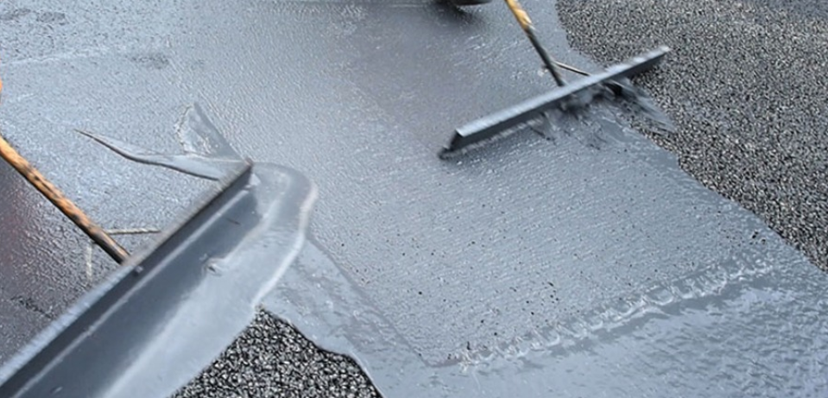
THANK YOU…!
Q
&
A
Source: http://www.milesmacadam.co.uk/Products

