Slide 1
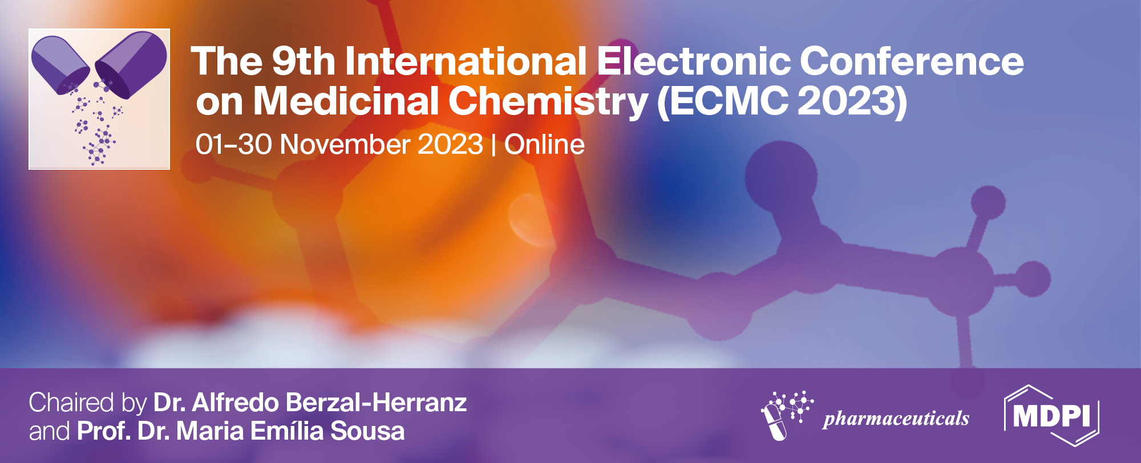
Chronic exposure to the antidepressant paroxetine disrupts fitness-related behaviours in fish
Carla S. S. Ferreira ¹, Cátia Venâncio ¹, Mónica Almeida ¹, Isabel Lopes¹, Peter Kille ² and Miguel Oliveira ¹
¹ Centre for Marine and Environmental Studies (CESAM), Department of Biology, University of Aveiro, 3810-193, Aveiro, Portugal
² School of Biosciences, Cardiff University, Cardiff, CF10 3AX, UK
* Corresponding authors: csofia@ua.pt

Slide 2
Chronic exposure to the antidepressant paroxetine disrupts fitness-related behaviours in fish

Slide 3
Abstract: The environmental levels of paroxetine (PAR), a selective serotonin reuptake inhibitor (SSRI) antidepressant, have risen due to increased consumption and the inefficiency of wastewater treatment removal. The functional conservation of important SSRI targets in vertebrates raises concerns about the potential adverse effects of exposure to pharmaceutically active molecules, such as PAR, on non-target organisms. This study addressed the effects of PAR chronic exposure (21 days) on adult zebrafish, assessing the effects of a low (40 µg/L - environmentally relevant concentration) and a high (400 µg/L – worst-case scenario) concentration in fish swimming behaviour, stress response and thigmotaxis. PAR-exposed fish displayed reduced swimming activity, stress response impairment and disruption of thigmotactic behaviour. These PAR-induced behavioural modifications may directly influence animal fitness, which, in turn, may lead to population and community disruption.
Keywords: Selective serotonin reuptake inhibitors; Zebrafish; Chronic effects; Behaviour modification; Animal fitness

Slide 4
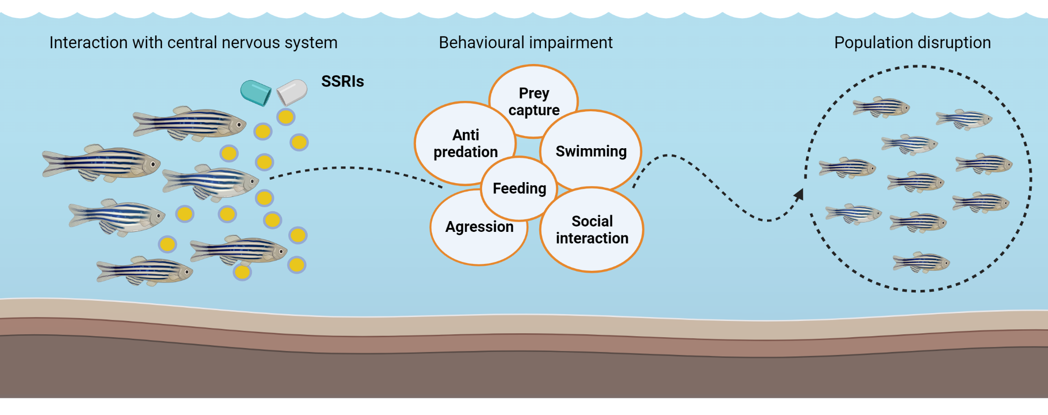
Introduction - Antidepressants-induced alterations in fish behaviour

Slide 5
Results and discussion – Basal activity
Alterations in swimming performance
Fitness reduction

Slide 6
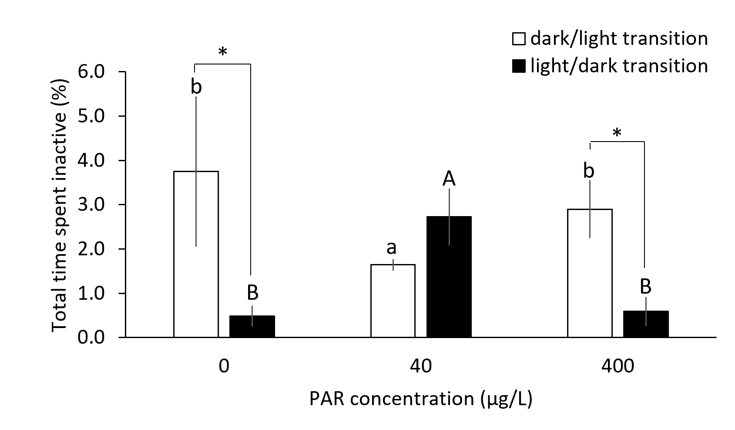
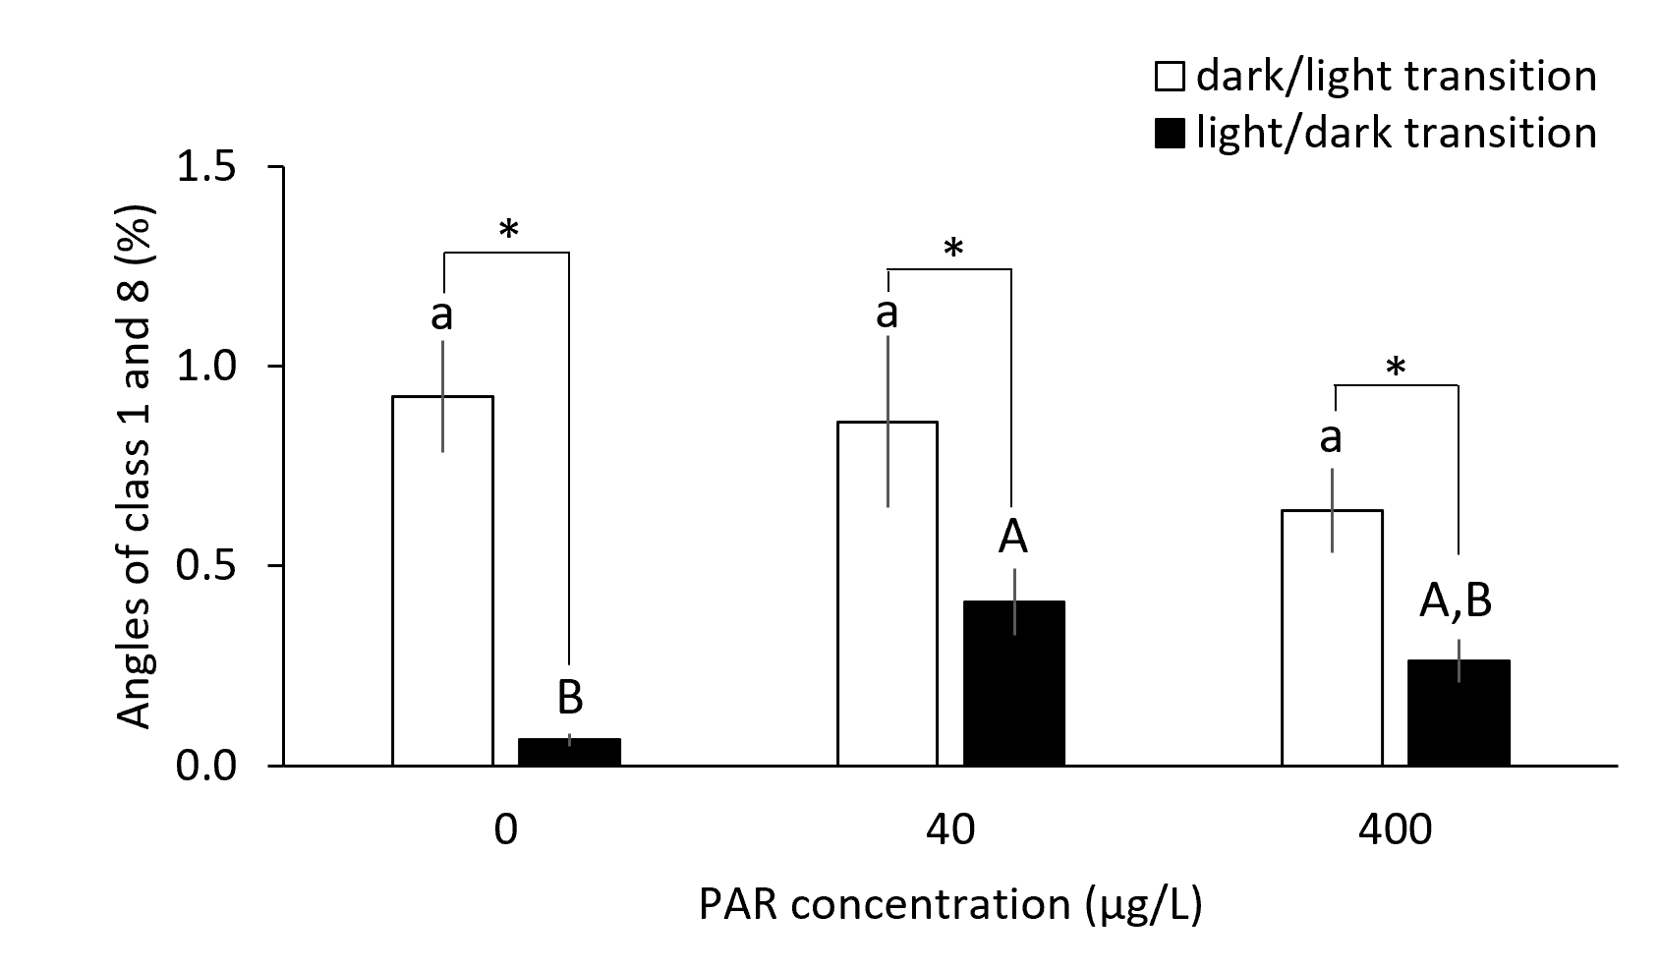
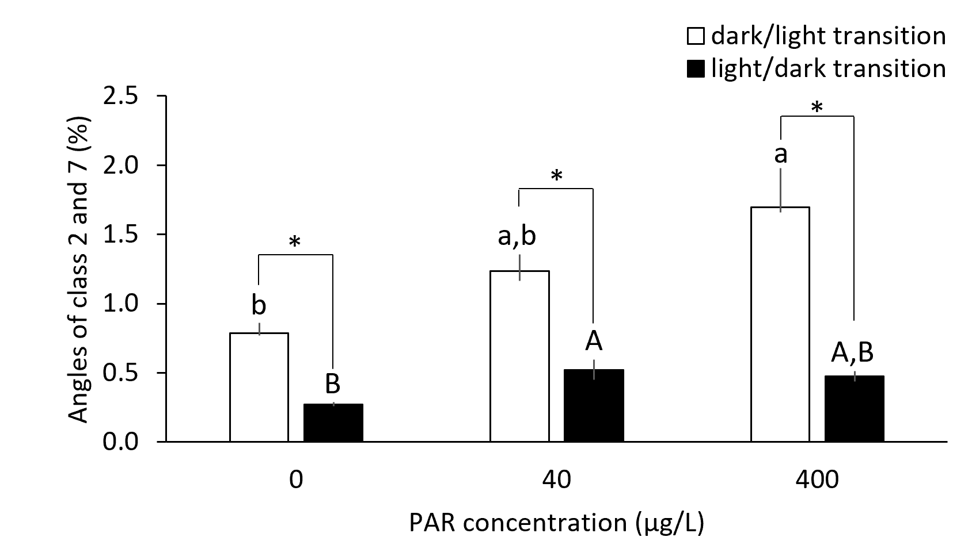
Results and discussion – Stress response
Stress response impairment
Fitness reduction

Slide 7
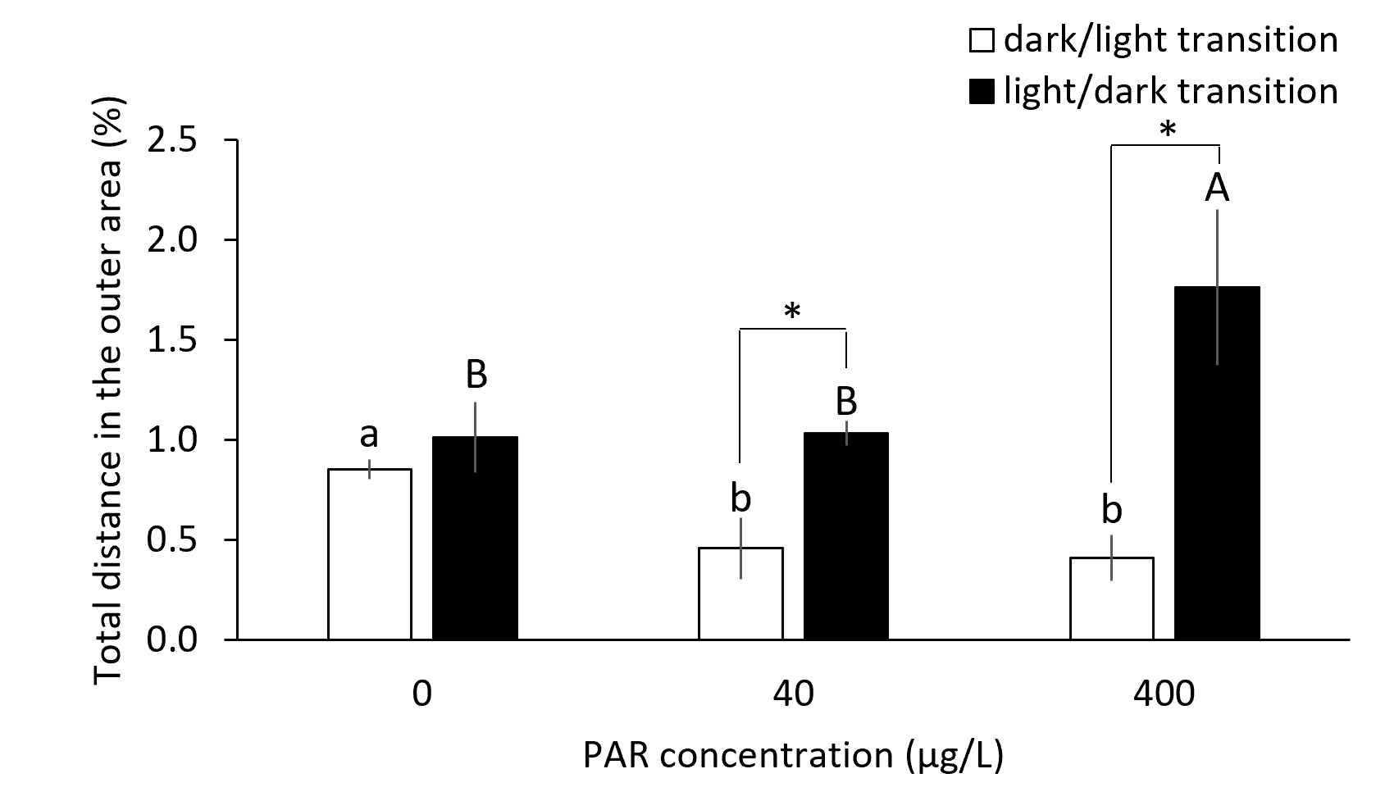
Results and discussion – Thigmotactic behaviour
Basal activity
Stress response
Alterations in anxiety-like behaviour during basal activity and throughout stress response
Fitness reduction

Slide 8
Conclusions
The effects of PAR on fish swimming behaviour and stress response may be translated into alterations of fitness-related behaviours with implications at the individual level but also in interactions with conspecifics and with other species.
These outcomes suggest neuroendocrine disruption, underpinning further studies for a comprehensive insight into the ecological adverse implications that may arise from PAR-induced changes in behaviour under environmentally realistic scenarios.
Additional studies are needed to examine the modulatory role of PAR in the behavioural response to other environmental contaminants to which aquatic organisms will be co-exposed.

Slide 9
Acknowledgements
Foundation for Science and Technology (FCT)
PhD Grant (2021.04580.BD) to Carla Melo;
UIDB/50017/2020+UIDP/50017/2020+LA/P/0094/2020 to CESAM.
FCT/Ministry of Science, Technology and Higher Education
financial support to the project NanoPlanet (DOI 10.54499/2022.02340.PTDC)
Contacts: csofia@ua.pt

