Slide 1
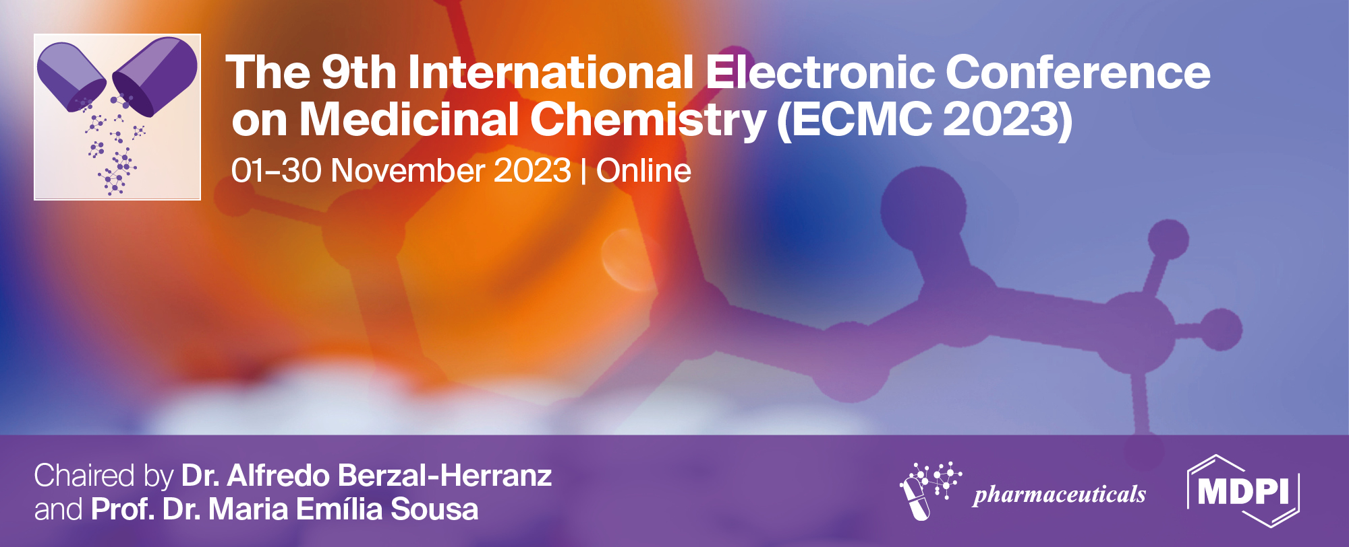


Methylphenidate and Amphetamine did not change neurite outgrowth in undifferentiated SH-SY5Y neuronal cells
Mariana Ferreira ^{1,2}*, Vera Marisa Costa ^{1,2}, Félix Carvalho ^{1,2}, and João Paulo Capela ^{1,2,3}*
¹ Associate Laboratory i4HB – Institute for Health and Bioeconomy, Faculty of Pharmacy, University of Porto, 4050-313 Porto, Portugal;
² UCIBIO/REQUIMTE – Applied Molecular Biosciences Unit, Laboratory of Toxicology, Department of Biological Sciences, Faculty of Pharmacy, University of Porto, 4050‐313 Porto, Portugal;
³ FP3ID, Faculdade de Ciências da Saúde, Universidade Fernando Pessoa, Porto, Portugal.
* Corresponding author: marianalferreira98@gmail.com; joaoc@ufp.edu.pt

Slide 2
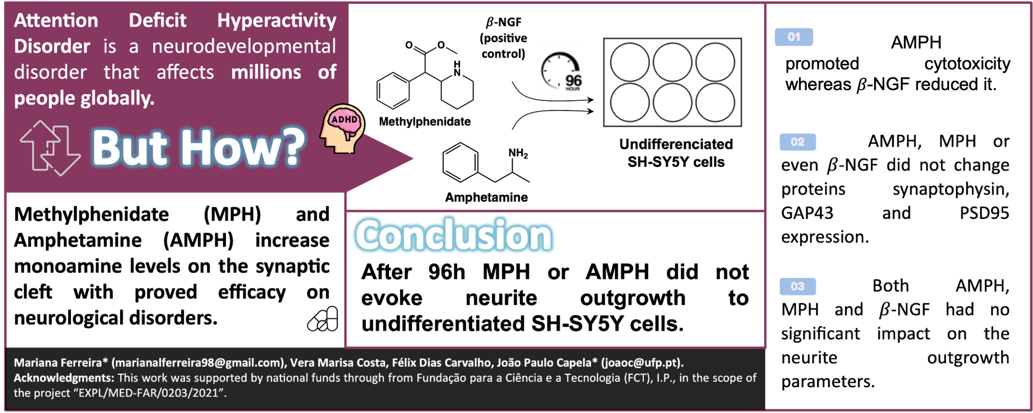
Methylphenidate and Amphetamine did not change neurite outgrowth in undifferentiated SH-SY5Y neuronal cells

Slide 3
Abstract: Attention-deficit/hyperactivity disorder (ADHD) globally affect 5%–7.2% of youth and 2.5%–6.7% of adults [1,2]. Methylphenidate (MPH) and amphetamine (AMPH), are well-known psychostimulants used in ADHD [3] and promote monoamine levels increase [4]. Herein, we evaluated AMPH and MPH potential to promote neurite outgrowth and synaptogenesis in undifferentiated SH-SY5Y neuronal cells. Undifferentiated SH-SY5Y neuronal human cells were exposed to clinically relevant concentrations of either MPH or AMPH for 96 hours to evaluate their cytotoxicity, neurite outgrowth and synaptogenesis, using a higher cellular density (25000cm²) and a lower cellular density (6250cells/cm²). To validate the experimental protocol, we completed equal procedures on the exposure of undifferentiated SH-SY5Y to 𝛽-NGF as a positive control. Results revealed that the second lower concentration of AMPH induced cytotoxicity at the lower cellular density, and lower concentration of AMPH promoted cytotoxicity at the higher cellular density after 96 hours of exposure. Importantly, both concentrations of 𝛽-NGF reduced cytotoxicity at both cellular densities, as expected. Neither drug affected the neuronal proteins expression, synaptophysin, PSD95 and GAP43, nor the positive control 𝛽-NGF. Finally, no changes in neurite outgrowth was evoked by AMPH or MPH or even 𝛽-NGF. As far as we know, this is the first study using MPH and AMPH clinically relevant concentrations in an acute exposure paradigm evaluating the neurogenesis effects in undifferentiated SH-SY5Y cells. More studies are needed for shorter exposure periods attempting to reveal new data and experimental paradigms assessing the neuroprotection potential on these amphetamines.
Keywords: Amphetamine; Cytotoxicity; Methylphenidate; Neurite Outgrowth; Synaptogenesis.

Slide 4



Introduction
Attention-deficit/hyperactivity disorder (ADHD) is a diverse neurodevelopmental condition characterised by symptoms of inattention, hyperactivity and impulsivity, and can have a significant impact on affected individuals’ lives.
5.5% – 7.2% of youth (<18 years of age)
2.5% – 6.7% of adults (≥18 years of age)
Bloch M, et al. Section II - Diagnostic Criteria and Codes. In: Diagnostic and Statistical Manual of Mental Disorders, 5th ed. G B. American Psychiatric Association: American Psychiatric Association, 2013 pp. 69-77.
Abdelnour, Elie et al. “ADHD Diagnostic Trends: Increased Recognition or Overdiagnosis?.” Missouri medicine vol. 119,5 (2022): 467-473.
Notes:
The prevalence of Attention Deficit Hyperactivity Disorder (ADHD) has seen a consistent rise in recent years. These numbers spark a debate over the reason for the observed trends, with some concerned about over diagnosis and over prescription of stimulant medications, and others raising the issue of diagnostic disparities, particularly in underrepresented populations.

Slide 5
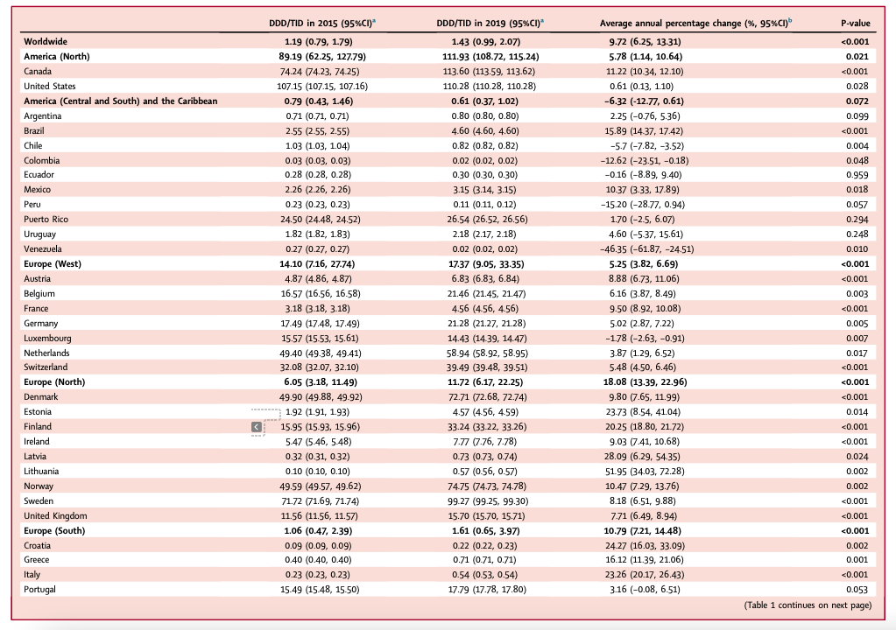
Introduction
Table 1 – ADHD medication consumption from 2015 to 2019. (CI, confidence interval; DDD/TID, Defined Daily Dose per 1000 child and adolescent inhabitants per day). Chan, Adrienne Y L et al. “Attention-deficit/hyperactivity disorder medication consumption in 64 countries and regions from 2015 to 2019: a longitudinal study.” EClinicalMedicine vol. 58 101780. 20 Mar. 2023, doi:10.1016/j.eclinm.2022.101780
AMPH and MPH, which increase monoamine’s level on the synaptic cleft, are used in the treatment of attention deficit hyperactivity disorder mostly since the 1990s, but also in other disorders,.
(MPH)
(AMPH)
Faraone, Stephen V. “The pharmacology of amphetamine and methylphenidate: Relevance to the neurobiology of attention-deficit/hyperactivity disorder and other psychiatric comorbidities.” Neuroscience and biobehavioral reviews vol. 87 (2018): 255-270. doi:10.1016/j.neubiorev.2018.02.001
Notes:
Among the 64 countries/regions, representing approximately 62.4% of the global population, there was an overall increase in ADHD medication consumption from 2015 to 2019, in portugal was na increase of 3.16 %(−0.08, 6.51)
(https://www.thelancet.com/action/showPdf?pii=S2589-5370%2822%2900509-0).
Since the 1950s, a class of medicines called stimulants has been the standard medication therapy for ADHD. These medicines work by increasing activity in the brain, particularly in areas that play a part in controlling attention and behaviour.

Slide 6
Introduction
Many studies show contradictory results: MPH and AMPH-induced improvement and no improvement following neuronal injury.
But how?
↑ brain-derived neurotrophic factor (BDNF), mRNA, synaptophysin and neurofilaments.
↑ dopamine overflow, maximum rate of dopamine clearance, and striatal transcription factor (c-fos) expression.
↓ lactate, total and free fatty acids levels.
↑ glucose metabolism.
↑ density and distribution of GAP43 and synaptophysin and neurite growth followed by synaptogenesis in the neocortex.

Slide 7

Aim
Evaluate AMPH and MPH potential, using clinically relevant concentrations to promote neurite outgrowth and synaptogenesis in undifferentiated SH-SY5Y neuronal cells in an acute exposure paradigm of 96 hours.

Slide 8
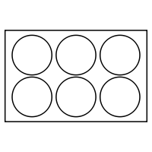
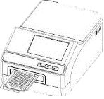



Methodology
MTT reduction assay
NR uptake assay
SH-SY5Y cells
(6 250 cells/cm²)
MPH
or
AMPH
or
Neurite counting
Nerve growth factor beta
(𝛽-NGF)
Western Blot analysis of Synaptophysin, GAP43 and PSD95
SH-SY5Y cells
(25 000 cells/cm²)
Positive control to neurite outgrowth and synaptogenesis

Slide 9
Results and discussion
The lower concentration of AMPH was cytotoxic at the higher cellular density, as well as AMPH second lower concentration induced cytotoxicity at the lower cellular density after 96-hours of exposure. 𝛽-NGF reduced cytotoxicity at both cellular densities.
Table 2 – Mitochondrial and lysosomal dysfunction evaluated by the MTT reduction assay in undifferentiated SH-SY5Y cells at density of 25000 cells/cm² (high) and at density of 6250 cells/cm² (low) incubated with AMPH or MPH or 𝛽-NGF for 96 hours. Results are presented as mean ± SD of 5 independent experiments (total of 24 wells/condition). Statistical analyses were performed using the ANOVA test, followed by Tukey's post hoc test. (*p <0.05 and ** < 0.005 vs Control; 🟰 – no alterations; ➖ – no applicable).
 | Concentration [lower (a) to higher (e)] | a | b | c | d | e | Lower | Higher
MTT reduction assay (% of control) – 25 000cm² density (high) | Methylphenidate | 🟰 | 🟰 | 🟰 | 🟰 | 🟰 | ➖ | ➖
 | Amphetamine | * | 🟰 | 🟰 | 🟰 | 🟰 | ➖ | ➖
 | 𝛽-NGF | ➖ | ➖ | ➖ | ➖ | ➖ | 🟰 | **
MTT reduction assay (% of control) – 6 250cm² density (low) | Methylphenidate | 🟰 | 🟰 | 🟰 | 🟰 | 🟰 | ➖ | ➖
 | Amphetamine | 🟰 | * | 🟰 | 🟰 | 🟰 | ➖ | ➖
 | 𝛽-NGF | ➖ | ➖ | ➖ | ➖ | ➖ | 🟰 | **

Slide 10
Results and discussion
After 96 hours, AMPH, MPH or even 𝛽-NGF did not change the expression of the proteins synaptophysin, GAP43 and PSD95.
Table 3 – Synaptophysin (34 kDa), GAP43 (43 kDa), and PSD95 (95 kDa) expression in undiferenciated SH-SY5Y cells evaluated by Western blotting after 96 hours of exposure to MPH or AMPH or 𝛽-NGF. Values were expressed as mean ± SD and were obtained from 6 independent experiments from each treatment group. Results were normalized by the expression of GAPDH (37 kDa) or ⍺-Tubulin (50 kDa) depending on the respective molecular weight, and also normalized by the % of control. Statistical analyses were performed using the ANOVA test, followed by Tukey's post hoc test. Control; 🟰 – no alterations; ➖ – no applicable).
 | Concentration [lower (a) to higher (d)] | a | b | c | d | Lower | Higher
Synaptophysin | Methylphenidate | 🟰 | 🟰 | 🟰 | 🟰 | ➖ | ➖
 | Amphetamine | 🟰 | 🟰 | 🟰 | 🟰 | ➖ | ➖
 | 𝛽-NGF | ➖ | ➖ | ➖ | ➖ | 🟰 | 🟰
GAP43 | Methylphenidate | 🟰 | 🟰 | 🟰 | 🟰 | ➖ | ➖
 | Amphetamine | 🟰 | 🟰 | 🟰 | 🟰 | ➖ | ➖
 | 𝛽-NGF | ➖ | ➖ | ➖ | ➖ | 🟰 | 🟰
PSD95 | Methylphenidate | 🟰 | 🟰 | 🟰 | 🟰 | ➖ | ➖
 | Amphetamine | 🟰 | 🟰 | 🟰 | 🟰 | ➖ | ➖
 | 𝛽-NGF | ➖ | ➖ | ➖ | ➖ | 🟰 | 🟰

Slide 11
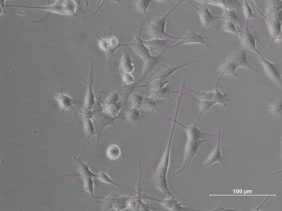
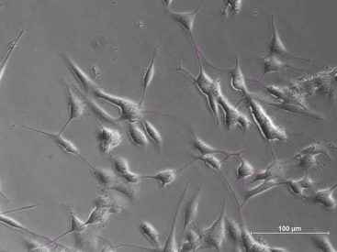
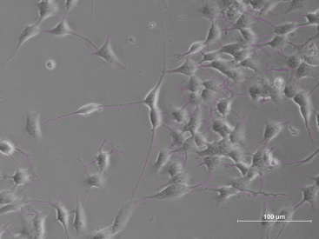
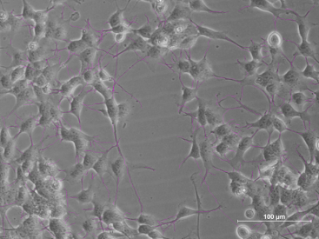
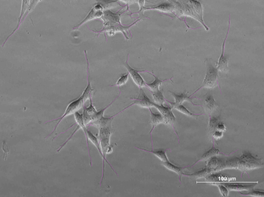
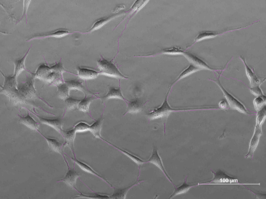
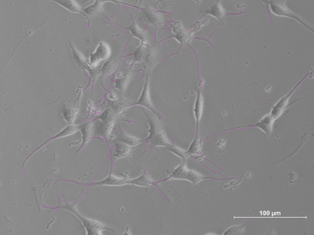
Results and discussion
Both AMPH, MPH and 𝛽-NGF had no significant impact on the neurite outgrowth parameters, including number of cells, number of neurites/number of cells, average neurite length (μm) and total length (μm)/number of cells, after a 96-hour exposure.
A
B
C
D
E
F
G
H
Figure 1 – Neurite outgrowth measurements in differentiated SH-SY5Y cells after 96 hours of exposure to 3 different concentrations of MPH [(A), (B), (C)]; AMPH [(E), (F), (G)] or 𝛽-NGF (H); H₂0 as control (D). Values were expressed as mean ± SD and were obtained from 4 independent experiments from each treatment group. Statistical analyses were performed using the ANOVA test, followed by Tukey's post hoc test, except in the number of cells parameter and total lenght µm/number of cells in which the Krustal-Wallis test was performed, followed by the Dunn’s post hoc test.

Slide 12
Conclusions
↑ cytotoxicity of AMPH 0.1μM at the lower cellular density, and of AMPH 0.01μM at the higher cellular density after 96 hours. ↓ cytotoxicity from both concentrations of 𝛽-NGF.
After 96 hours of exposure, no expression induced-alterations of the proteins synaptophysin, GAP43 and PSD95 by either drug or 𝛽-NGF
No significant effect on the neurite outgrowth parameters after a 96-hour exposure.
More studies are needed for shorter exposure periods revealing new data and experimental paradigms to assess the neuroprotection potential on these amphetamines.

Slide 13
This work was supported by national funds from Fundação para a Ciência e a Tecnologia (FCT), I.P., in the scope of the project “EXPL/MED-FAR/0203/2021”. V.M.C acknowledges FCT for her grant (SFRH/BPD/110001/2015) that was funded by national funds through FCT under the Norma Transitória – DL57/2016/CP1334/CT0006.
Acknowledgments

