Slide 1
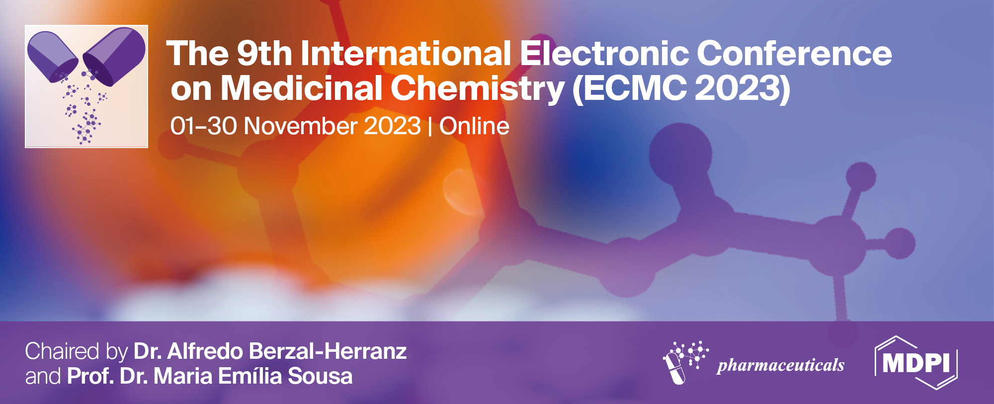
Investigation of chemical compounds of Astragalus galactites (Pall.) using GC-QTOF-MS and UPC2-QTOF-MS
Sugarjav E^{1,3}*, Gunbilig D², Irekhbayar J³, Chimedragchaa Ch¹
¹ Institute of Traditional Medicine and Technology, Ulaanbaatar, Mongolia
² Institute of Chemistry of Renewable Resources, University of Natural Resources and Life Sciences, Muthgasse 18, 1190 Vienna, Austria
³ School of Arts and Sciences, National University of Mongolia, Ulaanbaatar 14201, Mongolia
* Corresponding author: sugarjave@gmail.com

Slide 2
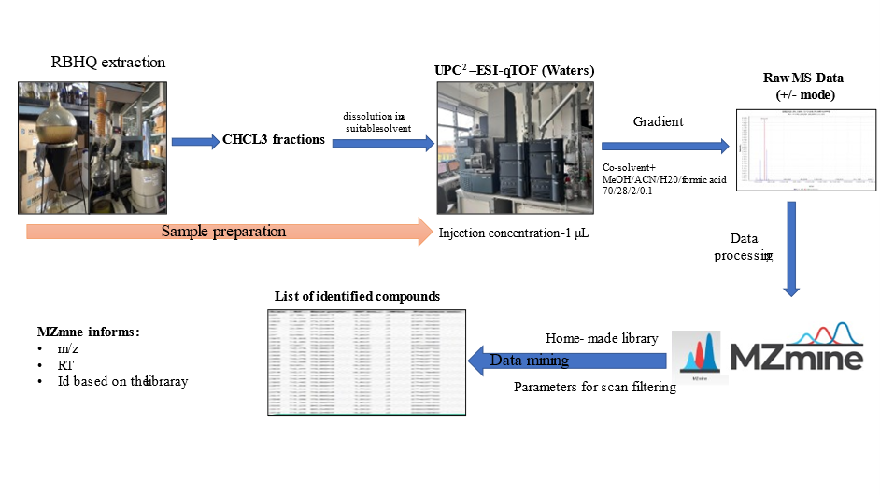
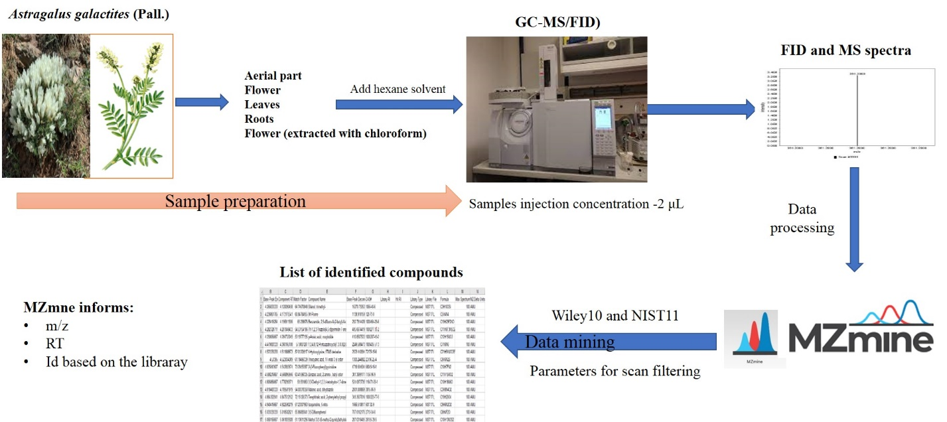
Investigation of chemical compounds of Astragalus galactites (Pall.) using GC-QTOF-MS and UPC2-QTOF-MS
Graphical Abstract
Scheme of UPC² -QTOF-MS system analysis
Scheme of GC -MS system analysis

Slide 3
Abstract:
Background: We present and discuss our recent findings on the chemistry of Astragalus galactites. More than 20 of potentially bioactive constituents, including saponins, polyphenolic acids, polysaccharides, alkaloids, and flavonoids, were putatively identified in extracts of A.galactites with the aid of GC-QTOF-MS, and UPC2-QTOF-MS. This article provides a first-time such effort for the untargeted metabolite profiling of A.galactites.
Objective: This study aimed to shotgun analyze biological active substances in A.galactites, a plant used in Mongolian traditional medicine.
Material and Methods: The plant sample was collected in the Tahiltayn Mountain area (47º 91’ 44” N, 106º 70’ 63” E), Songino Khairhan district, Mongolia, (May 2021). Untargeted metabolite profiling analyses were performed in various plant organs (aerial parts, leaves, roots, and flowers) and previously isolated fractions (XYZ) of chloroform extract using GC-QTOF-MS and UPC2-QTOF-MS instruments.
Results: Twenty-three compounds, eight phenolic acid derivatives, seven flavonoids, two diterpenoids derivatives, two monoterpenoids, one sesquiterpenoid, two fatty acids, and one lignan were identified by UPC2-QTOF-MS analysis in the chloroform fraction of A.galactites. Further 16 compounds, of which 14 are polysaccharide derivatives and two alkaloids were also identified putatively by GC-MS analysis in the extract of leaves, flowers, roots, and aerial parts of A.galactites.
Conclusion: A shotgun metabolite profiling showed the presence of numerous polyphenolic compounds, polysaccharides, and saponins to be containing in A.galactites samples, a medicinal plant for its anti-inflammatory properties. The presence of the above-mentioned compounds supports the pharmacological effects and radical scavenging activities we reported (XYZ) previously.
Keywords: Astragalus galactites Pall., GC-MS , UPC2-QTOF-MS

Slide 4
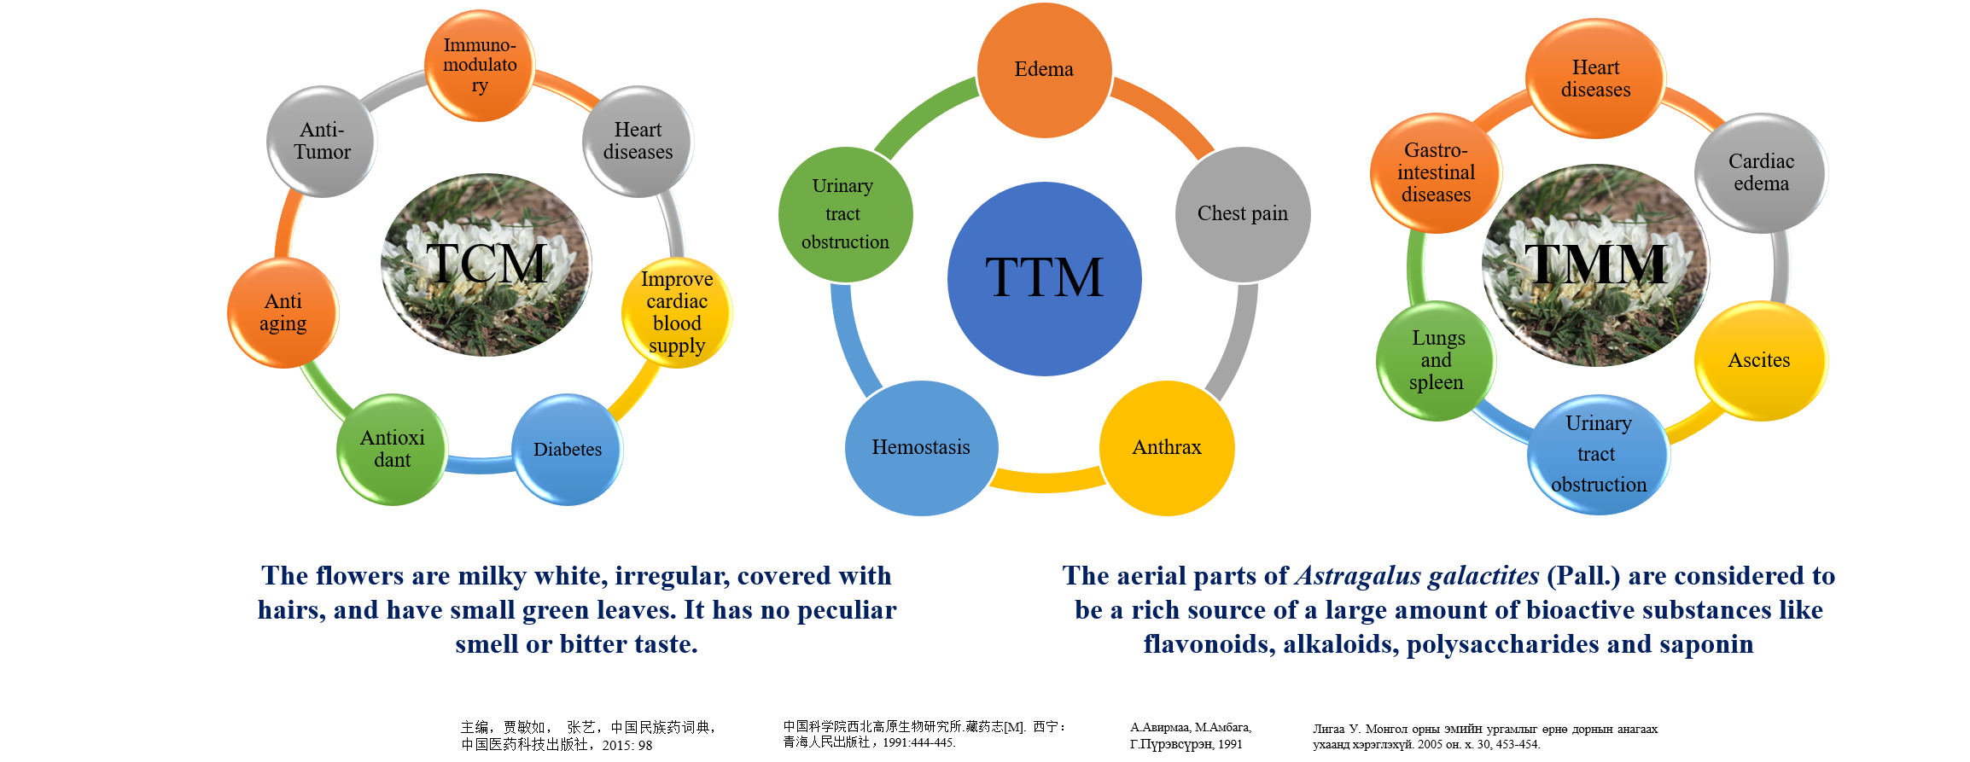
Introduction

Slide 5
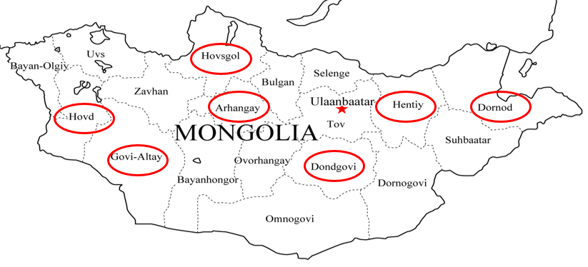
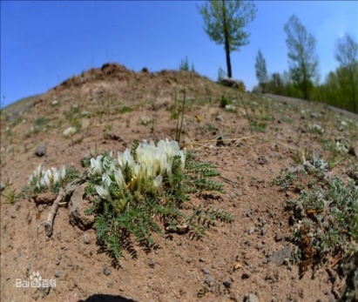
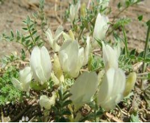
Research purpose
This study aimed to shotgun analyze biological active substances in A.galactites, a plant used in Mongolian traditional medicine.
Research material
The plant sample was collected in the Tahiltayn Mountain area (47º 91’ 44” N, 106º 70’ 63” E), Songinokhairhan district, Mongolia, (May 2021).
Astragalus galactites (Pall.) is a native species to the northern part of China, Mongolia, and Siberia.

Slide 6
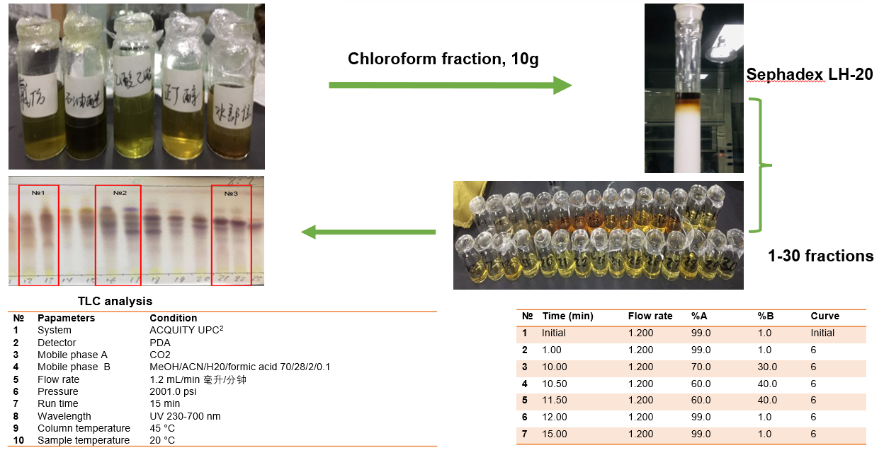
Results and discussion

Slide 7
UPC²-Q-TOF-MS/MS spectrum of Fraction-1
№ | m/z | RT /min/ | Compounds name | Chemical formula | Class of compound
1 | 225 | 4.36 | Dihydrosinapic acid | C11H14O5 | Phenolic acids
2 | 223 | 4.47 | Sinapic acid | C11H12O5 | Phenolic acids
3 | 291 | 6.04 | Methyl pinolenate | C19H32O2 | Fatty acid
4 | 305 | 6.43 | (+)-Gallocatechin | C15H14O7 | Flavonoids
5 | 178 | 9.89 | Hippuric acid | C9H9NO3 | Phenolic acids
6 | 289 | 10.95 | Catechin | C15H14O6 | Polyphenol
7 | 303 | 12.02 | 3'-O-Methylcatechin | C16H16O6 | Flavonoids

Slide 8
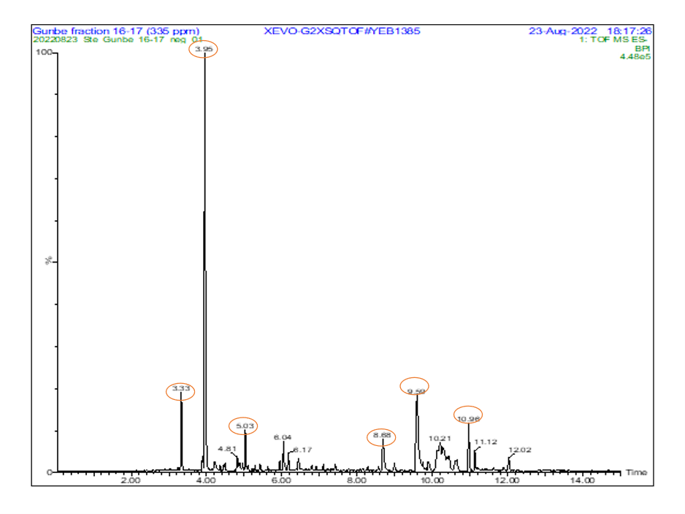
UPC²-Q-TOF-MS/MS spectrum of Fraction-2
№ | m/z | RT /min/ | Compounds name | Chemical formula | Class of compound
1 | 221 | 3.33 | Alpha-bisabolol | C15H26O | Sesquiterpenoids
2 | 195 | 3.95 | Hydroxycaffeic acid | C9H8O5 | Phenolic acids
3 | 178 | 5.03 | Hippuric acid | C9H9NO3 | Phenolic acids
4 | 419 | 5.68 | Apigenin 7-O-glucoside | C21H24O9 | Flavonoids
5 | 579 | 9.59 | Naringin | C27H32O14 | Flavonoids
6 | 289 | 10.96 | Manool | C20H34O | Diterpenes

Slide 9
UPC²-Q-TOF-MS/MS spectrum of Fraction-3
№ | m/z | RT /min/ | Compounds name | Chemical formula | Class of compound
1 | 151 | 4.29 | cis-verbenol | C10H16O | Monoterpenoids
2 | 135 | 4.57 | gamma-terpinene | C10H16 | Monoterpene
3 | 195 | 6.40 | Dihydroferulic acid | C10H12O4 | Phenolic acids
4 | 313 | 6.96 | Irisolidone | C17H14O6 | Flavonoids
5 | 433 | 8.68 | Quercetin 3-O-arabinoside | C20H18O11 | Flavonoids
6 | 359 | 9.26 | (+)-lariciresinol | C20H24O6 | Lignans
7 | 178 | 9.89 | Hippuric acid | C9H9NO3 | Phenolic acids
8 | 519 | 10.30 | 5,3',4'-Trihydroxy-3-methoxy-6:7-methylenedioxy flavone 4'-O-glucuronide | C23H20O14 | Flavonoids
9 | 289 | 11.12 | 13-epi-manoyl oxide | C20H34O | Diterpenes
10 | 305 | 11.62 | 7,11,14-Eicosatrienoic acid (Et) C20:3 | C20H34O2 | Fatty acid

Slide 10
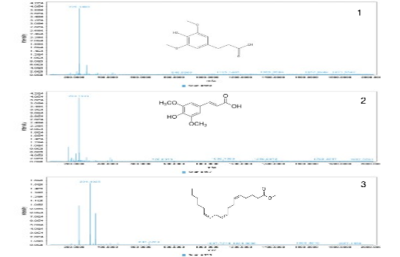
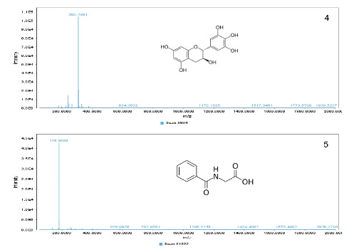
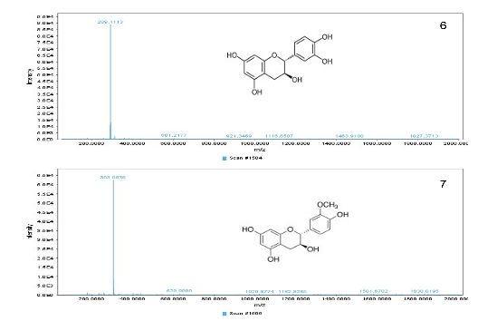
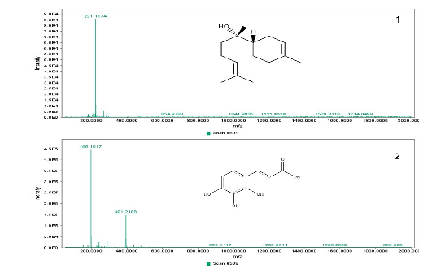
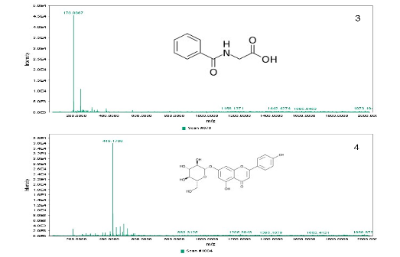
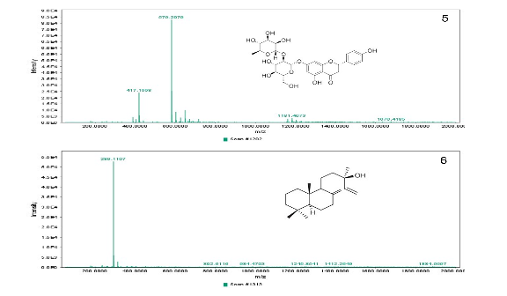
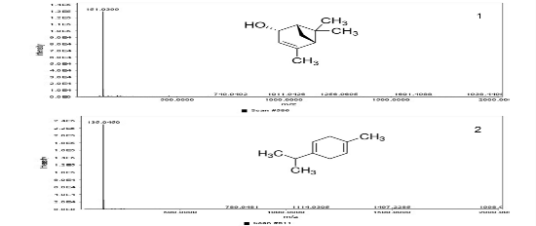
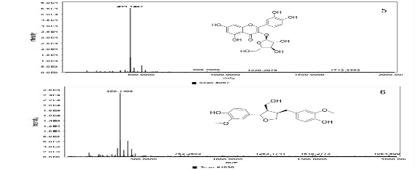
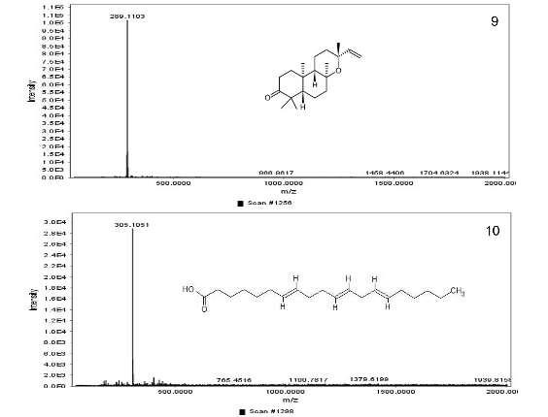
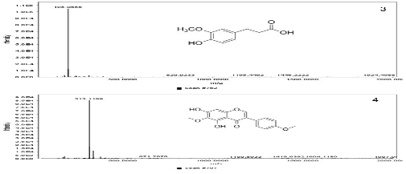
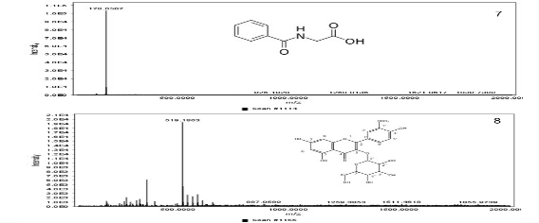
Fraction-1
Fraction-2
Fraction-3

Slide 11
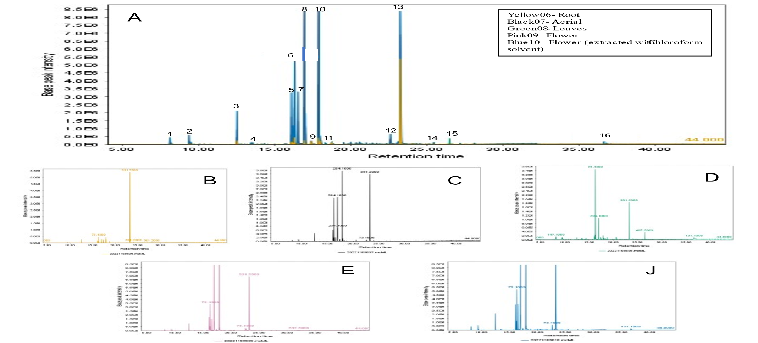
Figure 1. GC-MS total ion chromatogram of Astragalus galactites (5 groups)
A-GC-MS total ion chromatogram of aerial (black), flower (pink), root (yellow), leaves (leaves), flower (extracted with chloroform) (blue), B- root (yellow06), C- aerial (black07), D-leaves (green08), E-flower (pink09), J-flower (extracted with chloroform solvent-blue10)

Slide 12
GC-MS analysis of A. Galactites
№ | Peak RTª (min) | Compound detected* | Molecular Formula | Part of the plant
1 | 8.319517 | N-Benzyl-1H-benzimidazole | C14H12N2 | Aerial, Leaves, Flower, Flower^{b}
2 | 9.4346177 | Silanol, trimethyl-, phosphate | C9H27O4PSi3 | Root, Flower^{b}, Leaves, Aerial, Flower
3 | 12.5485025 | Malic acid, 3TMS derivative | C13H30O5Si3 | Root, Flower^{b}, Aerial, Flower
4 | 13.482329 | 2,3,4-Trihydroxybutyric acid tetrakis (trimethylsilyl), Threonic acid | C16H40O5Si4 | Leaves, Flower^{b}
5 | 16.112684 | D-(-)-Fructofuranose, pentakis(trimethylsilyl) ether (isomer 2) | C21H52O6Si5 | Root, Flower^{b}, Aerial, Flower
6 | 16.328128 | D-Pinitol, pentakis(trimethylsilyl) ether | C22H54O6Si5 | Root, Aerial, Leaves, Flower, Flower^{b}
7 | 16.555017 | β.-D-Galactofuranose | C21H52O6Si5 | Root, Aerial, Flower, Flower^{b}
8 | 16.953380 | D-(+)-Galactopyranose, 5TMS derivative | C21H52O6Si5 | Root, Aerial, Leaves, Flower, Flower^{b}
9 | 17.403437 | D-Sorbitol, 6TMS derivative | C24H62O6Si6 | Root, Aerial, Leaves, Flower
10 | 17.878917 | β-D-Glucopyranose, 5TMS derivative | C21H52O6Si5 | Root, Aerial, Leaves, Flower, Flower^{b}
11 | 18.760181 | Myo-Inositol, 6TMS derivative | C24H60O6Si6 | Root, Aerial Leaves, Flower, Flower^{b}
12 | 22.504929 | Docosanol, TMS derivative | C25H54OSi | Aerial, Flower, Flower^{b}
13 | 23.247551 | Sucrose, 8TMS derivative | C36H86O11Si8 | Root, Aerial, Flower, Flower^{b}
14 | 25.460362 | Silane,dimethyl(4-(2-phenylprop-2-yl)phenoxy) decyloxy- | C27H42O2Si | Leaves, Flower^{b}
15 | 26.442339 | 1-[(4-Methylbenzene) sulfonyl]pyrrole | C11H11NO2S | Leaves
16 | 36.521192 | D- (+)-Cellobiose, octakis(trimethylsilyl) ether, methyloxime | C37H89NO11Si8 | Leaves, Flower^{b}
*The compounds that were identified and compared with a similar mass fragmentation in the NIST database library. a R.T: Retention time; b Flower: Sample of flower extracted with chloroform solvent

Slide 13
Conclusions
In summary, polyphenolic compounds, polysaccharides, and saponins are the main compounds of A.Galactites medicinal plants with anti-inflammatory properties, and these biologically active compounds are explained by the pharmacological effects and radical scavenging activities that we have previously investigated. In the future, we are focused on researching and developing of new herbal medicines for anti-immune and gouty arthritis.

Slide 14
Acknowledgments
The authors would like to thank the team of the Researcher Center of the Institute of Traditional Medicine and Technology, Mongolia for their help during this study. GD thanks the Austrian Agency for Education and Internationalization, Federal Ministry of Education, Science and Research of Austria (Project KoEF 10/2020).

