Slide 1
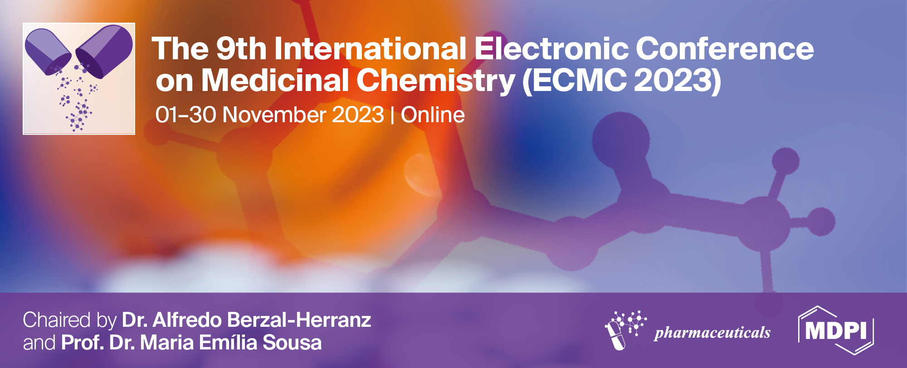
Delivery of nucleic acids into muscle cells by means of peptide carriers with anionic coating
Dmitriy Deviatkin ^{1, 2}, Sofia Shtykalova ^{1, 2}, Anna Egorova ¹ and Anton Kiselev ^{1, *}
¹ D.O. Ott Research Institute of Obstetrics, Gynecology and Reproductology, Saint-Petersburg, Russia;
² Saint-Petersburg State University, Saint-Petersburg, Russia.
* Corresponding author: ankiselev@yahoo.co.uk

Slide 2
Abstract:
Delivery of nucleic acids into muscle tissue is an urgent problem in the development of gene therapy for neuromuscular and other hereditary diseases.
Previously, we have developed non-viral carriers based on arginine-histidine-rich peptides, and have shown their ability to deliver DNA to cells. An anionic peptide coating was developed to increase the stability of the complexes in the serum. An urgent task is to reduce the volume of DNA packaging, which will allow delivering a larger number of therapeutic constructs to muscles in a smaller volume.
Arginine-histidine-rich and glutamic acid-containing peptides were synthesized and complexes were formed with plasmids carrying the 𝛽-galactosidase or GFP gene. DNA binding efficiency and physicochemical properties of the complexes was studied. C2C12 cells were transfected, followed by an assessment of toxicity and transfection activity of complexes. Intramuscular injections of mice with complexes solution were performed, followed by analysis of the GFP gene expression in muscle fibers using a fluorescent microscope.
Reduction of package volume does not adversely affect the complexes stability. Zeta potential and size of most of complexes are optimal for transfection. Toxicity, assessed using the Alamar Blue dye, did not exceed the threshold of 20% for all types of complexes. The transfection efficiency of complexes prepared in a small volume was comparable to that of complexes prepared in a large volume. A 5-fold increase in the dose of injected DNA due to a decrease in the package volume increased the efficiency of transfection in vivo.
Keywords: DNA delivery; peptide-based carriers; muscle transfection

Slide 3
Introduction
Delivery of nucleic acids into muscle tissue is an current problem in the development of gene therapy for neuromuscular and enzyme deficiency genetic diseases as well as mRNA and DNA vaccination. Transfection of muscle tissue is considered one of the most difficult to implement for several reasons, including the small number of receptors on the cell surface required for targeted delivery and the lack of mitotic divisions in myofibrils, which complicates the entry of plasmid DNA into the nucleus.
Anionic coating and reduction of package volume of the developed cationic peptide-based complexes improved transfection efficiency of muscular tissue.

Slide 4
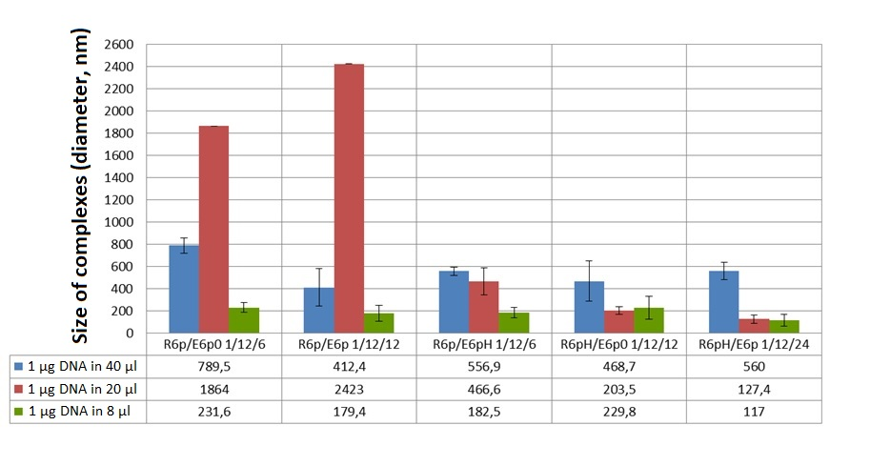
Results and discussion
Size of the formed complexes measured by means of dynamic light scattering. The results are presented as mean ± S.E.M.

Slide 5
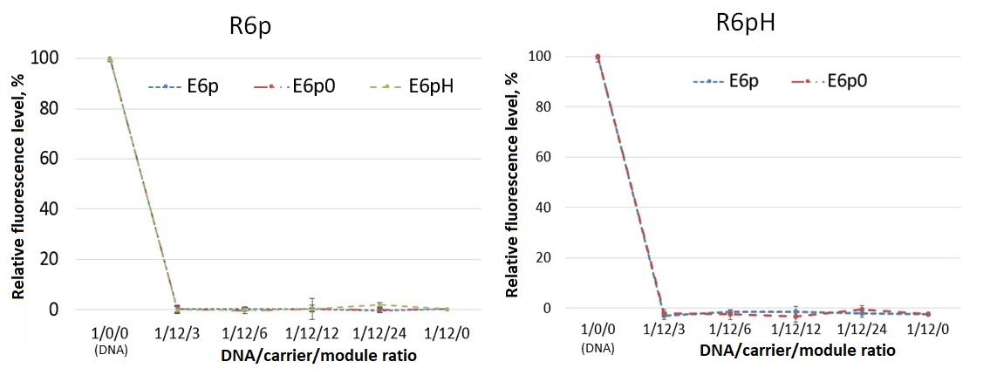
Results and discussion
Ethidium bromide fluorescence intensity in solution with complexes of different DNA/carrier/module charge ratio. The package volume is 1 μg DNA in 8 μl. The results are presented as mean ± S.D.

Slide 6
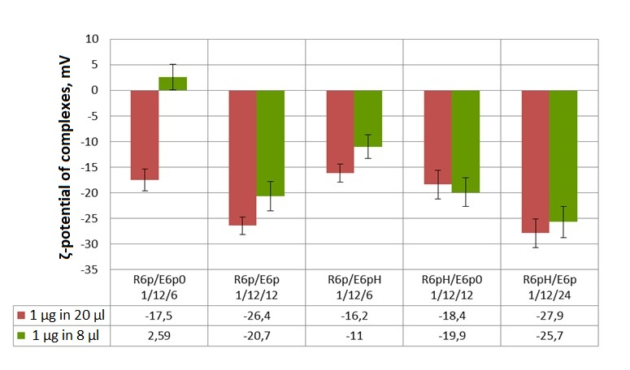
Results and discussion
Zeta-potential of the formed complexes measured by means of electrophoretic light scattering. The results are presented as mean ± S.E.M.

Slide 7
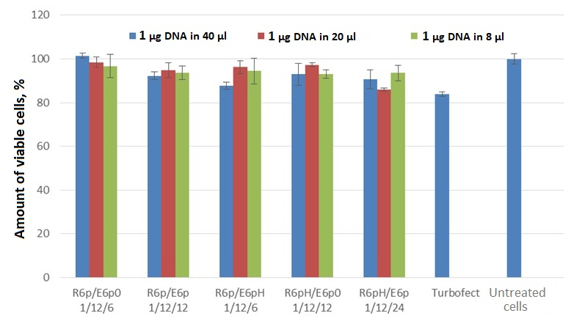
Results and discussion
Viability of the C2C12 cells after transfection with formed complexes. The results are presented as mean ± S.E.M.

Slide 8
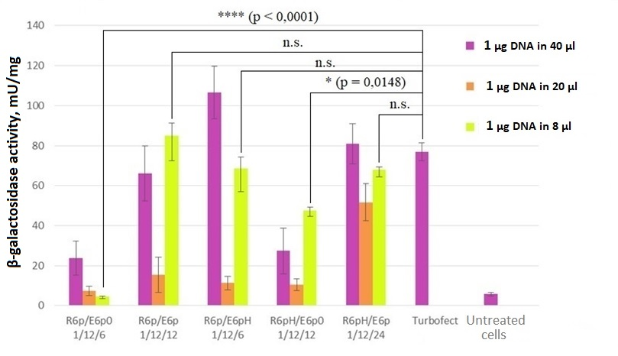
Results and discussion
β-galactosidase activity level in C2C12 cells after transfection with complexes containing lacZ-plasmid. The results are presented as mean ± S.E.M. Comparison was performed by means of ANOVA with Holm-Sidak adjustment.

Slide 9
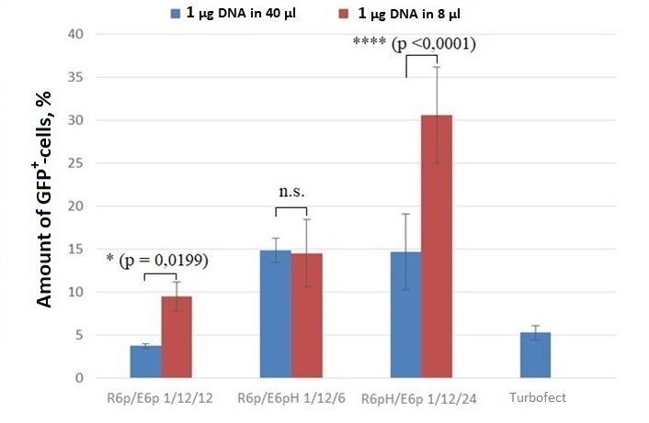
Results and discussion
Amount of C2C12 GFP⁺-cells after transfection with complexes containing GFP-plasmid. The results are presented as mean ± S.E.M. Comparison was performed by means of t-test.

Slide 10
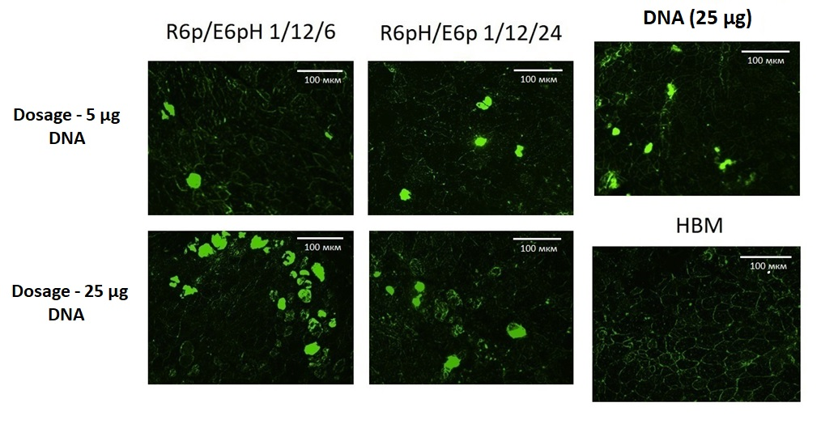
Results and discussion
Cross section of muscle tissue after transfection with GFP-containing plasmid. DNA dosage increase was achieved thanks to package volume reduction.

Slide 11
Conclusions
We showed enhanced transfection efficiency of muscle tissue by developed complexes formed in small volume. In addition, the most complexes demonstrate optimal physicochemical properties and low cytotoxicity.
Cationic peptide carriers with anionic coating is promising non-viral vector for nucleic acid delivery in muscle tissue.

Slide 12
Acknowledgments
The study was supported by RSF grant 21-15-00111

