Slide 1
Assessment of nuclear gems quantity as a potential biomarker for evaluating the efficacy of drugs for spinal muscular atrophy
Haya Al-Hilal ^{1,2}*, Marianna Maretina ², Anna Egorova ², and Anton Kiselev ²
¹ Department of Genomic Medicine named after V.S. Baranov, D.O. Ott Research Institute of Obstetrics, Gynecology and Reproductology, Mendeleevskaya Line 3, 199034 Saint-Petersburg, Russia
² Faculty of Biology, Saint-Petersburg State University, Universitetskaya Embankment 7-9, 199034, Saint-Petersburg, Russia
* Corresponding author: hayahilal.992@gmail.com

Slide 2
Assessment of nuclear gems quantity as a potential biomarker for evaluating the efficacy of drugs for spinal muscular atrophy
Quantification of gems number:
The median percentage of FL-SMN transcripts
Healthy
A Style
The number of gems in healthy cells was significantly high (29 gems per 100 nuclei, ranged from 15 to 55 per 100 nuclei)
0.73
Quantification of gems number:
The median percentage of FL-SMN transcripts
B Style
Patient
The number detected in SMA patient fibroblast cells (7 gems per 100 nuclei, ranged from 2 to 19 per 100 nuclei)(P<0.0001).
0.47
Quantification of gems number:
The median percentage of FL-SMN transcripts
Treated
The number detected in the nuclei of treated patient cells raised up to 17 per 100 nuclei compared to intact patient cells (P=0.0034)
C Style
0.64

Slide 3
Abstract:
Spinal muscular atrophy is a neuromuscular disorder caused by mutations in both copies of the survival motor neuron gene 1 (SMN1) which lead to reduction in the production of the SMN protein. This study aimed at investigating the quantity of gems in cell nuclei as a potential biomarker for SMA. Fibroblast cell cultures obtained from a patient with SMA type II and from a healthy individual were used to gain insight whether the number of gems in cell nuclei varies based on their SMN genotype and whether its increase is associated with therapeutic response.
We discovered a remarkable difference in the number of gems in the nuclei of cells with different genotypes, specifically when counting gems per 100 nuclei. SMA fibroblasts were further treated with antisense oligonucleotides previously proved to have beneficial effects in correcting the abnormal splicing of SMN2 exon 7. We observed a significant increase in the number of gems in the treated cells compared to the intact SMA cells. The obtained results correlate significantly with the increase in full-length SMN transcripts level. Based on our findings, it is evident that the number of gems can be considered as a reliable biomarker for SMA drugs development.
Keywords: spinal muscular atrophy; nuclear gems; antisense oligonucleotides.

Slide 4
Introduction
Spinal muscular atrophy is an autosomal recessive genetic disorder.
It is characterized by progressive muscle weakness which eventually leads to widespread skeletal muscle atrophy due to the consistent degeneration and loss of the α-motor neurons of spinal cord and lower brain stem.
Carrier frequency 1 carrier per 40-60 people (average 1 in 50), incidence approximately 7.8-10 in 100,000 live births or 1 in 10,000 live births worldwide.
It is classified into four main types depending on the achieved motor abilities and the age of onset.

Slide 5
Introduction
SMA is caused by a homozygous deletion of SMN1 gene which leads to decreased expression of survival motor neuron protein SMN .
This protein is expressed in human body by two paralogous genes; survival motor neuron gene 1 & 2 (SMN1&SMN2).
SMN1 gene produces correctly spliced full length FL-SMN1 transcripts leading to the production of functional SMN protein almost exclusively.
SMN2 gene produces mainly alternatively spliced and lacking exon 7 transcripts (SMNΔ7) giving rise to mislocalized, unstable malfunctioned SMN protein.
These genes are highly identical except for 5-nucleotide insertion in intron 6 of SMN2 gene and 14 single nucleotide changes.

Slide 6
Introduction
Clinical biomarkers can be measured frequently demanding less time, and enable researchers to avoid ethical problems accompanied with the analysis of clinical endpoints.
In this study, the number of gems in fibroblasts nuclei was tested as a putative biomarker for SMA.
SMN protein is located in speckle nuclear bodies basically established as “Gems”.
Gems or (Gemini of coiled bodies), are nuclear structures that are similar to Cajal bodies (CBs) in size and shape but they do not contain small ribonuclear proteins snRNPs.
Gems and Cajal bodies are indistinguishable in most cell types.

Slide 7
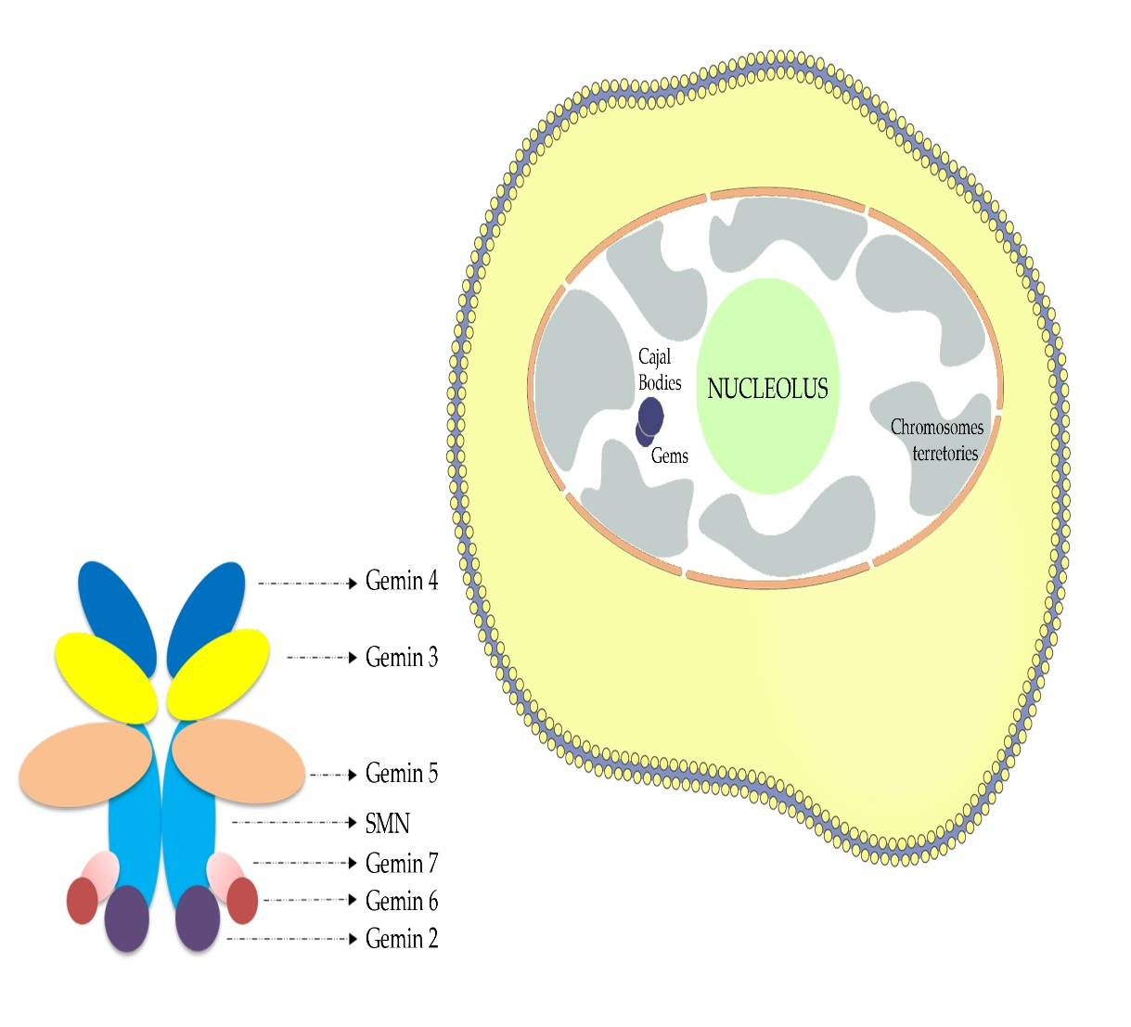
Introduction
The gems constituents have hence far been restricted to the components of the SMN complex although Cajal bodies have excess amounts of RNAs and their associated proteins.
Gems have established a useful means to observe and control the induction of SMN from a diversity of therapeutic molecules starting from drugs and not ending in viral vectors.
In this study, the number of gems in fibroblasts nuclei was tested as a putative biomarker for SMA.
Figure 1. Scheme depicting location of nuclear gems and SMN complex.

Slide 8
Results and discussion
We quantified the number of gems in nuclei of fibroblast cell cultures derived from SMA patient as well as fibroblast cells derived from a healthy individual.
We found significant difference between the number of gems in cells with different genotypes:
The number of gems in healthy cells was significantly higher (29 gems per 100 nuclei, ranged from 15 to 55 per 100 nuclei)
than the number detected in SMA patient fibroblast cells (7 gems per 100 nuclei, ranged from 2 to 19 per 100 nuclei) (P<0.0001).

Slide 9
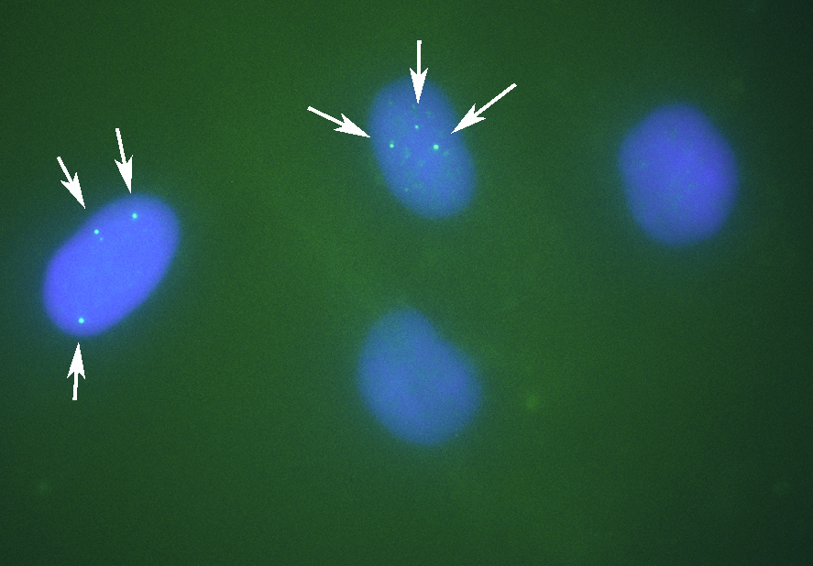
Results and discussion
Figure 2. Gems in the nuclei of cells derived from healthy individuals have greater number of gems.

Slide 10
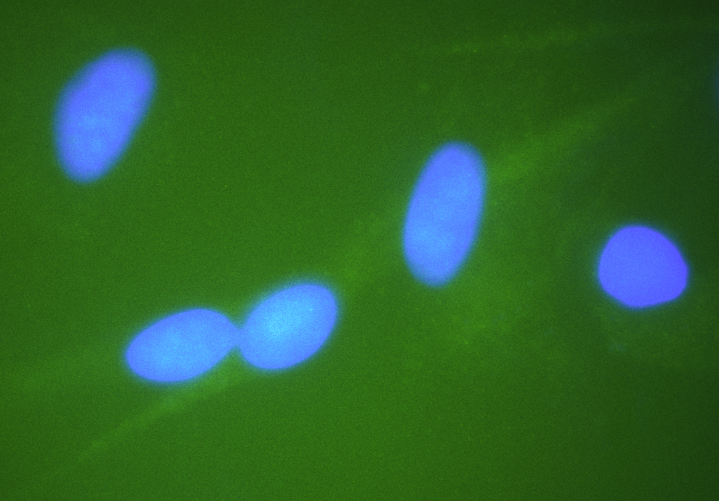
Results and discussion
Figure 3. Nuclei of SMA patient type II cells show lack of gems.

Slide 11
Results and discussion
We treated SMA fibroblasts with antisense oligonucleotide 3UP8 previously shown to have therapeutic effects on the level of SMN protein.
We have discovered a remarkable rise in the number of gems up to 17 found in the nuclei of treated patient cells, totaling 100 nuclei, in contrast to the quantity of gems observed in the intact patient cells (P=0.0034)

Slide 12
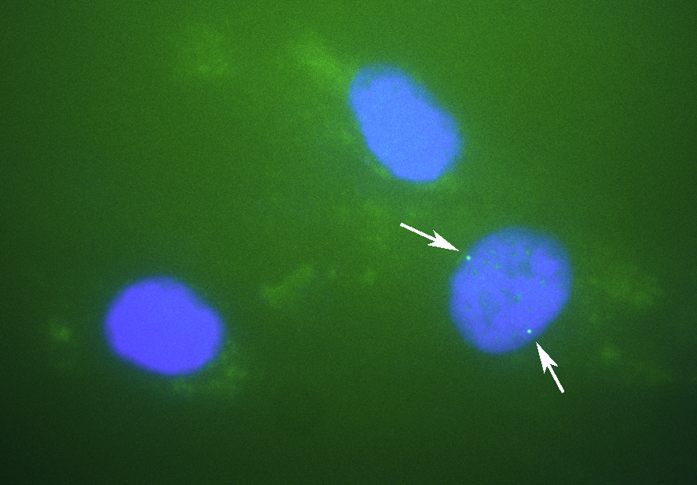
Results and discussion
Figure 4. Nuclei of SMA patient type II cells treated with 3UP8 increased number of gems related to intact SMA cells.

Slide 13
Results and discussion
We determined the mean value of full-length SMN transcripts percentage for each sample by calculating the ratio of the values acquired in the ImageJ software for FL-SMN transcripts to the total sum of the values of (FL-SMN + ∆7 SMN) transcripts based on the fluorescence intensity of the bands relative to the background (Figure 5).
The median percentage of FL-SMN transcripts was 0.73 for cells of healthy individuals, 0.64 for cells treated with 3UP8, and 0.47 for cells obtained from SMA II patient (Figure 6).
In this manner, we disclosed a very strong correlation (correlation factor = 0.98) between the level of full-length SMN transcripts and the number of gems in cells nuclei with different genotypes (intact SMA II patient cells, SMA II patient cells treated with 3UP8, and healthy cells) per 100 nuclei (Figure 6).

Slide 14
Results and discussion
Figure 5. Determination of gems number and FL-SMN transcripts percentage: differences in the number of gems in the nuclei of cells of different genotypes (intact SMA II patient cells, healthy cells and SMA II patient cells treated with 3UP8 oligonucleotide) per 100 nuclei.

Slide 15
Results and discussion
Figure 6. Determination of gems number and FL-SMN transcripts percentage: FL-SMN transcripts in cells of different genotypes (intact SMA II patient cells, healthy cells and SMA II patient cells treated with 3UP8). Medians with interquartile range are given.

Slide 16
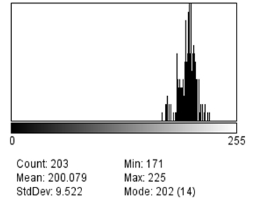
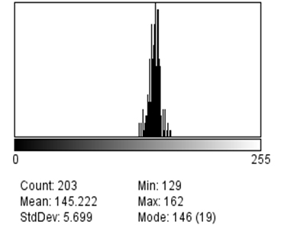
Results and discussion
(a)
(b)
Figure 7. Examples of the analysis of bands from gel-electrophoresis corresponding to full-length and exon 7-deleted SMN transcripts PCR products from healthy cells in ImageJ. “Mean” value indicates the intensity of band shining - (a) for FL-SMN transcripts, (b)for Δ7 SMN transcripts.

Slide 17
Results and discussion
The progression of a disease can be tracked by checking the changes in values of biomarkers, which can also serve as a reliable means to test the efficacy and safety of new drugs.
A single biomarker may not be necessarily sufficient to depict the progression of the disease as well as to test the efficacy of the treatment, but there is a remarkable opportunity in combining vigorous biomarkers that together work on different levels providing more accurate information and help in better understanding of the disease onset and progression.
The evaluation of the changes in SMN transcripts or protein levels as a direct consequence of targeting the basic genetic malfunction in SMA is considered very convincing in the context of determining the effect of SMA therapies

Slide 18
Results and discussion
Previously, in our laboratory we obtained results indicated the advancement of utilizing the mean percentage of full-length SMN transcripts as a potential biomarker works on the transcriptional level to estimate the efficacy of SMA therapy in vitro.
In this study, we showed that the nuclei of healthy fibroblasts have a greater number of gems compared to the nuclei of intact fibroblast cells derived from SMA patients
Furthermore, we demonstrated that the number of gems in patient fibroblast cells has increased significantly after treating with therapeutic ASOs compared to the number of gems in intact patient cells per 100 nuclei.
We also revealed a very strong correlation between the FL-SMN transcripts and the number of gems. We showed that the change in FL-SMN transcripts is followed by a change in gems number and hence, a change in SMN protein levels.

Slide 19
Conclusions
This allowed us to introduce a conclusion that the change in gems number is directly proportional to the FL-SMN transcripts and hence to the level of SMN protein levels, which is the main aim of all SMA therapeutic approaches.
In conclusion, the results presented in this presentation prove that the number of gems in the cells nuclei can be considered as a potential reliable molecular biomarker to evaluate the efficacy of existed SMA therapy and to help developing new therapeutic approaches.

Slide 20
Acknowledgments
This research was supported by the Ministry of Science and Higher Education of the Russian Federation (project "Multicenter research bioresource collection ”Human Reproductive Health” contract No. 075-15-2021-1058).

