Slide 1
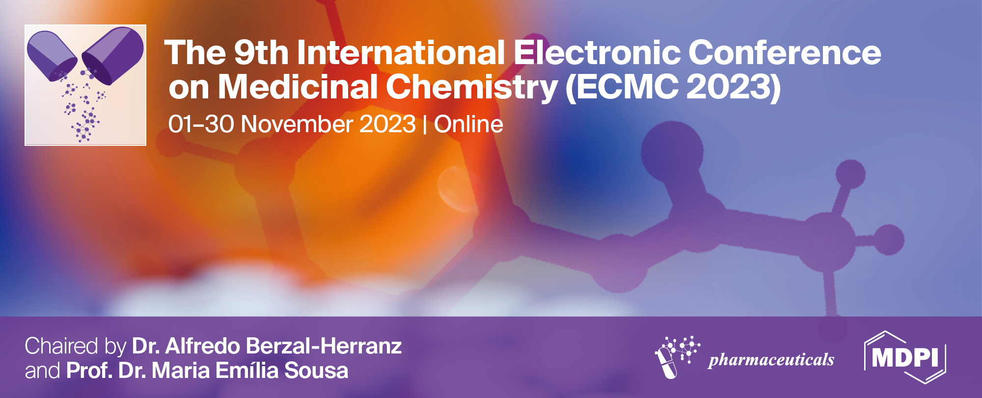
Development of new drugs to treat tuberculosis based on the dinitrobenzamide scaffold
Tiago Delgado ^{1,2}, João Pais ^{1,2,3}, David Pires ^{2,3,4}, Filipe Estrada ^{2,3,5}, Rita Guedes ^{2,3,5}, Elsa Anes ^{2,3,4} and Luís Constantino ^{1,2,3*}
¹Medicinal Organic Chemistry Group
²Research Institute for Medicines and Pharmaceutical Sciences (iMed.UL), Av. Prof. Gama Pinto, 1649-003 Lisboa, Portugal
³Faculdade de Farmácia, Universidade de Lisboa, Av. Prof. Gama Pinto, 1649-003 Lisboa, Portugal
⁴Host-Pathogen Interactions Unit
⁵Computational Medicinal Chemistry Group
* Corresponding author: constant@ff.ul.pt

Slide 2
Abstract: Despite the efforts made to stop the tuberculosis (TB) epidemic, it still remains one of the leading causes of death from an infectious disease. Previous work in the group uncovered a new family of amides which showed promising activities against Mycobacterium tuberculosis. A closer look at the literature showed that these compounds are structurally related to the DNB family of inhibitors of DprE1, an essential epimerase for the formation of a vital precursor of the arabinogalactan biosynthesis, one of the components of the mycobacterial cell wall. Following those results, we decided to study a wide range of substituted amides and determine their activity, focusing on unexplored structures related to the dinitrobenzamides (DNB) found in the literature. To synthesize our library of compounds we started from 3,5-dinitrobenzoic acid to form the nitroaromatic core that is characteristic of the DNB’s, to which we then added linear or cyclic amine moieties. Additionally, the impact of terminal aromatic moieties was also assessed for some derivatives, via an ether, ester or amide bond. In order to obtain the desired derivatives, multiple synthetic approaches were used, mainly focused in nucleophilic addition/elimination reactions, SN2 reactions and Mitsunobu reactions. The most interesting compounds exhibited activities in the 100-200 nM range, and we’re currently developing an extended family of compounds based in those structures. Additionally, computational studies were performed aimed at further understanding their interactions with DprE1 and comparing it to known DNB’s.
Keywords: Tuberculosis; DprE1; DNB; TB; Nitrobenzamides

Slide 3
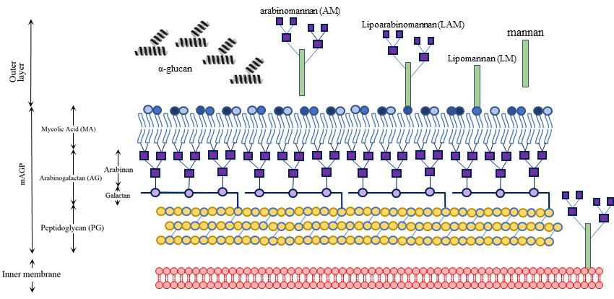
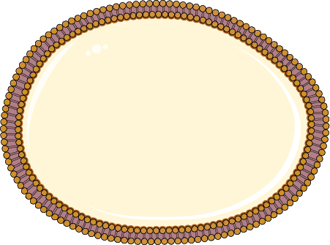
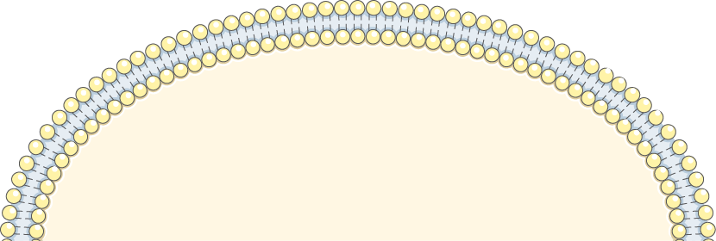
Development of new drugs to treat tuberculosis based on the dinitrobenzamide scaffold
DprE1
Key enzyme in the cell wall synthesis process
sPeriplasms
Inhibited by dinitrobenzamides
Mtb
New dinitrobenzamides
Family A
Families B, C and D
Family E
Family F
Notes:
Hello. I’m Tiago Delgado and I will be talking about the work I’ve done that was aimed at further exploring the nitrobenzamide class of inhibitors as compounds to treat tuberculosis.

Slide 4
Introduction
Every year around 10 million persons fall ill with tuberculosis
Standard treatment is a 6-month drug regimen of 4 different drugs
Every year around 1.5 million persons die from tuberculosis
Tuberculosis remains the second cause of death from an infectious agent, only behind SARS-CoV-2
Data from the World Health Organisation:
https://www.who.int/health-topics/tuberculosis#tab=tab_1
Notes:
So, why is it so important to discover new drugs against tuberculosis? Let me show you some facts:
World health organisation estimates that one quarter of the world population have been infected with tuberculosis bacteria, and every year around 10 million more get infected. The current standard treatment consists of a 6-month drug regimen with the use of 4 different drugs. Unfortunately, tuberculosis still remains one of the leading causes of death from an infectious agent, being is responsible for the death of around 1.5 million people every year.

Slide 5
What makes tuberculosis a hard disease to treat?
Long treatments
This is due to the characteristics of
Mycobacterium tuberculosis (Mtb)
Lack of drug compliance, and proper follow up of the patients
Appearance of drug resistances
Notes:
Now you’re probably wondering what makes TB so difficult to treat.
One of the main problems is the length of the treatments, leading to a lack of drug compliance, and proper follow up of the treatments. In turn, this has led to the development of drug resistances, which in turn require even longer and more aggressive treatments. This is one of the reasons why it is so important to develop new drugs and find new targets.
This is due to the characteristics of the microorganism responsible for causing this disease, mycobacterium tuberculosis.

Slide 6
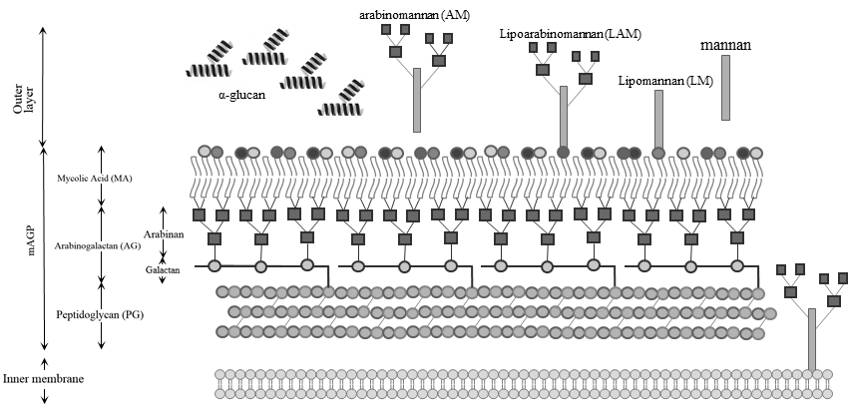
DprE1
Periplasm
Notes:
These mycobacteria have a cell wall structure which borrows characteristics from both gram-positive and gram-negative bacteria, having a thick peptidoglycan layer but also a structure (MA layer) that resembles the outer layer of the gram-negative bacteria.
Due to this structure’s hydrophobic character, the cell wall confers a high degree of impermeability to drugs. However, due to the importance of this structure in the survival of Mtb and the lack of human counterparts, the cell wall biosynthesis is one of the most targeted portions of the cell cycle when developing new drugs.
One promising new target is Dpre1, a FAD-dependent oxidoreductase that occupies the periplasm and that is essential for the formation of DPA, the only source of arabinose residues that are part of the cell wall.

Slide 7
DPR
DprE1
Nitrobenzamides
DPX
DprE2
DPA
DprE1 structure determined by X-ray crystallography, retrieved from PDB (4FDN)
Notes:
DprE1 is responsible for the oxidation of this alcohol here to a ketone, and in the process the FAD cofactor is reduced. Then another enzyme reduces the ketone, leading to the formation of DPA.
Multiple families of compounds can inhibit this enzyme. One of these are the nitrobenzamides, which are suicide inhibitors of the enzyme.

Slide 8
DprE1 structure determined by X-ray crystallography, retrieved from PDB (4FDN)
Notes:
The nitro group plays an essential part in the mechanism. As we can see in here, this group is reduced by the FAD cofactor, forming the nitroso moiety. Then, the sulfur from a nearby cysteine residue, Cysteine three hundred and eighty-seven, attacks the nitroso group, forming a covalent bond between the nitrobenzamide and the enzyme, permanently inhibiting it.

Slide 9
Previous work in the group:
Notes:
A previous work in the group uncovered a simple nitrobenzamide structure that only had an alkyl chain attached to it and that was able to match the activities of the best nitrobenzamides from the literature.

Slide 10
Nitrobenzamides of the literature:
[1]
[1]
[2]
[3]
Short linkers
Longer linkers containing ring structures
[1] Wang, H. et al (2019). Design, synthesis and antimycobacterial activity of novel nitrobenzamide derivatives. Chinese Chemical Letters
[2] Christophe, T. et al. (2009). High content screening identifies decaprenyl-phosphoribose 2′ epimerase as a target for intracellular antimycobacterial inhibitors. PLoS Pathogens
[3] Wang, A., Huang, G. et al (2018). Design, synthesis and antimycobacterial activity of 3,5-dinitrobenzamide derivatives containing fused ring moieties. Bioorganic and Medicinal Chemistry Letter
Notes:
Those, however, were considerably different from ours nitrobenzamides that employed either short linkers separating the nitro ring from a terminal group, or more complex linkers that employed complex ring structures.
These different structures exhibiting similar activities suggested that there was still potential for improvement within this class of inhibitors, and thus, we decided to further explore it by synthesising more nitrobenzamides that were different than the ones present in the literature.

Slide 11
B1-B3
D1-D2
E1-E2
A1-A8
C1-C4
F1
Notes:
To synthesize our library of compounds we started from 3,5-dinitrobenzoic acid to form the nitroaromatic core that is characteristic of the DNB’s, and synthesized these families of compounds. But we couldn’t use this starting material to form the respective amides directly, and instead we needed to transform it into a more reactive intermediate, …

Slide 12
Synthesis
Starting material:
Dinitrobenzoic acid
Reactive species that can react with the amine in the next step
Notes:
… and thus we decided to make the acyl chloride of this acid. For that we used an in-house protocol where we dissolved the acid in thionyl chloride and left it overnight at reflux, and then evaporated the excess of the thionyl chloride, and used the product without further purification.

Slide 13
Cyclic amines
Family A
Linear amines
Families B and C
Aromatic amines
Family F
Notes:
Now with this compound we could synthesize a wide range of nitrobenzamides by simply by adding the different amines to it.

Slide 14
Family A:
A1
A3
A5
A2
A4
A6
Solubility issues
Notes:
This step was similar in both approaches, starting by dissolving the amine and potassium carbonate in ethyl acetate and then adding the acyl chloride dropwise to the solution. After this the compounds were purified by column chromatography.
Now, in regards to the first family of compounds, these were the structures that were synthesized:
We also decided to further modify these 2 compounds to generate new derivatives.

Slide 15
A3
A7
A2
A8
Solubility issues
Notes:
For the first one we used the Mitsunobu reaction to add a phenol to this position, creating this derivative that had a terminal aromatic moiety connected by a ether bond.
The second one, however, was done because the DNpz intermediary had a very low solubility, thus being very difficult to purify. Because of this, we decided to add a methyl group to try to improve the solubility and be able to obtain a compound. For this, we performed a Sn2 reaction using iodomethane in ACN, obtaining this second product in here, and the last product of this family of compounds.

Slide 16
Family B:
B
B1: n=1
B2: n=2
B3: n=4
Secondary product!
Notes:
For the second family we started by synthetizing these structures:
Similarly to the first family of compounds, we also decided to further modify these compounds to generate new derivatives.
One of the things that spiked our interest was a secondary product that was also forming in the previous reaction, which corresponded to the addition of an extra acyl chloride moiety to the molecule, forming an ester bond.

Slide 17
Family C:
C1
C2
Notes:
So, we changed the amount of acyl chloride used in the reaction to synthesise these 2 compounds.

Slide 18
B3
C3: R=3,5-NO₂
C4: R=H
Notes:
Another modification that we did was creating diamide compounds from this intermediary. For this we substituted this hydroxy group by a chloro using a mixture of toluene/thionyl chloride as a solvent and DMF as a catalyst, and then purified the product. Afterward we substituted the chloro by an azide group, and then, using the Staudinger reaction we obtained this product with an amine group in here. Because purifying the amine formed would be hard, we decided to proceed to the next step without further purification and add the acyl chloride.

Slide 19
B1
(only secondary product E1 was formed)
B2
D1 no
(+Minor formation of secondary product E2)
B3
D2
Notes:
The last modification we wanted to do was adding a terminal aromatic ring joined by an ether bond, like previously done in the first family.
However, the Mitsunobu reaction using these intermediates formed a secondary product. In the first case only that product formed, but fortunately in the second this was only a minor product of the reaction.

Slide 20
Normal reaction:
Secondary product formation:
(Mitsunobu reaction intermediary)
E1: n=1
E2: n=2
secondary product
F1 product formation:
F1
Notes:
This happened because during the reaction this intermediary is formed, and the oxygen of the phenoxy should attack this carbon, leading to the elimination of OPPh3. However, in the formation of the secondary product this oxygen of the carbonyl can also attack the carbon in a intramolecular reaction, forming this product instead.
Finally, we also tried to synthesize a product where the amide was directly connected to a aromatic moiety. For this we used p-anisidine as the amine that was to be connected to the nitroaromatic core.

Slide 21
Biological assays – MIC and MBC
Compound | R | X | MIC (μg/mL) | MBC (μg/mL)
A1 | H | CH | >16 | >16
A3 | OH | CH | >16 | >16
A4 | - | O | >16 | >16
A5 | Bn | N | 2 | 4
A6 | Bn | CH | 0.5 | 2
A7 | OPh-(4-OMe) | CH | 2 | 4
A8 | Me₂ | N | >16 | >16
F1 | OMe | - | >16 | >16
INH | - | - | 0.063 | 0.125
A
F
Notes:
After the synthesis, the activity of the products was tested by determination of the MIC’s and MBC’s in the H37Rv strain of Mtb.
Regarding the first family of compounds we can see that the smaller compounds that don’t possess the terminal aromatic ring fail to have significant activity against the mycobacteria, while the ones that do have it exhibit some activity, albeit not at the level of Isoniazid, one of the drugs used in the treatment of tuberculosis.
Another interesting finding is the fact that the distance between the amide and the terminal aromatic ring does matter, as compound DNNPHOME which has the aromatic ring connected directly to the nitrogen atom of the amide also fails to have significant activity.

Slide 22
Compound | R | X | n | MIC (μg/mL) | MBC (μg/mL)
B1 | OH | - | 1 | 16 | -
B2 | OH | - | 2 | 4 | 16
B3 | OH | - | 4 | 2 | 4
C1 | 3,5-NO₂ | O | 1 | >16 | >16
C2 | 3,5-NO₂ | O | 4 | 0.063 | 0.25
C3 | 3,5-NO₂ | N | 4 | 0.25 | -
C4 | H | N | 4 | 2 | -
D1 | OMe | - | 2 | 0.063 | 0.125
D2 | OMe | - | 4 | 0.063 | 0.125
E1 | - | - | 1 | 2 | 4
E2 | - | - | 2 | 16 | >16
INH | - | - | - | 0.063 | 0.125
B
C
D
E
Notes:
In the second family we have several subgroups of compounds. In these first 3 we have the most simple that end with the hydroxyl group, and in which the only thing that varies is the chain size, and we can see that there seems to be an increase of activity as the size increases. Curiously, the two compounds from the E family invert the activity pattern, with the 2 carbon one being mor active. In the next 4 we have the compounds that have a terminal aromatic moiety connected by either an ester or amide bond. In the same fashion than before there’s an increase in the activity of the compound when the alkyl chain increases in size.
Between the 2 diamides of the group the best one was the one with 2 nitroaromatic cores in the molecule, which isn’t surprising since the molecule is symmetrical and both moieties could inhibit DPRE1, while only 1 moiety can inhibit the enzyme in the other molecule.
Finally, we have these compounds with similar activities. By comparing it with some of the previous compounds we can again see that the addition of the aromatic ring is essential for the antimycobacterial activity in both families. Besides this, we can also see that the family with the cyclic amides has lower activities than the linear amides, likely due to the added steric hindrance and/or the loss of flexibility that that family of compounds has.
3 of these compounds show activities that are able to match the level of activity of Isoniazid, and thus very good candidates to be leads in the future development of nitrobenzamides.

Slide 23
Computational studies
The three promising leads
The more active compounds have a higher Log(P)
This suggests that lipophilicity is important for the activity
Notes:
By calculating the lipophilicity of the compounds and plotting it against their activity we can see that the more active compounds are more lipophilic, which isn’t surprising given the characteristics of the cell wall of Mtb, which is effective at stopping the entry of more polar compounds. For future compounds, those that have a LogP value to the left of the red line are likely to be poorly active and thus not worthwhile to pursue.

Slide 24
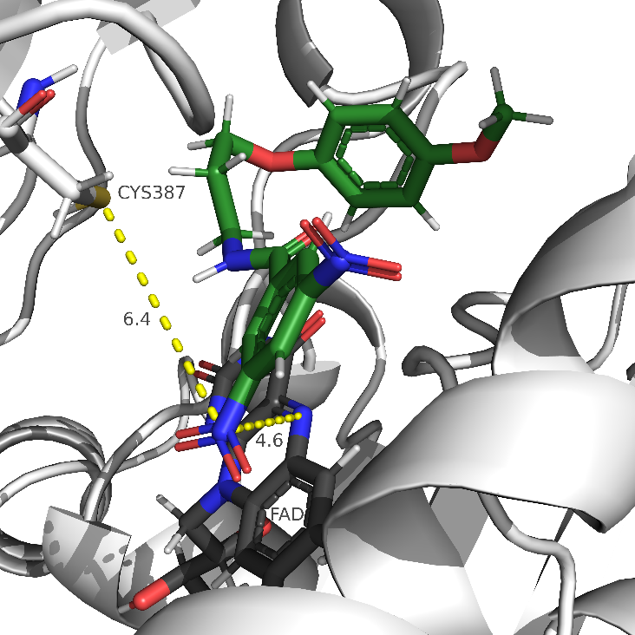
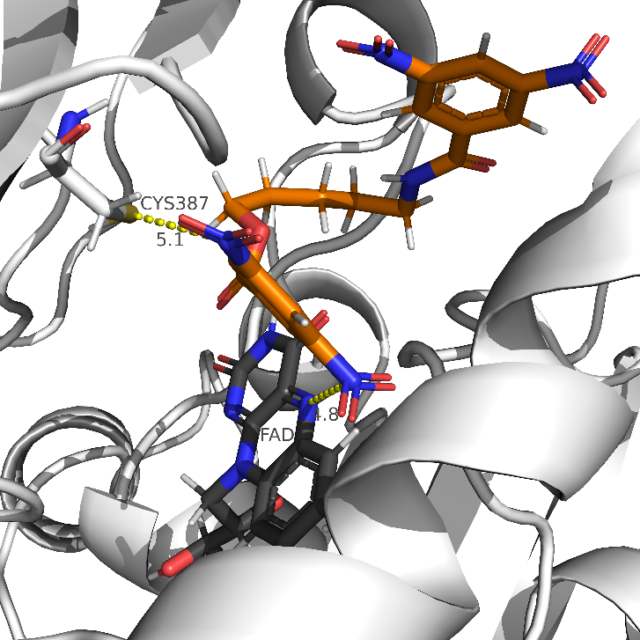
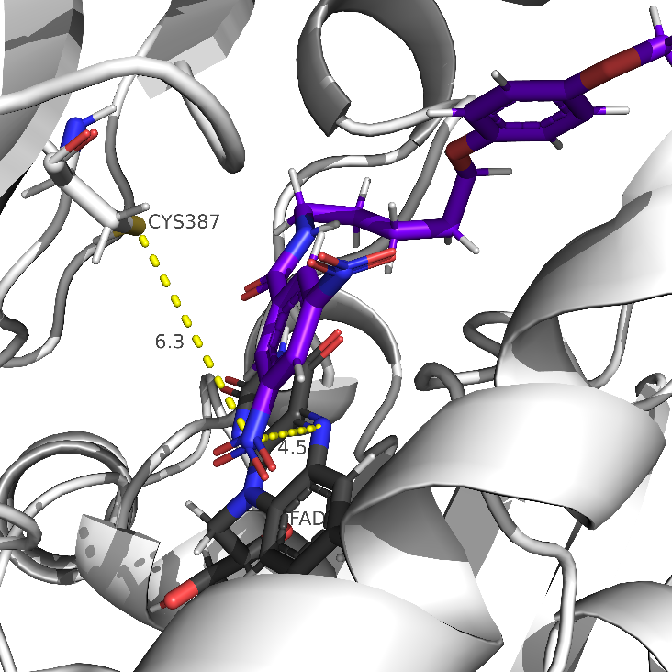
D1
C2
D2
The nitro groups of the lead compounds are near FAD and Cys387, which are essential groups in the inhibition mechanism of nitrobenzamides
Notes:
By conducting a molecular docking analysis using our compounds, we can see that the best poses of the lead candidates all get accommodated near the FAD and the cysteine that are essential for the mechanism of inhibition of nitrobenzamides. In particular they are closer to FAD, which is responsible for the first step in that mechanism. Thus, our new compounds likely act through a similar mechanism of inhibition.

Slide 25
The graph doesn’t show for a clear separation between active and not-active compounds
A distance over 5.5Å seems to lead to compounds with low activity.
Notes:
Plotting the distance of the nitro group to the FAD vs the activity doesn’t allow for a clear separation between active and not-active compounds. But a distance over 5.5 seems to lead to compounds with low activity.

Slide 26
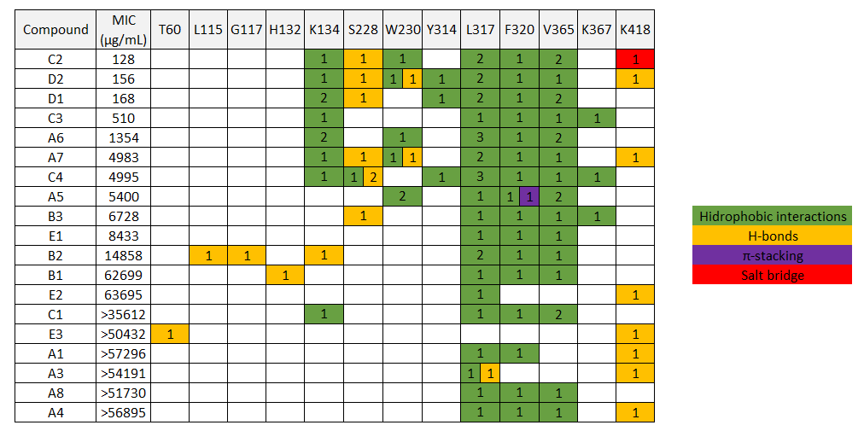
Interactions with DprE1 residues
Activity
K134 could be an important hydrophobic interaction since the most active compounds all make it, while the less active don’t
Notes:
Finally, looking at the list of interactions that the compounds make with the receptor, the interaction with Lysine 134 appears in all of the active compounds, and some of the moderately active compounds, while it fails to appear in the compounds with low activity, and thus it may be an important interaction with the receptor.

Slide 27
Conclusions
Revealed some important characteristics of the structure for the activity of the compounds:
terminal aromatic moieties are important for the activity, except when directly connected to nitrogen of the nitrobenzamide moiety;
lipophilicity should be above a certain threshold (consensus LogP>1.6) to have active compounds;
Interactions with K134 seem to be important for activity.
Developed synthetic approaches that can be adapted for the synthesis of future compounds;
Developed new dinitrobenzamides, some which are very promising as leads to further develop this class of compounds (compounds C2, D1, and D2).
Notes:
So, to recap, with this work we were able to develop new dinitrobenzamides, some of which that showed promising activities. The results also showed some important characteristics of this class of compounds, mainly the importance of having a terminal aromatic moiety and a level of lipophilicity above a certain threshold and the importance of having a “spacer” between that aromatic moiety and the nitrogen of the nitrobenzamide moiety.
3 of the compounds developed have interesting activities, on par with INH, and are good leads for future development of the nitrobenzamides. The results obtained from docking also show some characteristics that should be able to guide the design of future compounds.
Besides this, the synthetic approaches used in this work can be easily adapted for the synthesis of future compounds.

Slide 28
Acknowledgments
This research was funded by Fundação para a Ciência e Tecnologia (FCT), grant PTDC/SAU-INF/28080/2017 and Grant EXPL/SAU-INF/1097/2021. It also received financial support from FCT (via IMed ULisboa) from projects UIDB/04138/2020 and UIDP/04138/2020
Notes:
We would like to acknowledge FCT from Portugal and IMED from our university for supporting our work, and also you for your attention

