Slide 1
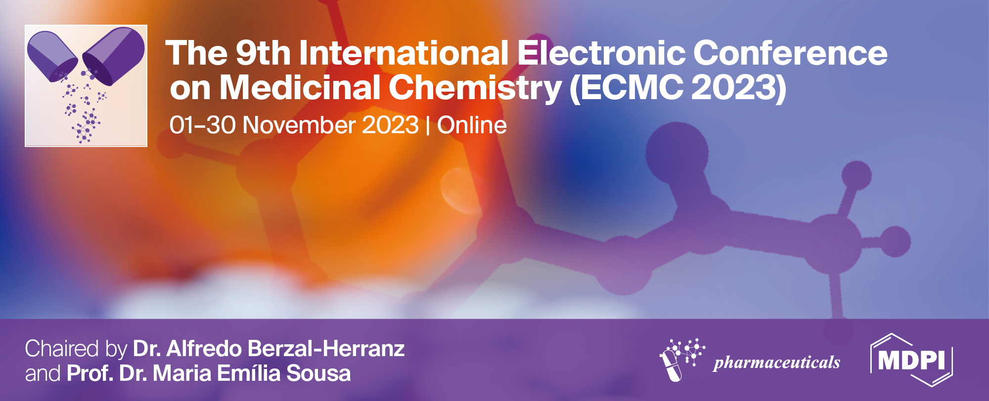
Optimization and Synthesis of Perfluorocarbon Nanoemulsion with Fluorous Photosensitizer for Photodynamic Therapy
Minh Tuan Nguyen ^{1,}*, Elizaveta Guseva ², Andrey Sigan ², Ivan Burtsev ¹, Anton Egorov ¹, Anna Shibaeva ¹, Vladimir Kuzmin ¹, Alexander Shtil ³ and Alina Markova ¹
¹ Emanuel Institute of Biochemical Physics, Russian Academy of Sciences, 4 Kosygin Street, 119334 Moscow, Russia;
² A.N. Nesmeyanov Institute of Organoelement Compounds, Russian Academy of Sciences, 28 Vavilov Street, 119991 Moscow, Russia;
³ Institute of Cyber Intelligence Systems, National Research Nuclear University MEPhI, 31 Kashirskoe Shosse, 115409 Moscow, Russia.
* Corresponding author: tuantonyx@yahoo.com

Slide 2
Optimization and Synthesis of Perfluorocarbon Nanoemulsion with Fluorous Photosensitizer for Photodynamic Therapy
Graphical Abstract
Encapsulation efficiency 60%
= Photosensitizer
= Photosensitizer-surfactant complex
5:1
= Emulsion droplet
Surfactant
Perfluorocarbon
to
Surfactant
Ratio (w/w)
= Aqueous phase
Perfluorocarbon with dissolved photosensitizer
Enhanced phototoxicity
15:1
Encapsulation efficiency 80%

Slide 3
Abstract: Perfluorocarbon-based nanoemulsions (PFC-NEs) have been shown to be an effective tool for oxygen delivery in various therapeutic modalities, including photodynamic therapy (PDT) in cancer treatment. PFC droplets are able to transport and supply oxygen to hypoxic cells as well as enhance the singlet oxygen generation by the photosensitizer (PS), functions which make them a promising platform for PDT. To further enhance PDT efficacy, we synthesized PFC-NEs with fluorous PS that is soluble in the perfluorocarbon phase, creating a closer proximity of the PS to the dissolved oxygen in PFC. However, the fluorous PS used in this work had a high tendency to leak into the aqueous phase with a surfactant, leading to less than desirable encapsulation efficiency (EE%). Therefore, the main goal of this study is to develop a formulation to ensure high EE% of fluorous PS in PFC droplets. PFC-NEs were prepared by ultrasonic emulsification and were characterized using dynamic light scattering, UV-Vis and fluorescence spectroscopy. The optimization of the PFC-NE formulation did not significantly affect the nanoemulsion properties, such as hydrodynamic diameter, polydispersity index and colloidal stability, and successfully increased EE%, as well as improved dark cytotoxicity profile and enhanced photoinduced cytotoxicity of PFC-NE.
Keywords: drug formulation; encapsulation efficiency; nanoemulsion; perfluorocarbon; photodynamic therapy.

Slide 4
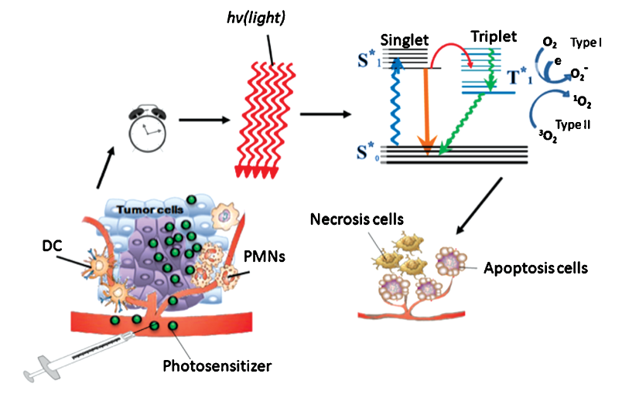
Introduction
Photodynamic therapy (PDT) is a minimally invasive method of cancer treatment Photodynamic processes are mostly oxygen-dependent
Hypoxia leads to tumor progression and resistance to oxygen-dependent therapies (radiotherapy, PDT) Perfluorocarbons are able to dissolve 20- to 40-fold larger amounts of oxygen compared to water and temporarily alleviate hypoxia
The mechanisms of PDT
Source: Denis, T. G.; Aziz, K.; Waheed, A. A.; Huang, Y.-Y.; Sharma, S. K.; Mroz, P.; Hamblin, M. R. Combination approaches to potentiate immune response after photodynamic therapy for cancer. Photochemical & Photobiological Sciences 2011, 10, 792–801. https://doi.org/10.1039/c0pp00326c

Slide 5
Previous work: Synthesis of Fluorous Photosensitizers and Preparation of Perfluorocarbon Nanoemulsions
650 nm
Reactive oxygen species
³О₂
³О₂
Chlorin-based PSs absorb
red light (600-700 nm)
=
Better and deeper
tissue penetration
Proximity of fluorous PS
to molecular oxygen in PFC
=
Optimized conditions for
singlet oxygen generation
¹О₂
¹О₂
¹О₂

Slide 6
0.9% NaCl
Proxanol-268 13%
Fluorous chlorins
3a-c
70-80ºC,
5 min
Sonication
FC-PFC-NE
Encapsulation efficiency (EE%) is on average 60%
Source: Nguyen, M.T.; Guseva, E.V.; Ataeva, A.N.; Sigan, A.L.; Shibaeva, A.V.; Dmitrieva, M.V.; Burtsev, I.D.; Volodina, Y.L.; Radchenko, A.S.; Egorov, A.E.; et al. Perfluorocarbon Nanoemulsions with Fluorous Chlorin-Type Photosensitizers for Antitumor Photodynamic Therapy in Hypoxia. Int. J. Mol. Sci. 2023, 24, 7995. https://doi.org/10.3390/ijms24097995
PFD:PFMCP 2:1 (w/w)

Slide 7
Previous work:
This work:
Components | Functions | Components
Fluorous chlorin 3b (FC-3b) 0.6507 mg | Photosensitizer | Fluorous chlorin 3b 1.952 mg
PFD 0.867 g | Oxygen carrier, PS solvent | PFD 2.6 g
PFMCP 0.433 g | Oxygen carrier, PS solvent, droplet stabilizer | PFMCP 1.3 g
Proxanol-268 0.2665 g | Surfactant | Proxanol-268 0.2665 g
0.9% NaCl solution Up to 10 ml | Dispersion medium, buffer solution | Phosphate Buffer Saline (PBS) Up to 10 ml
PFC/Proxanol-268 5:1
PFC/Proxanol-268 15:1

Slide 8
Results and discussion
PFC/Proxanol-268 5:1
PFC/Proxanol-268 15:1
Sonication settings:
Mode: pulsed
Duty cycle: 50%
Power: 5 (50%)
Duration: 4x2 min
Rest: 1-2 min
Ice bath
Translucent, slightly opalescent
Grayish green o/w nanoemulsion
Opaque
Green o/w nanoemulsion

Slide 9
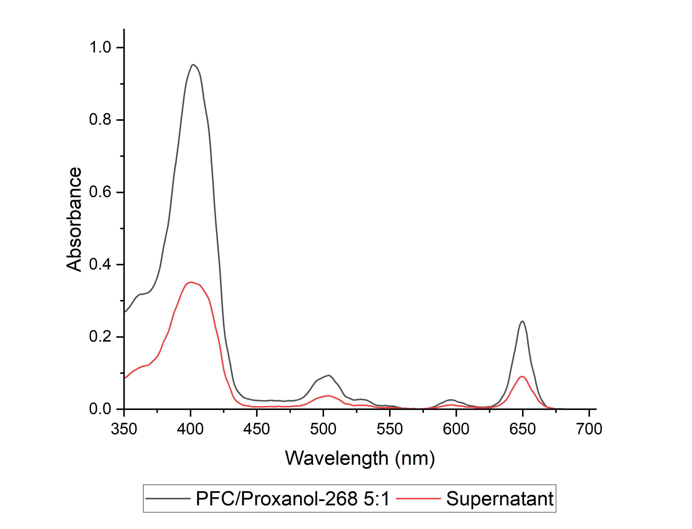
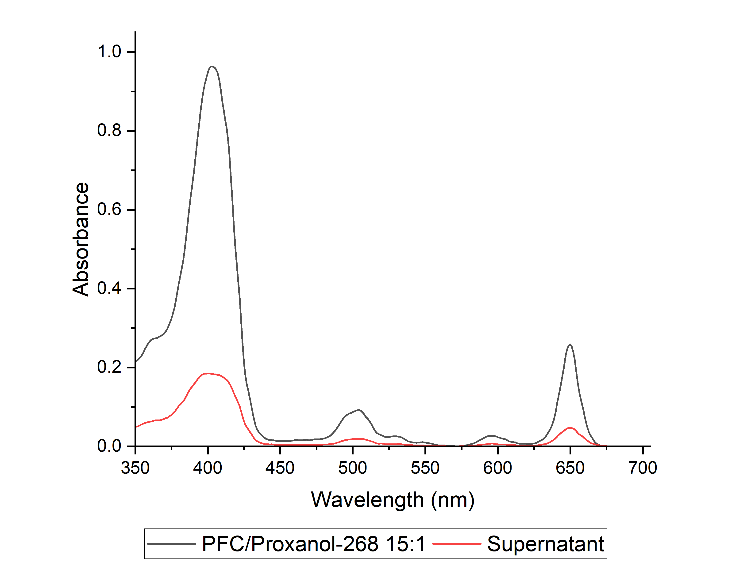
UV-Vis spectra of FC-3b in PFC-NEs and their supernatant
Less absorbance in the supernatant = higher EE%
EE% = (AUC (emulsion) – AUC (supernatant))/AUC (emulsion) × 100%

Slide 10
Characterization of PFC-NEs
Emulsion | Storage Temp., ºC | z-average hydrodynamic diameter, nm |  |  | Polydispersity index (PDI) |  |  | EE%
 |  | Day 1 | Day 7 | Day 30 | Day 1 | Day 7 | Day 30 | Day 1 | Day 30
PFC/Proxanol-268 5:1 | +4 | 200.6 ± 6.1 | 208.7 ± 5.6 | 221.1 ± 1.4 | 0.096 ± 0.01 | 0.027 ± 0.02 | 0.060 ± 0.04 | 63.8 | 44.1
 | -20 |  | 214.9 ± 4.8 | 192.9 ± 2.5 |  | 0.120 ± 0.03 | 0.089 ± 0.04 |  | 69.6
PFC/Proxanol-268 15:1 | +4 | 214.5 ± 8.5 | 221.5 ± 4.9 | 236.7 ± 0.3 | 0.070 ± 0.02 | 0.068 ± 0.02 | 0.025 ± 0.02 | 81.9 | 70.5
 | -20 |  | 217.4 ± 5.9 | 206.7 ± 0.7 |  | 0.083 ± 0.02 | 0.091 ± 0.02 |  | 83.2
Resulting PFC/Proxanol-268 15:1 formulation is a nanoemulsion;
Changes in droplet size and PDI are insignificant;
Both formulations are stable during storage;
Encapsulation efficiency has improved.

Slide 11
Improved dark and photoinduced cytotoxicity profile
Dark cytotoxicity
Photoinduced cytotoxicity
↓ Decreased dark cytotoxicity
↑ Increased phototoxicity
HCT116 cells, 48h incubation with PFC-NEs
HCT116 cells, 24h incubation + 24h after irradiation
Irradiation: 660 nm, 8.3 mW/cm², 45 J/cm²

Slide 12
Control experiment
HCT116 cells, 24h incubation + 24h after irradiation
Irradiation: 660 nm, 8.3 mW/cm², 45 J/cm²
FC-3b concentration: 10 µM
Treatment groups:
1) Blank emulsion (PFC/Proxanol-268 15:1 without FC-3b) – no cell death
2) PFC-free (PFC/Proxanol-268 15:1 without PFC) – no cell death
3) PFC-free + Blank emulsion – 40% cell death
4) PFC/Proxanol-268 5:1 – 85% cell death
5) PFC/Proxanol-268 15:1 – 85% cell death
Encapsulated FC-3b is the main photodynamically active component of PFC-NEs

Slide 13
Conclusions
Optimization of PFC-NE formulation resulted in:
Higher encapsulation efficiency;
Improved dark cytotoxicity profile;
Enhanced photoinduced cytotoxicity.
Optimization process did not affect:
- Particle size and polydispersity index – resulting o/w emulsion remained nanoscale;
Colloidal stability – optimized formulation is stable during storage.
Further research should and will be focused on:
Optimizing PS concentration in PFC;
Studying difference in physical and chemical properties of encapsulated and non-encapsulated PS in PFC-NEs;
Effect of surfactant on photochemistry of PFC-NEs.

Slide 14
Acknowledgments
The study was carried out using the equipment of the Core Facility “New Materials and Technologies” at the Emanuel Institute of Biochemical Physics, Russian Academy of Sciences.

