Slide 1
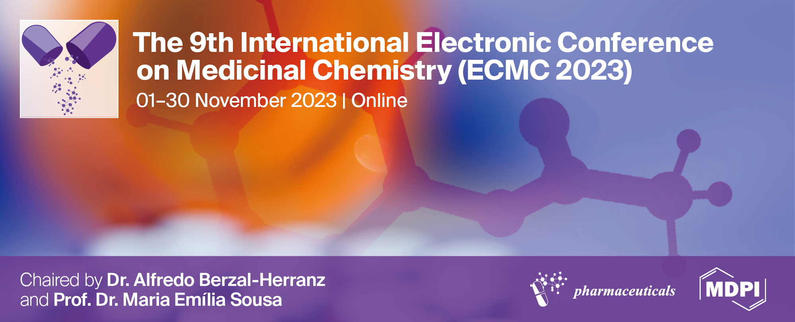
The effects of Lead stress on flavonoid content and antioxidant activity from Scrophularia striata Boiss.
Reyhaneh Danaeipour¹, Mohsen Sharifi^{1*}
¹Department of Plant Biology, Faculty of Biological Sciences, Tarbiat Modares University, Tehran, Iran, R.danaeipour@ modares.ac.ir, Msharifi@modares.ac.ir.
* Correspondence: Msharifi@modares.ac.ir
2023
Tarbiat Modares University

Slide 2
The effects of Lead stress on flavonoid content and antioxidant activity from Scrophularia striata Boiss.

Slide 3
Abstract: Scrophularia striata Boiss., a local name of Teshnehdari, is used as a common medicinal infusion of the plant aerial parts in hot water. For decades, Teshnehdari has been used in diverse forms, including oral decoction, incense, and poultice for treating various diseases containing eye and ear infections, infectious wounds, colds, and boils. Recently, researchers have recommended applying S. striata for clinical studies on COVID-19 viral illness. One of the reasons for using plants in medicine is the presence of their metabolites and antioxidant activities. Different environmental stresses incredibly affect their antioxidant capacity and medicinal metabolites. The reactive oxygen species (ROS) production often increases in response to heavy metal pollution, especially Pb stress. Plants have a defense system that responds to the imbalance between oxidant and antioxidant activities by increasing antioxidant production. The research purposed to evaluate the effects of Pb stress on the flavonoid content and antioxidant activity of S. striata. The antioxidant activity was distinguished with the evaluation of scavenger enzymes, including guaiacol peroxidase (POD), superoxide dismutase (SOD), and catalase (CAT), using extraction of shoot samples with different collecting times (24, 48, and 72 hours). After 24 h treatment, POD was the predominant antioxidant enzyme and significantly increased compared to control groups. However, SOD and CAT showed a significant increase in modulating the oxidative status at 72h after Pb stress. Statistical analysis showed a negative correlation between POD with CAT and SOD. Based on HPLC analysis of genistein flavonoid, a non-enzymatic antioxidant, meaningfully increased at 24 and 72 h after treatment. Also, Correlation coefficient analysis showed a significant negative relationship between genistein and antioxidant activity (CAT and SOD). Overall, S. striata can be a good source of enzymatic and non-enzymatic antioxidants with application in the pharmaceutical industry.
Keywords: Scrophularia striata Boiss., Flavonoid content, Antioxidant activity, Pb stress

Slide 4
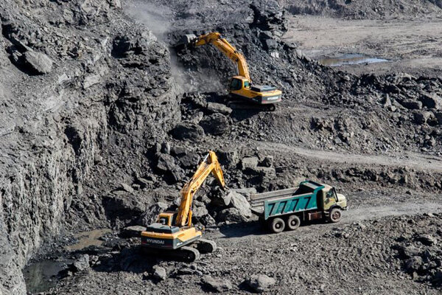
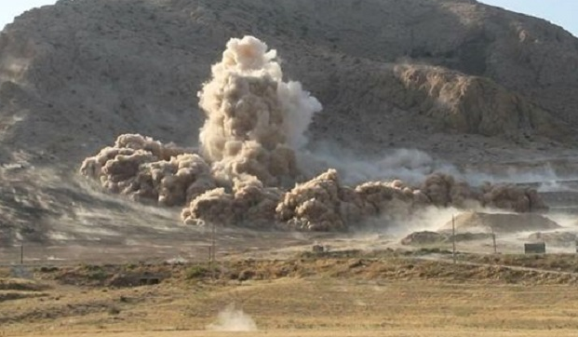
Ilam province and heavy metal pollutions
Ilam province, located in the west of Iran, is an area exposed to various metal mines and refineries, and the human health risk caused by heavy metals is increasing.
Dadkhah-Aghdash et al, 2022

Slide 5
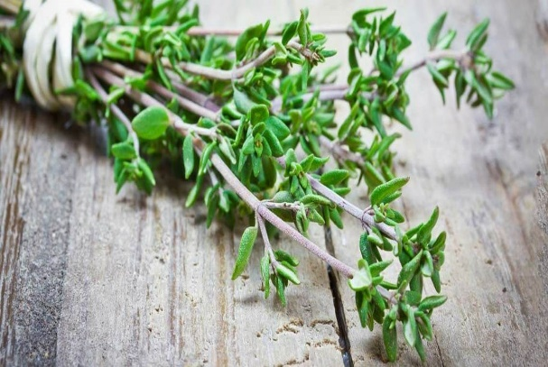
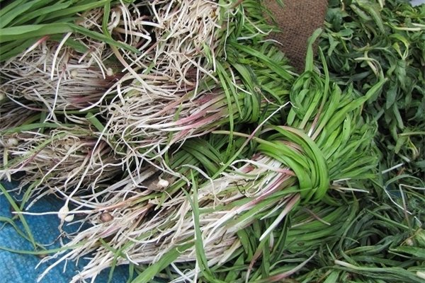
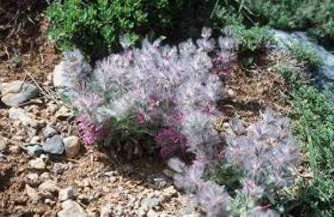
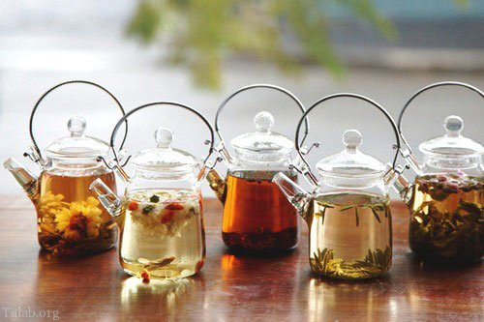
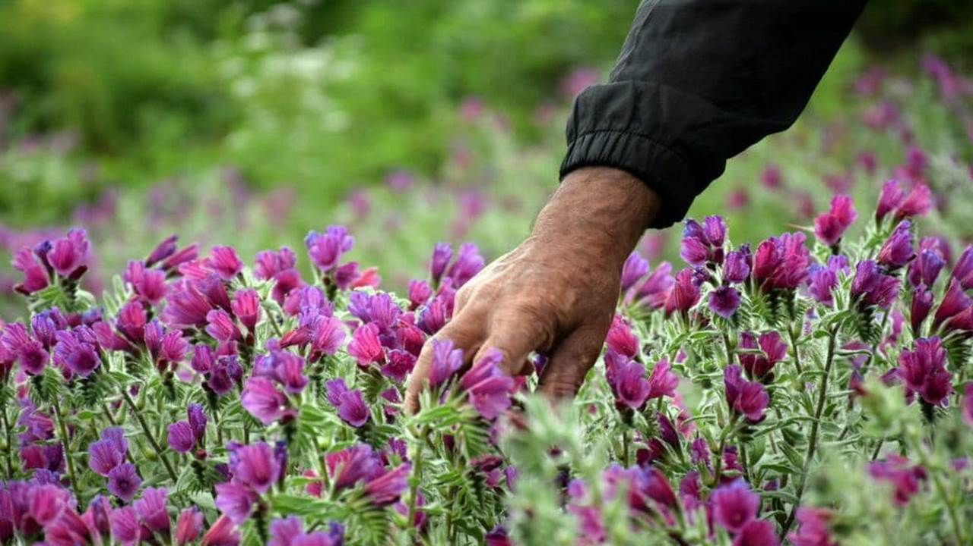
Ilam and medicinal plants
Scrophularia striata
Ilam is a city rich in medicinal plants, and native inhabitants have traditionally used these plants.

Slide 6
Taxonomic name
Order:
Lamiales
Family:
Scrophulariaceae
Genus:
Scrophularia
Species:
Scrophularia striata
Local name:
Teshnehdari
Kerdar et al, 2018
https://www.ncbi.nlm.nih.gov/data-hub/taxonomy/tree/?taxon=39249

Slide 7
Results
The antioxidant capacity was illustrated by assessing of antioxidant enzymes using shoot extractions.
Scavenger enzymes included superoxide dismutase (SOD), catalase (CAT), and peroxidase (POD).
POD significantly increased after 24 h treatment and compared to control samples.
POD was the predominant antioxidant enzyme.
SOD and CAT meaningfully increased at 72 h after stress and regulated the oxidative status.

Slide 8
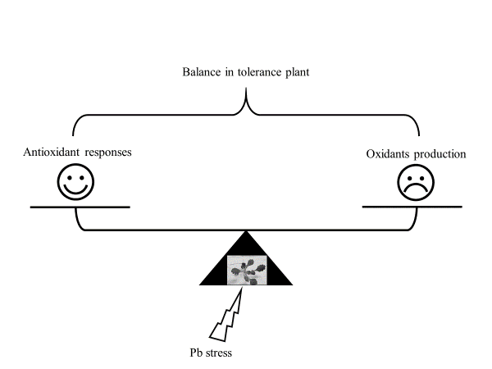
Discussion
It has been reported that Pb stress increases the content of intracellular ROS.
The ROS can also destroy cellular redox homeostasis, so the plant's antioxidant system is activated in response to Pb exposure, and the increased activities of this system go towards inducing them to quench and eliminate them.

Slide 9
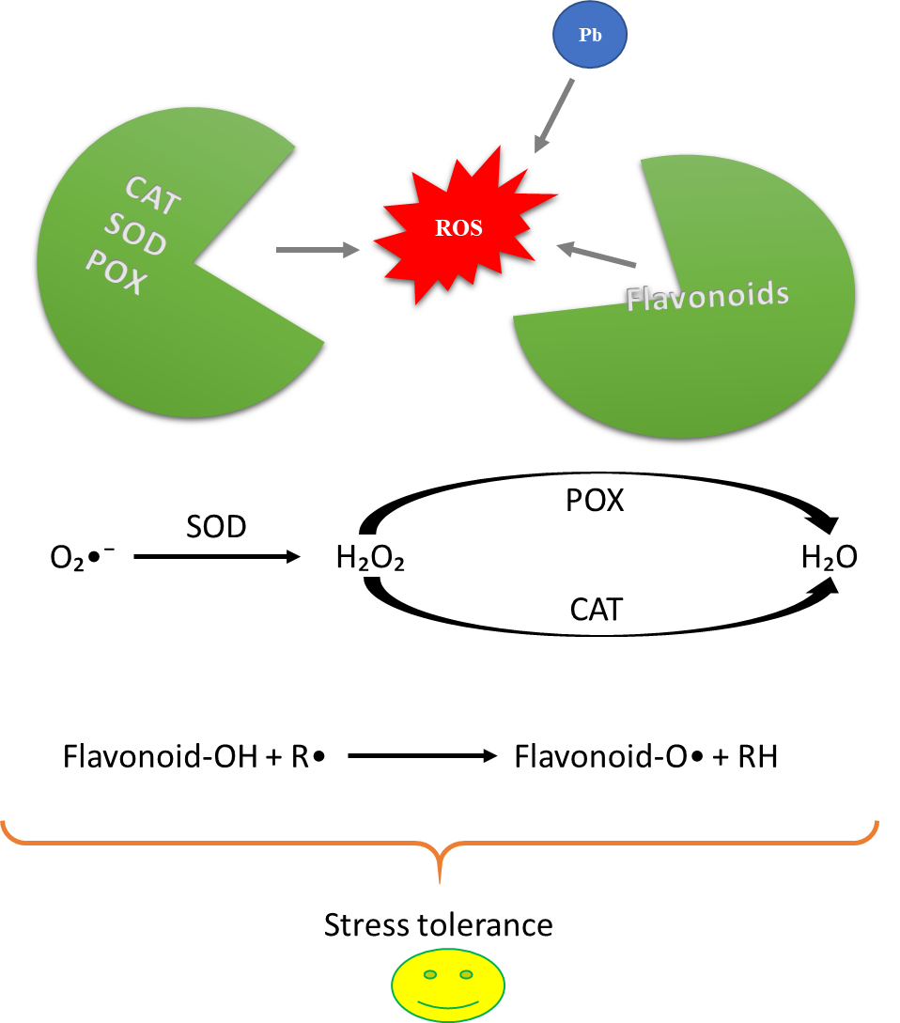
Discussion
In summary, it can be stated that secondary oxidative stress is created in plants under Pb stress, activating different shoots ' mechanisms in S. striata to cope with it.
Oxidative stress and antioxidative defenses in response of Pb stress in Scrophularia striata.
Notes:
SOD enzyme is often considered the first line of plant defense; through its activity, the O₂ ⁻ is converted to O₂ and H₂O₂. In the continuation of that, CAT and POX decompose H₂O₂ into H₂O [23,24].
The antioxidative activity of flavonoid compounds is primarily operated by phenolic hydroxyl groups in their structure [22]
In summary, it can be stated that secondary oxidative stress is created in plants under Pb stress, activating different shoots ' mechanisms in S. striata to cope with it. These responses of plants are summarized in Fig. 3.

Slide 10
Discussion
In this study, we evaluated the effects of Pb treatment on the flavonoid content and enzymatic antioxidant activities of S. striata. The amount of flavonoids and antioxidant capacities enhanced during Pb stress.
In a previous study, Beshamgan et al. (2019) also stated that flavonoids and antioxidant enzymes increased in Teshnehdari at all times (12, 24, 48, and 72 h) after Cadmium (Cd) stress against control samples.
Zafari et al. (2016) results demonstrated that the production of POD increased slower than CAT; this indicates that CAT may be more responsible for H₂O₂ removal in the early hours of Pb stress than POD.
In contrast, our findings showed that POD significantly increased after 24 h treatment, and POD increased faster than CAT. In the following, CAT enzymatic activity increased more than POD.
These results were comparable to previous studies under various stress resulting in secondary oxidative stress.

Slide 11
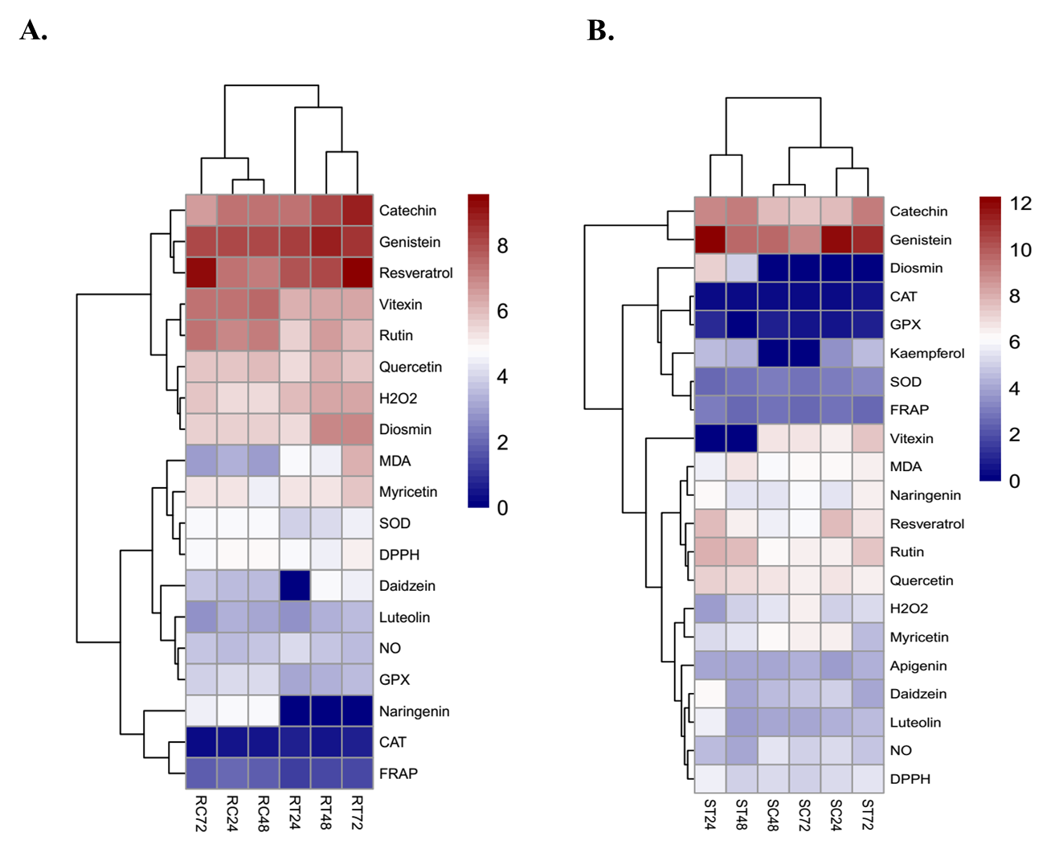
Results and discussion
The heatmap analysis of oxidative status and flavonoids contents in A) roots and B) shoots of S. Striata plants under Pb treatment: from low in dark blue to high in dark red.

Slide 12
Discussion
Statistical analysis presented a negative relationship between POD with CAT and SOD. The correlation coefficient analysis of genistein also showed a significant negative correlation between genistein and antioxidant activity (CAT and SOD).
Jakovljevic et al. 2021 also showed a negative relationship between POD with CAT and SOD by analyzing Pearson’s correlation in Basil under temperature stress.

Slide 13
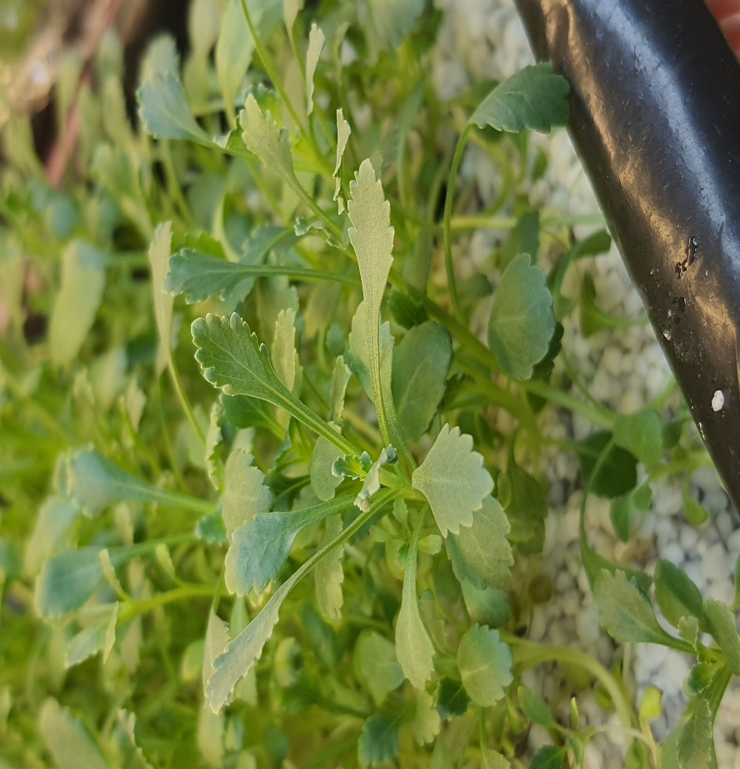
Conclusions
Our studies demonstrate that Theshnehdari can cope with Pb stress using diverse antioxidant defense responses.
This species can also be a good source of different antioxidants with the medicinal application.
Teshnehdari
a valuable candidate plant

Slide 14
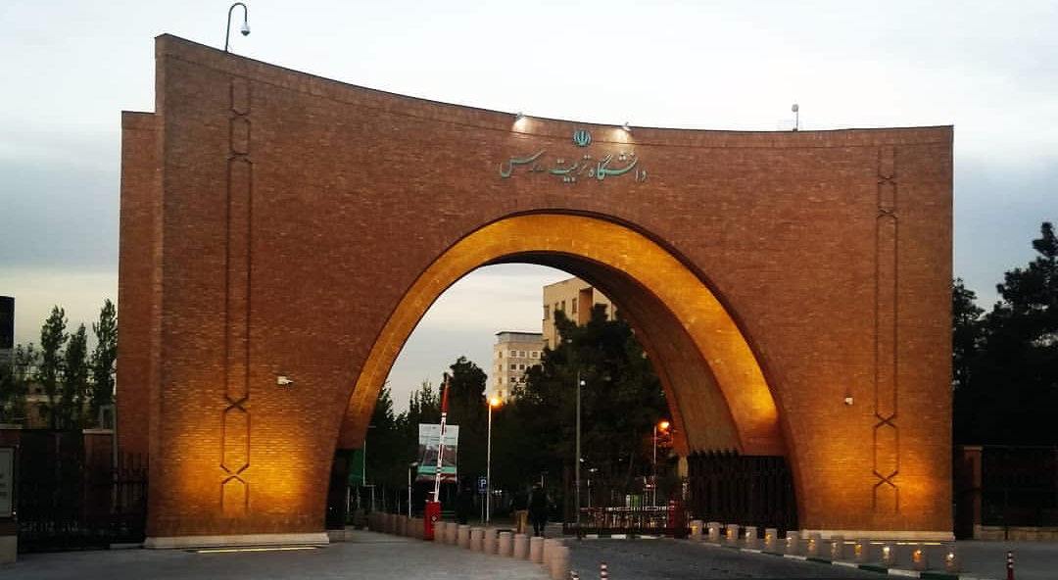
Acknowledgments
The authors sincerely appreciate Tarbiat Modares University for supporting their finance and providing the laboratory facilities.

