Slide 1
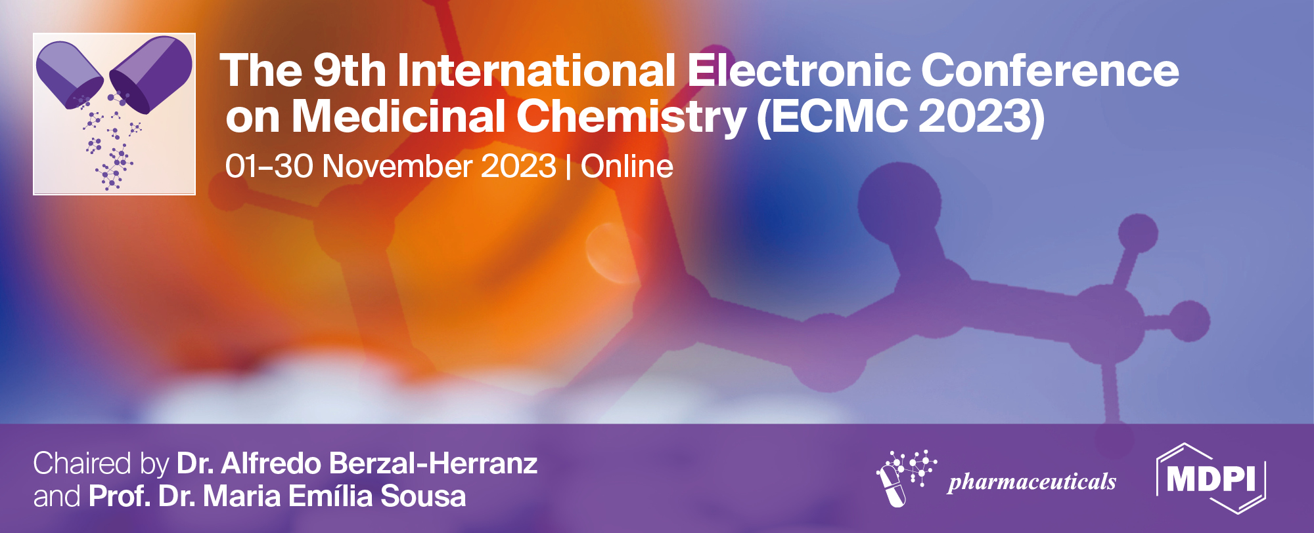



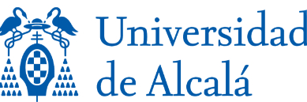

Plectranthus aliciae: Biological activity of 6,7-dehydroroyleanone and derivatives
Márcia Santos Filipe^{1,2}, Eva Domínguez-Martín^{1,2}, Vera M.S. Isca^{1,3}, Raquel Pereira¹, Filipa Mandim^{4,5}, Ricardo Calhelha^{4,5}, Ana María Díaz-Lanza², Lillian Barros^{4,5}, Patrícia Rijo^{1,3,}*
¹CBIOS – Universidade Lusófona’s Research Center for Biosciences & Health Technologies, Campo Grande 376, 1749-024 Lisbon, Portugal.
²Universidad de Alcalá de Henares. Facultad de Farmacia, Departamento de Ciencias Biomédicas (Área de Farmacología; Nuevos agentes antitumorales, Acción tóxica sobre células leucémicas. Ctra. Madrid-Barcelona km. 33,600 28805 Alcalá de Henares, Madrid, España.
³Instituto de Investigação do Medicamento (iMed.ULisboa), Faculdade de Farmácia, Universidade de Lisboa, 1649-003 Lisbon, Portugal.
⁴Centro de Investigação de Montanha (CIMO), Instituto Politécnico de Bragança, Campus de Santa Apolónia, 5300-253 Bragança, Portugal.
⁵Laboratório Associado para a Sustentabilidade e Tecnologia em Regiões de Montanha (SusTEC), Instituto Politécnico de Bragança, Campus de Santa Apolónia, 5300-253 Bragança, Portugal.
* Corresponding author: patricia.rijo@ulusofona.pt

Slide 2
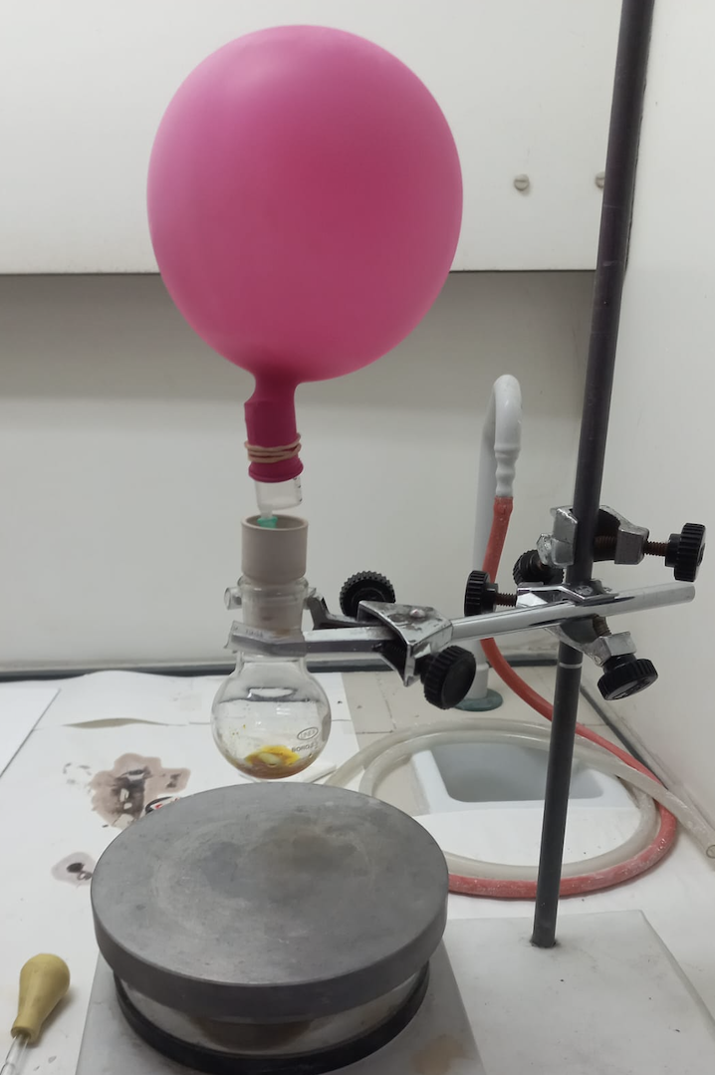
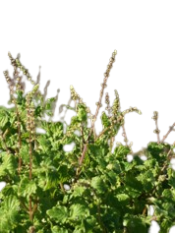
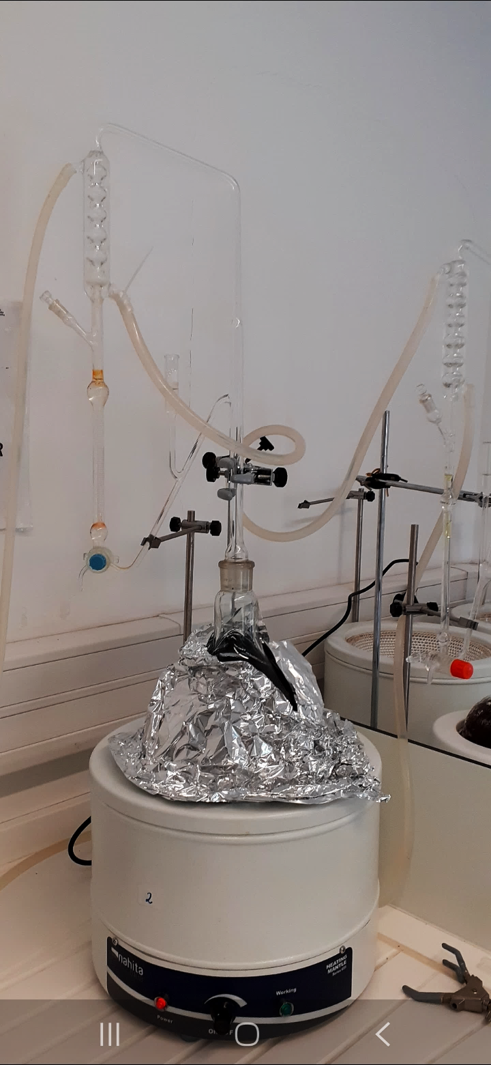
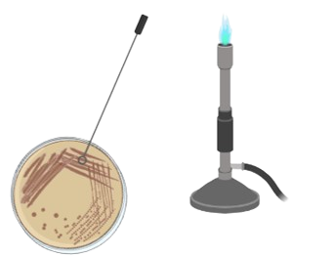

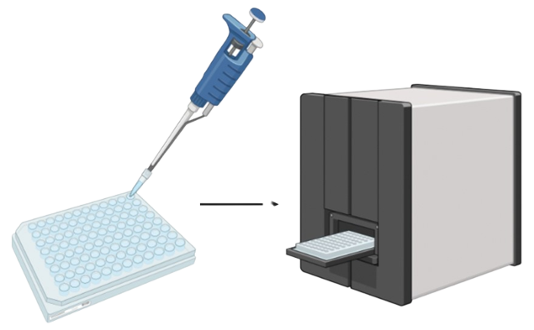
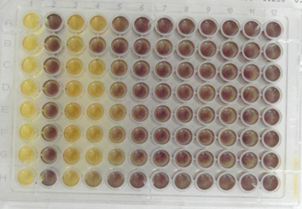
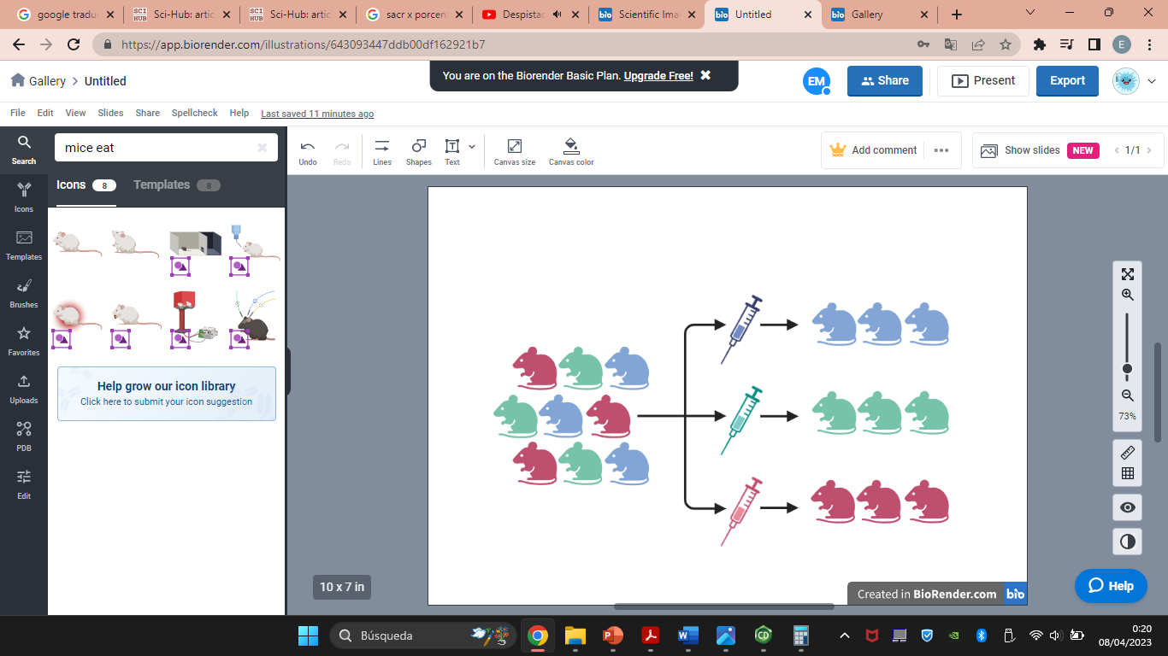
Plectranthus aliciae: Biological activity of 6,7-dehydroroyleanone and derivatives
6,7-dehydroxyroyleanone (1) and derivatives (2-4) synthesis
Coleus aliciae (Codd) A.J.Paton
Clevenger extraction
Bioactivity evaluation (1-4)

Slide 3
Abstract: Plectranthus genus (Lamiaceae) is known to be rich in bioactive abietane royleanone-type diterpenes, such as the 6,7-dehydroxyroyleanone (1), which have been previously found in P. madagascariensis (var. aliciae Codd). This abietane royleanone present moderate to significant cytotoxic activity against several cancer cell lines. Moreover, 1 has one hydroxyl group suitable for derivatization, that can be explored to enhance the cytotoxic potential of lead compound 1. Based on this, the aim of the present work was to explore the obtention of 1, from P. aliciae aliciae (Codd) van Jaarsv. & T.J.Edwards., a subspecie of P. madagascariensis to be further used in the preparation of new derivatives with enhanced biological activities. P. aliciae leafs hydrodestilation using a Clevenger equipment was performed, affording the essential oil (EO). 1 was assessed as the major compound of the EO, by HPLC-DAD, which was isolated and used as scaffold for esterification reactions. It was possible to obtain in three new acyl derivatives (2 to 4), with overall good yields (86 - 95 %). Regarding the biological activity screening, the semi-synthetic derivatives (2-4) improved the antioxidant activity and the cytotoxicity in MCF-7 and NCI-H460 human cancer cell lines, when comparing to 1. Amazingly, the new esters (2-4) showed a promising anti-inflammatory activity, in a range of 16 to 53 times higher than 1 and also than the positive control dexamethasone. Currently, the mechanism of action and safety of the potential anti-inflammatory derivatives are under evaluation.
Keywords: anti-inflammatory; bioactivity; essential oil; Plectranthus; royleanone

Slide 4
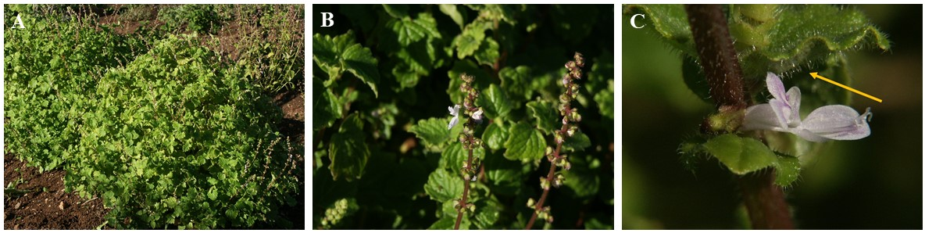
Introduction
🌱 Belongs to the Lamiaceae family and it’s a commercially important group of flowering plants.
🌱 Plectranthus L'Hér. genus was more than 300 species distributed essentially in Africa, Asia, Australia, and some Pacific islands.
🌱 P. aliciae has a history of traditional medicinal use by local communities to treat respiratory ailments.
FIGURE 1. P. aliciae plant: A. whole plant; B. Corolla and teethed leaves; C. Hairly ovate leaves with red glands.
Rattray, R.D.; Van Wyk, B.E. The Botanical, Chemical and Ethnobotanical Diversity of Southern African Lamiaceae. Molecules 2021, 26. | Ascensao, L., et al., 1998; Vol. 159.
Rice, L.J., et al., South African Journal of Botany 2011, 77, 947–959. DOI:10.1016/j.sajb.2011.07.001.

Slide 5
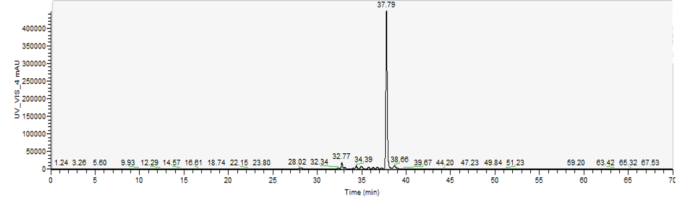
Results and discussion
🌱 Extraction and DHR quantification
FIGURE 2. 6,7-dehydroxyroyleanone (DHR 1), the major compound of P. madagascariensis EO and acetonic extract.
FIGURE 3. Extract chromatogram and UV spectra of DHR 1.

Slide 6
Results and discussion
🌱 Bioactivity evaluation of the compounds
TABLE 1. Antioxidant capacity of DHR 1 and its derivatives 2 to 4, using different methodologies.
TE- Trolox Equivalent; ORAC- Oxygen Radical Absorbance Capacity; HORAC- Hydroxyl Radical Absorbance Capacity; NO- Nitric Oxide; TAOC- Total Antioxidant Capacity.
TABLE 2. MIC and MBC values of the compounds obtained by the microdilution method against Gram-positive strains in µg/mL.
TABLE 3. Cytotoxicity results against different cell lines. GI₅₀ results expressed in μM.
AGS- gastric carcinoma; CaCo-2- colorectal adenocarcinoma; MCF-7- breast carcinoma; NCI-H460- lung cancer; PLP2- non-tumor cell line.

Slide 7
Results and discussion
🌱 Bioactivity evaluation of the compounds
TABLE 4. Anti-proliferative effect in MDA-MB-231S cancer cell line. IC₅₀ values presented in μM.
Dimethyl sulfoxide (DMSO) was used as the negative control. Doxorrubicin- positive control.
TABLE 5. Anti-inflammatory activity using RAW 264.7 macrophages. IC₅₀ results expressed in μM.
Dexametasone- positive control.

Slide 8
Conclusions
🌱 DHR 1 was the major constituent of the P. aliciae OE. This compound was quantified by HPLC, corresponding to 60% mg/g in the EO.
🌱 DHR 1 was derivatized and the results showed successful esterification reactions at the C-12 moiety led to the synthesis of three compounds (2-4) with overall good yields (86-95%).
🌱 The anti-inflammatory activity displayed the most promising results. Esterification at the C-12 esterification of 1 resulted in a significant increase in anti-inflammatory activity in derivatives 2 to 4.
FIGURE 2. 6,7-dehydroxyroyleanone (DHR 1), the major compound of P. madagascariensis EO and acetonic extract.

Slide 9
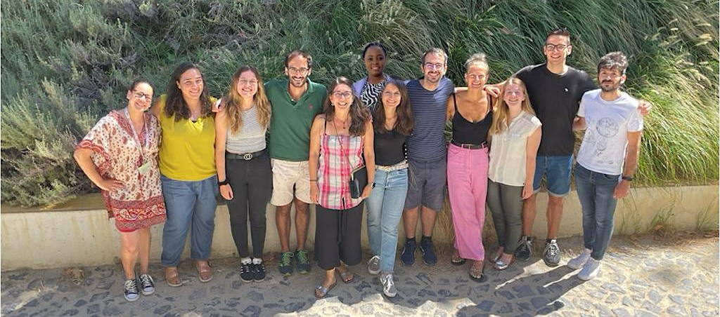
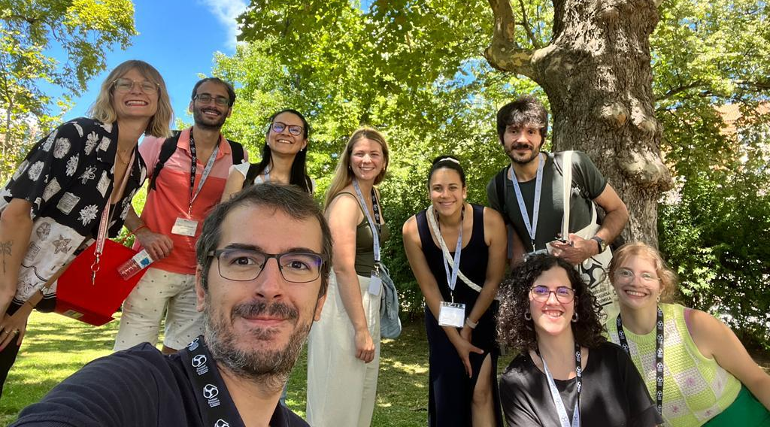
Acknowledgments
This research was funded by Foundation for Science and Technology (FCT, Portugal) for financial support through national funds FCT/MCTES (PIDDAC) to CIMO (UIDB/00690/2020 and UIDP/00690/2020), SusTEC (LA/P/0007/2020), and to the projects UIDB/04539/2020 and UIDP/04539/2020.
V.I., and F.M. would like to thank FCT for their PhD grants (SFRH/BD/137671/2018, and SFRH/BD/146614/2019, respectively). E.M.D.-M. gratefully acknowledges being the recipient of a predoctoral FPU-UAH 2019 fellowship and for the grant “Ayudas a la Movilidad del Personal Investigador en Formación 2022” from University of Alcalá de Henares (UAH).

