Slide 1
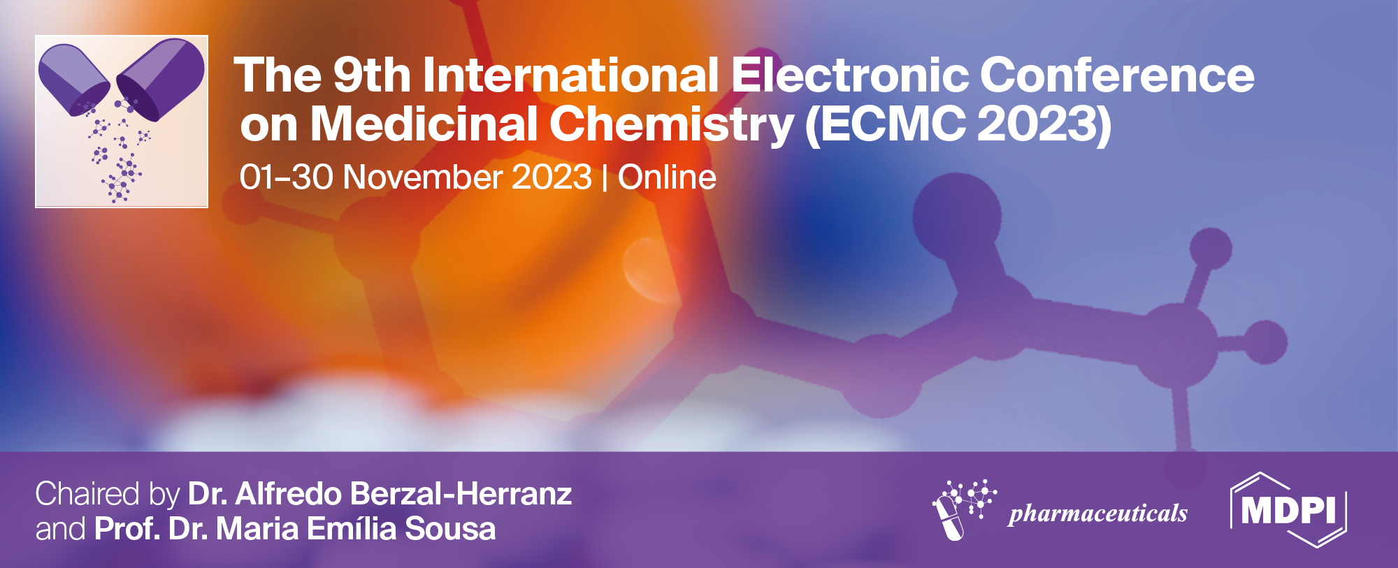
Synthesis, Molecular Docking, Antioxidant And Antibacterial Assessment Of Azo Derivatives Of Thymol
Riya Shikha ¹, Adity Kumari ^{2,}*
¹ Banasthali Vidyapeeth, Rajasthan
² Xavier University, Bhubaneswar
* Corresponding author: ur18053xustudent.edu.in

Slide 2
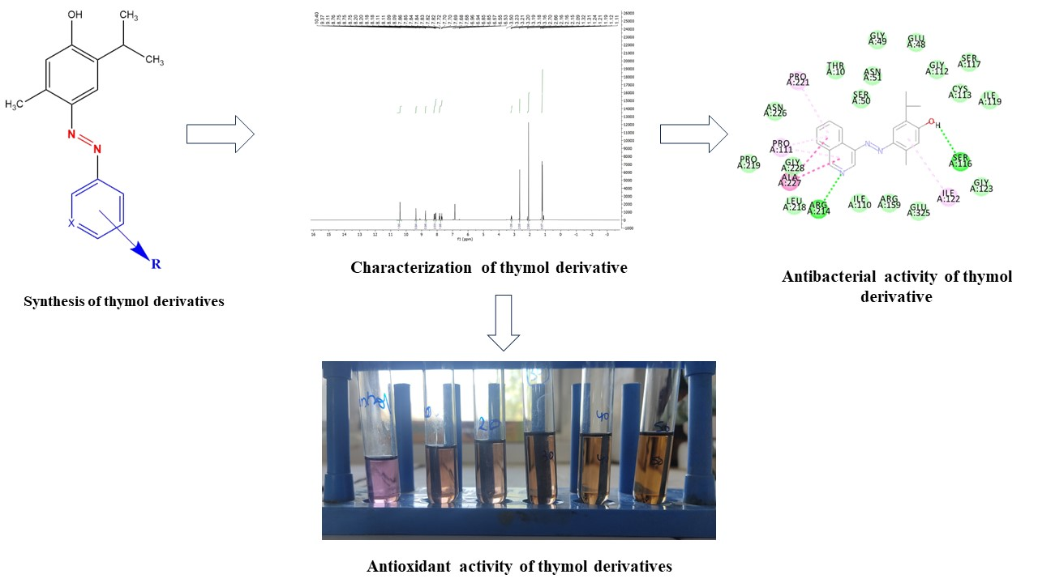
Synthesis, Molecular Docking, Antioxidant And Antibacterial Assessment Of Azo Derivatives Of Thymol
Graphical Abstract

Slide 3
Abstract:
Thymol, a naturally occurring monoterpenoid phenol, has sparked attention for its potential therapeutic properties, including antioxidant and antibacterial activities. In this study, I emphasized synthesizing azo derivatives of thymol and evaluating their molecular docking, antioxidant, and antibacterial properties. The synthesis involved the chemical modification of thymol to create azo compounds, followed by computational docking studies to predict their potential binding affinity towards specific target proteins. A total of nine azo derivatives of thymol have been synthesized from different substituted aromatic amines and characterized by IR and proton NMR. The antioxidant activity of the synthesized azo derivatives was assessed using a DPPH assay, highlighting their potential as free radical scavengers. Furthermore, the antibacterial properties of the derivatives were evaluated against Staphylococcus aureus and Escherichia coli to assess their potential as antimicrobial agents.

Slide 4
Additionally, drug-like properties of derivatives were evaluated using bioinformatic tools such as PASS prediction, molecular docking, and Lipinski rules of five, as well as toxic nature and LD 50 values. All nine compounds exhibited significant antibacterial action, with one showing strong antioxidant activity. Furthermore, the docking scores of derivatives fell between 124 to 106 (LibDock score) against two bacterial targets. The findings of this work provide important insights into potential applications of thymol azo derivatives as multifunctional molecules with antioxidant and antibacterial properties, necessitating additional research into their potential therapeutic usage.
Keywords: Thymol; Molecular docking; Azo derivatives; Antioxidant; Antibacterial

Slide 5
Introduction
Bacterial infections have a large impact on public health. Disease can occur at any body site and can be caused by the organism itself or by the body's response to its presence.
The five key areas of bacterial metabolism—cell wall synthesis, protein synthesis, RNA synthesis, DNA synthesis, and intermediary metabolism. The major mechanism of action of antimicrobial agents are as follows:
Inhibition of bacterial cell wall synthesis
Inhibition of nucleic acid synthesis
Interference in ribosomal function
Inhibition of metabolic pathway
To overcome the problem of antibacterial drug resistance development of an effective molecule is essential, one of the recent approach for this, is via modification of natural product-derived molecules as an active scaffold, which in turn increase its efficiency and

Slide 6
molecules as an active scaffold, which in turn increase its efficiency and raise the probability of additional interactions with biological targets.
Several phytochemicals were reported having antibacterial and antifungal activities and lend themselves to the preparation of mainstream medicine.
Thymol, 2-isopropyl-5-methylphenol is a natural monocyclic monoterpene phenol available in several plants such as, Thymus vulgaris and other Thymus sp., Cinnamomum zeylanicum, Eugenia caryophyllus, etc., had been reported as antibacterial, antifungal and antioxidative but could not be used directly due to drug likeness property and unknown pharmacological/chemical constraints.
Fig. 1: 2D & 3D structure of thymol

Slide 7
Azo derivatives, which consist of aryl/alkyl and –N=N– groups have been extensively reported due to their excellent biological properties.
Azo compounds contain –N=N- group. In aromatic azo compounds, the R groups are arene rings; the structures of these are more stable than if the R groups are alkyl groups.
Simple methods for producing azo molecules include diazotization and the aromatic coupling reaction. Diazotization is the process of turning primary aromatic amines into their diazonium salt.
Diazonium salts are significant synthetic intermediates that can go through electrophilic aromatic substitution reactions to add functional groups and coupling reactions to produce azo dyes and &the organic reaction between a diazonium salt and an additional aromatic compound is known as azo coupling.

Slide 8
Results and discussion
Table 1: Characteristics of azo derivatives of thymol
Compound Code | Molecular Formula | Molecular weight | Yield | Melting point | Appearance
8A | C₁₉H₁₉N₃O | 305.37g/mol | 81% | 125°C | Black color powder
3B | C₁₆H₁₇BrN₂ O | 332.05g/mol | 58% | 140-145°C | Yellowish powder
4B | C₁₆H₁₇BrN₂ O | 332.05g/mol | 75% | 150°C | Brick red color powder
2C | C₁₆H₁₇ClN₂O | 288.10g/mol | 60% | 130°C | Appearance: Brick red color powder
2,6C | C₁₆H₁₆Cl₂N₂O | 322.06g/mol | 59% | 140°C | Red color powder
3F | C₁₆H₁₇FN₂O , | 272.13g/mol | 47% | 125-130°C | Dark brown color powder
4F | C₁₆H₁₇FN₂O, | 272.13 g/mol | 92% | 120-130°C | Brick red color powder

Slide 9
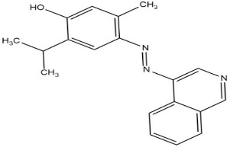
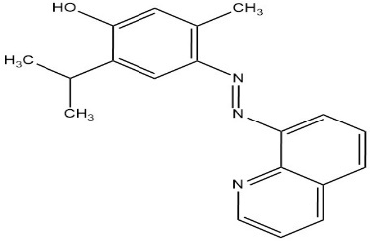
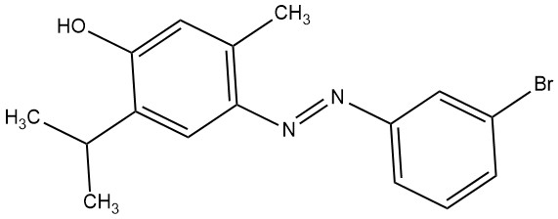
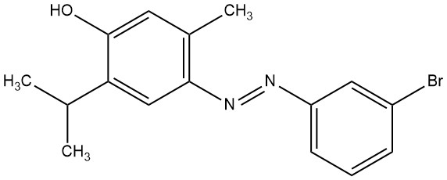
4-[(E)-(isoquinolin-4-yl) diazenyl]-5-methyl-2-(propan-2-yl)phenol (3A)
5-methyl-2-(propan-2-yl)-4-[(E)-(quinolin-8-yl) diazenyl] phenol (8A)
4-[(E)-(3-bromophenyl) diazenyl]-5-methyl-2-(propan-2-yl) phenol(3B)
4-[(E)-(3-bromophenyl) diazenyl]-5-methyl-2-(propan-2-yl) phenol(4B)

Slide 10
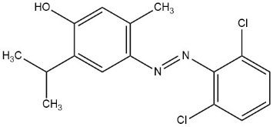
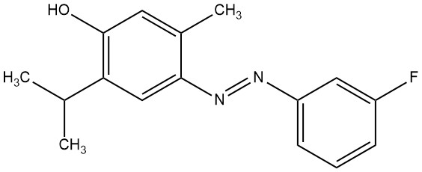
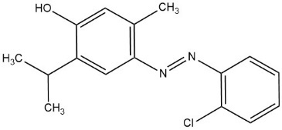
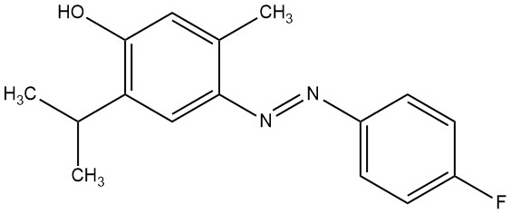
4-[(E)-(2,6-dichlorophenyl) diazenyl]-5-methyl-2-(propan-2-yl) phenol (2,6C)
4-[(E)-(3-fluorophenyl) diazenyl]-5-methyl-2-(propan-2-yl) phenol (3F)
4-[(E)-(2-chlorophenyl) diazenyl]-5-methyl-2-(propan-2-yl) phenol (2C)
4-[(E)-(4-fluorophenyl) diazenyl]-5-methyl-2-(propan-2-yl) phenol (4F)

Slide 11
Table 2: Solubility data of azo derivatives of thymol
Compound code | Water | Acetone | Chloroform | DCM | DMSO | Ethyl acetate
3A | - | + | + | ++ | +++ | +++
8A | - | + | + | ++ | +++ | +++
3B | - | +++ | +++ | +++ | ++ | ++
4B | - | +++ | +++ | +++ | ++ | ++
2C | - | +++ | +++ | +++ | ++ | ++
2,6C | - | +++ | +++ | +++ | ++ | ++
3F | - | +++ | +++ | +++ | ++ | ++
4F | - | +++ | +++ | +++ | ++ | ++
+++ = freely soluble, ++ =Soluble, + = slightly soluble, - = Insoluble

Slide 12
Table 3: Lipinski rule of synthesized compounds
Compound code | Molecular weight | No. of hydrogen bond | No. of hydrogen bond acceptor | TPSA (Aͦ) | No. of rotable bond | Log P
3A | 305.37 | 1 | 4 | 57.84 | 3 | 3.34
8A | 305.37 | 1 | 4 | 57.84 | 3 | 3.34
3B | 333.22 | 1 | 3 | 44.95 | 3 | 3.63
4B | 333.22 | 1 | 3 | 44.95 | 3 | 3.93
2C | 288.10 | 1 | 3 | 44.95 | 3 | 3.41
2,6C | 322.06 | 1 | 3 | 88.65 | 3 | 3.47
3F | 272.13 | 1 | 4 | 44.95 | 3 | 3.43
4F | 272.13 | 1 | 4 | 44.95 | 3 | 3.49

Slide 13
Table 4: Predicted toxicity of azo derivatives of thymol
S. N | Compound code | Predicted LD₅₀ (mg/kg) | Predicted toxicity class
1 | 3A | 5000 | 6
2 | 8A | 4818 | 5
3 | 3B | 4818 | 5
4 | 4B | 4818 | 5
5 | 2C | 1250 | 4
6 | 2,6C | 1250 | 4
7 | 3F | 4818 | 5
8 | 4F | 4818 | 5

Slide 14
Docking was performed using the LibDock module of DS v2.0 (Catalyst, Accelrys Software) to
investigate the binding method of synthesized compounds into the active site of MurB. LibDock
was chosen because of its capacity to dock onto the receptor's hot spots (polar and non-polar
interaction sites) and its short computation time. The ligand was kept flexible throughout the
process, whereas the target protein was remained rigid. MurB crystal structure was retrieved from
the protein data bank (PDB ID: 1UXY, 1HSK). Water molecules were removed, and hydrogen
atoms were introduced. In the active site, a radius of 9 was defined from the geometric centroid of
the ligand. The designed structure was docked in the active site. The best poses of each docking
study were selected based on LibDock scores.
Table 5: Molecular docking summary of azo derivatives of thymol against MurB of E.coli
S. N | Compound code | Docking score | No. of HBs
1 | 3A | 118 | 2
2 | 8A | 119 | 2
3 | 3B | 109 | 1
4 | 4B | 107 | 2
5 | 2C | 103 | 1
6 | 2,6C | 104 | 1
7 | 3F | 108 | 1
8 | 4F | 106 | 1

Slide 15
Table 6: Molecular docking summary of azo derivatives of thymol against MurB of S. aureus
Docking results shows that all the synthesized compound has hydrogen bond interactions (HBs), hydrophobic interactions (HyP), Halogen bond interaction and Vander Waals interaction (VdW)with target enzyme MurB of respective bacteria. In this, hydrogen bond is of type; conventional hydrogen bond & carbon-hydrogen bond. Conventional hydrogen bond represented in dotted dark green line while carbon-hydrogen bond in dotted light green line
S. N | Compound code | Docking score | No. of HBs
1 | 3A | 124 | 2
2 | 8A | 110 | 3
3 | 3B | 117 | 2
4 | 4B | 115 | 2
5 | 2C | 122 | 1
6 | 2,6C | 123 | 1
7 | 3F | 112 | 2
8 | 4F | 118 | 4

Slide 16
Dotted pink lines/purple line/orange line represents hydrophobic interaction that includes alkyl, π-alkyl, amide π stacked, π- π stacked, π-sigma, π-sulfur etc. Surrounding amino acids of target in green color shows hydrogen bond interaction with ligand. Dotted blue line represents halogen bond interaction (D...X-Y), which is interaction of a halogen and an electron donor species, where X is an electrophilic halogen atom, D is an electron donor, and Y is a carbon, nitrogen, or halogen atom.
The investigation of XB interaction has drive the interest of researchers in a variety of domains, including rational medication design and theoretical chemistry calculations.

Slide 17
Antioxidant activities of the synthesized compounds3A, 8A, 3B, 4B, 2C, (2,6C), 3F, 4F were performed by DPPH assay method. Ascorbic acid was taken as standard. Five concentrations 10, 20, 30, 40, 50µg/ml were taken for the screening of activity. Antioxidant activity was measured in terms of IC₅₀ values.
From the results showed in table 5, it was found that Compound 4F shows IC50 0.759 µg/ml which is less than IC50 of standard ascorbic acid 2.27 µg/ml. The lower the IC50 value, the more potent the compound for scavenging DPPH, implying more antioxidant activity.
Table 7: IC₅₀ of azo derivatives of thymol
S. N | Synthesized compounds | IC50(µg/ml )
1 | 3A | 5.0533
2 | 8A | 3.3603
3 | 3B | 2.7264
4 | 4B | 4.2882
5 | 2C | 3.53
6 | 2,6C | 2.7852
7 | 3F | 2.8229
8 | 4F | 0.7569
9 | Ascorbic acid | 2.27

Slide 18
Table 8: ZOI of azo derivatives of thymol against E.coli
S.N | Compounds | Zone of inhibition (in mm)
 |  | 10µg/ml | 50 µg/ml | 100 µg/ml
1 | 3A | 35±0.22 | 36.6±0.33 | 38.3±0.33
2 | 8A | 35.6±0.33 | 37.1±0.33 | 44±0.33
3 | 3B | 33.6±0.33 | 35.3±0.33 | 43.6±0.33
4 | 4B | 30±0.33 | 33.01±0.33 | 33.9±0.33
5 | 2C | 11±0.60 | 14.6±0.33 | 17.1±0.33
6 | 2,6C | 15.6±0.57 | 17.6±0.88 | 18.9±0.33
7 | 3F | 31.6±0.33 | 38.6±0.33 | 38.3±0.33
8 | 4F | 28.3±0.33 | 29.03±0.33 | 31.6±0.33
9 | Ampicillin | 29±0.44 | 29.88±0.33 | 31.09±0.33

Slide 19
Table 9: ZOI of azo derivatives thymol against S.aureus
S.N | Compounds | Zone of inhibition (in mm)
 |  | 10µg/ml | 50 µg/ml | 100 µg/ml
1 | 3A | 42±0.57 | 44.3±0.33 | 46.03±0.33
2 | 8A | 13.3±0.33 | 16.3±0.33 | 22±0.33
3 | 3B | 33.8±0.33 | 36.6±0.33 | 38.6±0.33
4 | 4B | 33±0.33 | 35.88±0.55 | 37.01±0.33
5 | 2C | 37.6±0.33 | 39.3±0.33 | 41.01±0.33
6 | 2,6C | 40±0.57 | 41.6±0.33 | 43±0.88
7 | 3F | 32.9±0.33 | 35.06±0.33 | 36.7±0.33
8 | 4F | 34.6±0.33 | 41.3±0.66 | 40.6±0.33
9 | Ampicillin | 32.3±0.55 | 38.71±0.33 | 38±0.33

Slide 20
Antimicrobial activity of the thymol derivatives were performed against gram positive bacteria S. aureus and gram negative bacteria E.coli by cup plate method. Ampicillin was taken as standard drug. Three different concentrations 10, 50, 100μg/ml of each test and standard were taken. Zone of inhibition was measured by the scale in nm.
Among these compounds 3A, 8A & 3B showed greater zone of inhibition than standard ampicillin against gram negative (E. coli) bacteria at the concentration of 10,50 and 100 μg/ml. 2C is the least active among all the synthesized compounds.
Synthesized compounds 3A,3B,2C,2,6C, 4F,4B showed excellent activity against gram positive bacteria (S. aureus) at concentrations 10,50 and 100 μg/ml.
Compound 3A,4B & 3B showed excellent activity against both gram negative as well as gram positive bacteria. It shows that -OH, halogen (Br), N=N, N in ring have greater role in antibacterial activity of synthesized compounds.

Slide 21
Conclusions
The present study deals with the synthesis of some thymol derivatives by diazotization followed by coupling reaction between thymol and primary aromatic amines (3- aminoquinoline,8-aminoquionoline, 2-chloroaniline, 2,6-dichloroaniline, 3-bromoaniline, 4-bromoaniline, 3-fluroaniline, 4-fluroaniline).
Solubility characters of synthesized compounds were carried out by using various solvent. Compound 3A & 8A is “freely soluble” in DMSO and ethyl acetate while other compounds are “soluble” in these two solvents. Compound 3B, 4B, 2C, 2_6C, 3F, 4F are “freely soluble” in acetone and chloroform but compound 3A and 8A “slightly soluble” in acetone, chloroform and “soluble” in DCM. All the synthesized compounds are insoluble in water.
Preliminary in-sillico studies (toxicity prediction, Lipinski rule of five) by different webservers were performed. All the compounds obey Lipinski rule of five.
The docking results showed all the compounds have significant docking score. Compound 3A have highest docking score 124 and 8A have lowest docking score 110 against target enzyme MurB of S.aureus(1hsk) whereas compound 8A have highest docking score 110 and compound 2C have lowest docking score 103 against target enzyme MurB of E.coli(1uxy). All the compounds showed H-bond interaction with target enzyme which is essential for biological activity. So, the compounds are comparatively less effective in gram negative bacteria in comparison to gram positive bacteria.

Slide 22
In DPPH assay the 4F compound was found to be most potent because the IC₅₀ value was obtained at lowest concentration i.e., 0.7569
The compound 8A showed maximum zone of inhibition against E.coli whereas compound 2C have lowest ZOI. In S.aureus compound 3A have highest ZOI and 8A have lowest ZOI. So we can conclude compounds are more active against S.aureus than E.coli based on the values of ZOI.
Based on the aforementioned results, it may be concluded that the synergistic interaction of hydrophilic and lipophilic properties of a molecule plays an important role in antibacterial activity. The presence of lipophilic aromatic rings capable of interacting with the hydrophobic spaces of bacterial enzymes. The azo moiety is also significant in bacteriostatic action. The presence of -N=N- is easily protonated under acidic conditions and reacted with the phosphate group on the peptidoglycan layer of bacteria, inhibiting cell wall synthesis or inhibiting bacterial growth via H-bond interaction of the compound with the active site of enzyme. The presence of a -OH group in the synthesized compounds contributes to the hydrophilic characteristics of the compounds, which improves antibacterial activity. Thus, the presence of -OH, -N=N-, halogens, and nitrogen containing heterocyclic nucleus played a significant effect on antibacterial activity of compound.

Slide 23
Acknowledgments
My sincere regards to Prof. Sarvesh Kumar Palliwal, Head of Department, Department of Pharmacy, Banasthali Vidyapeeth, Rajasthan and all the faculty members, for providing the facility to conduct this work.

