Slide 1
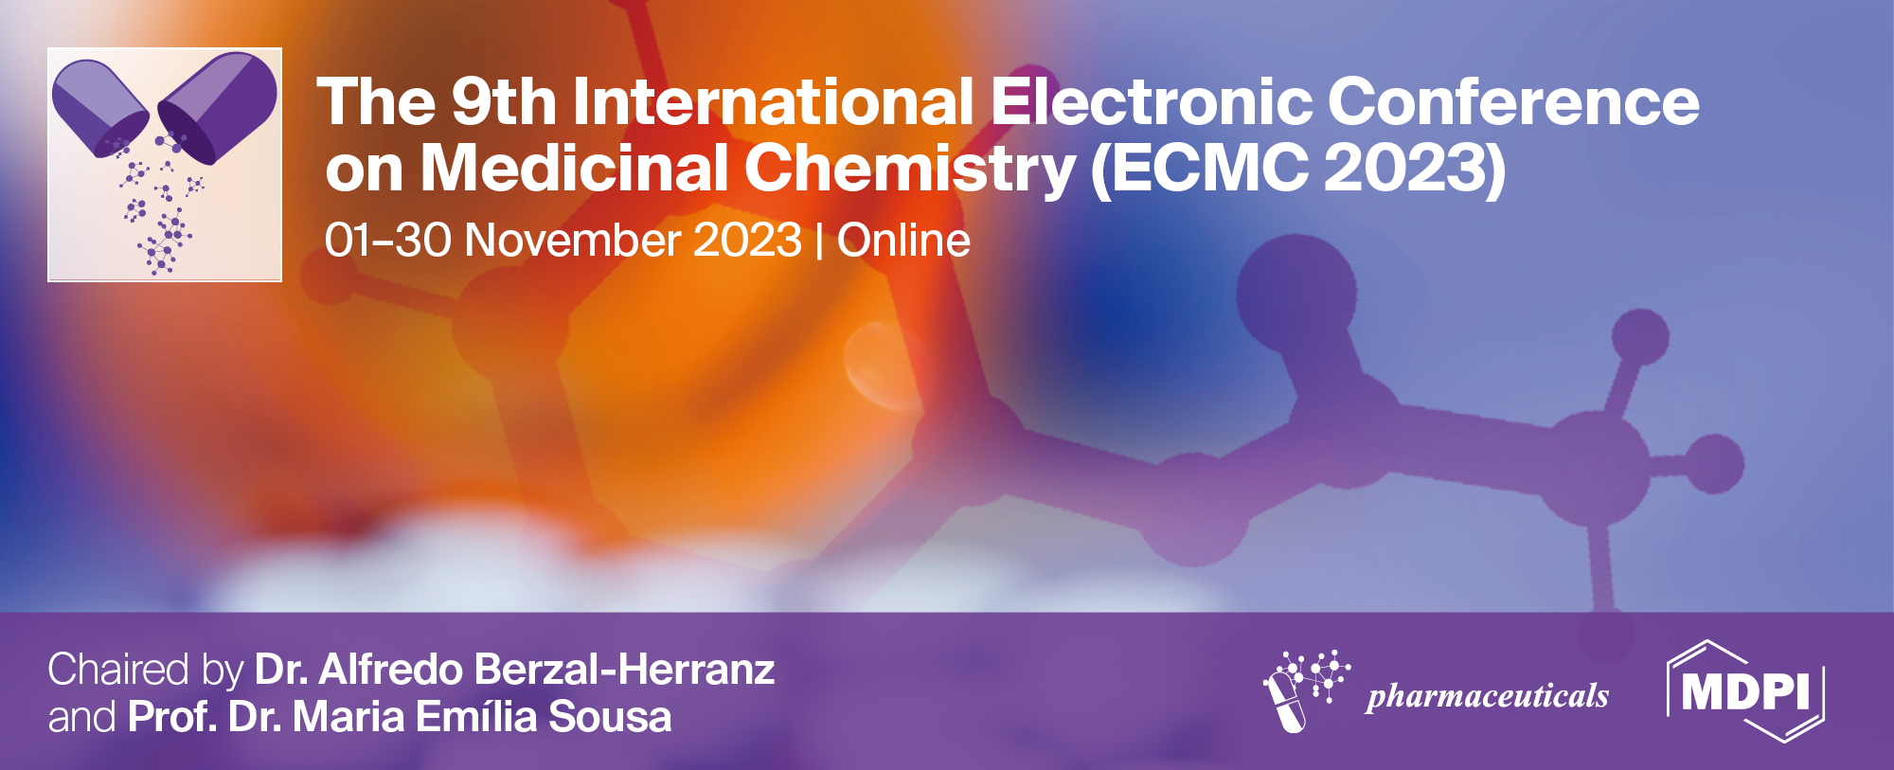
The prostate cancer-fighting powers of soursop fruit: in silico evaluation to give insight into binding affinity of selected bioactive compounds on selected prostate cancer targets.
Maryam Abdullahi,^{1*}Umar Ndagi,² Zainab Gambo Ibrahim,³ Quadri Abdulkabir Olalekan¹ and Monsurat Motunrayo Lawal ⁴
¹Department of Pharmaceutical and Medicinal Chemistry, Ahmadu Bello University Zaria, Nigeria;
²Africa Centre of Excellence for Mycotoxin and Food Safety, Federal University of Technology, Minna, Nigeria;
³Department of Pharmacology and Therapeutics, College of medical science, Abubakar Tafawa Balewa University, Bauchi, Nigeria;
⁴Drug Discovery Lab, Gallaudet University, Washington, DC United States of America
* Corresponding author: maryamabkif3@gmail.com

Slide 2
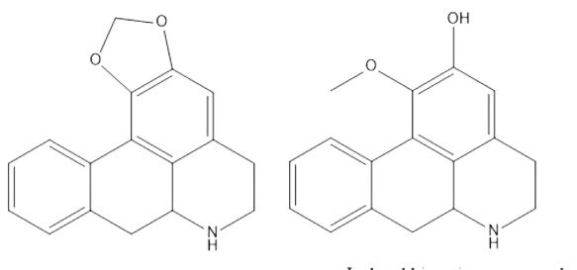
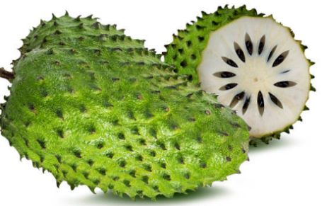
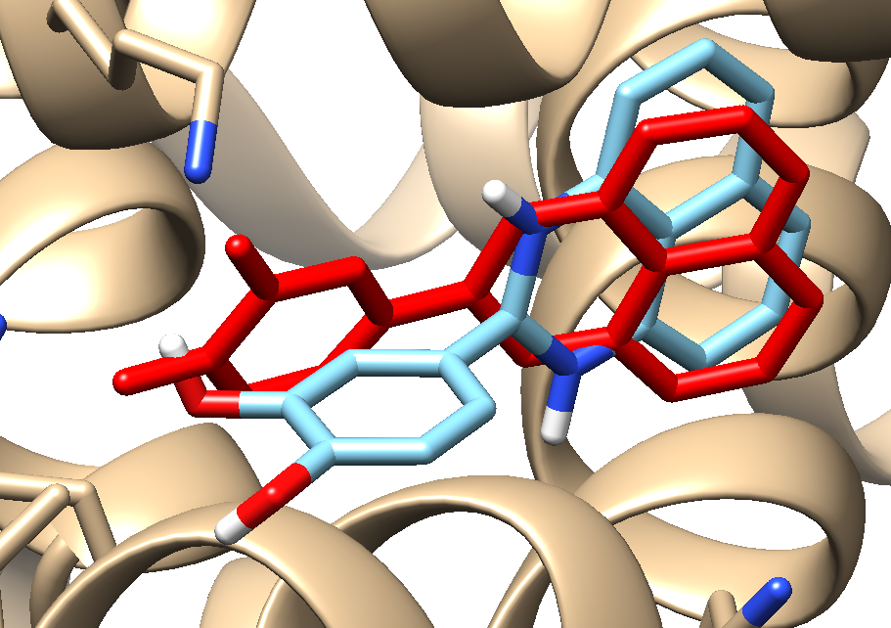
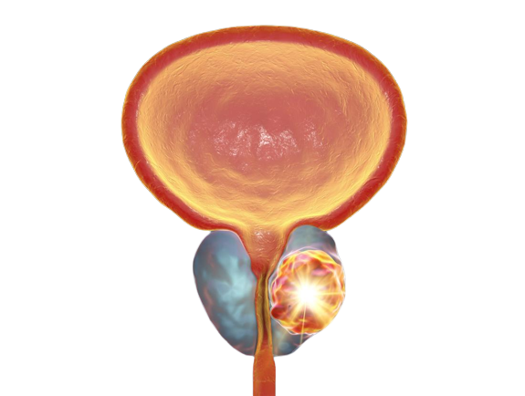
The prostate cancer-fighting powers of soursop fruit: in silico evaluation to give insight into binding affinity of selected bioactive compounds on selected prostate cancer targets.
Graphical Abstract
Soursop Fruit
Isolated Bioactive compounds
Isolated Bioactive compounds
Molecular Docking Simulations at active site of Prostrate cancer biotargets
Prostrate cancer

Slide 3
Abstract:
Soursop plant, (Annona muricata) which is indigenous to the tropics belongs to the family Annonaceae. Parts of the plant has been used in traditional medicine to cure several diseases. The physiological, physicochemical and nutritional characteristics of soursop plant has been reported in several studies, alongside the presence of bioactive compounds in the pulp, seed, columella and peel. Prostate cancer is the most cancer diagnosis in men and is still the third-leading cause of cancer related death in males.
Bioactive compounds isolated from the pulp have demonstrated cytotoxic activity against human prostate cancer cells, as reported by several studies. Amongst which seven were selected for the purpose of this study. This study employed in silico method to provide insight into the binding affinity of some bioactive compounds present in soursop pulp as compared to native ligand present in the target enzymes Androgen Receptor (AR) and primary poly (ADP-ribose) polymerase (PARP) with PDB (Protein Data Bank) codes, 2HYD and 7ONS respectively.
The results from this study, showed that all the chosen bioactive compounds had comparable binding activity to the native ligand with the exception of annonacin. These findings could give insights into the development of new pharmaceutical drugs with more cytotoxic effect against prostate cancer or even serve as alternate method for treating prostate cancer.
Keywords: ; Androgen Receptor (AR) ; binding affinity; bioactive compounds; primary poly (ADP-ribose) polymerase (PARP); Prostate cancer and Soursop.

Slide 4
Introduction
Worldwide, medicinal plants are regarded as the cornerstone of health maintenance and care. (Pinto et al., 2007)
Soursop Annona muricata is widely grown in tropical and subtropical regions of the world. (Ana et al., 2016)
Traditional medicine has utilized the stem, leaves, seeds, fruits and peel of soursop to treat a variety of diseases. Bioactive chemicals with a variety of in vitro and in vivo biological activities, including anti-inflammatory, anticancer and analgesic properties are thought to be responsible for majority of it’s health promoting effects in humans. (Ana et al., 2016).
Over 200 bioactive chemicals have reportedly been discovered from various parts of the plant, A. muricata. For the purpose of this study, seven bioactive chemicals present in the fruit were selected.

Slide 5
Introduction
With an estimated diagnosis of 1.4 million worldwide, prostate cancer is the second most diagnosed cancer in men. Prostate cancer would affect one in six men in their lifetime , and 1 in 36 will die from the disease. (Dehm and Tinadall, 2007)
Androgen receptor (AR) is a nuclear receptor transcription factor that mediates androgens, the male sex hormones and their biological effects. It is a key contributor to the onset and spread of prostate cancer. The development and maintenance of androgen-dependent tissues, such as prostate depends on androgen (Axerio-Cilies et al., 2011).
AR is a crucial target in the management of prostate cancer. Prostate cancer growth may be slowed down or prevented by compounds that block the action of AR or lower androgen production. (Messner et al., 2022)

Slide 6
Introduction
Cancer cells rely of poly (ADP-ribose) polymerase1 (PARP1)for single-strand repairing patients with certain genetic abnormalities that hinder double-strand DNA repair, such as BRCA2. PARP1 inhibitors, cause a buildup of DNA damage in cancer cells and ultimately cell death (Taylor et al., 2023).
Numerous biological processes depend mainly on protein-ligand interactions. Notably, a wide range of biological signal transduction pathways begin at the membrane receptor. It is therefore crucial to measure a ligand’s binding affinity for its transmembrane receptor since it reveals the potency of the ligand. (Johannes et al., 2021)

Slide 7
Methodology
Ligands & Enzymes Preparation
(Pettersen et al., 2004; )
Identification of isolated bioactive compounds
(Ana et al., 2016)
2D Structure generation & 3D optimization of bioactive compounds
Post-Docking Analysis
Molecular docking simulations (Trott and Olson, 2010).

Slide 8
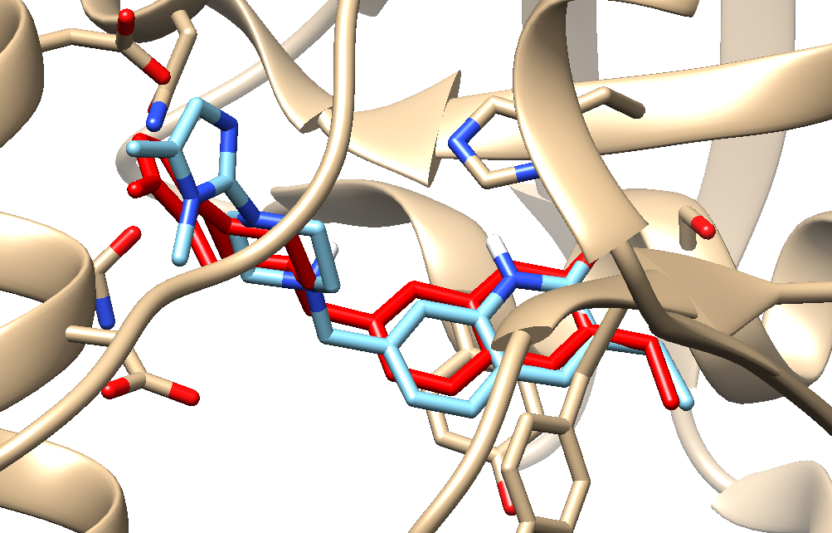
Results and discussion
FIG 1:Crystal structure of enzyme complex and re-docked ligand super-imposed on the crystal structure of AR for validation. The redocked ligand is blue
FIG 2 :Crystal structure of enzymes complexes and re-docked ligand super-imposed on the crystal structure for validation PARP1. The redocked ligand is blue.

Slide 9
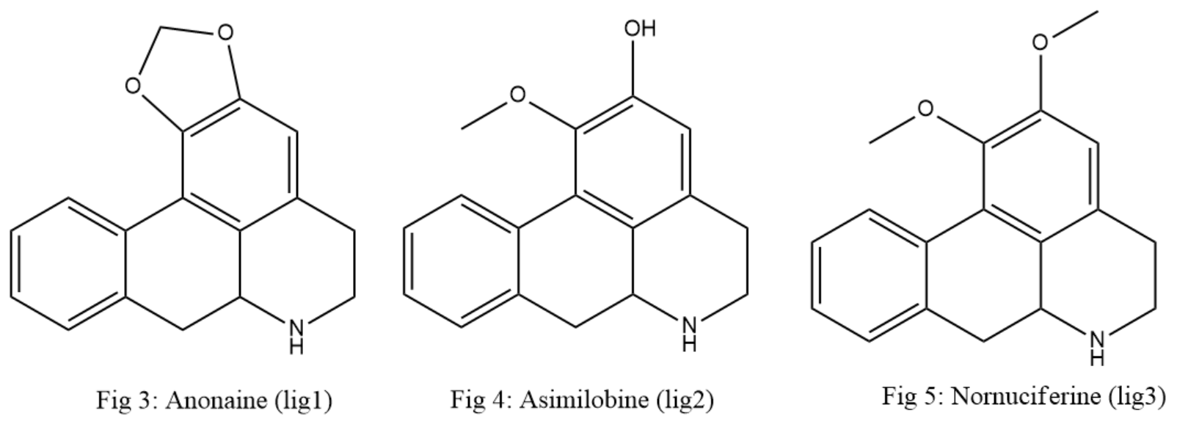
Results and discussion

Slide 10
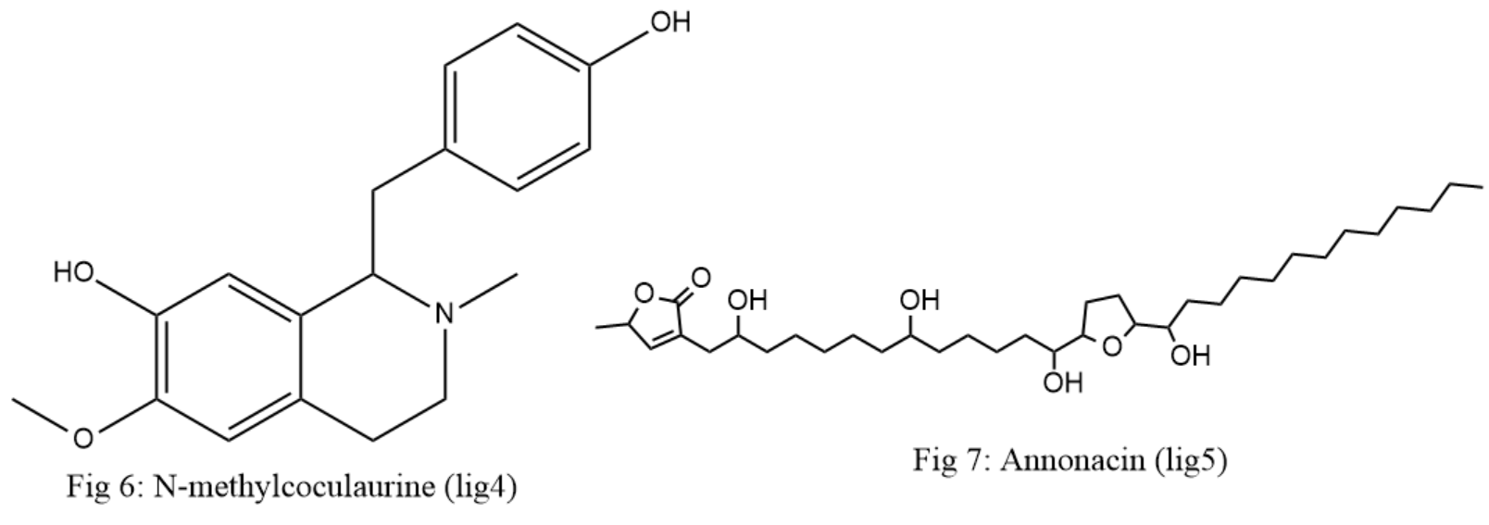
Results and discussion

Slide 11
Results and discussion

Slide 12
Results and discussion
Table 1: Showing the binding energy result of the co-crystallized ligands,Ligands 1-7 against PARP1 and AR
Ligands | PARP1 [7ONS);(-11.1 kcal/mol) | AR [2YHD] (-6.1) kcal/mol
Lig1 | -9.4 | -6.1
Lig2 | -9.0 | -5.6
Lig3 | -9.0 | -5.4
Lig4 | -8.8 | -5.5
Lig5 | -7.4 | -4.0
Lig6 | -9.3 | -5.7
Lig7 | -9.5 | -5.4

Slide 13
Results and discussion
Table 1 revealed that the docked complexes exhibited active-site orientations similar to the co-crystallized compounds with Lig 1,6 and 7 having high scores across both targets.

Slide 14
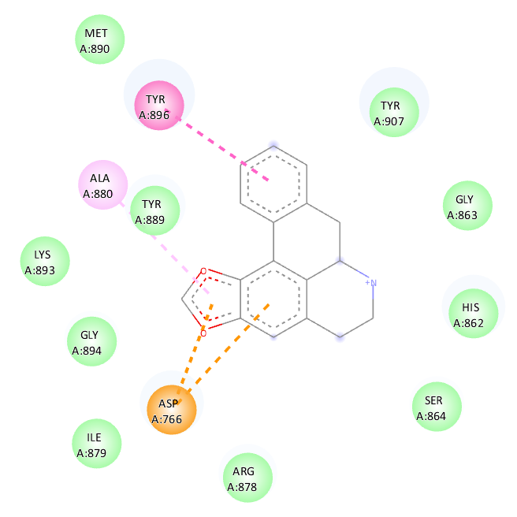
Results and discussion
Fig 10 : Showing 2D interaction between PARP1 (7ONS) and Anonaine (lig1)

Slide 15
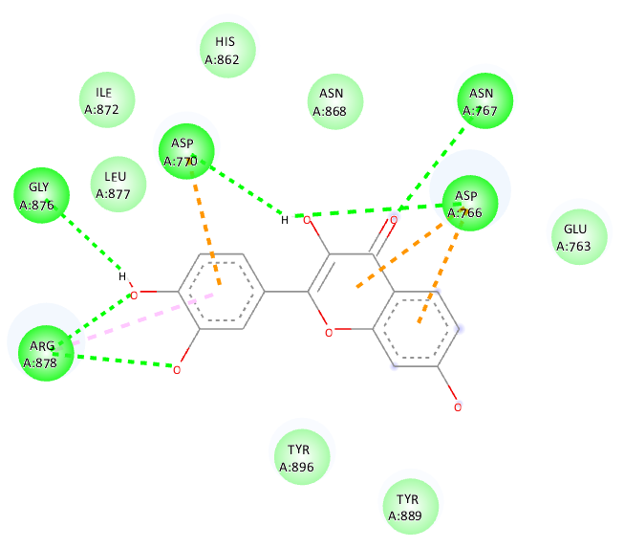
Results and discussion
Fig 11 : Showing 2D interaction between PARP1 (7ONS) and Fisetin (lig6)

Slide 16
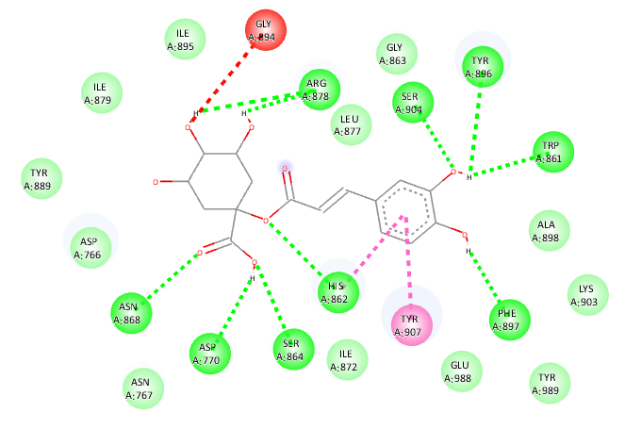
Results and discussion
Fig 13 : Showing 2D interaction between PARP1 (7ONS) and Caffeoylquinic acid (lig7)

Slide 17
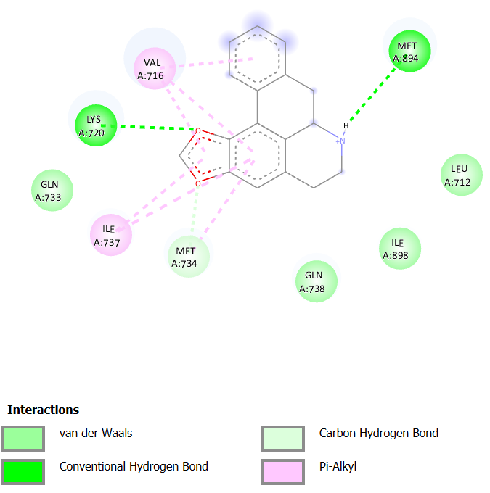
Results and discussion
Fig 14 : Showing 2D interaction between AR (2YHD) and Anonaine (lig1)

Slide 18
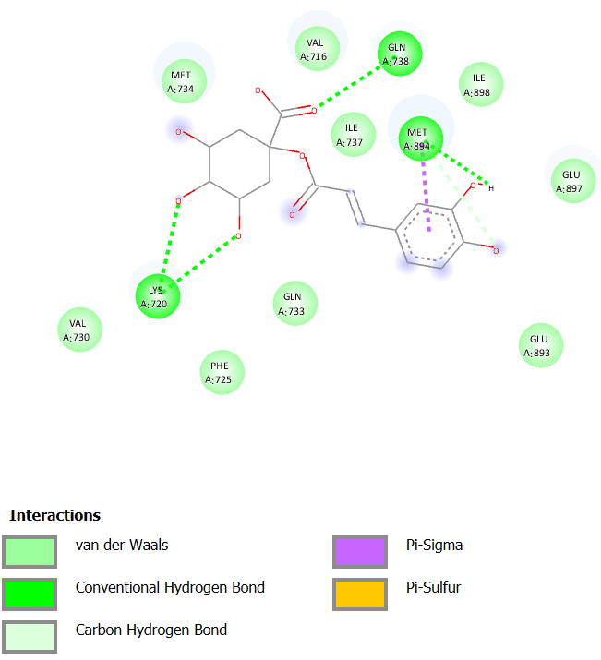
Results and discussion
Fig 15 : Showing 2D interaction between AR (2YHD) and Fisetin (lig6)

Slide 19
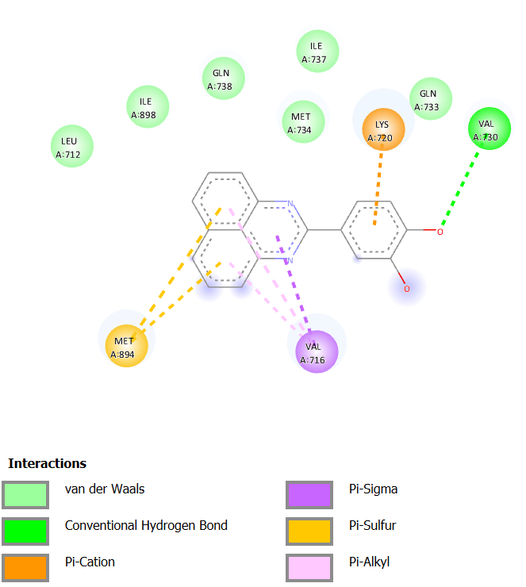
Results and discussion
Fig 16 : Showing 2D interaction between AR (2YHD) and Caffeoylquinic acid (lig7)

Slide 20
Conclusions
Binding free energy analysis revealed that Lig 1,6 and 7 binding to enzymes (2YHD and7ONS) was favorable with high negative ΔG values. This correlated with the favorable contribution of the van der Waals and electrostatic energy.
Favorable binding also existed between the active site residues of both enzymes 2YHD and 7ONS and the selected ligands which could account for its stabilization and binding affinity.
We are certain that these outcomes will advance therapeutic interventions towards the treatment of Prostate cancer and the structure-based design of potent anti-cancer.

Slide 21
References
Coria-Téllez, Ana. V., Montalvo-Gónzalez, E., Yahia, E. M., and Obledo-Vázquez, E. N. (2018) Annona muricata: A comprehensive review on its traditional medicinal uses, phytochemicals, pharmacological activities, mechanisms of action and toxicity. Arab. J. Chem. 11, 662–691.
Dietz, M. S., Fricke, F., Krüger, C. L., Niemann, H. H., and Heilemann, M. (2014) Receptor-ligand interactions: Binding affinities studied by single-molecule and super-resolution microscopy on intact cells. ChemPhysChem 15, 671–676.
Messner EA, Steele TM, Tsamouri MM, Hejazi N, Gao AC, Mudryj M, Ghosh PM. The Androgen Receptor in Prostate Cancer: Effect of Structure, Ligands and Spliced Variants on Therapy. Biomedicines. 2020; 8(10):422. https://doi.org/10.3390/biomedicines8100422
Pettersen, E. F., Goddard, T. D., Huang, C. C., Couch, G. S., Greenblatt, D. M., Meng, E. C., and Ferrin, T. E. (2004) UCSF Chimera - A visualization system for exploratory research and analysis. J. Comput. Chem. 25, 1605–1612.
Scott M. Dehm, Donald J. Tindall, Androgen Receptor Structural and Functional Elements: Role and Regulation in Prostate Cancer, Molecular Endocrinology, Volume 21, Issue 12, 1 December 2007, Pages 2855–2863, https://doi.org/10.1210/me.2007-0223

Slide 22
Acknowledgments
Ahmadu Bello University Zaria, Nigeria

